Slide 1
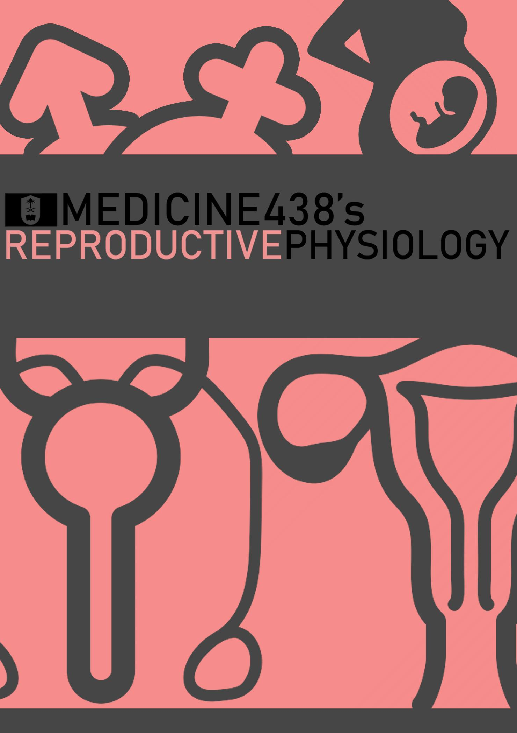
LECTURE II and III: Ovarian and Uterine Cycles
EDITING FILE
IMPORTANT
MALE SLIDES
EXTRA
FEMALE SLIDES
LECTURER’S NOTES

Slide 2
1
OVARIAN CYCLE
Lecture Two
OBJECTIVES
List the hormones of female reproductive organs and describe their physiological functions
Describe the changes that occur in the ovaries during the menstrual cycle
Describe the hormonal control of the development of ovarian follicles, mature oocytes and corpus luteum
Describe the pituitary ovarian axis and in correlation with the changes that occur in the ovaries leading up to and following ovulation during an ovarian cycle
Describe the normal menstrual cycle
Discuss the structural changes that occur in the endometrium during the menstrual cycle
Describe phases of the menstrual cycle
Describe the hormonal control of the menstrual cycle
Describe the major disorders of the menstrual cycle
Describe the physiology of menopause
Introduction
Monthly Ovarian Cycle: Monthly rhythmical changes in the rates of secretion of female hormones & corresponding physical changes in the ovaries & other sexual organs like the endometrial lining of the uterus.
Duration of the cycle: average 28 days (but can range from 20-45 days). There are two results of the female sexual cycle:
Uterine endometrium is prepared for implantation of fertilized ovum.
A single ovum is released from the ovaries each month.
Figure 2-1
The ovarian changes during the reproductive cycle depend on FSH & LH secreted by AP.
In the absence of these hormones, the ovaries remain inactive throughout childhood.
At puberty the AP starts to secrete FSH & LH which lead to the beginning of monthly reproductive cycles.
First menstrual cycle is called menarche.
Both FSH and LH stimulate their ovarian target cells by combining with highly specific receptors to increase (1) Rates of secretion, (2) Growth & proliferation of the cells.¹
Ovarian Cycle
Follicular Phase
(Preovulatory)
Luteal Phase
(Postovulatory)
Menstruation
Ovulation
1
5
14
28
Figure 2-2
FOOTNOTES
FSH and LH act through cAMP 2nd messenger system, 2nd messenger systems are capable of causing gene transcription, enzyme activation, growth and so on.

Slide 3
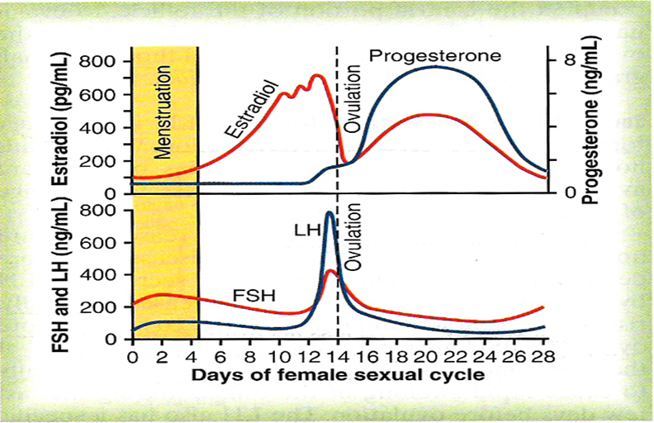
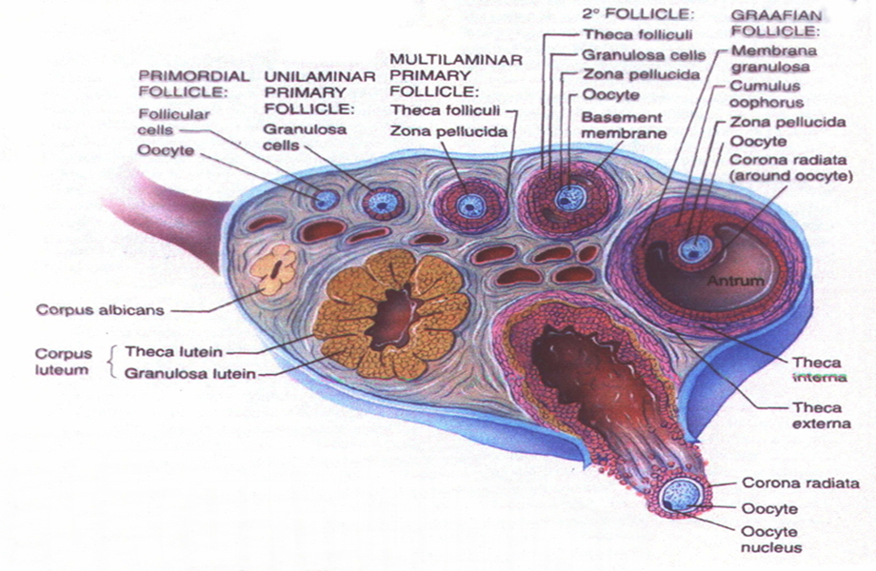
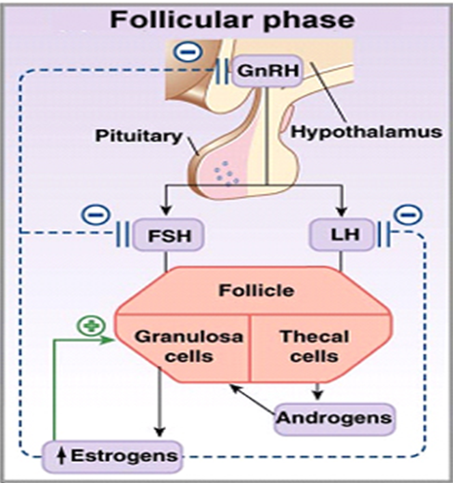
2
OVARIAN CYCLE
Lecture Two
Ovarian Cycle: Follicular Phase
By 6-7 weeks of gestation: 6-7 million oogonia.
At birth: 1-2 million oocytes.
At puberty: 300,000-500,000 oocytes.
The ovum of 400 to 500 hundred of follicles will normally ovulate during a female’s entire reproductive life (one for each cycle i.e. 12 times per reproductive year- approximately 12*39= 400-500)
What Happens From Childhood Until Puberty?¹
In female child each ovum is surrounded by single granulosa cell sheath called primordial follicle.
During childhood the granulosa cells provide nourishment for the ovum.
They secrete oocyte-maturation inhibiting factor which keeps the ovum in its primordial state. (arrested at prophase I of meiosis I)
After puberty: AP secretes FSH and LH which stimulate the ovaries and result in growth of some follicles.¹
Figure 2-4
Figure 2-3
From Primordial Follicles to Primary Follicles
Growth of the follicle begins with increase in size of the ovum & growth of additional layers of granulosa cells of some follicles
At this stage it is known as primary follicles.
During the first few days of the monthly female reproductive cycle: There is an increase in the secretion of FSH and LH.
Increase in FSH is slightly more & earlier than LH which causes the acceleration of growth of many ² primary follicles each month.
There is proliferation of the granulosa cells to many layers.
The ovary interstitium collect in several layers outside the granulosa cells to form a second mass of cells called theca cells.
Multilaminar Primary Follicles and Secondary Follicles.
Few days after proliferation & growth of the follicles, the granulosa cells secrete follicular fluids contain high concentration of estrogen.³
This fluid accumulate to form antrum within the mass of the granulosa cells.⁴
Figure 2-5
Figure 2-6
FOOTNOTES
During childhood the ovaries are in an inactive state due to low FSH levels (LH is needed later). But during puberty the surge of GnRH (unknown cause), the menstrual cycle is initiated and the ovaries become active. Creating a decline in the pool and eventually, all the primordial follicles will also degenerate, and no ovulation or fertilization will occur leading to menopause.
FSH secretion stimulates -nonspecifically- 1 to 12 follicles but one grows faster, secreting more estrogen and inhibin which inhibits the other underdeveloped follicles.
Keep in mind that the cells in this stage are yet to be sensitized to LH (possibly due to less number of LH receptors), so FSH works more on the cells. Estrogen is secreted by granulosa cells of the ovaries. And so in sense, if the granulosa cells are flat/inactive (childhood) or we have less primordial follicles (menopause) estrogen will be low.
Estrogen is secreted both into the blood and the follicles, fluids are also secreted by granulosa cells into the follicle (due to the non-selective stimulation of FSH), this causes a pool called the antrum to form inside the follicle, once this pool forms, the primary follicles become secondary ‘antral’ follicles.

Slide 4
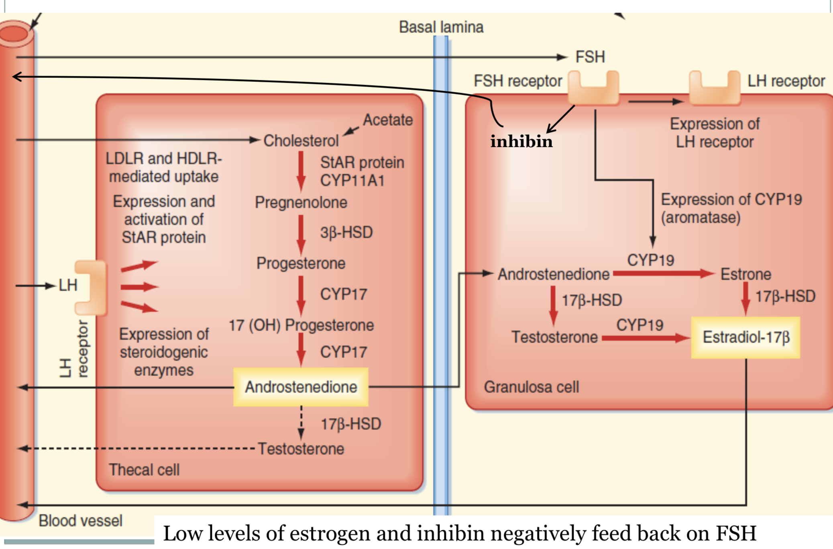
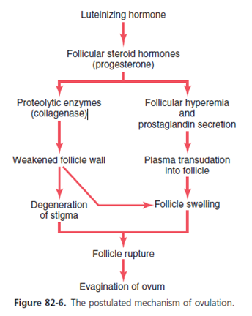
3
OVARIAN CYCLE
Lecture Two
Is Progesterone Synthesized in the Previous Stages?
Short answer? Yes.
Progesterone must be synthesized as an intermediate step in estrogen synthesis.
But almost all of the progesterone (before tertiary follicles form) is converted into androgens, and then into estrogen by aromatase.
After granulosa become sensitized to LH (form more receptors for LH), progesterone will be produced in very large amounts, and the cells won’t be able to convert all of the progesterone into estrogens. This will be discussed below and please take a look at Figure 2-8 for illustration.
FSH works only on granulosa cells and not theca cells.
Ovarian Cycle: Follicular Phase
Figure 2-7
This theca is divided into 2 layers:
1. Theca interna, the cells have epithelioid characteristics and similar to the granulosa cells and secrete sex hormones (estrogen and progesterone)
2. Theca externa, the outer layer, develops into a highly vascular connective tissue capsule of the developing follicle.
The early growth of the follicle up to the antral stage is under FSH stimulation.
Figure 2-8 CYP11A1 is also known as cholesterol desmolase (cholesterol side chain cleavage enzyme), 3β- HSD aka 3β-Hydroxysteroid dehydrogenase, CYP17 aka 17-α hydroxylase, 17β-HSD aka 17β-Hydroxysteroid dehydrogenase.
Note here that intermediate synthesis of androgens and progesterone is required for estrogen production.
Granulosa cells work mainly as converters of androgens synthesized by theca cells, and steroidogenesis happens in theca cells, granulosa cells convert the androgens produced by theca cells into estrogens.
Three main estrogens are produced in a human female: Estradiol-17β (most potent, highest secretion-in nonpregnant women), estrone (12 times less potent, secreted in lower amounts), estriol (oxidative product of both estradiol and estrone, 80 times less potent than estradiol)
For practical purposes, whenever we refer to estrogen we usually mean estradiol.
Tertiary Vesicular Follicles (Known As Graafian Follicles)
Then there is accelerated growth of the follicle to larger follicle called vesicular follicle caused by:
1. Estrogen upregulates FSH receptors on granulosa cells (positive feedback)
2. Both estrogen & FSH combine to promote LH receptors on the granulosa cells, allowing more increase follicular secretion.
3. The increasing estrogen from the follicle plus increasing LH from the AP causes proliferation of the follicular theca cells & increase their secretion.
The antral follicles begin to grow. The ovum enlarges & remain embedded
at one pole¹ of the granulosa cells of the follicle.
Only one follicle continues to grow & the remaining follicles (5 to 11) involute. (A process called atresia) (the dominant follicle will be sensitized to effects of pituitary hormones (d.t upregulation of its receptor), therefore it will remain to grow while others will be atretic as they didn’t upregulate enough receptors)
Causes:
(1) Rising estrogen levels (positive feedback locally and negative feedback centrally), (2) Rising inhibin levels (further negative feedback), (3) Declining FSH levels (Withdraw growth support, causing atresia in lesser follicles)
Initiation of Ovulation: Rupture of Tertiary Follicles and Formation of Corpus Luteum
It occurs 14 days after the onset of menstruation in 28 days cycle.
Before ovulation, a small area in the center of the follicle called stigma² protrude & fluids ooze from the follicle
The stigma ruptures allowing more viscous fluid outward carrying with it the ovum surrounded by mass of granulosa cells called corona radiata.
Figure 2-9
FOOTNOTES
The cumulus oophorus is a column of granulosa cells that attaches the oocyte to the follicle wall-creating a pole like attachment as seen in Figure 2-7. Its postulated that it provides nutrients to oocyte and aid in sperm selection via chemotactic stimuli.
The action of LH on theca externa cells of tertiary follicles, causes them to release proteolytic enzymes, leading to weakening of the wall of the follicles and the fluid within the antrum starts leaking within the follicle, this results in the formation of a transitory nipple-like structure called a ‘stigma’, which as proteolytic enzymes continue their hydrolytic activity, will eventually rupture. Neovascularization caused by LH, and subsequent increased vascular permeability due to PGs effect also contribute to this rupture, as seen in figure 2-9.

Slide 5
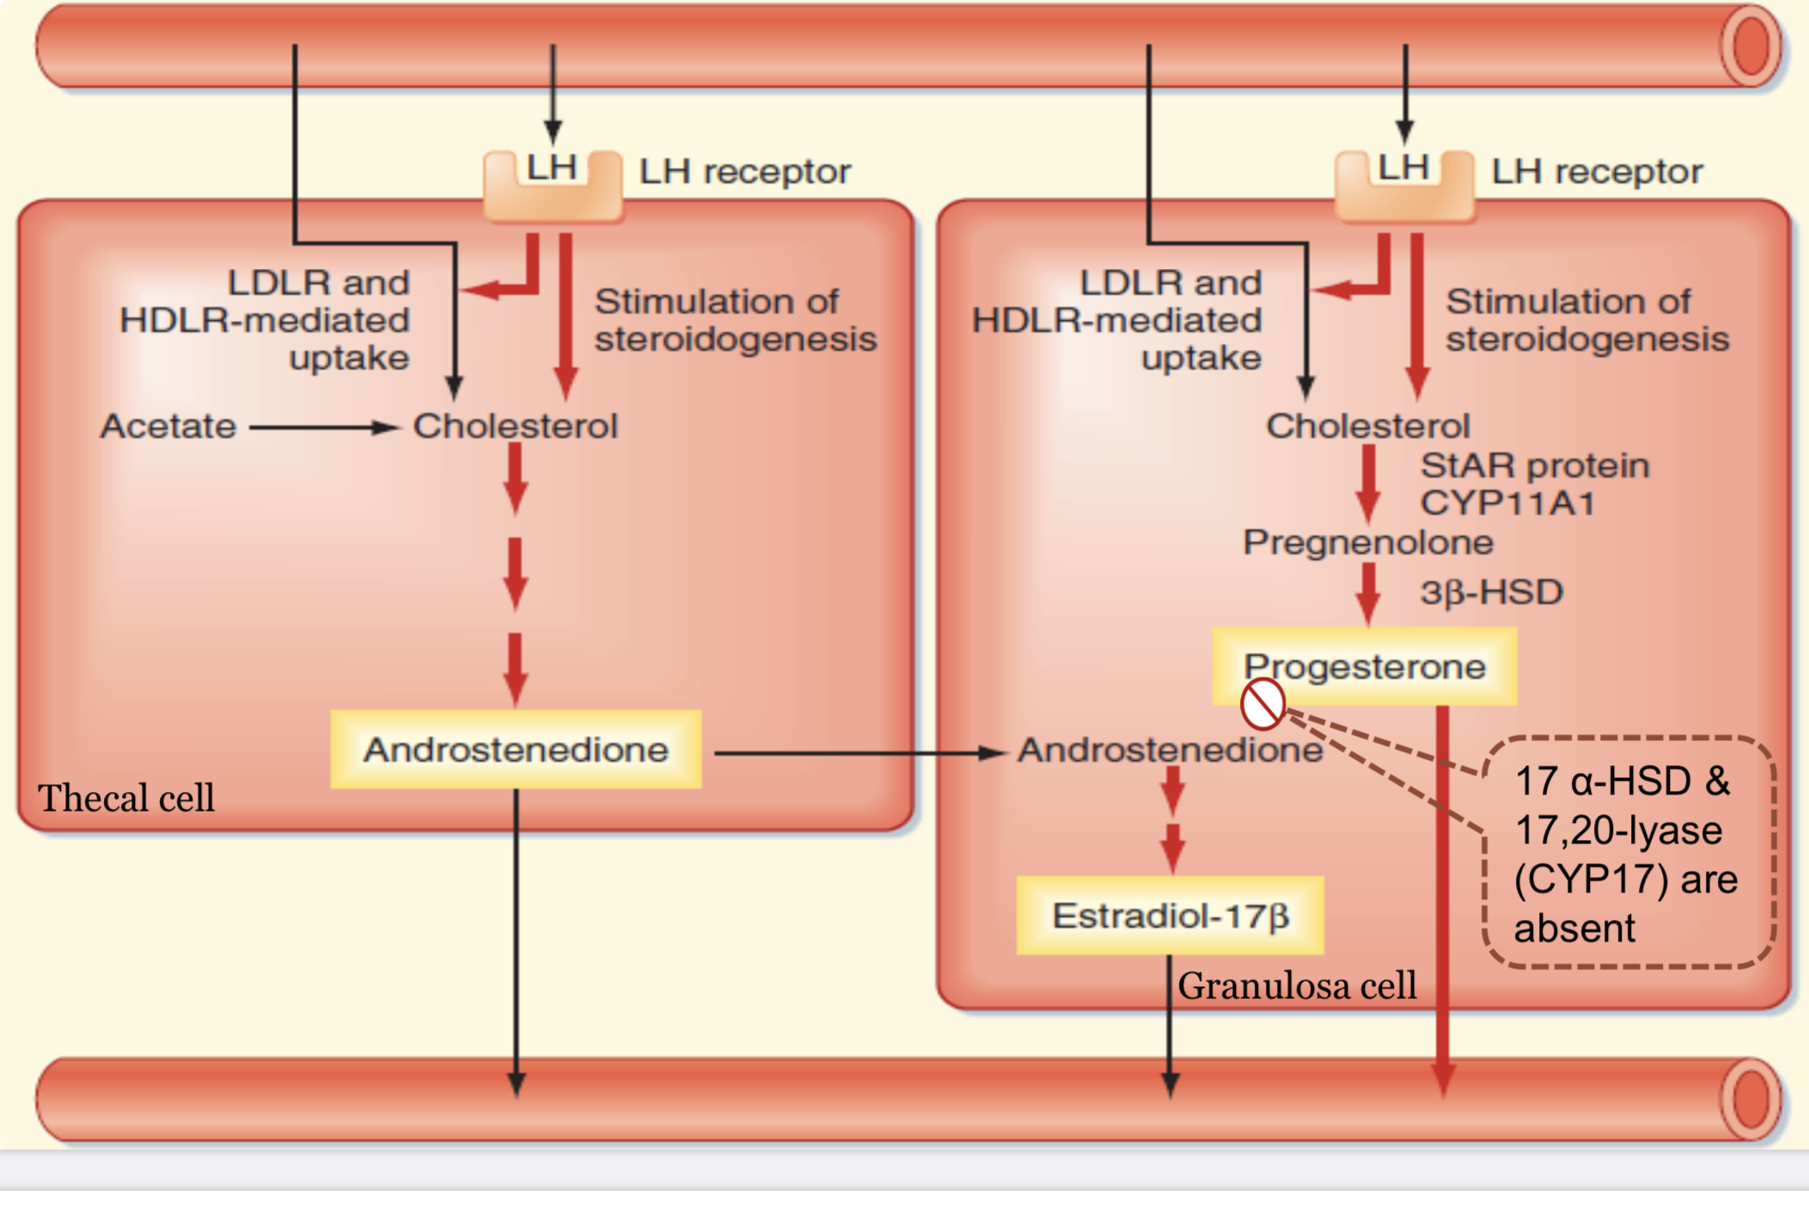
4
OVARIAN CYCLE
Lecture Two
Ovarian Cycle: Follicular Phase (continued)
LH surge is necessary for ovulation:
2 Days before ovulation, the rate of LH secretion from the AP increase markedly to 6-16 fold & peak about 16 hrs before ovulation.
FSH also increases to 2 to 3 fold & acts synergistically with LH to cause swelling of the follicle before ovulation.
Initiation of ovulation: Large quantity of LH secreted by the AP causes rapid secretion of progesterone from the follicle. Within a few hours two events occur which are necessary for ovulation:
The theca externa begins to secrete proteolytic enzymes → weakening of the wall → swelling of the follicle → degeneration of the stigma.
Rapid growth of new blood vessels into the follicle wall & prostaglandins are secreted into the follicular tissue.
Those two changes causes plasma transudation into the follicle and swelling of the follicle and eventually degeneration of the stigma with discharge of the ovum. (Figure 2-9)
What Causes The Positive Feedback of Estrogen?
There are two main receptors of estrogen (ER)- α and (ER)-β
GnRH neurons only possess (ER)-β subtype of estrogen receptors, which mediate negative feedback.
(ER)- α mediates positive feedback, and is expressed on some neurons in the hypothalamus which send efferents to GnRH neurons, influencing GnRH release, these neurons reside in the periventricular areas of the hypothalamus.
When estrogen levels become elevated for prolonged periods of time, these periventricular neurons start to ‘read’ the high levels of estrogen (perhaps through upregulation of receptors) and send signals to GnRH neurons to release more GnRH, which is released in fast pulses (higher frequency), this causes the release of LH. (slower frequency leads to release of FSH more than LH)
Mutations in (ER)- α eliminates the positive feedback of estrogen on LH in mice.
(ER)- α also during the early and late periods of menstrual cycle causes negative feedback through kisspeptin neurons, as mentioned in HPG axis lecture.
Ovarian Cycle: Luteal Phase
After expulsion of the ovum from the follicle, the remaining granulosa & theca interna cells change to lutein cells & become filled with lipid inclusions giving them yellowish appearance.
The granulosa cells with the theca cells called corpus luteum.
They will develop extensive intracellular endoplasmic reticula & form large amount of progesterone & estrogen.
The theca cells form mainly androgens which are converted by granulosa cells into female hormones.
The corpus luteum grow to about 1.5 cm in diameter, at about 7 to 8 days after ovulation.
Then begins to involute & losses its secretory function & its yellowish characteristic about 12 days after ovulation.
Becomes corpus albicans & replaced by scar connective tissue & absorbed which is removed by macrophages.
The corpus luteum has no need for FSH, and it is dependent mainly on LH for its growth. LH maintains the life of corpus luteum, the excess estrogen and progesterone from corpus luteum will decrease LH production from AP by negative feedback. Therefore corpus luteum kills itself by this mechanism.
If pregnancy occurs, the hCG (human chorionic gonadotropin) from the trophoblast of the placenta act on the corpus luteum to prolong its life for 2 to 4 months of pregnancy until the placenta fully develops.
Figure 2-10 Vascularization of the corpus luteum makes low LDL available to the granulosa-lutein cells. LH causes upregulation of 3β-HSD, CYP17 and cholesterol uptake.
Consequently large amounts of progesterone are formed, and not all of it can be converted to androgens and then to estrogens.
Consequently, both estrogen and progesterone secretion is increased in this stage.
Degeneration of the basal lamina between the two cells that was present in the previous stage creating a Lutin cell.
The absence of the hormones in the figure will prevent conversion of progesterone into androgens, therefore more progesterone will be released.
Figure 2-11 Rescue of corpus luteum.

Slide 6
5
OVARIAN CYCLE
Lecture Two
Ovarian Cycle: Luteal Phase (continued)
A local hormone in the follicular fluid called luteinization – inhibiting factor hold the luteinization process until after ovulation.
Luteinizing Function of LH:
Causes ovulation¹.
Causes luteinization (converts granulosa and theca cells into lutein cells after ovulation)
Maintains secretion of progesterone & estrogen from the corpus luteum.
Figure 2-12
Involution of the Corpus Luteum and Onset of the Next Ovarian Cycle.
Lutein cells of the corpus luteum secrete: Progesterone & Estrogen which inhibit the secretion of FSH & LH. Inhibin which inhibit secretion of FSH by AP.
Low levels of both FSH & LH causes the corpus luteum to degenerate completely, called involution of the corpus luteum.
Around 26th days of normal reproductive cycle & after involution of corpus luteum, ↓ estrogen, progesterone & inhibin → removes the feedback inhibition of the AP → ↑ secretion of FSH & LH again.
FSH & LH initiate the growth of new follicles, beginning a new ovarian cycle.
FOOTNOTES
anovulatory cycles -leading to irregular menses- places the women at risk of hyperplastic endometrium (due to the continuous uninhibited estrogen exposure)
This is the hormone that rises in the mid-cycle surge about 36 hours before ovulation and is the basis for home ovulation predictor kits, as the level of urinary Luteinizing Hormone detected corresponds with the LH surge that precedes ovulation. But these tests aren’t conclusive because LH surges may not signify true ovulation- for more, read Further Reading page 13.

Slide 7
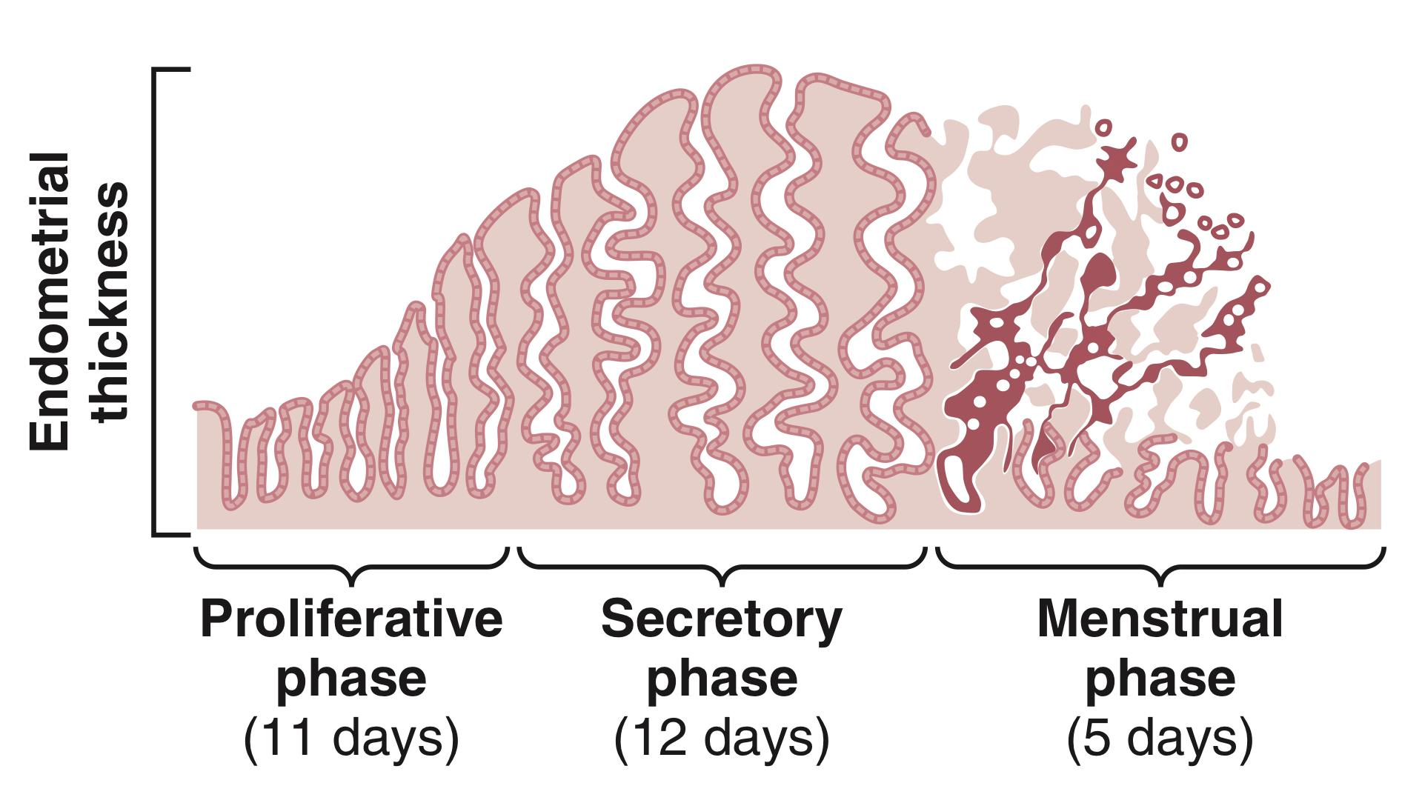
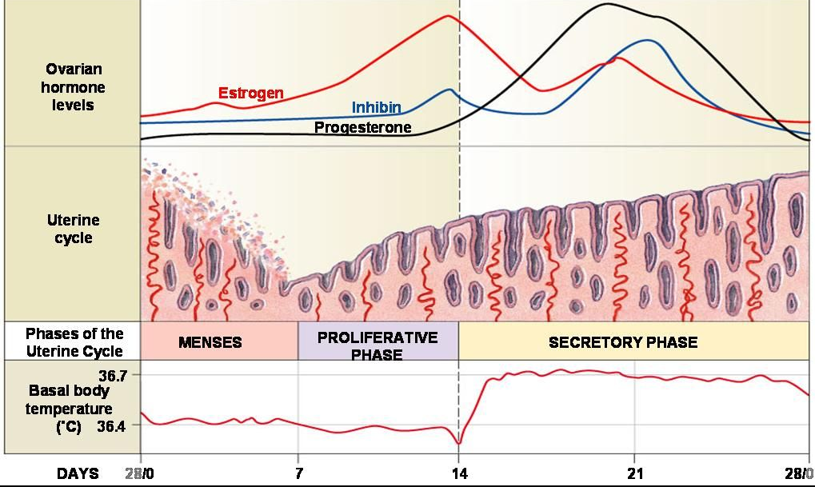
6
UTERINE CYCLE
Lecture Three
Uterine (Endometrial) Cycle
Associated with the monthly cyclical production of estrogens and progesterone by the ovaries is an endometrial cycle in the lining of the uterus that operates through the following stages:
(1) proliferation of the uterine endometrium; (2) development of secretory changes in the endometrium; and (3) desquamation of the endometrium, which is known as menstruation.
Figure 3-1. Phases of endometrial growth and menstruation during each monthly female sexual cycle.
Proliferative phase (preovulatory) is dominated by Estradiol.
Secretory phase (postovulatory) is dominated by Progesterone.
Uterine Cycle: Proliferative Phase (Estrogen Phase), Occurring Before Ovulation.
At the beginning of each cycle, most of the endometrium has been desquamated by menstruation.¹
After menstruation, only a thin layer of the endometrial stroma remains and the only epithelial cells that are left are those located in the remaining deeper portions of the glands & crypts of the endometrium.
Under the influence of estrogens, secreted in large quantities by the ovaries, the stromal cells and the epithelial cells proliferate rapidly.
The endometrial surface is re-epithelialized within 4-7 days after the beginning of menstruation.
Before ovulation, the endometrium increases greatly in thickness, due to increase numbers of stromal cells, progressive growth of the endometrial glands, and new blood vessels spiral arteries.
At the time of ovulation, the endometrium is 3-5 mm thick.
The endometrial glands in the cervical region secrete thin, stringy mucus. The mucus strings actually align themselves along the length of the cervical canal, forming channels that help guide sperm in the proper direction from the vagina into the uterus.²
Figure 3-2
FOOTNOTES
Endometrial growth is maintained by estrogen and progesterone, these two hormones bind stromal cells (like fibroblasts) and activate genes (like VEGF) to cause the formation of new blood vessels, this carries nutrients and even more hormones to the endometrium. The major source of estrogen and progesterone at the end of each cycle is the corpus luteum, which we know degenerate shortly before menstruation ends (around day 26), therefore less estrogen and progesterone will be produced, and the endometrium will start degeneration. Estrogen and progesterone are required for growth of the endometrium. They increase nutrient supply and even glycolysis.
The combined effects of this spike in estrogen on the uterus and the cervix help optimize the chance of fertilization, which is highest between day 11 and day 15.

Slide 8
7
UTERINE CYCLE
Lecture Three
Uterine Cycle: Secretory Phase (Progestational Phase), Occurring After Ovulation.
After ovulation, during most of the latter half of the monthly cycle, estrogen and progesterone are secreted in large quantities by the corpus luteum.
Estrogen causes slight cellular proliferation in the endometrium, whereas progesterone causes marked swelling and secretory development of the endometrium.
The glands increase in tortuosity, and an excess of secretory substances accumulates in the glandular epithelial cells.
Stromal cells cytoplasm increases due to the increase in lipid and glycogen deposits.
The blood supply to the endometrium increases with the blood vessels becoming more tortuous.
About 1 week after ovulation (day 21), the endometrium has a thickness of 5-6 mm.
The whole purpose of all these changes is to produce a highly secretory endometrium that contains large amounts of stored nutrients to provide appropriate conditions for implantation of a fertilized ovum.
The uterine secretions, called “uterine milk”, provide nutrition for the diving ovum.
The trophoblastic cells on the surface of the implanting ovum begin to digest the endometrium and absorb the endometrial stored substances.
Uterine Cycle: Menstruation
If the ovum is not fertilized, about 2 days before the end of the monthly cycle, the corpus luteum involutes ¹ and the ovarian hormones (estrogens & progesterone) decrease to low levels of secretion.
Menstruation is caused by the reduction of estrogens and progesterone, especially progesterone, at the end of the monthly ovarian cycle.
The first effect is decreased stimulation of the endometrium, followed rapidly by involution of the endometrium to about 65% of its previous thickness.
Then, during the 24 hours preceding the onset of menstruation, the tortuous blood vessels become vasospastic due to the release of a vasoconstrictor material (prostaglandins).
The vasospasm, the decrease in nutrients to the endometrium, and the loss of hormonal stimulation initiate necrosis in the endometrium, especially of the blood vessels.
As a result, blood at first seeps into the vascular layer of the endometrium and the hemorrhagic areas grow rapidly over a period of 24 to 36 hours.
Gradually, the necrotic outer layers of the endometrium separate from the uterus at the sites of the hemorrhages until, about 48 hours after the onset of menstruation, all the superficial layers of the endometrium have desquamated.
The mass of desquamated tissue and blood in the uterine cavity, plus the contractile effects of prostaglandins, all acting together, initiate uterine contractions that expel the uterine contents.²
During normal menstruation, about 40 ml of blood and an additional 35 ml of serous fluid are lost.
The menstrual fluid is normally non-clotting due to the presence of fibrinolysin.
Within 4 to 7 days after menstruation starts, the loss of blood ceases because, by this time, the endometrium has become re-epithelialized.
FOOTNOTES
Corpus Luteum becomes scar tissue called “Corpus Albicans” and the secretory cells of corpus luteum will be phagocytosed by macrophages.
After day 15 the cervical mucus starts to thicken and becomes less hospitable to the sperm. A group of contraceptives known as progestin-only pill (POP) prevent pregnancy by thickening the mucus in the cervix. (POP) contains progestin only (progestin is the synthetic form of progesterone).

Slide 9
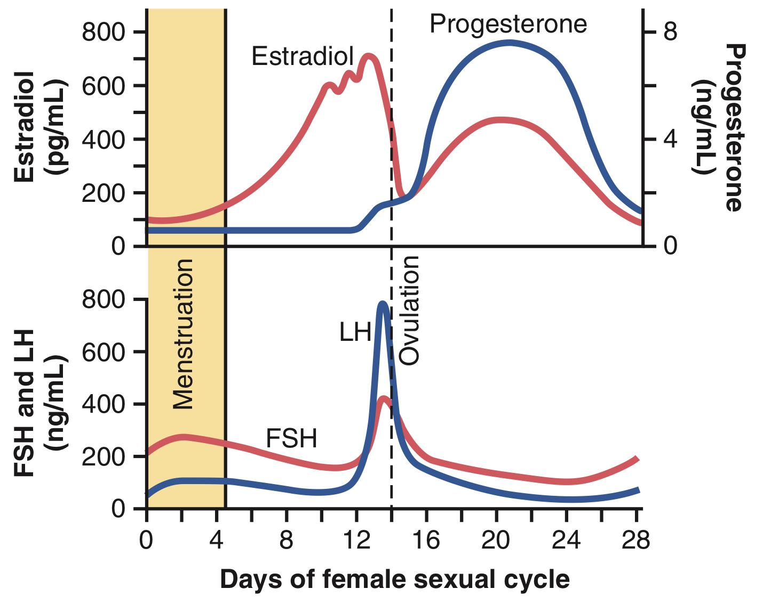
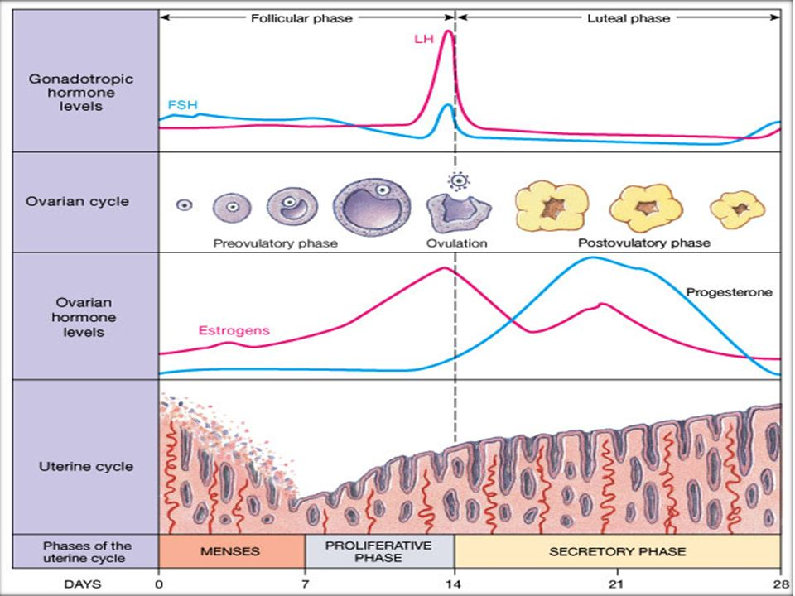
8
UTERINE CYCLE
Lecture Three
Figure 3-3. Approximate plasma concentrations of the gonadotropins and ovarian hormones during the normal female sexual cycle.
Leukorrhea During Menstruation¹
During menstruation, large numbers of leukocytes are released along with the necrotic material and blood.
As a result of these leukocytes and possibly other factors, the uterus is highly resistant to infection during menstruation (protective mechanism).
Feedback Oscillation of the Hypothalamic-Pituitary-Ovarian System
Postovulatory secretion of the ovarian hormones and depression of the pituitary gonadotropins:
Between ovulation and the beginning of menstruation, the corpus luteum secretes large quantities of progesterone and estrogen, as well as the hormone inhibin.
All these hormones together have a combined negative feedback effect on the anterior pituitary gland and hypothalamus, causing the suppression of both FSH and LH secretion and decreasing them to their lowest levels about 3 to 4 days before the onset of menstruation.
Functions of Estrogen and Progesterone
Estrogen | Progesterone
Estrogens increase the size of ovaries, fallopian tubes, uterus, and external genitalia. Estrogens cause marked proliferation of the endometrial stroma and greatly increased development of the endometrial glands. Estrogens cause:² Development of the stromal tissues of the breasts Growth of an extensive ductile system Deposition of fat in the breasts. Estrogens stimulate bone growth and slightly increase protein deposition.³ Estrogens increase body metabolism and fat deposition.⁴ Estrogens cause sodium and water retention by the kidney tubules. | Progesterone promotes the secretory changes in the uterine endometrium. Progesterone promotes increased secretion by the mucosal lining of the fallopian tubes. Progesterone promotes development of the lobules and alveoli of the breasts, causing the alveolar cells to proliferate, enlarge, and become secretory in nature. (however prolactin is necessary for milk to be produced) Progesterone decreases the frequency and intensity of uterine contractions.
FOOTNOTES
As we might remember, necrosis is a form of cell death that can result in inflammation (the ischemic cells will release damage associated molecular patterns or DAMPs) which will recruit leukocytes to the site of necrosis.
Estrogen will cause growth of both male and female breasts, in fact, with appropriate cocktail of hormones, males in the first two decades of life can be made to produce milk.
Estrogen causes a somewhat rapid growth of the skeleton in the female after puberty, much like testosterone in males, but unlike testosterone, estrogens cause rapid fusion of epiphyseal plates, therefore female growth tend to stop earlier than males.
Estrogen causes increase fat deposition in areas like the thigh and buttocks, areas associated with the image of a “feminine figure”. Estrogen will also increase vascularization of the skin, producing the warmer skin associated with females.

Slide 10
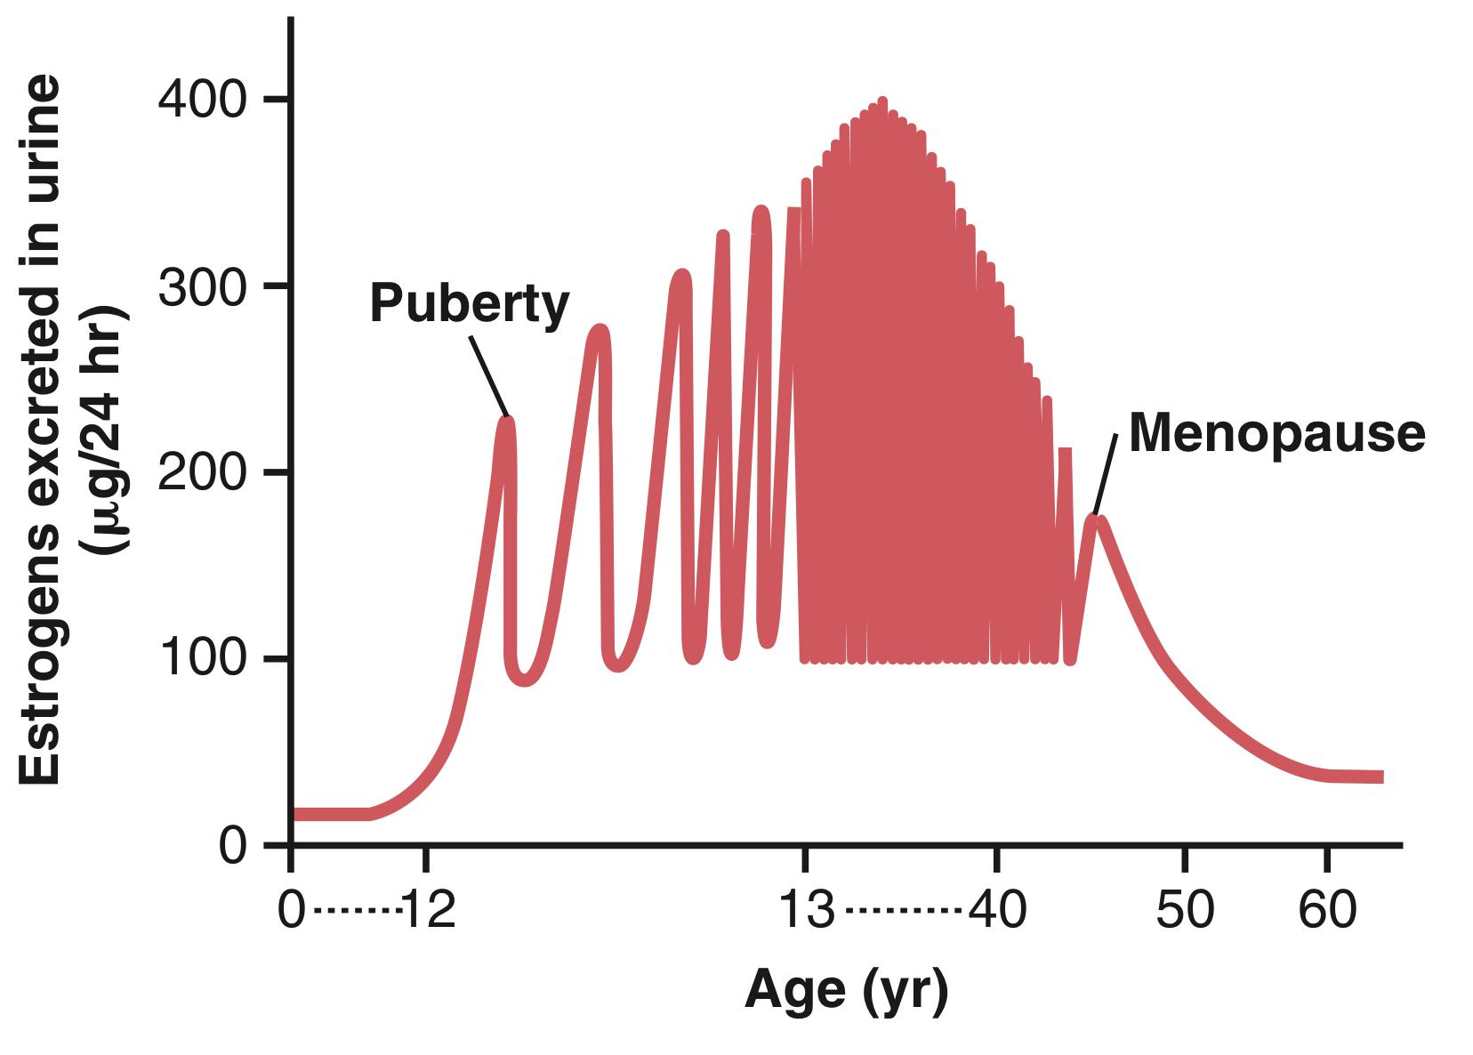
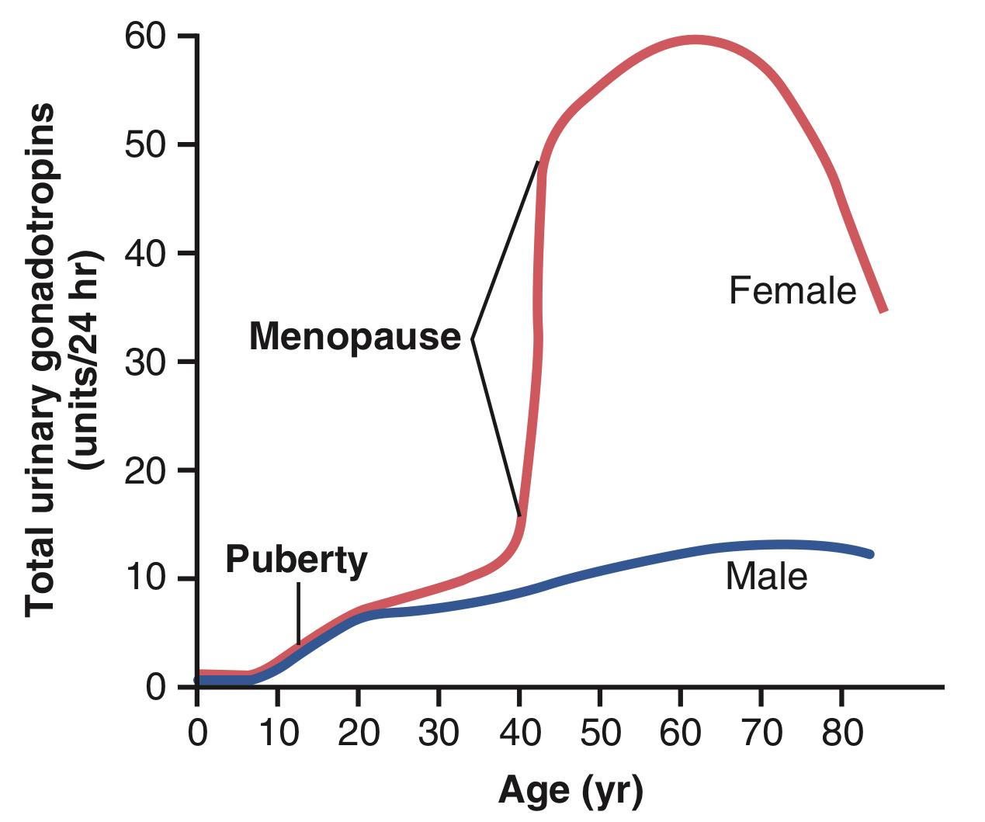
9
UTERINE CYCLE
Lecture Three
Menopause
At age 40 to 50 years, the sexual cycle usually becomes irregular and ovulation often fails to occur. After a few months to a few years, the cycle ceases altogether.
The period during which the cycle ceases and the female sex hormones diminish to almost none is called menopause.
The cause of menopause is “burning out” of the ovaries. At about age 45 years, only a few primordial follicles remain to be stimulated by FSH and LH, and the production of estrogens by the ovaries decreases as the number of primordial follicles approaches zero.
When estrogens production falls below the critical value, the estrogens can no longer inhibit the production of the gonadotropins FSH & LH.
Instead, the gonadotropins FSH and LH (mainly FSH) are produced after menopause in large and continuous quantities, but as the remaining primordial follicles become atretic, the production of estrogens and progesterone by the ovaries falls virtually to zero.
Uterine and vaginal atrophy.
The loss of estrogens often causes marked physiological changes in the function of the body, including:
Hot flushes, characterized by extreme flushing of the skin especially during the night which can lead to trouble sleeping.
Psychic sensations and dyspnea.
Irritability.
Fatigue.
Anxiety.
Decreased strength and calcification of bones throughout the body.
Cardiovascular diseases due to the loss of the protective effect of estrogen on the blood vessels.
Figure 3-4. Estrogen secretion throughout the sexual life of the female human being.
Figure 3-5. Total rates of secretion of gonadotropic hormones throughout the sexual lives of female and male human beings, showing an especially abrupt increase in gonadotropic hormones at menopause in the female.

Slide 11
10
UTERINE CYCLE
Lecture Three
Menstrual Disorders
Amenorrhea (absence of menstruation) | Primary amenorrhea in which menstrual bleeding has never occurred.
 | Secondary amenorrhea: the abnormal cessation of cycles in a woman with previously normal periods. Causes: Pregnancy (the most common cause). Emotional stimuli and changes in the environment. Hypothalamic diseases (decreased GnRH pulses). Pituitary disorders (decreased FSH & LH) e.g. Sheehan syndrome (postpartum hypopituitarism) ¹ Hypothyroidism (TRH stimulates prolactin which decreases GnRH) Primary ovarian disorders and various systemic disease.
Menorrhagia | Refers to abnormally heavy or prolonged bleeding.
Hypomenorrhea | Refers to scanty ﬂow.
Dysmenorrhea | Painful menstruation (cramps due to accumulation of prostaglandins in the uterus) Treated with inhibitors of prostaglandin synthesis.
Oligomenorrhea | Refers to infrequent (irregular) menstrual periods.
FOOTNOTES
Severe blood loss during or after childbirth which deprives the body of oxygen and seriously damages the pituitary gland.

Slide 12
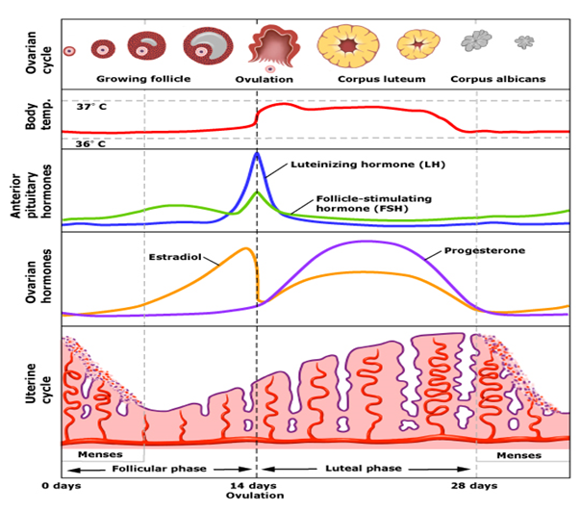
11
OVARIAN & UTERINE CYCLES
Lecture II & III
LECTURE SUMMARY
The Menstrual Cycle (approximately 28 days) It can be described by the ovarian or uterine cycle. The ovarian cycle describes changes that occur in the follicles of the ovary, whereas the uterine cycle describes changes in the endometrial lining of the uterus. The ovarian cycle consists of the follicular phase, ovulation, and the luteal phase, whereas the uterine cycle consists of menstruation, proliferative phase, and secretory phase.
Pre-ovulation |  | Ovulation | Post-ovulation
Follicular Phase |  |  | Luteal Phase
Menstruation | Proliferative Phase |  | Secretory Phase
Follicular phase (approximately days 1 to 14) is also called the proliferative or preovulatory phase. Dominated by the peripheral effects of estrogen, which include the replacement of the endometrial cells lost during menses. By convention, the first day of bleeding (menses) is called day 1 of the menstrual cycle. During follicular phase, the ovarian follicles mature and get ready to release an egg. Through the influence of a rise in FSH during the first days of the cycle, a few ovarian follicles are stimulated. These follicles compete with each other for dominance. All but one of these follicles will stop growing, while one dominant follicle in the ovary will continue to maturity. The follicle that reaches maturity is called a tertiary or Graafian follicle, and it contains the ovum. Theca Cells: Stimulated by LH to produce androgen, which enters the adjacent granulosa cells for conversion to estradiol. Granulosa Cells: FSH induces the granulosa cells to make aromatase that converts the androgens made by the theca interna into estrogens (mainly estradiol). Estrogen: Some of the estrogen produced by the granulosa cells is released into the blood and inhibits the release of LH and FSH from the anterior pituitary. However, another fraction of the estrogen acts locally on granulosa cells, increasing their proliferation and sensitivity to FSH. This local positive effect of estrogens causes a rising level of circulating estrogens during the follicular phase, but at the same time FSH is decreasing because of the inhibitory effect of estrogen on FSH release. Granulosa cells also release inhibin B. Inhibin B inhibits the secretion of FSH by the pituitary. Peripheral effects of estrogen produced by the granulosa cells during the follicular phase include: Circulating estrogens stimulate the female sex accessory organs and secondary sex characteristics. Rising levels of estrogens cause the endometrial cells of the uterine mucosal layers to proliferate. Circulating estrogens cause the cervical mucus to be thin and watery, making the cervix easy for sperm to traverse. |  | Ovulation (approximately on day 14) Preceded by the LH surge Near the end of the follicular phase, there is a dramatic rise in circulating estrogen. When estrogens rise above a certain level, they no longer inhibit the release of LH and FSH. Instead, they stimulate the release of LH and FSH. This causes a surge in the release of LH and FSH. Only the LH surge is essential for the induction of ovulation and formation of the corpus luteum. Large quantity of LH causes rapid secretion of progesterone from the follicle. During ovulation, the ovarian follicles will rupture, causing the oocyte to be released from the ovary. Follicular rupture occurs within hours after the onset of the LH surge. | Luteal phase (approximately days 14 to 28) In this phase, the ruptured follicle closes after releasing the egg and forms a structure called a corpus luteum. Once formed, the luteal cells are stimulated by LH to secrete considerable progesterone and some estrogen. Progesterone inhibits LH secretion (negative feedback). The corpus luteum secretes inhibin A, which has negative feedback on FSH. The increased plasma level of progesterone has several actions: Prepares the uterus in case an embryo is implanted. Causes the endometrium to thicken, filling with fluids and nutrients to nourish a potential embryo. Over time, the level of FSH and LH fall quickly, and the corpus luteum subsequently atrophies (becomes corpus albicans). Falling levels of progesterone trigger menstruation and the beginning of the next cycle. The loss of the corpus luteum is prevented by fertilization of the egg (due to the secretion of hCG).

Slide 13
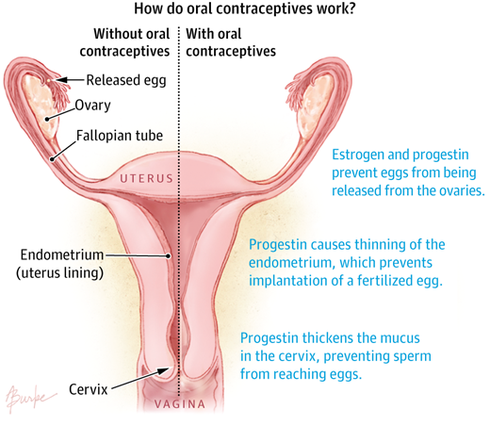
12
OVARIAN & UTERINE CYCLES
Lecture II & III
Further Reading
Oral Contraceptives, Pregnancy Tests & Ovulation Dysfunction
Oral contraceptives (birth control pills):
Our targets for taming the cycle are FSH and LH, which are required to trigger ovulation. And one way of controlling theses two hormones is via the negative feedback of estrogen (E) and progesterone (P).
Most oral contraceptives contain a combination of 2 types of hormones: E (estrogen) and P (progesterone). Some pills contain only P (“mini-pill.”)
They are usually prescribed for 4 weeks at a time, with each 4-week packet containing 4 to 7 days of hormone-free pills (inactive to allow menstruation; to avoid breakthrough bleeding and prevent estrogen excess from causing hyperplasia).
How do they work? Well by three main mechanisms: preventing egg ovulation and release while P causes thinning of the endometrium which prevents implantation of fertilized egg and increasing thickness of cervical secretion preventing sperm from reaching egg.
Because both P and E are at high levels throughout pregnancy, some people describe taking the Pill as “tricking the body into thinking it’s pregnant”
Clinical info.: Continuous menstrual suppression via the Pill has also been used to treat endometriosis (see next page), debilitating menstrual pains and other menstruation-related ailments.
Pregnancy & Fertility tests:
hCG test
Human chorionic gonadotropin is a hormone produced by the placenta of a pregnant woman.
Early in pregnancy, the level of hCG increases in the blood and is eliminated in the urine. A pregnancy test detects hCG in the blood or urine and confirms or rules out pregnancy.
However, during the early weeks of pregnancy, hCG is important in maintaining function of the corpus luteum, levels then fall slowly during the remainder of the pregnancy.
LH test
While serum estradiol (the most potent estrogen secreted by the dominant follicle) concentration reaches a threshold level, a positive feedback mechanism works on the hypothalamus and anterior pituitary gland, which results in an abrupt secretion of LH into bloodstream.
The onset of the LH surge precedes ovulation by 35–44 hr.
Detection of LH in urine using an over‐the‐counter device is much more convenient and less invasive than measures.
The fertility window begins approximately 3–5 days (sperm lifespan) before ovulation and continues to a point approximately 1–2 days (oocyte lifespan) after ovulation. Identifying this window is vital for encouraging or discouraging contraception.
Ovulation dysfunction:
Ovulation problems reduce the chances of an egg being fertilized, and they may include:
Premature ovarian failure (early menopause): the ovaries stop functioning before a natural menopause
Polycystic ovary syndrome: -explained in next page-
Hyperprolactinemia: as we recall from endocrine block, prolactin inhibits the effect of gonadotropins which are required from the process.
Luteinized unruptured follicle: -explained in next page-
Low Body Mass Index (eg: Anorexia Nervosa): it was evident that women must have a minimum body weight and fat content in order for menarche to occur and these studies were supported by the observation of amenorrhea in women with Anorexia Nervosa, malnutrition and chronic disease.

Slide 14
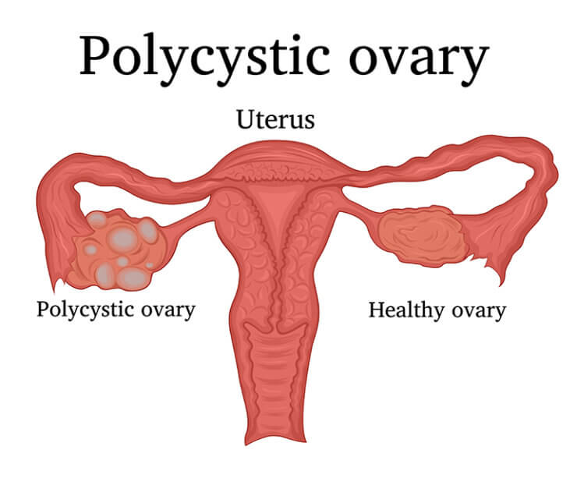
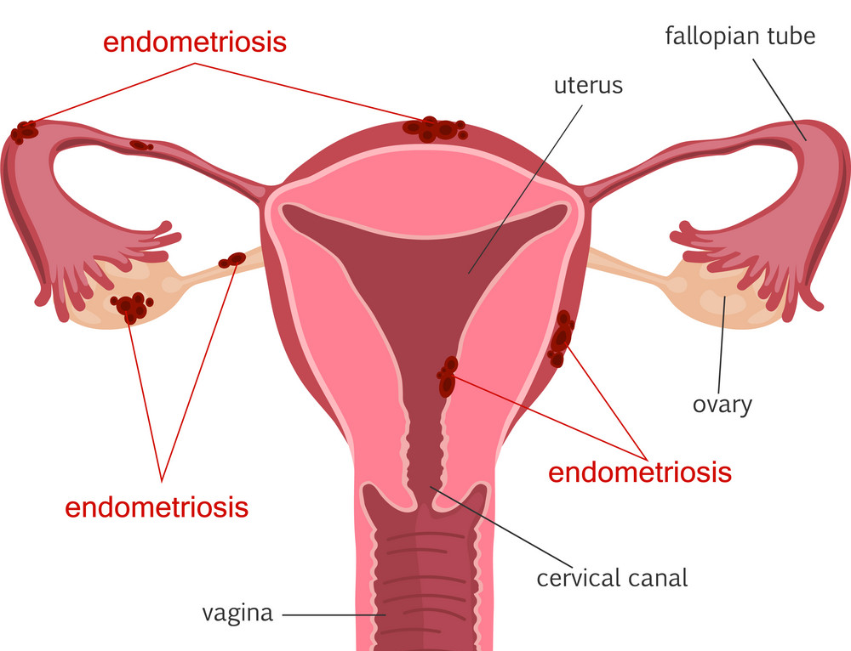
13
OVARIAN & UTERINE CYCLES
Lecture II & III
Further Reading
Luteinized Unruptured Follicle:
What If the dominant follicle decides not to rupture?
In a small percentage of normal women (fertile), the dominant follicle will occasionally undergo the luteinization process without rupture following the mid-cycle surge. As a result of the increased progesterone secretion, the uterine lining develops its normal characteristic changes following ovulation, but no oocyte is released and conception cannot occur. This phenomenon is called the luteinized unruptured follicle
Fortunately, this problem is easily resolved by ovulation induction medication and by “triggering” ovulation via an appropriate dose of injectable HCG or gonadotropin-releasing hormone agonist
Ovarian and Uterine Disorders
Ovarian cysts:
Fluid filled sacs that develop in or on the ovaries and are very common in women of reproductive age.
Follicular cysts: Dominant follicle that fails to rupture forming a cyst. This occurs when the normal
surge of LH doesn’t happen during a given menstrual cycle.
Polycystic Ovary Syndrome (multiple follicular cysts): Caused by a dysfunction in the hypothalamic-pituitary-ovarian axis.
Characterized by: Chronic anovulation which may lead to amenorrhea, absent menstruation and excess androgen production.
Corpus Luteal cyst (hemorrhagic cysts): Dominant follicle that ruptures but closes again. In this case the corpus luteum doesn’t dissolve but instead continues to grow. As it grows the arteries nourishing it can rupture; hence the name hemorrhagic cysts.
Theca Lutein Cysts: Caused by overstimulation of the hCG, thus they’re only seen in pregnancy.
Endometriosis:
A condition in which the cells that make up the endometrium migrate and implant themselves in other parts of the body. Once there, they grow and form a mass of endometrial tissue.
Most affected body parts are: The ovaries, the fallopian tubes and uterine ligaments.
Those endometrial cells have estrogen receptors, therefore they go through the same proliferation, secretion and menstruation cycle. The implants can bleed especially during menstruation.
The exact cause is unknown. However, there are 5 theories that might explain this condition:
Retrograde menstruation theory: During menstruation some blood carrying endometrial cells will flow backward into the fallopian tube and will implant on nearby tissue.
Dysfunction with the immune system theory: Suggests that B-cells and T-cells don’t respond to endometrial implants and allow it to grow.
Metaplastic theory: Suggests that the cells of the peritoneum can transform into endometrial tissue. This theory explains how in rare cases when a patient undergoes hysterectomy they can still develop endometriosis later on.
Benign metastases theory: Suggests that the endometrial cells can travel to distant organs through the lymph and blood.
Extrauterine stem cell theory: Suggests that the stem cells in the bone marrow differentiate into endometrial cells and then travel to other parts of the body.

Slide 15
Two days before the onset of menstruation, secretions of FSH and LH reach their lowest levels. What is the cause of this low level of secretion?
The anterior pituitary gland becomes unresponsive to the stimulatory effect of GnRH
Estrogen from the developing follicles exerts a feedback inhibition on the hypothalamus
The rise in body temperature inhibits hypothalamic release of GnRH
Secretion of estrogen, progesterone, and inhibin by the corpus luteum suppresses hypothalamic secretion of GnRH and pituitary secretion of FSH
What causes menopause?
Reduced levels of gonadotropic hormones secreted from the anterior pituitary gland
Reduced rate of secretion of progesterone from the corpus luteum
Reduced numbers of follicles available in the ovary for stimulation by gonadotropic hormones
Reduced responsiveness of the follicles to the stimulatory effects of gonadotropic hormones
Oligomenorrhea refers to
Failure to have menstrual periods
Bleeding from the uterus between menstrual periods
Reduced frequency of menstrual periods
Excessive loss of blood during menstrual periods
Follicular fluid secreted by granulosa cells contains high concentration of
Progesterone
Estrogen
Testosterone
LH
Early growth of primary follicle up to the antral stage is stimulated mainly by
FSH
LH
Estrogen
hCG
Without preovulatory surge of this hormone ovulation will not occur
FSH
LH
Estrogen
Progesterone
Stromal cells outside the basal lamina in the maturing follicle differentiate to form
Granulosa cells
Theca cells
Trophoblast cells
Both A & B
ANSWER KEY: D, C, C, B, A, B, B

Slide 16
Nayef Alsaber, Hameed M. Humaid
Maha Alnahdi, Taif Alshammari
Co-editors: Njoud Alabdullatif, Nouf Alshammari
FEMALE PHYSIOLOGY CO-LEADERS
Maha Alnahdi, Taif Alshammari
MALE PHYSIOLOGY CO-LEADERS
Nayef Alsaber, Hameed M. Humaid
REFERENCES
Guyton and Hall Textbook of Medical Physiology
Ganong’s Review of Medical Physiology

