Slide 1
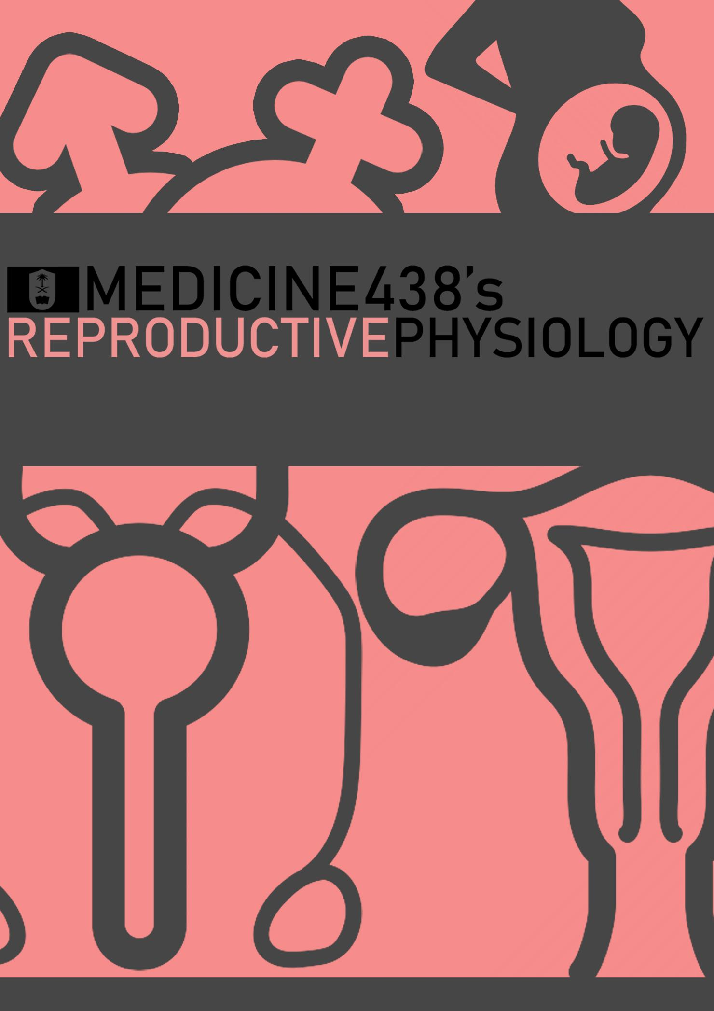
LECTURE IV: Physiology of Androgens and Control of Male Sexual Functions
EDITING FILE
IMPORTANT
MALE SLIDES
EXTRA
FEMALE SLIDES
LECTURER’S NOTES

Slide 2
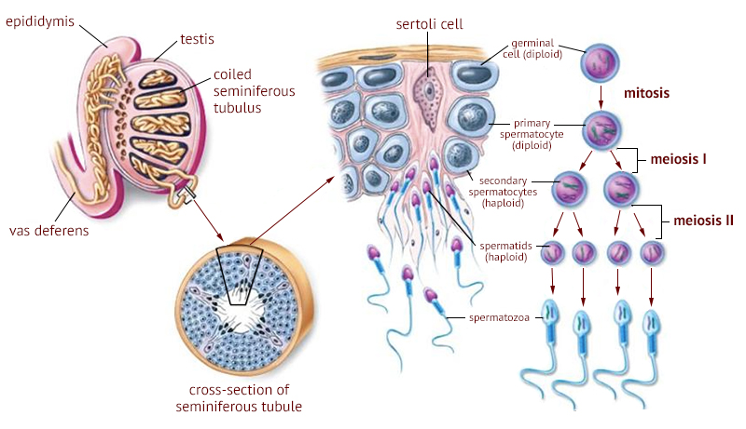
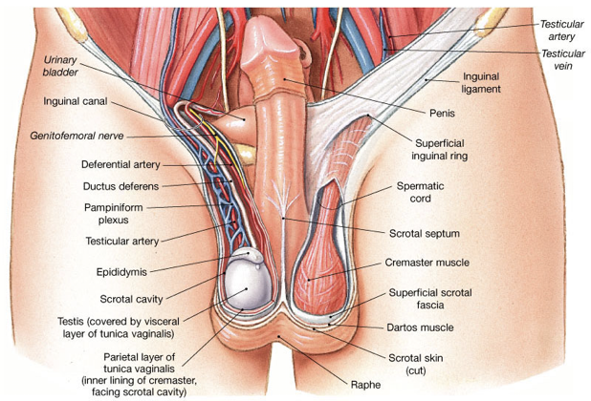
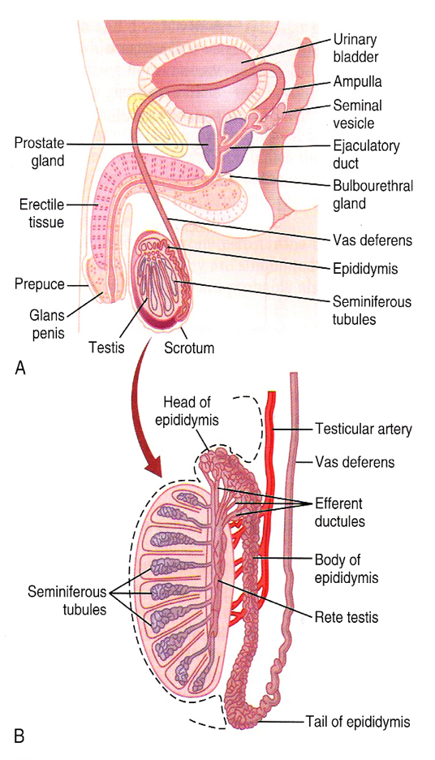
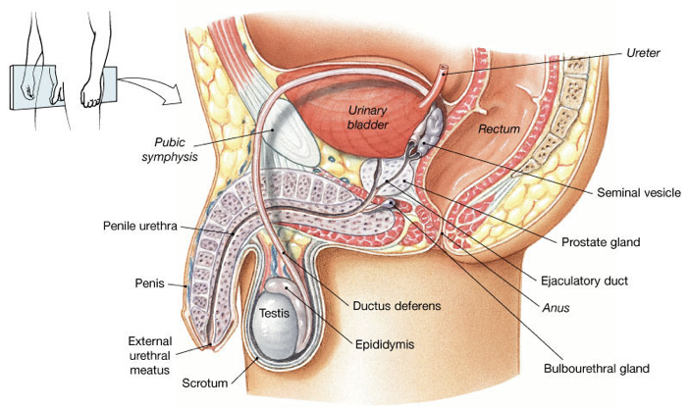
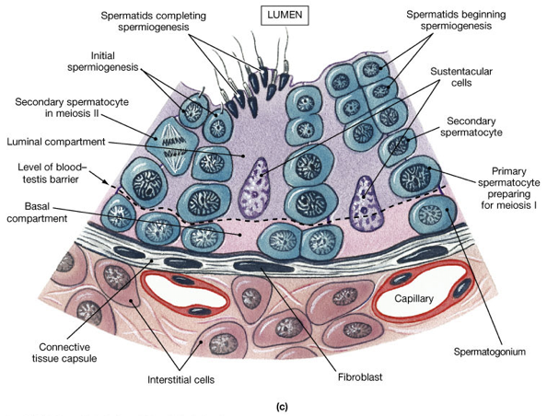
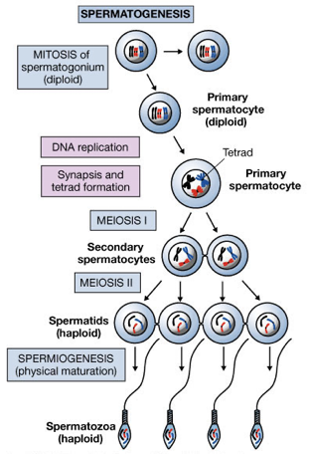
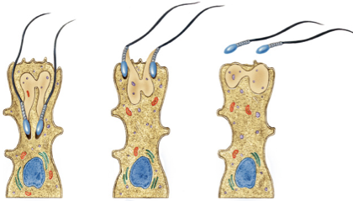
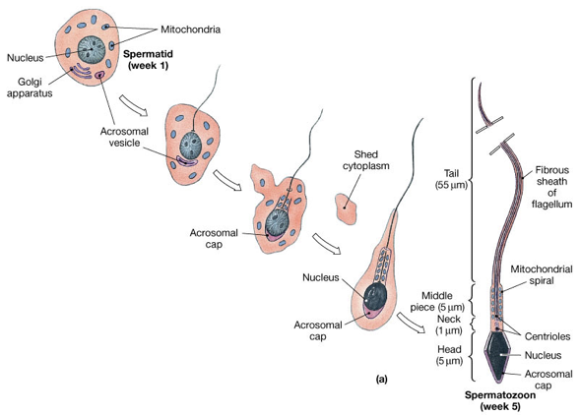
1
PHYSIOLOGY OF ANDROGENS & CONTROL OF MALE SEXUAL FUNCTIONS
Lecture Four
OBJECTIVES
By the end of this lecture, you should be able to:
Understand the functions of the male reproductive organs and glands.
Describe the synthesis, secretion, metabolism and effects of testosterone.
Explain how the hypothalamus and anterior pituitary gland regulate male reproductive function.
Describe the major testicular abnormalities.
Discuss the normal mechanism of the male sexual act.
Male Reproductive Anatomy and Physiology
Figure 4-1
Testis
Epididymis
Vas deferens
Seminal vesicle
Prostate
Bulbourethral
Ejaculatory duct
Urethra
Penis
Figures 4-2
Figure 4-3
Testes
The testes reside outside the abdominal cavity in the scrotum.
This location maintains testicular temperature at about 2°C lower than body temperature (clinical significance of this location will be discussed in page 9)
Each testis is composed of 300 lobules.
The seminiferous tubule is lined by a complex seminiferous epithelium composed of two cell types:
1. Sperm cells in various stages of spermatogenesis.
2. Sertoli cell, which is a “nurse cell” in intimate contact with all sperm cells.
Spermatogenesis¹
Figures 4-4:
The Seminiferous Tubules
Spermatogenesis is the formation of sperm.
Occurs in the seminiferous tubules during active sexual life due to stimulation of AP-GnHs. (Anterior pituitary gonadotropic hormones)
Seminiferous tubules contain:
Spermatogonia: Stem cells involved in spermatogenesis.
Sertoli (Sustentacular) cells: Sustain and promote development of sperm.
Begins at an average age of 13, continues throughout life & decreases in old age.
Figure 4-5:
Spermatogenesis
Spermiogenesis³
Maturation of spermatozoa.
Phagocytosis of cytoplasm by the Sertoli cells
Figures 4-6: Spermiogenesis
Large with overflowing cytoplasmic envelopes.
Surround the developing spermatogonia around the central lumen of the seminiferous tubules.
Form blood-testes barrier:²
Prevents autoimmune destruction of sperm.
Produce FAS ligand which binds to the FAS receptor on surface to T lymphocytes, triggering apoptosis of T lymphocytes.
Prevents immune attack.
Secrete inhibin and MIS (causes degeneration of the primordial female reproductive system ‘mullerian duct)
Phagocytize residual bodies (excess cytoplasm shed by spermatocytes as they mature)
May transmit information molecules from germ cells to Sertoli cells.
Secrete androgen-binding protein (ABP):
Binds to testosterone and concentrates testosterone in the tubules.
Sertoli Cells
Leydig
Cells
Lie within the interstices between the seminiferous tubules.
They are almost non-existent in the testis during childhood when the testes secrete almost no testosterone.
Numerous in the newborn male infants for the first few months of life.
Active at puberty & throughout adult life. It secrete testosterone.
FOOTNOTES
Footnotes
Check further reading 1.
How does it prevent autoimmunity? The antigens of testes are said to be ‘sequestered’ (antigen sequestration), and if they are exposed to immune cells, they will be recognized as foreign bodies and an immune reaction will ensue. FASL binding to its receptor is a major mechanism for immune regulation, in fact, autoreactive cytotoxic and T-helper cells are removed in this manner by unique cells, called T-regulatory cells. (or T-reg).
Spermiogenesis is the final step of Spermatogenesis.

Slide 3
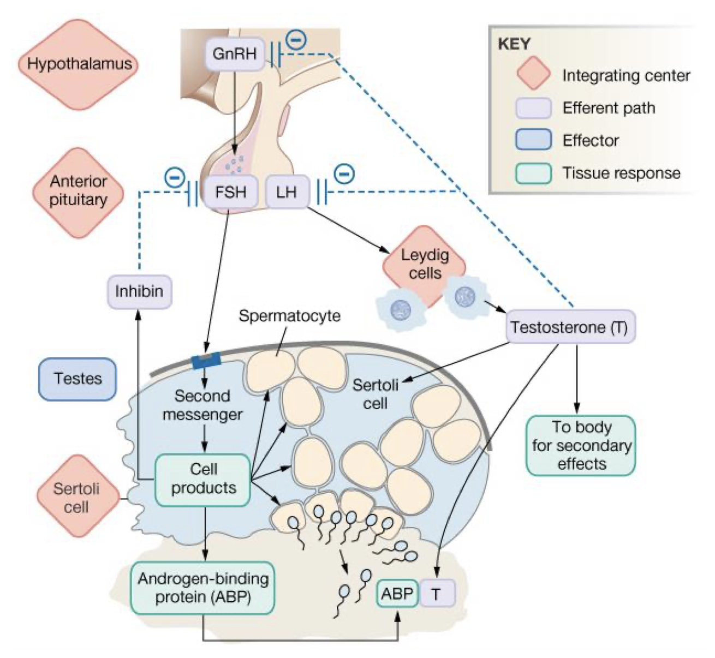
2
PHYSIOLOGY OF ANDROGENS & CONTROL OF MALE SEXUAL FUNCTIONS
Lecture Four
Regulation of Spermatogenesis
GnRH > LH > Leydig cells > Testosterone > growth and division of germ cells.
GnRH > FSH > Sertoli cells > Spermatocyte maturation.
Inhibin feedback – FSH, testosterone – short & long loops.
Estrogen.
Growth hormone.
Figure 4-6
Hormonal Factors that Stimulate Spermatogenesis
1- Testosterone: Secreted by the leydig cells which are located in the interstitium of the testis. It is essential for the growth and division of the testicular germinal cells.
2- Luteinizing hormone (LH): Secreted by the anterior pituitary gland, stimulates
the Leydig cells to secrete testosterone.
3- Follicle stimulating hormone: (FSH): Secreted by the anterior pituitary gland, stimulates the Sertoli cells, stimulate the conversion of spermatids to sperm (also important for spermatogenesis).
4- Estrogen: Formed from testosterone by the sertoli cells under FSH stimulation, also essential for spermatogenesis. (Sperm has receptors for estrogen, mutation in estrogen receptors reduces fertility)
5- Growth hormone (GH) -and other body hormones-: Is necessary for controlling metabolic functions of the testis. GH promotes early division of Spermatogonia; in its absence (as in pituitary dwarfs), the spermatogenesis is severely deficient or absent, thus causing infertility.
Maturation of Sperm in the Epididymis
After formation in the seminiferous tubules, the sperm require several days to pass through the epididymis (still non-motile). Sperm in the early portion of epididymis are non-motile.
After the sperm have been in the epididymis for 18 to 24 hours, they develop the capability of motility, even though several inhibitory proteins in the epididymal fluid still prevent final motility until after ejaculation.
After ejaculation they become motile.
Physiology of mature sperm:
Mature sperm are motile & capable of fertilizing the ovum.
Their activity is greatly enhanced in a neutral and slightly alkaline medium, as exists in the ejaculated semen, but it is greatly depressed in a mildly acidic medium.¹ (sperm does not actually become motile unless the pH of surrounding environment reaches >6-6.5.)
The life expectancy of ejaculated sperm in the female genital tract is only 1 to 2 days.
FOOTNOTES
Footnotes
Sperm has special alkaline-sensitive Ca⁺⁺ channels called CatSper, they are activated when sperm passes through an alkaline medium. Calcium entry activates complex cellular pathways that enhance the movement of flagella. Mice with knockout CatSper have immotile sperm, and are infertile.
In an unrelated note, sperm also express olfactory receptors (yes, same ones we use for smelling), and detect the aroma of ovaries and move towards them as they enter the female genital tract.

Slide 4
3
PHYSIOLOGY OF ANDROGENS & CONTROL OF MALE SEXUAL FUNCTIONS
Lecture Four
Storage of Sperm
The two testes of the human adult form up to 120 million sperm each day.
Most of these sperm are stored in the epididymis, although a small quantity is stored in the vas deferens.
They can remain stored, while maintaining their fertility, for at least a month.
The sperm are kept inactive by multiple inhibitory substances in the secretion of the ducts.
After Ejaculation
The sperm become motile and capable of fertilizing the ovum, a process called “maturation”.
The sertoli cells and the epithelium of the epididymis secrete a nutrient fluid (that is ejaculated along with the sperm) which contains hormones (testosterone & estrogens), enzymes, and special nutrients that are essential for sperm maturation.
Function of the Seminal Vesicle
Secretes a mucoid material containing fructose, citric acid, and other nutrient substances, as well as large quantities of prostaglandins & fibrinogen.
The prostaglandins are important help in fertilization by:
1
2
Reacting with the female cervical mucus making it more receptive to sperm movement.
Causing backward reverse peristaltic contractions of the uterus & fallopian tubes to move the ejaculated sperm toward the ovaries.
Function of the Prostate Gland¹
The prostate gland secretes a thin milky fluid that contains Ca2+ ion, citrate ion, phosphate ion, a clotting enzyme, and a profibrinolysin.
The alkaline prostatic fluid is important for successful fertilization of the ovum.
Function of Alkaline Prostatic fluid
1
Successful fertilization of the ovum.
2
Help to neutralize the slightly acidic fluid of the vas deferens (due to the presence of citric acid and metabolic end products of the sperm that inhibit sperm fertility).
3
Helps to neutralize the acidity of other seminal fluids -as well as the vaginal fluids (pH is around 4, sperm becomes motile in pH of 6 or higher)- during ejaculation and thus enhances the motility & fertility of the sperm.
FOOTNOTES
Footnotes
Prostatic secretion also contain some zinc, this can inhibit the growth of some pathogenic bacteria, like E. coli, which contributes to the decreased risk of UTIs in males. Androgens control the growth and survival of prostatic cells, castration results in atrophy and apoptosis of prostatic cells.

Slide 5
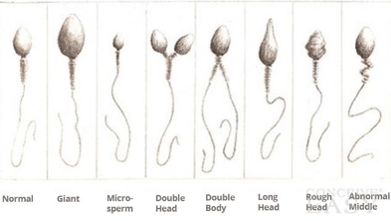
4
PHYSIOLOGY OF ANDROGENS & CONTROL OF MALE SEXUAL FUNCTIONS
Lecture Four
Semen
Milky white, sticky mixture of sperm and accessory gland secretions.
Ejaculated semen during sexual act is composed of the fluid & sperm.
Provides a transport medium and nutrients (fructose), protects and activates sperm, and facilitates their movement.
The average pH is about 7.5, the alkaline prostatic fluid help to neutralize the mild acidity of other portions of the semen.
The prostatic fluid gives the semen a milky appearance.
Fluid from the seminal vesicles and mucous glands gives the semen a mucoid consistency.
Prostaglandins in semen:
Decrease the viscosity of mucus in the cervix
Stimulate reverse peristalsis in the uterus
Facilitate the movement of sperm through the female reproductive tract
Clotting factors coagulate semen immediately after ejaculation, then fibrinolysin liquefies the sticky mass during the next 15-30 minutes¹.
After ejaculation, sperms can live 24-48 h.
Fluid from the seminal vesicles (~60%, 65%).
Fluid from the vas deferens (~10%).
Fluid from the prostate gland (~30%, 25%).
Small amounts from the mucous glands, especially the bulbourethral glands.
Factors Affecting Fertility
Sperm Count |  | Sperm Morphology & Motility When the majority of the sperm are morphologically abnormal or nonmotile then person is likely to be infertile.
The quantity of ejaculated semen during each coitus is about 3.5 ml (2-5 ml). Normal male count vary between 35 million to 200 million sperm/ml (Each milliliter contains about 120 million sperm). Sperm count below 20 million leads to infertility.
 |  | Abnormal Shape | Abnormal Motility
 |  | Sometimes sperm count is normal but still infertile when about one half of the sperm have abnormal shape. | Sometimes the shape of the sperm is normal but they’re either relatively non-motile or entirely non-motile which causes infertility.
Figure 4-8
FOOTNOTES
Footnotes
The exact role of coagulation in fertilization is not clear, However, it might play a role in sperm stability once it enters the female reproductive system, and also to keep sperm close to the external OS. Keep in mind that coagulation happens deep within the vaigina.

Slide 6
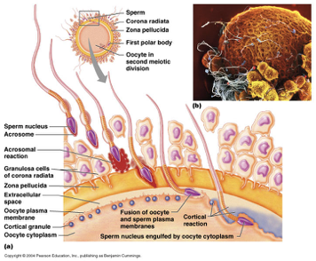
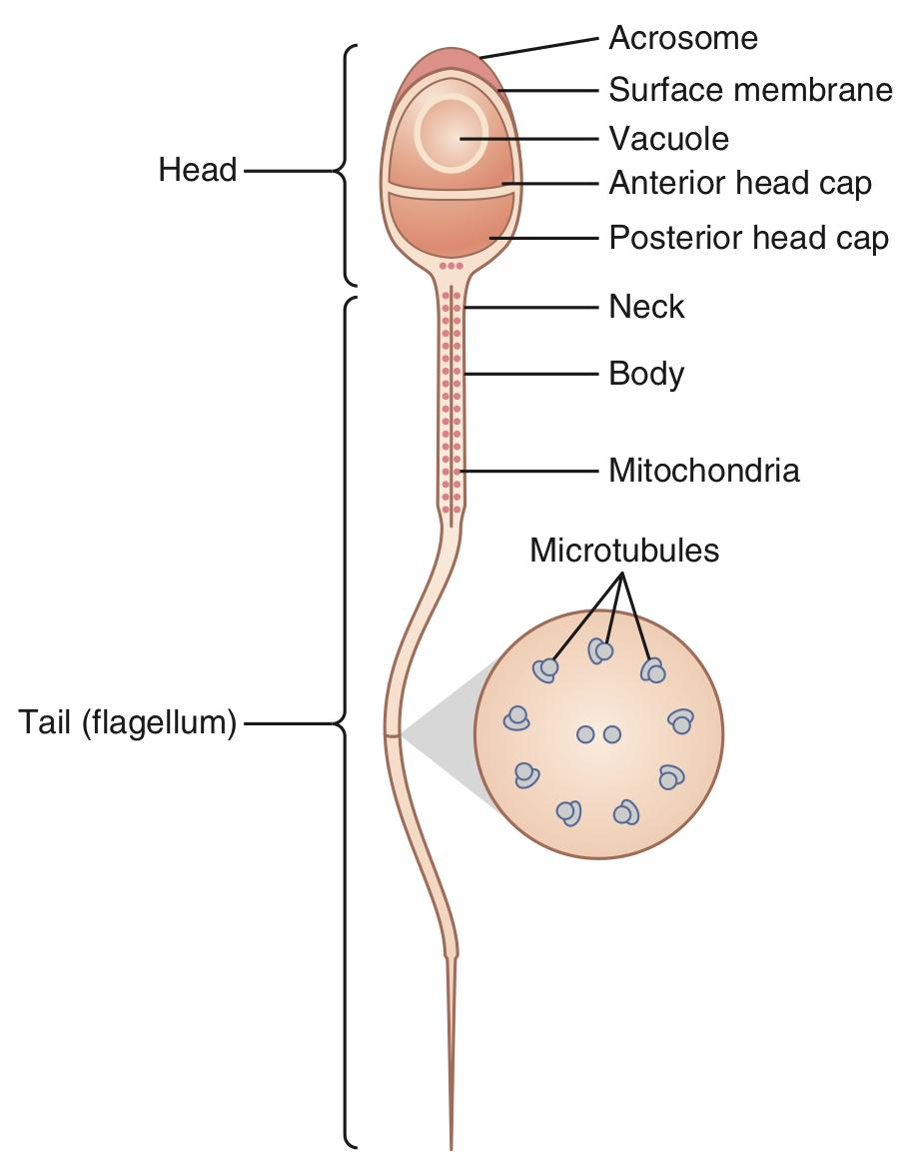
5
PHYSIOLOGY OF ANDROGENS & CONTROL OF MALE SEXUAL FUNCTIONS
Lecture Four
Capacitation of the Spermatozoa
Capacitation = Making it possible for spermatozoa to penetrate the ovum:
Sperm in the epididymis is kept inactive by multiple inhibitory factors secreted by the genital duct epithelia.
They will be activated in the female genital tract, for the processes of fertilization.
These activation changes are called capacitation of the spermatozoa (it requires from 1 to 10 hrs).
1
Uterine and fallopian tube fluids wash away the inhibitory factors which suppress the sperm activity in the male genital ducts.
Cellular membrane covering the acrosome is covered with cholesterol which prevent the release of its enzymes. After ejaculation, the sperm is removed -swims away- from the cholesterol vesicles & this makes the membrane of the sperm head (the acrosome) becomes much weaker.
2
3
The sperm membrane becomes more permeable to Ca²⁺ ion which increase their movements & help to release the proteolytic enzymes from the acrosome which aid in penetrating the ovum.
Acrosome enzymes, the “Acrosome Reaction” & Penetration of the ovum
The acrosome of the sperm store large quantities of hyaluronidase and proteolytic enzymes.
Hyaluronidase depolymerizes hyaluronic acid polymers in the intracellular cement that hold the ovarian granulosa cells together.
Also the proteolytic enzymes digest the proteins.
Figure 4-4
Figure 4-9

Slide 7
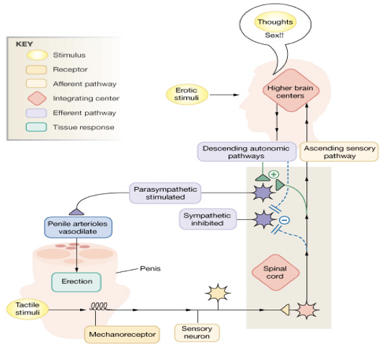
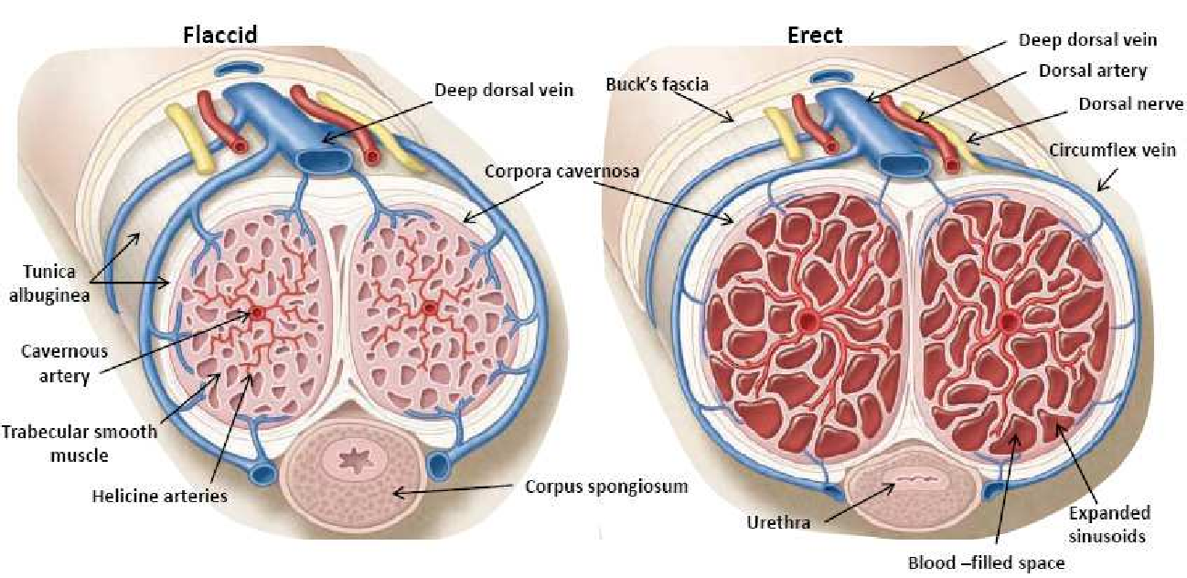
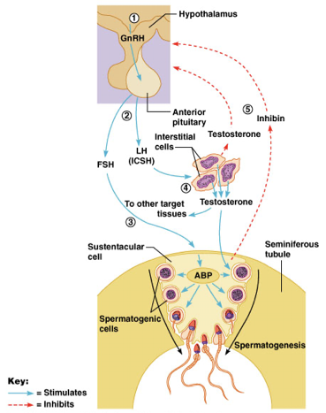
6
PHYSIOLOGY OF ANDROGENS & CONTROL OF MALE SEXUAL FUNCTIONS
Lecture Four
Male Sexual Act
 | 1. Penile erection: Enlargement and stiffening of the penis from engorgement of erectile tissue with blood. Erection is caused by parasympathetic impulses that pass from the sacral portion of the spinal cord through the pelvic nerves to the penis. Erection is initiated by sexual stimuli including: Touch and mechanical stimulation of the glans penis and other parts. Erotic sights, sounds, and smells. Erection can be induced or inhibited solely by emotional or higher mental activity. | Mechanism During sexual arousal, a parasympathetic reflex promotes the release of nitric oxide, VIP, and Acetylcholine. Nitric oxide¹ relaxes the penis arteries and causes erectile tissue to fill with blood. Expansion of the corpora cavernosa: Compresses their drainage veins Retards blood outflow and maintains engorgement.
 | 2. Lubrication: Parasympathetic impulses cause the urethral glands & the bulbourethral glands to secrete mucous.
 | 3. Emission and ejaculation: Functions of the sympathetic nerves.
 | Emission When the sexual stimulus becomes extremely intense, spinal cord begins to send sympathetic impulses to initiate emission. Emission begins with contraction of the vas deferens and the ampulla to cause expulsion of the sperm into the internal urethra. Contraction of the prostate & seminal vesicles to expel their fluid into the urethra. All these fluids mix in the internal urethra with the mucus already secreted by the bulbourethral glands to form the semen. This process at this point is called emission. | Ejaculation Filling of the internal urethra with semen elicits sensory signals, that are transmitted through pudendal nerves to the sacral region of the cord, which promotes ejaculation. Fullness of the internal urethra causes rhythmical contractions of the internal genital organs which increases their pressure to ejaculate the semen to the outside. This process is called ejaculation.
 | 4. Resolution: After orgasm, the excitement disappears within 1-2 minutes (resolution)².
Stages of Male Sexual Act
Figure 4-10: The Erection Reflex
Hormonal Regulation of Testicular Function
The hypothalamus releases gonadotropin-releasing hormone (GnRH).
GnRH stimulates the anterior pituitary to secrete FSH and LH.
FSH causes Sertoli cells to release androgen-binding protein (ABP).
LH stimulates interstitial (Leydig) cells to release testosterone.
ABP binding of testosterone enhances spermatogenesis.
Feedback inhibition on the hypothalamus and pituitary results from:
Rising levels of testosterone.
Increased inhibin.
Figure 4-11
FOOTNOTES
Footnotes
How does Viagra work? Sildenafil, aka Viagra, is a phosphodiesterase inhibitor that inhibit the degradation of cGMP (the 2nd messenger of nitric oxide), therefore the effect of NO will be potentiated. The erectile tissue, like corpus cavernosum, is usually empty of blood, therefore when vasodilation occurs, it becomes engorged with blood and enlarges.
Refractory Periods After Ejaculation: Males tend to have refractory periods after orgasms where it is physiologically impossible to maintain erections and have another orgasm, it lasts from minutes (in young individuals) up to days (in elderly). Females are known to have multiple orgasms, therefore it is suspected that females do not actually have refractory periods. The mechanism for refractory periods are complex and involves several hormones, which is not our topic of discussion at the moment.

Slide 8
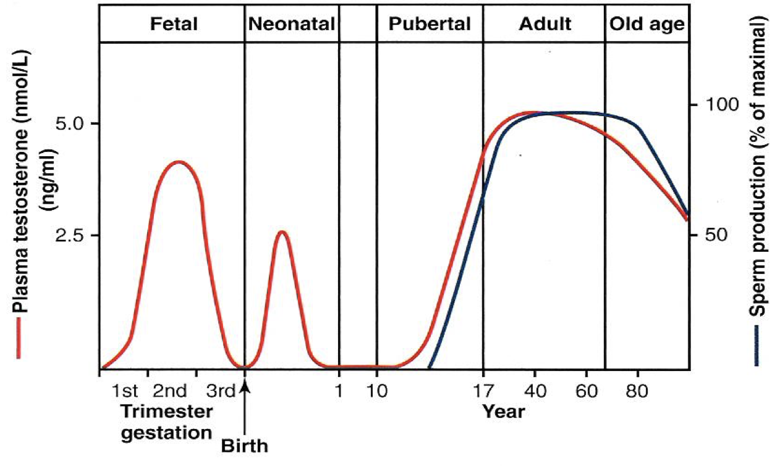
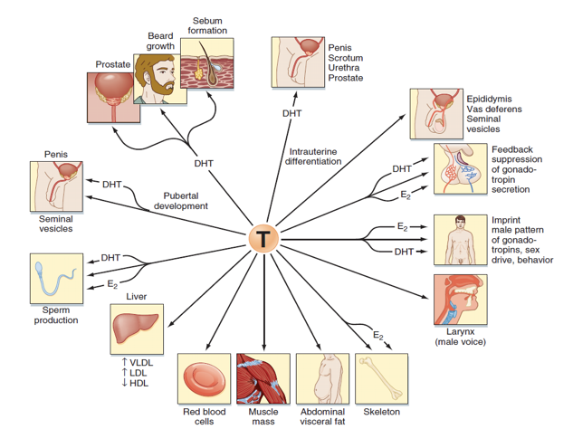
7
PHYSIOLOGY OF ANDROGENS & CONTROL OF MALE SEXUAL FUNCTIONS
Lecture Four
Testosterone and Other Male Sex Hormones: Secretion, Metabolism & Chemistry
Secretion of testosterone by the interstitial cells of leydig in the testis.
The testes secrete several male sex hormone called androgens, including testosterone, dihydrotestosterone & androstenedione.
Testosterone is the most abundant form while dihydrotestosterone is the more active form.
Testosterone is converted into dihydrotestosterone in the target cells.
Secretion & Chemistry of androgens in the body:
From the testes and adrenal glands.
It is synthesized either from cholesterol or directly from acetylcoenzyme A.
Metabolism of testosterone:
Testosterone binds to a beta globulin and circulates in the blood for 30 minutes to several hours.
Converted to estrogen in the liver.
Excreted either into the gut through liver bile or into the urine through the kidneys.
Functions of Testosterone
It is responsible for the characteristic masculine body.
During fetal life, the testis are stimulated by placenta chorionic gonadotropin
to produce testosterone throughout the fetal life & for 10 weeks after birth.
During childhood there is no more testosterone production.
At puberty, under the anterior pituitary gonadotropic hormones stimulation, testosterone production increases rapidly and lasts throughout life.
Beyond 80 years it decline to 50%.
Figure 4-12
Function of Testosterone During Fetal Development
Testosterone is secreted first by the genital ridges and later by the fetal testis.
It is responsible for development of the male body
characteristics including the formation of:
Penis & scrotum.
Prostate gland & seminal vesicles.
Male genital ducts.
Suppressing the formation of female genital organs.
Figure 4-13
Effect of testosterone to cause descent of the testis:
The testis descend into the scrotum during the last 2 to 3 months of gestation when the testis begin secreting reasonable quantities of testosterone.

Slide 9
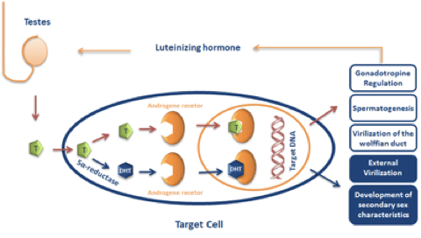
8
PHYSIOLOGY OF ANDROGENS & CONTROL OF MALE SEXUAL FUNCTIONS
Lecture Four
Effect of Testosterone on Development of Adult Primary and Secondary Sexual Characteristics:
1. After puberty: The increasing amounts of testosterone cause enlargement of the penis, scrotum, testis & secondary sexual characteristics. It targets all male reproductive organs and accessory glands, its deficiency causes these organs to atrophy. | 2. Effect on the distribution of body hair: Causes the appearance of pubic, axillary, and facial hair. Testosterone causes growth of hair: (1) over the pubis (upward along the linea alba of the abdomen to the umbilicus), (2) on the face, (3) on the chest, and (4) less often on other regions of the body, such as the back.
3. Baldness: Testosterone decreases the growth of hair on the top of the head. Two factors causing baldness: 1. Genetic background. 2. Large quantities of androgenic hormones. | 4. Effect on voice & Chest: Enhances growth of the chest and deepening of the voice. It causes hypertrophy of the laryngeal mucosa and enlargement of the larynx (typical adult masculine voice).
5. Testosterone increases thickness of the skin and contribute to the development of acne: Skin thickens and becomes oily: Testosterone increases the thickness of the skin over the body & the subcutaneous tissues. It also increases the secretion of the sebaceous glands. Excessive secretion by the sebaceous glands of the face can result in acne. | 6. Testosterone increases protein formation and muscle development:¹ Testosterone have anabolic effect by: Increasing muscular development after puberty by a 50% increase in muscle mass over that in the female. Increasing protein content in non-muscle parts of the body.
7. Testosterone increases bone matrix (Density), and causes Ca²⁺ retention: Bones grow thicker & deposit additional Ca²⁺ thus it increases the total quantity of bone matrix causing Ca²⁺ retention (anabolic effect). Testosterone has specific effect on the male pelvis shape: (makes it narrow, long & funnel-like shaped). Narrows the pelvic outlet, Lengthen it & Causes the funnel-like shape instead of the broad ovoid shape of the female pelvis.² It causes the epiphyses of the long bones to unite with the shafts of the bones & early closure of the epiphyses.³
8. Testosterone increases basal metabolism: It increases the basal metabolic rate by about 15% (indirectly as a result of the anabolic effect). | 9. Effect on red blood cells: It increases red blood cells/ml (due to increased metabolic rate).
10. Effect on electrolyte and water balance: It increases the reabsorption of Na⁺ in the distal tubules of the kidneys.
11. It also causes hair growth (pubic, axillary) and libido in females. | 12. Spermatogenesis and erection.
The Basic Intracellular Mechanism of Action of Testosterone
Once it diffuses to cells it either binds to androgen receptor or converted to DHT (by 5-alpha reductase) which then binds to the androgen receptor.
It increases the rate of protein synthesis in target cells.
This combination moves to the cell nucleus, where it binds a nuclear protein and induces protein formation.
It binds to testosterone–binding globulin (TeBG), ABP, serum albumin, or to corticosterone-binding globulin (CBG)
Figure 4-14
FOOTNOTES
Footnotes
Testosterone increases protein deposition in the muscle, enhancing muscle mass. Therefore it has been abused by some athletes. Some elderly individuals take testosterone as a “youth pill” in-order to enhance their strength and maintain their masculine characteristics in old age.
In testosterone’s absence, males will develop a pelvis similar to that of a female.
This effect actually causes people with excess testosterone secretion to be shorter, eunuchs with absence of testosterone secretion from testes tend to be taller than males with testes.

Slide 10
9
PHYSIOLOGY OF ANDROGENS & CONTROL OF MALE SEXUAL FUNCTIONS
Lecture Four
Abnormalities of Male Sexual Function
Prostate gland abnormalities
Hypogonadism
Cryptorchidism
Testicular tumors
& Hypergonadism
Prostate gland and its abnormalities
Benign prostatic fibroadenoma, develops in older men, due to overgrowth of prostate tissue (not caused by testosterone).
Cancer of the prostate gland caused by stimulation of cancerous cells by testosterone.
Hypogonadism in male
During fetal life when the testis are non-functional, none of the male sexual characteristics develop in the fetus. Instead, female organs are formed.
If a boy loses his testis before puberty, a state of eunuchism occurs (he have infantile sex organs & infantile sexual characteristics). The height of an adult eunuch is slightly greater than normal because of slow union of the epiphyses.
If a man is castrated after puberty, sexual organ regress in size, the voice regress, loss of the thick masculine bones, loss of masculine hair production, and loss of musculature of the virile male.
Adiposogenital syndrome, Frohlich’s syndrome or hypothalamic eunuchism:
Hypogonadism due to genetic inability of the hypothalamus to secrete normal amount of GnRH.
This condition is often associated with a simultaneous abnormality of the feeding center of the hypothalamus, causing the person to greatly overeat. Consequently, obesity occurs along with eunuchism.
Cryptorchidism¹:
Failure of the testes to descend in the scrotum which normally occur during fetal life.
10% of newborn males and it falls to 2% at age 1 year.
0.3% after puberty
They should be treated before puberty because of higher incidence of malignant tumors.
Testicular tumors and hypergonadism in male:
Interstitial leydig cell tumors (rare), overproduction of testosterone. In children, they cause rapid growth of the musculature and bones but also early union of the epiphyses, so that the eventual adult height is actually considerably less than that which would have been achieved otherwise.
These tumors cause excessive development of the male sexual organs.
Tumor of the germinal epithelium (more common).
FOOTNOTES
Footnotes
Testes in the abdomen will be exposed to higher temperature, and the seminiferous epithelium will degenerate and therefore sterility will occur. Cryptorchidism is treated with testosterone which causes testes to descend, or GnRH which will stimulate testosterone production.

Slide 11
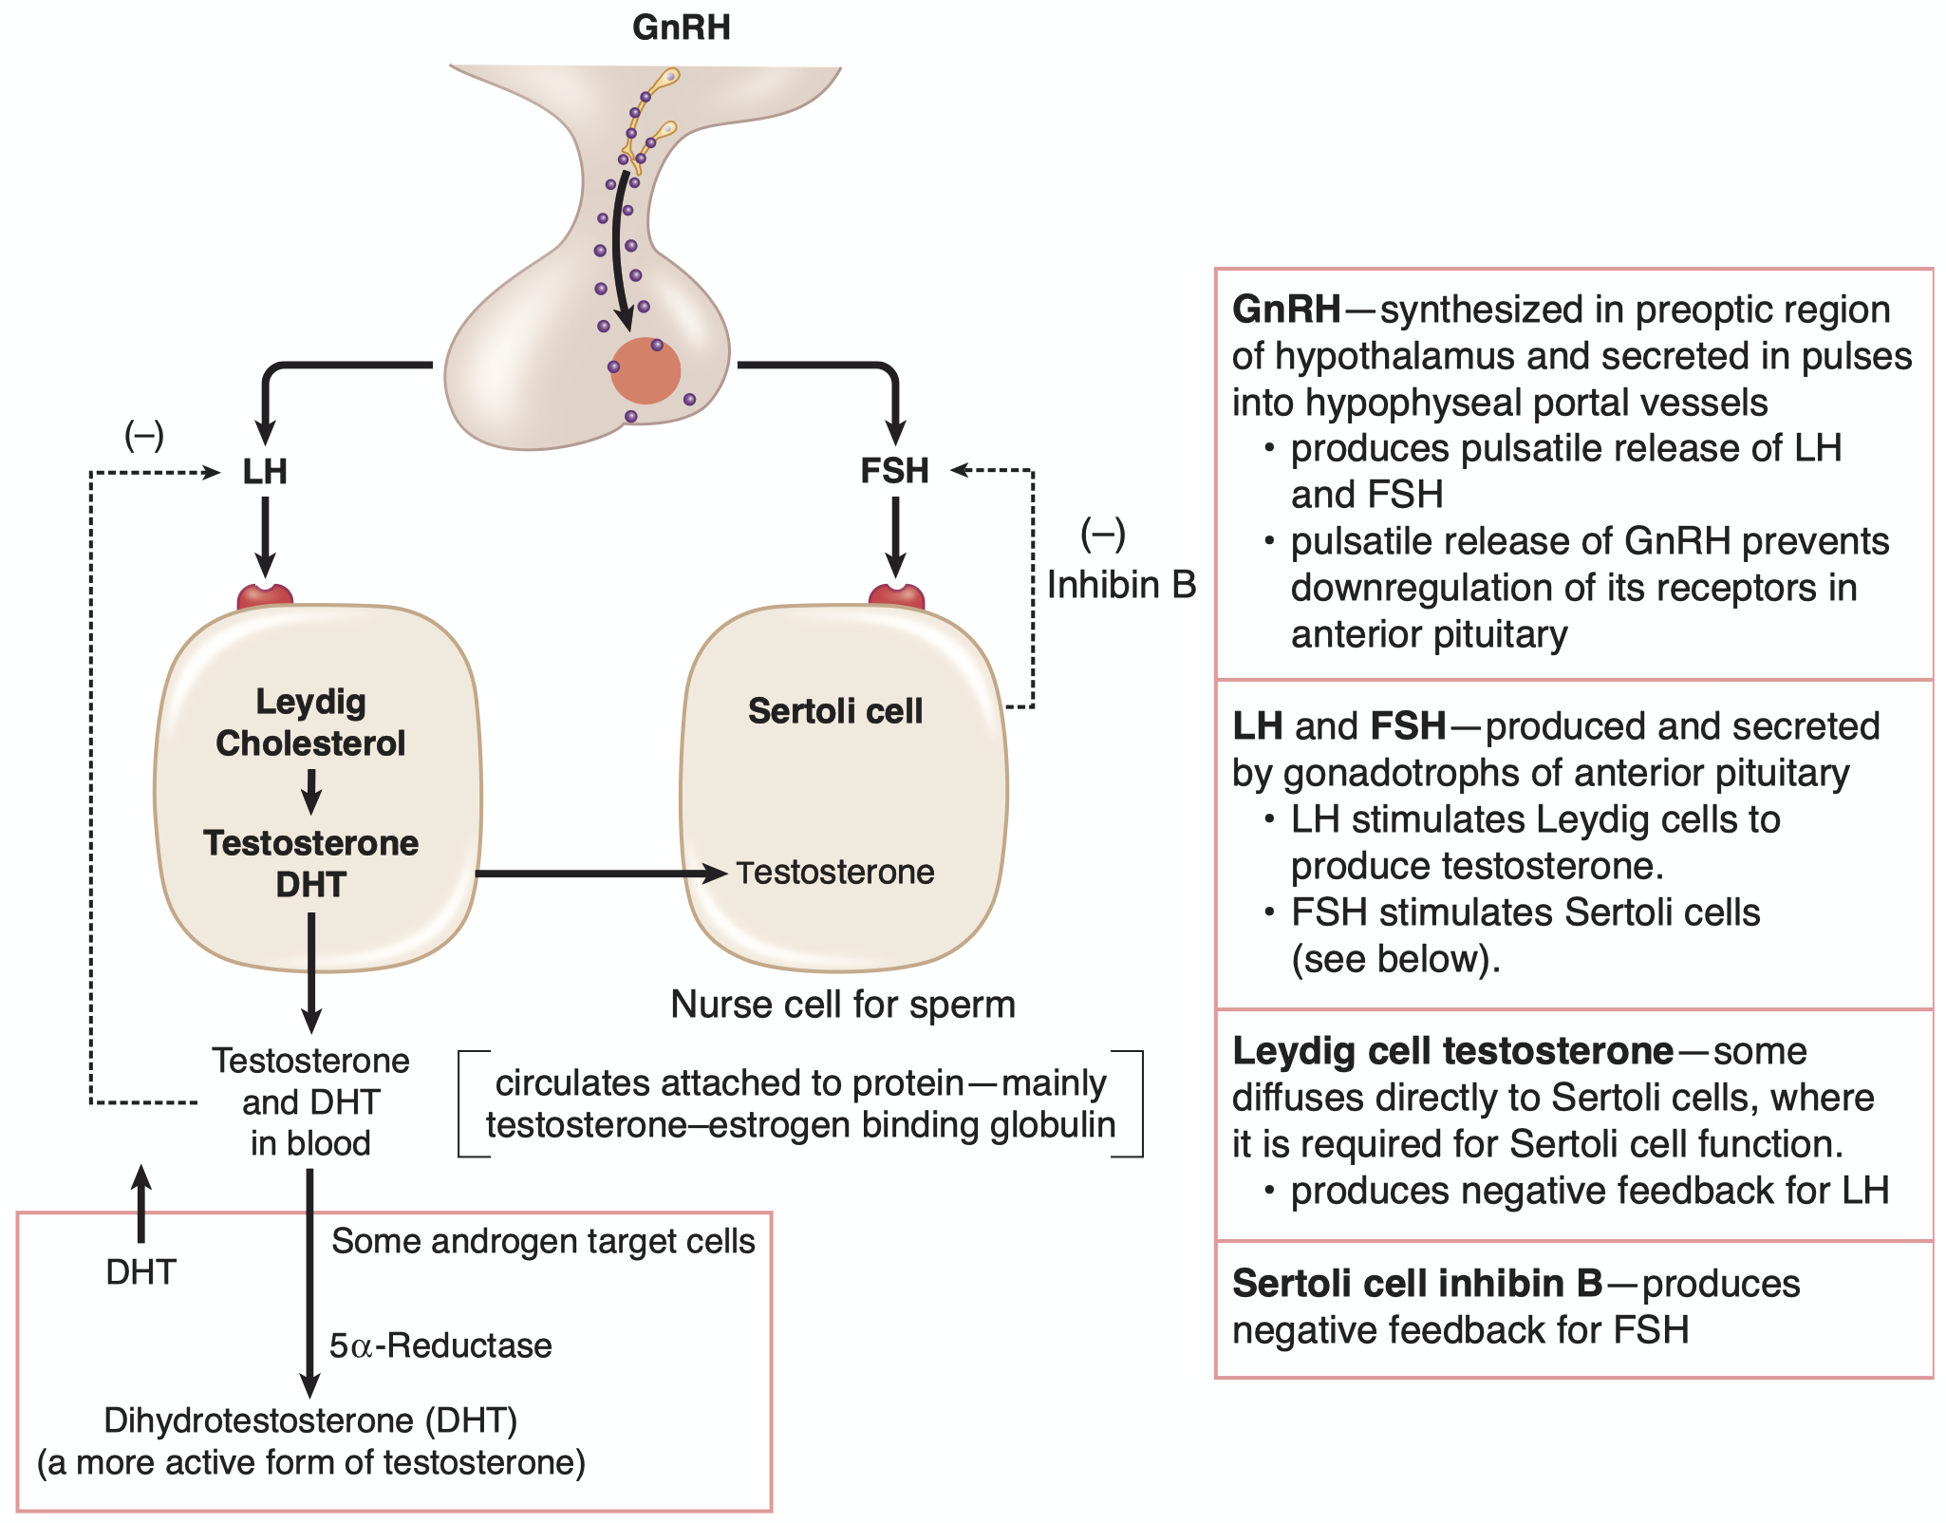
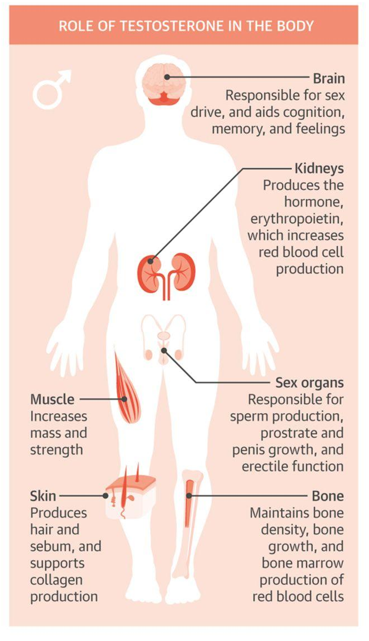
10
PHYSIOLOGY OF ANDROGENS & CONTROL OF MALE SEXUAL FUNCTIONS
Lecture Four
LECTURE SUMMARY:
Spermatogenesis
Formation
Formation of sperm from spermatogonia occurs in the seminiferous tubules due to stimulation of HPG
Facilitated by:
- Sertoli Cells (surround spermatogonia)
- Leydig Cells (in interstices) secrete Testosterone
Maturation
Occurs in Epididymis.
- Mature sperm are motile & capable of fertilizing ova.
- Activity is enhanced in alkaline medium.
- Motility is inhibited in epididymis due to inhibitory proteins (work after ejaculation).
Storage
Epididymis (major).
Vas deferens (minor).
While stored, sperm maintain fertility for > month.
Sperm are kept inactive by multiple inhibitory factors while stored.
Capacitation:
= Making it possible for sperm to penetrate ova.
1- Uterine fluid removes inhibitory factors.
2- Removed from cholesterol vesicles.
3- Increased Ca²⁺ = Increase movement of sperm & release of enzymes.
Seminal vesicles
Prostate gland
Secrete mucoid material containing: fructose, citric acid nutrients, large quantities of Prostaglandins & Fibrinogen
Prostaglandins help in fertilization:
1- Making the female cervical mucus more receptive to sperm movement.
2- Causing reverse peristaltic contractions of the uterus & fallopian tubes.
Secretes thin milky fluid contains Ca2+ ion, citrate ion, phosphate ion, a clotting enzyme & profibrinolysin.
Alkaline Prostatic fluid is important for successful fertilization of the ovum; it neutralizes acidic vaginal secretions.
Semen
Testosterone
Ejaculated semen during sexual act is composed of the fluid & sperm:
- From the seminal vesicles (~60%). - From the prostate gland (~30%).
- From the vas deferens (~10%). - Small amounts from the bulbourethral glands.
- Secreted by the interstitial cells of Leydig.
- The testes secrete several androgens including:
Testosterone, Dihydrotestosterone & Androstenedione.
- Most abundant: Testosterone
- Most active: Dihydrotestosterone.
- Testosterone is converted to Dihydrotestosterone in the target cells by 5 α-reductase.
1- Penile erection: Parasympathetic.
2- Lubrication: Parasympathetic.
Stages of male sexual act
3.1- Emission: Sympathetic - Contraction of: vas deferens, prostate & seminal vesicles to expel their fluid into the urethra.
3.2- Ejaculation: Sympathetic - Rhythmical contractions to push the semen outside.
Figure 4-15: Control of testes.
Abnormalities of male sexual function
Prostate gland abnormalities
1. Fibroadenoma (not caused by testosterone).
2. Cancer: caused by testosterone.
Hypogonadism
In fetal life testes are non-functional.
1. Eunuchism: loss of testes before puberty.
2. Castration: loss of testes after puberty.
3. Adiposogenital syndrome: hypogonadism secondary to HPG axis failure.
Cryptorchidism
Failure of testis to descend.
Testicular tumors
& Hypergonadism
Interstitial leydig cell tumors (rare).
Tumor of the germinal epithelium (more common).
Figure 4-16: role of Testosterone in the body.

Slide 12
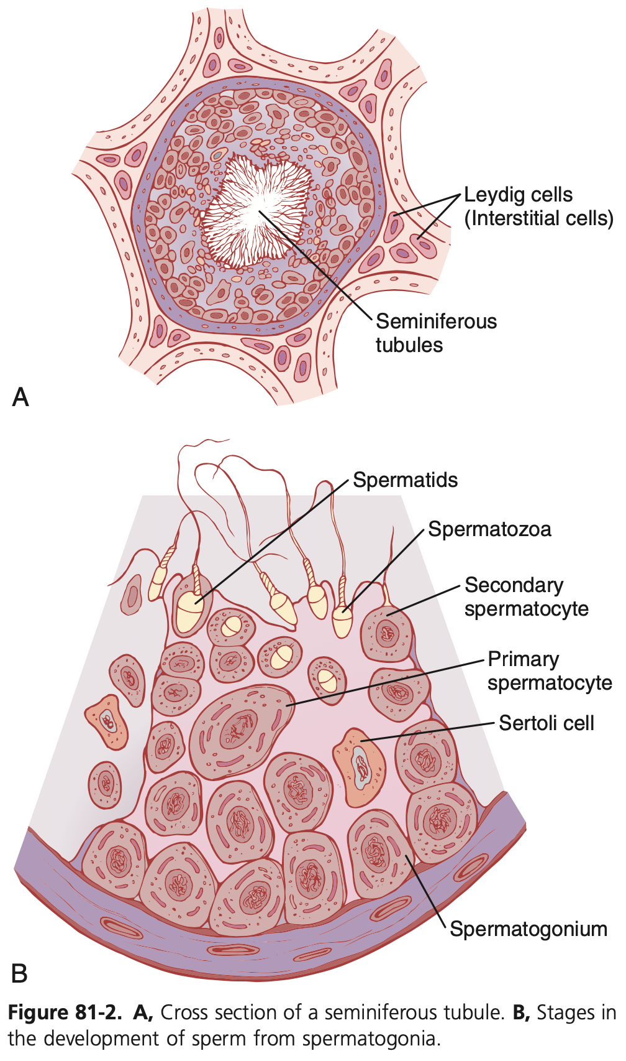
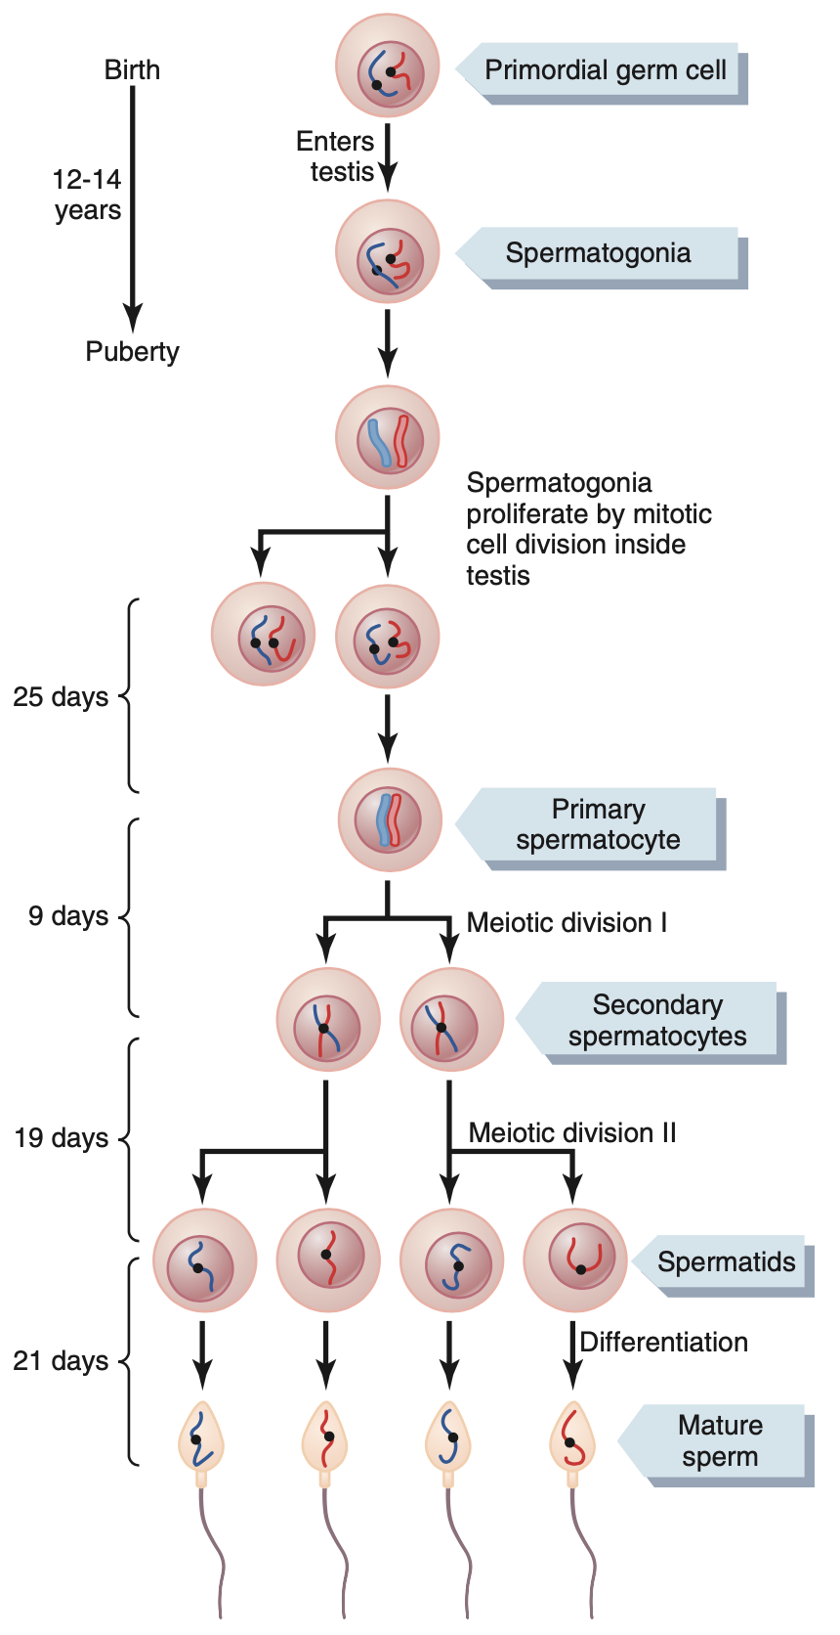
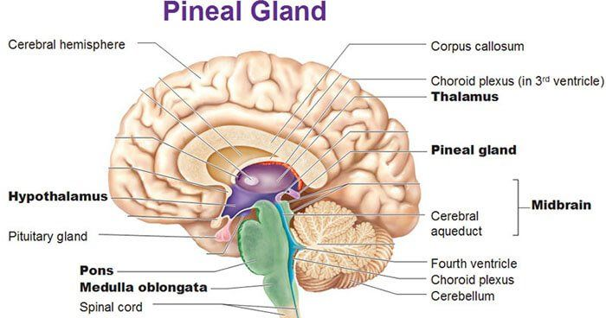
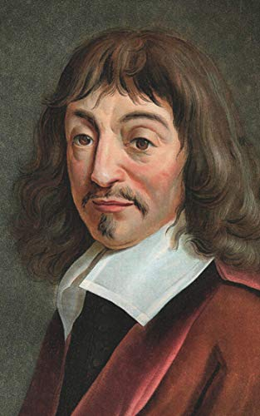
11
PHYSIOLOGY OF ANDROGENS & CONTROL OF MALE SEXUAL FUNCTIONS
Lecture Four
Further Reading
Spermatogenesis
Spermatogonia (46 chromosomes) undergo Mitosis producing a Primary Spermatocyte & Spermatogonium (for self sustainability).
\
Primary Spermatocytes undergo Meiosis to form 2 Secondary Spermatocytes which will further divide to yield a total of 4 Spermatids (23 chromosomes).
In each spermatogonium, the 23rd pair of chromosomes carries the genetic informa­tion that determines the sex of each eventual offspring:
- X called the female chromosome. - Y called the male chromosome.
During meiotic division, the Y chromosome goes to one spermatid making it a male sperm, and the X chromosome goes to another spermatid making it a female sperm.
When the spermatids are first formed, they still have the usual characteristics of epithe­lioid cells, but soon they begin to differentiate & elon­gate into spermatozoa, in a process called Spermiogenesis.
The entire period of spermatogenesis (from spermato­gonia to spermatozoa) takes about 74 days.
Figures 4-17
Pineal Gland Function: A Seat for the Soul, A Third Eye
Even though our curriculum didn't pay much attention to the pineal gland, it is an elusive, sometimes poetic and intriguing structure.
A seat for the soul, as the french philosopher Rene Descartes put it. This was quite imaginative for his time, now we know more about this elusive structure and its origins.
It is now known that the pineal gland in humans is a remnant of a third eye that is present in some lower animals (sea turtles and lizards), and during the process of evolution, it lodged itself between the two hemispheres in a groove between the two thalami.
A well-known function of the pineal gland is its secretion of melatonin, an activity regulated by light and darkness.
(More light > More activation of suprachiasmatic nucleus of hypothalamus which inhibits the activity of pineal gland > less melatonin) the opposite happens in darkness.
The Pineal Gland Plays A Role in Sex Regulation
It is believed that the melatonin produced (or perhaps some other substance released from the pineal gland) can reach the hypothalamus, either through blood or brain fluids in the ventricles, and inhibit the release of gonadotropins of the anterior pituitary.
This has been observed in some animals where sexual activity was inhibited in the winter months where there is prolonged periods of darkness.
In humans, this was also observed but in a clinicopathological manner, a pineal gland tumor which produces excess melatonin and other pineal hormones is associated with hypogonadism and decreased gonadal function.
Is melatonin responsible for the onset of puberty? From the above we can conclude that melanin inhibits the secretion of GnRH, puberty is characterized with a sudden rise in GnRH levels. It has been found that melatonin levels decrease at the time of onset of puberty and during reproductive years and are higher during childhood, What’s more intriguing is that people with removed pineal glands experience puberty earlier than those with intact pineal glands.
Being the only unpaired structure in the brain, the famous french philosopher Rene Descartes had this to say about the pineal gland:
"Since it is the only solid part in the whole brain which is single, it must necessarily be the seat of the common sense, i.e., of thought, and consequently of the soul; for one cannot be separated from the other."
- Rene Descartes

Slide 13
12
PHYSIOLOGY OF ANDROGENS & CONTROL OF MALE SEXUAL FUNCTIONS
Lecture Four
Further Reading
The Physics of Human Sperm
The laws of physics apply everywhere within the universe, as it basically includes everything in space and time.
- Living matter, scientifically speaking, are sac of chemicals clustered within a plasma membrane. Humans are merely larger collection of communicating matter.
In accordance with this view, even the human body with its constituent cells obeys the laws of physics. Newton's laws hold true even within our bodies. We're gonna be looking into fluid dynamics and how it relates to human sperm:
- Sperm always travels in a liquid medium from the lumen of seminiferous tubules which is filled with testicular fluids formed by Sertoli and Leydig cells, and then into the epididymal lumen where sperm starts to flap its flagella powered by ancient organisms buried in our cells, the mitochondria.
- And through the proteinaceous and inorganic mesh of epididymal fluids, sperm emerges into the vas deferens and is further decorated there with more nutrients and cholesterol and finally reaches the urethra to mix up with other contents of the semen.
- Therefore in order for sperm to travel from two points in space it'll have to swim its way through all of these fluids (with the help of peristaltic contractions of male genital tract).
The laws of physics govern this journey, as it also govern the billions of chemical processes that happen each second in our body.
Let us examine this further (click here).

Slide 14
What is the correct trajectory of sperm during ejaculation?
Ejaculatory duct, epididymis, vas deferens, ampulla of vas deferens, urethra.
Epididymis, ejaculatory duct, ampulla of vas deferens, vas deferens, urethra.
Epididymis, vas deferens, ampulla of vas deferens, ejaculatory duct, urethra.
Vas deferens, ejaculatory duct, ampulla of vas deferens, urethra.
What would NOT be a side effect of a drug that hypo-stimulates the Leydig (interstitial) cells on a pubertal human?
Increased secretion of GnRH (gonadotropin-releasing hormone) by hypothalamus.
Increased secretion of FSH (follicle stimulating hormone) by anterior pituitary.
Decreased secretion of GnRH (gonadotropin-releasing hormone) by hypothalamus.
Increased secretion of LH (luteinizing hormone) by anterior pituitary.
What is the function of the epididymis?
Sperm maturation and storage.
Produces the bulk of seminal fluid.
Provides nitric oxide needed for erections.
Spermatogenesis.
Which hypothalamic hormone contributes to the regulation of the male reproductive system?
Luteinizing Hormone.
Gonadotropin-Releasing Hormone.
Follicle-Stimulating Hormone.
Androgens.
Which one of the following are the earliest cells of spermatogenesis?
Primary spermatocytes.
Spermatids.
Secondary spermatocytes.
Spermatogonia.
A 1-year old boy comes to the office for a routine check-up. Physical examination shows that his right testis is not palpable in the scrotum. This same finding was noted on his discharge from the newborn nursery. What is your provisional diagnosis?
Prostatic Fibroadenoma..
Cryptorchidism.
Adiposogenital syndrome.
Hypergonadism.
A 40-year-old woman comes to the physician because of a 6-month history of increased facial hair growth. Her last menstrual period was 4 months ago. She is 165 cm (5 ft 5 in) tall and weighs 70 kg (154 lb); BMI is 26 kg/m . Her pulse is 80/min, and blood pressure is 130/82 mm Hg. Physical examination shows temporal balding and coarse dark hair on the upper lip and chin. Pelvic examination shows clitoral enlargement. Her serum testosterone concentration is increased. Serum concentrations of androstenedione, dehydroepiandrosterone, and urinary 17-ketosteroids are within the reference ranges. Ultrasonography of the pelvis shows a 12-cm ovarian mass. Which of the following best describes this mass?
Granulosa tumor.
Ovarian carcinoid.
Sertoli-Leydig tumor.
Teratoma.
ANSWER KEY: C, C, A, B, D, B, C

Slide 15
Mohammed Alhumud
Co-editor: Nouf Alshammari
FEMALE PHYSIOLOGY CO-LEADERS
Maha Alnahdi, Taif Alshammari
MALE PHYSIOLOGY CO-LEADERS
Nayef Alsaber, Hameed M. Humaid
REFERENCES
Guyton and Hall Textbook of Medical Physiology
Ganong’s Review of Medical Physiology

