Slide 1
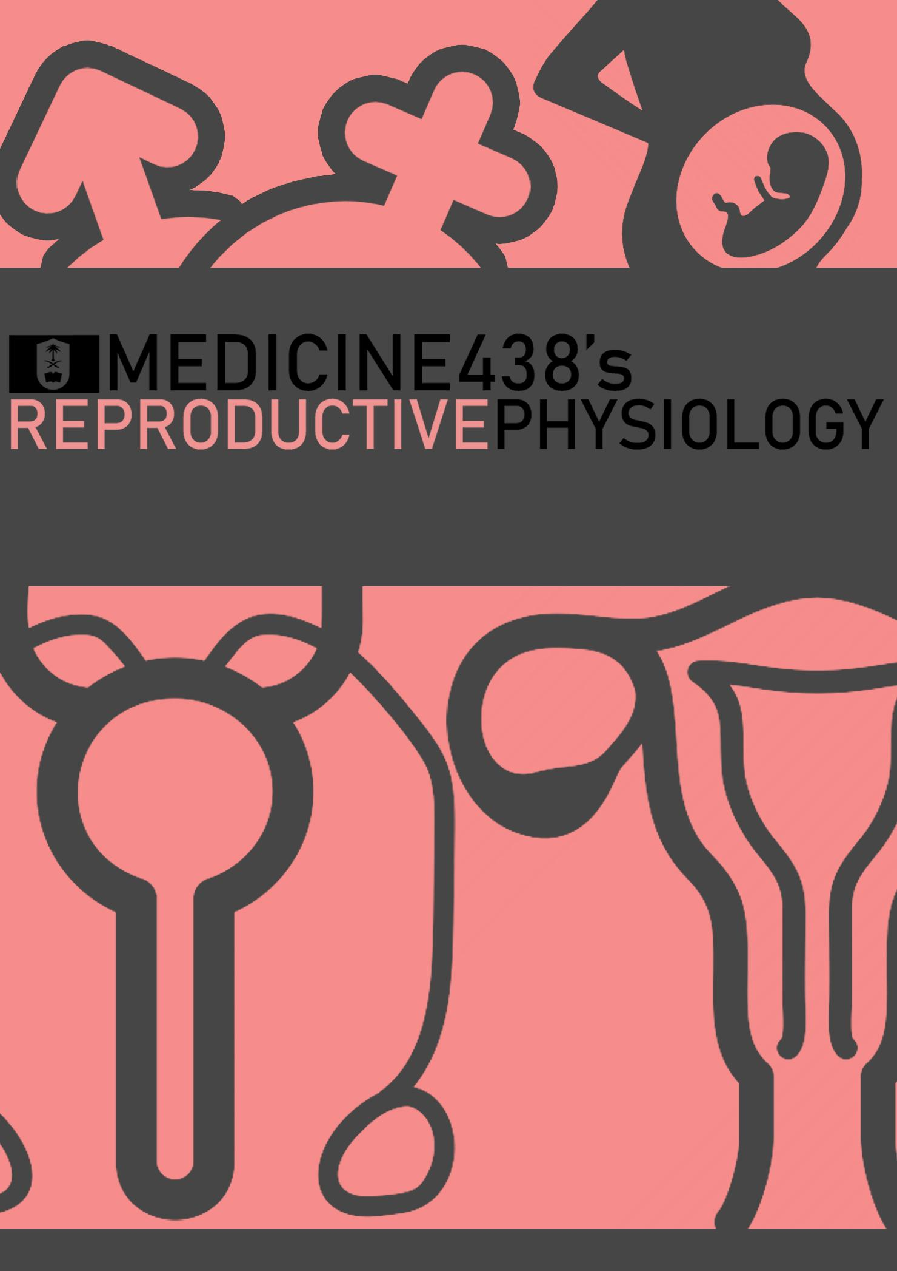
LECTURE V: Puberty in Males and Females
EDITING FILE
IMPORTANT
MALE SLIDES
EXTRA
FEMALE SLIDES
LECTURER’S NOTES

Slide 2
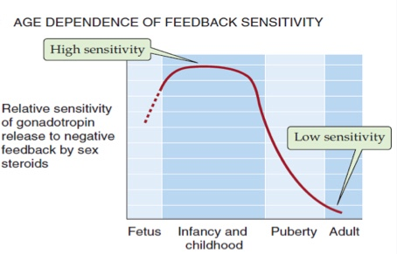
1
PUBERTY IN MALES AND FEMALES
Lecture Five
OBJECTIVES
Define puberty.
Recognize the physiology of puberty related to changes in hypothalamic-pituitary-gonadal axis.
Describe the physical changes that occur at puberty in boys and girls.
Recognize the influencing factors leading to puberty.
Describe the pathophysiological conditions associated with puberty.
Puberty
Puberty (AKA: adolescence) is a physiological transition from childhood (juvenility) to adulthood, Accelerated somatic growth.
Characteristics of puberty:
HPG axis matures.
The primary sexual organs mature (gonads).
The secondary sexual characteristics develop.
The adolescent experiences the adolescent growth spurt.
The adolescent achieves the ability to procreate.
Terms & Events
GnRH Receptors Sensitivity
Thelarche: development of breast.
Pubarche: development of pubic and axillary hair.
Menarche: the first menstrual period¹ .
Adrenarche: the onset of an increase in the secretion of androgens; responsible for the development of pubic/axillary hair, body odour and acne.²
Gonadarche: maturation of gonadal function.
Figure 5-1 Increased sensitivity of the GnRH receptors to very low gonadotropins before puberty.
Hormonal Changes
1
Pulsatile secretion of GnRH from the hypothalamus³ → Increased sensitivity of the GnRH⁴ receptors in anterior pituitary.
2
Pulsatile secretion of LH and FSH → Appearance of large nocturnal pulses of LH, during REM sleep⁵.
3
Maturation of primary sexual characteristics (gonads) → Secretion of gonadal steroid hormones (testosterone & estradiol)
4
Appearance of the secondary sex characteristics at puberty (pubic and axillary hair, female breast development, male voice changes)⁶
FOOTNOTES
For unclear reasons, the initial menstrual periods (during the first one-to-two years of puberty) are anovulatory, however this does suggest that the ovary is being made ready for reproduction during the first one-to-two years of puberty.
Adrenarche occurs before puberty and is not physiologically related to puberty since it depends on the HPA axis rather than the HPG axis.
The pulsatile secretion is essential especially for peptide hormones like GnRH, if GnRH is infused in a continuous manner then the receptors for GnRH in the anterior pituitary will be downregulated and no gonadotropins will be secreted. A pulsatile infusion of GnRH during childhood can induce puberty, and this had actually been proven in experimental monkeys.
Kallman’s Syndrome: Is a unique syndrome caused by impaired maturation of both olfactory and GnRH neurons, which can results in failure of sexual maturation. This syndrome can be treated by pulsatile GnRH infusion. These patients also suffer from impaired smell sensation due to the close relation of olfactory neurons and GnRH neurons in fetal life.
CNS Flashback: REM sleep is the shorter sleep normally associated with dreams and high ACh secretion, it has been found that an increased GnRH secretion in fast pulses during sleep induces LH secretion in large amounts shortly before the onset of puberty, this is probably earliest indicator of puberty. The fast pulses permit higher release of LH rather than FSH. Recently it has been found that this also occurs in slow-wave sleep.
Testosterone causing thickening of the larynx, hence sound waves are traveling through a denser medium and voice is deeper. Estrogen’s effects are not clear, but it was observed that it causes thinning of the vocal cords and so the vocal cords are more ‘flappy’ and the soundwaves of female voice as a result has higher frequency.
Footnotes

Slide 3
2
PUBERTY IN MALES AND FEMALES
Lecture Five
Hormonal Changes (continued)
In young children, low gonadotropins and increased sensitivity of GnRH receptors to low gonadotropins cannot initiate gonadal function¹.
Between 9-12 yrs, blood levels of LH and FSH increase.
High levels of LH and FSH initiate gonadal development.
Nocturnal GnRH pulsatility (LH secretion) precedes phenotypic changes by several years.
First phenotypic changes:
Breast development/Testicular enlargement
Menstruation and spermatogenesis begin.
Menstruation (between 8-14 years old)
Spermatogenesis (between 9-14 years old)
HYPOTHALAMUS
GnRH, GHRH, CRH, TRH
Anterior pituitary
Growth Hormone²
LH & FSH
ACTH Hormone³
TSH Hormone
IGF-1 from the liver
Sex steroid synthesis in the testes & ovaries
Cortisol & Androgens
from the Adrenal cortex
Thyroid hormone from the thyroid gland
Somatic growth
Sexual maturation
Increased metabolic rate
Tissue growth
Females | Males
First sign is breast enlargement (Thelarche). Menarche usually occurs 2-3 yrs after breast development (Thelarche). Growth spurt peaks before menarche. Pubic & axillary hair growth (dependent on increased secretion of adrenal androgens). Growth spurt and closure of the epiphyses typically begin and end earlier in girls than in boys⁴. | First signs is testicular enlargement. Leydig cell proliferation in the testes, and increased synthesis and secretion of testosterone. Growth of the testes (largely because of an increased number of seminiferous tubules), the sex accessory organs (such as the prostate), and the penis. There is a pronounced linear growth spurt. As plasma levels of testosterone increase, facial, pubic, and axillary hair appears, lowering of the voice, and initiation of spermatogenesis (spermarche).
FOOTNOTES
One of the theories that attempts to explain the sudden rise in GnRH secretion at the age of puberty suggests that the hypothalamus and anterior pituitary are very sensitive to the very small amount of sex hormones that are released from the gonads of children, this results in a powerful negative feedback that gradually weakens as the child approaches the age of puberty until sufficient GnRH can be released to fully stimulate the ovaries or testes. However, experiments in which gonads had been removed in childhood resulted in only small increase in GnRH and gonadotropin secretion, this suggests that at least this isn’t the primary mechanism for prevention of early/ “precocious” puberty.
GH is also released in a pulsatile manner, however for some reason after puberty the pulses increase both in frequency and amplitude (meaning the amount that is being secreted in each pulse).
The role of ACTH in increased androgen secretion from the adrenal glands before puberty is very questionable, since experiments failed to detect increased ACTH secretion at that age. Instead, it had been found that the enzymes that synthesize androgens are expressed more and also, a novel pituitary hormone called AARH (Adrenal Androgen Releasing Hormone) is postulated to exist to cause the release of androgens before puberty in both males and females.
The process starts way before the baby is birthed. Studies show that the composition of mother’s milk for a female is different than that of a male with a highlight to the Calcium:Phosphorus ratio, being more in females. Which precipitates in the early development of skeletal system in females.

Slide 4
3
PUBERTY IN MALES AND FEMALES
Lecture Five
Figure 5-2 Major events of puberty in males and females.
Physical Changes
5 stages from childhood to full maturity.
Tanner Scale (1 – 5) which reflect progression in changes of the external genitalia, breast, and pubic hair.
Secondary sexual characteristics
Mean age 11 years in girls
Mean age 11.5 – 12yrs in boys
Stage | Physical Development (Girls) | Average age For both genders | Stage | Physical Development (Boys)
B1(breast) PH(pubic hair) | Prepubertal. No glandular breast tissue palpable, just an elevation of breast papilla (check figures below for an illustration). No pubic hair. | 0-15 | G1(genitals) PH1 | Prepubertal. Testicular volume < 3 mL. No pubic hair.
B2 PH2 | Breast budding with elevation of breast and papilla as a small mound [1st pubertal sign in girls]. Downy soft pubic hair. Growth spurt (between stage 2-3) | 8-15 | G2 PH2 | Enlargement of testicular volume (3-6 mL) [1st pubertal sign in boys]. Little or no change in penile size. Downy soft pubic hair.
B3 PH3 | Further enlargement of breast and areola. Darker, coarser and curled hair. | 10-15 | G3 PH3 | Testicular volume 8-12 mL. Penile lengthening. Darker, coarser, and curled hair. Growth spurt (between stage 3-4)
B4 PH4 | Projection of areola and papilla to form a “double mound” above the level of the breast. More dense hair that fills the entire triangle overlying the pubic region and external genitalia and no spread to the inner thigh. Menarche (between stage 4-5) | 10-17 | G4 PH4 | Testicular volume 12-15 mL. Penile lengthening and broadening. Terminal hair that fills the entire triangle overlying the pubic region and external genitalia and no spread to the inner thigh.
B5 PH5 | Mature breast. Loss of double mound due to the projection of papilla only and recession of the areola to the level of the breast. Dense hair that extends beyond the inguinal area onto the inner thigh. | 12.5-18 | G5 PH5 | Testicular volume > 15 mL. Adult genitalia. Terminal hair that extends beyond the inguinal area onto the inner thigh.
Breast & Genitals Development
B1
B2
B3
B4
B5
G1
G2
G3
G4
G5

Slide 5
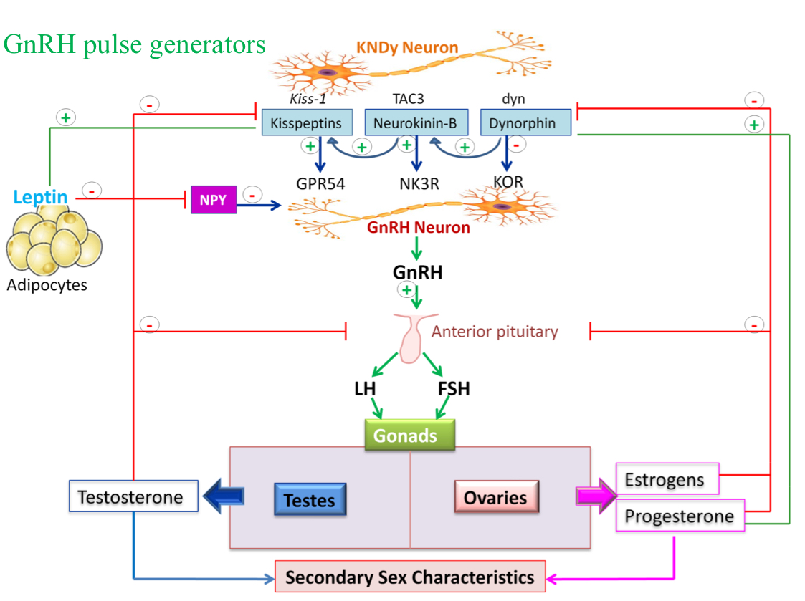
4
PUBERTY IN MALES AND FEMALES
Lecture Five
Puberty
Puberty usually completed within 3 - 4 yrs of onset.
Timing of puberty describes how mature a child is relative to his/her peers at the same age and sex (early, on time, or delayed).
Tempo describes how quickly or slowly a child progresses throughout the stages of puberty to the complete development (slow, average, or fast).
Factors That Influence Puberty
Genetics factors: 50-80% variation in pubertal timing.
Environmental factors: Geographical differences, psychosocial stresses, endocrine disruptors from pollutants, and exposure to chemical and industrial compounds.
Obesity: e.g. Leptin¹ hormone regulates appetite & metabolism through hypothalamus. Permissive role in regulating the timing of puberty.
Malnutrition and strenuous physical activity delay puberty.
Figure 5-3 Leptin acts in both the hypothalamus and the pituitary (through interneuronal pathways involving Neuropeptide Y and Kisspeptin) to stimulate the release of GnRH, leading to increased secretion of LH & FSH. As a result this will cause decrease food intake and increase thermogenesis and reproduction.
FOOTNOTES
What Actually Stops GnRH From Being Released During Childhood? Leptin has gathered attention due to the effects mentioned above, obese individuals have higher body fat which causes adipose tissue expansion and more leptin released, this has been associated with increased onset of puberty in obese women (but not men, which indicates that leptin isn’t the only factor at play). Mice with mutation in leptin are infertile, as well as women with anorexia nervosa as they stop eating but both become fertile again when leptin is infused into them.
Other factors, The Role of Melatonin: Melatonin is a natural inhibitor of GnRH secretion, and melatonin levels are highest during childhood and lowest during adulthood, and so it was proposed that melatonin might be a primary inhibitor of GnRH release before puberty, this view has gathered support because pineal gland removal also precipitates early puberty.

Slide 6
5
PUBERTY IN MALES AND FEMALES
Lecture Five
Pubertal Disorders
Early/precocious puberty.
Delayed puberty.
Precocious Puberty
Precocious onset of puberty is defined as occurring younger than 2 years before the average age, often before 8 years of age in girls and before 9 years of age in boys Gonadotropin-dependent (true/central) Gonadotropin-independent
Central Precocious Puberty (Gonadotropin-dependent) | Pseudoprecocious (Peripheral) Puberty (Gonadotropin-independent)
Idiopathic central precocious puberty. CNS tumours¹. CNS congenital abnormalities. Infectious or post-infectious conditions of hypothalamus. | Congenital adrenal hyperplasia (CAH). Sex steroid secreting tumours (adrenal or ovarian). FSH and LH are suppressed. No spermatogenesis or ovarian development.
Delayed Puberty
Initial physical changes of puberty are not present. by age 13 years in girls (or primary amenorrhea at 15.5-16y) by age 14 years in boys. Pubertal development is inappropriate. The interval between first signs of puberty and menarche in girls/completion genital growth in boys is > 5 years.
Gonadal Failure Hypergonadotropic Hypogonadism | Gonadal Deficiency Hypogonadotropic Hypogonadism
Turner syndromes² (45, X0), Klinefelter syndrome³ (47, XXY). Gonadal damage secondary to trauma, tumours, post malignancy chemo/radio therapies, surgical removal, and infectious or autoimmune diseases. Congenital gonadal dysgenesis or cryptorchidism. FSH, LH and androgen receptor gene mutations. | Idiopathic FSH and LH gene mutations from pituitary gonadotropes. CNS congenital anomalies and panhypopituitarism. Low FSH and LH levels. KiSS-1 or GPR54 gene mutations.
FOOTNOTES
Due to disruption of the pathway that normally keeps the pulsatile GnRH in cheek.
Turner’s Syndrome: Hypogonadism also occurs in these patients due to complex mechanisms, however the underlying reason is similar to that of Klunefelter patients, which is basically the genome losing its stability.
Klinefelter’s Syndrome: Why Does Having an Extra X Chromosome Precipitates Hypogonadism in These Males? The genome is very tightly regulated, with each gene having an identical copy in the genome. Having an extra chromosome causes a third copy of the gene to be present in the genome, genes influence the expression of other genes and in the case of Klinefelter, the extra copy of the X chromosome causes an abnormality in androgen receptors’ expression. This results in hypogonadism.

Slide 7
Which of the following signs of puberty is usually the first to occur in males?
Penile enlargement
Testicular enlargement
Development of pubic hair
Growth of facial hair
Which of the following is the most reliable first sign of puberty in females?
Development of breast buds
Development of pubic hair
Accelerated growth
Menarche
Menarche typically occurs how long after thelarche?
4 years
6 years
One year
2-3 years
On physical examination, a female has the presence of growing breast tissue but no contour or secondary mound, coarse pigmented pubic hair covering the pubes, and the presence of axillary hair. What is her Tanner stage?
Tanner stage 1
Tanner stage 2
Tanner stage 3
Tanner stage 4
ANSWER KEY: B, A, D, C

Slide 8
Shahad BinSelayem, Sara Alhelal
Co-editor: Njoud Alabdullatif
FEMALE PHYSIOLOGY CO-LEADERS
Maha Alnahdi, Taif Alshammari
MALE PHYSIOLOGY CO-LEADERS
Nayef Alsaber, Hameed M. Humaid
REFERENCES
Guyton and Hall Textbook of Medical Physiology
Ganong’s Review of Medical Physiology
Physiology by Linda S. Costanzo
Elsevier’s Textbook of Medical Physiology

