Slide 1
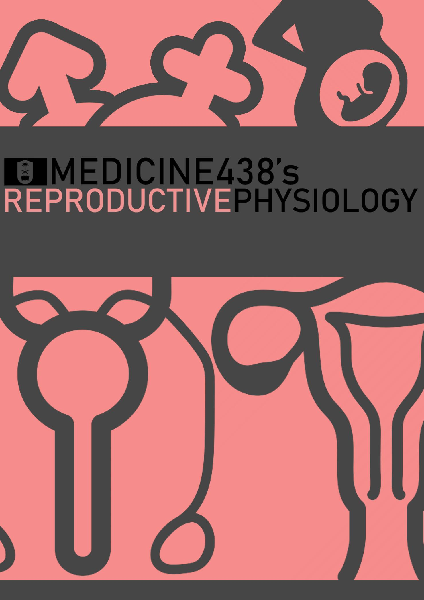
LECTURE VI: Physiology of Pregnancy
EDITING FILE
IMPORTANT
MALE SLIDES
EXTRA
FEMALE SLIDES
LECTURER’S NOTES

Slide 2
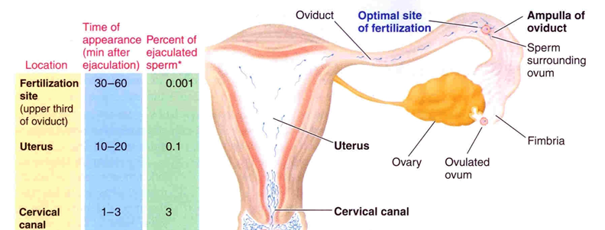
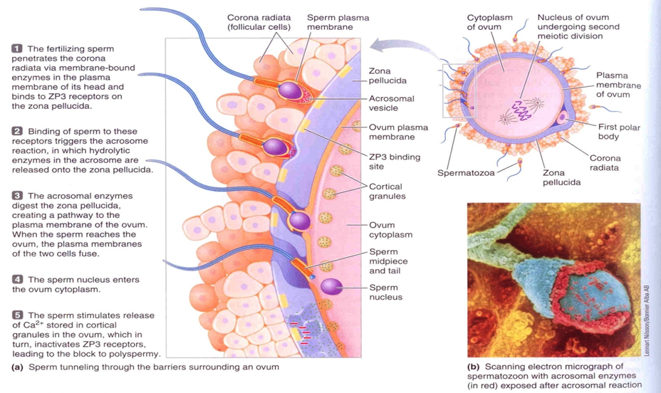
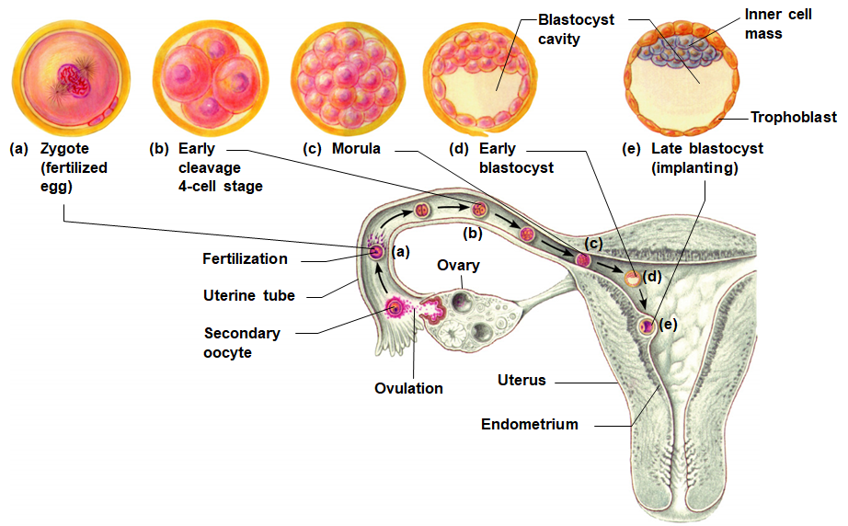
1
PHYSIOLOGY OF PREGNANCY
Lecture Six
OBJECTIVES
Describe fertilization and the implantation of the blastocyst in the uterus.
Recognize the development and the normal physiology of the placenta.
Describe the physiological functions of placental hormones during pregnancy.
Explain the physiological response of mother’s body to pregnancy.
How many sperms in the ejaculated semen? 35-200 million sperms per ml of semen, usually 2-5 ml of semen is ejaculated. On average, half a billion sperms are deposited in the vagina, and only few thousands make it to the fallopian tubes.
In which stage the ova is after ovulation? Secondary oocyte, arrested at metaphase of meiosis II.
What is the % of ovulated ova that can reach fallopian tube? Around 98%.
Can the ova that is released from the right ovary reaches the left fallopian tube? Yes. some women who only had one ovary and only one remaining fallopian tube (on the contralateral side) had several children with ease. Ova are released into the abdominal cavity and are then picked up by the fimbriae of the fallopian tube which are equipped with cilia that beat inwards towards the uterus thereby reinforcing this “hooking” process.
What are the factors that help the ovulated ova to reach the fallopian tube? The cilia of the fallopian tubes beat towards the uterus are adhesive and they help pick up the ovum after its release.
Is there any obstacles? Yes, the irregularity of fallopian tube lining impedes the movements of the fertilized ovum, and the isthmus remain tonically constricted until progesterone causes its relaxation around three days after ovulation.
What are the factors that help the sperm to travel in the female genital tract? Sperm motility through its flagella, PGs from the semen and oxytocin released from the female during orgasm can initiate antiperistaltic contractions that help propel sperm into the ovum, oocytes release certain chemicals that attract sperm through olfactory receptors and other factors.
Is there any obstacles? Acidity of vaginal fluids, thick cervical mucus, possible antigenicity due to the occasional WBC infiltration of vagina and cervix, the barriers around ovum itself (zona pellucida and corona radiata)
How does the ova survive in the fallopian tube? Secretion of peg cells of the fallopian tubes nourishes the ovum, the ovum is also protected by thick outer layer of glycoproteins (zona pellucida) and granulosa cells (corona radiata).
Fertilization
Group Activity For Group F, Coordinated By Dr. Hana
If the ovum becomes fertilized by a sperm, a new sequence of events called gestation or pregnancy takes place, and the fertilized ovum eventually develops into a full-term fetus.
After ejaculation, sperms reach ampulla of fallopian tube within 30-60 min¹ (Prostaglandins from seminal vesicles and oxytocin from posterior pituitary actions).
Sperm penetrate corona radiata and zona pellucida (hyaluronidase & proteolytic enzymes).
Oocyte divides to form mature ovum (female pronucleus 23 unpaired chromosomes.) Each of the 23 pairs loses its partner which gets incorporated in the 2nd polar body-to be expelled and eaten by macrophages.
Head of sperm swells (male pronucleus 23 unpaired chromosomes).
Fertilized ovum (zygote) contains 23 paired chromosomes.
The 23 chromosomes of the male and female pronuclei align themselves to re-form a complete complement of 46 chromosomes.
Figure 6-1
Figure 6-2
Cleavage
Following fertilization, the zygote undergoes several mitotic divisions inside the zona pellucida (overall size does not change).
1st cleavage yields a 2 celled embryo,
each cell is called a blastomere and is totipotent (give rise to embryonic and extraembryonic tissue)
Divisions continue rapidly until the 32 cell stage (morula).
Figure 6-3
FOOTNOTES
How Does Sperm Wait For The Ovum? & Fate of Unfertilized Sperm: Sperm can live for an average of two days inside the female genital tract, however it reaches the fallopian tube within 30-60 minutes! So what if there was no ovum? Does the sperm simply travel through the fallopian tube and through the fimbriae parachutes itself into the female abdominal cavity (actually yes, this can happen and then sperm can enter the opposite oviduct!), but what mainly happens inside the fallopian tube once sperm enters is that the isthmus of the oviduct forms a reservoir for the sperm, sperm attaches to specific receptors on the oviduct lining as it waits vehemently for an ovum, once ovulation occurs, the temperature of the ampulla increases and the ovum starts releasing specific aromatic molecules that activate sperm olfactory receptors, also thermosensitive receptors of sperm are activated! Sperm then rapidly becomes activated “capacitated”, it downregulates receptors for attachment with oviduct lining and courses towards the ovum. If ovulation doesn’t occur, sperm simply can cross to the abdominal cavity (usually harmless) or be phagocytosed by cells in oviducts. We hope that this explanation fills the apparent gap of knowledge in this incoherent, yet at times breathtaking physiology.

Slide 3
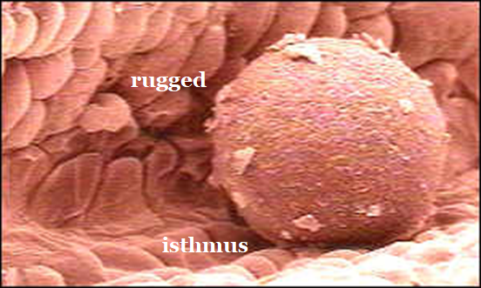
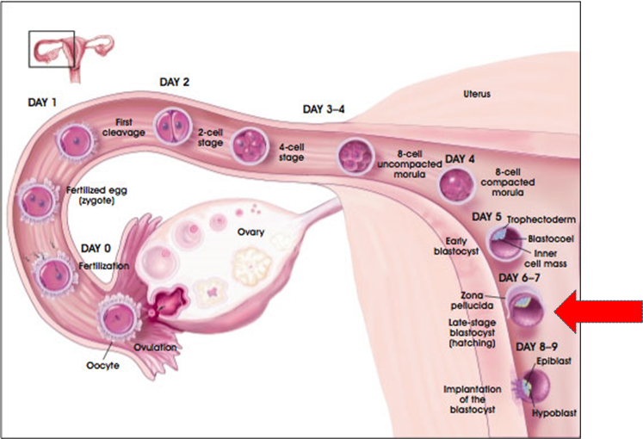
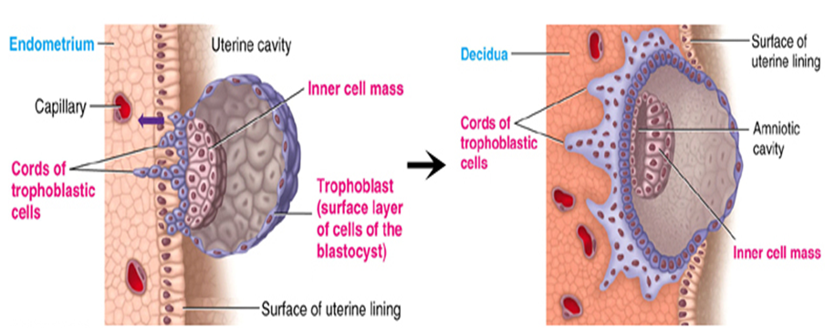
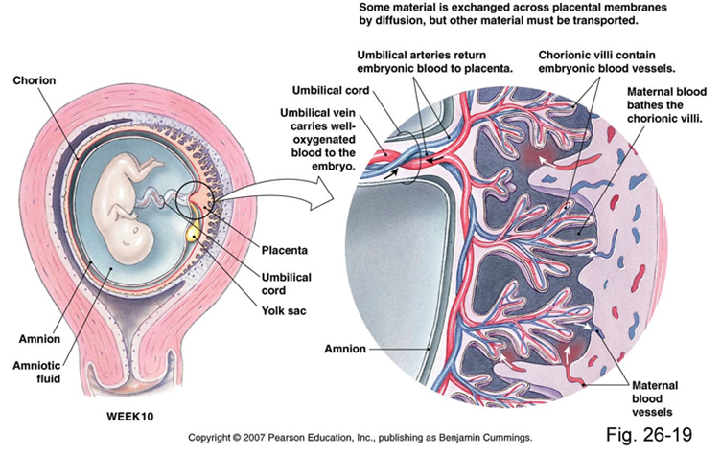
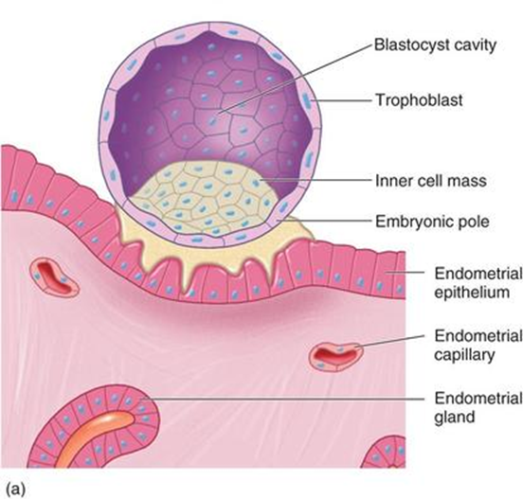
2
PHYSIOLOGY OF PREGNANCY
Lecture Six
Transport of Fertilized Ovum and Implantation
Zygote begins to divide as it travels through oviduct. The zygote reaches the uterine cavity 3-5 days after fertilization.
Transport: fluid current + action of cilia (activated by estrogen) + weak contractions of the fallopian tube.
Delayed transport allows cell division to occur before the dividing ovum enters the uterus.
Isthmus (last two centimeters) relaxes under effect of progesterone.
(Blastocyst ~100 cells) enters the uterus. Implants into lining of uterus (endometrium).
Implantation occurs 5-7 days after ovulation (Fertilization).
Figure 6-4
Figure 6-5 In day 8-9 hatching occurs, which is the separation of zona pellucida from the fertilized ovum, to be replaced by trophoblasts, with the consequent development of blastocyst cavity from uterine milk through thin membrane of trophoblast in preparation of implantation.
Placenta
Trophoblastic cords from blastocyst.
Blood capillaries grow in the cords.
21 days after fertilization, blood starts to be pumped by fetal heart into the capillaries.
Maternal blood sinuses develop around the trophoblastic cords.
More and more trophoblast projections develop (placental villi).
Function of The Placenta
Respiration.
Nutrition.
Excretion.
Endocrine.
Protection.
Figure 6-6
Figure 6-8
Figure 6-7 Blastocyst Differentiation.
FOOTNOTES
Simplified Model of The Placenta, Placental Cords: A morula (in uterine cavity) sheds its zona pellucida ‘Hatching process’ and some cells of the morula differentiates into trophoblasts to surround it→ Trophoblasts allow some uterine milk to enter the morula and the morula forms a cavity and is then transformed into a blastocyst → Trophoblast cells attach to the endometrial lining through adhesion proteins (integrins) → This triggers release of proteolytic enzymes from trophoblasts → Digestion of endometrium releasing stored nutrients —engulfed by trophoblast which starts proliferating extensively → The proliferating cells fuse to form an outer mesh of cells called syncytiotrophoblasts whilst the remaining cells underneath form cytotrophoblasts → Cytotrophoblasts continue proliferating, and clump together to reach deeper layers of endometrium within the hole they created, this forms the “placental cords” → Cytotrophoblasts begin laying mesenchyme underneath their mass which lies between the trophoblasts and the developing embryo → This mesenchyme differentiates into blood vessels → These blood vessels eventually connect the embryo to the maternal capillaries.

Slide 4
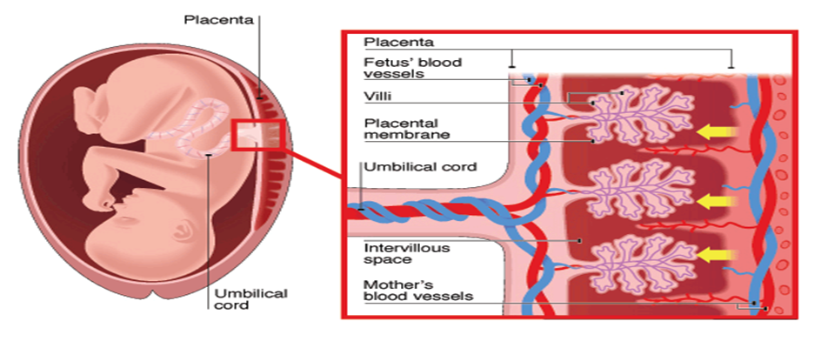
3
PHYSIOLOGY OF PREGNANCY
Lecture Six
Placental Permeability and Membrane Diffusion Conductance
In the early months of pregnancy, the placental membrane is still thick and the surface area is small because it is not fully developed and grown. (permeability is low)
In later pregnancy, the permeability increases¹ because of thinning of the membrane diffusion layers and because the surface area expands many times over.
Figure 6-9
Important Factors Facilitating Delivery of Oxygen to The Fetal Tissues (Respiration)
Diffusion of oxygen through the placental membrane:
PCO₂ is 2-3 mm Hg higher in fetal than maternal blood.
Dissolved O₂ in mother’s blood passes to fetal blood by simple diffusion.
The mean partial pressure of oxygen (PO₂) of the mother’s blood in the placental sinuses is about 50 mm Hg, and the mean PO₂ in the fetal blood after it becomes oxygenated in the placenta is about 30 mm Hg.
50 mm Hg (M) – 30 mm Hg (F) = 20 mm Hg (mean pressure gradient).
Meanwhile, in adult gas exchange in the lung the alveoli has a pO2 of 100 mm Hg, and the venous blood has a pO2 of 40 mm Hg, creating a difference of 60 mm Hg.
There are three reasons why this low PO₂ is sufficient to deliver O₂ to the fetal tissues:
Hemoglobin of the fetus.
High fetal hemoglobin concentration (16-17 g/dl) and its about 50% greater than that of mother.
The Bohr effect (next slide).
Hemoglobin of the fetus:
Fetal hemoglobin (HbF).
Fetal hemoglobin (HbF) concentration is about 50% greater than that of the mother (HbA).
At the low PO₂ levels in fetal blood, the fetal hemoglobin can carry 20 to 50% more oxygen than maternal hemoglobin. (HbF has a higher oxygen carrying capacity than HbA)².
FOOTNOTES
IgG is the only class of immunoglobulins able to cross the placenta due to specific transport of IgG is carried out by the neonatal Fc receptor) which is helpful against most microorganism and viruses. But the largest amounts if igG crosses during last weeks of pregnancy (due to this increased preamblity—as the cytotrophoblast layer disappears. So preterm infants may be deficient in maternal Abs and therefore more susceptible to infections.
Hemoglobin F binds to 2, 3-DPG less effectively than hemoglobin A does, which increases O2 affinity.

Slide 5
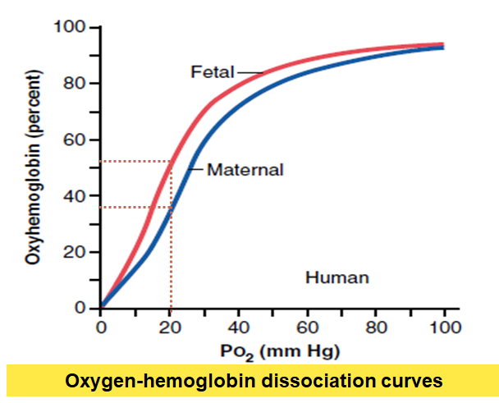
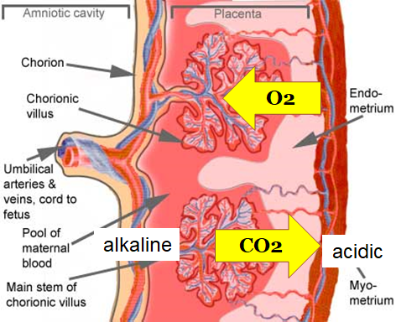
4
PHYSIOLOGY OF PREGNANCY
Lecture Six
Important Factors Facilitating Delivery of Oxygen to The Fetal Tissues (Respiration) Cont.
Double Bohr Effect¹:
High pH in fetal blood (alkaline).
Low pH in mother’s blood (acidic).
These changes cause the capacity of fetal blood to combine with O₂ to increase, and maternal blood to decrease, which forces more O₂ from the maternal blood while enhancing oxygen uptake by the fetal blood.
Important shifts of the dissociation curves take place in the placenta:
The maternal blood gains CO₂, the pH falls and the curve shifts to the right releasing additional oxygen.
On the fetal side of the placenta CO₂ is lost, the pH rises and the curve shifts to the left allowing additional oxygen uptake.
Other factors:
High maternal intervillous blood flow (almost double the fetal placental flow).
High fetal cardiac output (120-170 BPM).
The fetal metabolic acidosis-due to increased metabolic activity in cells →more CO₂-which shifts the curve to the right and thus aids delivery of oxygen to the tissues.
Figure 6-10 A shift to the left in the curve indicates higher affinity of Hb to oxygen.
here the X-axis represents the partial pressure of oxygen (reflecting oxygen conc. in blood) So even though fetal blood contains lower conc. of oxygen, HbF is able bind more oxygen than adult hemoglobin (mainly HbA)
Nutrition
Fetus uses mainly glucose for nutrition so the trophoblast cells in placental villi transport glucose by carrier molecules; GLUT-1 (facilitated diffusion).
Fatty acids diffuse due to high solubility in cell membrane (more slowly than glucose).
The placenta actively transports all amino acids, with fetal concentrations exceeding maternal levels.
K⁺, Na⁺ and Cl⁻ diffuse from maternal to fetal blood.
Figure 6-11
Excretion
Excretory products of the fetus diffuse through the placental membrane to maternal blood to be excreted with the waste products of the mother:
Urea, uric acid and creatinine.
Higher conc. of excretory products in fetal blood ensures continuous diffusion of these substances to the maternal blood.
FOOTNOTES
Making Sense of Bohr’s Effect: Bohr’s effect simply describes the effect of carbon dioxide and pH on hemoglobin’s affinity for oxygen, carbon dioxide binds with H2O inside the RBC, this makes carbonic acid which disintegrates into bicarbonate and hydrogen ions. Hydrogen ions can then bind to specific sites on the hemoglobin molecules and basically kicks out oxygen. Deoxygenated fetal blood contains higher concentration of carbon dioxide (fetal blood comes through the umbilical arteries, branch of internal iliac, they degenerate after the umbilical cord is cut), this carbon dioxide then diffuses into the maternal blood, flows into the RBCs of the mother and forms protons which kick the maternal oxygen towards the fetal blood. The fetal blood contains HbF, which means it’s a better catcher for those fallen oxygen molecules than HbA. Because the effects of CO2 and pH is acting on hemoglobin in both the fetal and maternal blood, this is called a double Bohr effect, the usual pulmonary one works between the alveoli and pulmonary blood, and so hemoglobin is present in only one side.

Slide 6
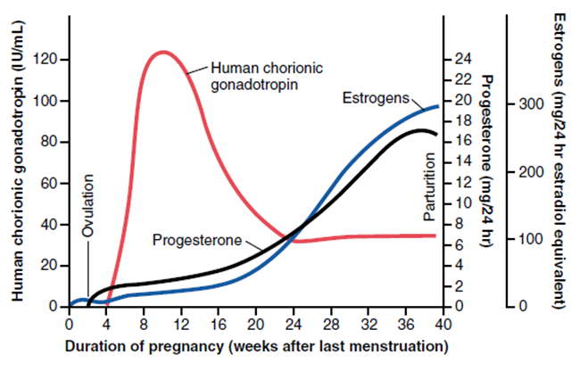
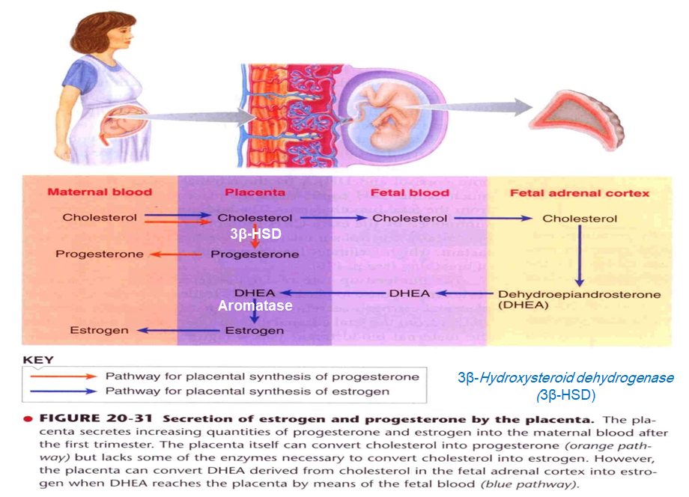
5
PHYSIOLOGY OF PREGNANCY
Lecture Six
Figure 6-12 HCG level (pregnancy test)
Figure 6-13
Placenta as an Endocrine Organ
Figure 6-14¹
Hormone | Characteristics | Functions
Estrogen | Steroid hormone. Secreted by syncytial trophoblast cells. Towards the end of pregnancy it reaches 30×. Derived from weak androgen (DHEA) released from maternal & fetal adrenal cortex. | Enlargement of uterus, breast & external genitalia. Relaxation of pelvic ligaments in preparation for labor. (sacroiliac and symphysis pubis) Activation of the uterus (gap junctions)(myometrium)² Increases synthesis of thyroid-binding globulin, transcortin and sensitizes uterus to oxytocin. Functions mentioned elsewhere in the lecture: Increases blood volume of pregnant woman.
Progesterone | Steroid hormone. Secreted by syncytial trophoblast cells. Towards the end of pregnancy it reaches 10×. Derived from cholesterol. | Provides nutrition to developing embryo (uterine secretory phase). Development of decidual⁴ cells. Inhibits the contractility of the uterus. Development of breast lobules. Functions mentioned elsewhere in the lecture: Increases the sensitivity of respiratory center to CO₂
Relaxin³ | Polypeptide. Secreted by corpus luteum and placenta. | Relaxation of symphysis pubic ligament (weak). Softens the cervix at delivery.
Human Chorionic Gonadotropin (hCG) | Glycoprotein. Secreted by syncytial trophoblast cells. | Most important function is to maintain corpus luteum (↑estrogen & progesterone) till 13-17 weeks of gestation. Exerts interstitial (Leyding) cell-stimulating effect on testes of the male fetus (growth of male sex organs).⁵ Functions mentioned elsewhere in the lecture: TSH-like activity to increase thyroxine production.
Human Chorionic Somatomammotropin or Human Placental Lactogen (hPL) | Protein hormone. Secreted by placenta around 5th gestational week. Its secretion exceeds the secretions of all the above hormones combined! | Breast development. Weak growth hormone’s action. Inhibits insulin sensitivity = ↓ glucose utilization.⁶ Promotes release of fatty acids.
FOOTNOTES
Figure 6-14: The placenta synthesizes the five main hormones mentioned above, of concern are estrogen and progesterone. Estrogen is synthesized from from progesterone (after its conversion into hydroxyprogesterone by 17-alpha hydroxylase, and then a variant of the same enzyme converts hydroxyprogesterone into androgens, androgens are then converted by aromatase into estrogens). Progesterone itself, like other steroid hormones is synthesized from cholesterol (cholesterol → pregnenolone → progesterone), but the placenta lacks sufficient 17-alpha hydroxylase to convert this progesterone into androgens. Therefore, it must be supplied with androgens from the adrenal glands (there are almost no functional follicles from the ovaries during pregnancy to supply androgens, so adrenal glands, especially fetal adrenal glands which are large during fetal life supply the needed androgen demand).
Estrogen and prostaglandins increase the number of gap junctions allowing smooth muscle cells to act as syncytium, with action potentials jumping from one muscle cell to another through the transfer of ions through gap junctions.
The sensitivity of the uterine musculature to oxytocin is enhanced by estrogen and prostaglandins and inhibited by progesterone. In late pregnancy, the uterus becomes very sensitive to oxytocin coincident with a marked increase in the number of oxytocin receptors leading to progressively stronger contractions—will be discussed in depth in the next lecture.
Continuous secretion of progesterone causes the endometrial cells to swell further and to store more nutrients. These cells are now called decidual cells— for more, please refer to footnote 1 page 2.
hCG has a similar structure and function of a Luteinizing hormone, by which it stimulates Leydig cells to secrete fetal testosterone to aid in testis descent.
Insulin resistance mechanism: hPL causes an increase in plasma free fatty acids, these fatty acids can act on inflammatory cells to cause the release of inflammatory mediators such as (TNF-alpha, IL-1 and IL-6), in turn, these cytokines can act on body tissues to antagonize the effect of insulin. This mechanism is also mainly responsible for the increased incidence of diabetes in obese individuals

Slide 7
6
PHYSIOLOGY OF PREGNANCY
Lecture Six
Physiological Adaptation to Pregnancy
Organ or System | Changes
Maternal Endocrine System | Anterior pituitary gland enlargement (50%): Release of ACTH, TSH and PL increase. FSH and LH almost totally suppressed. GH is suppressed, probably due to hPL effect to suppress its release (false negative feedback) Adrenal gland: Increase glucocorticoids secretion (mobilize AA). Increase aldosterone (retain fluid). Increased synthesis of corticosteroid-binding globulin → ↓ Free cortisol → ↑ ACTH → ↑ Cortisol production. Thyroid gland enlargement (50%): Increase thyroxine production (hCG). (TSH-like activity, binds TSH receptors) A substance called human chorionic thyrotropin is also secreted with TSH-like activity. Increased synthesis of thyroxine-binding globulin → ↓ Free thyroxine → ↑ TSH → ↑ Thyroxine production. Parathyroid gland enlargement:¹ Increase PTH secretion (maintains normal Ca⁺²).
Different Organs | Increase in uterine size (50 gm to 1100 gm). The breasts double in size. The vagina enlarges. Development of edema and acne. Masculine or acromegalic features due to the weak GH-like effect of Human Chorionic Somatomammotropin. Weight gain 10-12 kg (last 2 trimesters). Increase appetite. Removal of food by fetus. Hormonal effect.
Circulatory System | Increase in cardiac output (30-40%) by 27th weeks. To compensate for blood rush through fetal sinuses and avoid hypotension in the mother. Increase in blood flow through the placenta. Increase in maternal blood volume² (30%) due to: Increase aldosterone and estrogen (↑ ECF). Increase activity of the bone marrow (↑ RBCs).
Respiration | Increase in O₂ consumption (20%): Increase BMR. Increase in body size. Growing uterus presses upwards (restriction) Increase in respiratory rate (RR). Progesterone ↑ sensitivity of respiratory centers to CO₂. Increase in minute ventilation (Tidal Volume × Respiratory Rate) by 50% and a decrease in arterial PCO₂ to several millimeters.
Metabolism & Kidney Function | Increase basal metabolic rate (15%). Increase in daily requirements for: Iron. Phosphates. Calcium. Vitamins: vitamin D (Ca⁺² absorption). The renal tubules’ reabsorptive capacity for Na, Cl, and water is increased as much as 50%. The renal blood flow and GFR increase up to 50%. Normal pregnant woman accumulates only about 5 pounds (2.27Kg) of extra water and salt.
FOOTNOTES
As the fetus takes calcium away from maternal blood to ossify its bones, the mother literally starts digesting her own bones through PTH to provide even more calcium to the fetus.
During birth, the mother has about 1 to 2 liters of extra blood in her circulatory system. Only about one fourth of this amount is normally lost through bleeding during delivery of the baby, thereby allowing a considerable safety factor for the mother. But this exact increase leads to a physiological anemia (normal number of RBC diluted in blood).

Slide 8
7
PHYSIOLOGY OF PREGNANCY
Lecture Six
Further Reading
Eclampsia and Preeclampsia
High blood pressure in pregnancy is classified to include four main conditions: preeclampsia-eclampsia, gestational hypertension, chronic hypertension and preeclampsia superimposed on chronic hypertension.
We’ve established thus far that during normal placental development, the trophoblasts invade the arterioles of the uterine endometrium forming lacunae or ‘holes’ to remodel maternal arterioles into large blood vessels with low resistance to allow more blood flow and to decrease the high resistance of arterioles through uncertain mechanisms.
But in pregnancy-induced hypertension, things -for unknown reasons- don’t really go according to plan.
It involves a decrease in placental blood flow, leading to an ischemic placenta that releases inflammatory substances (TNF, IL-6) that disturb endothelial cells throughout the body, the endothelial cells will release less nitric oxide, and blood flow into the kidney, brain, liver, and heart be severely decreased. And the vasoconstriction from the dysfunctional endothelial cells incapable of releasing nitric oxide will lead to hypertension. (Keep in mind that aldosterone and estrogens are also released, leading to more water retention in pregnancy, and with less blood flow to the placenta the blood is further trapped in the circulation).
Preeclampsia is different from gestational hypertension is that includes proteinuria as well.
Preeclampsia or Toxemia of Pregnancy:
Initiated by placental hypoperfusion, an ischemic placenta releases substances that disrupt endothelial cells throughout the body, less NO released leads to a rapid rise in arterial blood pressure.
And is often characterized by excess salt and water retention, development of edema and hypoperfusion of vital organs increasing the risk of acute renal failure (due to reduced renal blood flow from low NO and GFR).
It also affects the fetus as it frequently results in intrauterine growth restriction and prematurity (recall that it was started by decreased blood flow to placenta).
Delivery of fetus is curative.
Eclampsia:
It's basically the convulsive stage of preeclampsia being characterized by vascular spasm throughout the body unattributed to other causes; Clonic seizures in the mother followed by coma.
The exact mechanism remains unclear but it has been attributed to both increased blood coagulability and fibrin deposition in the cerebral vessels.
This greatly spastic condition puts the kidney and the liver at a vulnerable position leading to malfunction and a generalized toxic condition of the body. Usually happens shortly before birth of the baby.
Optimal use of rapid acting vasodilators to reduce arterial pressure followed by immediate termination of the pregnancy -by c-section if necessary- reduces mortality rates.
Treatment:
Hydralazine: A vasodilator, the proposed mechanism of action is that it acts on receptors on endothelial cells to cause release of nitric oxide.
Labetalol: A cardioselective beta-blocker, decreases cardiac output with minimal systemic effects.
Nifedipine: Calcium channel blockers are sometimes used, they block calcium entry into SMCs leading to blood vessel relaxation and thereby restoring blood flow to vital organs

Slide 9
1. Which of the following stages is the one that is implanted into the endometrium of the uterus?
Zygote
Morula
Early Blastocyst
Late Blastocyst
2. How many days does it take for the fertilized zygote to travel through the oviduct?
2-4
3-5
4-5
5-6
3. DHEA is converted to Estrogen in …?
Placenta
Maternal blood
Fetal blood
Fetal adrenal cortex
4. Which of the following will inhibit the contractility of uterus?
Estrogen.
Oxytocin.
Prolactin.
Progesterone.
5. Which ONE of the following is a function of RELAXIN?
Act upon uterine cervix.
Developmental function.
Promotes release of fatty acids.
Decrease glucose sensitivity.
6. Which ONE of the following is secreted by placenta around 5th gestational week?
Human Chorionic Gonadotropin.
Human Placental Lactogen.
Relaxin.
Gonadotropins.
SHORT ANSWER QUESTION:
Mention three functions of progesterone in pregnancy?
ANSWER
Development of the breast lobules, Provides nutrition to developing embryo (uterine secretory phase), Development of decidual cells & Inhibits the contractility of the uterus.
ANSWER KEY: D, B, A, D, A, B

Slide 10
Abdulrahman M. Bedaiwi
Co-editor: Nujud Alabdullatif
)
FEMALE PHYSIOLOGY CO-LEADERS
Maha Alnahdi, Taif Alshammari
MALE PHYSIOLOGY CO-LEADERS
Nayef Alsaber, Hameed M. Humaid
REFERENCES
Guyton and Hall Textbook of Medical Physiology
Ganong’s Review of Medical Physiology

