Slide 1
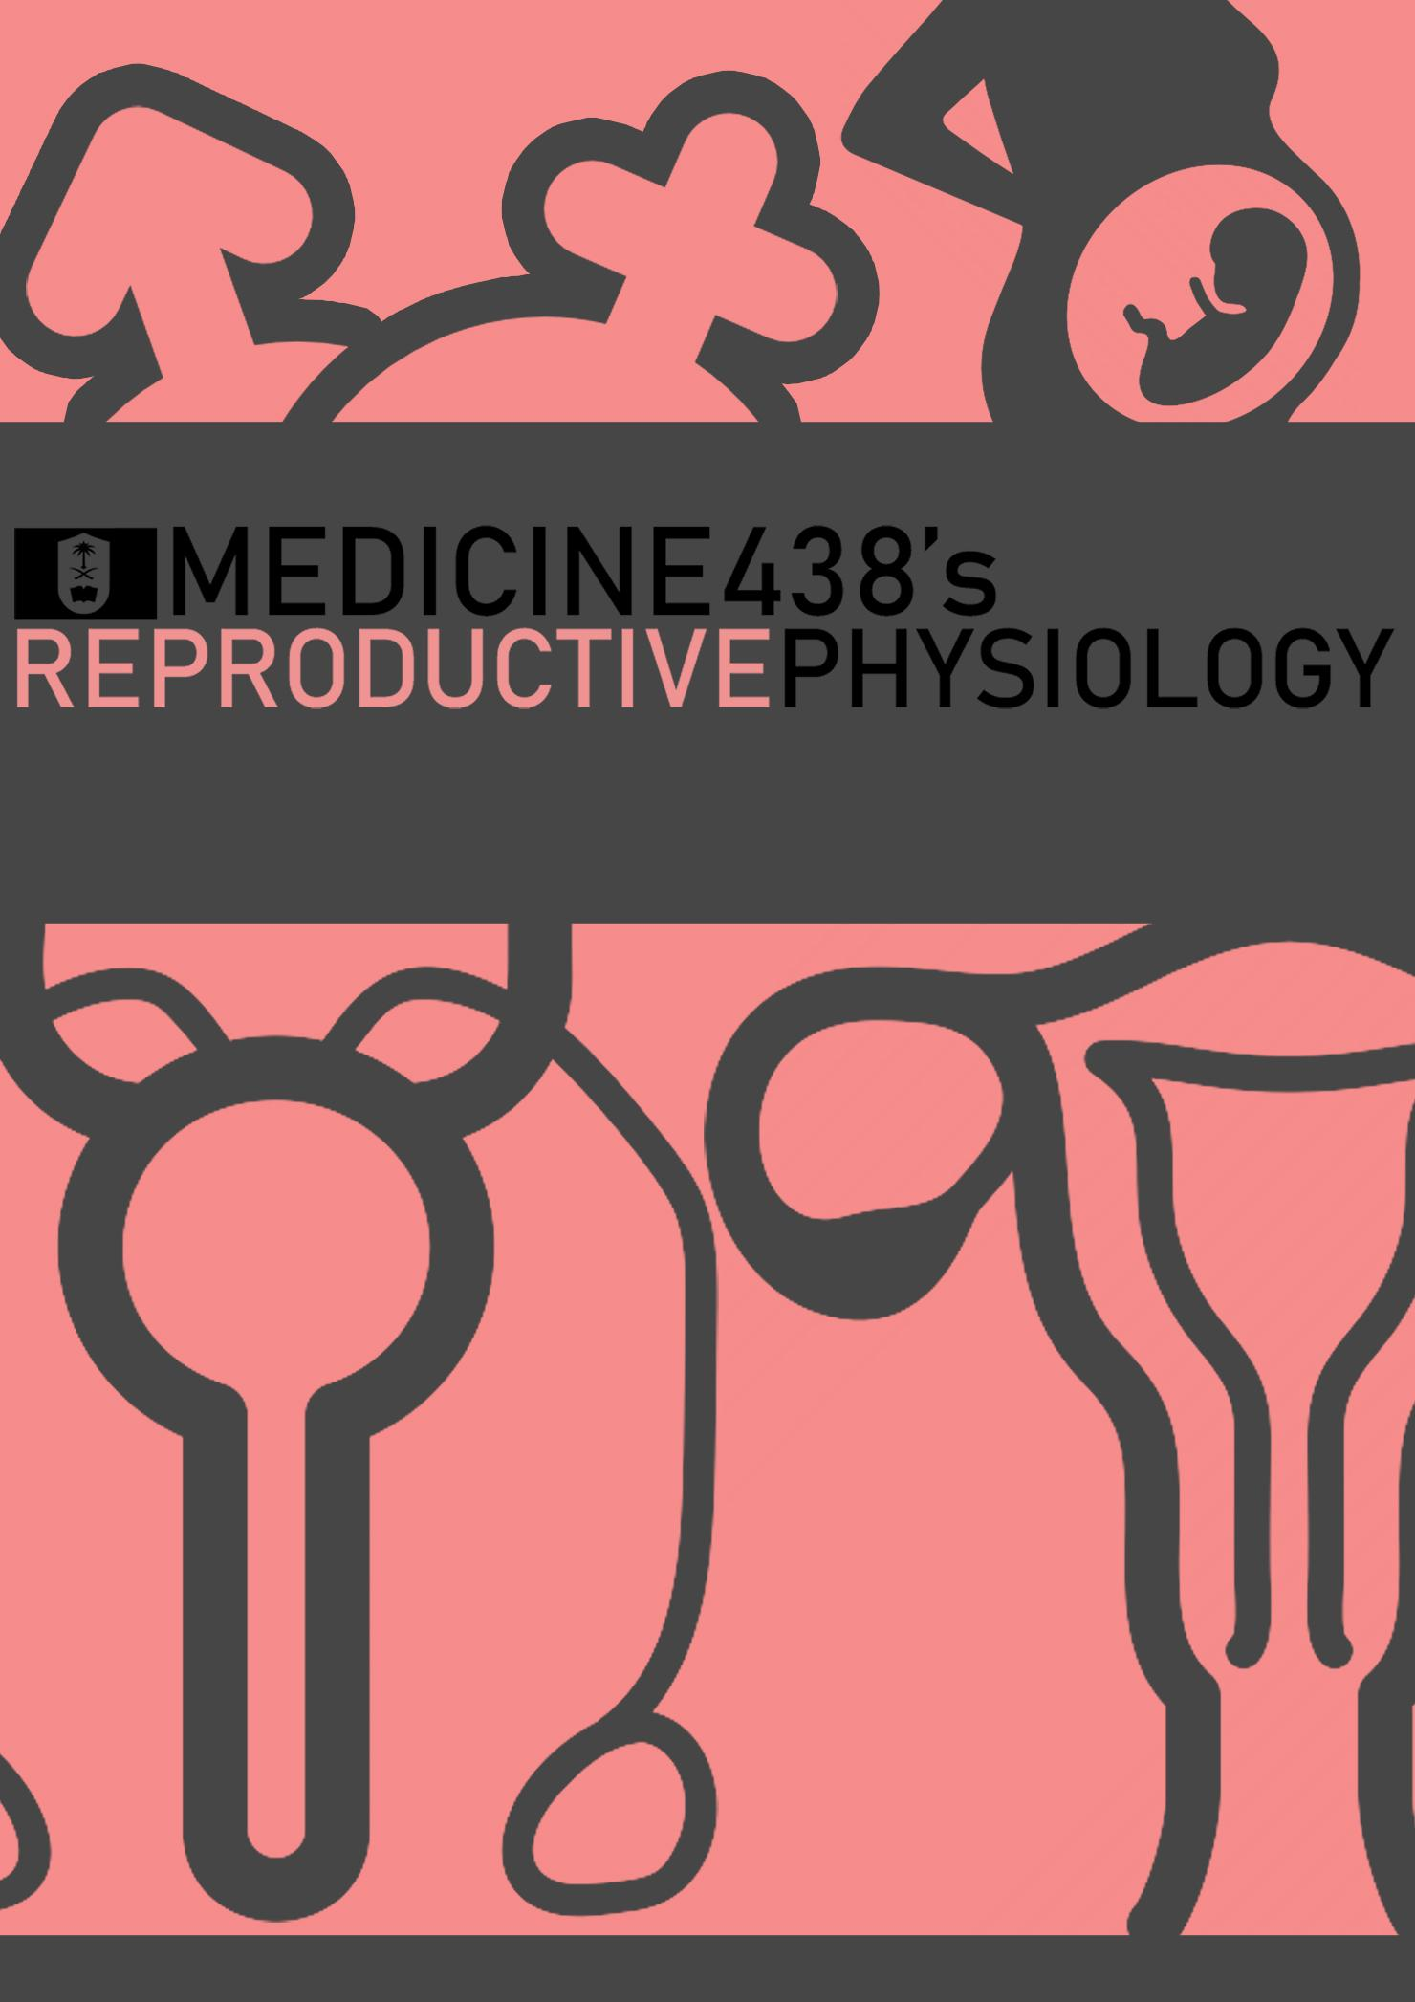
LECTURE VII: Physiology of Labor
EDITING FILE
IMPORTANT
MALE SLIDES
EXTRA
FEMALE SLIDES
LECTURER’S NOTES

Slide 2
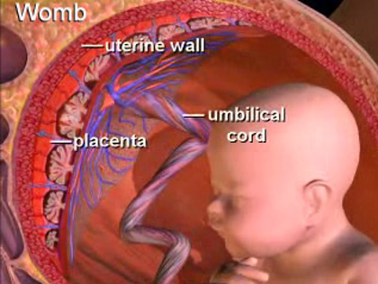
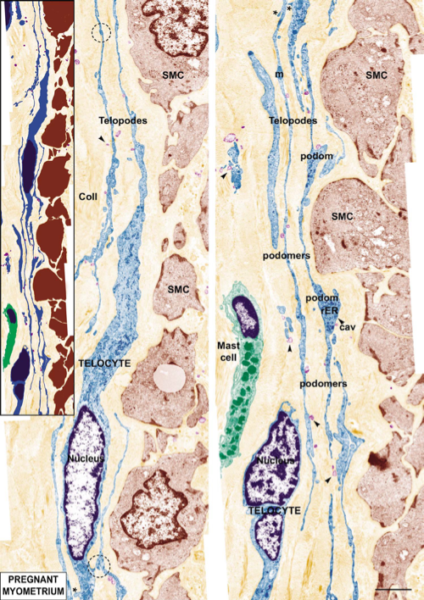
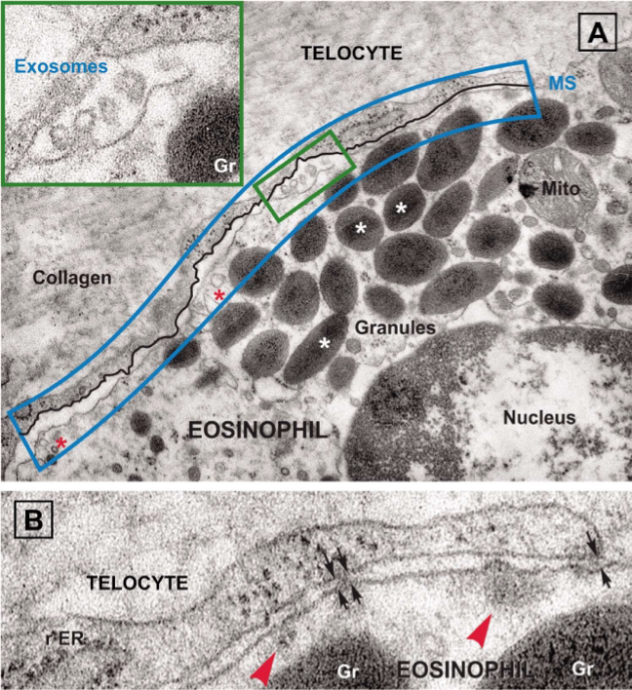
1
PHYSIOLOGY OF LABOR
Lecture Seven
OBJECTIVES
Define labor/labour (parturition).
Recognize the factors triggering the onset of labor.
Describe the hormonal changes that occur before and during labor.
Describe the phases of uterine activity during pregnancy and labor.
Know the clinical stages of labor.
Parturition/Labor
It is the uterine contractions that lead to expulsion of the fetus to extrauterine environment.
Towards the end of pregnancy the uterus become progressively more excitable and develops strong rhythmic contractions that lead to expulsion of the fetus and placenta.
Interactions
Fetus
Placenta membranes
Mother
In normal pregnancy (uterine quiescence, immature fetus, closed cervix).
In labor (coordinated uterine activity, maturation of the fetus, progressive cervical dilation).
Uterus is spontaneously active.
Spontaneous depolarization of pacemaker cells (telocytes)¹.
Gap junctions spread depolarization.²
Exact trigger is unknown.
Two type of changes occur:-
1
2
Hormonal changes
Mechanical changes
Estrogen
Progesterone
Oxytocin
Prostaglandins
Stretch of the uterine muscle
Stretch of the cervix
Figure 7-1 Telocytes
Hormonal Changes
Progesterone | Estrogen
inhibit uterine contractility | stimulate uterine contractility
↓ GAP junction | ↑ GAP junctions with onset of labour
↓ Oxytocin receptor | ↑ Oxytocin receptors
↓ Prostaglandins | ↑ Prostaglandins
↑ Negativity of the resting membrane potential
From 7th month till term
Progesterone secretion remain constant or decreases slightly | Estrogen secretion continuously increase
Estrogen/progesterone ratio increases sufficiently toward the end of pregnancy to be at least partly responsible for the increased contractility of the uterus
Estrogen
Progesterone
Figure 7-2
FOOTNOTES
Footnotes
How Pacemaker Cells Work: Usually cells experience a period of hyperpolarization after depolarization, and then returns to resting membrane potential (RMP) and waits for another stimulus, like ACh in skeletal muscle, to increase membrane potential slightly to open voltage gated positive ion channels (they are usually opened by a voltage slightly higher than RMP) inside the cell to trigger another depolarization. Pacemaker cells have a false resting membrane potential, meaning as soon as one depolarization ends, the resting membrane potential is often sufficient to allow continuous entry for positive ions and initiate a new action potential.
Made of connexin 43, a protein that creates pores between cells to allow transfer of ions, these ions carry a charge that change the potential within the cells to create an AP. Smooth muscles act as a syncytium, meaning that an action potential in one cell can spread to all other cells due to gap junctions that spread positive ions. Smooth muscles are typified into: Unitary type, and multiunit type. Unitary smooth muscles contract spontaneously in response to stretch, like the uterus. Multiunit, like ciliary muscles of the eye and muscles of iris.

Slide 3
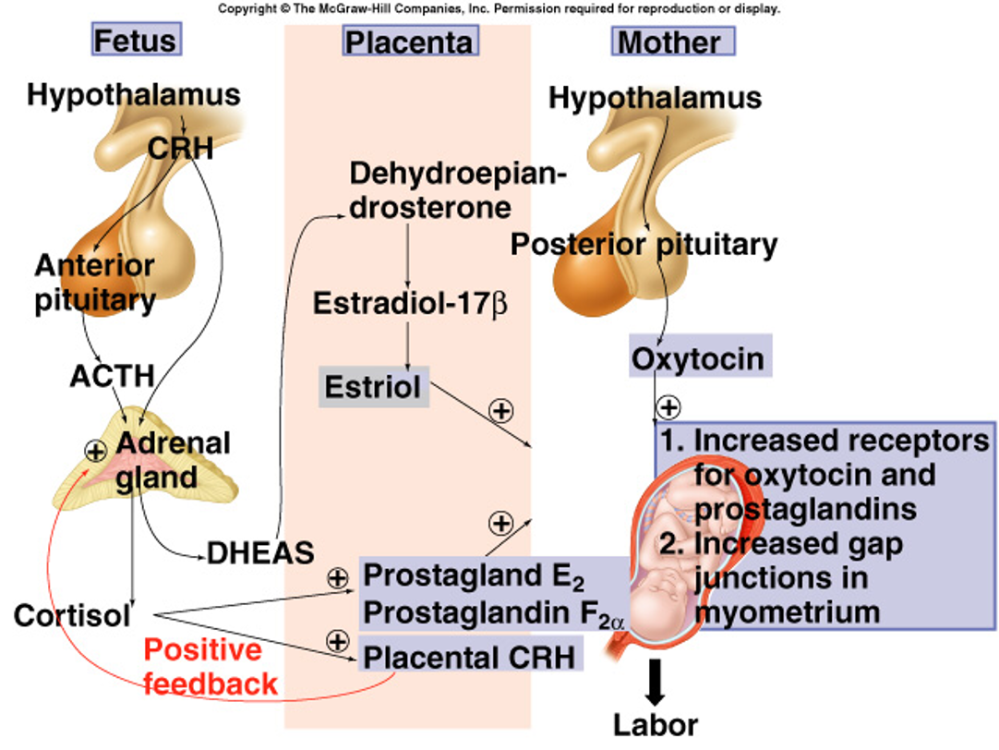
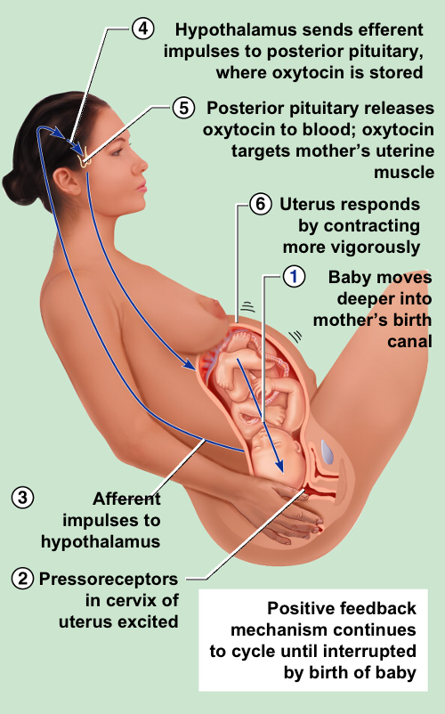
2
PHYSIOLOGY OF LABOR
Lecture Seven
Oxytocin:¹
Dramatic ↑ of oxytocin receptors at the last few months of pregnancy (200 folds)
Gradual transition from passive relaxed to active excitatory muscle (↑ responsiveness).
Increase in oxytocin secretion at labor by posterior pituitary gland.
Oxytocin increases uterine contractions by:
Directly on its receptors.
Indirectly by stimulating prostaglandin (PGF2α) production.
Prostaglandins:¹
Central role in initiation & progression of human labour.
Locally produced (intrauterine), paracrine.
Oxytocin and cytokines stimulate its production.
PGF2α, PGE1, PGE2, Thromboxane A2 generally cause uterine contraction, PGI2 (prostacyclin) causes uterine relaxation.
Prostaglandin stimulate uterine contractions by:
Direct effect:
Through their own receptors.
Upregulation of myometrial gap junctions.
Indirect effect:
Upregulation of oxytocin receptors.
Effect of Fetal Hormones on The Uterus¹:
The fetus’s pituitary gland secretes increasing quantities of oxytocin.
The fetus’s adrenal glands secrete large quantities of cortisol, another possible uterine stimulant.
The fetal membranes release prostaglandins in high concentration at the time of labor.
Mechanical Changes
Stretch of the uterine muscle²:
Increases contractility
Fetal movements
Multiple pregnancy (twins)/size of uterus
Stretch of the cervix:
Increases contractility (reflex)
Membrane sweeping³ & rupture.
Fetal head.
Positive feedback mechanism.
Mechanisms: (1) Myogenic: Stretch allows calcium entry into the SMCs and depolarization spreads to body of uterus. (2) Spinal Reflex: Stretch of cervix initiates a spinal reflex and efferents from the spinal cords cause contraction of the uterine body, (3) Neuroendocrine Reflex: Stretch of cervix triggers release of oxytocin from hypothalamus, furthering contraction.
Figure 7-3¹
Onset of Labor
During pregnancy:-
Periodic episodes of weak and slow rhythmical uterine contractions (Braxton Hicks) 2nd trimester.
Towards end of pregnancy:-
Uterine contractions become progressively stronger.
Suddenly uterine contractions become very strong leading to cervical effacement and dilatation.
Figure 7-4 Initiation of labor
Positive Feedback Mechanisms
Labor contractions obey all the principles of positive feedback:
Stretching of the cervix causes the entire body of the uterus to contract.
Stretching of the cervix also causes the pituitary gland to secrete oxytocin.
Figure 7-5
FOOTNOTES
Footnotes
What Exactly Triggers Labor? A Coherent Mechanism: The proposed mechanism is a sudden shift in increased estrogen/progesterone ratio, this happens in the following manner: From the previous lecture we mentioned placenta only synthesizes estrogens from androgens (DHEAS) → Fetal hypothalamus starts maturing enough near labor to secrete large amounts of CRH (CRH gene is also encoded in the placenta, so it is also produced by placenta) → ↑ACTH → ↑Cortisol and androgens from both fetal and maternal adrenal cortex → Cortisol can inhibit progesterone receptors, leading to an increase estrogen/progesterone ratio, androgens are converted to estrogens → More estrogen action and less progesterone action leads to upregulation of oxytocin receptors and more gap junctions → Oxytocin and estrogen cause increased synthesis of PGs → PGs cause softening and dilation of cervix (explained later) and PGs and Oxytocin cause uterine contraction → Fetus descends into cervix, activation of cervix pressure-receptors causes more release of oxytocin through neuroendocrine reflex, and through a spinal reflex from mechanosensitive neurons from the cervix the body of uterus is triggered to contract.
This happens through what we call a “myogenic mechanism”, there are mechanosensitive calcium channels on unitary smooth muscles, when the muscle is stretched, the calcium channels is “pulled apart” and calcium enters the cell and causes contraction.
Membrane sweeping: A procedure to induce labor in which a doctor injects their finger into the vagina towards the uterus to separate fetal membranes (amnion and chorion) from the uterus. This seemingly increases prostaglandin production through uncertain mechanisms.
Stretching of cervix
Stretch-sensitive nerve cells send
Brain interprets input and releases
Contraction of uterus wall force baby’s head or body into the cervix, thus
Increasing
Receptors
Input
Control center
Nerve impulses
Output
Oxytocin
Positive feedback:
Increased stretching of cervix causes release of more oxytocin, which results in more stretching of cervix
Effectors
Baby’s body stretches cervix more
Muscles in wall of uterus contract more forcefully

Slide 4
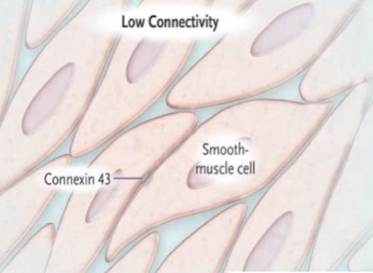
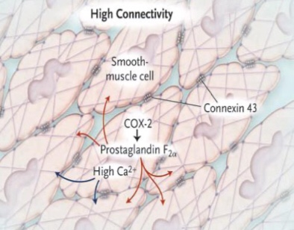
3
PHYSIOLOGY OF LABOR
Lecture Seven
Phases of Parturition¹
Phase 0 (Pregnancy)
1
Occurs during early pregnancy. The uterus is relaxed (quiescent).
Increase in cAMP level.²
It has been hypothesized that the higher progesterone levels increase in production of:-
Prostacyclin (PGI₂), Nitric oxide (NO), and Parathyroid hormone-related protein (PTHrP) which can all cause uterine relaxation.
Figure 7-6
CRH: Increases cortisol production in both the fetus and mother and results in inhibition of progesterone receptors (shifting the balance towards estrogen, and thereby uterine contraction), CRH receptors are expressed in the uterus, they are postulated to be responsible for PGs production.
Uterotrophins: Enhancive of the excitatory functions of the uterus.
Uterotonins: Inducers of uterine contraction.
Phase 1 (Activation)
2
Quiescence
Uterotrophins
Occurs in third trimester.
Promote a switch from quiescent to active uterus.
Increase excitability & responsiveness to stimulators by:-
Increasing expression of gap junctions.
Increasing G protein-coupled receptors (Oxytocin receptors & PGF2 alpha receptors).
Involution
Uterotonins
Figure 7-7
Phase 2 (Stimulation)
Phase 3 (Uterine Involution)
3
4
Occurs in the last 2-3 gestational weeks.
Increase in synthesis of uterotonins (cytokines, prostaglandins and oxytocin).
Includes 2 stages:-
Occurs 4-5 weeks after delivery.
Pulsatile release of oxytocin.
Delivery of the placenta and involution of the uterus.
Lactation helps in complete involution.³
Includes stage 3.
Stage one.
Stage two.
Mechanism of Parturition
Contractions start at the fundus and spreads to the lower segment⁴.
The intensity of contractions is strong at the fundus but weak at the lower segment.
In early stages: 1 contraction/30 min, As labor progress: 1 contraction/1-3 min.
Abdominal wall muscles contract.
Rhythmical contractions allows blood flow.⁵
FOOTNOTES
Footnotes
Difference Between Stages and Phases: Phases are changes that occur within the uterine muscle at the cellular level and it starts from the beginning of pregnancy until the involution of the uterus. Stage: is what you observe clinically.
Beta agonists such as ritodrine cause uterine relaxation through activation of cAMP second messenger system. Whilst activation of phospholipase C/IP3 second messenger system causes contraction (oxytocin and PGs)
Lactation Helps in Uterine Contractions: This is due to nipple stimulation, which happens also during suckling, this transmits signals to the hypothalamus to release oxytocin. Fooling the hypothalamus, since oxytocin causes milk ejection as well as uterine contraction.
Prostaglandins: PGs have a selective stimulant action on the fundus, whereas there is a progressive decrease in sensitivity in the lower segment. This is important to to push the baby downward toward the cervix. The mechanism of cervical dilation will be discussed in the footnotes of the next page.
Why Rhythmical Contractions? Refractory periods occur in-between contractions, relative refractory periods, in which only a very strong stimulus can cause contraction. An example of this is ergot drugs (ergometrines), they cause tetanic contractions because their action on uterine smooth muscles is strong enough to diminish refractory periods.

Slide 5
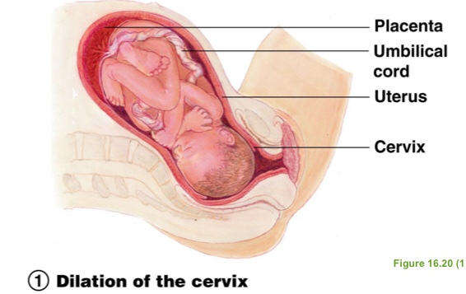
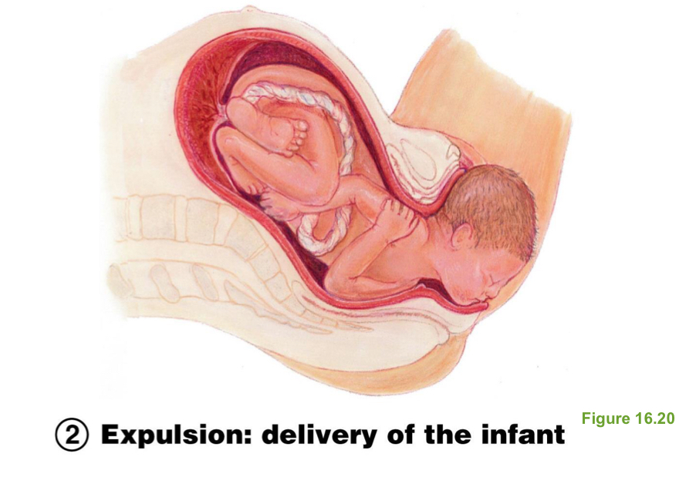
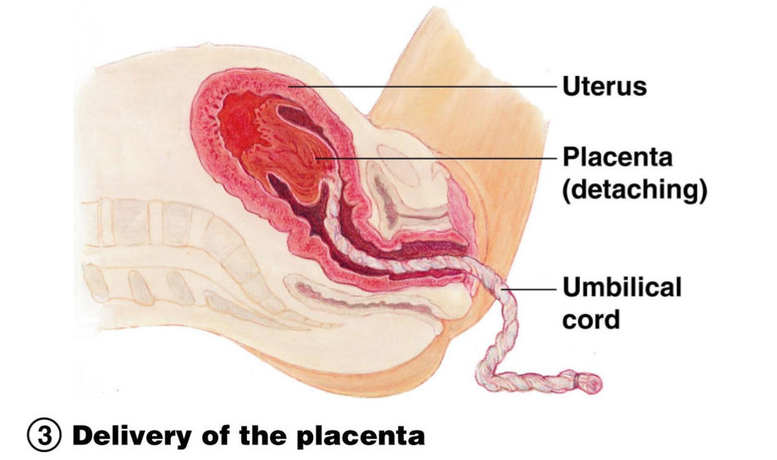
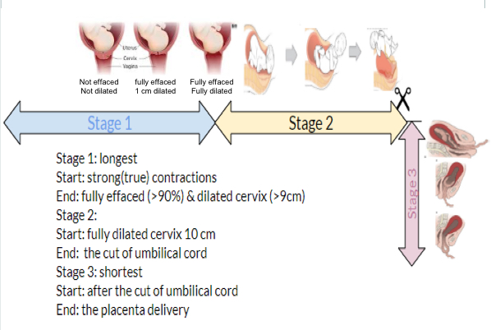
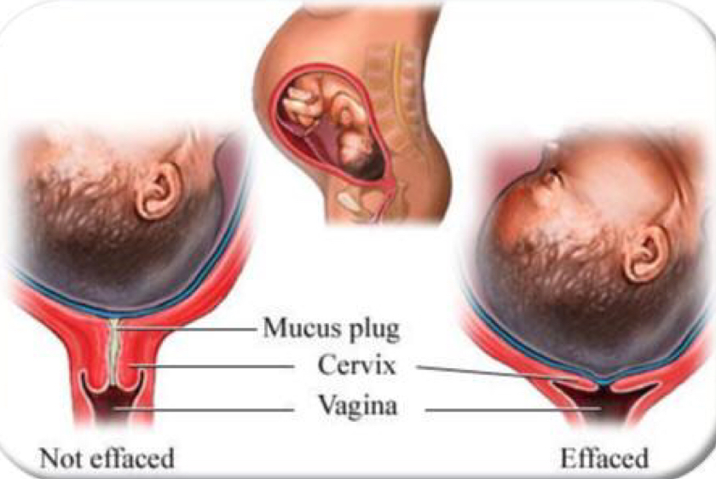
4
PHYSIOLOGY OF LABOR
Lecture Seven
Stages of Labor
Stage 1 (Dilation)
1
It’s the longest stage of labor.
6-12 hours.
6–20 hours (primipara), 6-14 hours (multipara)
Cervix becomes dilated, full dilation is 10 cm.
Uterine contractions begin and increase.
Cervix softens and effaces (thins)¹
The amnion ruptures “breaking the water”.
Figure 7-8
Stage 2 (Expulsion/Descent of the fetus)²
2
Duration: can last as long as 2 hours in a multipara and 3 hrs in a primipara, but typically is 50 minutes in the first birth and 20 minutes in subsequent births.
Begins with complete cervical dilation and ends with delivery of the fetus.
It includes:
The passive phase (passive descent of the fetal head)
The active phase (expulsive phase, bearing down or pushing by the mother)
Infant passes through the cervix and vagina.
Normal delivery is head first (vertex position).
Breech presentation is buttocks-first.
Figure 7-9
Stage 3 (Placental Stage)
3
Delivery of the placenta, usually accomplished within 15-30 minutes after birth of infant.
Begins with delivery of the fetus and ends with expulsion of the placenta.
Afterbirth—placenta attached to the fetal membranes are delivered.
All placental fragments should be removed to avoid postpartum bleeding.
Figure 7-10
Figure 7-11
Figure 7-12
FOOTNOTES
Footnotes
What is Meant By Cervix Thinning or Dilation? It doesn’t mean relaxation of smooth muscles of the cervix, as they actually might contract, but it means thinning of the substance (stroma) of the cervix itself. PGs, especially PGF2alpha activate collagenases in the cervix, this degrades the connective tissue within the cervix, as well as it increases the synthesis of GAGs like hyularinic acid, this leads to a more flexible cervix that is easily forced open by the higher intrauterine pressure caused by contraction of the body and fundus. Oxytocin plays no or minimal role in cervical softening, that is why in our pharmacology it is recommended that we only give it after dilation.
Stage 2: This stage depends on the 3 Ps: 1-Power: forceful uterine contractions 2-Passenger: refers to the fetus (the unfused skull bone make the infant’s head just flexible enough to pass through the birth canal). 3-Passage: the route that the fetus has to travel through the bony pelvis.
Sometimes the several hours after delivery is called the “Fourth Stage” and in this stage the mother starts adapting to the blood loss.

Slide 6
5
PHYSIOLOGY OF LABOR
Lecture Seven
Further Reading
Postpartum Hemorrhage
Postpartum hemorrhage is a significant loss of blood after giving birth and it’s the most common cause of maternal morbidity and maternal death.
Significant bleeding in the first 24 hours after delivery is called “Primary Postpartum Hemorrhage”. If the bleeding is after 24 hours it’s called “Secondary or Late Postpartum Hemorrhage”.
Causes of postpartum hemorrhage (The 4 Ts):
1- Tone: Normally after delivery the myometrium continues to contract to reduce uterine bleeding but with loss of uterine tone the uterus fails to contract leading to excessive blood loss.
Causes of uterine atony:
1- repeated distention (multiple pregnancies) 2- overstretching from twins 3- uterine muscle fatigue during the delivery process because of prolonged labor 4- medications
2- Trauma: damage to any of the genital structures.
This can include:
1-Incisions from a C-section 2- incidental trauma from a baby coming through the vaginal canal.
3- Tissue: refers to placental fragments retained in the uterine cavity which can prevent effective uterine contractions and leads to uterine atony.
Causes:
1-Placenta Accreta: a condition in which the placenta does not properly separate from the uterus during labor and delivery because it has grown too deeply into the uterine wall. 2- Traction on umbilical cord.
4- Thrombin: Any blood clotting condition:
1- Genetic: Von Willebrand disease.
2- Obstetric: Eclampsia and placental abruption (can lead to disseminated intravascular coagulation).

Slide 7
During labor, oxytocin increases uterine contractions by stimulating formation of?
PGE_{2.}
PGI_{2.}
PGF_{2a.}
Nitric oxide.
Uterine contractions is stimulated by?
Estrogen .
Oxytocin .
Prostaglandins .
All of the above .
What happens during uterine involution phase?
Pulsatile release of oxytocin for milk ejection and intermittent uterus contraction .
Increase in synthesis of uterotonins.
Increase excitability and responsiveness to stimulators .
Increase in cAMP level.
What happens during stage I of labor?
Infant passes through cervix and vagina.
Delivery of placenta.
Cervix becomes dilated .
Uterine relaxation .
Which hormone inhibits uterine contractions?
Estrogen.
Progesterone .
Oxytocin .
Prostaglandin .
SHORT ANSWER QUESTION:
In phase 0 of parturition, list the substances that will be increased and their effect.
PGI2: uterine relaxation
NO: uterine relaxation
PTHrP: inhibit uterine contraction
cAMP: uterine relaxation
List the delivery presentations of the infant in expulsion stage.
Vertex position: normal delivery, head first.
Breech presentation: buttocks first.
Explain the positive feedback theory.
Stretching of the cervix by the fetus head becomes great enough to cause the contraction of the entire body of the uterus.
Stretching of the cervix will push the baby forward which stretches the cervix more and initiate more positive feedback to uterine body. Thus causing the pituitary to secrete oxytocin.
ANSWER KEY: C, D, A, C, B

Slide 8
Amirah Al-Zahrani, Taif alshammari
Quiz Writer: Elaf Almuseheal
Co-editor: Nouf Alshammari
FEMALE PHYSIOLOGY CO-LEADERS
Maha Alnahdi, Taif Alshammari
MALE PHYSIOLOGY CO-LEADERS
Nayef Alsaber, Hameed M. Humaid
REFERENCES
Guyton and Hall Textbook of Medical Physiology
Ganong’s Review of Medical Physiology

