Slide 1
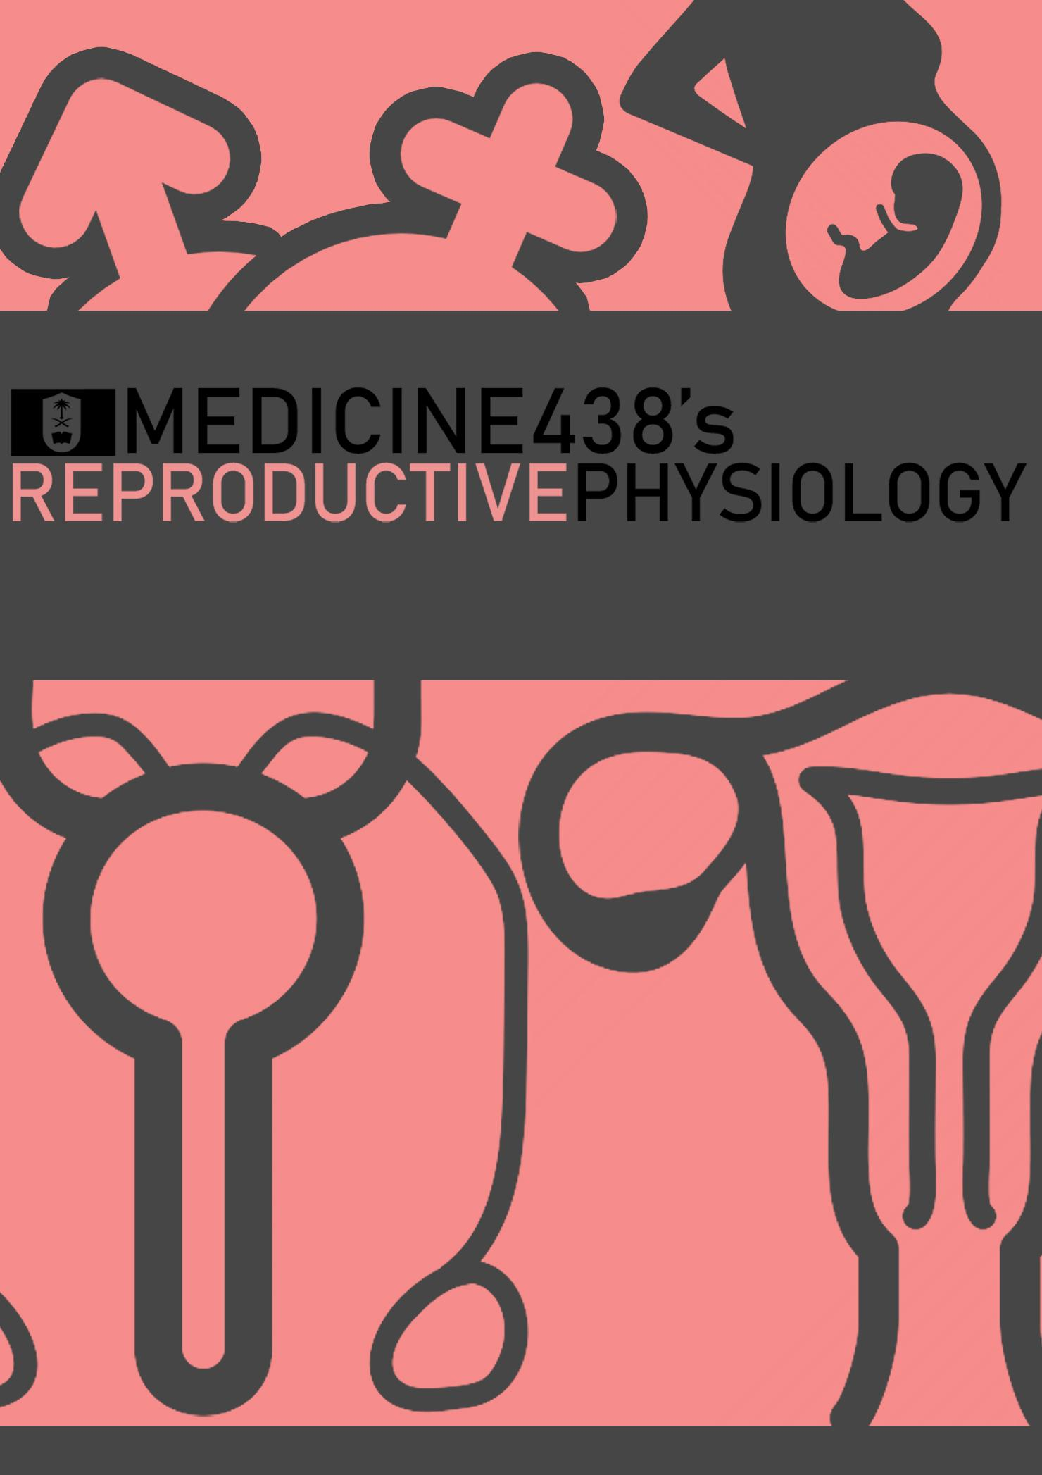
LECTURE VIII: Hormones Affecting the Breast
EDITING FILE
IMPORTANT
MALE SLIDES
EXTRA
FEMALE SLIDES
LECTURER’S NOTES

Slide 2
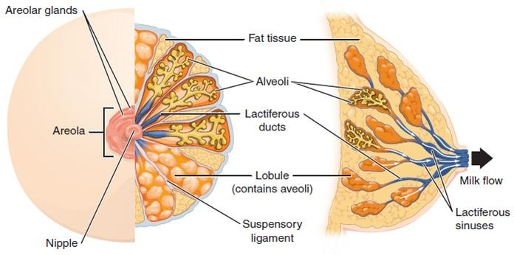
1
HORMONES AFFECTING THE BREAST
Lecture Eight
OBJECTIVES
Physiological anatomy of the breast
Physiological changes during breast development (Mammogenesis)
Physiological changes during lactation (Lactogenesis) and their physiological action
Phases of lactogenesis.
Physiological changes during Galactopoiesis.
Endocrine and autocrine control.
Involution (the termination of milk production).
Explain the physiological basis of suckling reflex and its role in lactation.
Structure of Human Breast
Ductal System
Alveolar tubule
Secondary tubule
Mammary duct
Ampulla (lactiferous sinus)
Lactiferous duct
Lobule-alveolar System
The function of the alveolar epithelial cells is to remove nutrients from the blood and transform these nutrients into the components of milk.
Each breast consists of 15-20 lobes of secretory tissue:
Each lobe has one lactiferous duct.
Lobes (and ducts) are arranged radially.
Lobes are composed of lobules.
Lobules are composed of alveoli.
The fundamental secretory unit of the breast is the alveolus.
Figure 8-1
Figure 8-2
Figure 8-3
Where Does the Milk Come From?
Uterine milk theory:¹
Vessel connecting the uterus to the breast (diversion of menstrual blood to the breast).
Chyle theory:
Milk is derived directly from chyle (milky fluid of emulsified fat absorbed from the intestinal tract into lymphatic system).
Synthesis theory:
Milk is formed from substrates carried to the gland in the blood.
Figure 8-4
Figure 8-5
Stages of Mammary Gland Development
1
2
Mammogenesis
Growth and development of mammary gland to a functional state.
Lactogenesis
Initiation of milk secretion.
(It involves two phases)
3
4
Galactopoiesis
Maintenance of milk secretion in the postpartum period.
Involution²
Cessation of milk production.
FOOTNOTES
Uterine Milk Theory and Chyle Theory: The first theory has its roots in ancient greece, where Aristotle and Hippocrates (the father of medicine) believed that milk is merely menstrual blood rerouted into the breasts and transformed to milk during lactation. However no such miraculous vessel to transport milk was found, even though this theory had made its way wll into the 17th century. Chyle is the product of digestion in the small intestines (chyme is for stomach), and it was believed that it served as origin for breast milk.
Alveolar cells undergo apoptosis at the end of each menstrual period and after lactation, through upregulation of proapoptoric factors but the precise mechanisms for this are uncertain.

Slide 3
2
HORMONES AFFECTING THE BREAST
Lecture Eight
Breast Development (Mammogenesis)
The postnatal development of female mammary tissue occurs in several steps regulated by hormones.
At birth, the mammary epithelium consists of limited ducts.
At puberty, high levels of circulating hormones stimulate both the proliferation of the mammary epithelial cells (MECs) and the enlargement of the surrounding fat pad.
Estrogen stimulate proliferation of ducts and deposition of fat.
Progesterone stimulate development of lobules.
At the onset of pregnancy, epithelial ducts elongate, branch and alveoli develop.
During pregnancy → Complete development of glandular tissue.
During lactation, the mammary epithelium reach its maximal development containing numerous alveoli, which produce huge amounts of milk.
Upon weaning, milk production ceases, the mammary alveoli regress (involution) and the mammary epithelium returns to a non-pregnant state.
Figure 8-6
Figure 8-7
Mammogenesis
The endocrine system plays a major role in synchronizing development (mammogenesis) and function (lactogenesis) of mammary gland with reproduction. Mammogenic hormones: promoting the proliferation of ductal and alveolar cells (ductal & alveolar morphogenesis). Three categories of hormones:
Reproductive hormones (endocrine) | Metabolic hormones (endocrine) | Mammary hormones (autocrine)
Estrogen¹, progesterone², prolactin^{2, 3}, oxytocin and hPL (prolactin-like effect). During puberty, ovarian hormones (estrogen & progesterone) stimulate mammary growth. | GH¹, corticosteroids (cortisol)⁴, thyroxin, PTH and insulin. | GH, prolactin, parathyroid hormone-related protein (PTHrP) and leptin.
FOOTNOTES
Estrogen and Growth Hormone: Is the first and one of the most important factors, high estrogen from placenta during pregnancy causes (1) Development of extensive ductal system (lengthening of the ducts), (2) proliferation of stroma which serves as a plate for (3) deposition of fat. Estrogen deficient mice fail to develop rudimentary ducts, see figure 8-6, estrogen is essential as a starting hormone, because it readies the cells for progesterone by upregulating its receptors “priming”. The role of GH in ductile growth is same as that of estrogen and upregulates estrogen receptors within mammary gland, except that GH deficient mice show a more advanced tree structure than estrogen deficient mice, the action of GH is through IGF-1.
Progesterone and Prolactin then takes over the role of ductile development from estrogen (estrogen did its main role up by now), and causes more branching of mammary tree, and branching of the branches and also upregulates prolactin receptors, therefore it primes the alveolar cells for the action of prolactin. Prolactin and progesterone together cause cells to enlarge and assume a glandular structure, a process called “alveologenesis”, if either prolactin or progesterone deficient mice show normal ductal growth, but the ducts have tapered ends and no alveoli. Progesterone makes the factory (alveoli), prolactin decorates it and makes it secretory (Figure 8-6).
Prolactin can’t exert its full effect to produce milk because some of progesterone protein products antagonizes prolactin’s, also, progesterone blocks the effect of cortisol (the effect of which will be discussed in the next footnote). Therefore full milk production will not occur until after birth when progesterone levels drop.
Cortisol act synergistically with prolactin, it upregulates synthesis of milk proteins like casein, and they upregulate the receptors of one another.
Just like normal breast cells some breast cancer cells have hormone receptors (Estrogen or Progesterone) that allow them to grow in the presence of the hormones.

Slide 4
3
HORMONES AFFECTING THE BREAST
Lecture Eight
Figure 8-8 The rise in prolactin parallels with that of estrogens (estriol), estrogens inhibits the secretion of dopamine from the arcuate nucleus of hypothalamus, which is the main inhibitor of prolactin secretion. Also estrogens act directly on anterior pituitary gland to stimulate prolactin secretion. Remember that the pituitary gland is enlarged during pregnancy, which further contributes to this release. Oxytocin after birth also acts directly on pituitary gland to increase prolactin production.
Reproductive Hormones (Direct Effect)
Estrogen (placenta) | Growth & branching of ductal system (with GH)¹. Fat deposition in the stroma.
Progesterone (placenta) | Growth of lobule-alveolar system (budding of alveoli and secretory changes in epithelial cells) Although estrogen and progesterone are essential for physical development of the breasts, they inhibit actual secretion of milk during pregnancy by interacting with prolactin receptors.²
Prolactin (anterior pituitary) | Its level steadily rises from the 5th week of pregnancy until birth, enhanced by estrogen (10-20 times nonpregnant level). Its main function is milk production. It has mammogenic, lactogenic and galactopoietic effects. It stimulates expression of genes that encode several milk components (casein/lactalbumin, lactose and lipids). Sudden drop in estrogen & progesterone after delivery allows milk production. It is inhibited mainly by hypothalamic hormone, PIH (Dopamine). Thyrotropin-releasing hormone (TRH) can increase PRL.
Human placental lactogen (placenta) | Facilitate mammogenesis. Delay milk production.³
Figure 8-9
FOOTNOTES
GH and Estrogen: Role was explained footnote number one in the previous page.
The mechanisms isn’t clear for this inhibition, but is thought that estrogen interferes with signaling of prolactin whereas progesterone’s inhibitory effect on cortisol (Footnote number 3, 4 in previous page) and the effect of progesterone’s products on prolactin signaling causes inhibition of milk secretion. Therefore the abundance of oxytocin during childbirth doesn’t cause oozing of milk from the breasts.
It is thought that it inhibits milk production by competing with prolactin.

Slide 5
4
HORMONES AFFECTING THE BREAST
Lecture Eight
Lactogenesis
Lactogenesis: cellular changes by which mammary alveolar epithelial cells are converted from a non secretory state to a secretory state (initiation of milk secretion).
Lactogenic hormones (promoting initiation /onset of milk production by alveolar cells).
It involves two stages:
Lactogenesis 1
Cytologic (histological) and enzymatic differentiation of alveolar epithelial cells.
Starts in mid pregnancy and characterized by expression of many (but not all) genes involved in synthesis of milk components.
This increases the uptake transport systems for amino acids, glucose, and calcium required for milk synthesis.
Hormones involved:
Progesterone (suppresses milk secretion)
Prolactin
Placental lactogen (hCS)
Growth hormone¹
Glucocorticoids (Cortisol)²
Further differentiation is inhibited by high levels of progesterone from the placenta.
Production and secretion of milk components in this stage are restricted to a limited number of alveolar epithelial cells with incompletely developed secretory mechanisms.
Lactogenesis 2
Copious secretion of all milk components, starts 2-3 days postpartum.
At parturition, withdrawal of progesterone + high level of prolactin leads to:
Further increase in expression of milk protein genes.
Glands absorb increased quantities of metabolic substrates from the blood.
Movement of cytoplasmic lipid droplets and casein into alveolar lumen.
Transfer of immunoglobulins³ (IgA).
Secretion of colostrum⁴ followed by milk.
Suckling stimulates further increase in expression of genes involved in milk secretion with expansion of alveolar epithelium.
Lactation is maintained by removal of milk⁵ due to switch from endocrine to autocrine control of milk production.
Hormones involved:
Prolactin (milk production)
Oxytocin (milk let-down)
Growth hormone
Glucocorticoid (Cortisol)
Thyroid hormone¹
Insulin
All are required to facilitate the mobilization of nutrients and minerals.
Figure 8-10
Figure 8-11 After delivery of placenta → withdrawal of high progesterone conc.
FOOTNOTES
Thyroid hormone and GH: Thyroid hormone has a permissive action on GH, GH maintains the ductal structure of mammary gland and provides substrates (glucose, amino acids) into the mammary gland. (Remember GH effects: Increases fatty acids, glucose and amino acids in the circulation).
Cortisol: Helps in synthesis of milk proteins like casein, by participation in initiation of their transcription. Also, recent research has revealed cortisol acts as a messenger to her child, its concentration increases in low maternal nutrient states “stress” which informs the neonates of the mother’s state and triggers changes in the baby’s metabolism and temperature regulation to be adapt to new nutritional content of breast milk. This has been observed in monkeys for now.
Some of which are lethal certain pathogens like E. coli, which cause diarrhea in newborns.
Colostrum is also known as “Early milk”, it is produced by mammary glands instead of milk in early days of lactation, it has the same constituents as milk but higher in immunoglobulins, has less fats and acts as a laxative which helps the baby pass the first stool aka meconium. Which indicates that mammary glands continue to grow after delivery due to loss of progesterone and the acquisition of full prolactin effect, one of the effect allowed due to withdrawal of progesterone is increased formation of tight junction between mammary epithelial cells, hence why drugs administered in first week postpartum can be found in higher concentration in breast milk.
Autocrine Control: Discussed in page 6.

Slide 6
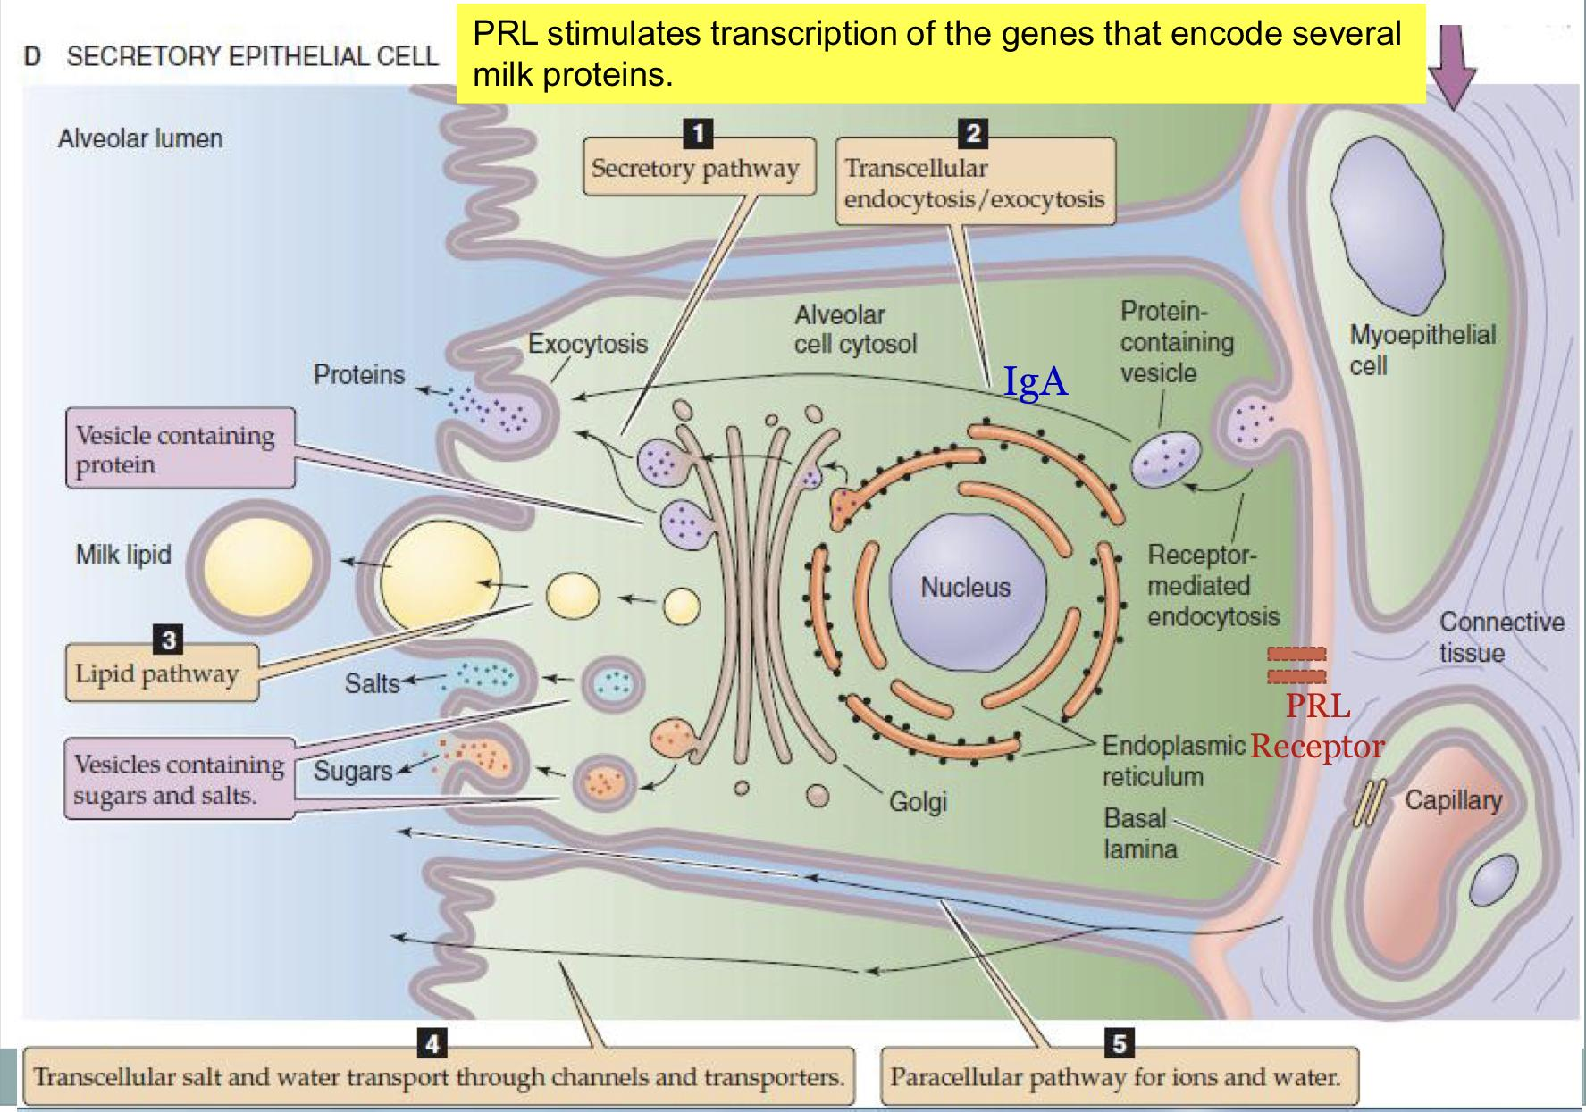
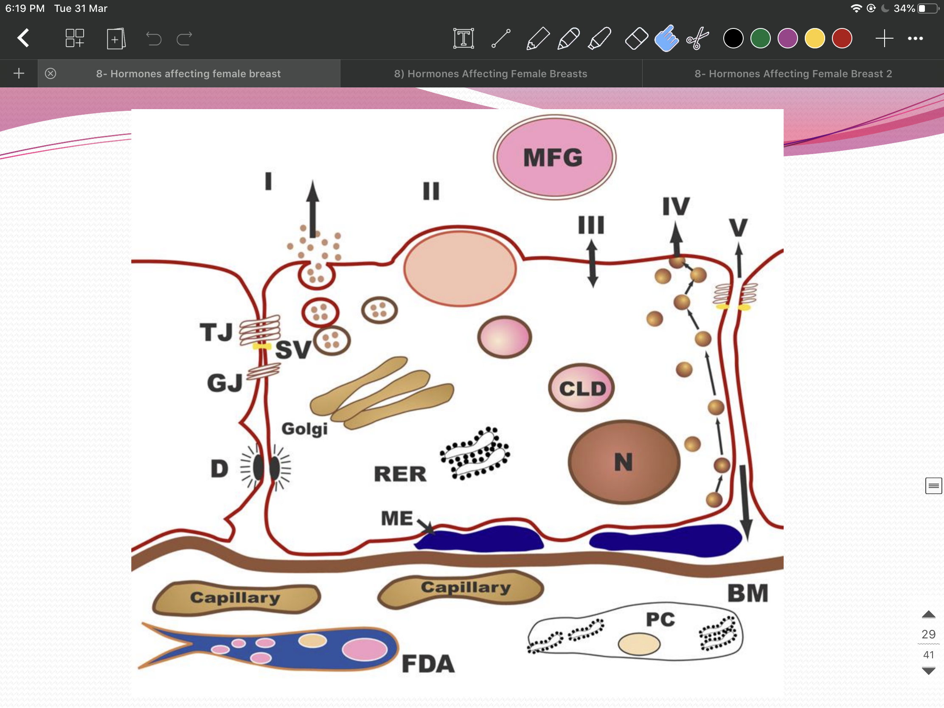
5
HORMONES AFFECTING THE BREAST
Lecture Eight
Hormonal Regulation of Lactogenesis
Metabolic Hormones (Direct Effect)
GH | Its secretion is stimulated by progesterone. Increases production of IGF-1 by the liver and locally. Mediate ductal cell survival and ductal growth.
Corticosteroids | Increases during pregnancy (five fold). Involved in breast development (permissive action on milk protein synthesis).
Thyroxin | Essential for milk production. Thyroxine & TSH level decreases during lactation. TRH increases leading to stimulation of PRL (TRH can be administered nasally to treat inadequate lactation).
Insulin | Low during lactation. Shunt of nutrients from storage depots to milk synthesis.
Mammary Hormones
GH | Progesterone stimulates its secretion.
Leptin | Increases during pregnancy (increase adipose tissue). Decreases with lactation.
PTHrP | Increases during lactation Mobilizes bone calcium Increase in alkaline phosphatase
Milk Synthesis
The alveolar cell secretes the components of milk through ﬁve pathways.
The pathways for milk secretion and synthesis by the mammary epithelial cell:
I: Exocytosis of milk protein, lactose, and other components of the aqueous phase in Golgi-derived secretory vesicles.
II: Milk fat secretion via the milk fat globule.
III: Direct movement of monovalent ions, water, and glucose across the apical membrane of the cell.
IV: Transcytosis of components of the interstitial space.
V: The paracellular pathway for plasma components and leukocytes. Pathway V is open only during pregnancy, involution, and in inflammatory states such as mastitis.
Figure 8-13
SV = Secretory vesicle;
RER = Rough endoplasmic reticulum;
BM = Basement membrane; MFG = Milk fat globule;
CLD = Cytoplasmic lipid droplet; N = Nucleus;
PC = Plasma cell;
FDA = Fat-depleted adipocyte; TJ = Tight junction; GJ = Gap junction; D = Desmosome;
ME = Myoepithelial cell.
Figure 8-12

Slide 7
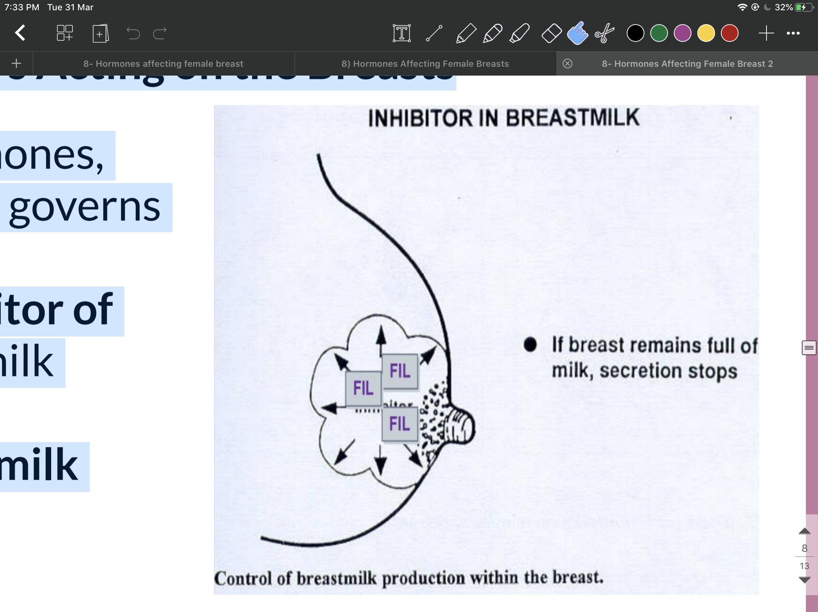
6
HORMONES AFFECTING THE BREAST
Lecture Eight
Galactopoiesis
Galactopoiesis is defined as the maintenance of lactation once lactation has been established, starts 9-15 days postpartum.
Galactopoietic hormones (maintaining milk production after it has been established):
PRL (primary)
Cortisol, Insulin, thyroid hormone and growth hormone (permissive)
Oxytocin
Ovarian hormones
Galactopoietic Hormones
Prolactin | Milking-induced surge is a direct link between the act of nursing (or milk removal) and the galactopoeitic hormones involved in maintaining lactation.
Growth Hormone | Support increase in synthesis of lactose, protein, and fat in the mammary gland.
Glucocorticoids | Galactopoietic in physiological doses.
Thyroid Hormones | Galactopoietic.
Ovarian Hormones | Estrogen in very low doses is galactopoietic. Progesterone alone has no effect on galactopoiesis because there are no progesterone receptors in the mammary gland during lactation.
Oxytocin and Psychic Stimuli Initiate Milk Ejection (“let-down”)
Milk Ejection Reflex:
○ Oxytocin contracts the myoepithelial cells, forcing milk from the alveoli into the ducts and sinuses where it is removed by the infant (galactokinetic effect).
Galactokinetic Hormones
○ Promoting contraction of myoepithelial cells, and thus milk ejection).
Oxytocin
Vasopressin (similar chemical structure, differ by two amino acids. Even oxytocin has ADH effects)
Autocrine Control of Lactation
Influence of Local Factors Acting on the Breasts
It is not just the level of maternal hormones, but the efficiency of milk removal that governs the volume product in each breast.
A protein factor called feedback inhibitor of lactation (FIL) is secreted with other milk components into the alveolar lumen.
FIL, insensitive to prolactin decreases milk production.
Its presence inhibits further milk secretion, therefore whenever it is removed there will be less inhibition and more milk secretion.
Figure 8-14

Slide 8
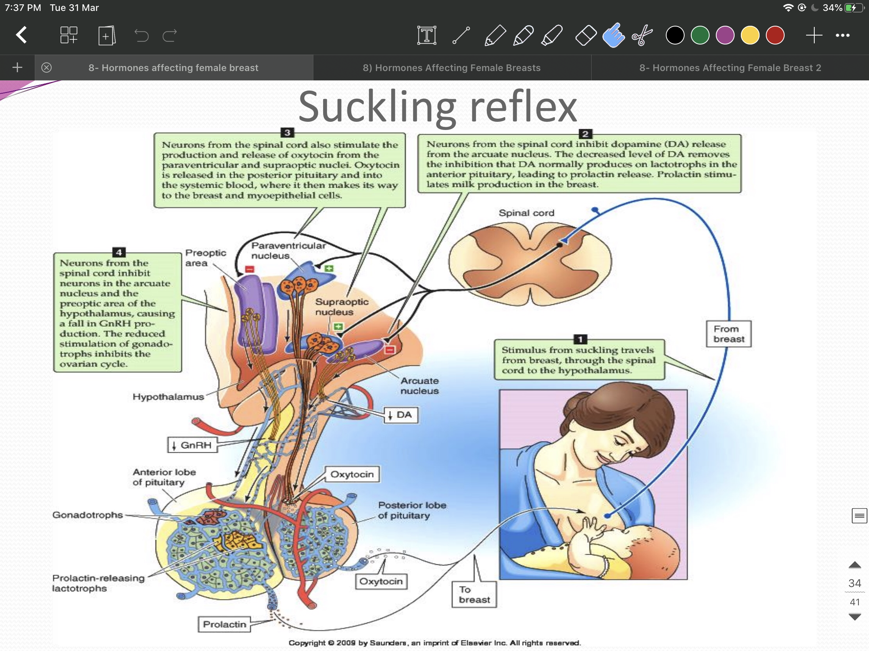
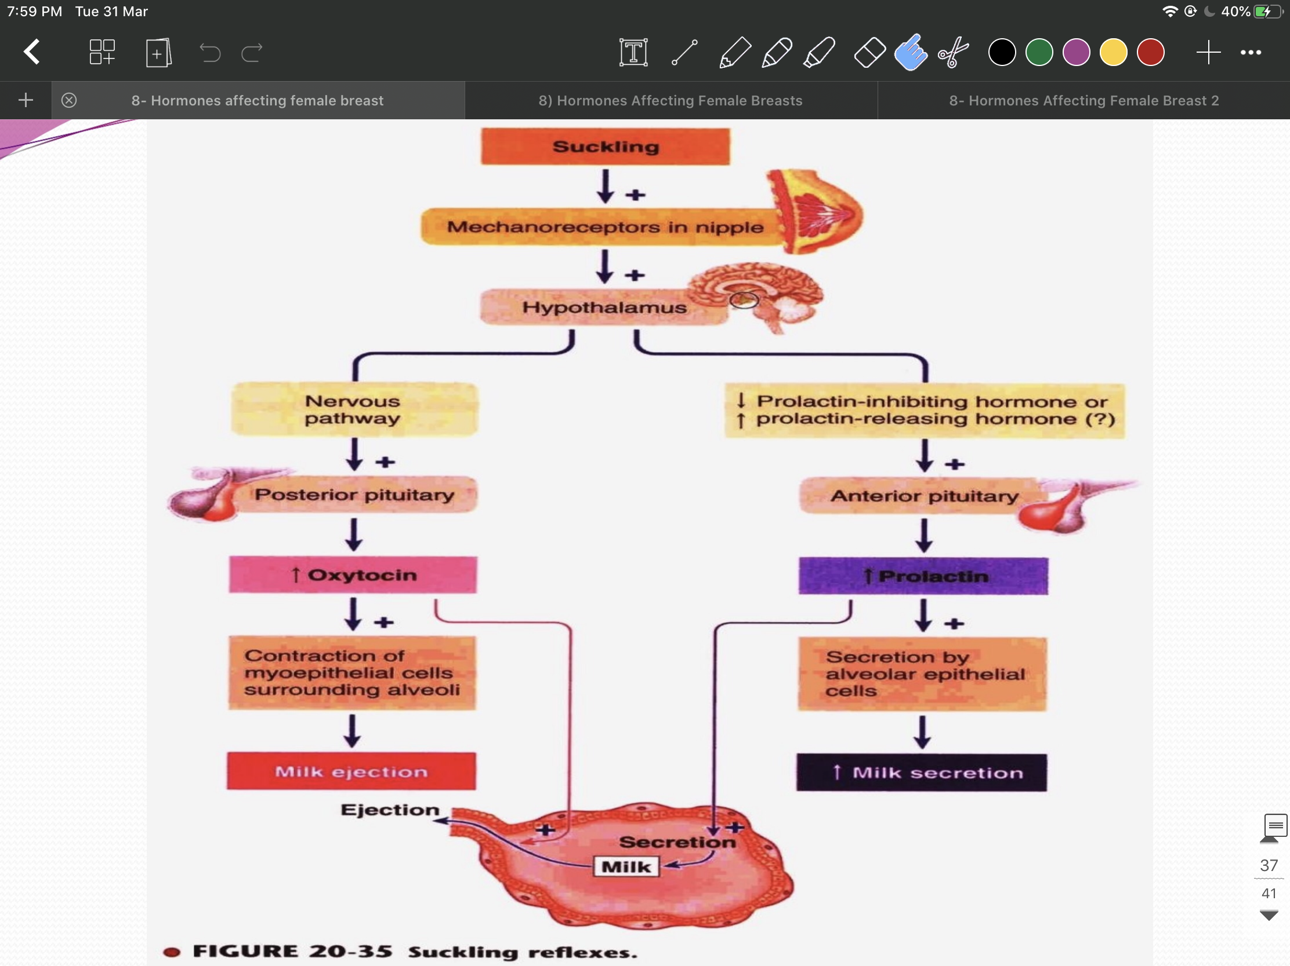
7
HORMONES AFFECTING THE BREAST
Lecture Eight
Suckling Reflex
Figure 8-15 suckling stimulates the release of TRH from the hypothalamu. The other breast will also be stimulated.
Figure 8-16
Figure 8-17 Suckling is the most powerful physiological stimulus for PRL release.
This graph shows the peaks in prolactin release in response to suckling.
Milk Production
Milk production is a "use it or lose it" process.
The more often and effectively the baby nurses, more milk will be produced.
Lactation is maintained by continuous removal of milk.
Milk production <100 ml/day in day 1 postpartum.
Milk production by day 3 reaches 500 ml/day.
Involution: when the breasts stop producing milk completely after weaning.
Milk composition changes dramatically (↓Na+2 & Cl- ) due to closure of tight junctions that block paracellular pathway.
Figure 8-18
AAP Recommendations
○ Exclusive breastfeeding for the first six months of life.
○ Continued breastfeeding for at least one year, ‘As long as is desired by mother and child’.

Slide 9
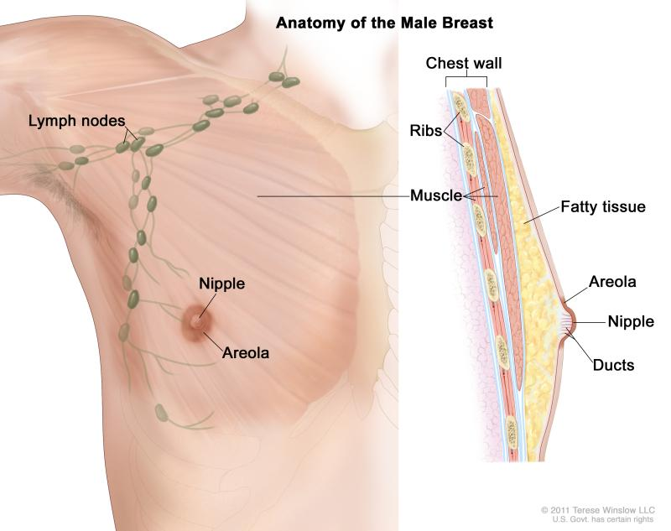
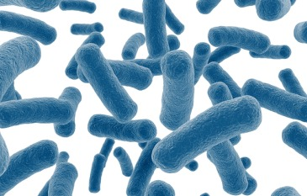
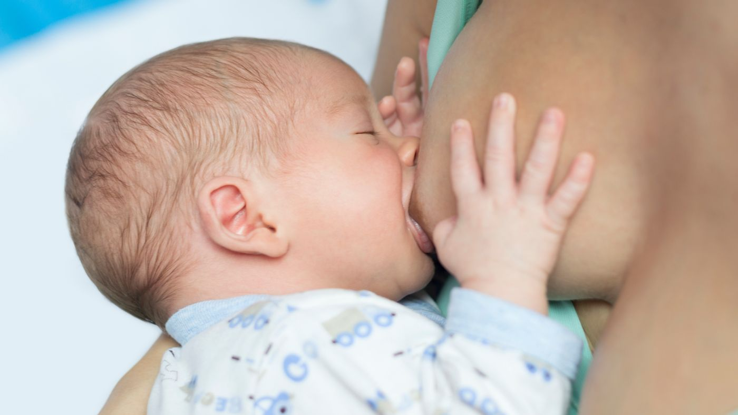
8
HORMONES AFFECTING THE BREAST
Lecture Eight
Further Reading
Why Do Males Have Nipples Then?
Nipples (or papilla) are elevations on the surface of the breasts in order to provide a surface that the infant can latch and effectively suckle from the breasts. Nipples contain the openings of lactoferrous ducts that carry the milk from the factory of the breasts, the mammary gland.
But if breastfeeding occurs naturally only in female sex, why do men have nipples?
The function and existence of the male papilla interested even the father of modern biology Charles Darwin, who agreed with the view that they are the remnant of our less evolved ancestors, back when separate sexes didn't exist and mammals were hermaphrodites (both male and female).
The prevalent view is that when the fetus's sex is determined during gestation, the male nipple is only a piece of mammalian structure that persisted and wasn't left out, by being simply harmless.
Male mice don't even have nipples, and mammary structures completely degenerate.
Functions of Male Nipples:
1. Sexual stimulation (both males and females respond to sexual stimulation through the nipples, in fact, there has been some cases of men getting breast implants to maximize this effect).
2. Male breasts can be induced to lactate. In fact the composition of milk in lactating men was very much similar to that of lactating women.
The Microbes of Human Milk: Is Milk Really Sterile?
The prevalent belief was that breast milk is sterile, free of any microbes and that any microbes isolated from breast milk were mere contaminants from the infant's mouth, mother's skin or breastpumps.
However even when breast milk was isolated in the most sterile of ways, microbes were detected. And the microbes isolated from breastmilk were also found in the baby's gut. (Through fecal analysis)
Therefore when a mother feeds her children she is not only feeding them nutrients, she is also feeding them their first dose of microbes.
One of the most important microbes both found and nourished by breast milk is Bifidobacterium infantis (B. infantis), this microbe also feeds on oligosaccharides found in the breast milk. And it is the prevalent microbe in breastfed infants, it has the following beneficial effects:
(1) They actually feed on breast milk and the produce fatty acids that nourish intestinal cells,
(2) it releases factors that cause intestinal cells to produce adhesive proteins "tight junctions" that seal the intestinal epithelium from the lumen, thereby preventing bacteremia (gut microbes entering the blood)
(3) probiotics (foods that contain beneficial microbes) that contain Bifidobacterium improved the symptoms of depression (which indicates that it somehow interacted with the nervous system),
4) Bifidobacterium of infant's intestinal cells, therefore preventing possible bacteremia from gut microbiome.
An additional role of breast milk is that it contains bacteriophages (viruses that kill bacteria). In fact, there is around 10 bacteriophages for each bacterial cell in the gut.
Bacteriophages love mucus, and so it will attach to mucusal layer of intestinal epithelia and prevent entry of gut flora into the bloodstream.
If bacteria does bypass bacteriophages, then it will be faced by antimicrobial peptides produced by enterocytes. If it bypasses that and enter the bloodstream then it might face the reticuloendothelial system, filled of macrophages, in the liver (some microbes hide in immune cells and avoid detection, like salmonella with typhoid fever).

Slide 10
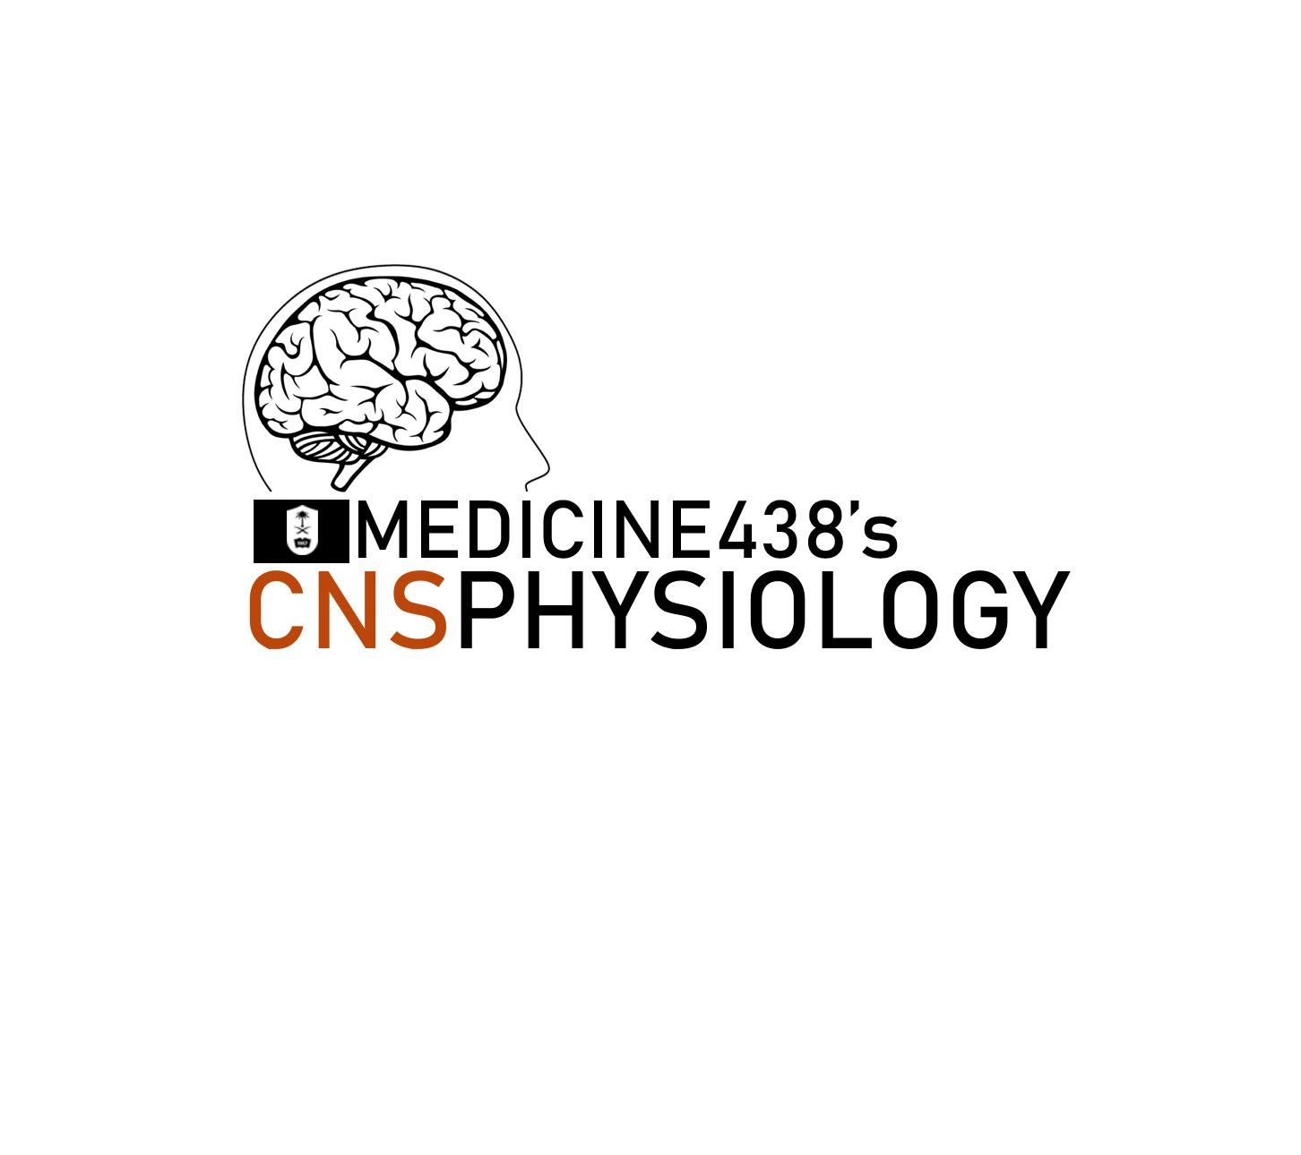
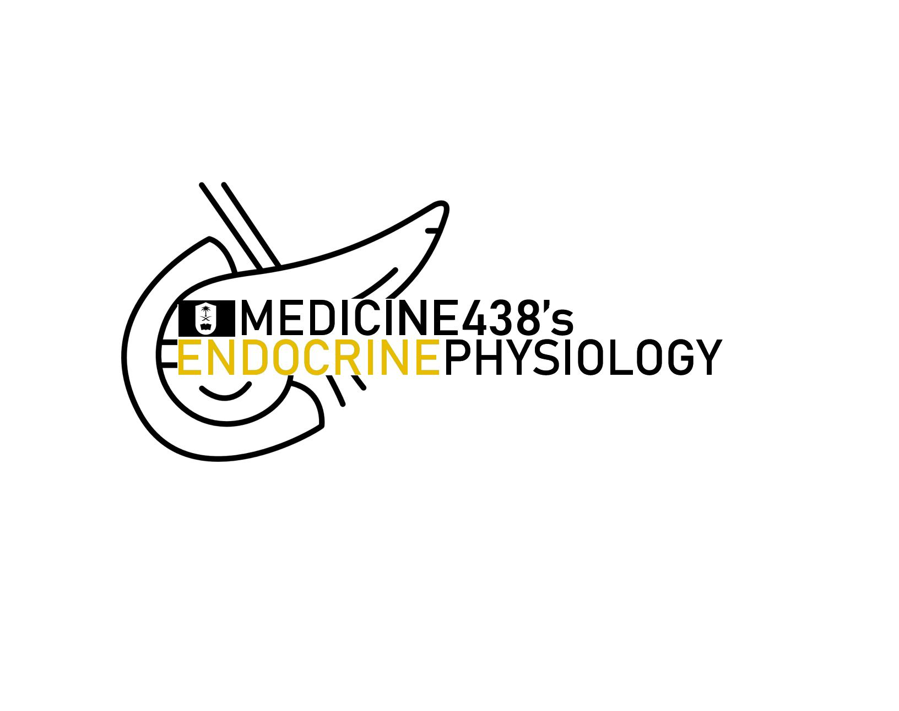
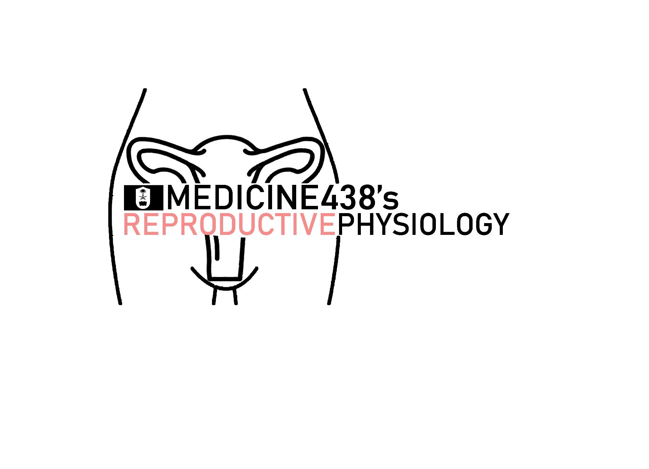
Thank you so much for partaking in this journey throughout the different blocks of this year, but most importantly thank you for contributing to the betterment of our team.
We're truly proud of the work we produced, a work that was further refined by your feedback, so we hope that you are equally proud of our work, as we were always making these lectures with the hidden eyes of the reader watching over us, reminding us to keep the lectures accessible and informative.
We’d like to express our warmest thanks to our marvellous team members for putting up with our demands and polishing them in their own unique manner:
Abdullah Alassaf - Abdullah Almuammar - Abdulrahman Alsayyed - Abdulrahman Bedaiwi - Amirah Aldakhilallah - Amirah Alzahrani - Arwa Alemam - Aued Alanazi - Deema Almaziad - Elaf Almusahel - Haifa Alessa - Haifa Alwaily - Hussain Alkharboush - Leena Alnassr - May Babaeer - Meshari Alzeer - Mohammed Alhumud - Mohammed Alqahtani - Mohammed Alshehri - Mohannad Alqarni - Naif Alsulais - Norah Alharbi - Nouf Alhumaidhi - Noura Alturki - Omar Aldossari - Rahaf Alshebri - Rakan Alfaifi - Rayan Almousa - Reema Almasoud - Sarah Alarifi - Sarah Alhelal - Savanna - Sedra Elsirawani - Shahad BinSelayem - Shahad Althaqeb - Shahd Alsalamh - Taibah Alzaid - Yazeed Almalki - Zyad Aldossari
Special thanks to our reviewers:
Njoud Alabdullatif for being a stupendous, indispensable addition to our teamwork, and for always shining in reviewing our lectures, gracing them into an unmatched level of excellence with unparalleled exquisiteness.
Our gratitude also extends to Nouf Alshammari for her superb additions to our lectures, embellishing them with wonderfully expressed, approachable and enlightening material.
We’d also like to thank the physiology team leaders of last year for paving the way for us and making our jobs exponentially easier, for the teamwork of last year exemplified excellence under their leadership:
Omar Alshenawy, Abdulrahman Alhawas, Elaf Almusahel, Sedra Elsirwani and of course our CNS co-leader Ghaliah Alnufaei.
And this wouldn’t be complete without thanking our partners throughout this entire year, Ibrahim Aldakhil, Razan AlRabah and The Hidden Reviewers, for their guidance proved invaluable in rectifying our oversights.
Farewell.
We also appreciate you guys taking the time and energy just to help the batch and that’s truly selfless and noble.
Stay hydrated, Have a good one,
-The hidden reviewers

Slide 11
Progesterone is mainly responsible for which of the following effects on the breasts?
Proliferation of ducts
Deposition of fat
Stimulate development of lobules
Deposition of stroma
Why is milk produced by a woman only after delivery, not before?
Levels of LH and FSH are too low during pregnancy to support milk production
High levels of progesterone and estrogen during pregnancy suppress milk production
Prolactin is not produced in significant amounts during pregnancy
High levels of oxytocin are required for milk production to begin, and oxytocin is not secreted until the baby stimulates the nipple.
Which of the following closely works with estrogen to cause ductal lengthening and growth of mammary glands?
GH
Progesterone
Prolactin
Thyroid hormone
During pregnancy, which of the following placental hormones is thought to be mainly responsible for the increased prolactin secretion?
Estrogen
Progesterone
TRH
CRH
When does the process of lactogenesis begin?
Before pregnancy
During pregnancy
After parturition
During the suckling reflex
ANSWER KEY: C, B, A, A, B

Slide 12
Shahd Alsalamh, Taibah Alzaid
Quiz Writer: Shahad Althaqeb
Co-editor: Nouf Alshammari
FEMALE PHYSIOLOGY CO-LEADERS
Maha Alnahdi, Taif Alshammari
MALE PHYSIOLOGY CO-LEADERS
Nayef Alsaber, Hameed M. Humaid
REFERENCES
Guyton and Hall Textbook of Medical Physiology
Ganong’s Review of Medical Physiology

