Slide 1
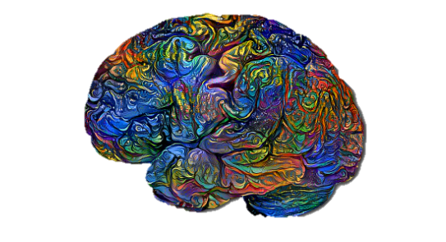
Psychological & Behavioral changes of Adolescence
{. . وَمَا تَوْفِيقِي إِلَّا بِاللَّهِ. . }
Objective | Color index
Know the adolescence definition. Know the physical changes in adolescence. Know the behavioral changes in adolescence. Know the emotional changes in adolescence. Know the cognitive changes in adolescence. Know the social changes in adolescence. | Black : Main content. Gray : Notes. Red : important.
Editing File
Team Leaders
Njoud Alali Abdullah shadid
boys slides
girls slides

Slide 2
What is Adolescence ?
Adolescence is a period of global¹ & pervasive changes and not a matter of developmental crisis.
Most of adolescents pass through it smoothly².
Averagely, it expands between 12 & 18³ years of age.
The period of adolescence lasts till the individual becomes a young man or woman (Bridge to the reproductive life).
Context of adolescent development: (Factors that can affect adolescence, the main factor depends on the individual.)
Family Friends & Peers School Media
Adolescents Development
Physical Development
Cognitive Development
Social Development
Emotional development
1- Physical Development
Puberty
Primary sexual characters (Gonadarche)
Secondary sexual characters (Breast development in females, deepening of voice in males)
Increased hormonal release (Secretion of Growth hormone, they always feel tired and sleepy)
Fast & disproportional growth (frequent falls and things easily slip because of the fast growth of long bones “arms, thighs”)
Health status (Bad health because of junk food and inappropriate sleeping)
Psychological consequences of physical changes: (Because of acne, disproportion, and other changes)
Embarrassment
Sensitivity to criticism
Social isolation
Sadness (Hormonal changes, ideas thinking about, always feeling bored)
Irritability
Means covering all the aspects of a person’s life.
Could be difficult because of (problems between parents, temperamental issues).
Some people earlier and others in the 20s.

Slide 3
2- Cognitive Development (The most important to psychiatrist)
IQ & special talents (They have stable IQ score, but they develop skills and talents).
Attention span & concentration (Increase in attention).
Perception & deep meanings (Thinking outside the box).
Memorizing (Relates things in memorizing).
Day-dreams (Stress relieving and future planning).
Formal operational thinking.
Idealism.
Independence.
Identity (Looking for an identity, what they want to be “interfering ideas”).
3- Social Development
“The conflict between the need to belong to a group and the need to be seen as unique and individual is the dominant struggle of adolescence “
Jeanne Elium
Social relationship during adolescence :
Relationship with parents (Conflict & less time spent with family to ensure independency).
Relationship with peers (Long talks)
4- Emotional development
Extreme & inconsistent
Impulsivity & recklessness
Anger outbursts & easily provocation
Looking for self-assertion
Authority resistance
Critical comments
Love & romance (In the middle of adolescence they try to talk about the opposite gender, in late adolescence they try to build a relationship with the opposite gender).
Skills needed preadolescence
Preparation Understanding Resilience Respect Friendship-Love expression Social skills
(values, self- discipline, taking responsibility)

Slide 4
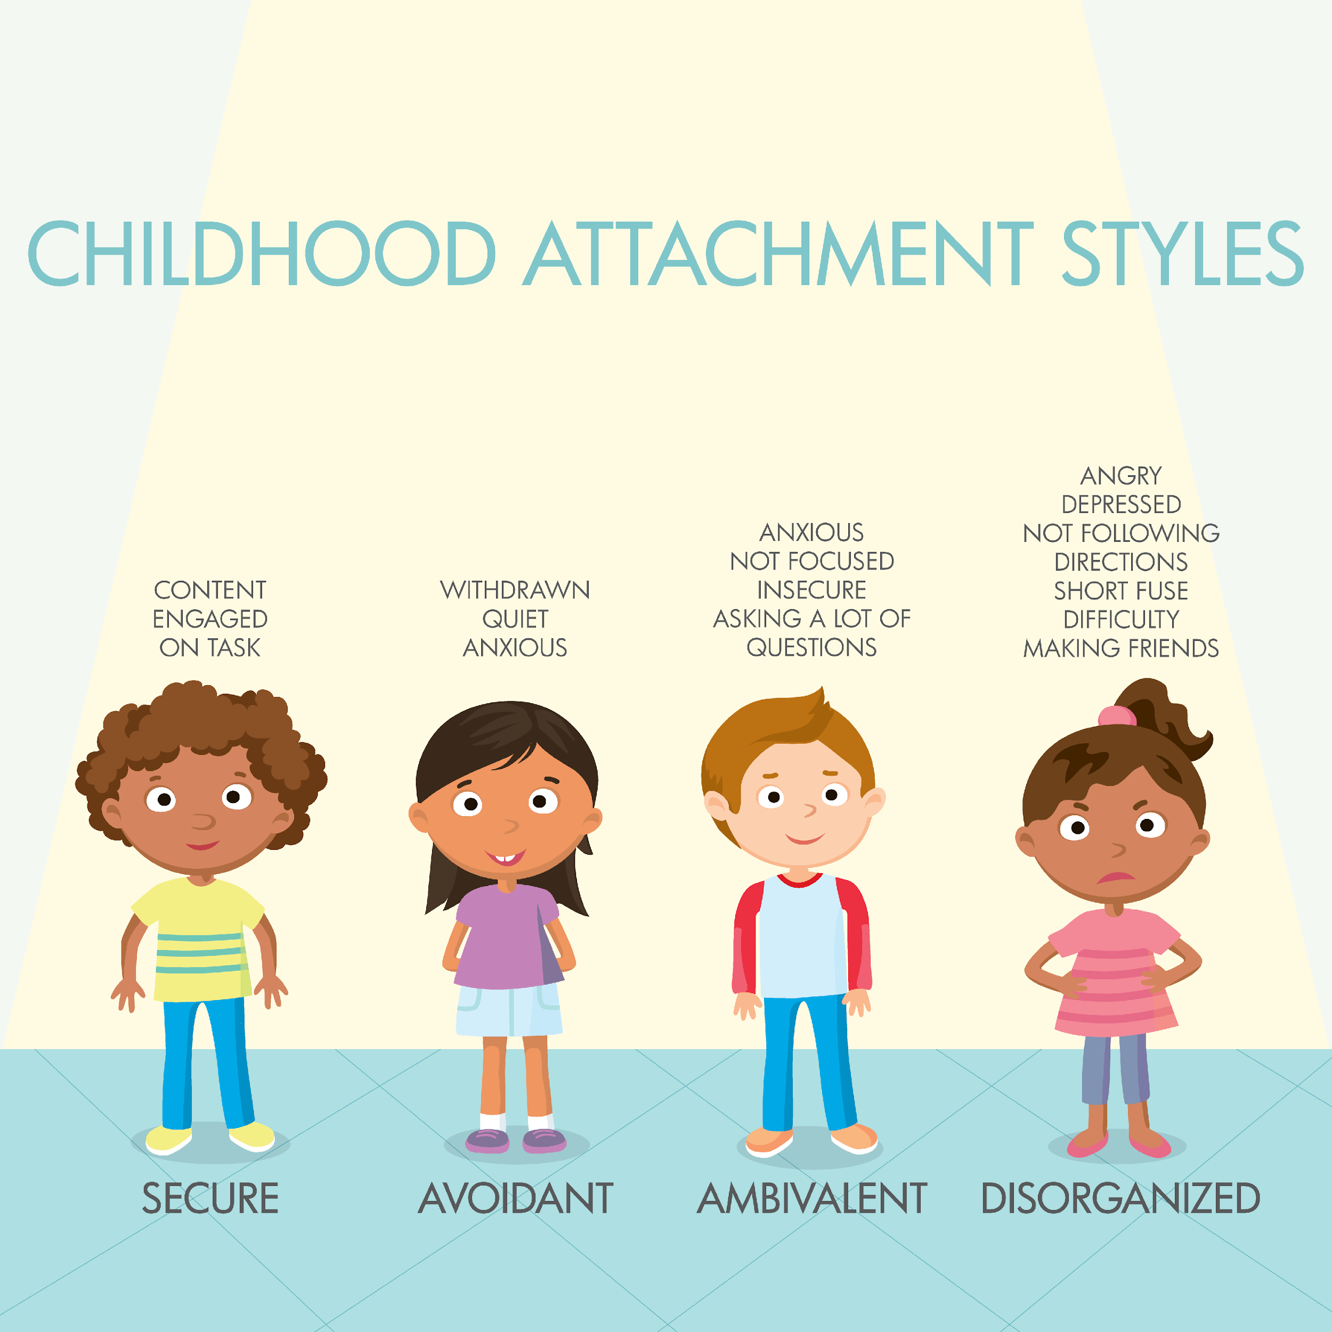
ATTACHMENT
Attachment: Emotional tone developed between a child and its caregiver, evidenced by seeking and clinging behavior, developed within one year.
Attachment behaviour: maintenance of physical contact between mother and child when child is hungry, frightened or in distress (coined by Bowlby)
Bonding: The intense emotional and psychological relationship a mother develops with her baby, often through early skin-to-skin contact. Diﬀers from attachment as mothers do not o=en seek out baby as source of security.
Temperament: Constitutionally based individual diﬀerences in emotion, motor reactivity and self- regulation that demonstrate consistency across situations and over time. Biologically based: hereditary, neural and hormonal factors aﬀect response to environment. Can be modulated by environmental factors and parental response
Attachment Styles
Secure
Children typically receive more consistent and developmentally appropriate parenting through most of their life. Believed to experience their caregivers as emotionally available and appear to be more exploratory and well adjusted. Parents are more likely to maintain these aspects through a divorce.
Insecure
Believed to result from a young child’s perception that the caregiver is not consistently available
Insecure/avoidant:
children are more anxious, clingy, and angry with parent. Parents themselves are often insecurely attached in their own families unable to provide consistency, emotional responsiveness, and care. Children have a difficult time with divorce, more likely to become rejecting
Insecure/ambivalent:
children generally raised with disorganized, neglecting and inattentive parenting. Parents even less able to provide stability after divorce. Children become clingy and inconsolable, act out, suffer mood swings and become oversensitive to stress.
Disorganized:
believed to be experiencing the need for proximity to the caregiver with apprehension in approaching the caregiver. Can appear to be “dazed” or apprehensive around caregiver.
Contributing Theorists To Attachment Theory
Harlow | Bowlby | Ainsworth
Studied social learning and effect of social isolation on rhesus monkeys. He placed newborn monkeys with a wire mother and feeding bottle and a terrycloth mother without feeding bottle (one variation). Monkeys spent more time with terrycloth mom except when hungry (and would return quickly after feeding). When they were frightened, they would show intense clinging behaviour and appeared to be comforted by terrycloth monkey, whereas those with wire mother gained no comfort and appeared disorganized. Results: infant attachment is not just secondary to feeding, all monkeys unable to adjust to life, had difficulty mating, and did not mother own children. | Suggested that attachment constituted a central motivating force and that mother-child attachment was an essential medium of human interaction Believed attachment had important consequences for later development and personality functioning Coined term “attachment behaviour” Believed attachment was essentially “monotropic” but that an infant could form attachment to father and other caregivers as well | Found that interaction between mother and baby during attachment period signiﬁcantly inﬂuences baby’s current and future behaviour Conﬁrmed that attachment serves to reduce anxiety in strange situation procedure Secured base effect enables a child to move away from the attachment ﬁgure and explore the environment Maternal sensitivity and responsiveness: main determinants of secure attachment Infant temperament: main determinant of type of insecurity (avoidant, anxious and ambivalent) Found male infants are less likely to have secure attachments and are more vulnerable to changes in maternal sensitivity than female infants Found the attachment of ﬁrstborn child is decreased by the birth of a second, but it is decreased much more if the ﬁrstborn is 2-5 years of age when the younger sibling is born. Also depends on mother’s own sense of security, conﬁdence and mental health. According to Ainsworth, disorganization is a severe form of insecure attachment and a possible precursor of severe personality disorder and dissociative phenomena in adolescence and early adulthood

Slide 5
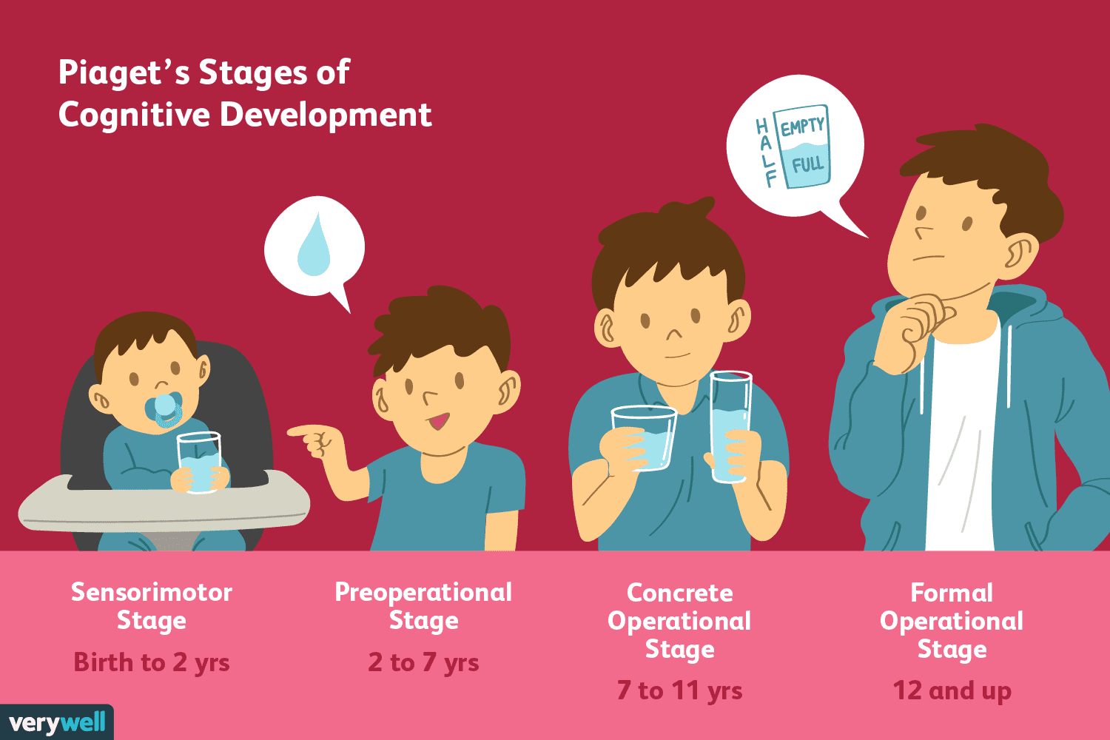
Piaget’s Stages Of Cognitive Development
THEORIES
Period of Development | Cognitive Spatial Stages | Cognitive Achievements
Gestational |  | Fetus can “learn” sounds and respond diﬀerently to them after birth
Infancy: Birth to 2 years Birth – 1 month 4 – 8 months 8 – 12 months 12 – 18 months 18 months – 2 years | Sensorimotor Reﬂective, egocentric (refuted by current research) Secondary circular: looks for objects partially hidden Secondary circulation coordinated: peek-a-boo, ﬁnds hidden objects Tertiary circular; explores properties and drops objects Mental representation, make-believe play, memory of objects | Infants “think with their eyes, ears and senses” Can learn to associate stroking with sucking Can learn to suck or to produce certain visual displays to music Can remember for one-month periods Memory improves Body parts used as objects Can stack one object within another Remembers hidden objects Drops objects over crib Knows animal sounds, names objects
Early Childhood: 2-5 y | Preoperational Egocentrism – “I want you to eat this too” Animistic: “I’m afraid of the moon” Lack of hierarchy: “where do these blocks go?” Centration: “I want it now, not a=er dinner” Irreversibility: “I don’t know how to go back to that room” Transductive reasoning: “we have to go that way because that’s the way daddy goes” | Preschoolers use symbols Development of language and make-believe No sign of logic 3y – can count 2-3 objects, know colors and age 4y – can fantasize without concrete props 5-6y – get humor, understand good and bad, can do some chores
Middle childhood 6-11 y | Concrete operational Hierarchical classiﬁcation – arrange cars by types Reversibility – can play games backward and forward Conservation – lose two dimes and look for same Decentration – worry about small details, obsessive Spatial operations: likes models for directions Horizontal decalage – conservation of weight, logic Transitive inference – syllogisms, compare everything, brand names important | Children begin to think logically 7-11y – good memory, recall, can solve problems Understand conservation of matter (frozen milk same as melted) Can organize objects into hierarchies Children seem rational and organized
Adolescence: 11-19y | Formal operational Hypothetical-deductive reasoning: adolescent quick thinking or excuses Imaginary audience: everybody is looking at them Personal fable: inﬂated opinion of themselves Propositional thinking: logic | Abstraction and reason Can think of all possibilities
The Piaget stages of development is a blueprint that describes the stages of normal intellectual development, from infancy through adulthood. This includes thought, judgment, and knowledge. The stages were named after psychologist and developmental biologist Jean Piaget, who recorded the intellectual development and abilities of infants, children, and teens.
Mahler’s Separation-individuation (not important)
Normal autism (birth-2 mos)
Periods of sleep outweigh periods of arousal in a state reminiscent of intrauterine life.
Symbiosis (2-5 mos)
Developing perceptual abilities gradually enable infants to distinguish the inner from the outer world; mother-infant is perceived as a single fused entity.
Diﬀerentiation (5-10 mos)
Progressive neurological development and increased alertness draw infants' attention away from self to the outer world. Physical and psychological distinctiveness from the mother is gradually appreciated.
Practicing (10-18 mos)
The ability to move autonomously increases children's exploration of the outer world.
Rapprochement (18-24 mos)
As children slowly realize their helplessness and dependence, the need for independence alternates with the need for closeness. Children move away from their mothers and come back for reassurance.

Slide 6
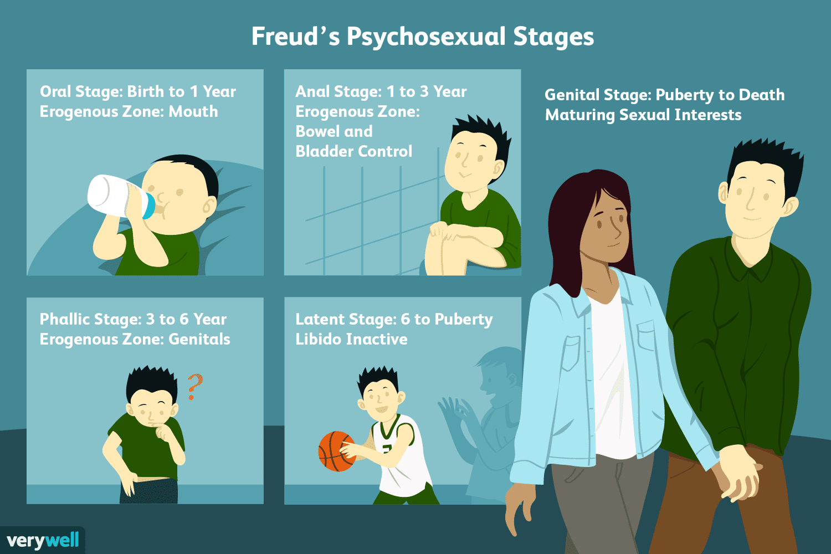
Erik Erikson's theory of psychosocial development
THEORIES
Psychosexual Development Theory by Freud
Comparison Of Stages Of Development
Instinctual Phases | Separation-Individuation | Object Relations | Psychosocial Crises(Erikson)
Oral | Autism, symbiosis | Primary narcissism, need-satisfying | Trust or mistrust
Anal | Diﬀerentiation, practicing, rapprochement | Need-satisfying, object constancy | Autonomy or shame, self-doubt
Phallic | Object constancy, Oedipal complex | Object constancy, ambivalence | Initiative or guilt
Latency | - | - | Industry or inferiority
Adolescence | Genitality, secondary individuation | Object love | Identity or identity confusion
Adulthood | Mature genitality | - | Intimacy or isolation, generativity or stagnation, integrity or despair

Slide 7
Quiz
Answers Key!
1.B 2.A 3.C 4.B 5.B 6.A 7.C 8D
1- Which of the following is false regarding cognitive development?
Adolescents develop skills.
IQ level increases with adolescence.
Thinking outside the box.
Independency.
2- Which one of the following is a primary sexual character?
Gonadarche
Axillary hair growth
acne
voice change
3- The cause of sadness in adolescents?
Weight loss
Disease
Hormonal changes
Family support
4- Adolescents prefer to spend more time with family?
True
False
5- Which one of the following characteristics of cognitive development happen during adolescence? A. Decrease in attention and concentration
B. Day dreaming C. Increase intelligence D. Authority obedience
6-Which one of the following is related to emotional development in adolescence? A. Easily provocation
B. Less emotion C. Consistent emotions
D. Concrete thinking
7-What is the age of adolescent?
A. 12-20
B. 5-18
C. 11-19
D. 15-24
C
8- A 13 years old girl is seeing herself as an obese and ugly girl. Despite that, she is often going out with her friends, she has a good appetite and has no problem with her sleeping. The girl is?
A. Depressed
B. OCPD
C. Has low thyroid hormone secretion
D. Showing normal teenage behavior
Good luck!

