Slide 1
Organization of The Nervous System

Slide 2
Objectives
At the end of the lecture, the students should be able to:
List the parts of the nervous system.
List the function of the nervous system.
Describe the Structural & Functional Organizations.
Define the terms:
Nervous tissue, grey matter, white matter, nucleus, ganglion, tract, nerve.
List the parts of the brain.
List the structures protecting the central nervous system.

Slide 3
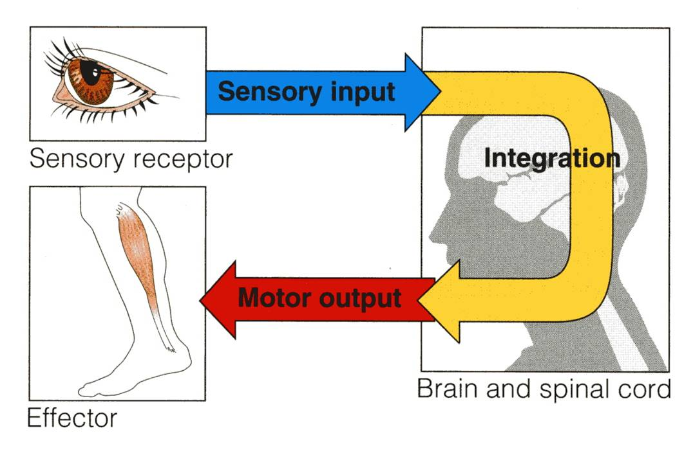
How does the nervous system work ?
The nervous system has three functions:
Collection of sensory input:
Identifies changes occurring inside or outside the body by using sensory receptors. These changes are called stimuli.
Integration:
Processes, analyzes , and interprets these changes and makes decisions.
Motor output, or response by activating muscles or glands (effectors).

Slide 4
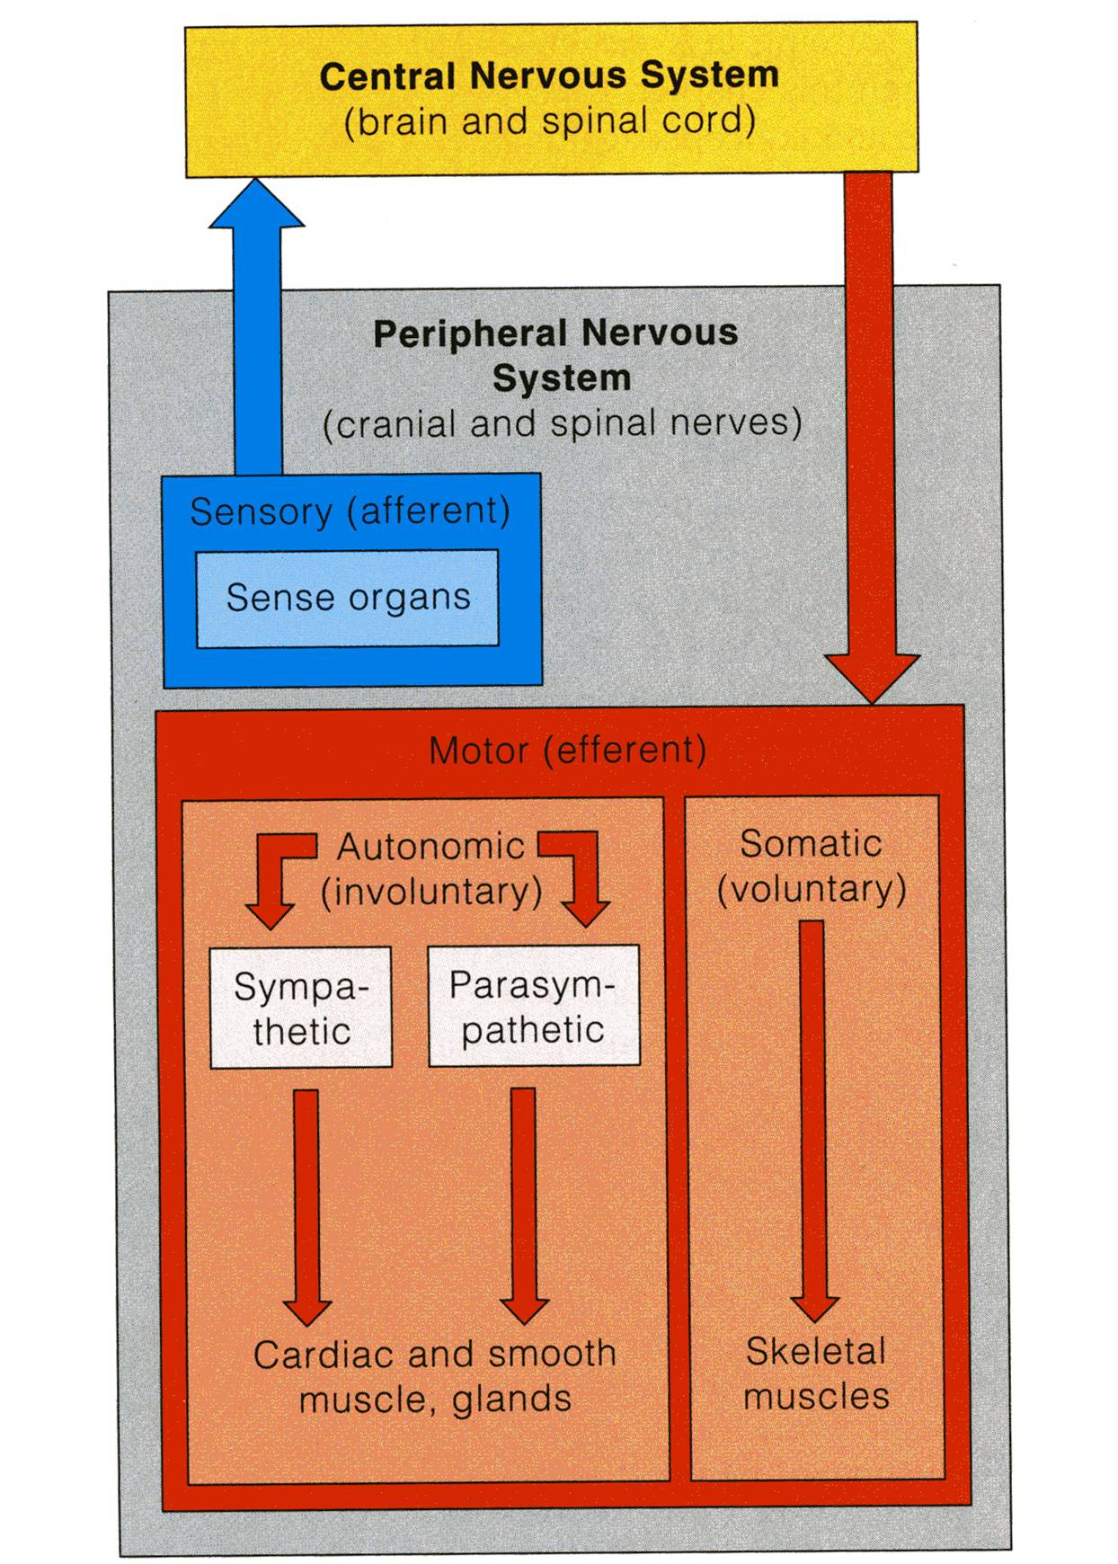
CLASSIFICATION
I- Anatomical or Structural classification:
1- Central NS
2- Peripheral NS
Physiological or Functional classification:
1-Sensory division (Afferent)
2-Motor division (Efferent)
- Autonomic
- Somatic

Slide 5
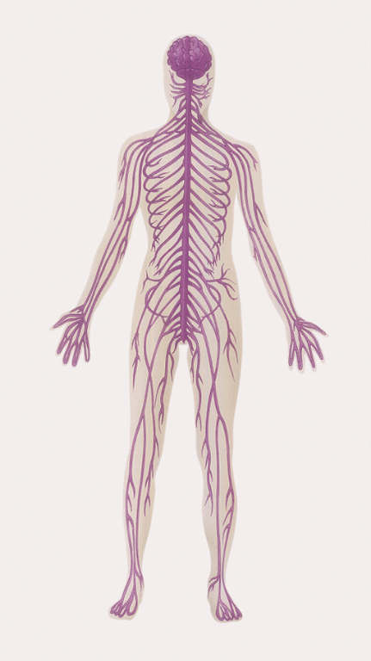
Structural Organization
Two subdivisions:
Central Nervous System (CNS)
Consists of Brain & Spinal cord
Occupies the dorsal body cavity
Acts as the integrating and command centers.
Peripheral Nervous System (PNS)
Consists of nerves, ganglia, receptors.
It is the part of the nervous system outside the CNS.

Slide 6
Functional Organization
Two subdivisions:
Sensory or Afferent division:
Consists of nerve fibers that convey impulses from receptors located in various parts of the body, to the CNS.
Motor or Efferent division:
Consists of nerve fibers that convey impulses from the CNS to the effector muscles, organs, and glands.
The sensory and motor division are subdivided into :
Somatic division: concerned with skin, skeletal muscles and joints.
Autonomic division: concerned with the visceral organs.

Slide 7
The Nervous System
It is the major controlling, regulatory & communicating system in the body.
It is the center of all mental activity including :
Thought,
Learning,
Behavior and
Memory.
Together with the endocrine system, the nervous system is responsible for regulating and maintaining homeostasis.

Slide 8
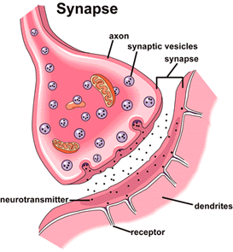
Nervous Tissue
Nervous system is composed of nervous tissue, which contains two types of cells:
1- Nerve cells or neurons
2- Supporting cells or neuroglia (glia).
Nervous system contains millions of neurons that vary in their shape, size, and number of processes.
The junction site of two neurons is called a “synapse or relay”.
In the synapses the membranes of adjacent cells are in close apposition (contiguity=contact, not continuity).

Slide 9
Neurons What is neuron?
It is the basic structural (anatomical), functional and embryological unit of the nervous system.
The human nervous system is estimated to contain about 10¹⁰.

Slide 10
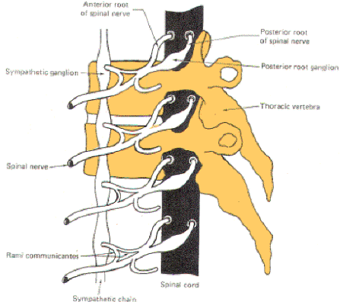
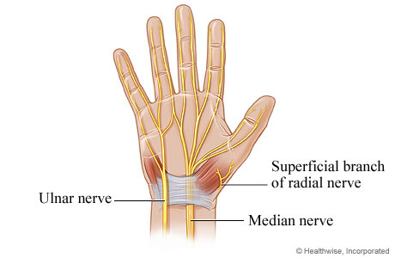
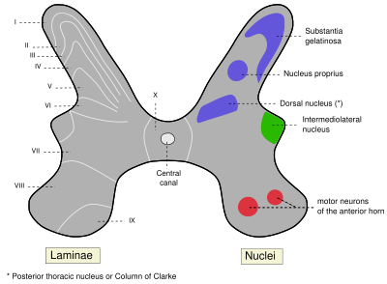
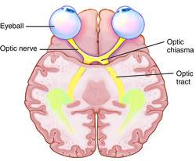
Remember…
Ganglion= A group of neurons outside the CNS
Nerve =A group of nerve fibers (axons) outside the CNS
Nucleus= A group of neurons within the CNS
Tract =A group of nerve fibers (axons) within the CNS

Slide 11
Nervous tissue is organized as:
Grey matter, Which contains 1- Cell bodies &
2- Processes of the neurons,
3- Neuroglia and
4- Blood vessels.
White matter, Which contains:
1- Processes of the neurons
2- Neuroglia and
3- Blood vessels
NO cell bodies in the white matter.

Slide 12
Neuroglia or glia or glial cells
Neuroglia, or glial cells constitute the other major cellular component of the nervous tissue.
It is a specialized connective tissue supporting framework for the nervous system.
Unlike neurones, neuroglia do not have a direct role in information processing but they are essential for the normal functioning of the neurons, they act as supporting and nutrition for neurons.

Slide 13
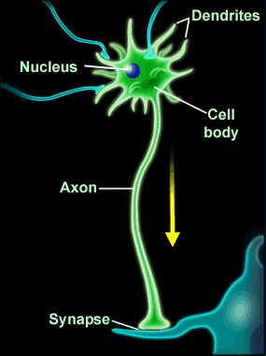
Most of the processes of the cell body are short with variable numbers and are receptive in function.
They are known as Dendrites.

Slide 14
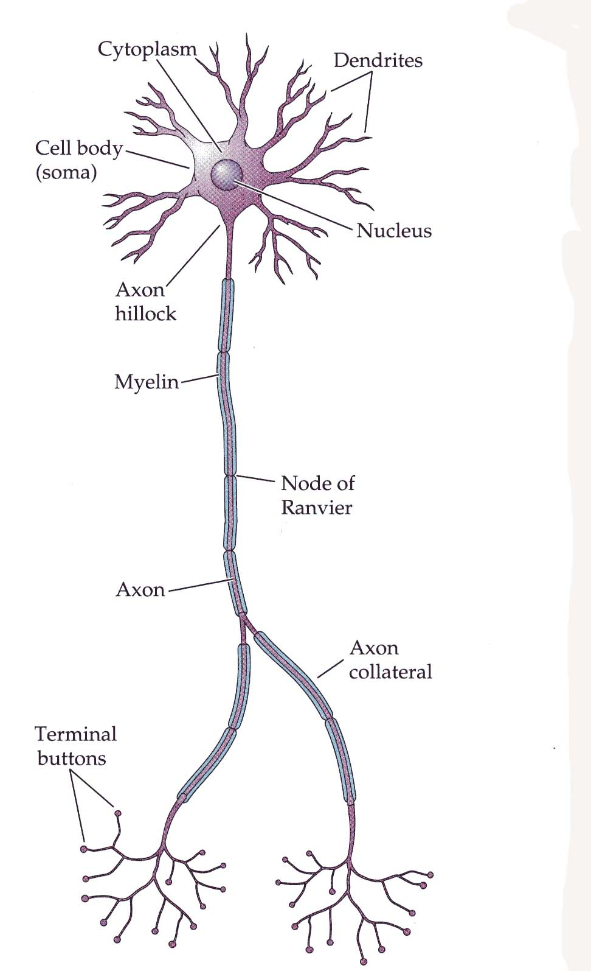
One of these processes leaving the cell body is called the axon which carries information away from the cell body.
Axons are highly variable in length and may divide into several branches or collaterals through which information can be distributed to a number of different destinations.
At the end of the axon, specializations called terminal buttons occur.
Here information is transferred to the dendrites of other neurones.

Slide 15
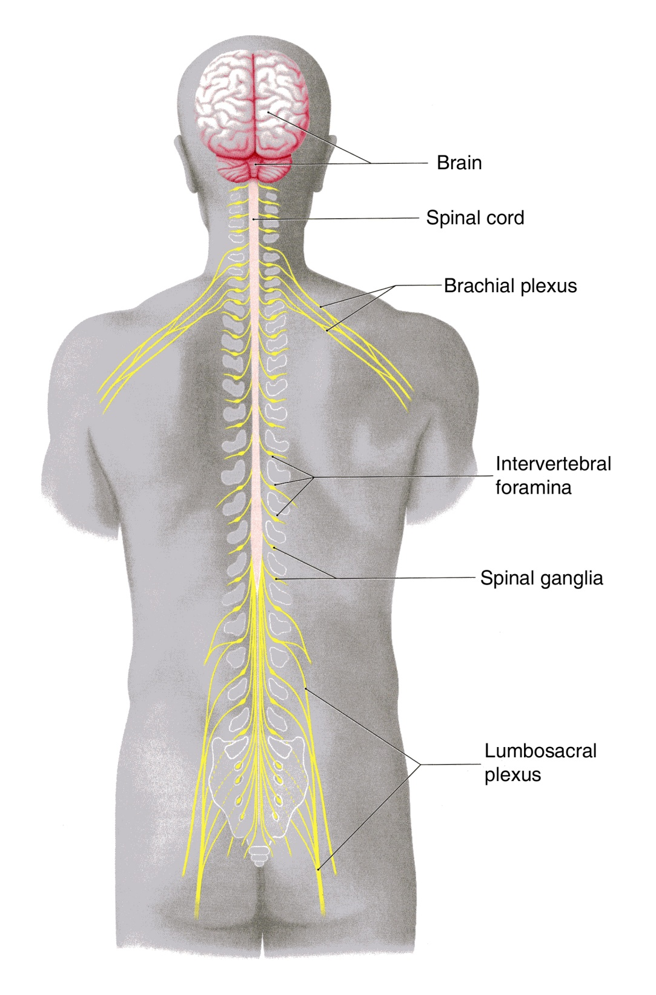
Peripheral NS
Spinal nerves supplying the upper or lower limbs form plexuses e.g. brachial or lumbar plexus.
Nerve cell bodies that are aggregated outside the CNS are called GANGLIA

Slide 16
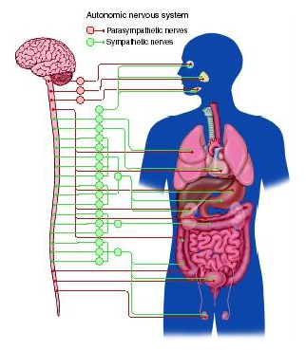
Autonomic Nervous System
Neurones that detect changes and control the activity of the viscera are collectively referred to as the autonomic nervous system.
Its components are present in both the central and peripheral nervous systems.

Slide 17
SYMPATHETIC & PARASYMPATHETIC SYSTEMS
The autonomic nervous system is divided into two anatomically and functionally distinct parts:
Sympathetic: Or Thoracolumbar outflow
Parasympathetic: Or Craniosacral outflow.
Sympathetic and parasympathetic , divisions are generally have antagonistic effects on the structures that they innervate.
E.g. Sympathetic increases the heart rate, while the parasympathetic decreases the heart rate.

Slide 18
The autonomic nervous system innervates:
Smooth muscles,
Cardiac muscle,
Secretory glands.
It is an important part of the homeostatic mechanisms that control the internal environment of the body with the endocrine system.

Slide 19
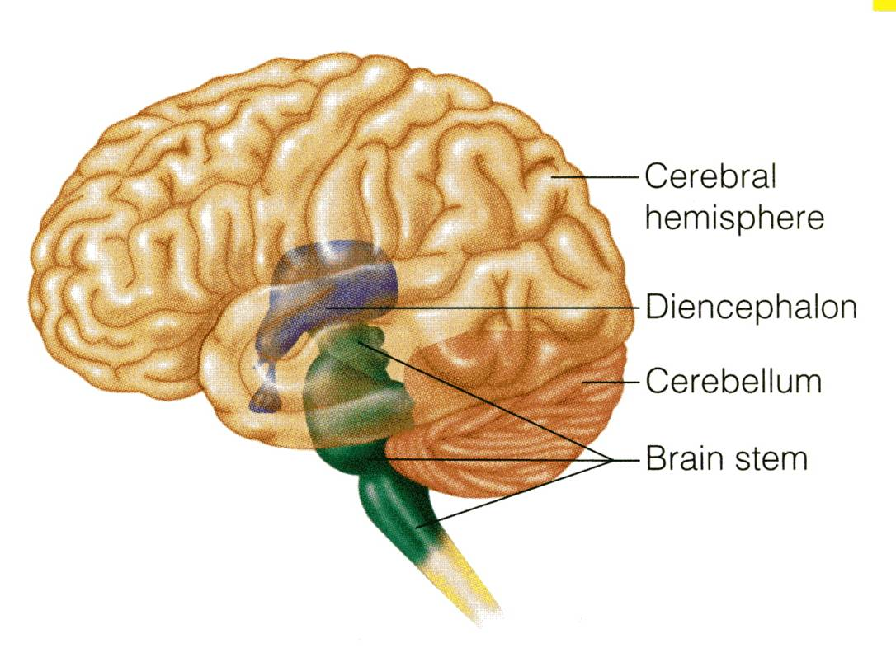
PARTS OF THE BRAIN
The brain composed of 4 parts:
Cerebral hemispheres
Diencephalon
Cerebellum
Brain stem

Slide 20
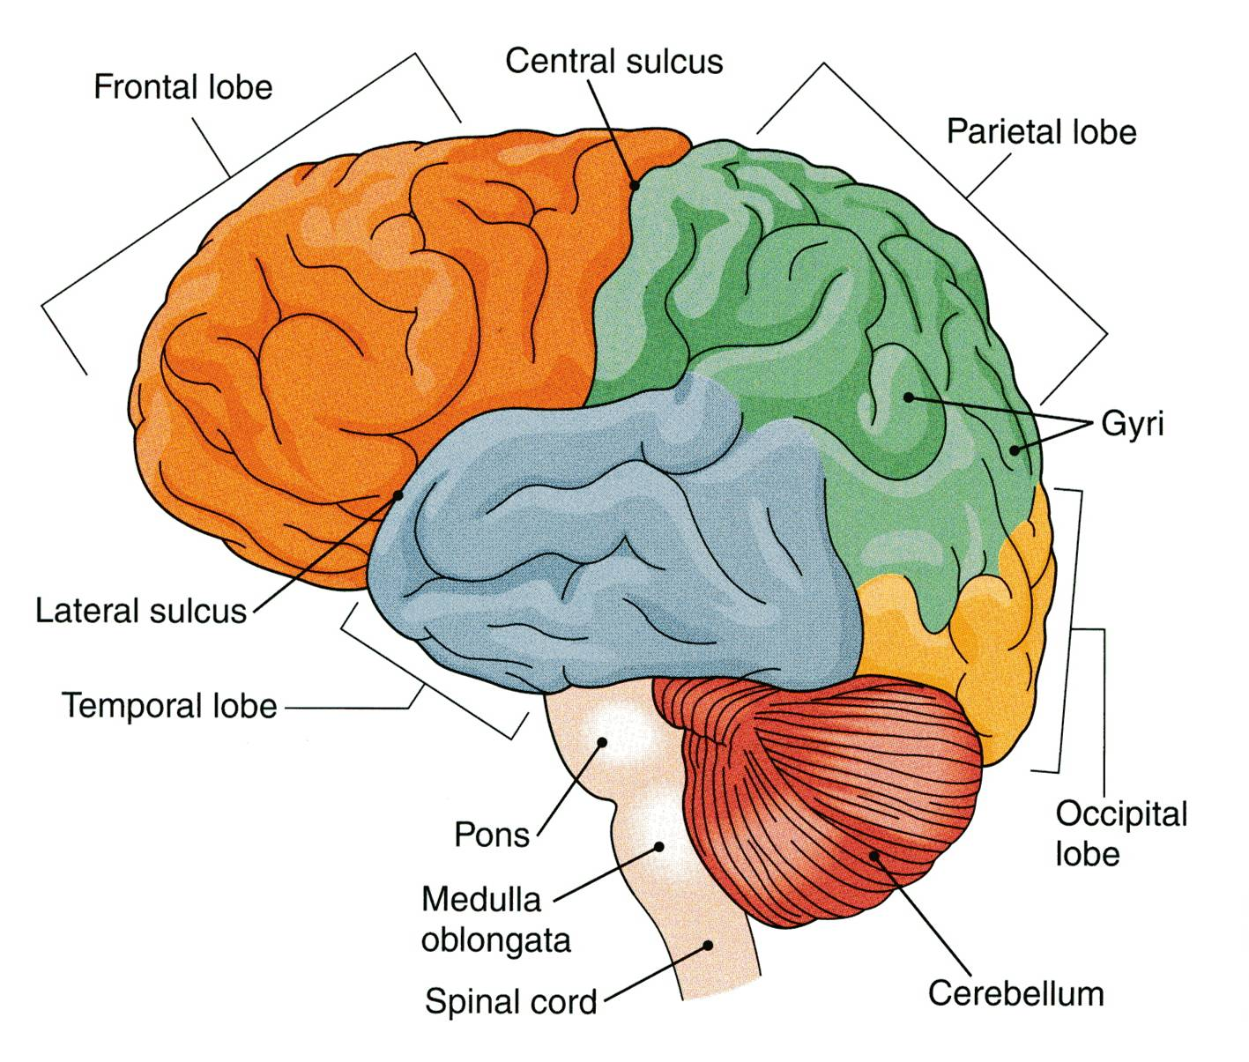
CEREBRAL HEMISPHERES
The largest part of the brain.
They have elevations, called gyri.
Gyri are separated by depressions called sulci.
Each hemisphere is divided into 4 lobes named according to the bone above.
Lobes are separated by deeper grooves called fissures or sulci.

Slide 21
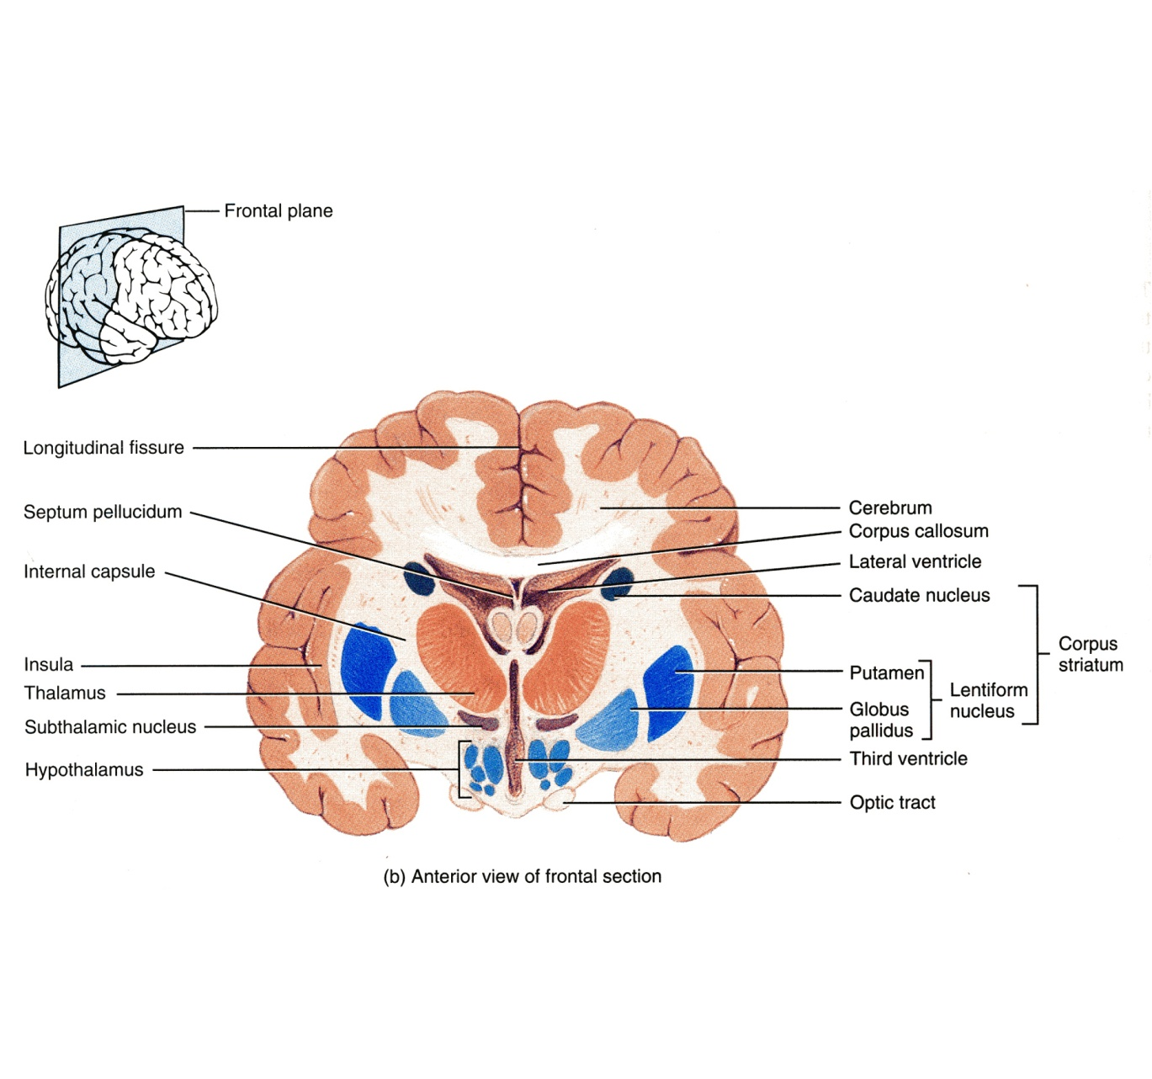
TISSUE OF THE CEREBRAL HEMISPHERES
The outer layer is the gray matter or cortex
Deeper is located the white matter, or medulla, composed of bundles of nerve fibers, carrying impulses to and from the cortex
Basal nuclei are gray matter that are located deep within the white matter
They help the motor cortex in regulation of voluntary motor activities.

Slide 22
DIENCEPHALON
The diencephalon is located between the 2 cerebral hemispheres and is linked to them and to the brainstem.
The major structures of the diencephalon are the Thalamus, Hypothalamus, Subthalamus and Epithalamus.

Slide 23
BRAIN STEM
The brainstem has three parts: midbrain, Pons and medulla oblongata.
It is connected to the cerebellum with
3 paired peduncles
Superior, middle and inferior

Slide 24
CEREBELLUM
Cerebellum has 2 cerebellar hemispheres with convoluted surface.
It has an outer cortex of gray matter and an inner region of white matter.
It provides precise coordination for body movements and helps maintain equilibrium.

Slide 25
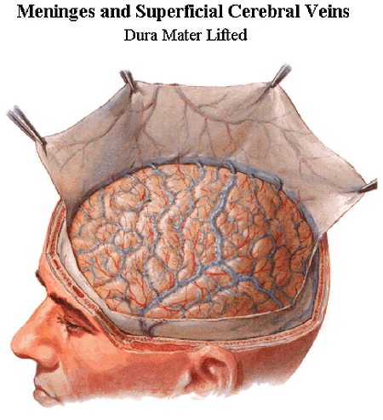
MENINGES
There are three connective tissue membranes invest the brain and the spinal cord.
These are from outward to inward are:
1- Dura mater.
2- Arachnoid mater.
3- Pia mater.

Slide 26
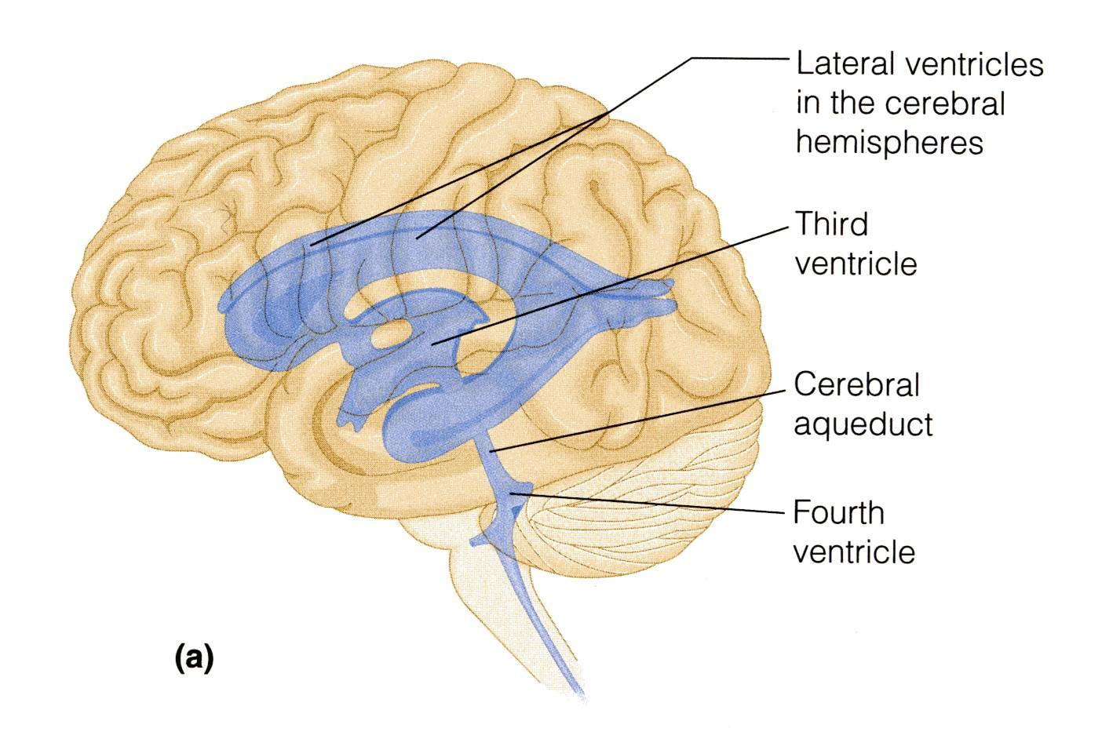
BRAIN VENTRICLES
Brain is bathed by the cerebrospinal fluid (CSF).
Inside the brain, there are 4 ventricles filled with CSF.
The 4 ventricles are:
2 lateral ventricles:
One in each hemispheres.
3rd ventricle:
in the Diencephalon.
4th ventricle:
between Pons, Medulla oblongata & Cerebellum.
N.B. Cerebral aqueduct: connects the 3rd to the 4th ventricle.

Slide 27
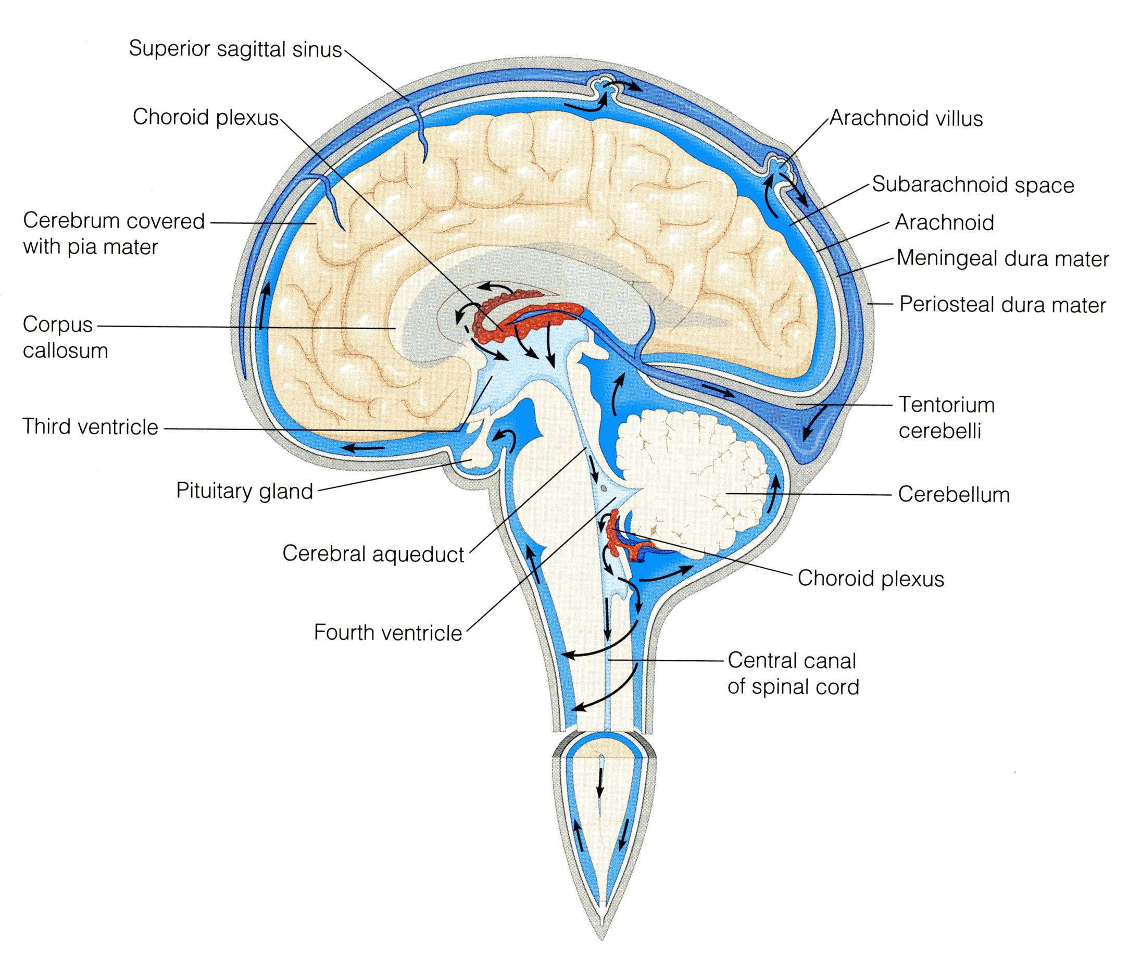
CEREBROSPINAL FLUID
CSF is constantly produced by the choroid plexuses inside
1-third ventricle
2-fourth ventricle
3- lateral ventricle
Inside the brain, CSF flows from the lateral ventricles to the 3rd and 4th ventricles
From the 4th ventricle, part of the CSF flows down in the central canal of the spinal cord.
Most of the CSF drains from the 4th ventricle through the three apertures of the 4th ventricle to distribute in the subarachnoid space around the brain and returns to the dural venous sinuses through the arachnoids villi.

Slide 28
GOOD LUCK

