Slide 1
Development of Spinal Cord & Vertebral Column
Department of Anatomy
King Saud University
Dr Sameerah Shaheen
Assistant Professor Anatomy
sshahee@ksu.edu.sa
20 September 2020
1

Slide 2
OBJECTIVES
At the end of the lecture, students should be able to:
Describe the development of the spinal cord from the neural tube.
List the layers of the spinal cord and its contents.
List subdivisions of mantle & marginal zones.
List meningeal layers and describe positional changes of spinal cord.
Describe development of vertebral column from sclerotomic portion of paraxial mesoderm.
Describe chondrification & ossification stages in vertebral development.
Describe spina bifida and its types.
2

Slide 3
Second Week
Epiblast
Hypoblast
Amniotic cavity
Yolk sac cavity
3

Slide 4
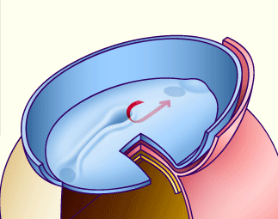
Third Week
Primitive node
Primitive streak
Intra embryomic mesoderm
Notochord
4

Slide 5
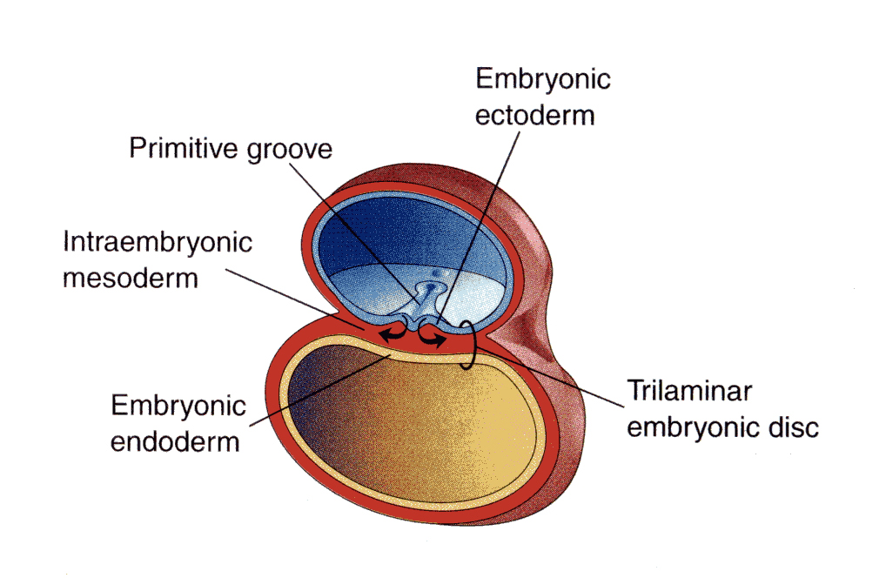
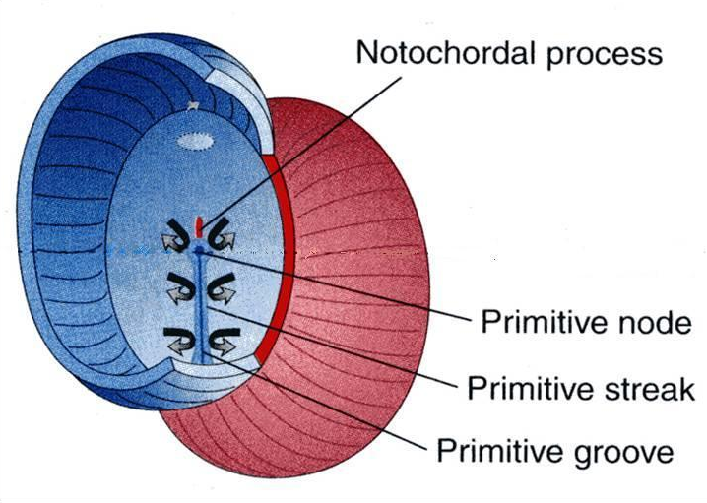
The Three Germ Layers
Ectoderm
Mesoderm
Endoderm
Amniotic
cavity
Notochord stimulates neural tube formation which in turn stimulates development of the vertebral column.
Yolk sac
The Neural Tube is a derivative of the ectoderm
5

Slide 6
Neural Tube
Arises from the ectoderm overlying
the notochord
Gives rise to the brain and
the spinal cord
Cervical flexure
Cephalic flexure
6

Slide 7
Neural Tube Formation
The notochord induces the
ectoderm above it which
thickens to form the neural plate
The neural plate folds to
form neural groove with
prominent neural folds
The neural folds approaches
each others with deepening
of the neural groove
7

Slide 8
Neural Tube Formation
The neural folds fuse and
a neural tube is formed
The tube then separates
from the overlying ectoderm
8

Slide 9
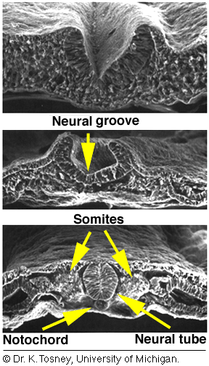
Neural Tube Formation
9

Slide 10
Neural Tube Closure
Closer of the neural tube
begins in the future neck
region (4th somite)
Then proceeds cranially
and caudally
10

Slide 11
Neural Tube Closure
The most cranial and caudal
ends of the tubes still open as
Anterior neuropores
Posterior neuropores
The anterior pore will close at
day 25 lamina terminalis
The posterior pore closes at day 27
The lumen of the tube ventricles of the brain and central canal of spinal cord
11

Slide 12
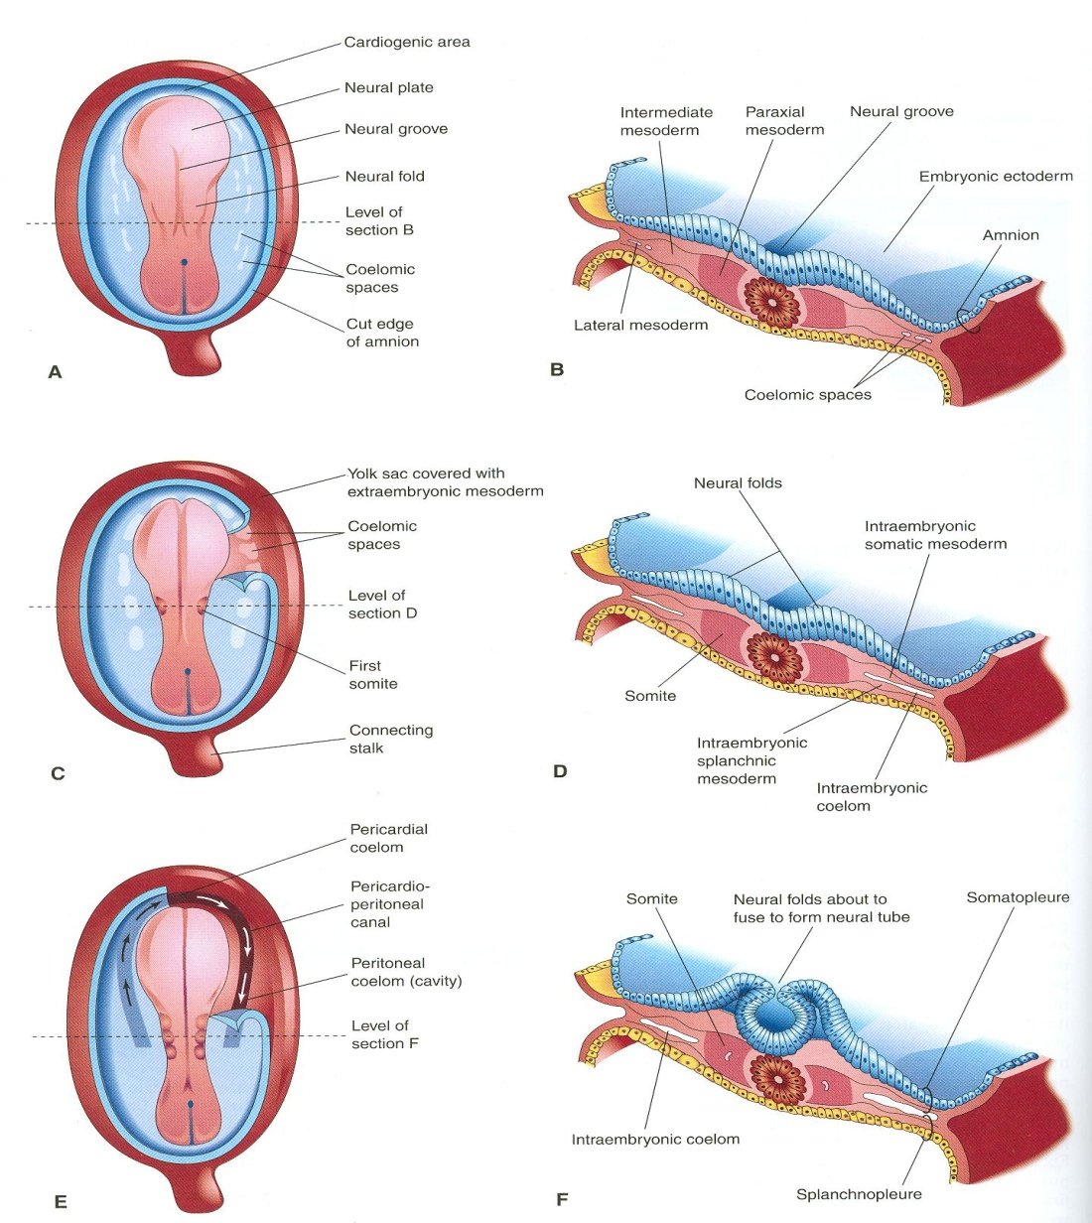
Development of Neural Tube
Ectodermal cells dorsal to notochord thicken to form the neural plate.
A longitudinal groove, neural groove, develops in the neural plate.
The margins of the neural plate (neural folds) approach to each other and fuse to form the neural tube.
12

Slide 13
Development of the Spinal Cord
The spinal cord develops from the caudal 2/3 of the neural tube
13

Slide 14
Layers of the spinal cord :
The cells of the neural tube are arranged in three layers :
An inner ventricular zone of undifferentiated cells
A middle mantle zone of cell bodies of neurons (future grey matter)
An outer marginal zone of nerve fibers or axons of neurons (future white matter)
14

Slide 15
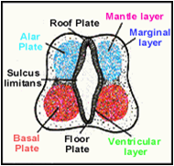
Development of the Spinal Cord (Mantle Layer)
Neurons of mantle layer (future grey matter) differentiate into :
A dorsal alar plate (future dorsal horn): containing sensory neurons
A ventral basal plate (future ventral horn): containing motor neurons
The 2 areas are separated by a (sulcus limitans).
15

Slide 16
Dorsal median septum
Central canal
Ventral median fissure
Proliferation and bulging of both alar & basal plates result in:
Formation of dorsal median septum
Formation of ventral median fissure
Narrowing of the lumen of the neural tube to form a small central canal
16

Slide 17
Development of the Spinal Cord (Marginal Layer)
Dorsal
funiculus
Lateral
funiculus
Ventral
funiculus
The marginal layer (future white matter) increases in size due to addition of ascending, descending & intersegmental nerve fibers & is divided into : dorsal, lateral and ventral funiculi
Myelination of nerve fibers starts at 4th month & continues during the 1st postnatal year. Motor fibers myelinate before sensory fibers. So, After a nerve injury, both motor and sensory axons have the ability to regenerate and, given a proper pathway.
17

Slide 18
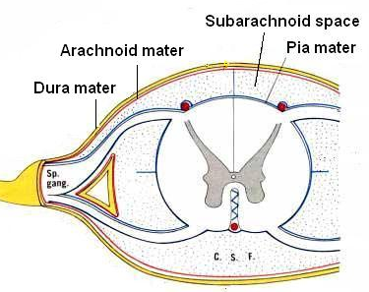
Meninges
These are 3 membranes covering the neural tube:
Outer thick dura mater: MESODERMAL in origin
Middle arachnoid mater & Inner thin pia mater are ECTODERMAL in origin
A cavity appears between the arachnoid & the pia mater (subarachnoid space) & becomes filled with cerebrospinal fluid (CSF).
18

Slide 19
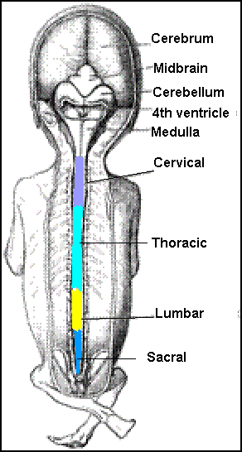
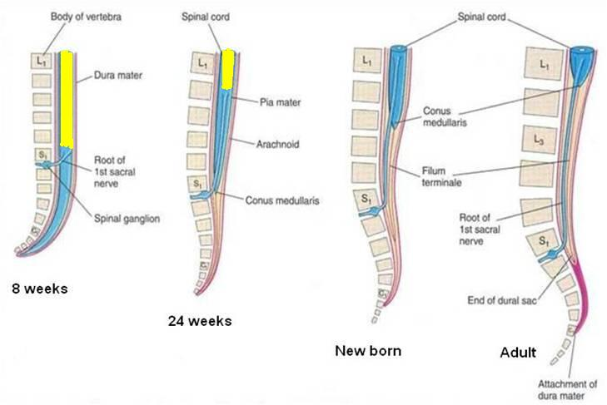
Positional Changes of Spinal Cord
Initially, the spinal cord occupies the whole length of the vertebral canal.
As a result a faster growth of vertebral column, the caudal end of spinal cord (conus medullaris) shifts gradually to a higher level.
Spinal Cord Positioning
Spinal Cord Positioning
L2
L3
19

Slide 20
Spinal Cord Positioning
@ 3rd month same length as vertebral canal
@ birth spinal cord
terminates at 3rd lumbar
vertebra
@ adult spinal cord
terminates at L1
20

Slide 21
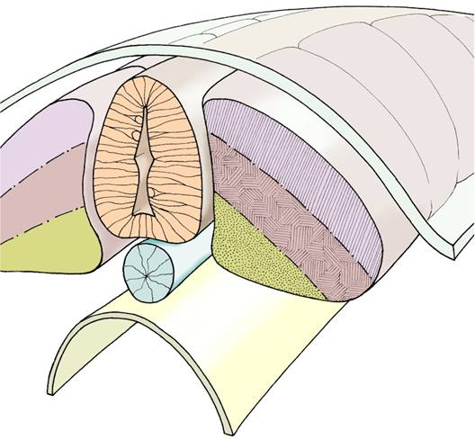
Development of the Vertebral Column
The vertebral column develops from the ventromedial parts (sclerotomes) of the somites
The somites develop from the para-axial mesoderm.
21

Slide 22
Specialization of Mesoderm
Appearance of the
notochord (first sign)
Three collections of the
mesoderm appear lateral to
the notochord
Somites
Intermediate mesoderm
Double sheets of lateral plate mesoderm
22

Slide 23
Intraembryonic Mesoderm
Located between Ectoderm & Endoderm EXCEPT in the central axis of embryo where NOTOCHORD is found.
Differentiates into 3 parts:
Paraxial mesoderm
Intermediate mesoderm
Lateral mesoderm
Paraxial mesoderm divides into segments called ‘somites’.
Each somite divides into 3 parts:
Dermatome
Myotome
Sclerotome
NT
1
2
3
N
Gut
somites
23

Slide 24
Specialization of Mesoderm
Each one of somites divide into
3 parts:
Sclerotome: form the
vertebrae & ribs
Dermatome: forms the
dermis of the skin on the
dorsal part of the body
Myotome: forms the skeletal
muscles of the neck, trunk & limbs
24

Slide 25
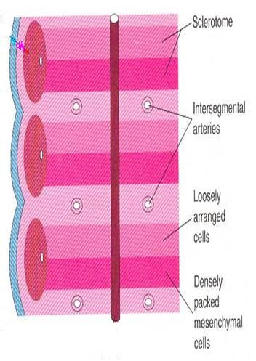
Formation of Body of Vertebra
At 4th week, each sclerotome becomes subvidided into two parts :
an cranial part, consisting of loosely arranged cells
a caudal part, of more condensed tissue.
25

Slide 26
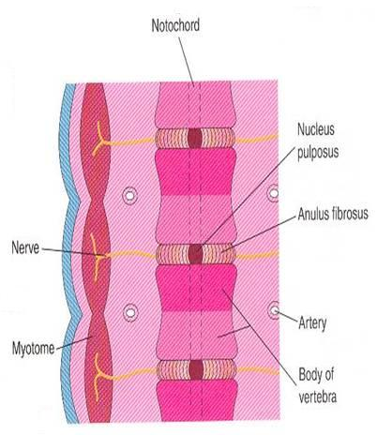
Formation of Body of Vertebra
The caudal part of each somite fuses with the cranial part of the consecutive somite, around the notochord to form the body of the vertebra, called the centrum.
Thus each centrum develops from 2 adjacent sclerotomes
Thus the bodies of the vertebrae are intersegmental in origion
26

Slide 27
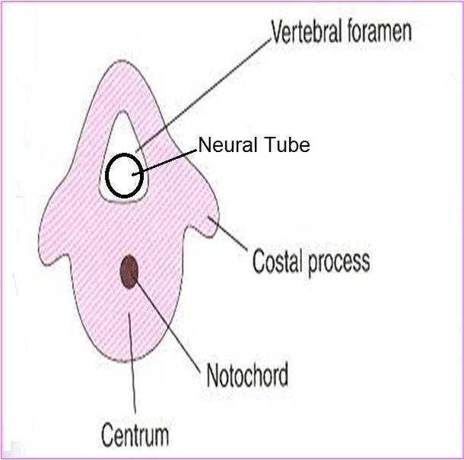
The fused sclerotomes grow dorsally around the neural tube and form the vertebral (neural) arch.
Ventrolaterally, costal processes develop that give rise to ribs in thoracic region.
Vertebral Arch
28

Slide 28
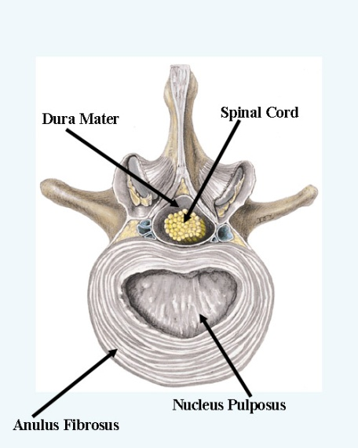
Fate of Notochord
In the region of the bodies of vertebrae: It degenerates
Between bodies of vertebrae: It forms the central part, ’nucleus pulposus’ of the intervertebral discs
Annulus fibrosus of the intervertebral discs is formed by the mesoderm surrounding the notochord.
27

Slide 29
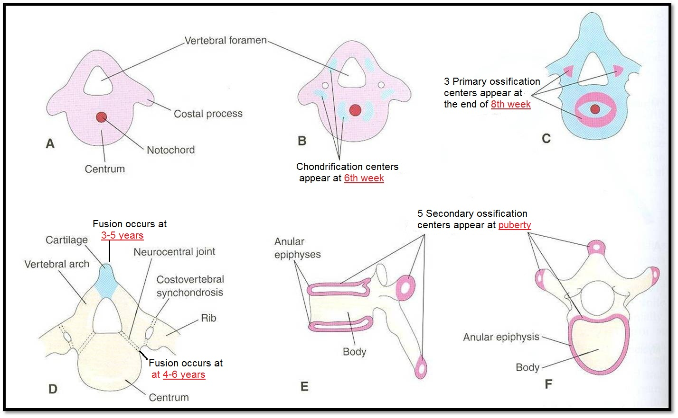
Vertebral Development
Primary Ossification Stage
Mesenchymal Stage
Chondrification Stage
Fusion of 2 V.arches
Stage of Fusion
Stage of Secondary Ossification
All centers unite around 25 years
29

Slide 30
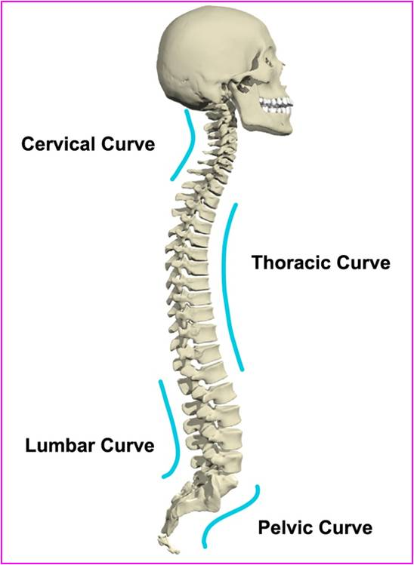
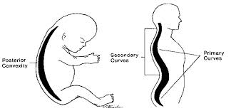
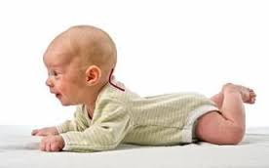
Curvatures of Vertebral Column
Primary curvatures (concave anterior) : develop prenatally
Thoracic
Pelvic or Sacral
Secondary curvatures (convex anterior) : develop postnatally
Cervical: concave posteriorly
-as a result of lifting the head
Lumbar: concave posteriorly
-as a result of walking
-Help support trunk, upper body
30

Slide 31
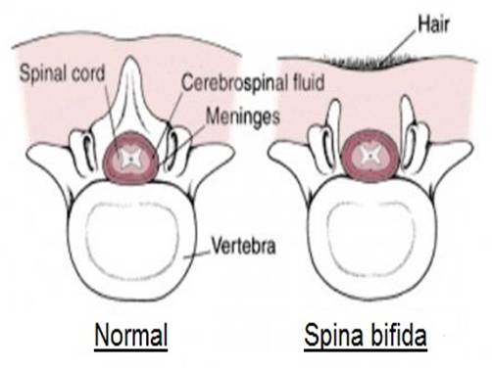
Spinal Cord Anomalies
Spina Bifida
Failure of fusion of the halves of vertebral arches
Incidence: 0.04 - 0.15% Sex: more frequent in females
Occulta
Spinal dermal sinus
Tethered cord
Manifesta
Meningocele
Meningomyelocele
Myelochisis
31

Slide 32
Spina Bifida Occulta
The closed type
Only one vertebra is affected
No clinical symptoms
Skin overlying it is intact
Sometimes covered by a tuft of hair
Usually does not involve underlying neural tissue
32

Slide 33
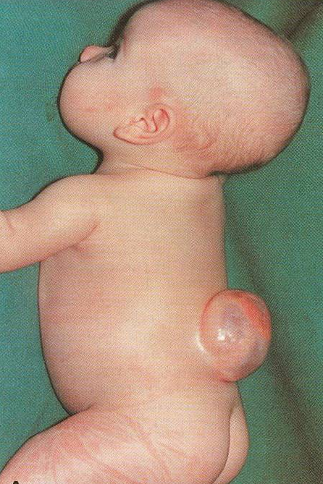
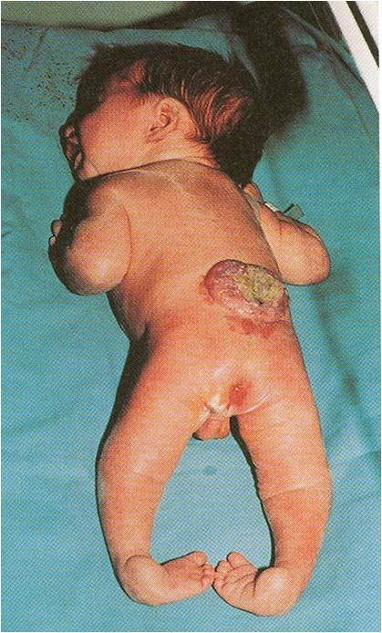
Spina Bifida Cystica
The open type
Cystica is the most severe and complex form of spina bifida. It usually involves serious neurological problems. A portion of the nerves and the spinal cord are exposed outside the body
Neurological symptoms are present
Subdivided into:
Spina bifida with meningocoele: protrusion of sac containing meninges & cerebrospinal fluid
Spina bifida with meningomyelocoele: protrusion of sac containing meninges with spinal cord and/or nerve roots
Spina bifida with myeloschisis : spinal cord is open due to failure of neural folds to develop
1
with meningocoele
with meningomyelocoele
2
3
with myeloschisis
33

Slide 34
Welcome back
34

