Slide 1
Microbiology of middle ear infection (otitis media) Prof. Hanan Habib

Slide 2
Objectives
Upon completion of the lecture , students should be able to:
Define middle ear infection
Know the classification and etiology of otitis media (OM).
Know the epidemiology of OM
Know the pathogenesis & risk factors of OM.
List the clinical features of OM.
Know the diagnostic approaches of OM.
Know the management of OM.
Recall common complications of OM.

Slide 3
Definitions
Middle ear is the area between the tympanic membrane and the inner ear including the Eustachian tube.
Otitis media (OM) is inflammation of the middle ear.

Slide 4
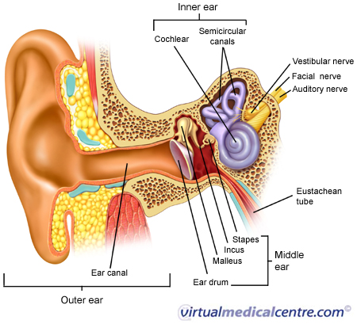
Anatomy of the Middle Ear

Slide 5
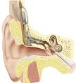
Classification of OM
Acute OM
Secretory ( Serous) OM
Chronic OM

Slide 6
Epidemiology
Most common in infants 6 to 18 months of age (2/3 of cases).
Improves with age, why ?
The Eustachian Tube which vents the middle ear to the Nasopharynx is horizontal in infants, difficult to drain naturally, its surface is cartilage ,and the lymphatic tissue lining is an extension of adenoidal tissue from the back of the nose.
Often preceded by viral upper respiratory infection .

Slide 7
Pathogenesis and Risk Factors
Functions of the tube ( ventilation, protection and clearance ) disturbed.
URTI or allergic condition cause edema or inflammation of the tube.
Oxygen lost leading to negative pressure
Pathogens enter from Nasopharynx into the middle ear.
Colonization and infection result.

Slide 8
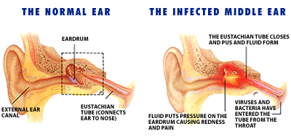

Slide 9
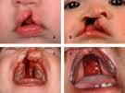
Other risk factors
Anatomic abnormalities
Medical conditions such as Cleft palate ,obstruction due to adenoid or Nasogastric tube tube or malignancy, immune dysfunction.
Exposure to pathogens from day care.
Exposure to smoking.

Slide 10
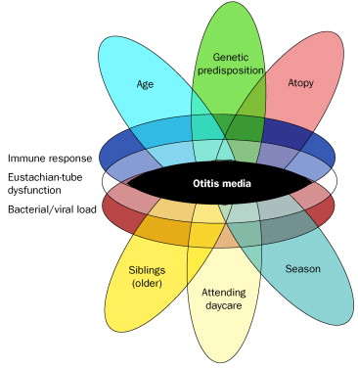

Slide 11
Clinical presentation
Acute OM
Mostly Bacterial ,often a complication of viral URTI. Pain often severe and continuous in bacteria causes.
First 1-2 days:
Fever (39 C), irritability, earache , muffled nose.
Bulging tympanic membrane ,poor mobility and obstruction by fluid or inflammatory cells on otoscopic examination.

Slide 12
3-8 days:
Pus and ear exudative discharge released spontaneously then pain and fever begin to decrease.
2-4 weeks :
Healing phase, discharge clears and hearing becomes normal.

Slide 13
Clinical presentation

Slide 15
Serous OM (OM with effusion)
Collection of fluid within the middle ear as a result of negative pressure produced by altered Eustachian tube function.
Represents a form of chronic OM or allergy-related inflammation.
Over weeks to months, middle ear fluid become very thick and glue like( glue ear)
Tends to be chronic , with non –purulent secretions.
Leads to conductive hearing impairment.

Slide 16
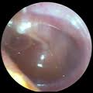
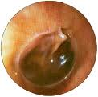
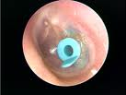
Images of serous OM

Slide 17
Chronic OM
Usually result from unresolved acute infection due to inadequate treatment or host factors that perpetuate the inflammatory process.
Involves perforation of tympanic membrane and active bacterial infection for long period.
Pus may drain to the outside (otorrhea).
Results in destruction of middle ear structures and significant risk of permanent hearing loss.

Slide 18
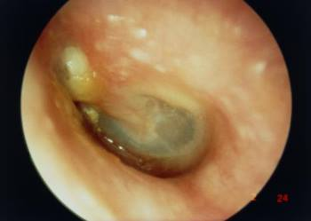
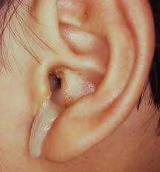
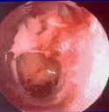
Images of chronic OM

Slide 19
Microbiology (Bacterial Causes)
Acute OM
< 3months of age
> 3 months of age
S.pneumoniae,(40%) group B Streptococcus, H.influenzae (non typeable) ,
Gram negative bacteria including P. aeruginosa
S.pneumoniae,
H.influenzae S.pyogenes,
Moraxella catarrhalis, S.aureus

Slide 20
OM: Microbiology-cont.
Chronic OM
Serous OM
Mixed flora in 40% of cases
P.aeruginosa, H.influenzae, S.aureus, Proteus species, K.pneumoniae, Moraxella catarrhalis, anaerobic bacteria.
Same as chronic OM, but most of the effusions are sterile
Few acute inflammatory cells

Slide 21
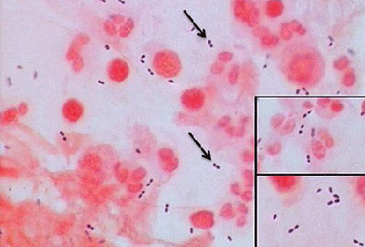
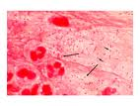
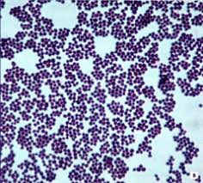
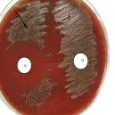
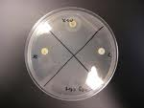
Microbiology of OM

Slide 22
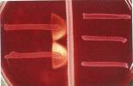
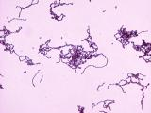
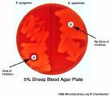
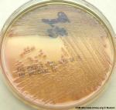
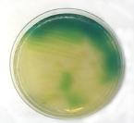
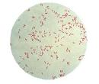
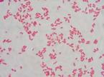
Microbiology of OM

Slide 23
Microbiology (Viral causes)
RSV( Respiratory Syncytial Virus) -74%
Rhinovirus
Para-influenza virus
Influenza virus

Slide 24
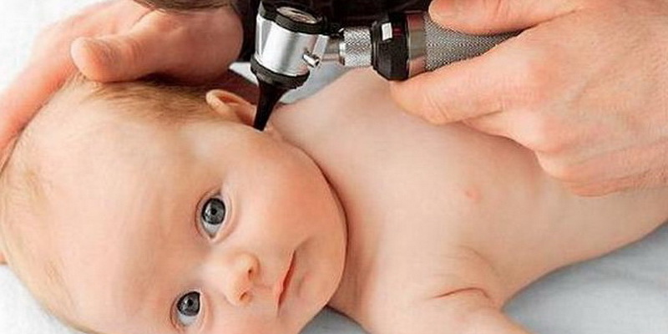
Diagnostic approaches of OM
Clinical examination
Tympanometry ( detects the presence of fluid)
Gram stain and culture of aspirated fluid to determine the etiologic agents.

Slide 25
Management of OM
Acute OM requires antimicrobial therapy & careful follow up.
Antimicrobial usually empirical depending on the most likely bacterial pathogens, usually to cover S.pneumoniae and H.influenzae.
Drainage of exudates may be required.
Chronic or serous OM need complex management, possibly surgical.

Slide 26
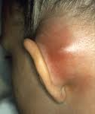
Complications of OM
Extracranial
Intracranial
Hearing loss
Tympanic membrane perforation
Mastoiditis
Cholestatoma
Labyrinthitis
others
Meningitis
Extradural abscess
Subdural empyema
Brain abscess
others

Slide 27
Reference book
Sherris Medical Microbiology, an Introduction to Infectious Diseases.
Latest edition, Kenneth Ryan and George Ray. Publisher : McGraw Hill .

