Slide 1
Drugs Related to Balance System
The overall incidence of dizziness, vertigo & imbalance is 5-10%
It reaches 40% in patients older than 40 years
Accounts for 3% of total visits to emergency department
The incidence of falling is 25% in subjects older than 65 years
1% of falls results in hip fracture
Roughly 50% of fractured hips will not function normally.

Slide 2
Drugs Related to Balance System
ILOS
To differentiate between classes of drugs used to control or to prevent vertigo
To hint on some disorders of balance
To detail on some drugs used to control or to prevent vertigo
To identify drugs that can precipitate vertigo.

Slide 3
Drugs Related to Balance System
Balance Disorders
Definition
Terms
Dizziness
Light headedness
Ménière's disease
Vertigo
Notes:
Dizziness is the feeling of being lightheaded, woozy, or unbalanced. It affects the sensory organs, specifically the eyes and ears, so it can sometimes cause fainting.
Dizziness isn’t a disease, but rather a symptom of various disorders.
Light headedness is a feeling that you are about to faint or "pass out." Lightheadedness often goes away or improves when you lie down. If lightheadedness gets worse, it can lead to a feeling of almost fainting. You may sometimes feel nauseated or vomit when you are lightheaded.
Ménière's disease:-This causes repeated episodes of dizziness, usually with ringing in the ear and progressive low-frequency hearing loss.
Vertigo is a sensation of spinning dizziness

Slide 4
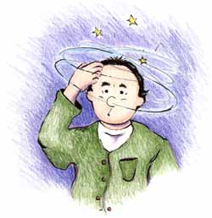
Symptoms
Spinning (vertigo)
Confusion or disorientation
Falling or feeling as if one is going to fall
Nausea or vomiting
Sweating
Abnormal eye movement (nystagmus).
Notes:
Vertigo is a feeling that you or your surroundings are moving when there is no actual movement. You may feel as though you are off balance, spinning,
Disorientation: Loss of one's sense of direction. When you have severe vertigo, you may feel very nauseated or vomit. You may have trouble walking or standing, and you may lose your balance & fall.

Slide 5
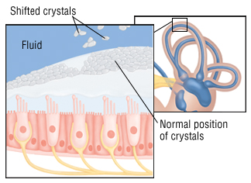
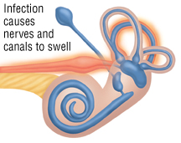
Balance disorders
Benign paroxysmal positional vertigo:-A change in head position causes a sudden sensation of spinning
Acute labyrinthitis:-Inflammation of the balance apparatus of the inner ear, probably caused by a viral infection
Ménière's disease:- This causes repeated episodes of dizziness, usually with ringing in the ear & progressive low-frequency hearing loss.
Notes:
Benign Paroxysmal Positional Vertigo (or BPPV) is the most common cause of vertigo, a false sensation of spinning
Benign – it is not life-threatening
Paroxysmal – it comes in sudden, brief spells
Positional – it gets triggered by certain head positions or movements
Vertigo – a false sense of rotational movement
BPPV is a mechanical problem in the inner ear. It occurs when some of the calcium carbonate crystals (otoconia) that are normally embedded in gel in the utricle become dislodged & migrate into one or > of the 3 fluid-filled semicircular canals, where they are not supposed to be. When enough of these particles accumulate in one of the canals they interfere with the normal fluid movement that these canals use to sense head motion, causing the inner ear to send false signals to the brain.
In the inner ear Cochlea = snail shape filled with fluid lined with tiny hairs
Fluid & hair cells in the three loop-shaped semicircular canals & the sac-shaped utricle and saccule provide the brain with information about head movement.
Signals travel from the labyrinth to the brain via the vestibulo-cochlear nerve (the eighth cranial nerve), which has two branches.

Slide 6
Pharmacologic approach
Involves targeting the underlying cause of the vertigo (e.g., ear infection).
Specific treatment
Symptomatic treatment
Involves controlling the acute symptoms & autonomic complains (e.g., vertigo & vomiting)
Prophylactic treatment
Aims to reduce the recurrence of specific vertiginous conditions
Diuretics (but not loop diuretics)
Corticosteroids
Ca & K Channel Blocker & antihistamine e.g. Cinnarizine.
Notes:
The goal of the treatment of vestibular disorders should be to
Be careful of some AB may cause ototoxicity
Diuretics are used to reduce fluid and edema, Also advice the patients restriction of salts & fluids
Corticosteroids: anti-inflammatory

Slide 7
Symptomatic control
Vestibular suppressants
are drugs that reduce the intensity of vertigo & nystagmus evoked by a vestibular imbalance, e.g :
Antiemetics
1-Anticholinergics
2-Benzodiazepines
3-Betahistine
Notes:
The vestibular system, is the sensory system that provides the leading contribution to the sense of balance & spatial orientation for the purpose of coordinating movement with balance.
Nystagmus is a vision condition in which the eyes make repetitive, uncontrolled movements. These movements often result in reduced vision & depth perception and can affect balance and coordination.
Vestibular suppressants include three general drug classes: anticholinergics, benzodiazepines & Betahistine

Slide 8
1-Anticholinergics
2-Benzodiazepines
Anticholinergics inhibit firing in vestibular nucleus neurons
In small dosages useful for the management of acute vertigo
Minimize anxiety & panic associated with vertigo
Reduce the velocity of vestibular nystagmus
e.g. hyoscine, also useful in motion sickness & sedation
e.g. Lorazepam, Clonazepam, Diazepam
ADRs:- Dependence, impaired memory, increased risk of falling.
ADRs:- dry mouth, blurred vision, sedation.
Notes:
The main output of the vestibular nucleus neurons is cholinergic, The neurons of the vestibular nuclei release ACh as a neurotransmitter
Muscarinic antagonists: Scopolamine (hyoscine), a prototypic muscarinic receptor antagonist, is one of the best agents for the prevention of motion sickness.
Vestibular system is a critical system for detecting the position & motion of the head, particularly angular motions such as rotation
Vestibular disturbances, especially motion sickness, appear to involve muscarinic cholinergic transmission. Scopolamine is often effective in preventing or reversing these disturbances.
Vest nystagmus :involuntary, rapid, rhythmic movement (horizontal, vertical, rotatory, or mixed, i.e., of two types) of the eyeball.
Vestibular nystagmus, the most common type of nystagmus, is caused by dysfunction of the vestibular part of the inner ear, the nerve, the vestibular nucleus within the brainstem, or parts of the cerebellum that transmit signals to the vestibular nucleus.
BDZ for seizure & hypnotic it has a muscle relaxant effect

Slide 9
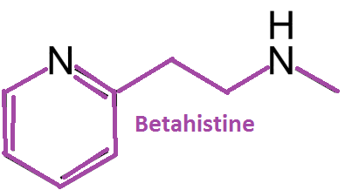
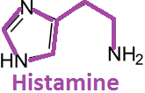
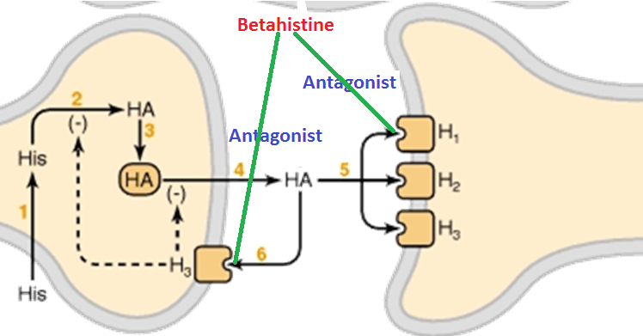
3-Betahistine
Mechanism of Action:-
By stimulating H₁ receptors located on blood vessels in the inner ear→ local vasodilation & increased permeability, which helps to reverse the underlying problem of endolymphatic hydrops.
Betahistine increases the level of serotonin in the brainstem →↓the activity of vestibular nuclei.
It is a structural analog of histamine with weak histamine H1 receptor agonist & more potent histamine H3 receptor antagonist properties
By bloking H3 receptors, Betahistine increases the local concentration of histamine in the inner ear.
Agonist
Notes:
is an anti-vertigo drug. It is commonly prescribed for balance disorders or to alleviate vertigo symptoms associated with Ménière's disease.
Endolymphatic hydrops: endolymph (the fluid within the endolymphatic sac, a compartment of the inner ear).
Endolymphatic hydrops may be either primary or secondary. Primary idiopathic endolymphatic hydrops (known as Ménière’s disease) occurs for no known reason.
Secondary endolymphatic hydrops appears to occur in response to an event or underlying condition. For example, it can follow head trauma or ear surgery, and it can occur with other inner ear disorders, allergies, or systemic disorders (such as diabetes or autoimmune disorders).
Betahistine is a potent H3 receptor antagonist. Stimulation of the H3 receptor reduces histamine release, so antagonism of H3 increases histamine release.
H3 inhibitory presynaptic receptor.
H3-receptor antagonism increases the levels of neurotransmitters such as serotonin in the brainstem, which inhibits the activity of vestibular nuclei, helping to restore proper balance and decrease in vertigo symptoms.
OTC
It improves the microcirculation in the inner ear, thus reducing endolymphatic pressure.

Slide 10
Pharmacokinetics of betahistine
Formulated as tablet or oral solution
Rapidly & completely absorbed
ADRs:-
t½= 3-4 hours,
excreted in urine within 24 hours
Headache
Nausea
Low protein binding.
GIT side effects.
Contraindications
Phaeochromocytoma
Bronchial asthma
History of peptic ulcer
Hypersensitivity reactions.
Notes:
As betahistine is a synthetic analogue of histamine it may induce the release of catecholamines from the tumor resulting in severe hypertension.
histamine causes bronchoconstriction

Slide 11
Clinical indications
Betahistine is indicated for treatment of Ménière's syndrome.
Efficacy and safety of betahistine treatment in patients with Meniere’s disease: primary results of a long term, multicentre, double blind, randomised, placebo controlled, dose defining trial (BEMED trial) BMJ 2016; 352
Current evidence is limited as to whether betahistine prevents vertigo attacks caused by Meniere’s disease, compared with placebo reactions.
94% of ENT surgeons in Britain prescribe betahistine for Meniere’ disease, while in USA they think it is no better than a placebo.

Slide 12
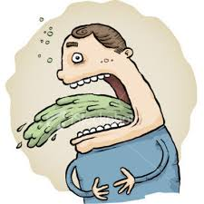
Antiemetics
Antiemetics are drugs used to control vomiting & nausea such as:
Antihistamines e.g. Dimenhydrinate
Phenothiazines e.g. prochlorperazine
Dopamine antagonists e.g. metoclopramide & domperidone.

Slide 13
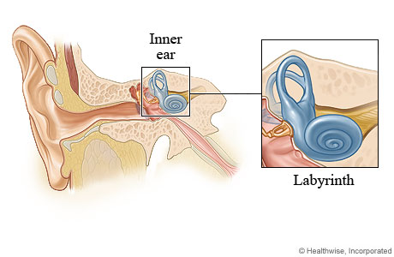
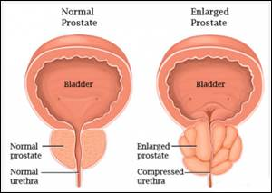
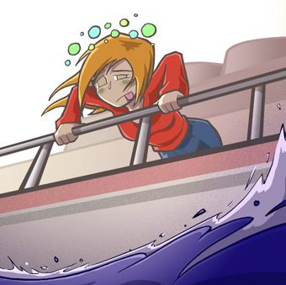
Diminhydrinate
ADRs:-
Sedation
Dizziness
Anticholinergic side effects.
- Block H₁ receptors in CRTZ
- Sedative effects
- Weak anticholinergic effects
↓ Excitability in the labyrinth & blocking conduction in vestibular-cerebellar pathways
Contraindications:-
Glaucoma
Prostatic enlargement
Indications
In vertigo
Prevent nausea & vomiting associated with motion sickness.
Notes:
An action on the medullary chemoreceptive trigger zone (CRTZ- Vomiting center) may also be involved in the antiemetic effect.
The inner ear help support hearing & balance. They diminish vestibular stimulation & depress labyrinthine function.
Most vertigo with definable cause is otologic, caused by dysfunction of the labyrinth in the inner ear.
Many of the first-generation antihistamines also possess anticholinergic activity. This might contribute to some of the side effects (dry mouth, urinary retention) associated with these agents, but it also might contribute to their efficacy in the treatment of nausea.
Most medications that could adversely affect glaucoma, or increase the chance of developing glaucoma, have the potential to narrow the drainage angle of your eye, called the trabecular meshwork. This would prevent eye fluid from exiting properly resulting in high eye pressure. The “angle” that is being referred to is the angle between the iris, which makes up the colored part of your eye, and the cornea, which is the clear window front part of your eye. Medications that have anticholinergic properties can adversely affect patients with narrow angles.

Slide 14
Prochlorperazine
Antipsychotic, some sedation + antiemetic
Mechanism of action:
Blocks DOPAMINE receptors at CRTZ
Indications:
One of the best antiemetics in vertigo,
has some vestibular suppressant action.
Notes:
Most older typical antipsychotic drugs, with the exception of thioridazine, have a strong antiemetic effect. This action is due to
dopamine-receptor blockade, both centrally (in the chemoreceptor trigger zone of the medulla) and peripherally (on receptors in the
stomach).
What are Antipsychotics
Antipsychotics are drugs that are used to treat symptoms of psychosis such as delusions (for example, hearing voices), hallucinations, paranoia, or confused thoughts. They are used in the treatment of schizophrenia, severe depression and severe anxiety. Antipsychotics are also useful at stabilizing episodes of mania in people with Bipolar Disorder.
Their main action is on dopamine receptors, reducing levels of excess dopamine. They may also affect levels of other neurotransmitters, namely acetylcholine, noradrenaline, and serotonin.

Slide 15
Metoclopramide & DOMPERIDONE
block DOPAMINE D2 receptors in the CRTZ of the medulla, resulting in potent central antinausea & antiemetic action
Has some sedative action
Has potent gastroprokinetic effect
ADRS:-
Restlessness or drowsiness
Extrapyramidal manifestations on prolonged use.
Notes:
Within the GIT; activation of dopamine receptors inhibits cholinergic smooth muscle stimulation; blockade of this effect is believed to be the primary prokinetic mechanism of
action of these agents. These agents increase esophageal peristaltic amplitude, increase lower esophageal sphincter pressure, & enhance gastric emptying.
Metoclopramide & domperidone also block dopamine D2 receptors in the CRT of the medulla (area postrema), resulting in potent antinausea & antiemetic action.
Extrapyramidal effects (dystonias, akathisia, parkinsonian features) due to central dopamine receptor blockade occur acutely in 25% of patients given high doses and in 5% of patients receiving long-term therapy.
Dystonia is a disorder characterized by involuntary muscle contractions that cause slow repetitive movements or abnormal postures.
Akathisia is a movement disorder characterized by a feeling of inner restlessness & a compelling need to be in constant motion, as well as by actions such as rocking while standing or sitting, lifting the feet as if marching on the spot,

Slide 16
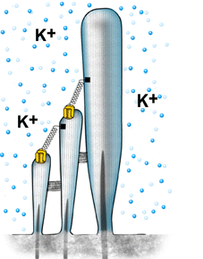
Cinnarizine
Mechanism of action
Selective Ca²⁺channel blocker (vascular smooth muscle relaxation), antihistamine, antiserotonin, antidopamine
It promotes cerebral blood flow
Increased hydrostatic pressure on hair cells activates K+ currents
Cinnarizine inhibits K⁺ currents.
Inhibition of K⁺ currents lessen the vertigo & motion-induced nausea by dampening the over-reactivity of the vestibular hair cells.
Notes:
It acts by interfering with the signal transmission between vestibular apparatus of the inner ear & the vomiting centre of the hypothalamus by limiting the activity of the vestibular hair cells which send signals about movement.
Hair cells are the sensory receptors of both the auditory system & the vestibular system in the inner ears.
Cinnarizine inhibits Ca2+- & pressure-dependent K+ currents.

Slide 17
Pharmacokinetics
Taken orally in tablet form
Rapidly absorbed
Low oral bioavailability due to hepatic first pass metabolism
If administered IV in lipid emulsion, it has better bioavailability.
Clinical uses:-
Used to treat nausea & vomiting associated with motion sickness, vertigo & Meniere’s disease.
ADRS:-
Sweating
Drowsiness & Headache
Muscle rigidity & tremor
Contraindications
Parkinsonism
Car drivers.
Notes:
IV in lipid emulsion: Important source of calories & essential fatty acid
In Parkinson's disease, neurons of the substantia nigra progressively degenerate; as a result, the amount of DA available for neurotransmission in the corpus striatum is lowered

Slide 18
Drugs inducing vertigo
Drugs producing damaging effects on structure or function of labyrinthine hair cells &/ or their neuronal connections
Vestibular toxins
Mixed ototoxins
Drugs altering fluid & electrolyte balance: Diuretics
Drugs altering vestibular firing (neuronal depressants):
Anticonvulsants
Antidepressants
Sedative hypnotics
Alcohol
Cocaine
Alter function
Notes:
Furosemide is a very commonly used loop diuretic in current clinical practice. Ototoxicity is a significant side effect which may be transient or permanent. Due to electrolyte alteration & damage of hair cells.
Because the inner ear is involved in both hearing and balance, ototoxicity can result in disturbances of either or both of these senses.

Slide 19
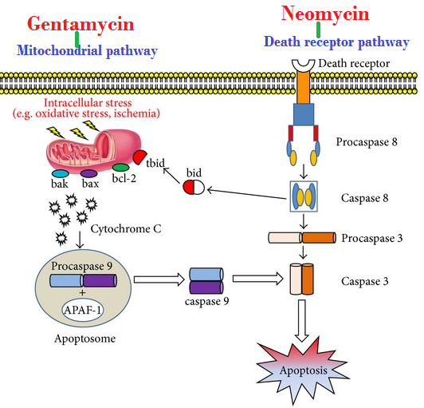
Mixed ototoxins
Quinine, chloroquine, quinidine
Nitrogen mustard
Loop diuretics
NSAIDs
Tobacco
Aminoglycoside antibiotics; e.g. gentamycin, kanamycin, neomycin, streptomycin
Alter function
Gentamycin → Induce apoptosis by evoking free radicals → Mitochondrial Pathway
Neomycin →Induce apoptosis by activating caspases → Death Receptor Pathway
↓Local blood flow → biochemical changes → ↓ electromechanical transduction → ↓firing of impulse
Alter structures
Notes:
Quinoline derivatives such as quinine, quinidine, and chloroquine are well known for their use in the treatment of malaria.
Nitrogen mustards are cytotoxic chemotherapy agents derived from mustard gas
Permanent damage
The caspase family of proteases is activated in the apoptotic signaling pathway and is responsible for cellular destruction.

Slide 20
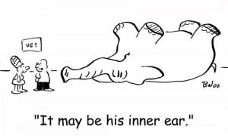
Synopsis
Drugs Affecting Balance
Drugs to treat vertigo
Specific
e.g. Antibiotics
Symptomatic
Vestibular suppressants
Anticholinergics
Benzodiazepines
Betahistine
Antiemetics
Antihistamines
Phenothiazines
Dopamine antagonist
Prophylactic
Diuretics
Corticosteroids
Ca/K
antagonists
Drugs inducing vertigo
Vestibular toxins
Mixed ototoxins
Notes:
In a Summary outline

