Slide 1
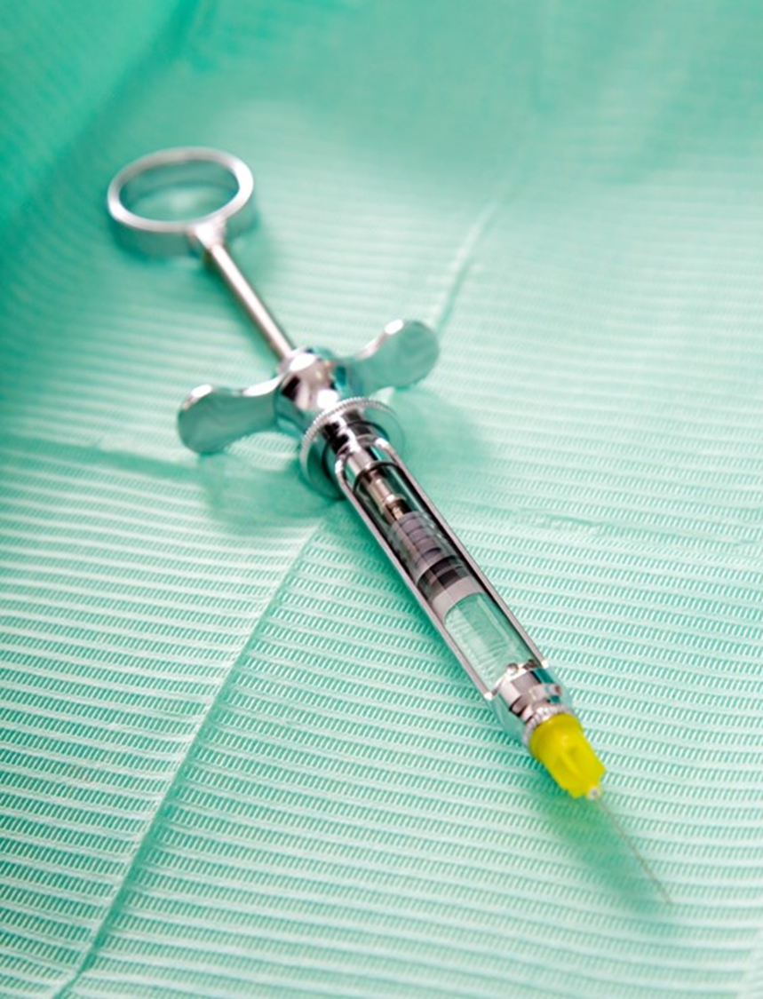
General anesthetics

Slide 2
Introduction
Drugs used to induce loss of pain sensation, consciousness, skeletal muscle relaxation, analgesia, amnesia and inhibitions of undesirable reflexes.
10/19/2020
Prof. Hanan Hagar

Slide 3
Types of Anesthesia
General anesthesia
Local and regional anesthesia
10/19/2020
Prof. Hanan Hagar

Slide 4
Character s of an Ideal anesthetic drug
Smooth and rapid induction.
Rapid recovery.
Wide safety margin.
Minimal side effects.

Slide 5
Balanced Anaesthesia
Is the use of more than one drug in combination to fulfil the patient needs.
Beneficial effects
Adverse effects

Slide 6
How we can obtain balanced anesthesia
Balanced anesthesia is achieved by a combination of
I.V and inhaled anesthesia and Pre-anaesthetic medications

Slide 7
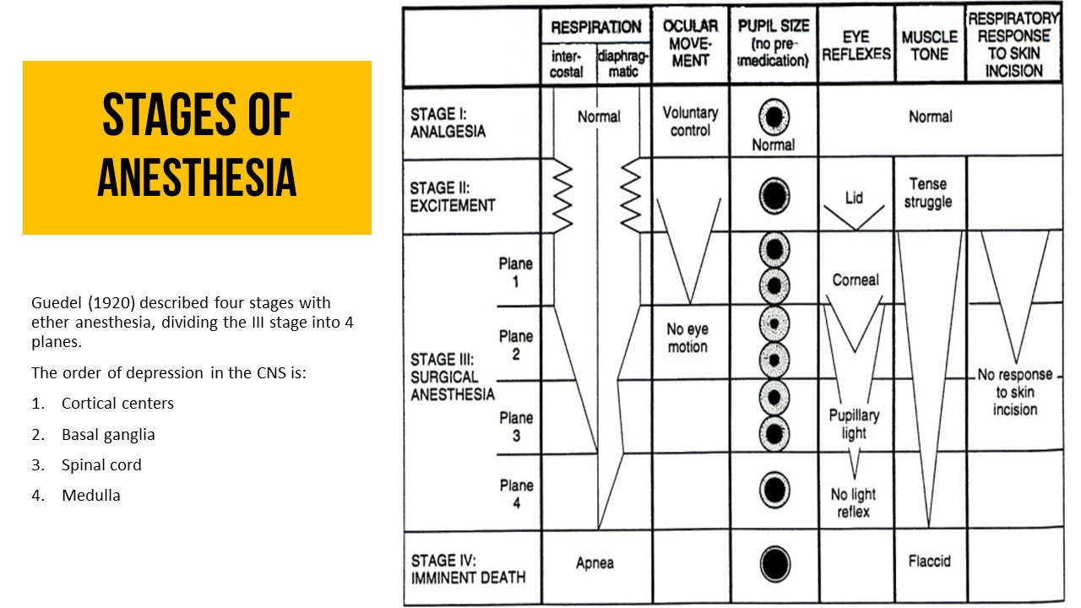
Stages of anesthesia
Stage I (analgesia)
Loss of pain sensation.
The patient is conscious and conversational.
Stage II (Excitement)
Increased respiratory rate.
Increased, irregular blood pressure.
Patient may experience delirium & violent behavior.
Eye dilated & reactive.

Slide 8
Stages of anesthesia
Stage III (Surgical anesthesia)
- Regular respiration & relaxation of Sk. muscles.
- Eye reflexes decrease until the pupil is fixed.
Stage IV (coma and death)
- Medullary paralysis.
Severe depression of vasomotor
Depression of respiratory centers.
Death may occur.

Slide 9
Pre - anaesthetic medication
Opiates: induce analgesia.
Anticholinergics: prevent secretion of fluids into the respiratory tract.
Sedatives & anxiolytics: relieve anxiety. E.g. diazepam
Antihistaminics: allergic reactions. e.g. diphenhydramine
Antiemetics : post surgical N&V. e.g. metoclopramide, prochlorperazine
H2-receptor blockers: reduce gastric acidity e.g. ranitidine
Thiopental: smooth induction
Prof. Hanan Hagar
10/19/2020

Slide 10
Pre-anesthetic medication
Calm the patient, relieve pain
Protect against undesirable effects of the subsequently administered anesthetics or the surgical procedure.
Facilitate smooth induction of anaesthesia
Lowered the dose of anaesthetic required
Prof. Hanan Hagar
10/19/2020

Slide 11
Adjuncts to general anaesthetics
Pre-anesthetic medication.
Neuromuscular blocking agents
e.g. succinylcholine, vecuronium, atracurium
Facilitate intubation
Suppress muscle tone.
Prof. Hanan Hagar
10/19/2020

Slide 12
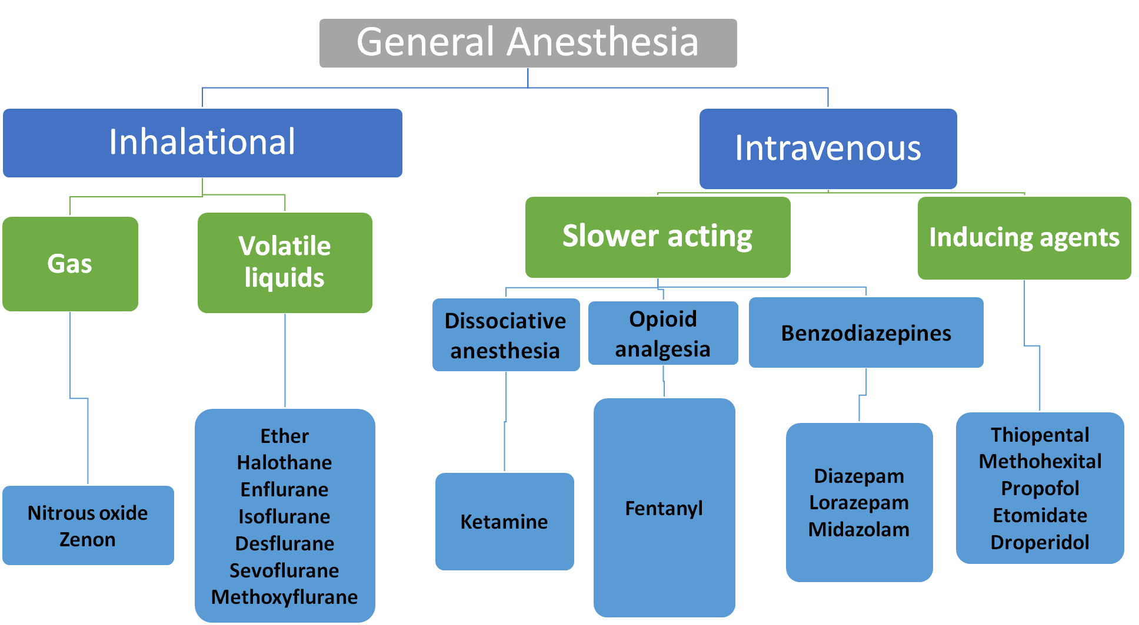
General Anesthesia
Inhalational
Gas
Volatile liquids
Intravenous
Slower acting
Nitrous oxide
Zenon
Ether
Halothane
Enflurane
Isoflurane
Desflurane
Sevoflurane
Methoxyflurane
Dissociative anesthesia
Opioid analgesia
Benzodiazepines
Thiopental
Methohexital
Propofol
Etomidate
Droperidol
Ketamine
Fentanyl
Diazepam
Lorazepam
Midazolam
Inducing agents

Slide 13
Mechanism of action of general anaesthetics
Enhance the action of GABA and glycine on receptors thus decrease neuronal excitability.
10/19/2020
Prof. Hanan Hagar

Slide 14
Inhalation anesthetics
Volatile liquids
Methoxyflurane
Halothane
Enflurane
Isoflurane
Desflurane
Sevoflurane
Nitrous oxide (Gas)
Prof. Hanan Hagar
10/19/2020

Slide 15
Pharmacokinetics of Inhalation anesthetics
Rate of induction
Depth of anesthesia and recovery.
Prof. Hanan Hagar
10/19/2020

Slide 16
Inhalation anesthetics
Induction
Time elapsed between onset of administration of anesthetic and
development of effective surgical anesthesia.
Maintenance
Time during which the patient is surgically anesthetized.
Recovery
The time from discontinuation of anesthetic drug until consciousness is regained.
Prof. Hanan Hagar
10/19/2020

Slide 17
Pharmacokinetics of Inhalation anesthetics
Factors controlling induction & recovery
The anesthetic concentration: (Direct).
Rate and depth of ventilation (Direct).
Blood solubility: Blood: gas partition coefficient (Inverse relation).
Prof. Hanan Hagar
10/19/2020

Slide 18
Drugs Solubility Induction & Recovery
(Blood : gas partition coefficient )
Methoxyflurane 12 Slow
Halothane 2.3 Slow
Enflurane 1.8 Medium
Isoflurane 1.4 Medium
Sevoflurane 0.69 Rapid
Desflurane (low volatility) 0.42 poor & Rapid
Nitrous Oxide 0.47 Rapid

Slide 19
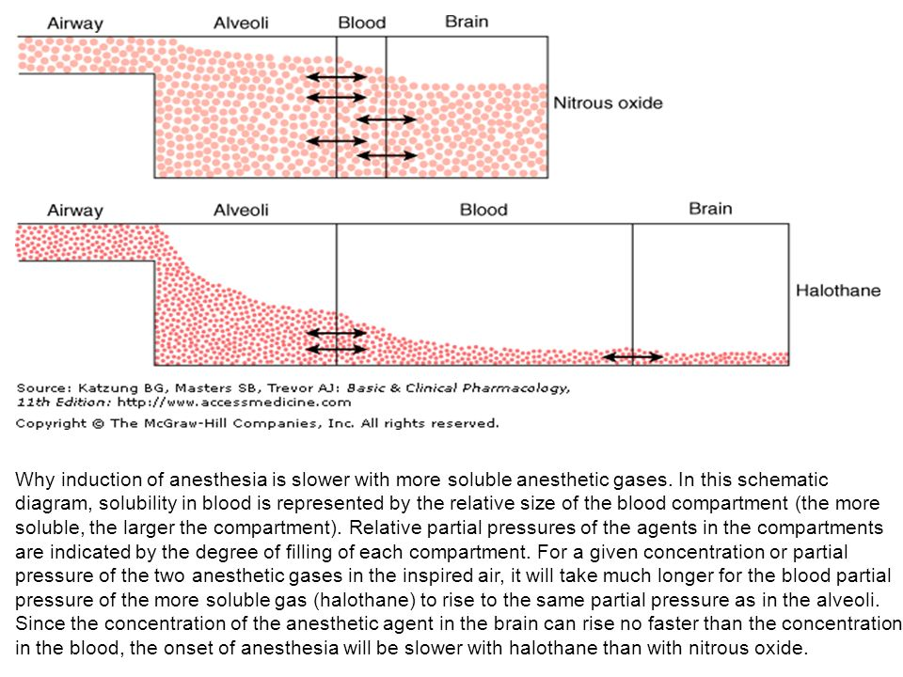
Solubility and induction of anesthesia

Slide 20
Minimum alveolar concentration (MAC)
It is the concentration of inhalation anesthetic that produce
immobility in 50 % patients in response to surgical operation.
The lower the MAC value the more potent the drug.
Mac value increases with CNS stimulants and decreases with CNS
depressants.
Prof. Hanan Hagar
10/19/2020

Slide 21
Drugs MAC (%) POTENCY
Methoxyflurane 0.16
Halothane 0.75
Isoflurane 1.4
Enflurane 1.7
Sevoflurane 2
Desflurane 6-7
Nitrous oxide >100
Prof. Hanan Hagar
10/19/2020

Slide 22
Pharmacological actions of inhalation anesthetics
CNS
- ↓ metabolic rate.
- ↑ ICP (due to cerebral vasodilatation) # in head injuries.
Dose dependent EEG changes (Enflurane).
CVS
- Hypotension
- Bradycardia Except (Isoflurane & Desflurane ).
- Myocardial depression (Halothane – Enflurane).
Sensitize heart to catecholamines (Halothane)
Prof. Hanan Hagar
10/19/2020

Slide 23
Pharmacological actions of inhalation anesthetics
Respiratory
- All respiratory depressants.
Airway irritation (Desflurane-Enflurane).
Uterus & Skeletal Muscles
Uterine relaxation [nitrous oxide has minimal relaxant effect].
skeletal muscle relaxants.
Prof. Hanan Hagar
10/19/2020

Slide 24
POTENCY & INDUCTION AND VELOCITY (Summary keep in mind solubility and MAC values)
Drugs
Methoxyflurane: The most potent, low MAC value, slow induction& recovery
Halothane: Potent, slow induction & recovery (pleasant odor)
Enflurane: less potent, medium induction & recovery (pungent odor)
Isoflurane: less potent, rapid induction & recovery
Sevoflurane : less potent, rapid induction & recovery (better smell)
Desflurane: Rapid induction & rapid recovery (pungent odor)
Nitrous oxide: The least potent, high MAC value, rapid induction& recovery
Prof. Hanan Hagar
10/19/2020

Slide 25
Inhalation anesthetics
Properties | Anesthetic drugs
For veterinary use only | Methoxyflurane
Non irritant - Potent anesthetic, Weak analgesic. Can be used in children | Halothane
Stable compound (2%), Low biotransformation (Less fluoride). No nephrotoxicity - No hepatotoxicity. | Isoflurane
is metabolized to fluoride (8%) Contraindicated in patients with seizure disorders. renal failures (release fluoride). | Enflurane
Less metabolized (0.05 %), low boiling point (special equipment) | Desflurane
Better smell, little effect on HR, No airway irritation (children) | Sevoflurane
Potent analgesics, Minimal CVS adverse effects, contraindicated in pregnancy (uterine relaxant ). | Nitrous oxide

Slide 26
Side effects of inhalation anesthetics
Side effects | Anesthetic drugs
Slow induction, nephrotoxicity | Methoxyflurane
Slow induction and recovery (why ??????). Sensitization of heart to catecholamines Hepatotoxicity Malignant hyperthermia | Halothane
Pungent odor Airway irritation | Desflurane
Pungent (less induction -Not for pediatrics). Airway irritation CNS stimulation (Epilepsy-like seizure- abnormal EEG). | Enflurane
Weak anesthetic (low potency, combined). Diffusion hypoxia, Nausea and vomiting. Inactivation of B 12 ⎯→ megaloblastic anemia, congenital anomalies | Nitrous oxide

Slide 27
Intravenous anesthetics
Ultra short acting barbiturates e.g. thiopental
Benzodiazepines (diazepam, lorazepam, midazolam)
Opioids (fentanyl)
Ketamine
Propofol
Etomidate
Prof. Hanan Hagar
10/19/2020

Slide 28
Intravenous anesthetics
NO need for special equipments.
Rapid induction & recovery EXCEPT benzodiazepines (BZs).
Injected slowly (rapid induction).
Recovery is due to redistribution from CNS.
Analgesic activity: Opioids & ketamine
Amnesic action: BZs & ketamine.
Can be used alone in short operation & Outpatients anesthesia.
Prof. Hanan Hagar
10/19/2020

Slide 29
Character s of intravenous anaesthetic drugS
Drug | Induction and recovery
Thiopental | Fast onset, slow recovery, hangover
Etomidate | Fast onset, fairly fast recovery, less hangover
Propofol | Fast onset, rapidly metabolized, very fast recovery
Ketamine | Slow onset, Produces good analgesia and amnesia.
Midazolam | Slower onset than other agents, has amnesic effect.

Slide 30
Ultrashort acting barbiturates
e.g. Thiopental, Methohexital
Rapid onset of action 1 min (high lipid solubility).
Ultra short duration of action 15 - 20 min
Metabolized slowly by the liver (slow recovery)
Potent anesthetic.
CNS: ↓ ICP (Used in head injuries).
CVS collapse & respiratory depression, precipitate porphyria attack, hypersensitivity reaction.
Used for induction in major surgery and alone in minor surgery.

Slide 31
Etomidate
Ultrashort acting hypnotic (non barbiturates).
Rapid onset of action, short duration of action.
Rapidly metabolized in liver (less hangover).
Minimal CVS and respiratory depressant effects.
Postoperative nausea & vomiting.
Pain at sit of injection.
Involuntary movements during induction
Adrenal suppression
Prof. Hanan Hagar
10/19/2020

Slide 32
Propofol
Hypnotic (non barbiturates).
Rapid onset, short duration of action, Faster recovery than thiopental
Rapidly metabolized in liver (10 times - Elimination ½ = 30 – 60 min).
Decreases ↓ ICP, Antiemetic action.
Side Effects
Hypotension (↓PVR)
Excitation (involuntary movements)
Pain at site of injection
Expensive
Prof. Hanan Hagar
10/19/2020

Slide 33
Benzodiazepines
Midazolam, Diazepam , Lorazepam
No pain, have anxiolytic and amnesic action
Slow induction & recovery.
Cause respiratory depression.
Used in induction of general anesthesia (Midazolam).
Alone in minor procedure (endoscopy).
In balanced anesthesia (Midazolam).
Prof. Hanan Hagar
10/19/2020

Slide 34
ketamine
Dissociative anesthesia (analgesic & amnesic actions, immobility, complete separation from the surrounding environment).
Rapid onset of action, short duration, is given IV, IM (Children).
↑ Potent bronchodilator (asthmatics)
↑central sympathetic activity (↑ BP & cardiac output).
↑ Increases plasma catecholamine levels (↑ ICP).
Used in (hypovolemic, shock & elderly) patients.
Post operative hallucination vivid dreams & disorientation &illusions
Risk of hypertension & cerebral hemorrhage, ↑ ICP
Prof. Hanan Hagar
10/19/2020

Slide 35
Opiate drugs
Fentanyl, Alfentanil
Rapid onset, Short duration of action, Potent analgesia.
Uses
Cardiac surgery (morphine + nitrous oxide).
Neuroleptanalgesia (Fentanyl + droperidol ).
Neuroleptanesthesia (Fentanyl +droperidol + nitrous oxide).
Side Effects
Nausea & vomiting
Respiratory depression, bronchospasm (wooden rigidity).
Hypotension
Prof. Hanan Hagar
10/19/2020

Slide 36
Neuroleptanalgesia
A state of analgesia, sedation and muscle relaxation without loss of consciousness.
Used for diagnostic procedures that require cooperation of the patient.
Innovar (Fentanyl + droperidol ).
Contraindicated in parkinsonism.
Neuroleptanesthesia
A combination of (Fentanyl + droperidol + nitrous oxide).
Prof. Hanan Hagar
10/19/2020

Slide 37
Contraindication of opiate drugs
1. Head injuries.
2. Pregnancy.
3. Bronchial asthma.
4. Chronic obstructive lung diseases.
5. Hypovolemic shock (Large dose only).
Prof. Hanan Hagar
10/19/2020

Slide 38
Induction drugs effects on CVS system
Drug | Systemic BP | Heart rate
Propofol | ↓ | ↓
Etomidate | No change or slight ↓ | No change
Ketamine | ↑ | ↑
Prof. Hanan Hagar
10/19/2020

Slide 39
Side effects of intravenous anaesthetic drug
Drug | Main side effects
Thiopental | CVS collapse and respiratory depression (Laryngospasm, bronchospasm), porphyria
Etomidate | Adrenocortical suppression, Excitatory effects during induction pain at site of injection, Post-operative NV
Propofol | CVS and respiratory depression, Excitation (involuntary movements) Pain at injection site, expensive.
Ketamine | Psychotomimetic effects following recovery (vivid dreams, hallucination) Postoperative nausea, vomiting，salivation Risk of hypertension and cerebral hemorrhage
Midazolam | Slow induction & recovery
Opioids | Increase in ICP, Respiratory depression, Bronchospasm (wooden rigidity). Hypotension, Nausea & vomiting, Urinary retention. Prolongation of labor & fetal distress.

Slide 40
Contraindication of intravenous anaesthetic drugs
Drug | Contraindications
Thiopental | Porphyria (Severe abdominal pain, numbness, anxiety and confusion) Severe hypotension (hypovolemic & shock patient) Chronic obstructive lung disease.
Propofol | CVS and respiratory depression
Fentanyl | Head injuries, Pregnancy, Bronchial asthma, Chronic obstructive lung diseases. Hypovolemic shock (Large dose only).
Ketamine | CV diseases (hypertension-stroke). Head injuries.
Midazolam | respiratory patients

Slide 41
Thank you

