Slide 1
Drugs Used in Epilepsy-I

Slide 2
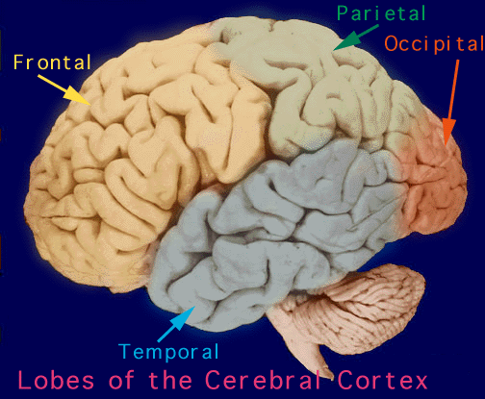

Slide 3
Objectives
At the end of the lectures, students should
Describe types of epilepsy
List the antiepileptic drugs
Expand on pharmacokinetic and dynamic patterns of first and second generation antiepileptic drugs
Specify their mechanism of action
Therapeutic indications and adverse effects
6- Describe treatment of status epilepticus

Slide 4
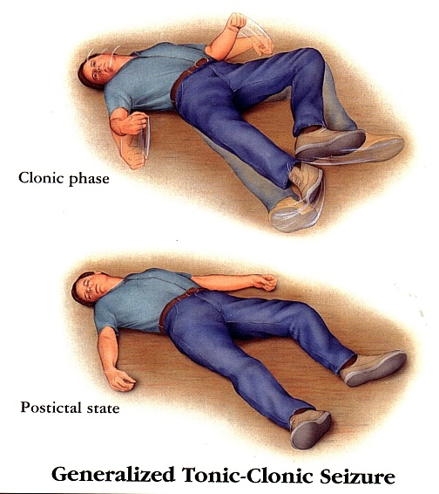
Definition
Epilepsy is a chronic medical condition characterized by 2 or more unprovoked seizures (within 6-12 months).
It is not a disease, it is a syndrome
(what is the difference ? )
What is the difference between seizure & epileptic syndrome?

Slide 6
Etiology
Congenital defects, head injuries, trauma, hypoxia
Infection ( bacteria or virus ) e.g. meningitis, brain abscess, viral encephalitis
Concussion, depressed skull fractures
Brain tumors (including tuberculoma), vascular occlusion, stroke.

Slide 7
Etiology, Cont.
Drug withdrawal, e.g. CNS depressants, alcohol or drug abuse or drug overdose e.g. penicillin
A poison, like lead
Fever in children (febrile convulsion)
Hypoglycemia
PKU ( phenylalanine tyrosine )
Photo epilepsy
Phenylalanine hydroxylase

Slide 8
Triggers
Fatigue
Stress
Sleep deprivation
Poor nutrition
Alcohol

Slide 9
Classification of Epilepsy
A) Partial(focal) Arise in one cerebral hemisphere
[1] Simple partial | consciousness is retained
[2] Complex partial | Altered consciousness
Partial with secondary generalization
Begins as partial (simple or complex) and progress into generalized seizure(tonic-clonic seizure).

Slide 10
B)Primary Generalized Both hemispheres + loss of consciousness
Stiffness followed by violent contractions & relaxation (1-2 min). | Tonic-clonic
Re-occuring tonic-clonic seizure (30 min or more) | Status epilepticus (Dangerous)
Muscle stiffness | Tonic
Spasms of contraction & relaxation | Clonic
Pt’s legs give under him & drop down | Atonic (loss of tone)
Jerking movement of the body | Myoclonic
Brief loss of consciousness with minor muscle twitches. Eye blinking (no fall down). | Absence

Slide 11
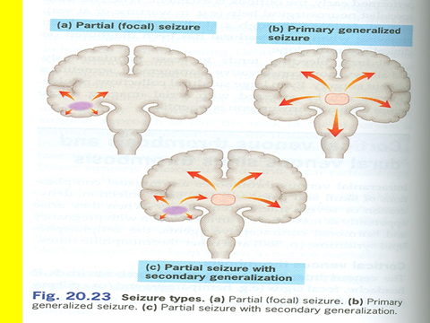

Slide 12
Treatment of Epilepsy
Drugs***
Surgery
Ketogenic diet
Vagal nerve stimulation

Slide 13
General rules for treatment of epilepsy
Epilepsy is usually controlled but not cured with medication
Up to 80% of patients can expect partial or complete control of seizures with appropriate treatment
Antiepileptic drugs are indicated when there is two or more seizures occurred in short interval (6 m -1y)
An initial therapeutic aim is to use only one drug (mono therapy)

Slide 14
General rules for treatment of epilepsy
Drugs are usually administered orally
Monitoring plasma drug level is useful
Triggering factors can affect seizure control by drugs
Sudden withdrawal of drugs should be avoided

Slide 15
Withdrawal considered
Seizure – free period of 2-5 yrs or longer
Normal IQ
Normal EEG prior to withdrawal
NO juvenile myoclonic epilepsy
Relapse rate when antiepileptics are withdrawn is 20-40%.

Slide 16
Mechanism of Anti-Epileptic Drugs
Antiepileptic drugs inhibit depolarization of neurons by following mechanisms:
Inhibition of excitatory neurotransmission
(Glutamate )
Enhancement of inhibitory neurotransmission
(GABA )
Blockage of voltage-gated positive current
(Na⁺ )
(Ca²⁺ )
Increase outward positive current
(K⁺ )

Slide 17
Classification of antiepileptic drugs:
First-generation
Second- generation
Phenytoin
Carbamazepine
Valproate
Ethosuximide
Phenobarbital and Primidone
Benzodiazepines (e.g.Clonazepam, lorazepam and diazepam)
Lamotrigine
Topiramate
Levetiracetam
Gabapentin
Felbamate
Zonisamide
Pregabalin

Slide 18
Phenytoin
Pharmacokinetics:
Given orally, well absorbed from GIT.
Also available i.v. and i.m. (fosphenytoin)
Enzyme inducer
Metabolized by the liver to inactive metabolites
Half life approx. 20 hrs
Excreted in urine

Slide 19
Fosphenytoin
Parenteral form of phenytoin
A Prodrug
Given i.v. or i.m. and rapidly converted to phenytoin in the body
Lower local tissue and cardiac toxicity than phenytoin
Less pain and phlebitis at injection site than phenytoin

Slide 20
Phenytoin
Mechanism of action:
Therapeutic uses:
Blockade of Na⁺ & Ca⁺⁺ influx into neuronal axon
Inhibit the release of excitatory transmitters
Potentiate the action of GABA
Partial and generalized tonic-clonic seizures Not in absence seizure.
In status epilepticus, IV

Slide 21
Phenytoin Side effects
Nausea or vomiting
Headache, vertigo, ataxia, diplopia , nystagmus
Sedation
Gum (gingival) hyperplasia
Hirsutism
Acne
Folic acid deficiency (megaloblastic anemia)
Vitamine D deficiency (osteomalacia)
Teratogenic effects

Slide 22
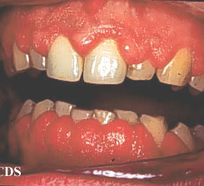
Phenytoin-induced gum hyperplasia

Slide 23
Questions ???

