Slide 1
Drugs Used in Epilepsy-II

Slide 2
Carbamazepine
Pharmacokinetics :
Available as capsules &Syrup only orally
Well absorbed
Strong enzyme inducer including its own metabolism
Metabolized by the liver to active & inactive metabolites
Half life 18-35 hr
Excreted in urine

Slide 3
Carbamazepine
Mechanism of action
Therapeutic uses:
Blockade of Na⁺ & Ca⁺⁺ influx into neuronal axon
Inhibit the release of excitatory transmitters
Potentiate the action of GABA
Drug of choice in partial seizures.
Tonic-clonic seizures (1ry & 2ry generalized) but Not in absence seizures.
Other uses:
Bipolar depression.
Trigeminal neuralgia

Slide 4
Side effects
GIT upset
Hypersensitivity reactions
Drowsiness , ataxia, headache & diplopia
Hyponatremia & water intoxication
Teratogenicity

Slide 5
Sodium Valproate
Broad spectrum antiepileptic
Pharmacokinetics:
Available as capsules, Syrup , I.V
Metabolized by the liver ( inactive )
Enzyme inhibitor
Half life 12-16 hr
Excreted in urine

Slide 6
Sodium valproate
Mechanism of action
Blocks activated Na⁺ channels.
Enhances GABA synthesis & reduces degradation
Suppress glutamate action.
Blocks T-type Ca²⁺ channels
Therapeutic Uses
[I] Epilepsy:
It is effective for all forms of epilepsy
Generalized tonic-clonic seizures (1^{ry} or 2^{ry} ).
Absence seizures
Complex partial seizures
Myoclonic
Atonic
photosensitive epilepsy
[II] Other uses:
Bipolar disorder and mania
Prophylaxis of migraine
Lennox-Gastaut syndrome

Slide 7
Sodium valproate, Side effects:
GI (nausea, vomiting , heart burn)
Weight gain (↑appetite )
Transient hair loss, with re-growth of curly hair
Thrombocytopenia (not used with aspirin or coumadin
Transient increase in liver enzymes & hepatotoxicity
Teratogenicity (neural tube defect)

Slide 8
Ethosuximide
Pharmacokinetics:
Absorption is complete
Syrup & capsule forms
Not bound to plasma proteins or tissues
Metabolized in liver
Half life 52-56 hr
10-20% of a dose is excreted unchanged the urine

Slide 9
Ethosuximide
Mechanism of action
Inhibits T- type Ca²⁺ channels in thalamo-cortical neurons

Slide 10
Ethosuximide
Therapeutic uses
Absence seizures
Adverse effects
Gastric distress
nausea
vomiting
Drowsiness, fatigue , hiccups, headaches

Slide 11
Lamotrigine
Pharmacokinetics
Available as oral tablets
Well absorbed from GIT
Metabolized primarily by glucuronidation
Does not induce or inhibit C. P-450 isozymes
Half life approx. 24 hr

Slide 12
Lamotrigine
Mechanism of action
Therapeutic Use
Blockade of Na⁺ channels
Inhibits excitatory amino acid release ( glutamate & aspartate )
As add-on therapy or as monotherapy in partial seizures
Lennox-Gastaut syndrome

Slide 13
Lamotrigine, Side effects:
Influenza-like symptoms
Skin rashes (may progress to Steven –Johnson syndrome)
Somnolence
Blurred vision
Diplopia
Ataxia

Slide 14
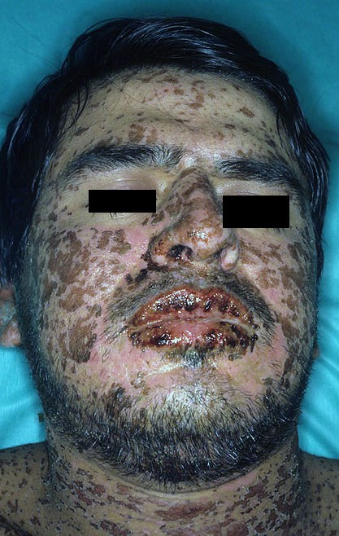

Slide 15
Topiramate
Pharmacokinetics:
Well absorbed orally ( 80 % )
Food has no effect on absorption
Has no effect on microsomal enzymes
9-17 % protein bound ( minimal )
Mostly excreted unchanged in urine
Plasma t½ 18-24 hrs

Slide 16
Topiramate
Mechanism of Action:
Blocks sodium channels (membrane stabilization) and also potentiates the inhibitory effect of GABA.
Clinical Uses:
Can be used alone for partial, generalized tonic-clonic, and absence seizures.
Lennox-Gastaut syndrome ( or lamotrigine, or valproate ).

Slide 17
Topiramate, Side effects:
Psychological or cognitive dysfunction
Weight loss ( can be desirable side effect)
Sedation
Dizziness
Fatigue
Urolithiasis
Paresthesias (abnormal sensation )
Teratogenecity (in animal but not in human)

Slide 18
Summary
Type of seizure |  | Choice among drugs
Partial seizures: Carbamazepine or phenytoin or valproate or lamotrigine.
Generalized seizures:
Tonic-clonic (grand mal) | Valproate or carbamazepine or phenytoin or Lamotrigine
Myoclonic | Valproate, clonazepam
Absence | Valproate, ethosuximide
Atonic | Valproate

Slide 19
Drugs used for treatment of Status Epilepticus
Most seizures last from few seconds to few minutes. When seizures follow one another without recovery of consciousness, it is called “status epilepticus”
It has a high mortality rate
Death is from cardiorespiratory failure.

Slide 20
Antiepileptics used in status epilepticus
Intravenous injection of :
Lorazepam, Diazepam (drugs of choice)
Phenytoin
Fosphenytoin
Phenobarbital
Valproate

Slide 21
Vagal nerve stimulation
It is an alternative for patients who have been refractory to multiple drugs
Who are sensitive to the many adverse effects of anti epileptic drugs
It is an expensive procedure

Slide 22
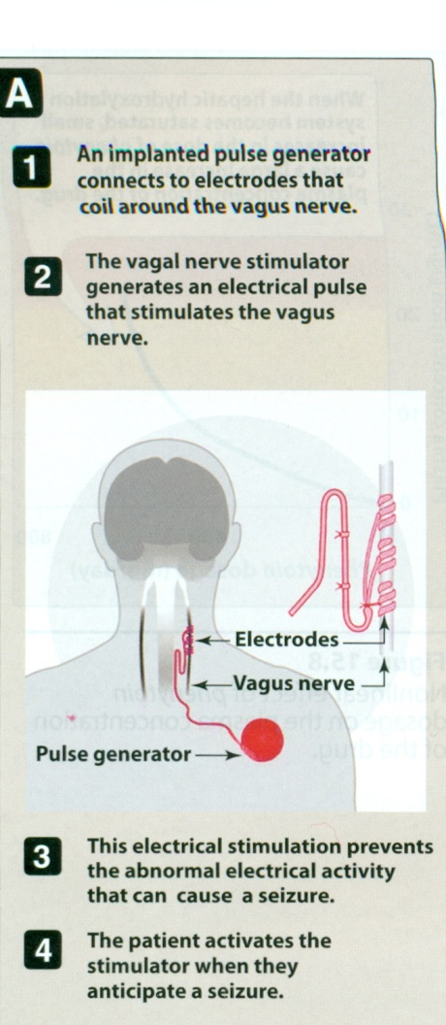

Slide 23
Pregnancy & antiepileptics
Seizure is very harmful for pregnant woman
NO antiepileptic drug is safe in pregnancy
Monotherapy usually better than drug combination
Valproate & phenytoin are contraindicated during pregnancy
Patient has to continue therapy

Slide 24
Summary
Epilepsy is classified into partial or generalized according to the site of lesion
The exact mechanism of action of antiepileptics is not known
Phenytoin is mainly used for treatment of generalized tonic-clonic seizures
Carbamazepine is mainly used for treatment of partial seizures

Slide 25
Summary
Sodium valproate is a broad spectrum antiepileptic drug
Lamotrigine & levetiracetam are used as monotherapy or adjunctive therapy in refractory cases
Lorazepam , diazepam , phenytoin are used intravenously for treatment of status epilepticus

Slide 26
Questions ???

