Slide 1
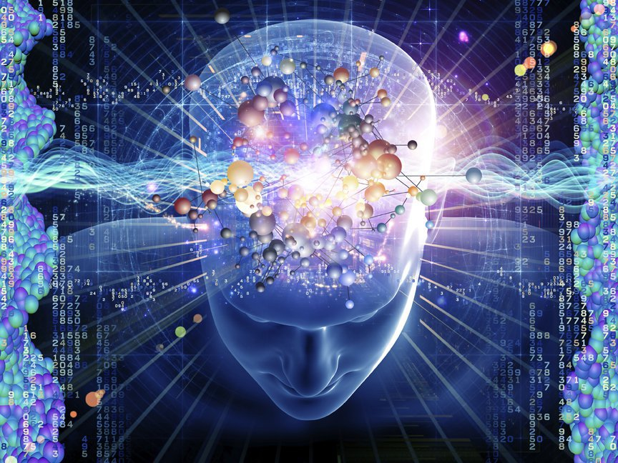
Physiology of Consciousness

Slide 2
Is the brain state in which a person is being aware of the self and surroundings
It is a product of electrical activity of the brain
4 levels of consciousness
1- Normal consciousness
2- Clouded consciousness
3- Sleep
4- Coma

Slide 3
Level of consciousness
(1) Normal Consciousness
State of normal arousal
Being fully awake
And
Aware of the self and surroundings

Slide 4
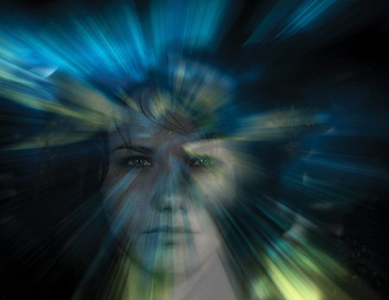
(2) Clouded consciousness :
person conscious but mentally confused
e.g.
Drug or alcohol intoxication
High fever associated (malaria or septicemia, dementia , etc)

Slide 5
(3) Sleep :
Person unconscious ( in relation to the external world & surroundings)
but is arousabale

Slide 6
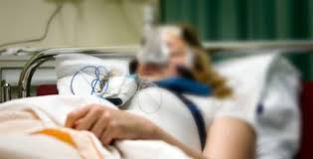
(4) Coma : person unconscious and not arausable

Slide 7
brain Structures involved in the conscious state:
1- Brain stem Reticular formation
2- Thalamus
3- Hypothalamus
4- Ascending projection pathways
5- Wide spread area in the cerebral cortex

Slide 8
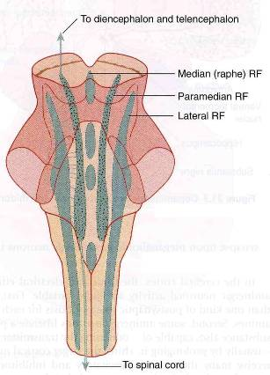
1- Reticular formation
Set of interconnected nuclei that are located throughout the brainstem (Pons, Midbrain, Upper medulla), and the thalamus
Role in behavioral arousal
Role in consciousness (sleep/awake cycle)
Connect the brain stem to the CC

Slide 9
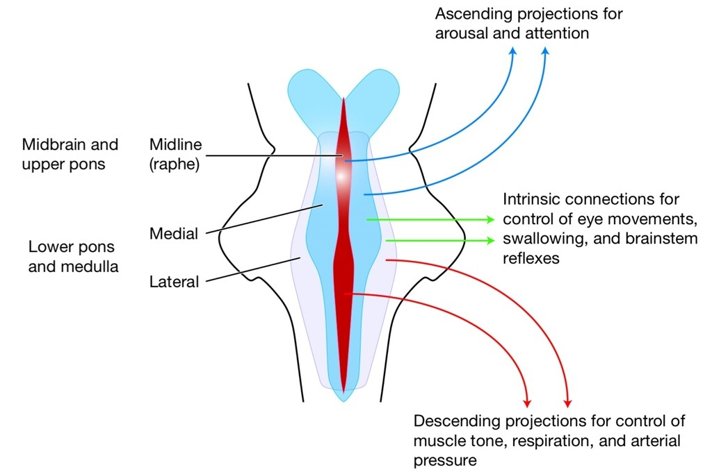
consists of 3 parts:
Lateral Reticular Formation
Paramedian Reticular Formation
Raphe nuclei (Median RF)

Slide 10
Lateral Reticular Formation
Has small neurones
Receives information from ascending tracts for touch and pain.
Receives vestibular information from median vestibular nerve.
Receives auditory information from superior olivary nucleus.
Visual information from superior colliculus.
Olfactory information via medial forebrain bundle

Slide 11
Paramedian Reticular Formation
Has large cells.
Receives signals from lateral reticular formation
Contains noradrenergic (NA) & Dopaminergic (DA) neurones, projects onto cerebral hemispheres.
Cholinergic (Chl) neurones project onto the thalamus

Slide 12
Raphe nuclei (Median RF)
In the midline of the reticular formation
Contain serotonergic projections to the brain and spinal cord.

Slide 13
Functions of reticular formation:
1. Somatic motor control (Reticulospinal tracts)
2. Cardiovascular control
Through cardiac and vasomotor centers of the medulla oblongata
3. Pain modulation
Pain signals from the lower body >> >> RF >> >> cerebral cortex
RF is origin of the descending analgesic pathways
(act on the spinal cord to block the transmission of some pain signals to the brain)

Slide 15
2- Thalamus:
Located n the mid-part of the diencephalon
Cholinergic projections from the thalamus are responsible for:
Activation of the cerebral cortex.
Regulation of flow of information through other thalamic nuclei to the cortex via projections into reticular nuclei.

Slide 16
3- Hypothalamus
Tuberomammillary nucleus in the hypothalamus projects to the cortex and is involved in maintaining the awake state

Slide 17
Reticular Activating System ( RAS):
The Bulboreticular Facilitory ( Excitatory ) Area + Thalamus =Reticular Activating System ( RAS)
The RAS is the system which keeps our cortex awake and conscious
Bulboreticular Facilitory ( Excitatory ) = Reticular Excitatory Area of the Brain Stem
Sends excitatory signals into Thalamus
>>>> thalamus excites almost all areas of the cortex .

Slide 18
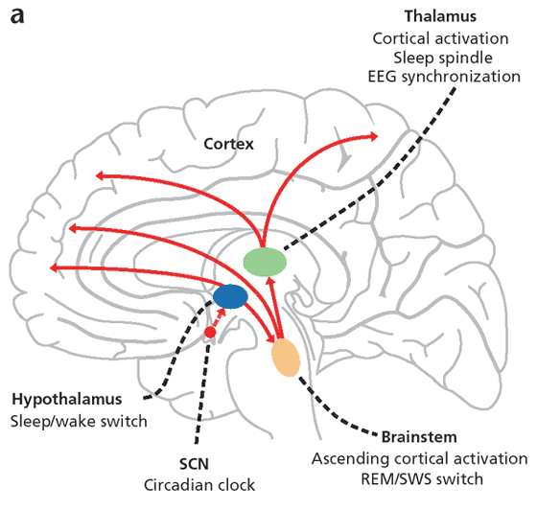
Anatomical components of RAS
The RAS is composed of several neuronal circuits connecting the brainstem to the cortex.
Originate in the upper brainstem reticular core and project through synaptic relays in the thalamic nuclei to the cerebral cortex
As a result, individuals with bilateral lesions of thalamic intralaminar nuclei are lethargic or drowsy

Slide 19
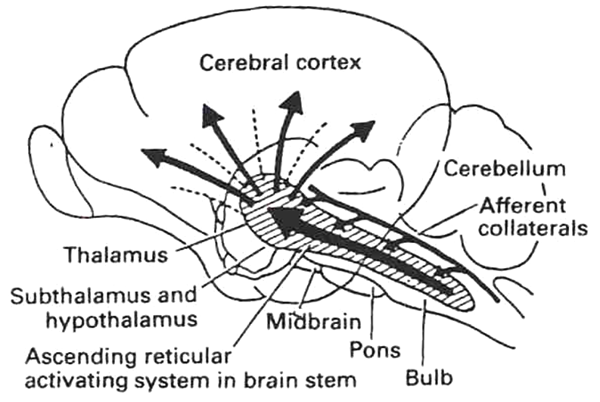
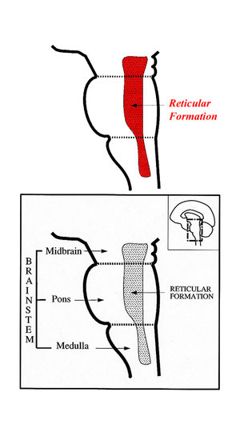
RAS
-Lesion in the mid-pons >>>>>>>unconsciousness
-Pons (uppers & middle) and midbrain are essential for wakefulness .

Slide 20
Sensory inputs to RAS

Slide 21
Functions of RAS:
1- Regulating sleep-wake transitions
If inhibitory area activity increase >>>> reduce the activity of RAS >>>>> less afferent signal to the CC >>>>> sleep
2-Attention:
RAS mediate transitions from relaxed wakefulness to of high attention
3-RAS and learning:
-The RAS is the center of balance for the other systems involved in learning, self-control or inhibition, and motivation.
-Provides the neural connections for processing and learning of information,
-Selective attention (to the correct task)

Slide 22
RAS dysfucntion
If RAS is depressed:
An under-aroused cortex
Difficulty in learning
Poor memory
Little self-control
lack of consciousness or even coma.
If the RAS is too excited,
Over aroused cortex
Hyper-vigilance (sensory sensitivity )
Touching everything
Talking too much
Restless
Hyperactive

Slide 23
Indices of Level of Consciousness
Appearance & Behavior :
Posture ( sitting , standing ? )
Open eyes ?
Facial expression ?
Responds to stimuli ( including the examiner’s questions about name , orientation in time & place ? & other general Qs like who is the president ? )
Vital signs :
Pulse , BP, respiration , pupils , reflexes , particularly brainstem reflexes , etc )
EEG → Each of these states ( wakefulness , sleep , coma and death ) has specific EEG patterns
Evoked potentials ( in cases of Brain Death ).

Slide 24
Electroencephalogram

Slide 25
Alpha waves:
Recorded from the parietal &occipital regions
Awake and relaxed+ eyes closed
10 to 12 cycles/second.
Beta waves:
Frontal lobes
Produced by visual stimuli and mental activity
13 to 25 cycles per second.

Slide 26
Theta:
Temporal and occipital
5 to 8 cycles/second
Normal in newborn
Theta waves in adults indicates severe emotional stress
Delta:
From the cerebral cortex
1 to 5 cycles/second
Sleep (adults) and in an awake infant
In an awake adult indicates brain damage.

Slide 27
Brain Death Confirmatory Testing with EEG
Normal EEG ( at normal magnification )
Brain Death ( Flat EEG ,at very high magnification )

Slide 28
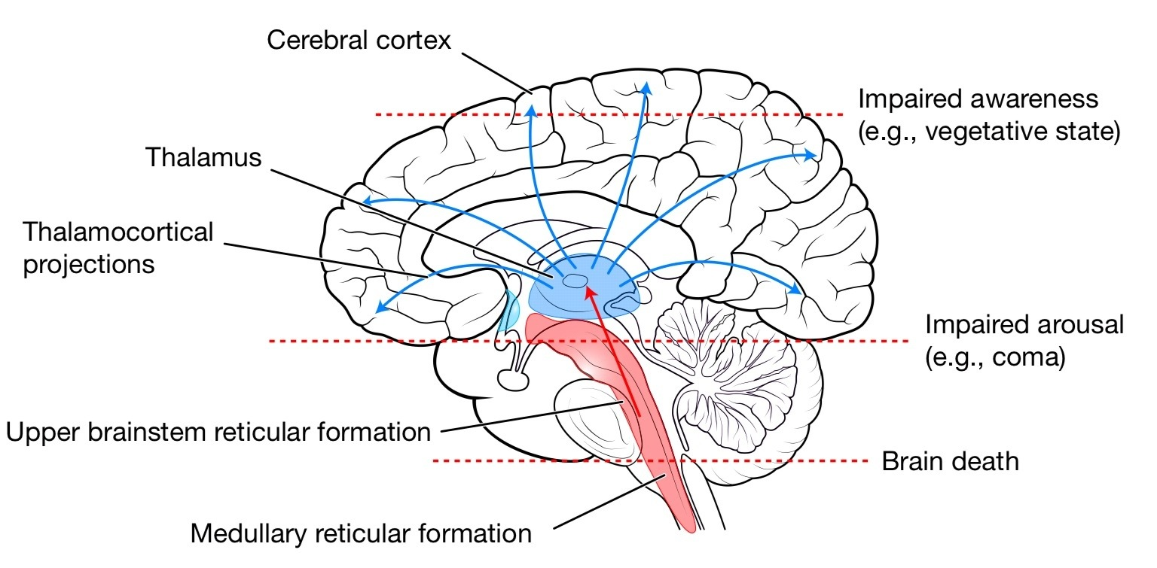

Slide 29
Thank you

