Slide 1
BASAL GANGLIA
Prof.Musaad Alfayez

Slide 2
OBJECTIVES
At the end of the lecture, the student should be able to:
Define “basal ganglia” and enumerate its components.
Enumerate parts of “Corpus Striatum” and their important relations.
Describe the structure of Caudate and Lentiform (Putamen & Globus Pallidus) nuclei.
Differentiate between striatum & paleostriatum in term of connections.
State briefly functions & dysfunctions of Corpus Striatum.

Slide 3
BASAL GANGLIA (NUCLEI)
Group of nerve cells deeply situated in cerebral hemispheres
Components:
Caudate Nucleus
Lentiform Nucleus: divided into Putamen & Globus Pallidus
Amygdaloid Nucleus
CN
LN
AN

Slide 4
Caudate & Lentiform nuclei are functionally related to each other & called “Corpus Striatum”:Part of extrapyramidal motor system, principally involved in the control of posture and movements (primarily by inhibiting motor functions)
Amygdaloid Nucleus (part
of limbic system) is only
embryologically related to
Corpus Striatum

Slide 5
CORPUS STRIATUM (Nomenclature)
Bands of grey matter pass from lentiform nucleus across the internal capsule to the caudate nucleus, giving the striated appearance hence, the name corpus striatum.

Slide 6
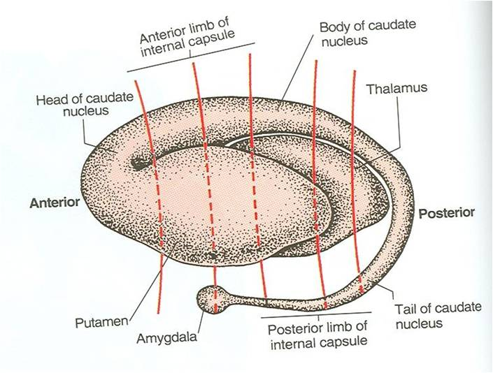
PARTS
LENTIFORM NUCLEUS
SHAPE: three sided, wedge-shaped mass of grey matter, with a convex outer surface and an apex which lies against the genu of the internal capsule (G)
DIVISION: divided into
Larger darker lateral portion called Putamen (P)
Smaller, lighter medial portion called Globus Pallidus (g)
G

Slide 7
Putamen is more closely related to Caudate nucleus (regarding development, function & connections) and together constitute the Neostriatum or Striatum.
Globus Pallidus is the oldest part of corpus striatum and is called Paleostriatum or Pallidum

Slide 8
PUTAMEN
Separated from globus pallidus by a thin sheath of nerve fibers, the Lateral Medullary Lamina
The white matter lateral to putamen is divided, by a sheath of grey matter, the Claustrum into two layers:
External capsule (1) between the putamen and claustrum and
Extreme capsule (2) between the claustrum and the insula
Insula
2
1

Slide 9
GLOBUS PALLIDUS
Consists of two divisions, the Lateral & the Medial segments, separated by a thin sheath of nerve fibers, the Medial Medullary lamina.
The medial segment is similar, in terms of cytology and connections with the pars reticulata of substantia nigra

Slide 10
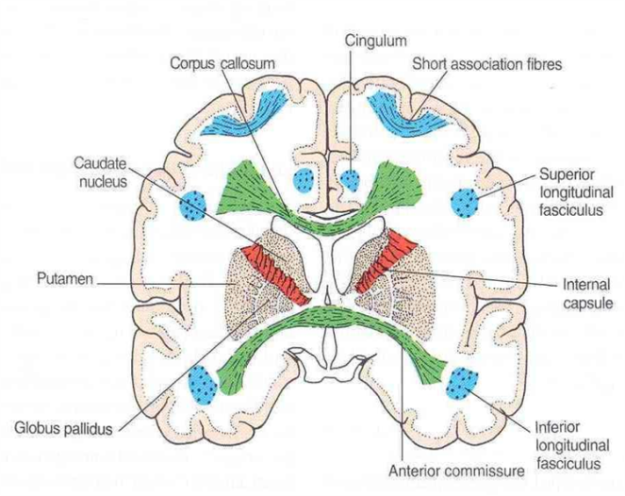
CAUDATE NUCLEUS
SHAPE: C-shaped mass of grey matter
COMPONENTS: head, body & tail
Head:
-Rounded in shape
-Lies anterior to thalamus (in frontal lobe)
-Completely separated from the putamen by the internal capsule except rostrally where it is continuous with the putamen

Slide 11
CAUDATE NUCLEUS
Body:
-Long & narrow
-Extends above thalamus (in parietal lobe)
Tail:
-Long & tapering
-Descends into temporal lobe
-Continuous with Amygdaloid Nucleus

Slide 13
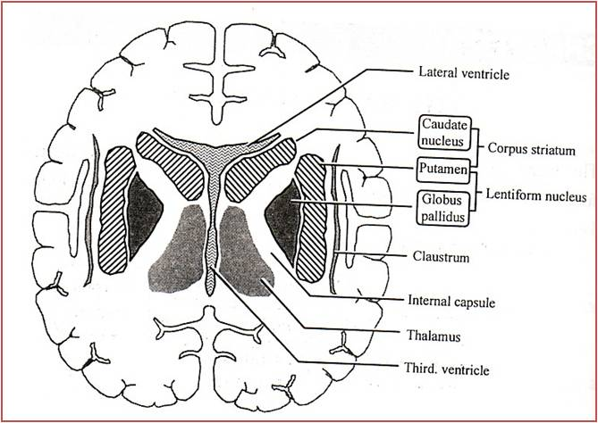
CORPUS STRIATUM (Important relations)
Head of Caudate Nucleus lies:
Anterior to thalamus
Medial to Lentiform & separated from it by anterior limb of internal capsule (A)
Lentiform Nucleus:
Lateral to thalamus & separated from it by posterior limb of internal capsule (P)
A
P

Slide 14
STRIATUM (CAUDATE & PUTAMEN)
“The input portion of Corpus striatum”
Cerebral Cortex
Striatum
G.P.
Lateral segment
G.P.
Medial segment
Thalamus
(Intralaminar nuclei)
Pars compacta
Substantia Nigra
Afferents
Pars reticulata
Efferents

Slide 15
PALEOSTRIATUM (GLOBUS PALLIDUS)
“The output portion of corpus striatum:
medial segment of G.P. + Pars Reticulata of S.N.”
Thalamic fasciculus
Thalamus
(Ventral lateral, Ventral anterior, centromedian)
Striatum
G.P.
Lateral segment
G.P.
Medial segment
Subthalamic fasciculus
Subthalamic
Nucleus
Afferents
Pars reticulata
Efferents
Substantia Nigra

Slide 16
CORPUS STRIATUM Function
The corpus striatum assists in regulation of voluntary movement and learning of motor skills as they:
Facilitate behavior and movement that are required and appropriate.
Inhibit unwanted or inappropriate movement.

Slide 17
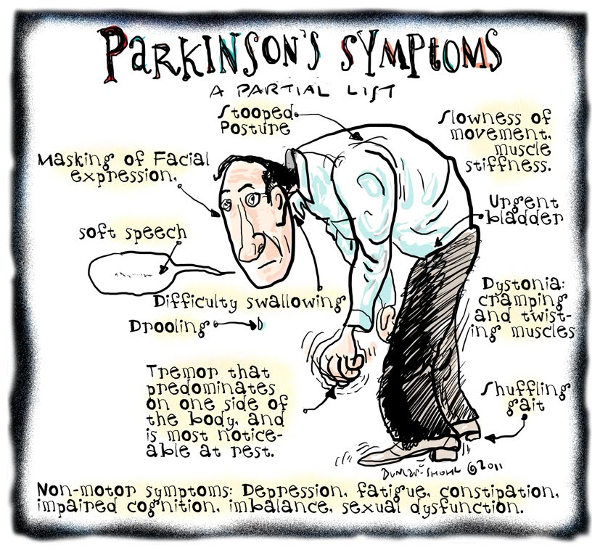
Dysfunction
Its dysfunction does NOT cause: paralysis, sensory loss or ataxia
It leads to:
Abnormal motor control: emergence of abnormal, involuntary movements (dyskinesias)
Alteration in muscle tone: hypertonia/hypotonia

Slide 18
Connection Of Corpus Striatum
Afferent Fibers ( Input):
I- Corticostriate Fibers: From all parts of cerebral cortex (mostly from sensory- motor cortex) axons pass to caudate nucleus and putamen.
Glutamate is the neurotransmitter of this fibers.
II-Thalamostriate Fibers : From intralaminar nuclei of thalamus axons pass to caudate nucleus and putamen.
III- Nigrostriate Fibers : Axons from Substantia nigra of midbrain pass to caudate nucleus and putamen.
Neurotransmitter is Dopamine.
IV_Brain stem Strial Fibers : Ascending fibers from brain stem end in caudate nucleus & putamen.
Serotonin is the neurotransmitter.
It is believed that the last 2 groups are inhibitory in function

Slide 19
Efferent fibers (Output):
1-Striatopallidal fibers:
These fibers pass from striatum (caudate nucleus & putamen) to globus pallidus.
Gamma-aminobutyric acid (GABA) is the neurotransmitter.
2-Striatonigral fibers:
These fibers pass from caudate nucleus & putamen to Substantia nigra.
Some fibers use GABA as a neurotransmitter, and others use substance p.

Slide 20
BASAL GANGLIA
FUNCTIONS
Control of movements
Planning and programming of movements
Cognition

Slide 21
Introduction to function of basal Nuclei
Basically the activity of basal nuclei begins by information received from sensory cortex, thalamus, substantia nigra, and red nucleus, according to thoughts of mind.
These information is integrated within striatum and channeled within globus pallidus and outflow back to motor areas of cerebral cortex, and other motor areas in brain stem.
Thus the basal nuclei can control muscular movement through its effect on cerebral cortex
So basal nuclei assist in regulation of voluntary movement and learning of motor skills.

Slide 22
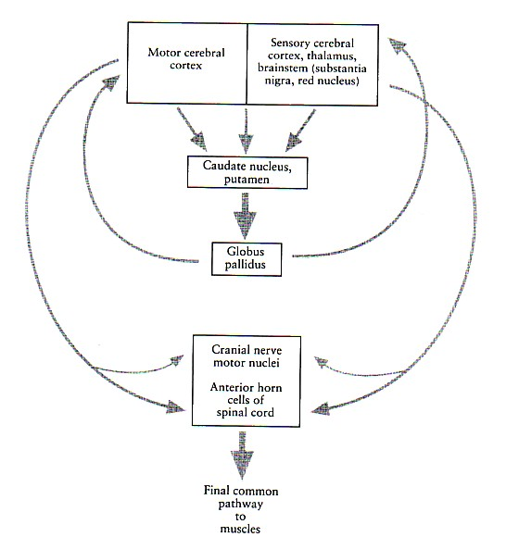

Slide 23
Functions of basal ganglia:
1- Design of plans, which convert thoughts and ideas into motor actions: to produce a coordinated organized purposeful movement.
e.g. dressing.
Determining the timing and scale of movement: to what extent the movement will be fast, and how long it will last.
Storage of motor programs of familiar motor actions: e.g. signature.

Slide 24
Parkinsonism Parkinson’s disease, paralysis Agitans
Lesion:
Neuronal degeneration in substantia nigra leading to reduction of dopamine within corpus striatum.
Features:
1- Tremors:
Pill-rolling, involuntary, rhythmic, oscillating movements. It occurs during rest, it is called static tremors.
2- Rigidity:
It occurs in both flexors, and extensors, but more in flexors giving flexion attitude. It is called lead pipe rigidity.
3- Akinesia:
it means lack of movement; Absence of swinging arm during walking, mask face, low- volume slow monotonous speech, and shuffling gait.

Slide 25
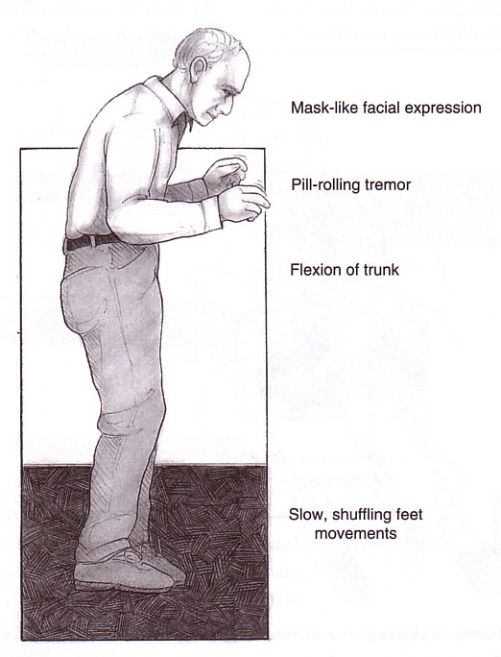
Parkinsonism

Slide 26
Parkinson’s Disease
Described by James Parkinson
Degeneration of dopaminergic nigrostriatal neurons (60-80 %).
Methyl-Phenyl-Tetrahydro-Pyridine (MPTP). The oxidant MPP+ is toxic to SN.
Four cardinal symptoms
Tremor
Rigidity
Akinesia & Bradykinesia
Postural Changes
Speech Changes
Notes:
Loss of DA --. Lose excitatory effect on direct, lose inhibition of indirect
Overactive GPi and overactive STN → increased inhibition of motor thalamus

Slide 27
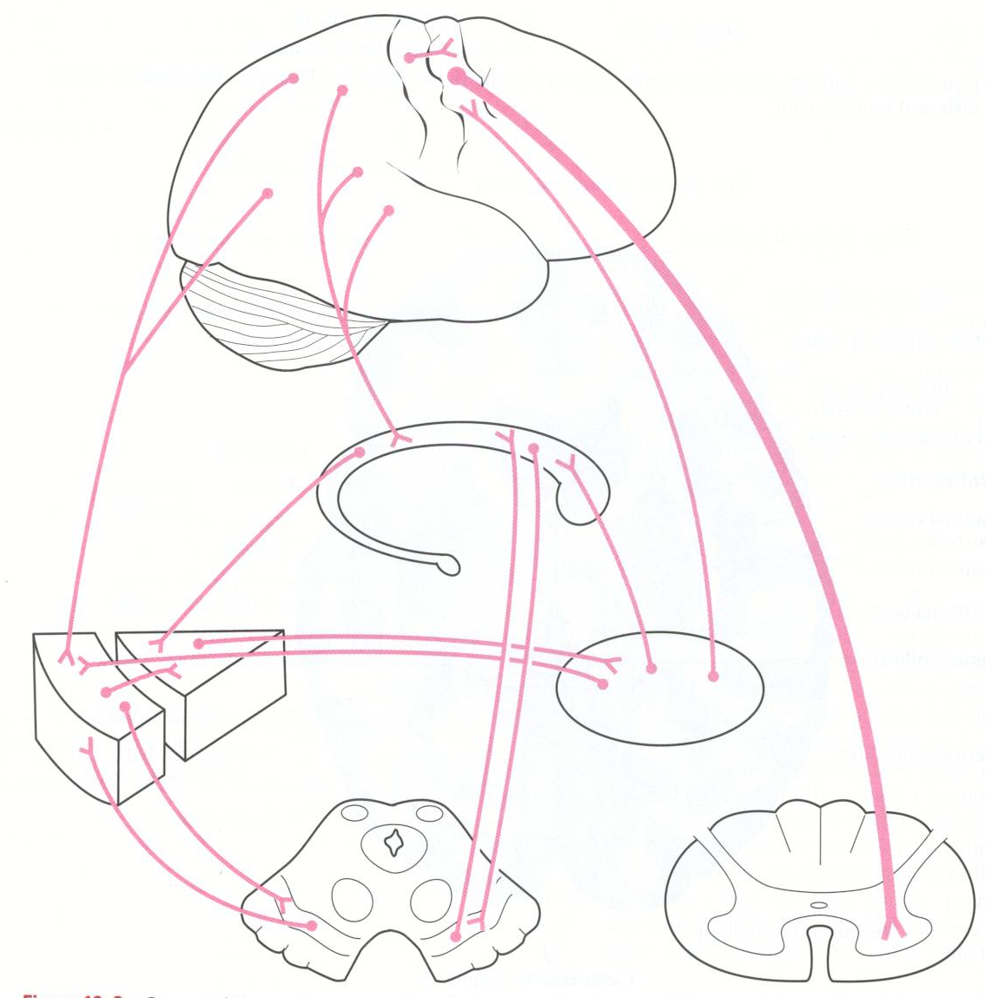
Main Connections between Cortex, basal Nuclei, Thalamic Nuclei Brainstem & Spinal Cord

Slide 28
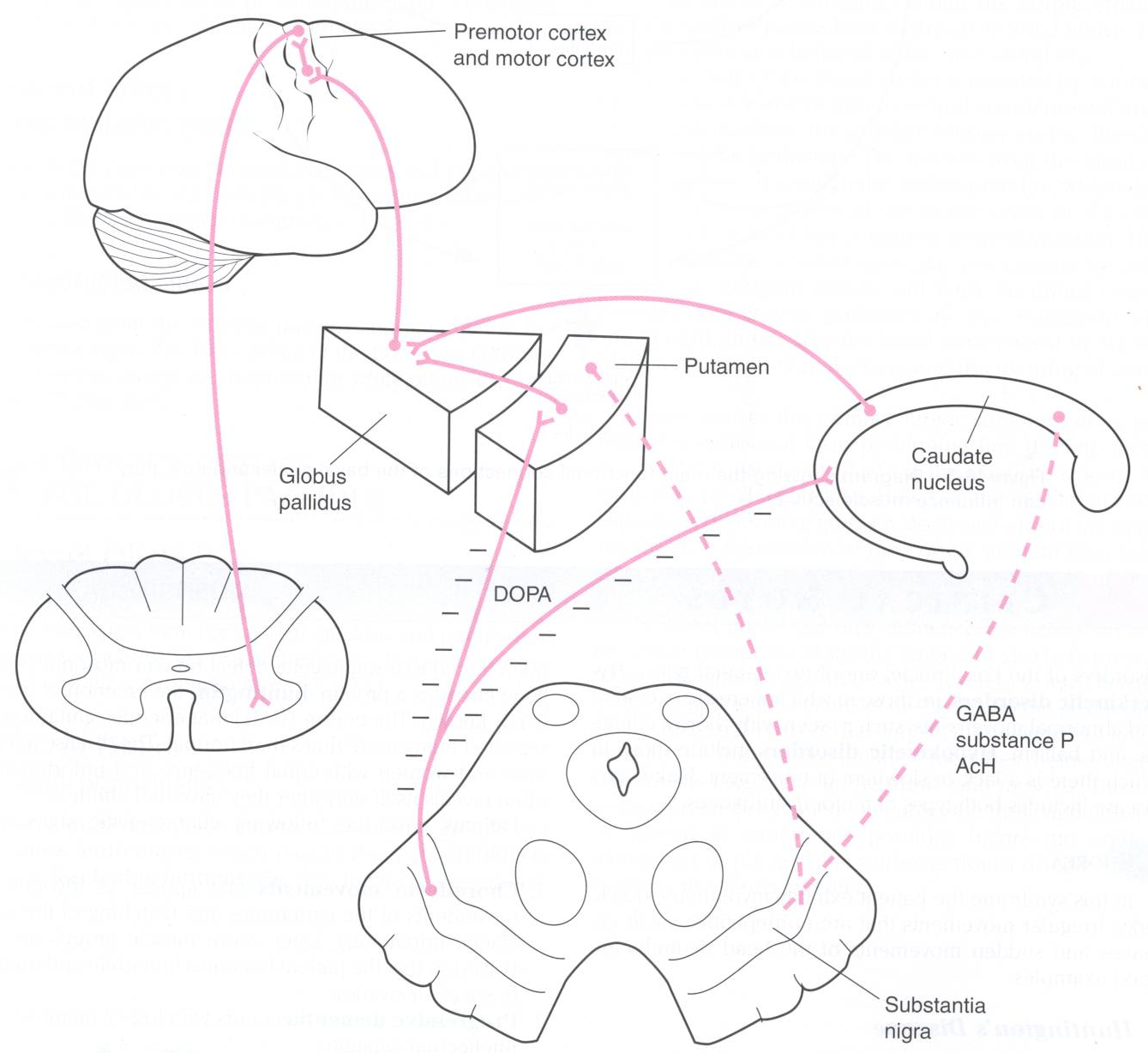
Huntington’s Disease: degeneration of inhibitory pathway between corpus striatum & S nigra

Slide 29
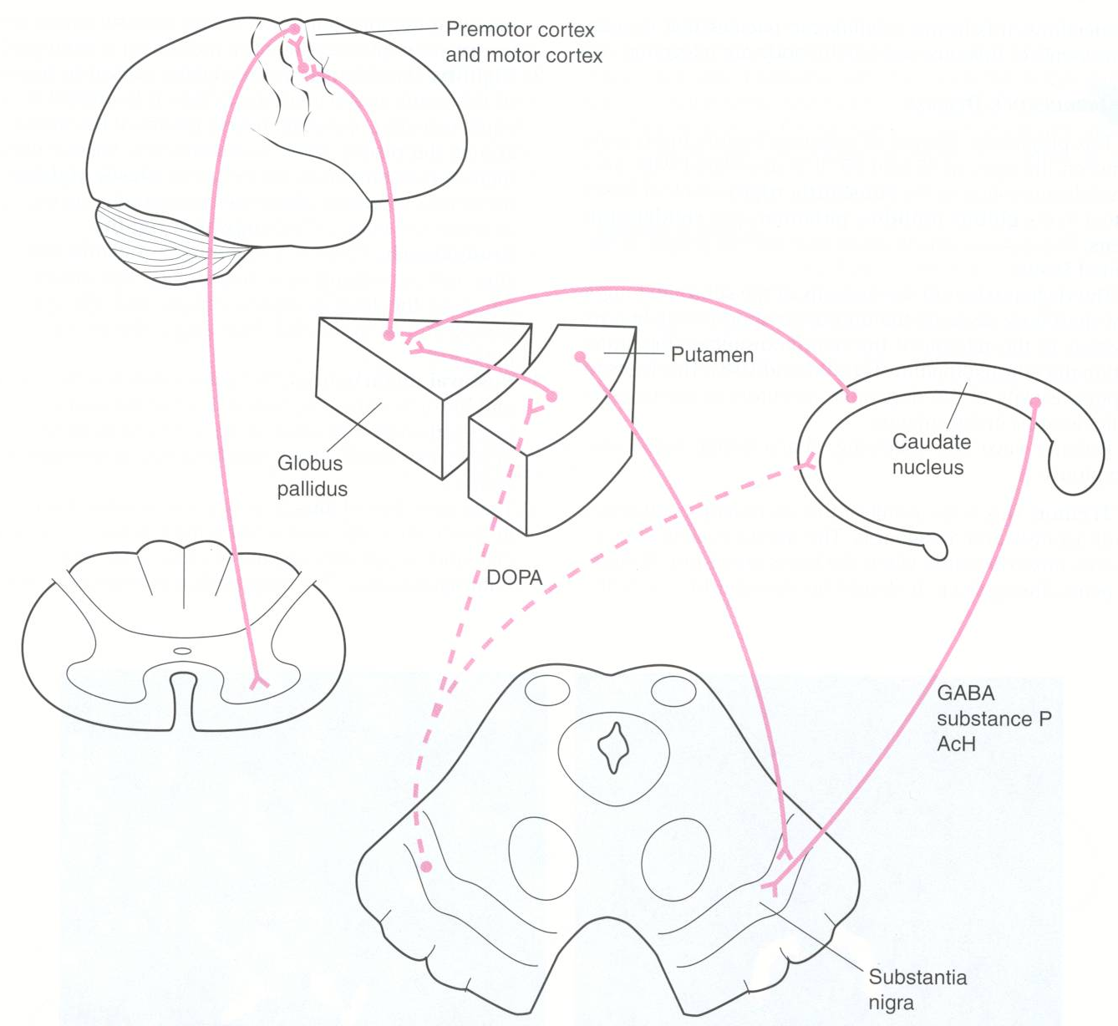
Parkinson’s Disease: degeneration of inhibitory pathways between S Nigra & corpus striatum

