Slide 1
Alcohol and the brain
Prof. Hanan Hagar
Dr. Ishfaq Bukhari
Pharmacology Unit
College of Medicine
KSU

Slide 2
Alcohol: The mother of All Evils

Slide 3
Ethyl alcohol (ethanol)
Ethyl alcohol (ethanol) is the most commonly abused drug in the world.
Pharmacokinetics
is a small lipophilic molecule
readily crosses all biological membranes
Rapidly & completely absorbed from GIT
Has large Vd (distributed to all body tissues)
Crosses placenta and excreted in milk
3

Slide 4
Pharmacokinetics of ethanol
metabolized in gastric mucosa & liver.
Oxidation of ethanol to acetaldehyde via alcohol dehydrogenase or cyt-p450 (CYP2E1).
Acetaldehyde is converted to acetate via acetaldehyde dehydrogenase
Acetate ultimately is converted to CO2 + water.
At low ethanol conc., minor metabolism by MEOS (microsomal ethanol-oxidizing system) mainly cyt-p450 (CYP2E1). Upon continuous alcohol use, this enzyme is stimulated and contribute significantly to alcohol metabolism.
Notes:
ADH; Alcohol dehydrogenase, ALDH; Aldehyde dehydrogenase . NAD⁺/NADH: nicotinamide adenine dinucleotide

Slide 5
Alcohol Metabolism; 90-98% metabolized in liver
ADH ALDH
CH3CH2OH →→ CH3CHO→→CH3COOH
Ethanol Acetaldehyde Acetic Acid

Slide 6
Pharmacokinetics of ethanol
Acute alcohol consumption inhibits liver enzymes CYP450 2E1, so decrease metabolism of other drugs taken concurrently as (warfarin, phenytoin).
Chronic alcohol consumption induces CYP450 2E1, which leads to significant increases in ethanol metabolism (Tolerance) & metabolism of other drugs as warfarin.
Notes:
ADH; Alcohol dehydrogenase, ALDH; Aldehyde dehydrogenase . NAD⁺/NADH: nicotinamide adenine dinucleotide

Slide 7
Genetic variation of alcohol metabolism
Aldehyde Dehydrogenase polymorphism
Asian populations have genetic variation in aldehyde dehydrogenase.
They metabolized alcohol at slower rate than other populations.
Can develop “Acute acetaldehyde toxicity” after alcohol intake characterized by nausea, vomiting, dizziness, vasodilatation, headache and facial flushing.
Notes:
Genetic Variation in alcohol metabolizing enzymes: ALDH
Polymorphism also occurs at the aldehyde dehydrogenase resulting in a variant allele - ALDH2*2. Its possessed by 50% of Asian populations (including Chinese, Japanese, Taiwanese, Korean). This results in an isozyme with a decreased elimination of acetaldehyde and consequently a characteristic flushing response to alcohol, along with nausea, headache and other unpleasant experiences. This makes the alcohol very aversive to these individuals and may protect them from becoming alcoholic. In fact, the prevalence of alcohol problems is almost zero in persons with the ALDH2*2 allele.

Slide 8
Alcohol excretion
Excreted unchanged in urine (2-8%).
Excretion unchanged via lung (basis for breath alcohol test).
Rate of elimination is zero-order kinetic (not concentration-dependent) i.e. rate of elimination is the same at low and high concentration.

Slide 9
Mechanism of action of alcohol
is a CNS depressants
Acute alcohol causes:
Enhancement the effect of GABA (inhibitory neurotransmitter) on its GABA receptors in brain leading to CNS depression
Inhibition of glutamate action (excitatory neurotransmitter) on NMDA receptors leading to disruption in memory, consciousness, alertness.
9

Slide 10
Chronic alcohol leads to
up-regulation of NMDA receptors & voltage
sensitive Ca channels (Ca influx to nerve cells)
leading to alcohol tolerance & withdrawal
symptoms (tremors, exaggerated response &
seizures).

Slide 11
Acute actions of alcohol:
In mild-moderate amounts
CNS depression
relieves anxiety, euphoria (feeling of well-being).
slurred speech, impaired judgment, ataxia
Sedation, hypnosis, loss of consciousness
In huge amounts, severe CNS depression (respiratory depression, respiratory acidosis, pulmonary aspiration, coma.
11

Slide 12
Acute actions of ethanol :
In severe amounts
Severe CNS depression
Nausea, vomiting, aspiration of vomitus.
Respiratory depression.
CVS depression
Volume depletion
Hypotension
Hypothermia
Coma, death.

Slide 13
Chronic ethanol abuse (alcoholism) is associated with many complications
Tolerance, dependence, addiction, behavioral changes
Liver: hepatic cirrhosis & liver failure.
CVS: hypertension, myocardial infarction
CNS: cerebellar degeneration, and peripheral neuropathy. Wernicke encephalopathy or Korsakoff psychosis may occur.
GIT system: irritation, inflammation, bleeding, nutritional deficiencies
Endocrine system: gynecomastia & testicular atrophy
Hematological disorders, neoplasia.

Slide 14
Chronic alcohol use (Alcoholism)
Liver
The most common medical complication
Fatty liver/ alcoholic steatosis
Hepatitis
Hepatic cirrhosis: jaundice, ascites, bleeding, encephalopathy.
Irreversible liver failure.

Slide 15
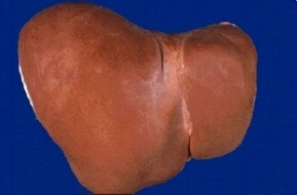
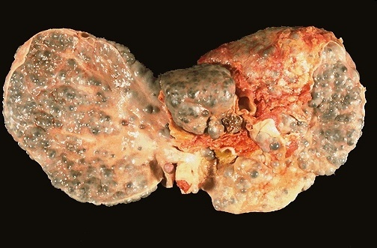
Healthy Liver
Liver in chronic alcoholics

Slide 16
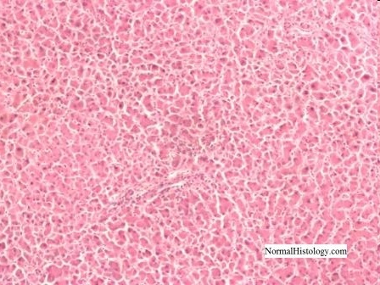
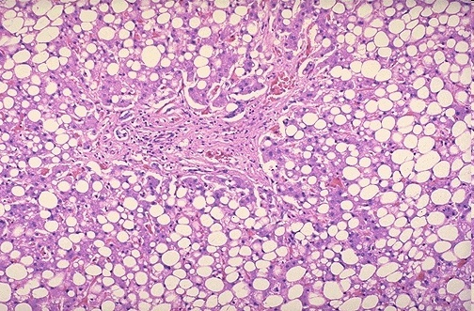
Healthy Liver vs Fatty Liver
Normal liver
Fatty liver
Acetaldehyde is more toxic than alcohol →causing mild inflammation and fat cell proliferation

Slide 17
Gastrointestinal system
Gastritis, hemorrhagic esopahgitis, ulcer diseases, pancreatitis (due to direct toxic action on epithelium)
Diarrhea
Deficiency of vitamins.
Exacerbates nutritional deficiencies
weight loss, and malnutrition

Slide 18
Alcoholism
Cardiovascular System
Chronic alcohol abuse can lead to cardiomyopathy
Cardiac hypertrophy
Congestive heart failure.
Arrhythmia (due to potassium and magnesium depletion)
Hypertension: due to increased calcium & sympathetic activity.

Slide 19
Hematological complications:
Iron deficiency anemia (due to inadequate dietary intake & GIT blood loss).
Megaloblastic anemia: (due to folate deficiency, malnutrition, impaired folate absorption).
Hemolytic anemia.
Bone marrow suppression
Thrombocytopenia (suppressing platelet formation, prolong bleeding times).
Impaired production of vitamin-K dependent clotting factors leading to prolonged prothrombin time.

Slide 20
Fetal Alcohol Syndrome: Irreversible
Ethanol rapidly crosses placenta
Pre-natal exposure to alcohol causes:
- Intrauterine growth retardation (due to hypoxia)
Congenital malformation (teratogenesis):
Microcephaly
Impaired facial development
Congenital heart defects
Physical and mental retardation.

Slide 21
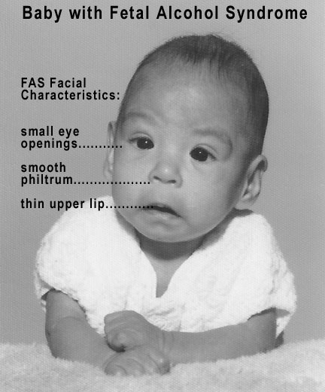
Fetal Alcohol Syndrome ( FAS )

Slide 22
Endocrine system:
Hypogonadism:
In women: ovarian dysfunction, amenorrhea, anovulation, hyperprolactinemia, infertility.
In men: gynecomastia, decreased muscle & bone mass, testicular atrophy and decrease in testosterone,
Hypoglycemia & ketoacidosis due to impaired hepatic gluconeogenesis & excessive lipolytic factors, especially increased cortisol and growth hormone.

Slide 23
Central Nervous System
Tolerance
Physiological and psychological dependence
Addiction: dopamine, serotonin and opioids are involved.
Neurologic disturbances
Wernicke-Korsakoff syndrome

Slide 24
Wernicke-Korsakoff syndrome
It is a combined manifestation of 2 disorders:
Wernicke's encephalopathy: characterized by
ocular disturbances - unsteady gait
changes in mental state as confusion, delirium, ataxia
Korsakoff's psychosis: impaired memory &
cognitive and behavioral dysfunction.
Cause: thiamine (vitamin B1) deficiency due to:
inadequate nutritional intake
decreased uptake of thiamine from GIT
decreased liver thiamine stores
Treated by: thiamine + dextrose-containing IV fluids.

Slide 25
Alcoholism Tolerance
Chronic consumption of alcohol leads to tolerance
That develops due to:
Metabolic tolerance (pharmacokinetic): due to
induction of liver microsomal enzymes.
Functional tolerance (Pharmacodynamic): due to
change in CNS sensitivity.

Slide 26
Alcoholism withdrawal symptoms
Autonomic hyperactivity & craving for alcoho
Profuse sweating, severe tachycardia
Vasodilatation, fever
Delirium, insomnia
Violent behavior, hallucinations.
Grand mal seizures (after 7-48 hr alcohol cessation)
Due to super-sensitivity of glutamate receptors &
hypoactivity of GABA receptors are possibly
involved.

Slide 27
Management of alcoholism withdrawal
Substituting alcohol with a long-acting sedative hypnotic drug then tapering the dose.
Benzodiazepines as (chlordiazepoxide, diazepam) or lorazepam that is preferable (shorter duration of action).
Efficacy: IV/ po
Manage withdrawal symptoms & prevent irritability, insomnia, agitation & seizures.
Dose of BDZs should be carefully adjusted to provide efficacy & avoid excessive dose that causes respiratory depression & hypotension.

Slide 28
Fluoxetine
Clonidine & Propranolol: inhibits the action of exaggerated sympathetic activity
Acamprosate: a weak NMDA receptor antagonist & GABA activator, reduce psychic craving.

Slide 29
To prevent alcohol relapse:
Disulfiram therapy: 250 mg daily
blocks hepatic aldehyde dehydrogenase, this will increase blood level of acetaldehyde.
Acetaldehyde produces extreme discomfort, vomiting, diarrhea, flushing, hotness, cyanosis, tachycardia, dyspnea, palpitations & headache.
Disulfiram-induced symptoms render alcoholics afraid from drinking alc.

Slide 30
Alcohol and drug interactions
Acute alcohol use causes inhibition of liver enzyme, decreases metabolism of some drugs and increases their toxicities e.g. bleeding with warfarin
Chronic alcohol use induces liver microsomal enzymes and increases metabolism of drugs such as warfarin, propranolol and etc
Alcohol suppresses gluconeogenesis, which may increase risk for hypoglycemia in diabetic patients.

Slide 31
NSAIDs + alcohol: Increase in the risk of developing a major GI bleed or an ulcer.
Acetaminophen + alcohol (chronic use): risk of hepatotoxicity. Alcohol can
Narcotic drugs (codeine and methahdone) + alcohol: risk of respiratory and CNS depression.

