Slide 1
Physiology of Consciousness

Slide 2
Consciousness
Is the brain state in which a person is being aware of the self and surroundings
It is a product of electrical activity of the brain
(flat EEG = unconscious)

Slide 3
4 levels of consciousness
1- Normal consciousness
2- Clouded consciousness
3- Sleep
4- Coma

Slide 4
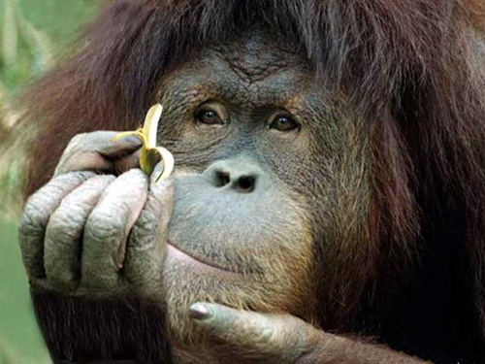
Level of Consciousness
(1) Normal Consciousness
(state of normal arousal , being fully awake and aware of the self and surroundings )

Slide 5
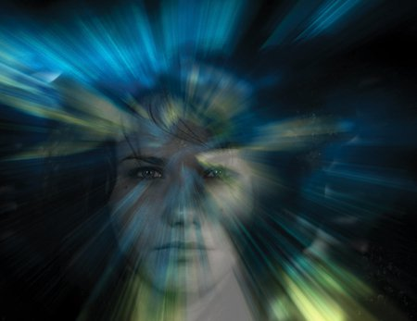
(2) Clouded consciousness :
person conscious but mentally confused
e.g., in cases of drug or alcohol intoxication
, High fever associated (malaria or septicemia , dementia , etc ) .

Slide 6

(3) Sleep :
person unconscious ( in relation to the external world & surroundings)
but is arousable ( can be aroused ) .

Slide 7
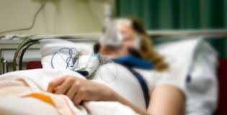
(4) Coma :
person unconscious and not arousable

Slide 8
Brain Structures involved in the conscious state
Brain stem Reticular formation
Thalamus
Hypothalamus
Ascending projection pathways
Wide spread area in the cerebral cortex

Slide 9
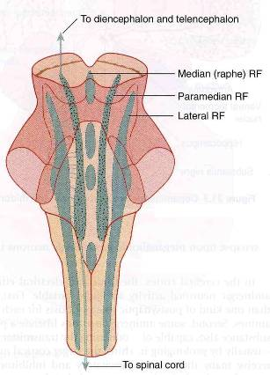
Reticular formation
  Set of interconnected nuclei that are located throughout the brainstem (Pons, Midbrain, Upper medulla), and the thalamus
Role in behavioral arousal
Role in consciousness (sleep/awake cycle)
Connect the brain stem to the CC

Slide 10
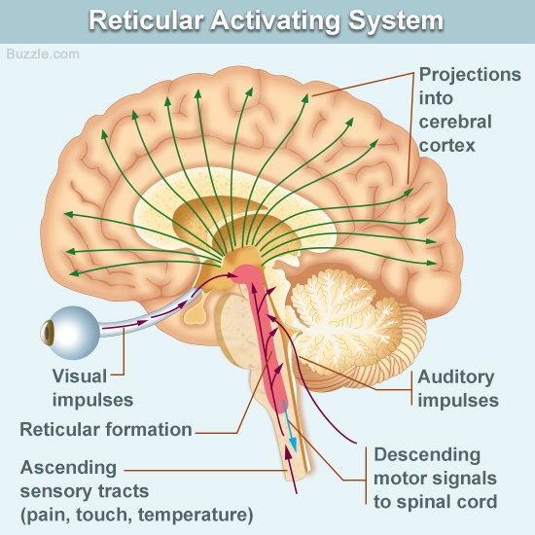

Slide 11
consists of 3 parts:
Lateral Reticular Formation
Para median Reticular Formation
Raphe nuclei (Median RF)

Slide 12
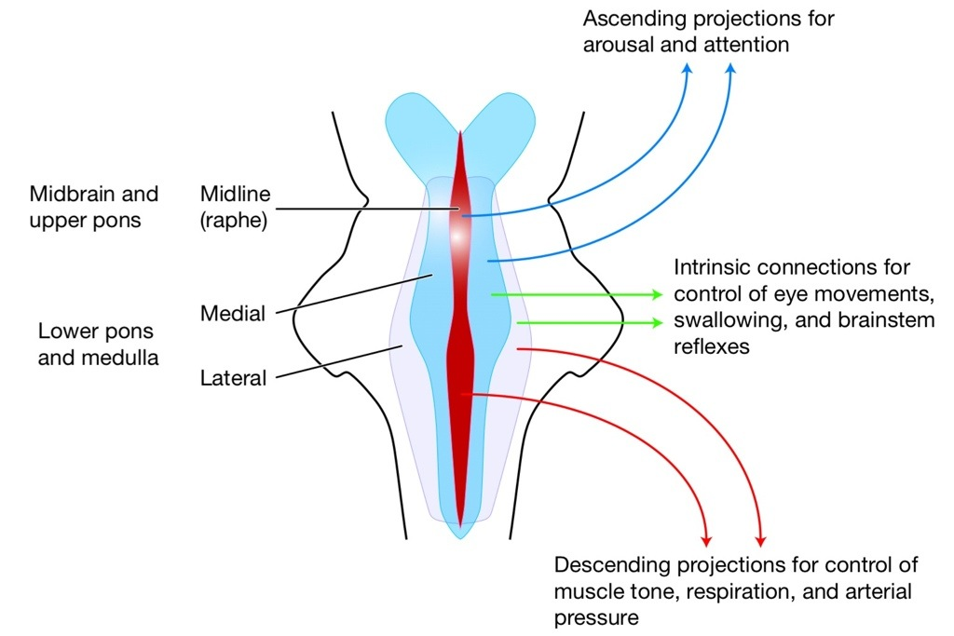
Lateral Reticular Formation
Has small neurones
Receives information from ascending tracts for touch and pain.
Receives vestibular information from median vestibular nerve.
Receives auditory information from superior olivary nucleus.
Visual information from superior colliculus.
Olfactory information via medial forebrain bundle

Slide 13
Paramedian Reticular Formation
  Has large cells.
  -Receives signals from lateral reticular formation
  -Nucleus ceruleus which located bilaterally and posteriorly at junction between pons and mid brain ,contains noradrenergic neurones and projects onto the cerebral cortex.
  -Ventral tegmental nucleus contains dopaminergic neurones that project directly onto the cortex.
  -Acetyl choline secreted by cholinergic gigantocellular neurones project onto the thalamus

Slide 14
Raphe nuclei (Median RF)
  In the midline of the reticular formation
  Contain serotonergic projections to the brain and spinal cord.

Slide 16
Functions of reticular formation
1. Somatic motor control (Reticulospinal tracts)
2. Cardiovascular control
  Through cardiac and vasomotor centers of the medulla oblongata
3. Pain modulation
Pain signals from the lower body >> >> RF >> >> cerebral cortex
RF is origin of the descending analgesic pathways
(act on the spinal cord to block the transmission of some pain signals to the brain)

Slide 17
Functions of reticular formation, cont…
4. Sleep and consciousness - The reticular formation has projections to the thalamus and cerebral cortex . It plays a central role in states of consciousness like alertness and sleep. Injury to the reticular formation can result in irreversible coma.
5. Habituation - This is a process in which the brain learns to ignore repetitive, meaningless stimuli while remaining sensitive to others. A good example of this is when a person can sleep through loud traffic in a large city, but is awakened promptly due to the sound of an alarm .

Slide 18
Thalamus
Located in the mid-part of the diencephalon
Almost every area of the cerebral cortex connects with its own highly specific area in the thalamus .
These functional segments are called Thalamocortical Sectors
They are made of
  Thalamo-cortical (TC) fibers
  Cortico-thalamic ( CT) fibers .
These neural circuits between the thalamus & cortex are essential for determining the level of consciousness .

Slide 19
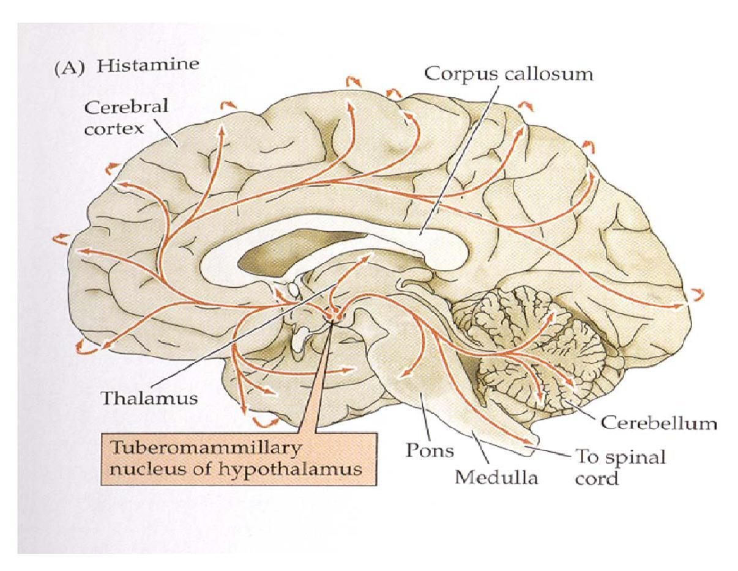
Hypothalamus
Tuberomammillary nucleus in the hypothalamus which consists of histaminergic neurons projects to the cortex and is involved in maintaining the awake state

Slide 20
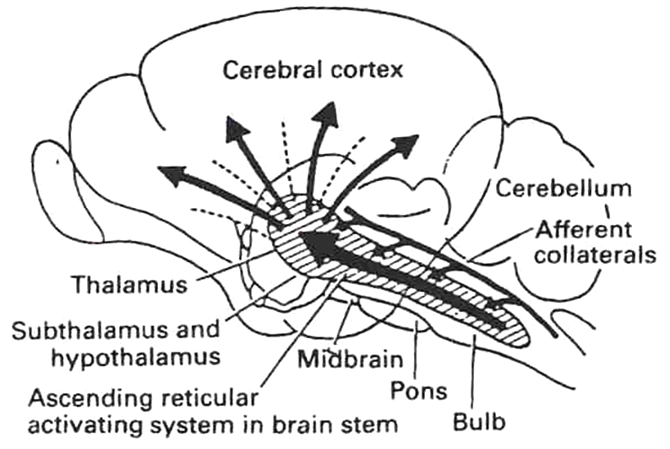
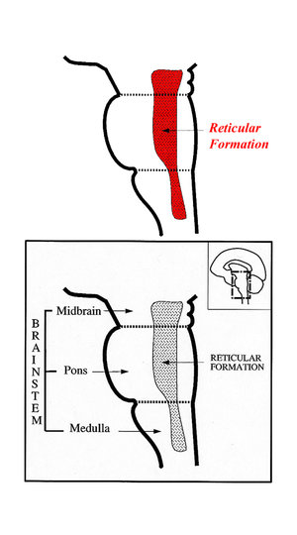
RAS
-Lesion in the mid-pons >>>>>>>unconsciousness
-Pons (uppers & middle) and midbrain are essential for wakefulness .

Slide 21
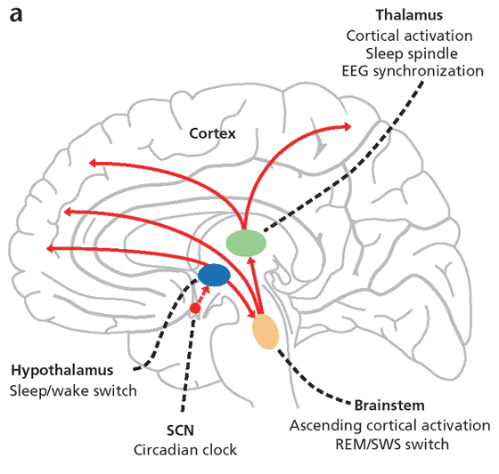
Anatomical components of RAS
The RAS is composed of several neuronal circuits connecting the brainstem to the cortex
Originate in the upper brainstem reticular core and project through synaptic relays in the thalamic nuclei to the cerebral cortex
As a result, individuals with bilateral lesions of thalamic intralaminar nuclei are lethargic or drowsy

Slide 22
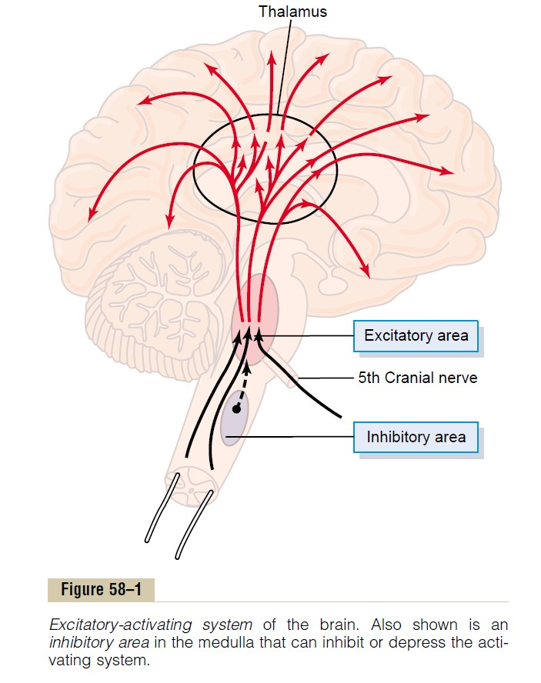
Bulboreticular Facilitory ( Excitatory ) = Reticular Excitatory Area of the Brain Stem
Sends excitatory signals into Thalamus
>>>> thalamus excites almost all areas of the cortex .
The Bulboreticular Facilitory ( Excitatory ) Area + Thalamus =Reticular Activating System ( RAS)
The RAS is the system which keeps our cortex awake and conscious

Slide 23
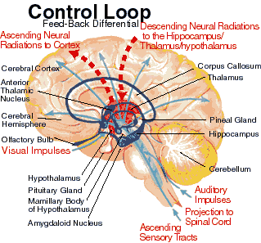
Sensory inputs to RAS

Slide 24
Functions of RAS
1- Regulating sleep-wake transitions
If inhibitory area activity increase >>>> reduce the activity of RAS >>>>> less afferent signal to the CC >>>>> sleep

Slide 25
2-Attention
RAS mediate transitions from relaxed wakefulness to of high attention.
There is increased regional blood flow in the midbrain reticular formation (MRF) and thalamic intralaminar nuclei during tasks requiring increased alertness and attention.

Slide 26
3-RAS and learning
The RAS is the center of balance for the other systems involved in learning, self-control or inhibition, and motivation.
When functioning normally, it provides the neural connections for processing and learning of information, , and the ability to pay attention to the correct task.

Slide 27
RAS dysfunction
If RAS is depressed:
  -An under-aroused cortex
  -Difficulty in learning
  -Poor memory
  -Little self-control
  -lack of consciousness or even coma.
If the RAS is too excited,
-Over aroused cortex
-Hyper-vigilance (sensory sensitivity )
-Touching everything
-Talking too much
-Restless
-Hyperactive

Slide 28
Indices of Level of Consciousness
Appearance & Behavior :
Posture ( sitting , standing ? )
Open eyes ?
Facial expression ?
Responds to stimuli ( including the examiner’s questions about name , orientation in time & place ? & other general Qs like who is the president ? )
Vital signs :
Pulse , BP, respiration , pupils , reflexes , particularly brainstem reflexes , etc )
EEG → Each of these states ( wakefulness , sleep , coma and death ) has specific EEG patterns
Evoked potentials ( in cases of Brain Death ).
(Stimulation of a sense organ can evoke a cortical response that can be recorded by scalp electrode over the primary receiving cortical area for that particular sense )

Slide 29
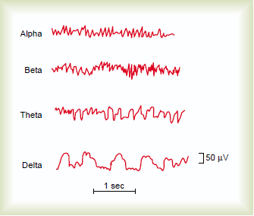
Electroencephalogram

Slide 30
Alpha waves:
Recorded from the parietal &occipital regions
Awake and relaxed+ eyes closed
10 to 12 cycles/second.
Beta waves:
Frontal lobes
Produced by visual stimuli and mental activity
13 to 25 cycles per second.

Slide 31
Theta:
-Temporal and occipital
-5 to 8 cycles/second
-(newborn)
Theta waves in adults indicates severe emotional stress
Delta:
-From the cerebral cortex
-1 to 5 cycles/second
-Sleep and in an awake infant
-In an awake adult indicates brain damage.

Slide 32
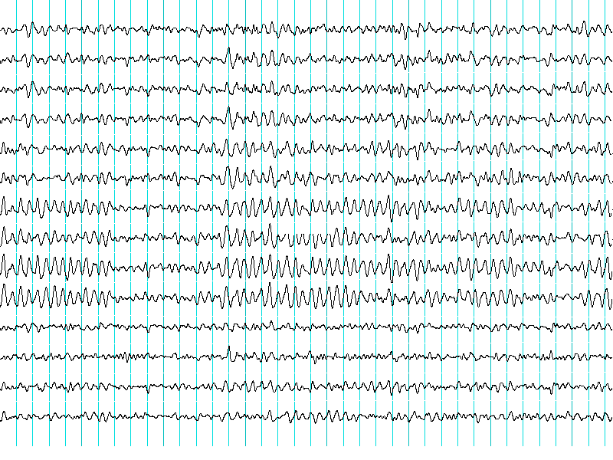
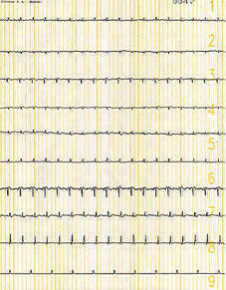
Brain Death Confirmatory Testing with EEG
Normal EEG ( at normal magnification )
Brain Death ( Flat EEG ,at very high magnification )

Slide 33
THANK YOU

