Slide 1
Brain Neurotransmitters
Dr. Salah Elmalik

Slide 2
objectives
By the end of this lecture you are expected to:
Describe the functions of glutamergic system
Describe the functions of NTs of the brain (the noradrenergic & serotonergic cholinergic, dopaminergic, GABAergic systems)
Appreciate that many drugs and CNS disorders affect function of brain neurotransmitters

Slide 3
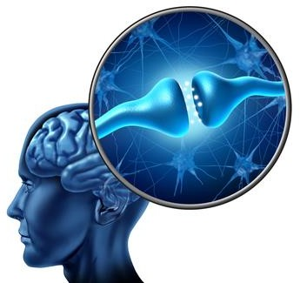
Brain Neurotransmitters
Chemical substances released by electrical impulses into the synaptic cleft from synaptic vesicles of presynaptic membrane
Diffuses to the postsynaptic membrane
Binds to and activates the receptors
Leading to initiation of new electrical signals or inhibition of the post-synaptic neuron

Slide 4
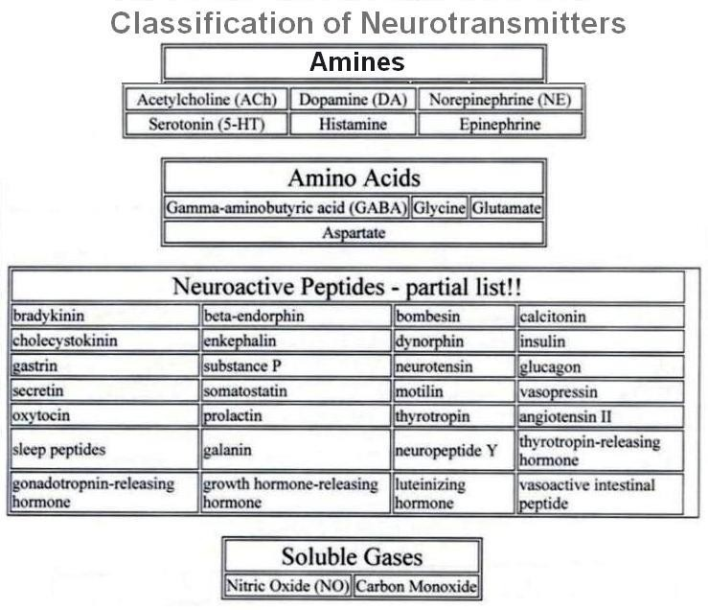

Slide 5
Some of the Brain Neurotransmitters
1. Ach
2. Glutamate
3. GABA
4. Norepinephrine (NE)/Epinephrine
5. Serotonin
6. Dopamine

Slide 6
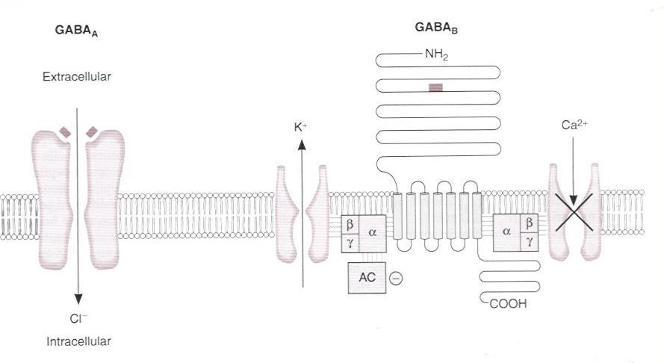
Classes of Receptors
Metabotropic = trans membrane receptor acts through a second messenger
Ionotropic = Ligand gated ion channel

Slide 7
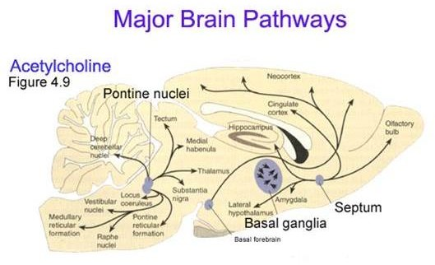

Slide 8
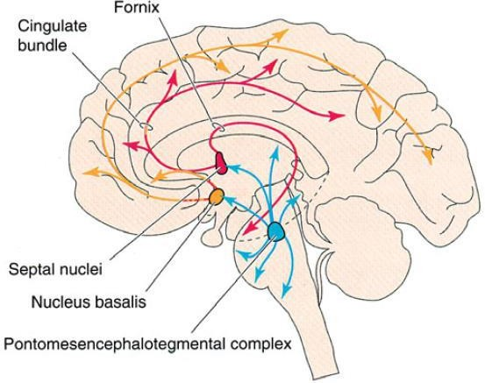
Cholinergic System
Acetylcholine is the major neurotransmitter in the peripheral nervous system
In the brain , cholinergic ( ACh producing ) neurons are present mainly in 2 areas :
1) Basal Forebrain ( namely Nucleus Basalis of Myenert and septal nuclei)
(2) Mesopontine tegmental area which is alas called ponto-mesencephalic cholinergic complex

Slide 9
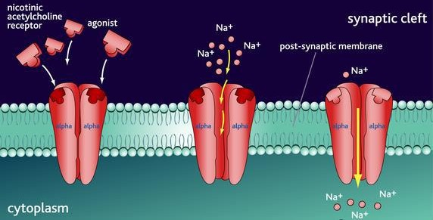
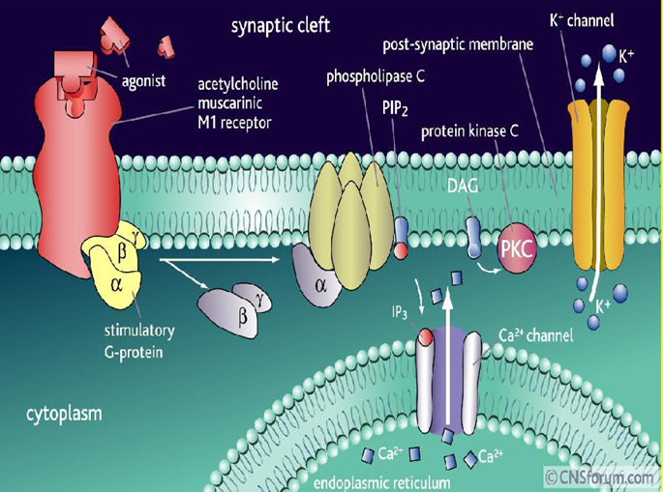
Acetylcholine Receptors
Acts on 2 cholinergic receptors:
❶Nicotinic (ionotropic)
(The muscle-type can be selectively blocked by curare, the neuronal-type by hexamethonium)
Excitatory
❷Muscarinic (metabotropic) (antagonist- Atropine): ●Excitatory or inhibitory ●
Five subtypes (M1-M5): all are found in the brain but M1 is abundant.

Slide 10
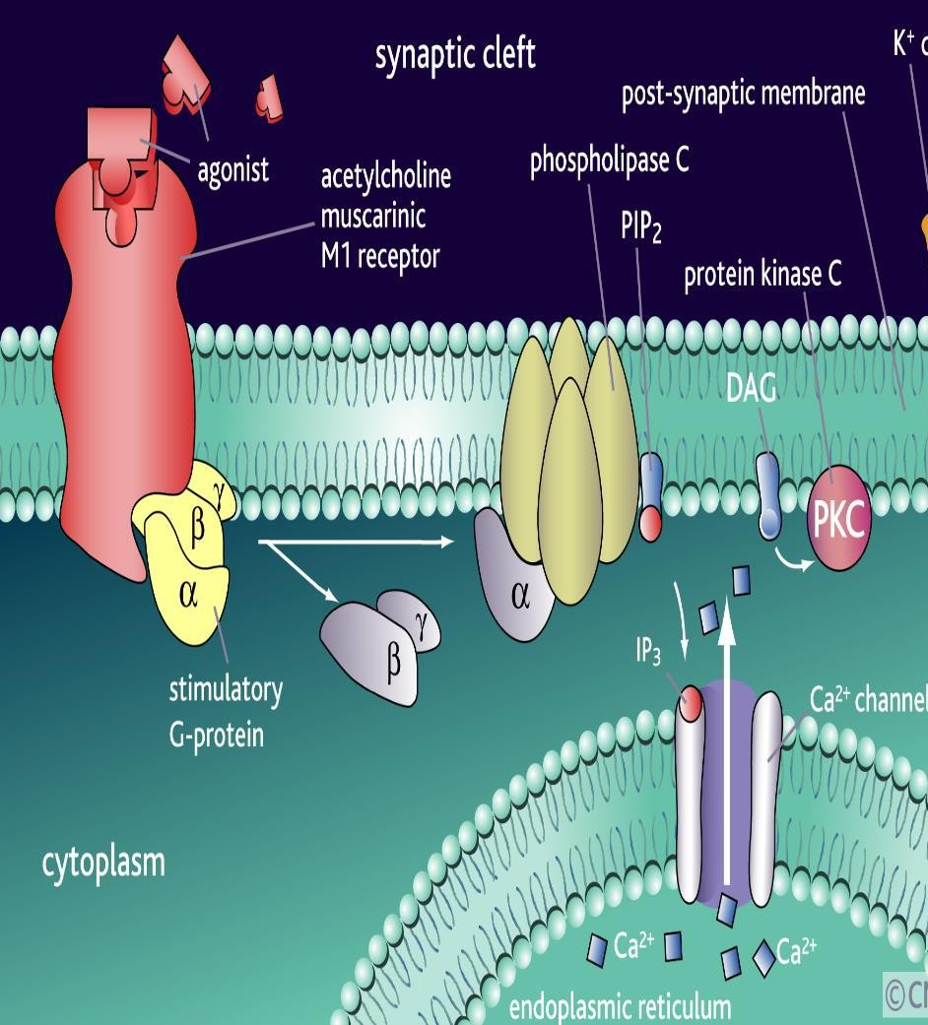
Muscarinic Receptors
M1 receptors most involved in cognitive functioning (evidence from Knockout mice and pharmacologic human studies with M1blocking drugs)
M2 blocking agents may facilitate cognition in animals (but these drugs are not being used in humans at this point).
M3 receptors do not seem to play much of a role in cognition (animal studies).
M4 and M5 functions in the brain are unknown

Slide 11
Ach Functions & Disorders
ACh influences mental processes such as
  Learning
  Memory
  Alertness
  sleep.
Alzheimer’s Disease- the most common form of dementia that is associated with acetylcholine loss
Damage to Ach producing cells in the basal forebrain
  Bipolar disorder
  Mood swings
  Depression
  Inhibitors of acetylcholinesterase in the brain are the main drugs used to treat Alzheimer’s disease.

Slide 12
Glutaminergic System
Glutamate is the most commonly found NT in the brain (king of NTs, ~50% neurons).
Glutamate is the major excitatory neurotransmitter of the brain and spinal cord, responsible for 75% of the excitatory transmission in the brain
Glutamate (can cause excitotoxicity) is converted in astrocytes into glutamine (not toxic) and passed onto glutaminergic neurons
Wide spread, but high levels in hippocampus; hypo function of NMDA receptors in this area and prefrontal cortex is associated with schizophrenia

Slide 13
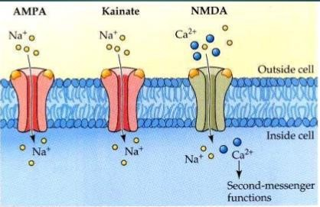
Glutamate Receptors
Are widely distributed in the brain; they are of two types:
Metabotropic receptors (G protein- coupled receptors): mGluR
Found in hippocampus, cerebellum and the cerebral cortex • act through second messengers which activate biochemical cascades, leading to modification of other proteins such as ion channels.
2. Ionotropic receptors (ligand-gated ion
channels).
Three types: •
AMPA receptors (α-amino-3-hydroxy-5-methylisoxazole- 4-propionate)
Kainate receptors (kainite is an acid isolated from seaweed),
NMDA receptors (for N-methyl D-aspartate); play a role in long term potentiation so they are involved in learning and memory

Slide 14
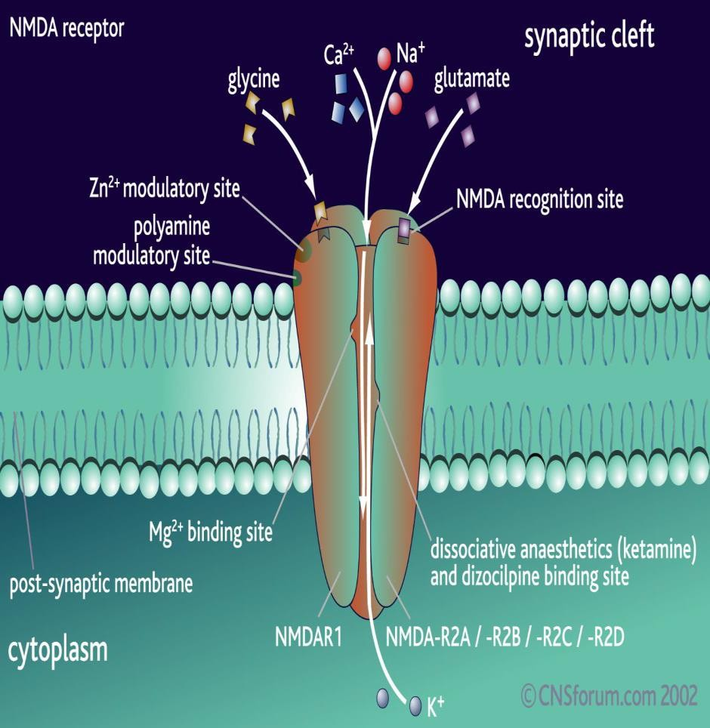
NMDA Receptors
Permits passage of Na+ and large amounts of Ca2+. They are unique:
Glycine is essential for their normal response to glutamate.
The channel is blocked by Mg2+ ion at normal membrane potentials
This blockade is removed by depolarization (caused by e.g. AMPA)
Excitatory post synaptic potential induced by activation of NMDA receptor is slower than that elicited by activation of AMP and kainate receptors

Slide 15
Functions & Disorders Of Glutamate
Glutamic acid (and aspartic acid) : are major excitatory NTs in CNS.
Glutamate NMDA receptor involved in Long-Term Potentiation & memory storage.
Disorders:
-Excess Glutamate activity is implicated in some types of epileptic seizures
- Under some pathological conditions , such Stroke , ALS (Amyotrophic Lateral Sclerosis) ,autism and Alzheimer's diseases, it acts as an excitotoxin ,producing excessive influx of calcium into the neurons and causing neuronal death .

Slide 16
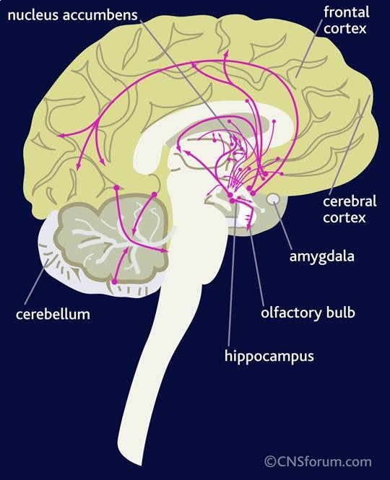
GABAergic System

Slide 17
GABAergic System
GABA is the main inhibitory neurotransmitter in the central nervous system (CNS).
GABAergic inhibition is seen at all levels of the CNC
(Hypothalamus, hippocampus, cerebral cortex and cerebellar cortex.
GABA interneurons are abundant in the brain, with 50% of the inhibitory synapses in the brain being GABA mediated

Slide 18
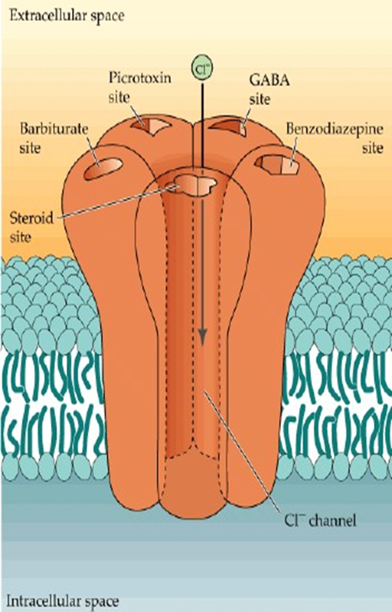
Gamma Aminobutyric acid (GABA)
Formed by decarboxylation of glutamate.
Three types of GABA receptors
e.g. GABA_{A B & C.}
GABA _{A & B} receptors are widely distributed in CNS.
GABA_{C} are found in retina only
GABA _{B} are metabotropic (G-protein) in function.
GABA A and C receptors (ionotropic) have multiple binding sides (for benzodiazepine and barbiturates).
The channel is a Cl-channel (not Na)

Slide 19
GABAergic System

Slide 20
Functions & Disorders of GABAergic System
Functions:
Presynaptic inhibition
GABAA receptors in CNS are chronically stimulated to regulate neuronal excitability.
Disorders:
-under activity of GABA leads to seizures.
Alcohol, barbiturates, progesterone and deoxycorticosterone also in part work by increasing GABA activity

Slide 21
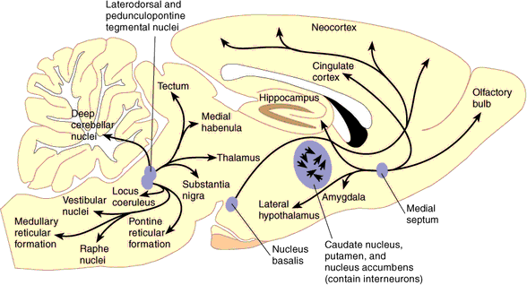
Norepinephrine System

Slide 22
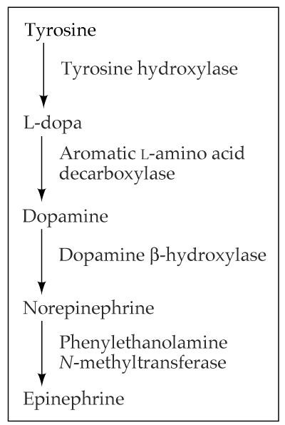
Noradrenergic System
Norepinephrine(NE): is a catecholamine that is synthesized from Dopamine
It is released from sympathetic nerves, the adrenal medulla and brain stem neurons
It acts on both α-and β- adrenergic receptors (G- protein-coupled receptors)
NE is believed to play a role in both learning and memory

Slide 23
Noradrenergic System
The Noradrenergic System has a very wide- spread projection system
Locus ceruleus is activated by stress and co-ordinates responses via projections to thalamus, cortex, hippocampus, amygdala, hypothalamus, autonomic brainstem centers, and the spinal cord

Slide 24
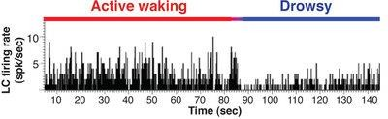
Locus ceruleus neurons fire as a function of vigilance and arousal
Irregular firing during quiet wakefulness
Sustained activation during stress
Their firing decreases markedly during slow-wave sleep
and virtually disappears during REM sleep.
23

Slide 25
Functions of NE
It constitutes part of the RAS ( Reticular Activating System Attention/Vigilance
Fight or flight response,
Learning
Enhances formation and retrieval of memory
Aggressive behaviour .

Slide 26
Disorders of NE
Norepinehrine (NE) Implicated in Stress-Related Disorders:
Depression
Withdrawal from some drugs of abuse
Anxiety and other stress-related disorders such as panic disorder.

Slide 27
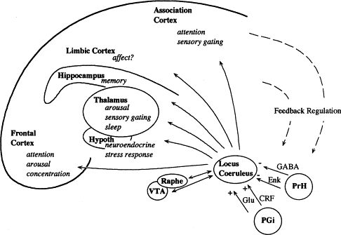
PGi: Nucleus paragigantocellularis PrH: Perirhinal Cortex

Slide 28


Dopamine
Dopamine is a catecholamine that is synthesized from tyrosine
Five dopaminergic receptors (D1-D5) .
Overstimulation of D2 receptors is thought to be related to schizophrenia

Slide 29


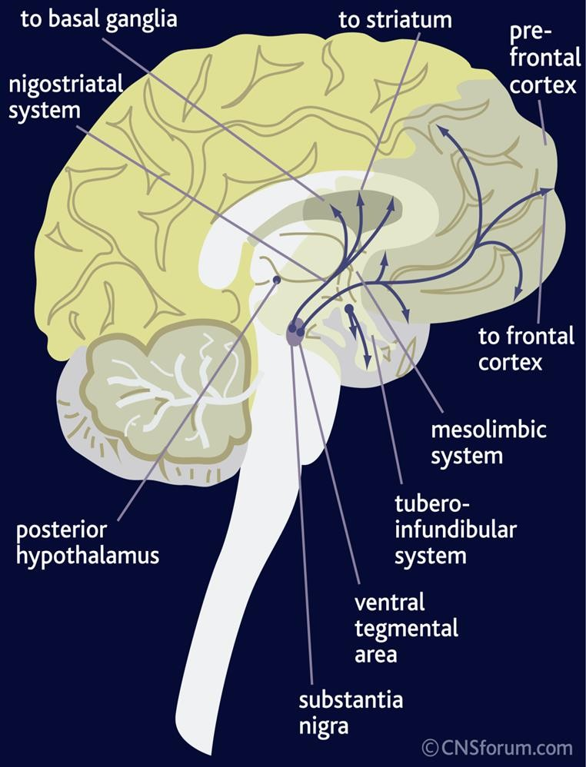
Dopaminergic Pathway
Dopamine is transmitted via three major pathways:
1- The first(nigro striatal system) extends from the substantia nigra to the caudate nucleus-putamen (neostriatum) and is involved in motor control.

Slide 30

2- The second pathway project to the mesolimbic forebrain
It involved in reward and emotional behavior and addiction
Dysfunction is connected to hallucinations and schizophrenia

Slide 31
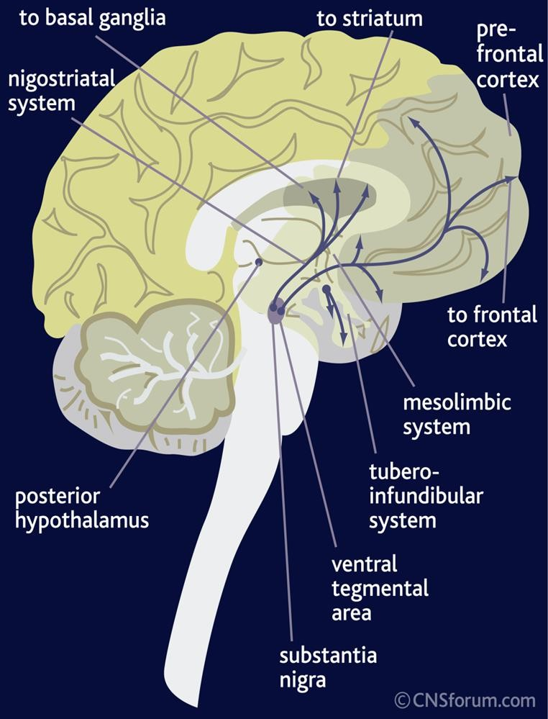

The Dopaminergic System cont …
3- The third pathway, known as the tubero- infundibular system It is concerned with:
    Regulation of secretion of prolactin from the anterior pituitary gland
    Maternal behavior (nurturing)

Slide 32


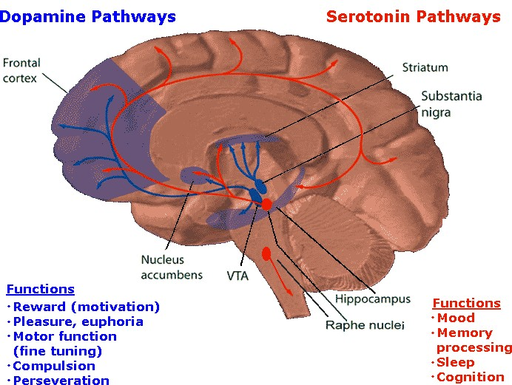
Dopaminergic Pathways/Functions
31

Slide 33

Dopaminergic Neurons Disorders
Schezophrenia.
Parkinson’s Disease.
Cocaine elevate activity at dopaminergic synapses

Slide 34
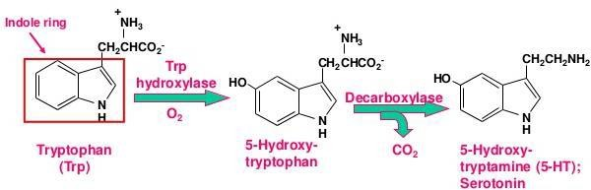
Serotonin
Serotonin is synthesized from the amino acid tryptophan, which is abundant in meat
Our bodies cannot make tryptophan (must get from diet)
Tryptophan deprivation alters brain chemistry and mood
There is only a few 100,000`s of 5-HT neurons in human brain
There is 7 classes serotonin receptors in different parts of CNS (most are metabotropic, except 5-HT3)
Mice in which the gene for 5-HT2 C receptors has been knocked out are obese

Slide 35
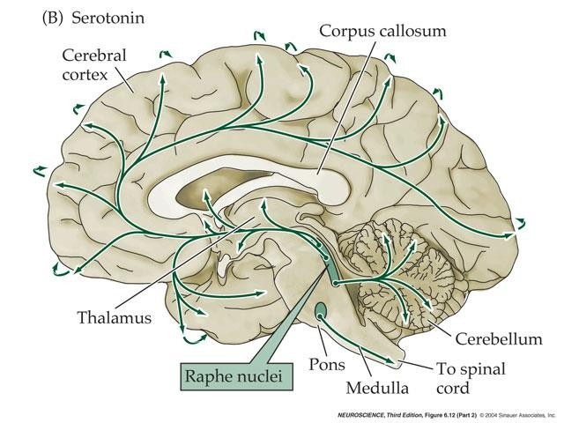
Serotonin
The serotonin pathways in the brain:
The principal centers for serotonergic neurons are the rostral and caudal raphe nuclei
>>>> axons ascend to the cerebral cortex, limbic & basal ganglia
Serotonergic nuclei in the Brain stem >>>> descending axons (terminate in the medulla& spinal cord

Slide 36
Serotonin (5-HT) Functions & Disorders
Functions:
  Improved mood
  Decrease appetite .
  Sleep
Disorders:
  Depression
  Anxiety
Drugs (e.g.Prozac) that prolong serotonin’s actions relieve symptoms of depression & obsessive disorders

Slide 37
Neurotransmitter | c effect | from | synthesis | receptor | Fate | Functions
1.Acetyl choline (Ach) | Excitatory | Acetyl co- A + Choline | Cholinergic nerve endings Cholinergic pathways of brainstem | 1.Nicotinic 2.Muscarini c | Broken by acetyl cholinesterase | Cognitive functions e.g. memory Peripheral action e.g. cardiovascular system
Catecholamines Epinephrine (adrenaline) | Excitatory in some but inhibitory in other | Tyrosine produced in liver from phenylalanin e | Adrenal medulla and some CNS cells | Excites both alpha α & beta β receptors | 1.Catabolized to inactive product through COMT & MAO in liver 2.Reuptake into adrenergic nerve endings 3.Diffusion away from nerve endings to body fluid | For details refer ANS. e.g. fight or flight, on heart, BP, gastrointestinal activity etc. Norepinehrine controls attention & arousal, sleep/wake cycle.
ii.Norepinephrine | Excitatory | Tyrosine, found in pons. Reticular formation, locus coerules, thalamus, mid-brain | Begins inside axoplasm of adrenergic nerve ending is completed inside the secretary vesicles | α₁ α₂ β₁ β₂
iii. Dopamine | Excitatory | Tyrosine | CNS, concentrated in basal ganglia and dopamine pathways e.g. nigrostriatal, mesocorticolim bic and tubero- hypophyseal pathway | D₁ to D₅ receptor | Same as above | Sensory motor Cognetive/emotion al behavior Endocrine Hypothalamic Decreased dopamine in parkinson’s disease. Increased dopamine 36 concentration

Slide 38
er | effect |  | synthesis | receptor
3. serotonin (5HT) | Excitatory | Tryptophan | CNS, Gut (chromaffin cells) Platelets & retina | 5-HT₁ to 5-HT ₇ 5-HT ₂ A receptor mediate platelet aggregation & smooth muscle contraction | Inactivated by MAO to form 5- hydroxyindoleace tic acid(5-HIAA) in pineal body it is converted to melatonin | Mood control, sleep, pain feeling, temperature, BP, & hormonal activity
4. Glutamate | Excitatory 75% of excitatory transmissio n in the brain | By reductive amination of Kreb’s cycle intermediate α – ketoglutarate. | Brain & spinal cord e.g. hippocampus | Ionotropic and metabotropic receptors. Three types of ionotropic receptors e.g. NMDA, AMPA and kainate receptors. | It is cleared from the brain ECF by Na ⁺ dependent uptake system in neurons and neuroglia. | Long term potentiation involved in memory and learning by causing Ca⁺⁺ influx.
5. Gama amino butyric acid(GABA) | Major inhibitory mediator | Decarboxylati on of glutamate by glutamate decarboxylase (GAD) by GABAergic neuron. | CNS | GABA – A increases the Cl ⁻ conductance, GABA – B is metabotropic works with G – protein GABA transaminase catalyzes. GABA – C found exclusively in the retina. | Metabolized by transamination to succinate in the citric acid cycle. | GABA – A causes hyperpolarization (inhibition) Anxiolytic drugs like benzodiazepine cause increase in Cl⁻ entry into the cell & cause soothing effects. GABA – B cause increase conductance of K⁺ into the₃c₇ell.

Slide 39
Thank You

