Slide 1
Physiology of Motor Tracts
Dr. Salah Elmalik

Slide 2
Neuropsychiatry Block
Chapter 56
Cortical & Brain Stem Control of Motor Function
(Guyton & Hall)
Reference book/ Ganong review of
medical physiology

Slide 3
Learning objectives:
At the end of this lecture the student should :
Appreciate what is upper motor neuron and lower motor neuron .
Explain the origin , course and functions of the following motor tracts:
Pyramidal tracts:
(corticospinal & corticobulbar tracts)
Extrapyramidal tracts as:
Rubrospinal .
Vestibulospinal .
Reticulospinal .
Olivospinal .
Tectospinal

Slide 4
Components of Motor Neurons
For performance of motor acts we need:
Upper motor neurons (UMN)
These are the motor neurons whose cell bodies lie in the motor cortex, or brainstem and they activate the lower motor neuron (LMN)
There are two UMN Systems :-
1- Pyramidal system (corticospinal tracts ).
2- Extrapyramidal system
Lower motor neurons: (LMN)
These are the motor neurons of the spinal cord (AHCs) and brain stem motor nuclei of the cranial nerves that innervates skeletal muscle directly.

Slide 5
Classification of descending motor systems
The descending motor pathways have commonly been divided into “pyramidal” and “extrapyramidal” tracts.
This classification is based on the finding that the motor tract which originates from the cerebral cortex and descends to the spinal cord (the corticospinal tract) passes through the pyramids of the medulla, and therefore has been called the “the pyramidal tract”.
The rest of the descending motor pathways do not travel through the medullary pyramids, and are therefore collectively gathered under the heading: “the extrapyramidal tracts”.

Slide 6
The following are the important sets of descending motor tracts, named according to the origin of their cell bodies and their final destination:
Corticospinal tract,
Corticobulbar tract. (= Pyramidal tract)
1) Rubrospinal tract,
2) Reticulospinal tracts,
3) Vestibulospinal tracts,
4) Tectospinal tract, and
5) Olivspinal tract .
Extrapyramidal tracts

Slide 7
Motor Areas
(1) The primary motor area ( M1 . Motor area 4)
occupies the precentral gyrus & contains large , highly excitable Betz cells.
MI of one side controls skeletal muscles of the opposite side of the body
Feet are at the top of the gyrus and face at the bottom , arms and the hand area in the mid portion
Facial area is represented bilaterally, but rest of the representation is generally unilateral
Area of representation is proportional with the complexity of function done by the muscle. So, muscles of hands and speech (lips, tongue , and vocal cord) occupies 50% of this area
The neurons of this area arranged in vertical Columns.
Notes:
الهيمنة الدماغية cerebral dominance

Slide 8
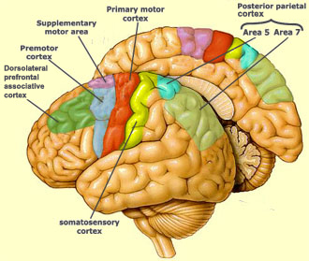
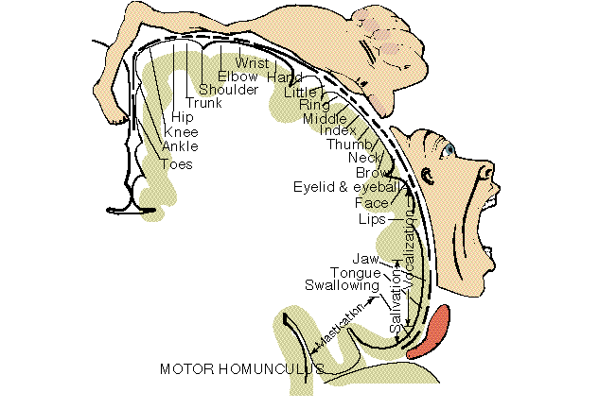

Slide 9
2.The Supplementary Motor Area (M2)
Lies in front of area 4 and above the pre­motor area
Stimulation of this area leads to bilateral grasping movements of both hands simultaneously.
This area involved in organizing or planning motor sequence

Slide 10
3. Premotor Area ( M3)
lies in front of the primary motor area & below supplementary motor area.
Stimulation of the premotor area produces complex coordinated movements, such as setting the body in a certain posture to perform a specific task.
It works in association with the supplemental motor area, establishing the motor programs necessary for execution of complex movements
It contains mirror neurons which are important for understanding the action of other people and for learning new skills by imitation.

Slide 11
Premotor Area cont….
A few highly specialized motor centers have been found in the premotor areas of the human cerebral cortex:
Broca’s Area for Speech
The Frontal Eye Movements Area:
located above Broca’s area in the frontal lobe
controls voluntary movements of the eyes toward different objects in the visual field.
Head Rotation Area:
located just above the eye movement area in the motor cortex .
directing the head toward different visual objects .
Area for Hand Skills
Damage to this area causes motor apraxia

Slide 13
Pyramidal Tracts

Slide 14
Corticospinal ( Pyramidal) Tracts
Cells of origin :
30% originate from the primary motor area,
30% from the premotor areas , and supplementary motor areas
40% from the somatic sensory areas posterior to the central sulcus.
3% of the fibres are large myelinated fibres, derived from the large , highly excitable pyramidal Betz cells of MI . These fibers form monosynaptic connections with motor neurons of the spinal cord.
But most of pyramidal fibers are unmyelinated
Fibers from the cerebral cortex descend in corona radiata to reach the posterior limb of internal capsule (between caudate and putamen nuclei of the basal ganglia)

Slide 15
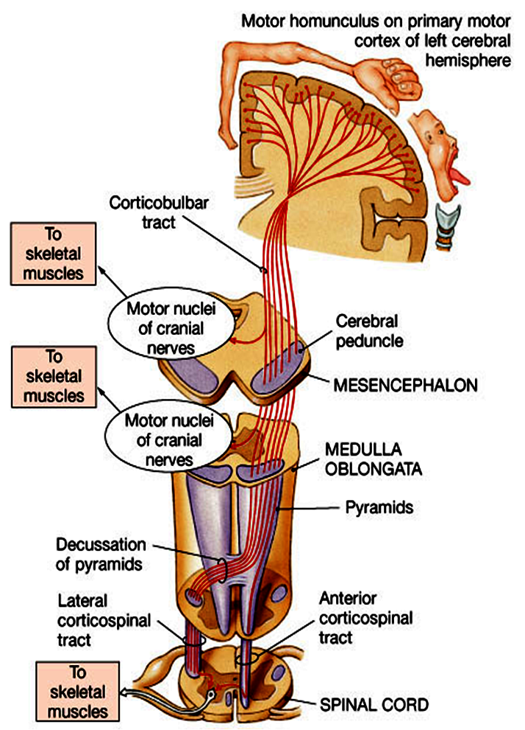
Then descend through the cerebral peduncle of midbrain and then through pons.
Some fibers cross in brainstem to
supply contralateral cranial nerve nuclei
constitute the Corticobulbar tract .
In the lower medulla
around 80% of the fibres cross to the
opposite side and descend in the lateral column of spinal cord as the Lateral Corticospinal Tract .
Some of these fibres end monosynaptically on contralateral anterior horn cells but the majority end on interneurons in the intermediate region of the spinal cord grey matter
These fibers controls and initiates fine discrete skilled movement of distal limb muscles (i.e. Fingers and hands)

Slide 17
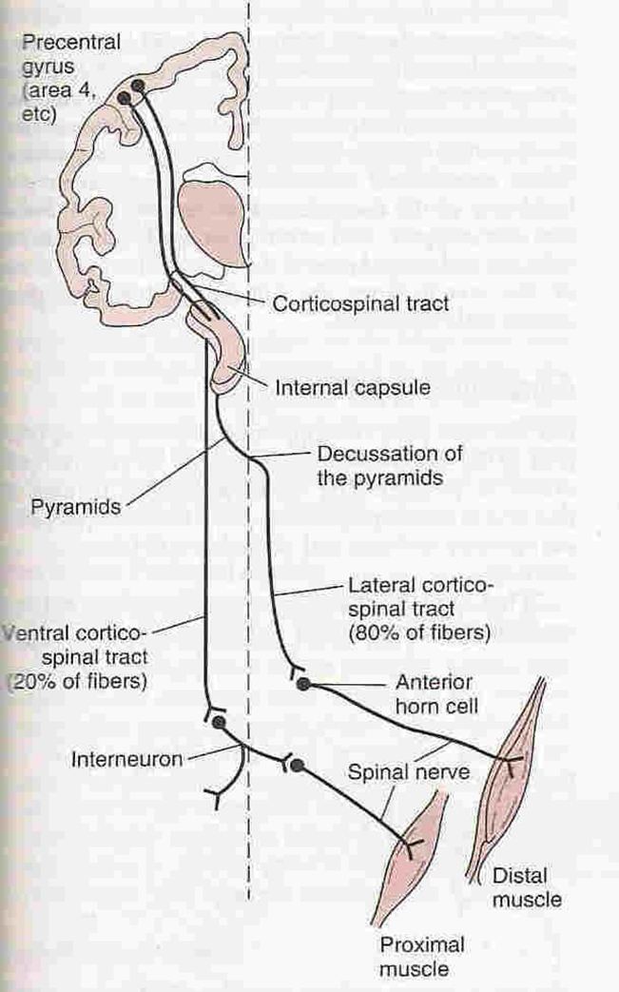
The remaining 20 % of
corticospinal fibers do not
decussate in the medulla .
They descend ipsilaterally
in the ventral column of the
spinal cord white matter ,
Constituting the Ventral
( Antrior) Corticospinal Tract .
Finally they decussate
(cross to the opposite side )
& synapse on the contralateral spinal motor neurons
These fibers control the axial and proximal limbs muscles so it concern with control of posture.

Slide 18
Course and Termination
fibers of the CBS tract descend from the cerebral cortex
collect together and descend through the posterior limb of the internal capsule
through the middle portion of the cerebral peduncles of the midbrain
The fibers are separated by transverse pontine fibers in the pons
In the upper medulla oblongata where they form the pyramids of the medulla
In the lower region of the medulla, most of the fibers cross to the opposite site forming the “medullary decussation”
About 80% to 90% cross to the opposite side of the spinal cord (contralaterally) and continue as the “lateral corticospinal tract”.
fibers which do not decussate in medulla (about 10-20%) descend on the same side of the spinal cord (ipsilaterally) as the “ventral corticospinal tract”.

Slide 19
Functions of Pyramidal System
Initiation of voluntary movements
The lateral corticospinal tract fibers that descend in the spinal cord for control of muscles of the distal parts of the limbs, especially the hand and digits muscles, which sub serve fine skilled movements used in manipulation by hand and fingers, and other accurate motor actions done by the limbs .
The ventral corticospinal tracts control posture of axial and proximal muscles for balance , climbing and walking.
Facilitation of muscle tone and deep reflexes through gamma motor neurons
Those fibers originate from parietal lobe are for sensory-motor coordination
Corticobulbar tracts /control face & neck muscles & facilitate their tone, and are involved in facial expression, mastication, swallowing

Slide 20
Extrapyramidal Tracts

Slide 21
Extrapyramidal Tracts
The extrapyramidal system is made up of all those part in the central nervous system that are concerned with motor control , other than pyramidal system. They consist of ;
1.Cortical motor areas, especially the premtor area and parietal cortex
2. The basal ganglia
3. The reticular formation , the red nuclei , the tectum of brain and vestibular nuclei
They include the following tracts:

Slide 22
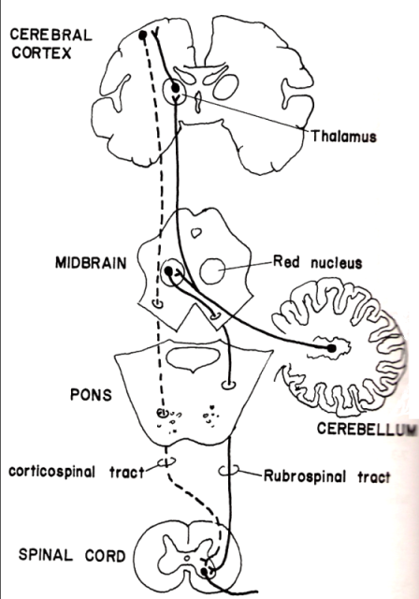
Rubrospinal Tracts
After emerging from Red Nucleus in midbrain , fibers decussate at same level of red nucleus
It receives afferent connections from:
Ipsilateral cortical motor area (corticorubral tract)
Contralateral side of cerebellum
Basal ganglia
Descend with the lateral corticospinal tract
In spinal cord tract occupies the lat. white column , & fibers synapse on the contralateral AHCs

Slide 23
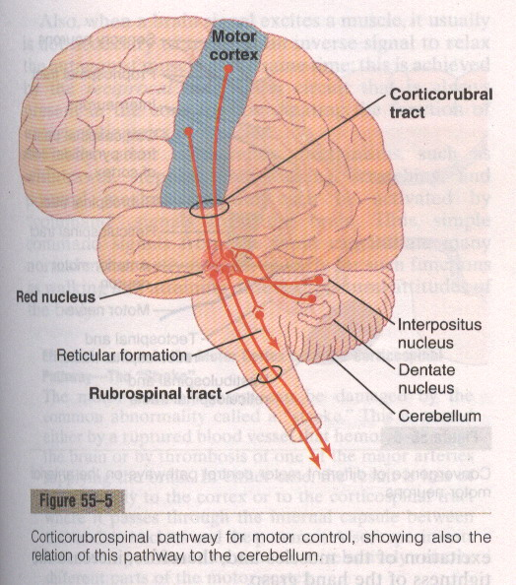

Slide 24
Functions of Rubrospinal Tract
An additional pathway for transmission of cerebral cortical motor commands to the lower motor neurons similar to those of the corticospinal tract. When the corticospinal fibers are destroyed , discrete movement can still occur but fine control of the fingers and hand is impaired..
This tract is excitatory for flexors & inhibitory for extensors (anti-gravity muscles).
Rubrospinal tract lies in the lateral columns of the spinal cord, along with the corticospinal tract, and terminates on the interneurons and motor neurons that control the more distal muscles of the limbs.
Therefore, corticospinal & rubrospinal tracts together are called the lateral system of the cord, in contradistinction to a vestibulo-reticulospinal system which lies mainly medially in the cord and is called the medial motor system of the cord

Slide 26
Vestibulospinal Tracts

Slide 27
Vestibulospinal Tracts
2 components of the tract:
Major component → Lat. V.S Tract
Minor component → Med. V.S Tract.
Lat. V.S Tract ← lat. Vest. Nuclei.
Med. V.S Tract ← med Vest. Nuclei.

Slide 28
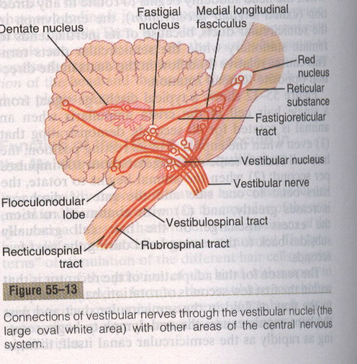

Slide 29
Functions of Vestibulospinal Tracts
Vestibulospinal tracts control reflexes e.g. Postural & righting ( which correct body position ) + control eye movements.
The lateral vestibulospinal
Cells of origin : Lateral Vestibular Nucleus
Axons descend in the ipsilateral ventral white column of spinal cord .
This tract mediates excitatory influences upon extensor motor neurons to maintain posture (when the otolith organs signal deviations from stable balance and upright posture)
The medial vestibulospinal tract :
Cells of origin : Medial Vestibular Nucleus
As its axons descend ipsilaterally in the ventral white column of spinal cord , they form part of the Medial Longitudinal Fasciculus
The medial longitudinal fasciculus consists of both ascending & descending fibers that link vestibular nuclei to nuclei supplying the extraocular muscles for coordination of head and eye movements

Slide 30
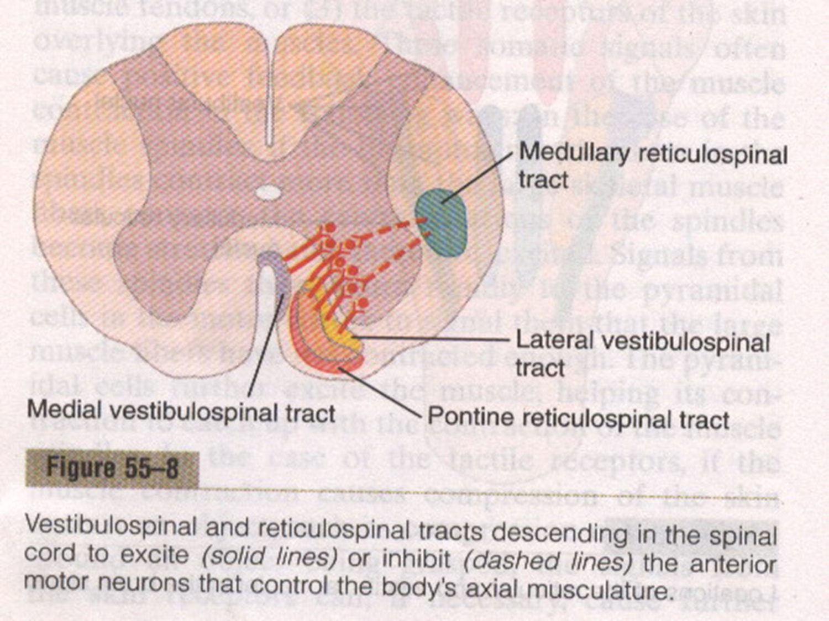
Reticulospinal tracts
Tract arises from reticular formation (groups of scattered neurons along with nerve fibers present in midbrain, pons & medulla).
It has two components:
Pontine reticulospinal tract
Medullary reticulospinal tract

Slide 31
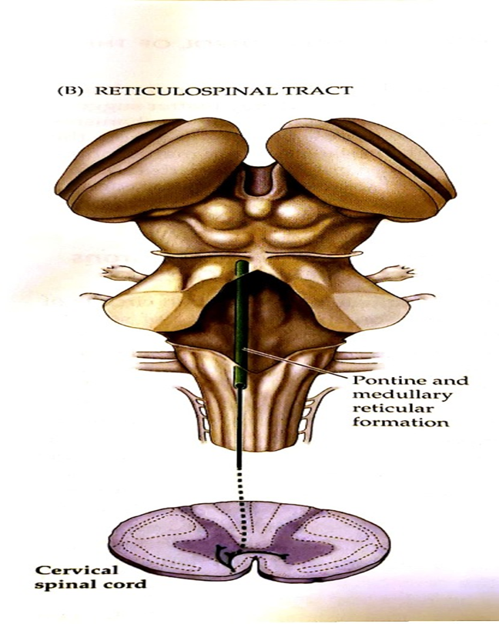

Slide 32
The Reticulospinal Tracts
Divisions:
1) Medial (pontine) reticulospinal tract. 2) Lateral (medullary) reticulospinal tract.
Lateral reticulospinal tract | Medial reticulospinal tract
arises from neurons in the “medullary reticular formation” its fibers descend to all levels of the spinal cord synapse with interneurons that inhibit the α- and γ-MNs of antigravity and extensor muscles , but they facilitate the α- and γ-MNs of flexor muscles. | Arises from neurons of the “pontine reticular formation” descends to all levels of the spinal cord Terminate mainly on interneurons in the spinal gray matter which excite the medially situated α- and γ-MNs innervating the antigravity muscles, that is, the muscles of the vertebral column and the extensor muscles of the lower limbs.

Slide 33
Lateral reticulospinal tract | Medial reticulospinal tract
The medullary reticular formation receives afferent signals from: (i) the premotor area of cerebral cortex, (ii) the paleocerebellum, and (iii) red nucleus. Functions: The medullary reticulospinal tract is inhibitory for extensors (like rubro-spinal). | The pontine reticular formation has a high degree of natural excitability. In addition, it receives strong excitatory signals from the vestibular nuclei and the neocerebellum Functions: the medial (or pontine) reticulospinal tract is excitatory for extensors & inhibitory for flexors (unlike rubro-spinal).

Slide 34
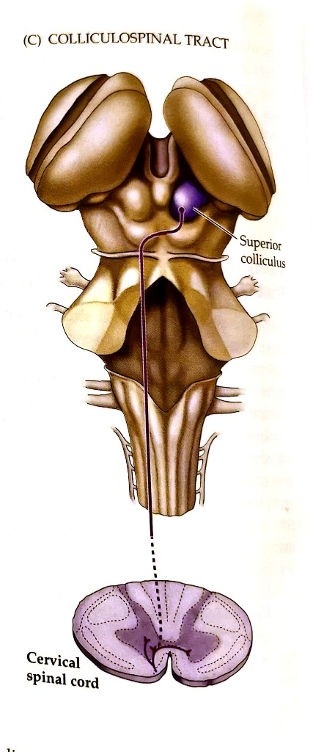
Tectospinal Tract
Originates in Superior Colliculus in the tectum of midbrain → then decussate in the dorsal tegmentum
Axons descend in ventral white column of spinal cord
And terminate on Contralateral cervical AHCs
Function :
This tract produces reflex turning of the head and neck ( in response to visual and auditory stimuli)

Slide 35
Olivospinal Tract
Originates in Inferior olivary nucleus of the medulla is found only in the cervical region of the spinal cord.
Function is uncertain, but thought to facilitate muscle tone

Slide 36
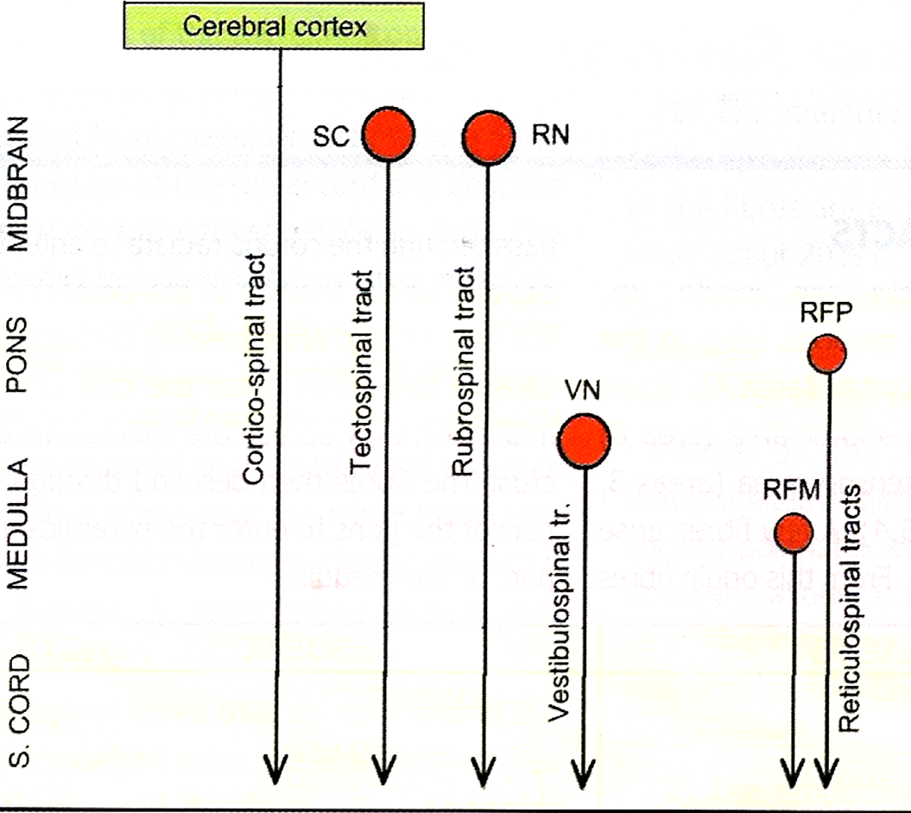
Summary of motor Tracts

Slide 37
General functions of Extrapyramidal tract
1. Help pyramidal tract in initiation of voluntary movement
2. Share in planning and programming of voluntary movement
3. Responsible for subconscious gross movements(swinging of arms during walking)
4. Keep equilibrium and adjust body posture
5. Regulation of muscle tone

Slide 38
Removal of (Area Pyramidalis) of the Primary Motor Cortex
Removal of the area that contains the giant Betz pyramidal cells (Area Pyramidalis)causes loss of voluntary control of discrete movements of the distal segments of the limbs, especially of the hands and fingers (This does not mean that the hand and finger muscles themselves cannot contract ( paralysis), but the ability to control the fine movements is gone)
That is because area pyramidalis is essential for voluntary initiation of finely controlled movements, especially of the hands and fingers

Slide 39
Effects of Lesions in the Motor Cortex or in the Corticospinal Pathway(The stroke)
The motor control system can be damaged by the “stroke -the result is loss of blood supply to the cortex or to the corticospinal tract where it passes through the internal capsule.
Muscle Spasticity Caused by Lesions That Damage Large Areas Adjacent . to the Motor Cortex
The primary motor cortex normally exerts a continual tonic stimulatory effect on the motor neurons of the spinal cord; when this stimulatory effect is removed, hypotonia results.
Most lesions of the motor cortex, especially those caused by a stroke, involve the primary motor cortex & adjacent parts of the brain such as the basal ganglia. In these instances, muscle spasm occurs in the muscles on the opposite side of the body.

Slide 40
THANK YOU

