Slide 1
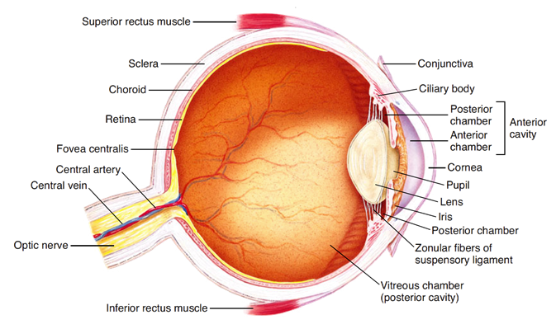
Physiology of Vision
Lecture-1-
Physiology of the eye & Refraction
By
Dr /Salah Elmalik
College of Medicine
King Saud University

Slide 2
Learning Objectives
At the end of this lecture, the student should be able -:
To Describe different components of the eye and function of each .
Describe the refraction of light as it passes through the eye to the retina
Identifying the refractive media of the eye
Know fluid system of eye & glaucoma
binocular vision .
Know layers of retina, blind spot, and fovea
Know principles of optics and errors of refraction

Slide 3
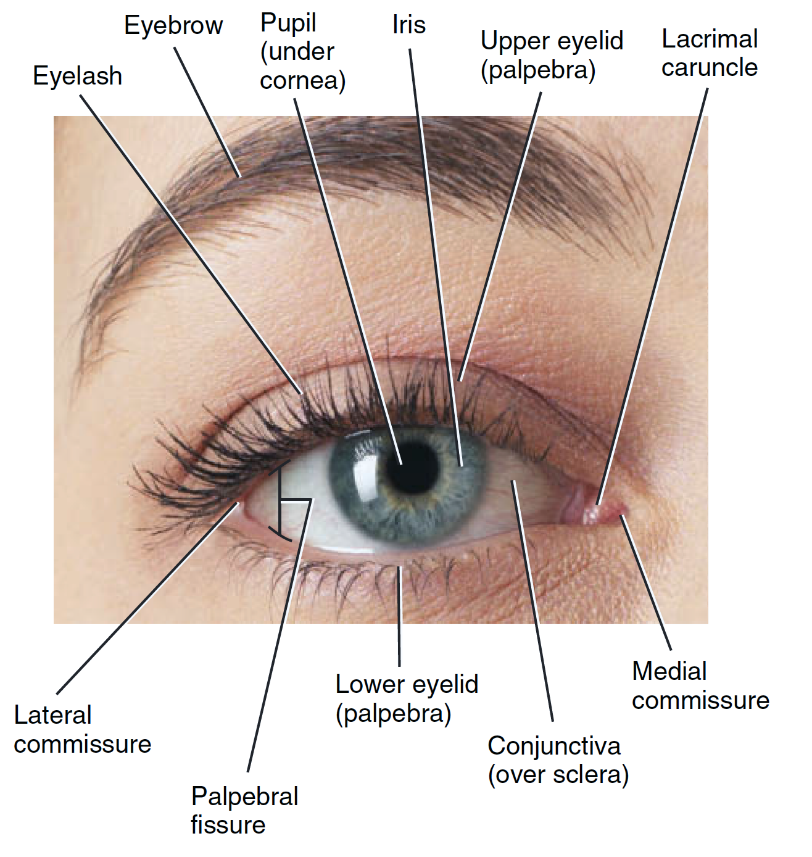
The Eye
Human vision is one of the most complex visual systems among animals.
The eye is a complex sensory organ, which capable of transduction physical stimuli of light rays into electrical and chemical signals that can be interpreted by the brain to construct physical images.

Slide 4
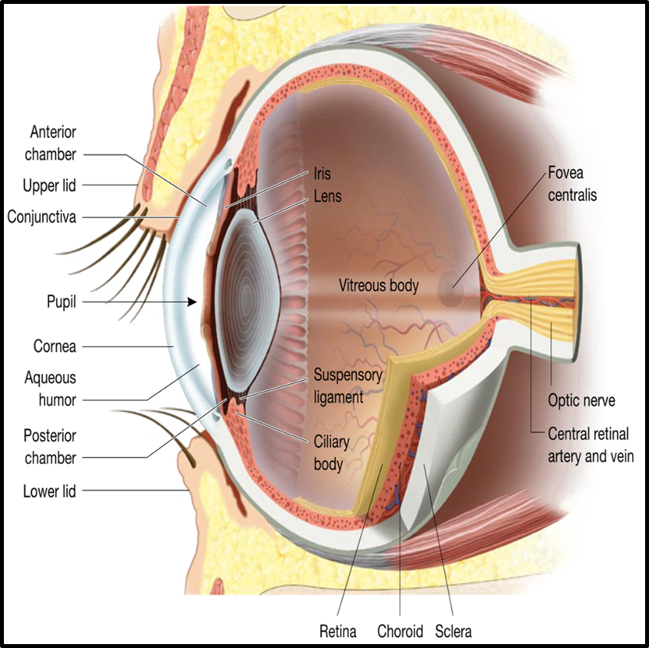
The eye consists of 3 layers :
  1/ Outer fibrous layer
  consists of :
  (a) Sclera
  (b) Cornea
Cornea is transparent anterior portion
Conjunctiva lines the eyelids and covers the sclera.
It is a transparent epithelium covered with mucus and tear and prevent entrance of microbes and dust into the eye

Slide 5
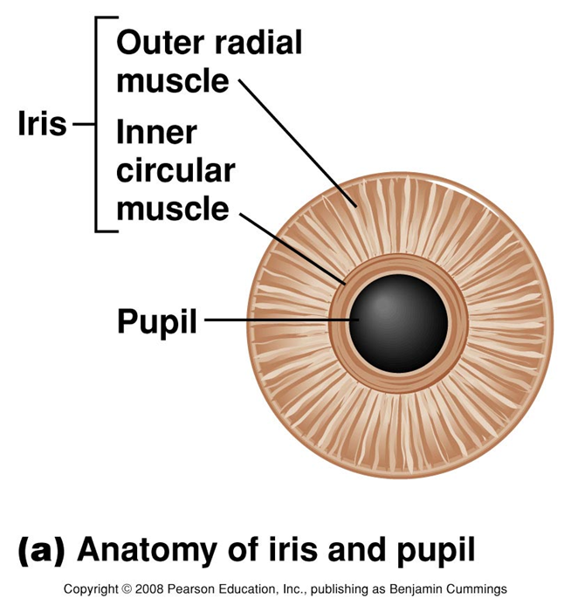
    2. Middle Vascular Layer:
    consists of :
  Iris:
  Is the colored part of the eye
  Has aperture (pupil) control & allow light to enter the eye
  (b) Ciliary body:
  Ciliary body consists of:
  Ciliary muscles
  Ciliary glands
  Suspensory ligaments which attached to the lens
  (c) Choroid
  Is highly vascular structure
  The outermost layer of the retina depends mostly on diffusion from choroid blood vessels for nutrition specially oxygen supplying
  Uvea = choroid + iris + ciliary body

Slide 6
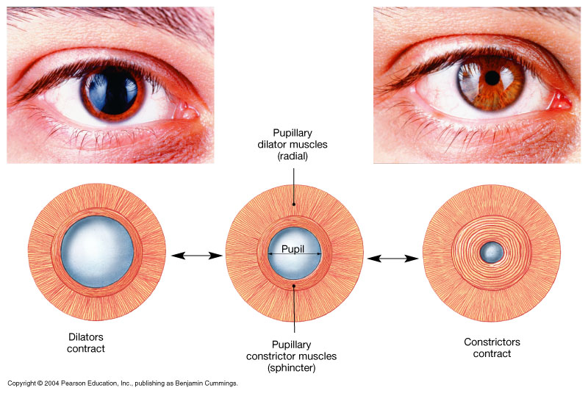
The Pupillary Muscles: consists of → Radial and Circular parts
Figure 17.5

Slide 7
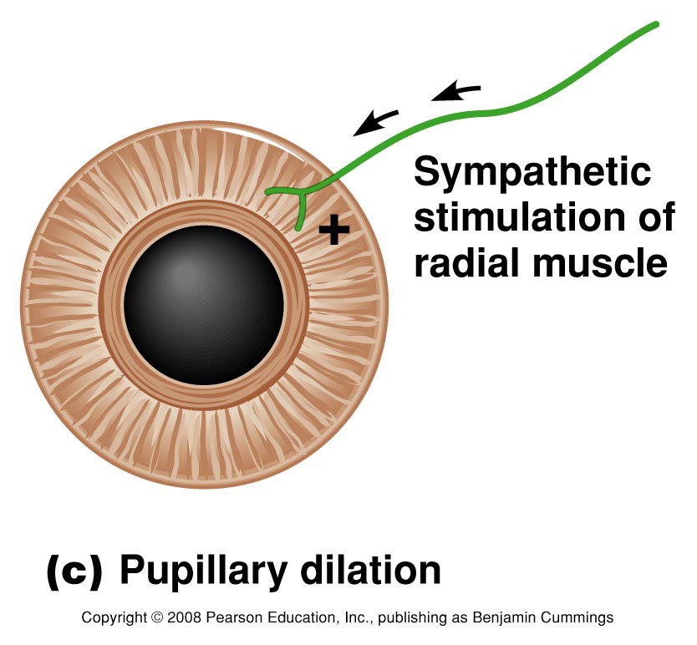
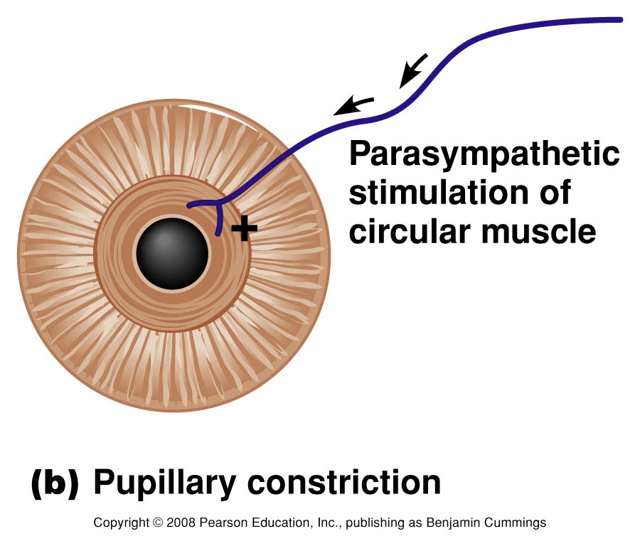

Slide 8
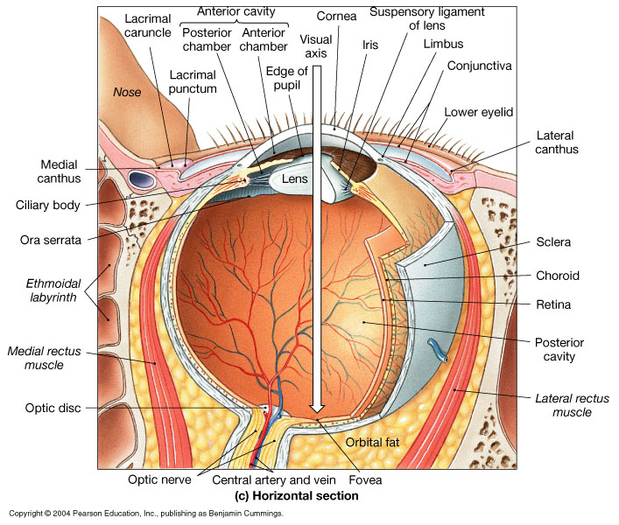
The Anterior & Posterior Cavities
The Ciliary Body (& its suspensary ligament ) and lens divide the eye into :
(1) Anterior cavity which contains a fluid called Aqueous Humor
(2) Posterior cavity
( which contains fluid called Vitreous Humor) .

Slide 9
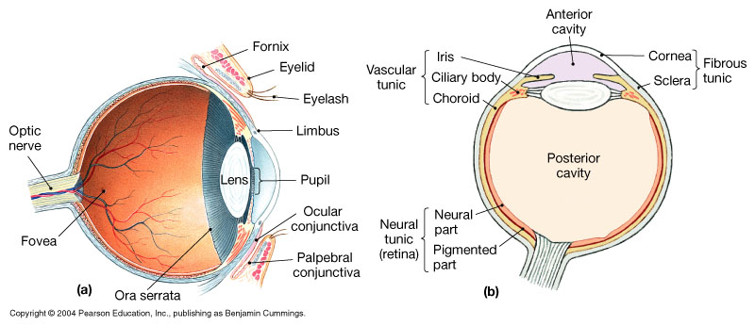
The Anterior and Posterior Chambers
Posterior Chamber
Anterior Chamber
Furthermore , the Iris further divides the anterior cavity into :
Anterior Chamber ( in front of the iris ) , and
Posterior Chamber ( behind the iris ; between the iris and lens ) .

Slide 10
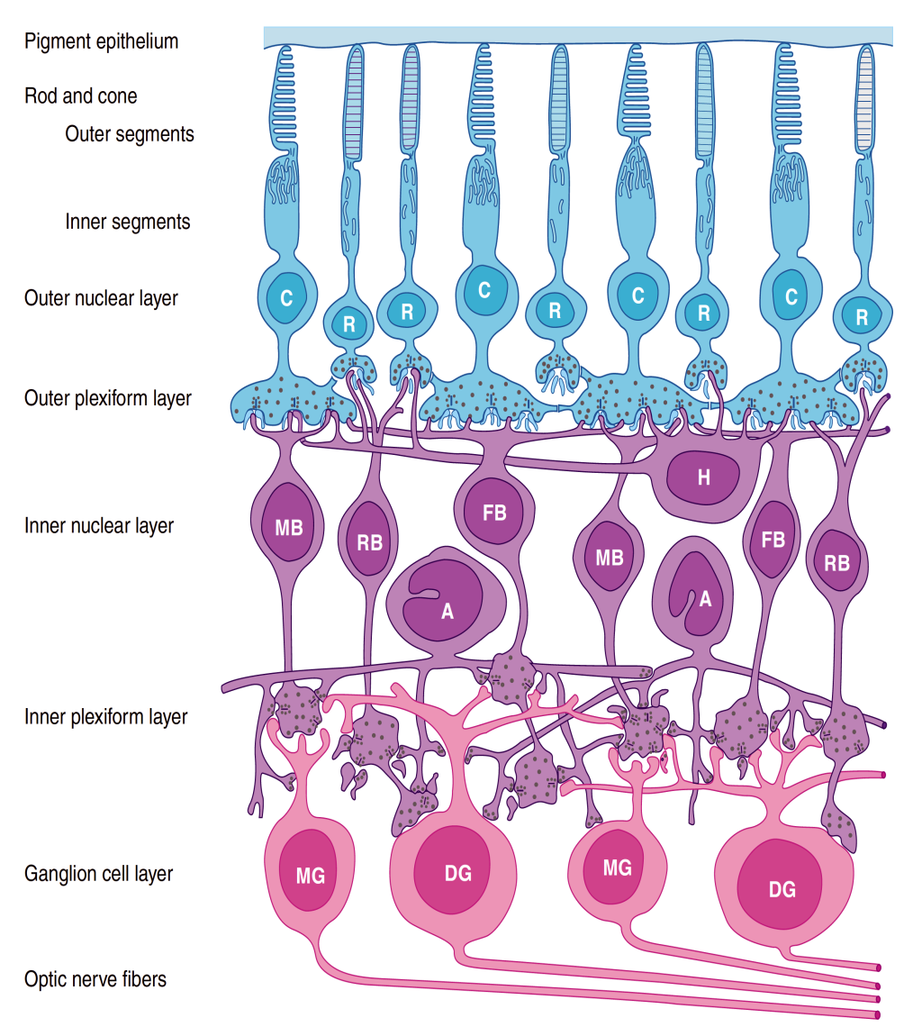
3. The Retina:
consists of :
Outer pigmented portion ( part )
Inner neural part , containing Photoreceptors called Rods and Cones .

Slide 11
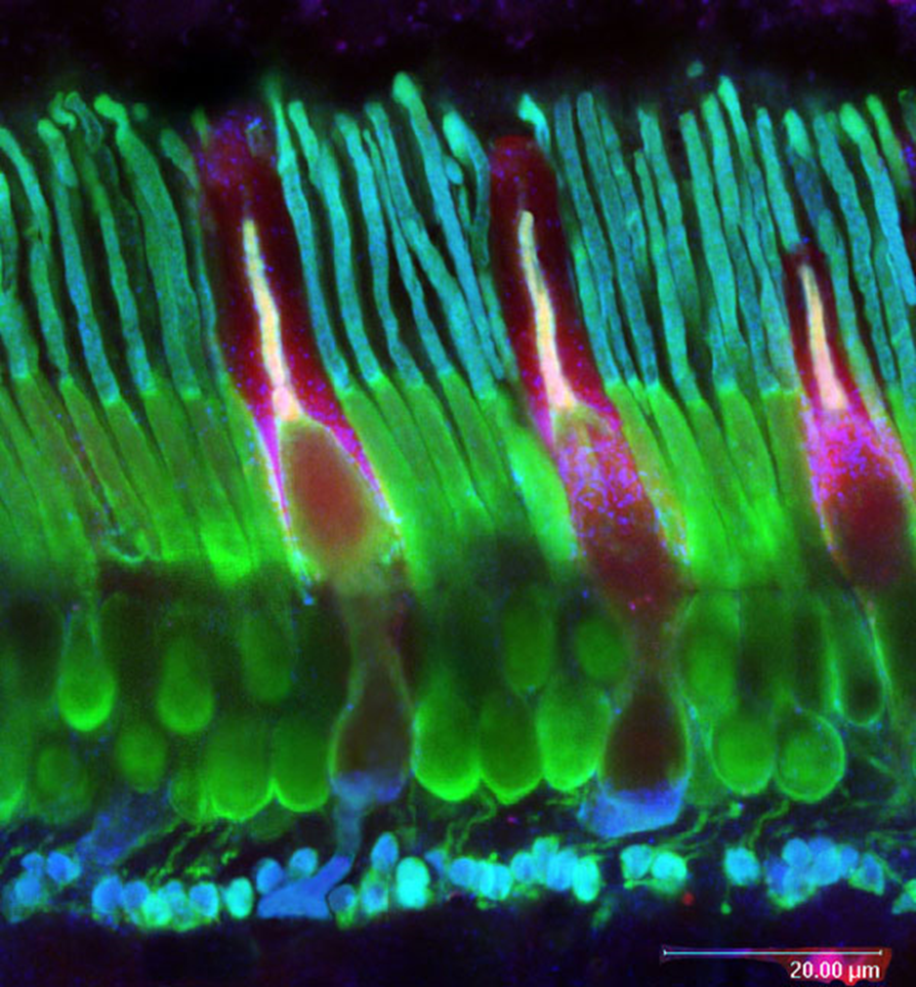
Rods & Cones
Rods
  are best for vision in dim light (scotopic vision)
  Cones
  are best for
  vision in daylight or bright light ( photopic vision)
  Color Vision ( color perception )
  Perception of detail ( acuity of vision )

Slide 12
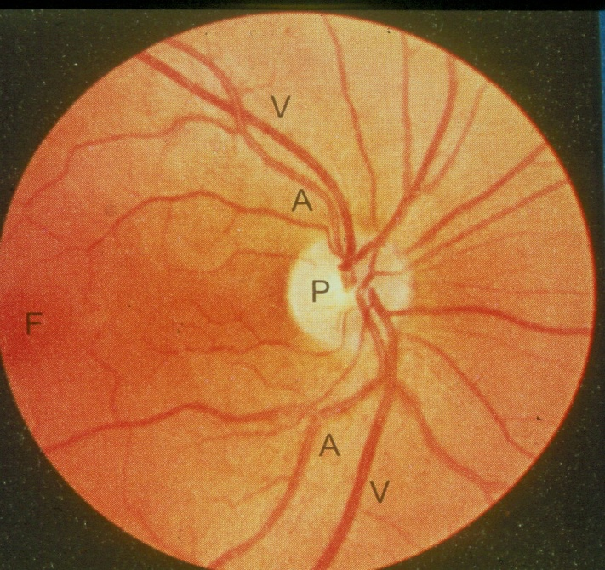
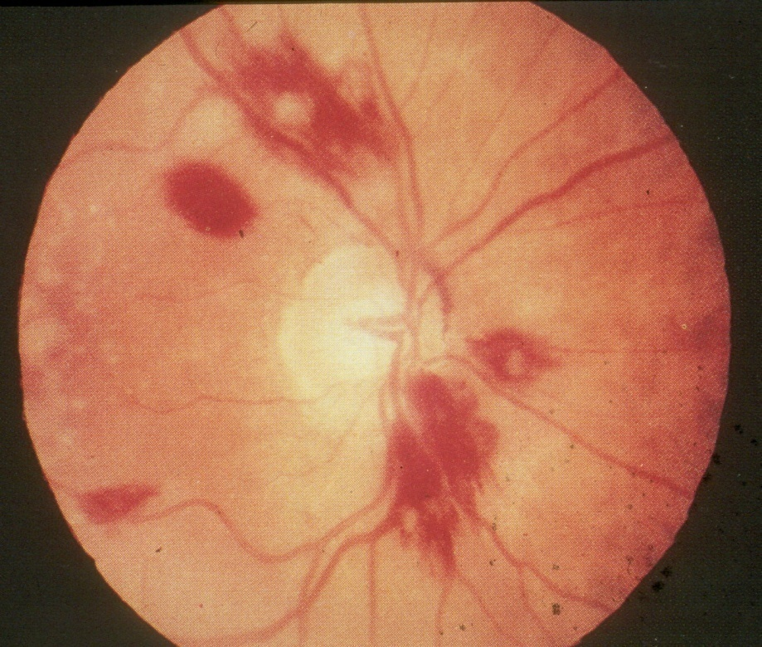
Macula & Fovea Centralis
Optic Disc
( Blind Spot )
An important part of the retina is the Macula Lutea .
At the center of the Macula we find the Fovea Centralis .
In the Fovea we find the maximum concentration of cones →consequently → the Fovea is the point of maximal visual activity in the retina .
Cones are densely packed at the Fovea .
When you turn your eye to look at an object → you tend to place its image in the Fovea
Fovea ( point ofconcentration of Cones )

Slide 13
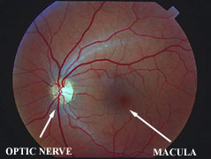
Normal Ophthalmoscopic View of Eye

Slide 14
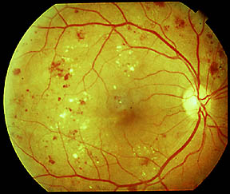
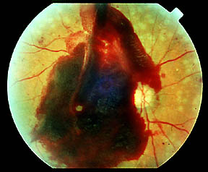
Disorders of the Eye and Vision: Retinopathy
Retinopathy in diabetes
  Vessels have weak walls – causes hemorrhaging and blindness

Slide 15
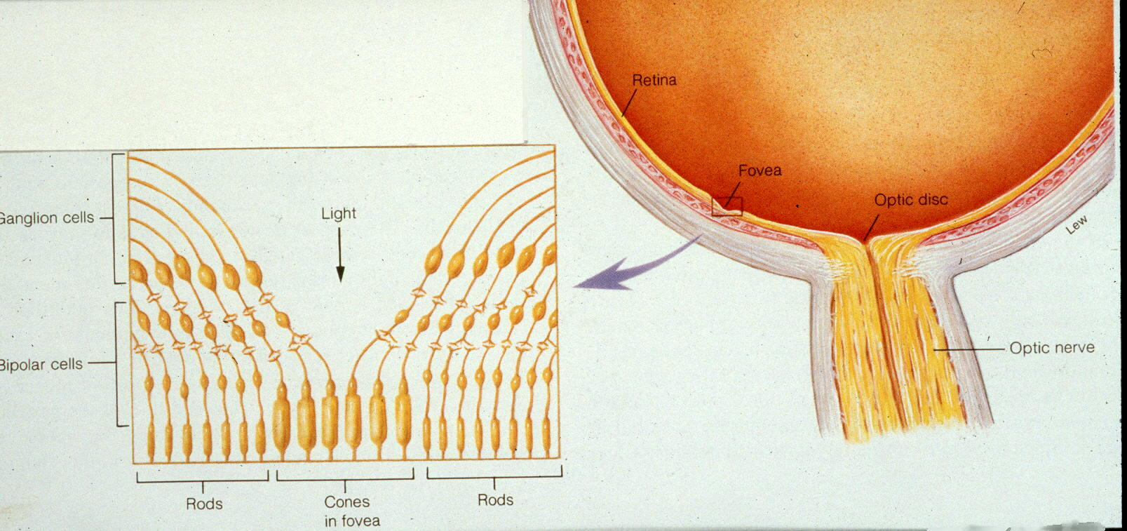
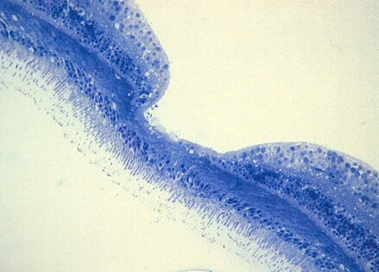

Slide 16
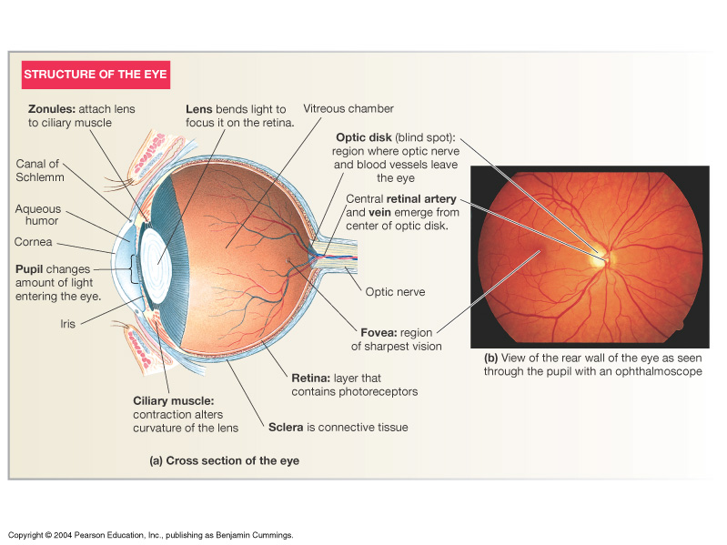

Slide 17
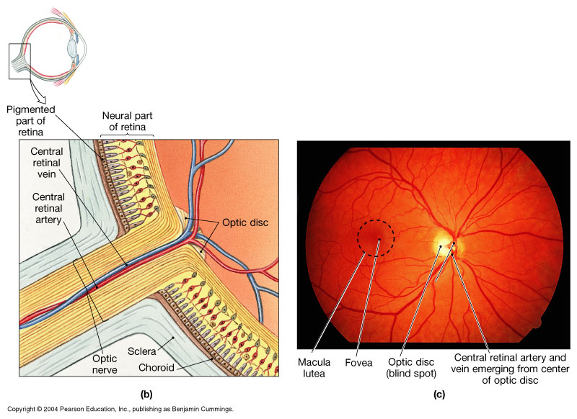
Organization of the Retina
Figure 17.6b, c

Slide 18
External Protection of The Eye
1. Bony orbit
2-Eye lids with their lashes
3 Conjunctiva
4-Tears from lacrimal gland:
  has antibacterial, lubricating effect
  keep cornea moist
  & clear
  provide nutrition to the cornea

Slide 20
Lenses
Principles of Optics

Slide 21
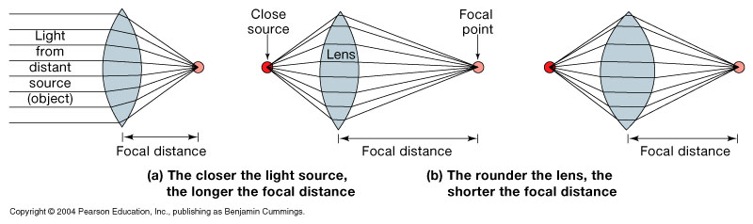
Image Formation
Figure 17.9

Slide 22
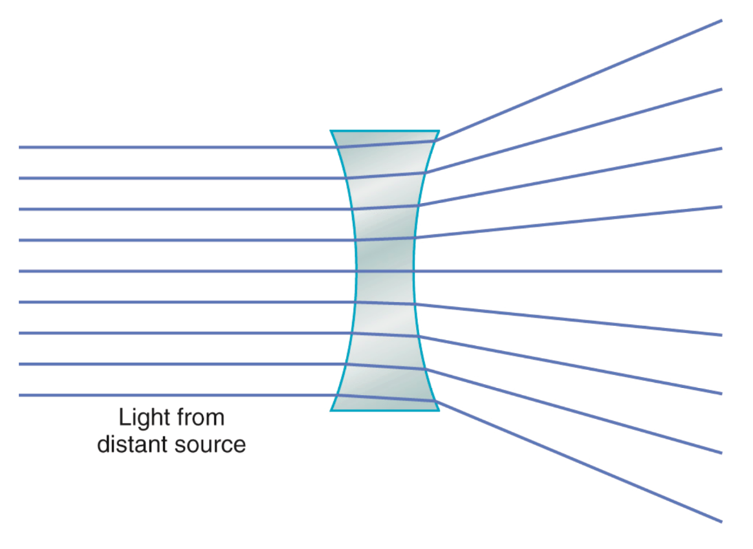
Principles of Optics
principle focus:-
parallel rays strike biconvex lens refracted in a point is PF.
principle axis:-
PF lies on line pass through centers of lens curvatures
Principal focal distance:-
distance between lens & PF.
Biconvex lens(converge) & biconcave lens(diverge)

Slide 23
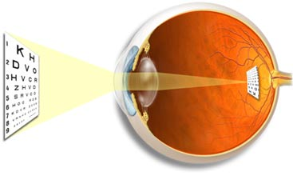
Emmetropic: objects focused on retina (normal)
Diopter:
Measure of refractive power) = 1 / Principal focal distance in meters
Exp/ if Principal focal distance of a lens is 25cm,so its R.P=1/ 0.25 meter = 4D
Emmetropic eye;-
Normal eye has image on retina , has diopteric power of 59D
Lens-retina distance =17mm
The greater the curvature of the lens, the greater the refractive power of the eye.

Slide 24
Refractive media of the eye
(1)The interface between air and the anterior surface of the cornea,
(2) The interface between the posterior surface of the cornea and the aqueous humor,
(3) The interface between the aqueous humor and the anterior surface of the lens of the eye,
(4) The interface between the posterior surface of the lens and the vitreous humor.
- a total refractive power of 59 diopters when the lens is accommodated for distant

Slide 25
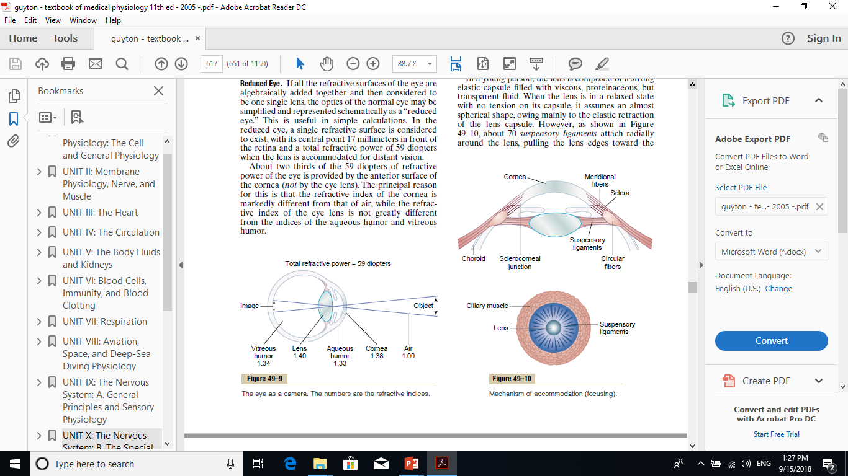
Refractive media of the eye-2
The Cornea
Its diopteric power is 40-45 diopter at its anterior surface.
About two thirds of the 59 diopters of refractive power of the eye is provided by the anterior surface of the cornea
-N.B/ The internal index of air is 1
  the cornea, 1.38
  the aqueous humor, 1.33
  the crystalline lens 1.40
  the vitreous humor 1.34.

Slide 26
2. Aqueous Humor
Fluid produced by ciliary body (cilliary processes)---to post chamber-----to pupil---to ant chamber----to canal of schlemm at angle of ant chamber---to veins
Function:
Nourishing a vascular structures ( cornea ,lens )
Causes intraocular pressure 10-20mm Hg
Produced at a rate of 2-3 microliter/min by active transport of NA+, followed by Cl- and HCO3- and then osmosis of water
Contains many nutrients like amino acids , ascorbic acids and glucose

Slide 27
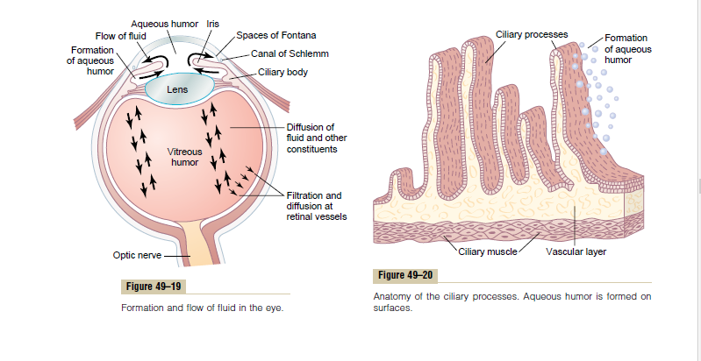
Aqueous Humor-2

Slide 28
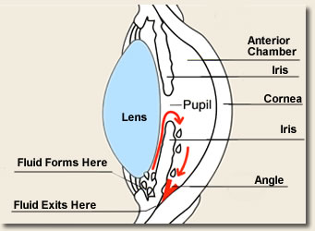
Glaucoma
Build up of Aqueous Humor
Volume
Increases pressure in eye
Damages nerve
Meds/surgery

Slide 29
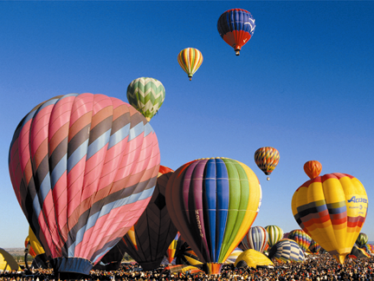

Normal Vision
Glaucoma
Glaucoma is an eye condition that develops when too much fluid pressure builds up inside of the eye. The increased internal pressure can damage the optic nerve, which transmits images to the brain. Without treatment, glaucoma can cause blindness within a few years. Glaucoma is most often inherited, meaning it is passed from parents to children. Less common causes of glaucoma include a blunt or chemical injury to the eye, severe eye infection, blockage of blood vessels in the eye and inflammatory conditions of the eye. Glaucoma usually occurs in both eyes, but it may involve each eye to a different extent.

Slide 30
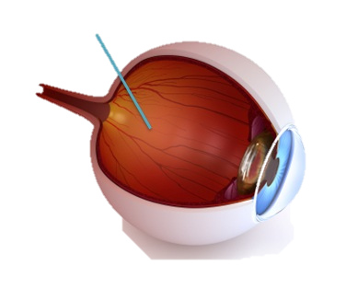
3. The Vitreous Humor
Is the transparent, colorless, gelatinous mass
It fills the vitreous chamber between the lens of the eye and the retina
The vitreous humour is clear and allows light to pass through
For nourishing retina & keep spheroid shape of the eye
Both water and dissolved substances can diffuse slowly in the vitreous humors
VITREOUS HUMOUR REMAINS FROM BIRTH

Slide 31
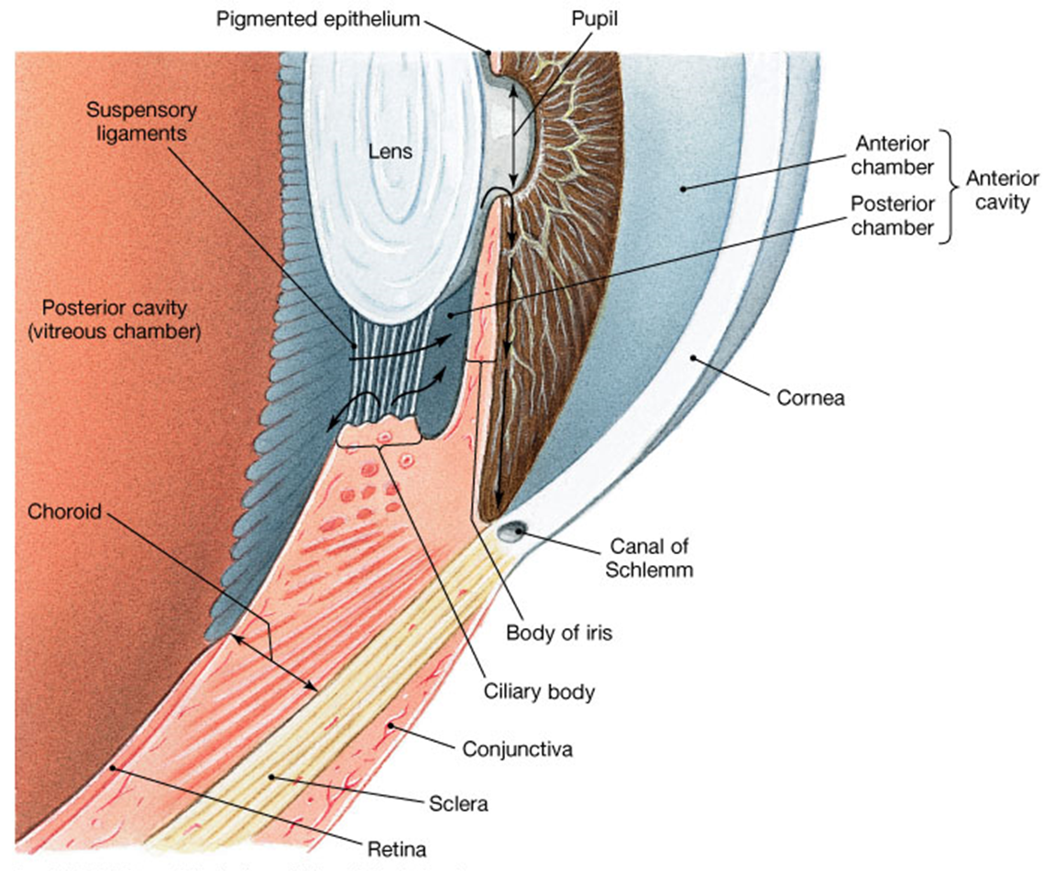
4. The Lens
Has diopteric power 15-20 D
(1/3 refractive power of eye) , more important than cornea.
why?
Importance of the internal lens is that, in response to nervous signals from the brain, its curvature can be increased markedly to provide “accommodation”

Slide 32
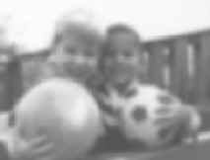
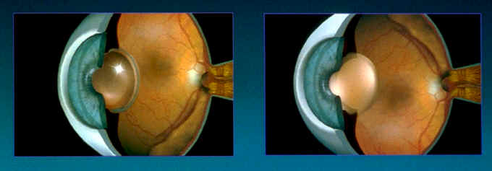
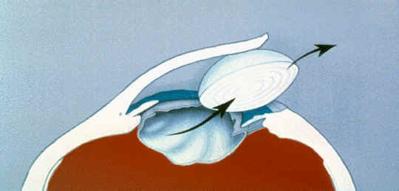
Cataracts
Lens clouds up
Must be removed
Typical to replace lens with implant
Can get clouding repeated
Laser removal

Slide 33
Binocular Vision
Are the areas in the centre of visual field of the two eyes in which any object in this area will be seen by both eyes.
BINOCULAR VISION for:
1- Large visual field
2- cancel the effect of blind spot
3- stereoscopic vision
4- one eye lesion does not affect vision
Monocular and binocular visual fields. -The dashed line encloses the visual field of the left eye;
-the solid line, that of the right eye. -The common area (heart-shaped in the center) is viewed with binocular vision.
-- The colored areas are viewed with monocular vision.

Slide 34
Errors of Refraction
Hypermetropia (long sight)
Myopia (Short sight)
Astigmatism
Presbyopia

Slide 35
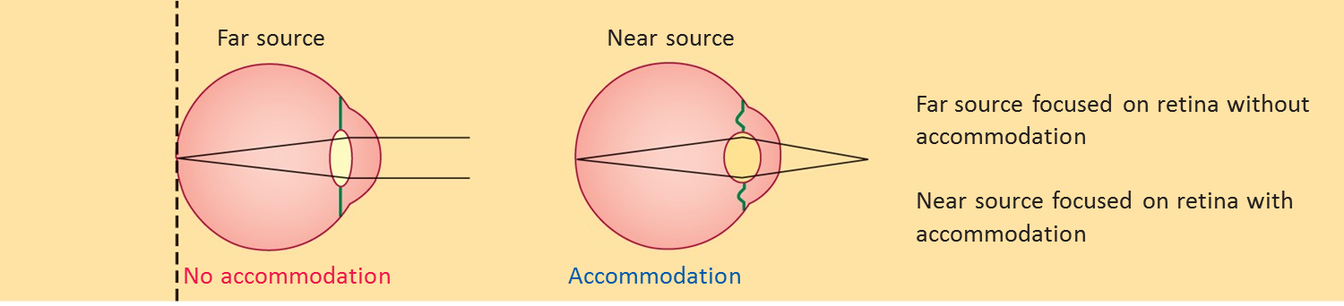
Normal eye (Emmetropia)

Slide 36
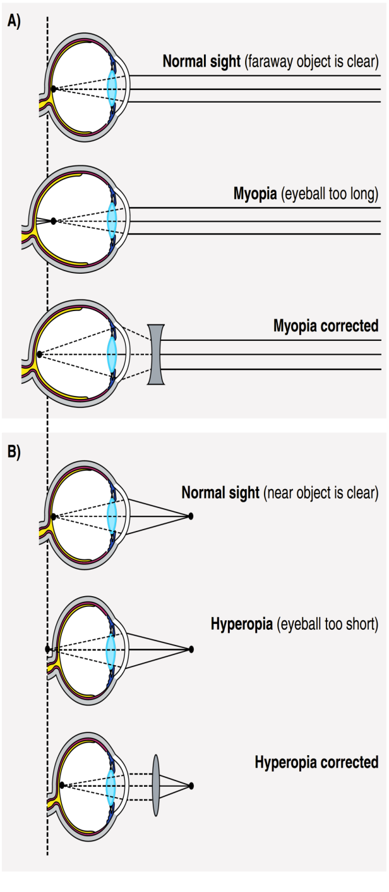
1- Hypermetropia (hyperopia = far-sightedness)
Short eyeball, focus behind retina,
An affected individual has to use accommodation even for distant objects.
Continuous accomodation to bring image on retina causes muscular effort on ciliary muscle & prolonged convergence , this leads to headache & finally squint
correction by biconvex lens.

Slide 37

2- Myopia(nearsightedness)
Genetic, large eye ball, long anteroposterior diameter, cause image to focus in front of retina
Causes of myopia:
Myopia is thought to be partially genetic in origin
However, there is a positive correlation between sleeping in a lighted room before the age of 2 and the subsequent development of myopia.
In young adults the extensive close work involved in activities such as studying accelerates the development of myopia
Correction by biconcave lens to diverge rays before strike lens)

Slide 38
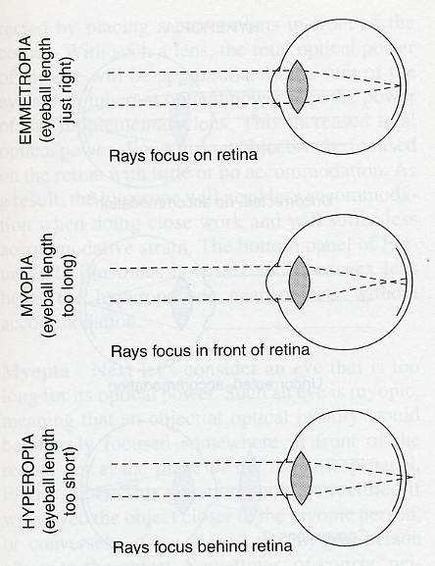
Image Focusing
Emmetropia
(normal vision)
Fully relaxed
unaccommodated
lens
Myopia
(Short sight)
Hyperopia
(long sight)

Slide 39
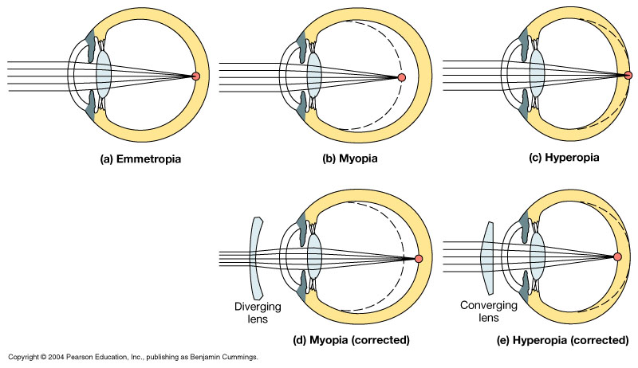
Visual Abnormalities
Long-shghted
Short-sighted
Normal
Biconcave lens
Biconvex lens
Figure 17.11

Slide 40
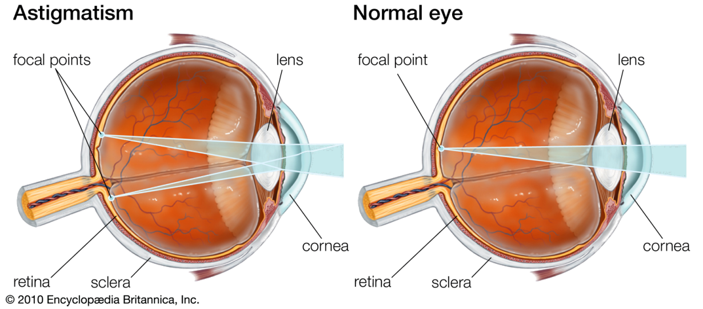
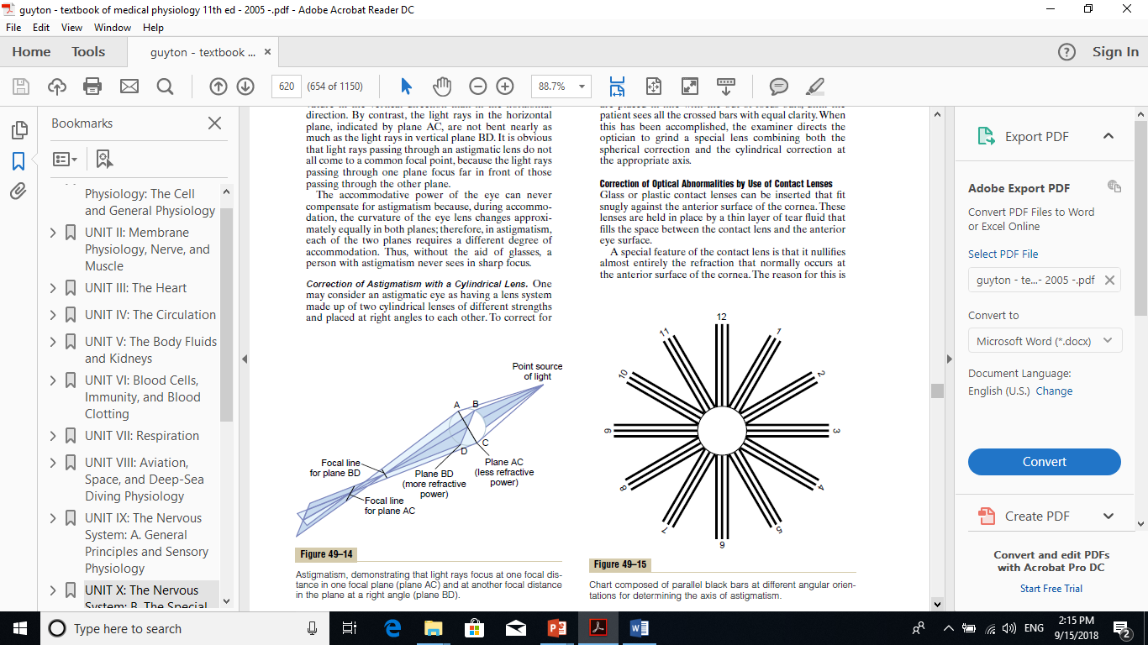
3. Astigmatism
Uneven & ununiformed corneal curvature, very rare ununiformed lens curvature
Rays refracted to diff focus---------blurred vision
Correction by cylindrical lens

Slide 41
Astigmatism
Retina
Distorted Cornea

Slide 42
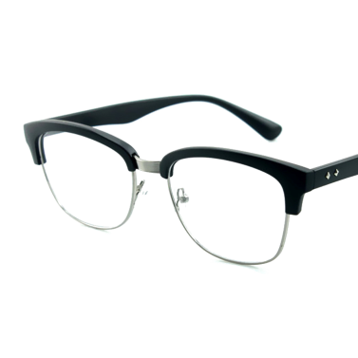
Corrected Astigmatism
Retina
Distorted Cornea
Cylindrical Lens

Slide 43
Presbyopia
Eye near point recedes by age due to loss of accomodation - -Focus behind retina - -correction by biconvex lens

Slide 44
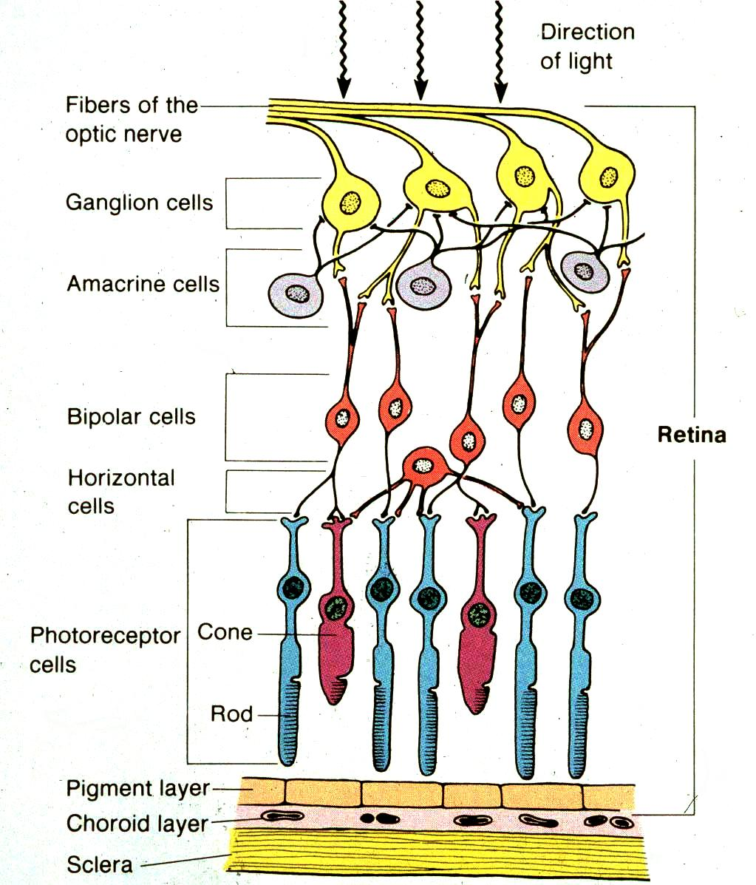
Retinal Layers

Slide 45
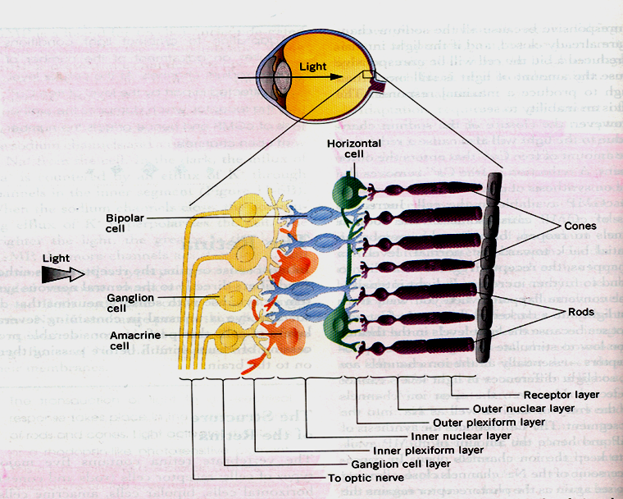
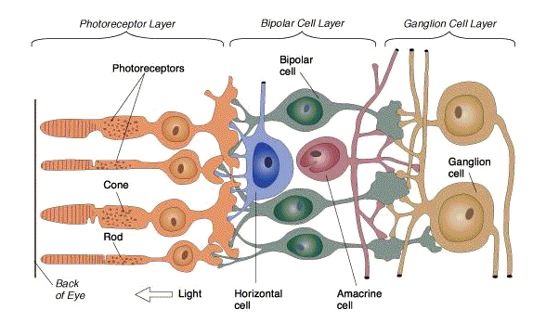
Light Pathway

Slide 46
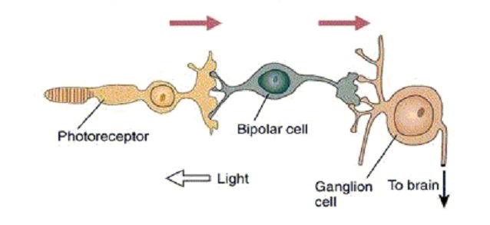
Retina: Neural Circuitry
Light hits photoreceptors, sends signal to the bipolar cells
Bipolar cells send signal to ganglion cells
Ganglion cells send signal to the brain

Slide 47

THANK YOU

