Slide 1
Integrated CNS Practical
Biochemical & Microbiological
Examination of CSF
CENTRAL NERVOUS SYSTEM BLOCK
2017-2018
CNS
Infection
Dr. Fawzia Al-Otaibi
Dr. Khalifa Binkhamis

Slide 2
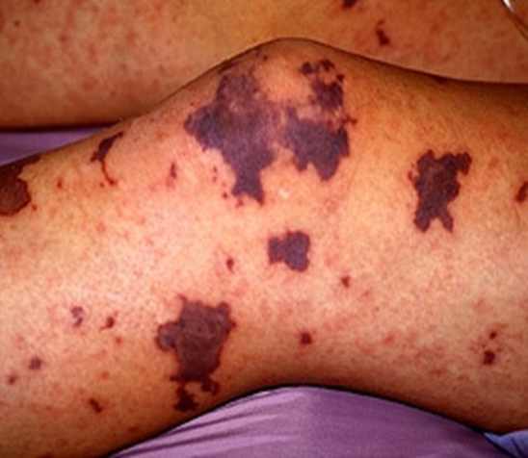
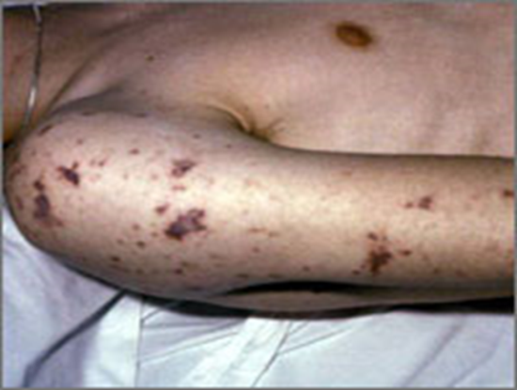
CASE 1
A 15-year-old healthy male visited emergency room presenting with fever, headache, vomiting and drowsiness. Physical examination showed decreased level of consciousness, neck stiffness, skin rash and high temperature (38°c). Cerebrospinal fluid (CSF) examination revealed opening pressure of 210 cm H2O.
The doctor in the emergency department takes a detailed history and conducts a clinical examination. Because of clinical findings, he decides to do a lumber puncture. The results of the lumber puncture are shown below:

Slide 3
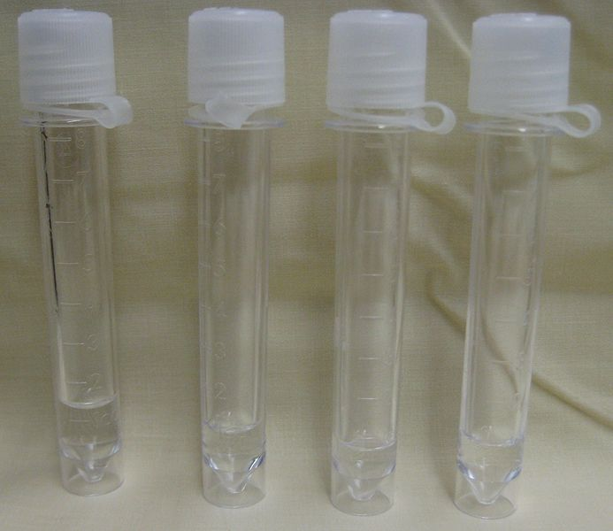
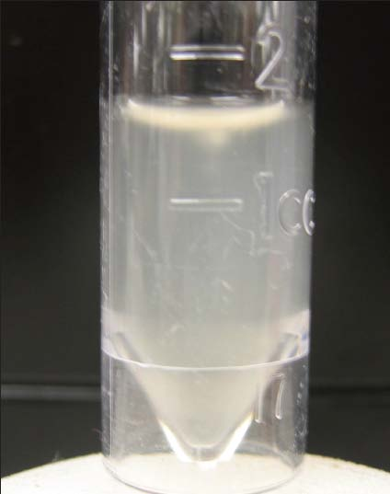
Normal and turbid CSF

Slide 4
CASE 1: LUMBER PUNCTURE RESULTS
CSF | Patient’s results | Normal range
Appearance | Turbid | Clear
WBCs and differential | 8,320 per mm³ Mainly polymorphonuclear leucocytes (84%) | Few (<5 cells/mm³)
Protein | 5.0 | 01-0.4 g/L
Glucose | 1.3 | 3.0-4.5 mmol/L
Chloride | 110 | 115-130 mmol/L

Slide 5
QUESTION 1:
What is your diagnosis?
……………………………………………………………………………………………………………………
QUESTION 2:
What is the most likely infection responsible?(Select only one)
Mycobacterium Avium
Fungal infection
Parasitic infection
Viral infection
Bacterial infection
Trepanoma pallidum (Neurosyphilis)
Mycobacterium tuberculosis

Slide 6
QUESTION 3:
What is your justification for your answer to question two?
……………………………………………………………………………………………………………………
QUESTION 4:
What further investigation would you like to do at this stage?
……………………………………………………………………………………………………………………
QUESTION 5:
Mention two of the recommended antibiotics that can be used as empiric treatment in such a case?…………………………………………………………………………………………………………

Slide 7
Microscopy of the cerebrospinal fluid showed gram –ve cocci.
The patient showed complete recovery after administration of ceftriaxone for 10 days.

Slide 8
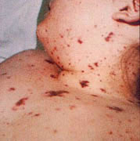
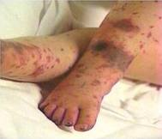
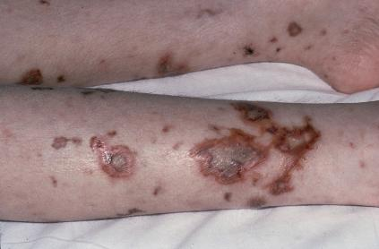
The characteristic skin rash (purpura) of meningococcal septicemia, caused by Neisseria meningitidis

Slide 9
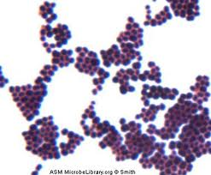
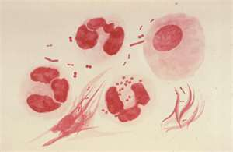
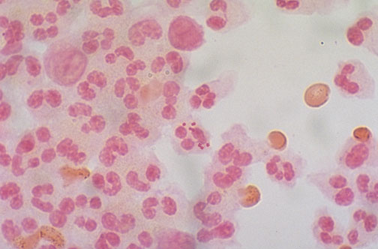
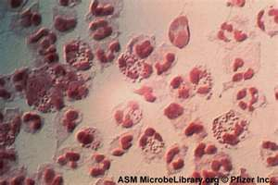
Bacterial meningitis: Neisseria meningitidis Microscopic Appearance Gram stained smear from CSF deposit showing : gram negative intracellular diplococci + many pus cells

Slide 10
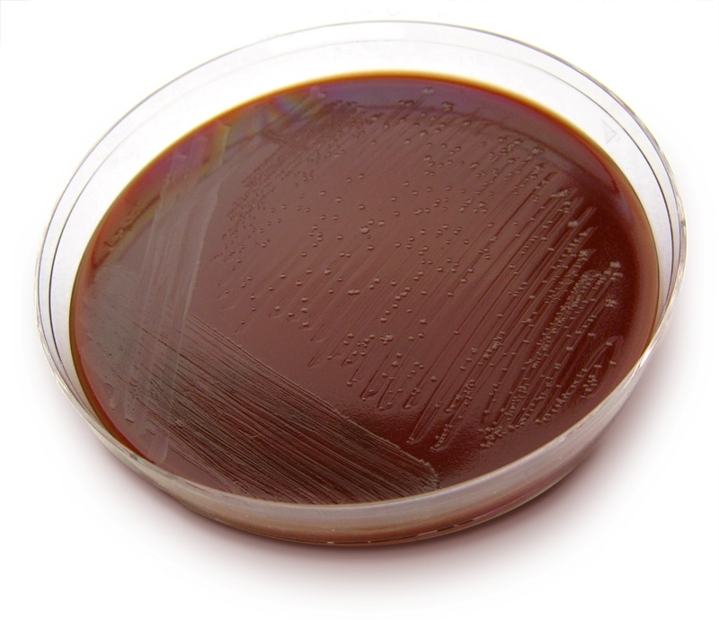
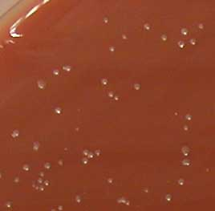
Bacterial meningitis: Neisseria meningitidis

Slide 11
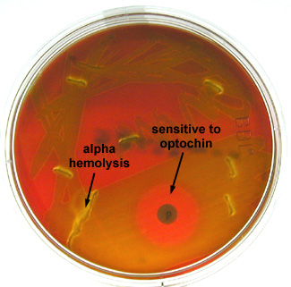
Case Study
A 59 y.o. male farmer with sudden onset of fever, headache, neck stiffness and confusion
Peripheral Blood count:
12,800 WBCs/mm³ (73% neutrophils; 12% bands)
Cerebrospinal Fluid:
3520 WBC/mm³ (100% neutrophils)
Glucose: <1 mg/deciliter
Protein: 368 mg/deciliter
Gray white, alpha-hemolytic colonies recovered on sheep blood agar with increased CO2 from spinal fluid sediment was Optochin sensitive

Slide 12
Questions
What is your most likely diagnosis?
…………………………………………………………………………………………………………………………………………………………………………………………………………………………………………………..
What is the most probable pathogen isolated?
…………………………………………………………………………………………………………………………………………………………………………………………………………………………………………………....

Slide 13
Questions
Mention two of the recommended antibiotics that can be used as empiric treatment in such a case?
……………………………………………………………………………………………………………………

Slide 14
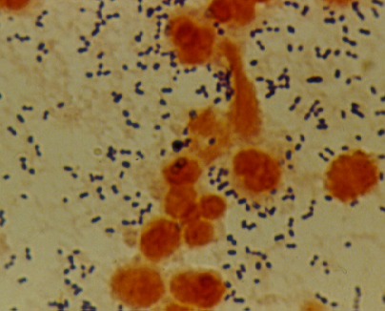
Bacterial meningitis: Pneumococcal Meningitis
Direct gram stain of a CSF deposit shows gram-positive diplococcic with lanceolate shape and polymorphneoclear leucocytes

Slide 15
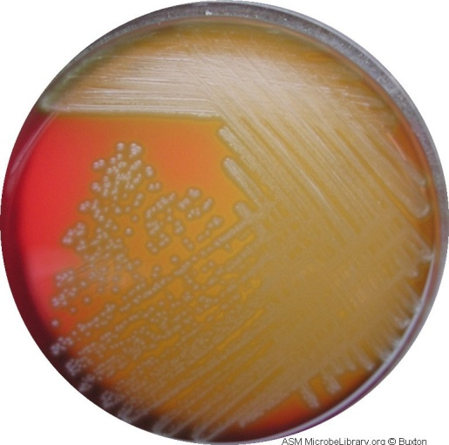
Bacterial meningitis: Pneumococcal Meningitis Culture on blood agar showing alpha-hemolytic colonies

Slide 16
Bacterial meningitis: Pneumococcal Meningitis
OPTOCHIN SENSITIVE ALPHA-HAEMOLYTIC STREPOCOCCI

Slide 17
Bacterial meningitis:
H. influenza Meningitis
Mainly caused by Hemophilus influenzae type b
Gram negative coccobacilli
Requires X & V growth factors for growth
The optimum growth temperature is 35°C - 37°C in 5% CO2

Slide 18
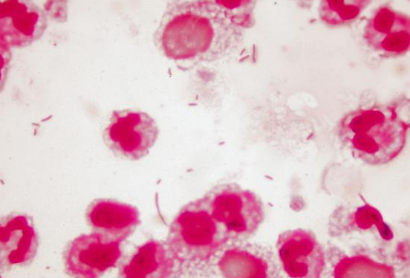
Bacterial meningitis: H. influenzae Microscopic Apearance Direct gram stain of a CSF deposit shows Gram-Negative pleomorphic coccobacilli with many polymorphneuclear leucocyte

Slide 19
Bacterial meningitis: H. influenzae
Culture on chocolate agar

Slide 20
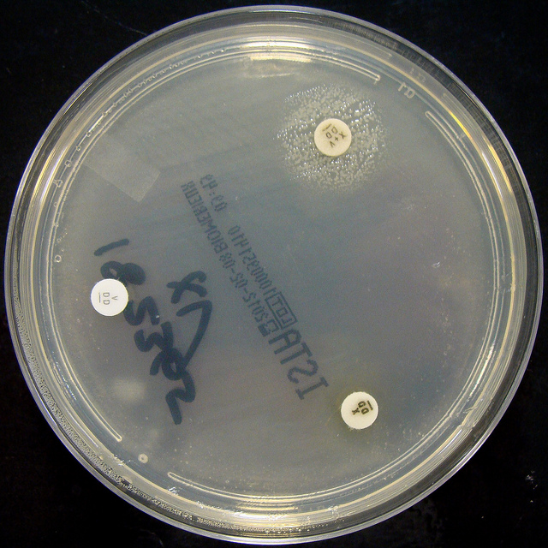
Bacterial meningitis: H. influenzae
Culture on Nutrient agar
H. influenzae :Growth arround XV factors( requires both factors XV)
no growth arround X or V alone

Slide 21
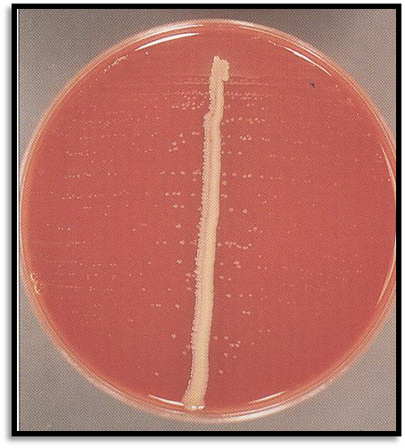
Bacterial meningitis: H. influenzae
Culture on Blood agar
Growth on blood agar showing satellitisim adjacent to a streak of S. aureus. S. aureus producing surplus factor increasing growth of adjacent H .influenzae

Slide 22
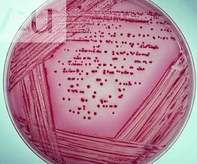
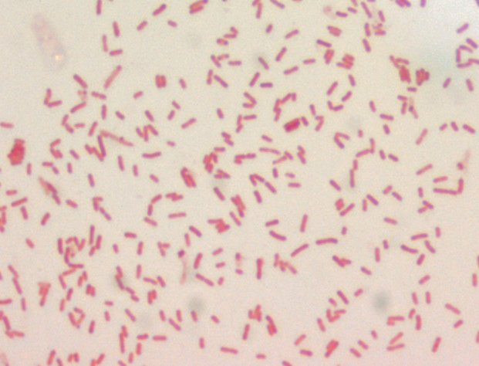
Bacterial meningitis: E. coli
Neonatal meningitis is most common due to
Colonization of infants with E. coli at delivery is
Escherichia coli on MacConkey agar plate: appear pink as they ferment lactose
gram negative bacilli

Slide 23
CASE 2
A 10-year old boy is brought to the emergency department (A&E) at King Khalid Hospital accompanied by his mother. He has fever, headache, and vomiting for the last 2 days. Clinical examination confirmed that he has meningeal irritation. The doctor decided to do a lumber puncture.
The results of the lumber puncture are shown below:

Slide 24
CASE 2: LUMBER PUNCTURE RESULTS
CSF | Patient’s results | Normal range
Appearance | Clear | Clear
WBCs and differential | 100 per mm3 Mainly lymphocytes (80%) | Few (<5 cells/mm3)
Protein | 0.5 | 0.1-0.4 g/L
Glucose | 3.7 | 3.0-4.5 mmol/L
Chloride | 115 | 115-130 mmol/L

Slide 25
QUESTION 1:
What is your most likely diagnosis?
……………………………………………………………………………………………………………………
QUESTION 2:
What is the most likely infection responsible?(Select only one)
Mycobacterium Avium
Fungal infection
Parasitic infection
Viral infection
Bacterial infection
Trepanoma pallidum (Neurosyphilis)
Mycobacterium tuberculosis

Slide 26
Question 3:
Justify your answer to question two?
……………………………………………………………………………………………………………………
QUESTION 4:
What further investigation would you like to do at this stage?
……………………………………………………………………………………………………………………

Slide 27
Microbiological Finding
CSF Molecular testing is positive for
Enterovirus

Slide 28
CASE 3
A 65-year-old is referred from a general practitioner because of headache, fever, excessive sweating at night, and weight loss over the last 4-5 months. He has lost his appetite for food. On examination, there is neck rigidity. Laboratory tests including blood count, serum and electrolytes, blood urea, creatinine and blood culture are all normal. The doctors decides to do a lumber puncture.
The results of the lumber puncture are shown in the next slide:

Slide 29
CASE 3: LUMBER PUNCTURE RESULTS
CSF | Patient’s results | Normal range
Appearance | Turbid | Clear
WBCs and differential | 300 per mm3 Mainly lymphocytes | Few (<5 cells/mm3)
Protein | 0.8 | 0.1-0.4 g/L
Glucose | 2.0 | 3.0-4.5 mmol/L
Chloride | 110 | 115-130 mmol/L
Notes:
Few (<5 cells/mm3)
0.1-0.4 g/L
3.0-4.5 mmol/L
115-130 mmol/L

Slide 30
QUESTION 1:
What is your most likely diagnosis?
……………………………………………………………………………………………………………………
QUESTION 2:
What is the most likely infection responsible?(Select only one)
Fungal infection
Parasitic infection
Viral infection
Bacterial infection
Trepanoma pallidum (Neurosyphilis)
Mycobacterium tuberculosis

Slide 31
QUESTION 3:
What is your justification for your answer to question two?
……………………………………………………………………………………………………………………
QUESTION 4:
What further investigation would you like to do at this stage?
……………………………………………………………………………………………………………………

Slide 32
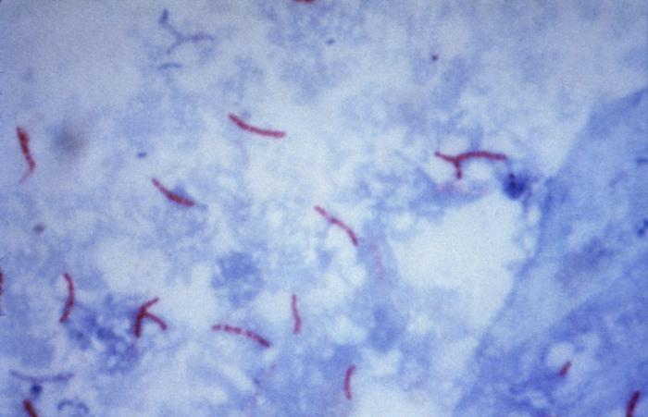
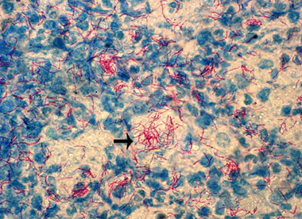
Bacterial meningitis: Mycobacterium tubercuolosis Microscopic Appearance Direct Ziel – Neelsen Stained Smear of a CSF deposit shows Acid – Fast Bacilli AFB

Slide 33
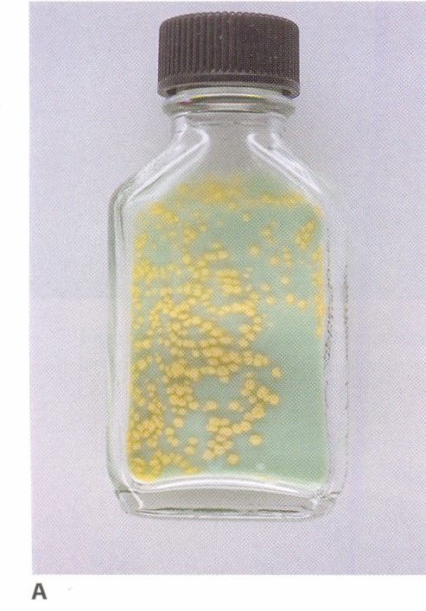
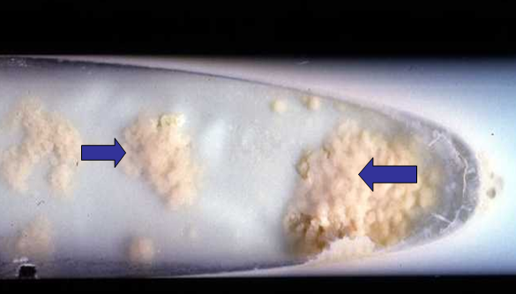
Bacterial meningitis: Mycobacterium tuberculosis Culture on Lowenstein – Jensen medium Colonies or growth is Rough, Tough and Buff

