Slide 1
CNS Practical
Case studies on
Biochemical &Microbiological
Examination of CSF
CENTRAL NERVOUS SYSTEM BLOCK
2020-2022
Prof. Fawzia Al-Otaibi
Dr. Khalifa Bin Khamees

Slide 2
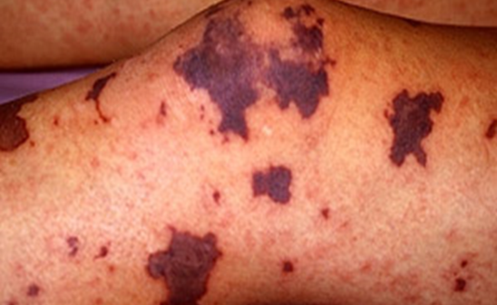
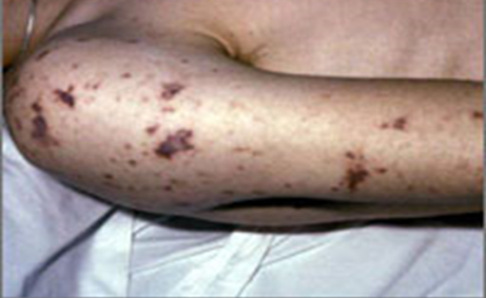
CASE 1
A 15-year-old healthy male visited emergency room presenting with fever, headache, vomiting and drowsiness.
Physical examination showed decreased level of consciousness, neck stiffness, skin rash and high temperature (38°c).

Slide 3
What is your provisional clinical diagnosis?
Meningitis
Brain abscess
Encephalitis
URTI

Slide 4
What further investigation would you like to do at this stage? Request for

Slide 5
Follow up 1
The results of the lumber puncture are shown in the next slide:

Slide 6
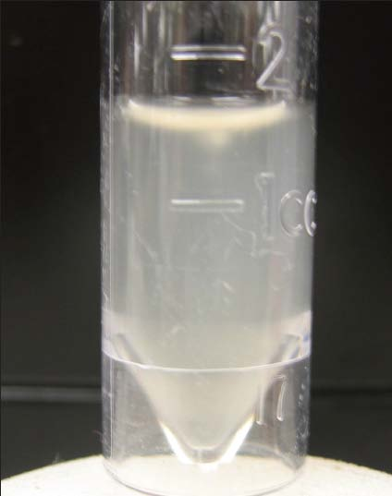
CASE 1: LUMBER PUNCTURE RESULTS
CSF | Patient’s results | Normal range
Appearance | Turbid | Clear
WBCs and differential | 8.320 per mm³ Mainly polymorphonuclear leucocytes (84%) | Few (<5 cells/mm³)
Protein | 5.0 | 01-0.4 g/L
Glucose | 1.3 | 3.0-4.5 mmol/L
Chloride | 110 | 115-130 mmol/L

Slide 7
What is your provisional diagnosis?
Fungal Meningitis
Parasitic Meningitis
Viral Meningitis
Bacterial Meningitis

Slide 8
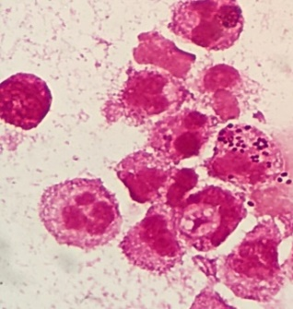
Follow up 2
Microscopic Appearance Gram stained smear from CSF showing : gram negative intracellular diplococci + many pus cells

Slide 9
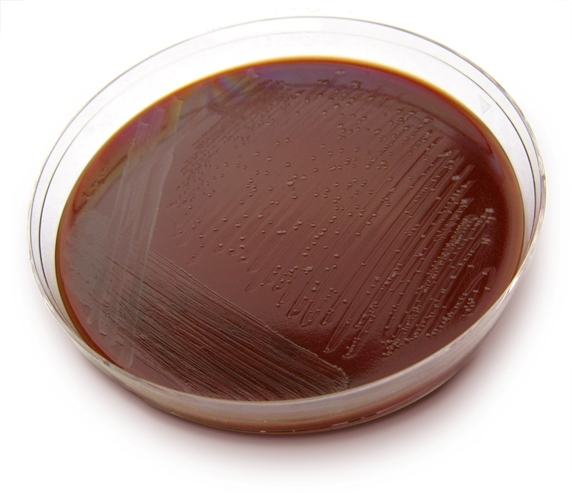
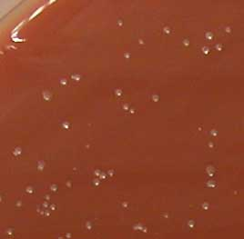

Slide 10
What is the most likely organism?
Streptococcus pneumoniae
Staphylococcus aureus
Mycobacterium tuberculosis
Neisseria meningitidis

Slide 11
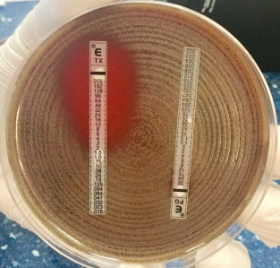
Follow up 3
Which of the following antibiotic combination is recommended as empiric treatment in such a case?
Ceftriaxone + vancomycin
Ceftriaxone + Gentamicin
Ampicillin + Vancomycin
Penicillin + Gentamicin
The patient showed complete recovery after administration of ceftriaxone for 10 days.

Slide 12
Final Diagnosis Bacterial meningitis Neisseria meningitidis

Slide 13
CASE 2
A 10-year old boy is brought to the emergency department (A&E) at King Khalid Hospital accompanied by his mother. He has fever, headache, and vomiting for the last 2 days. Clinical examination confirmed that he has meningeal irritation. The doctor decided to do a lumber puncture.
The results of the lumber puncture are shown below:

Slide 14
CASE 2: LUMBER PUNCTURE RESULTS
CSF | Patient’s results | Normal range
Appearance | Clear | Clear
WBCs and differential | 100 per mm³ Mainly lymphocytes(80%) | Few (<5 cells/mm³)
Protein | 0.5 | 01-0.4 g/L
Glucose | 3.7 | 3.0-4.5 mmol/L
Chloride | 100 | 115-130 mmol/L

Slide 15
What is the most likely type of infection? Justify your answer.
Fungal infection
Viral infection
Bacterial infection
Mycobacterium tuberculosis
What further investigation would you like to do at this stage?

Slide 16
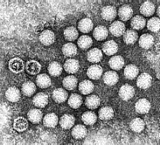
Microbiological Finding
Electron Micrograph of Enterovirus

Slide 17
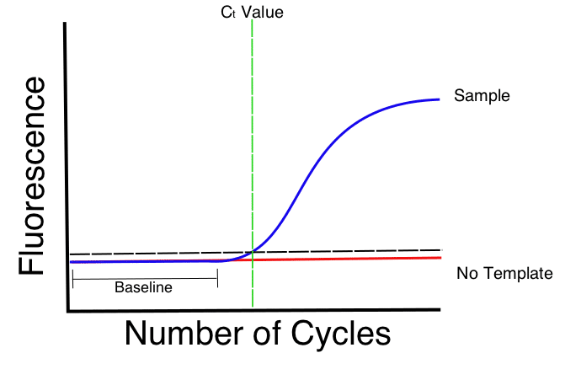
Microbiological Finding
CSF Molecular testing is positive for
Enterovirus

Slide 18
Case 3
A 38-year old male, not known to have any medical illness, in his usual state of health, he was visiting his family after which he felt tired and went to his house. He's bother was trying to call him several times and was found to be on the floor with LOC as he was not answering them, he was closing his eyes with his bilateral upper limbs contracted As per the brother. The patient complained of headache 2 days back. Physical Exam Vitals & Measurements T: 38.2 °C (Axillary), HR: 102, RR: 24, BP: 106 / 53, SpO2: 100% WT: 90 kg, kg GCS: (E=1, V=2, M4). Rigid neck, pupils:2-3 mm with sluggish reaction to light.
Assessment/Plan 38 years old male, not known to have any medical illness, presented with decreased LOC along with documented high-grade fever in the ER. LP done by ER Team.

Slide 19
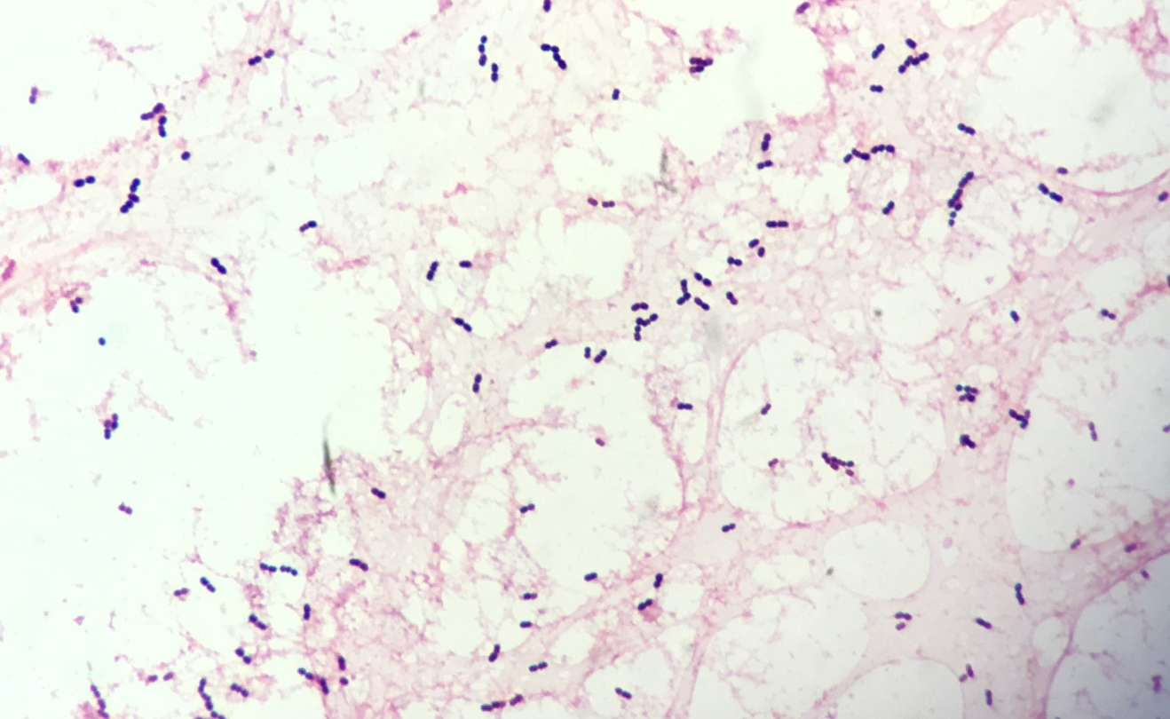
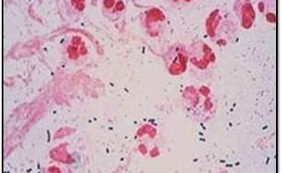
CSF Microscopic Appearance
Direct gram stain of a CSF deposit shows gram-positive diplococcic with lanceolate shape and polymorphneoclear leucocytes

Slide 20
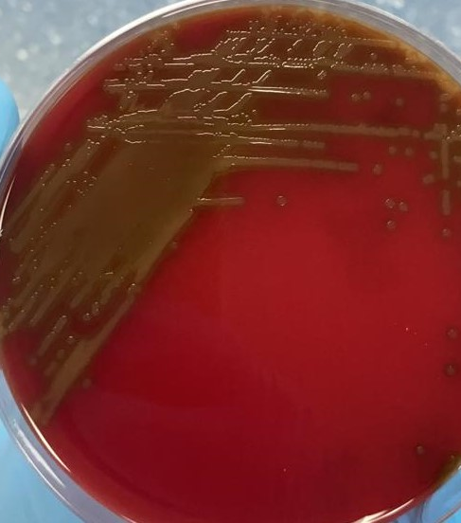
Culture on blood agar Alpha-hemolytic colonies

Slide 21
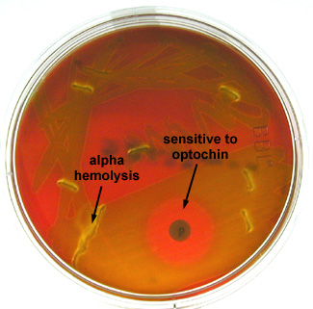
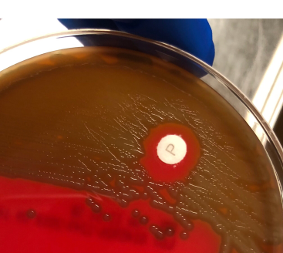
Optochin Sensitive Alpha-Hemolytic Streptococci

Slide 22
Final Diagnosis Bacterial meningitis Pneumococcal Meningitis

Slide 23
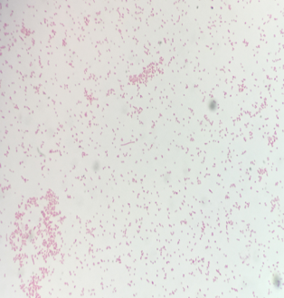
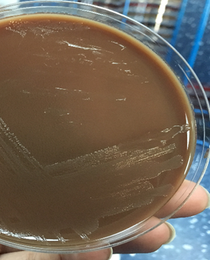
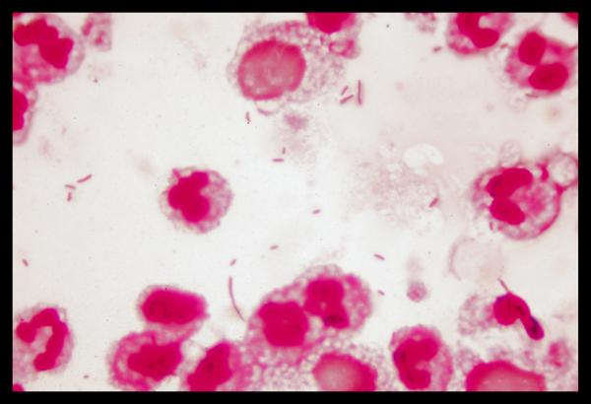
Case 4
Culture on chocolate agar
A 3-year old normal child became acutely ill, with temperature (40°C). She had neck stiffness and vomiting. There was no rash or bruising but the left ear drum was inflamed. The clinical diagnosis of meningitis was confirmed, and blood and cerebrospinal fluid (CSF) samples were taken immediately, and intravenous antibiotics started. The CSF showed increased numbers of neutrophil leucocytes and a few Gram-negative coccobacilli. Culture on chocolate agar is shown. The full blood count showed high neutrophil count and high C-reactive protein.
Microscopic Apearance Direct gram stain of a CSF deposit shows Gram-Negative
pleomorphic coccobacilli.

Slide 24
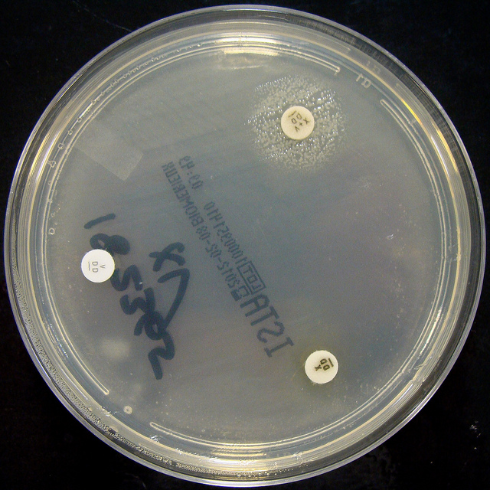
Identification of H. influenzae
Culture on Nutrient agar
H. influenzae :Growth around XV factors( requires both factors XV)
no growth around X or V alone

Slide 25
Final Diagnosis Bacterial meningitis Hemophilus influenzae

Slide 26
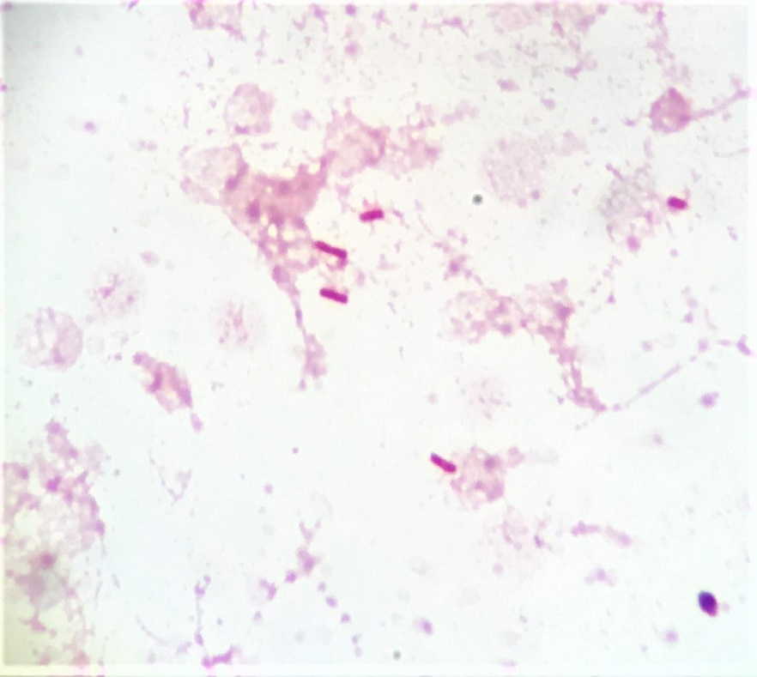
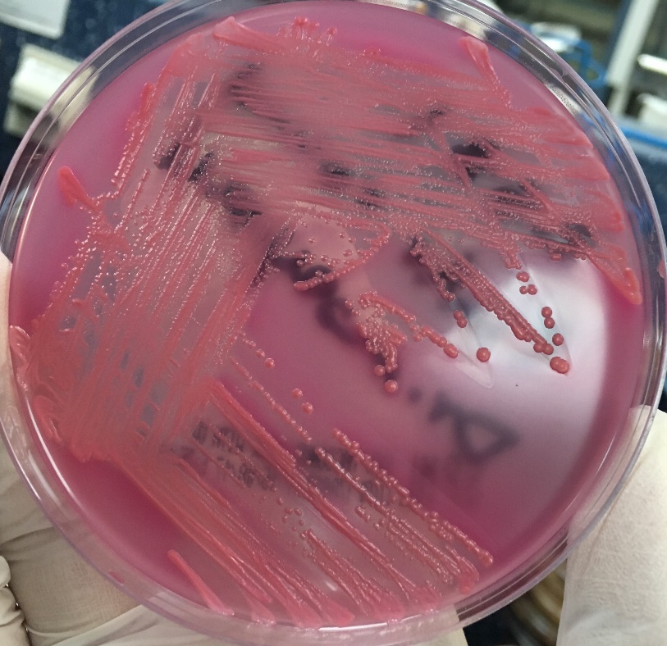
Bacterial meningitis E. coli
Culture on MacConkey agar E. coli appear pink as they ferment lactose
Gram-Negative Bacilli

Slide 27
CASE 5
A 65-year-old is referred from a general practitioner because of headache, fever, excessive sweating at night, and weight loss over the last 4-5 months. He has lost his appetite for food. On examination, there is neck rigidity. Laboratory tests including blood count, serum and electrolytes, blood urea, creatinine and blood culture are all normal. The doctors decides to do a lumber puncture.
The results of the lumber puncture are shown in the next slide:

Slide 28
CASE 3: LUMBER PUNCTURE RESULTS
CSF | Patient’s results | Normal range
Appearance | Turbid | Clear
WBCs and differential | 300 per mm³ Mainly lymphocytes | Few (<5 cells/mm³)
Protein | 0.8 | 0.1-0.4 g/L
Glucose | 2.0 | 3.0-4.5 mmol/L
Chloride | 115 | 115-130 mmol/L

Slide 29
What is the most likely infection responsible? What is your justification?
Fungal infection
Parasitic infection
Viral infection
Bacterial infection
Trepanoma pallidum (Neurosyphilis)
Mycobacterium tuberculosis
What further investigation would you like to do at this stage? (State 3)

Slide 30
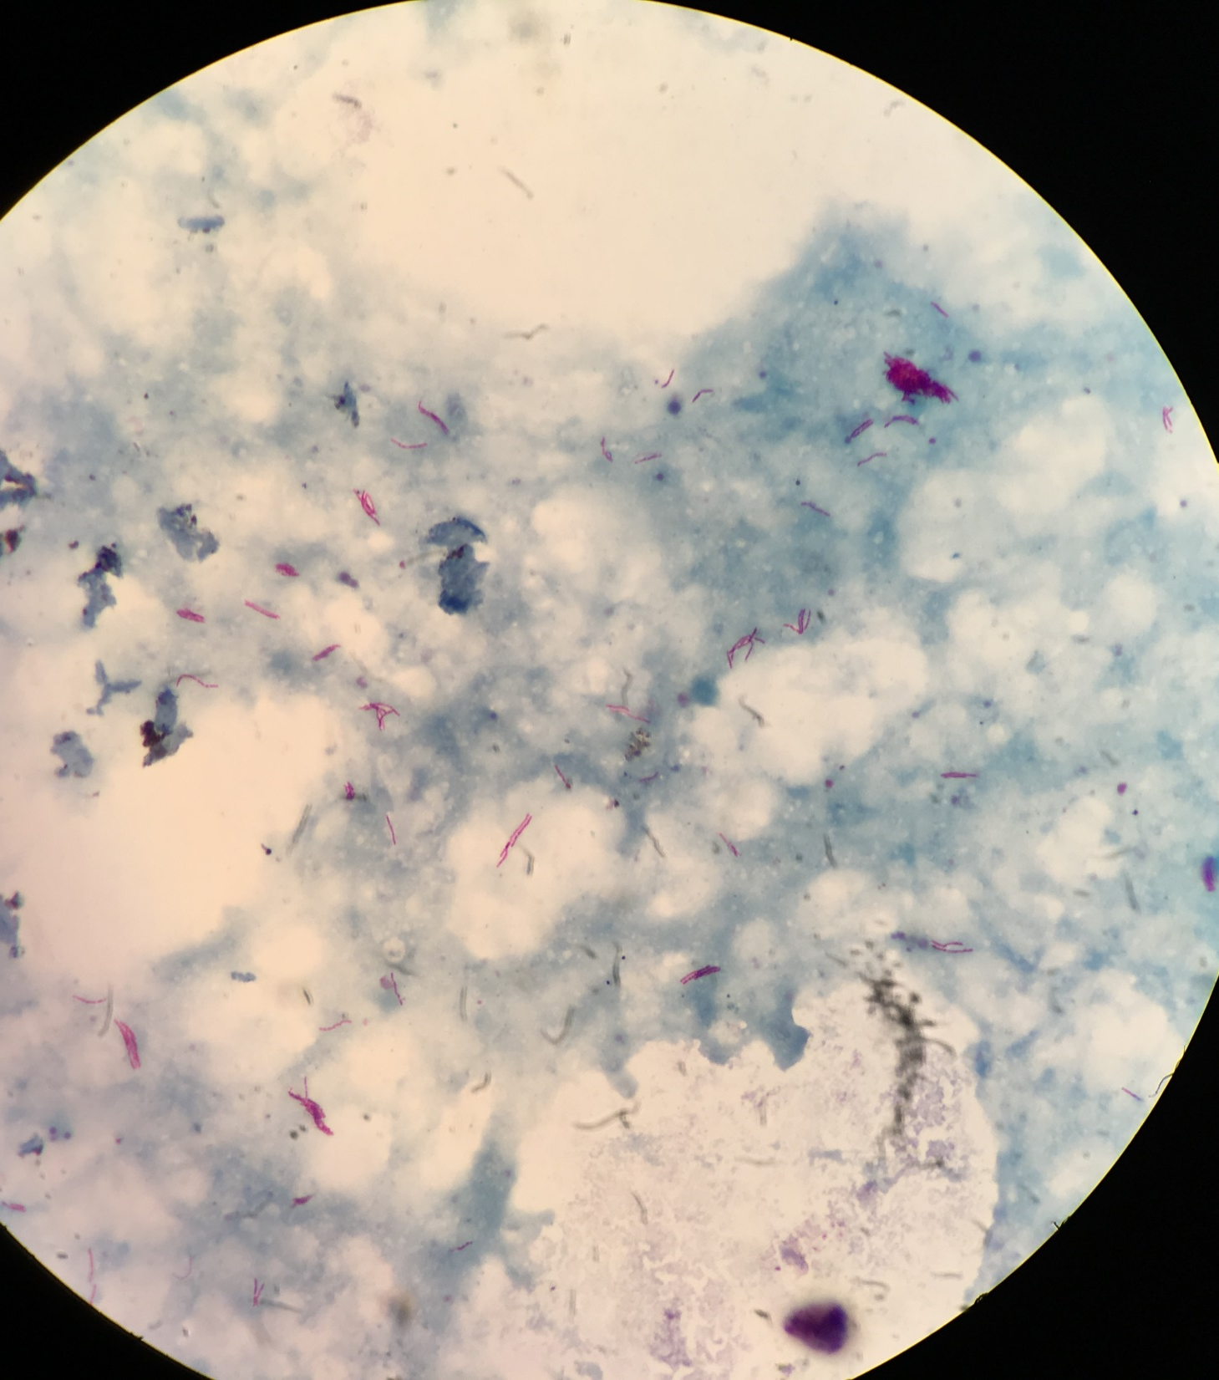
Bacterial meningitis: Mycobacterium tuberculosis Microscopic Appearance Direct Ziel – Neelsen Stained Smear of a CSF deposit shows Acid – Fast Bacilli AFB

Slide 31
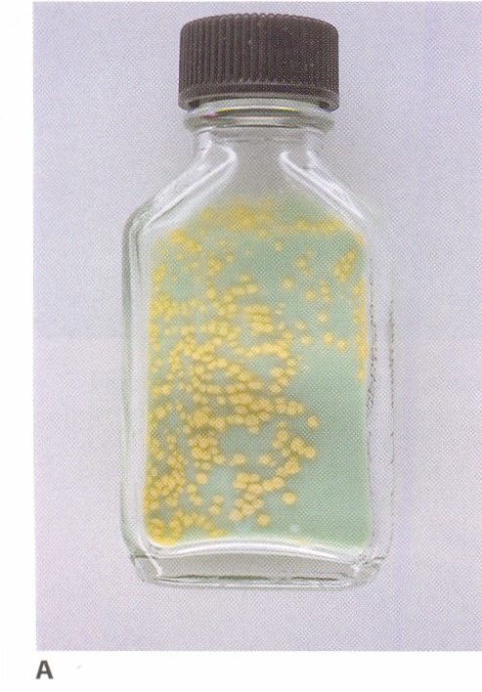
Culture on Lowenstein – Jensen medium Colonies or growth is Rough, Tough and Buff

Slide 32
Mention the 4 first line anti TB drugs.

Slide 33
Final Diagnosis Bacterial meningitis: Mycobacterium tuberculosis

