Slide 1
Central nervous system block Neuropathology practical
Dr. Maria A. Arafah
Assistant Professor – Department of Pathology
http://fac.ksu.edu.sa/mariaarafah/courses

Slide 2
Cerebrum, Cerebellum and Brain Stem
C71.2

Slide 3
Meninges

Slide 4
CNS Cells
Two cell types
Neurons
Conduct nerve impulses
Cannot be replaced if destroyed
Neuroglial cells
Support, nourish, and protect the neurons
Include astrocytes, oligodendrocytes, ependymal cells and microglia
Notes:
Tissues of the CNS has two types of cells. The neurons which conduct nerve impulses. Mitosis or cell division cannot take place in neurons so neurons cannot be replaced if they are destroyed.
The neuroglia or glia are the supporting cells of nervous tissue. The neuroglial cells support, nourish, and protect the neurons. Mitosis takes place in neuroglia. Neuroglial cells include astrocytes, oligodendrocytes, and microglia. A large percentage of brain tumors originate in neuroglial cells.

Slide 5
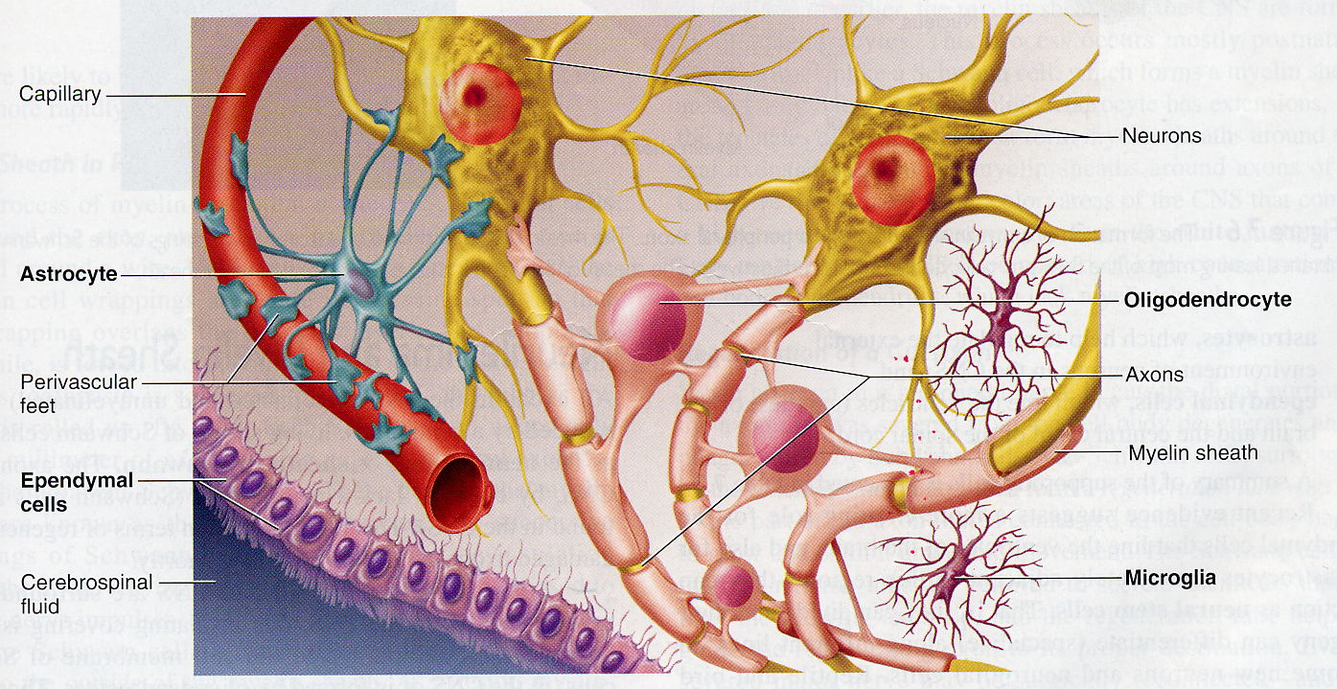
CNS Cells

Slide 6
Case 1
A 43 years old female complains of a headache and had two attacks of seizures in the past 4 months. Brain MRI revealed a 3 cm extra-axial mass in the parietal region. It was dural-based with mild edema in the surrounding brain tissue.
What is your provisional diagnosis?

Slide 7
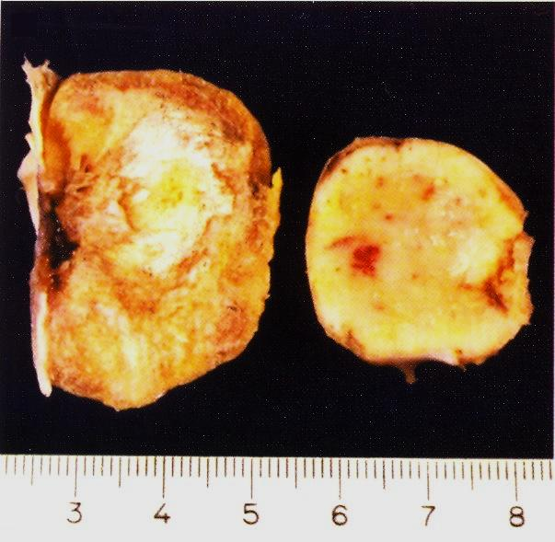
Case 1

Slide 8
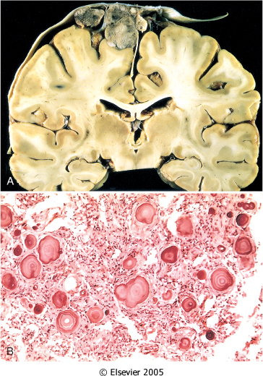
Case 1
A, A parasagittal multilobular meningioma attached to the dura with compression of the underlying brain.
B, Meningioma with a whorled pattern of cell growth and psammoma bodies.

Slide 9
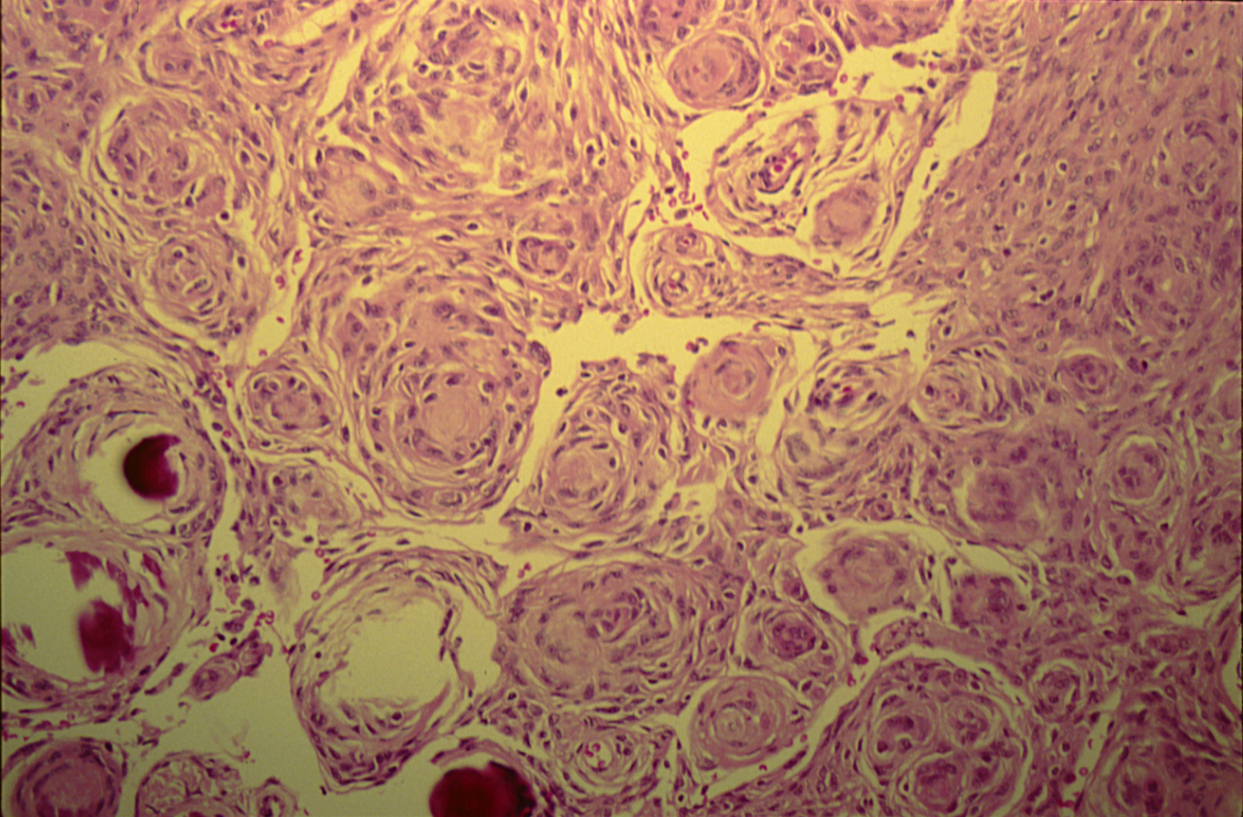
Meningioma (Dura-brain)

Slide 10
Meningioma (Dura-brain)
Sections show:
Whorls of fibrocellular tissue.
Cells are oval, spindle shape or elongated and lack mitosis.
Psammoma bodies (spherical calcified particles).

Slide 11
Case 2

Slide 12
Case 2
A 55 years old man complains of a headache for the last 2 months. Brain MRI reveals a 3 cm frontal intra-parenchymal space occupying lesion with a rim enhancement on contrast studies.
What is your provisional diagnosis ?

Slide 13
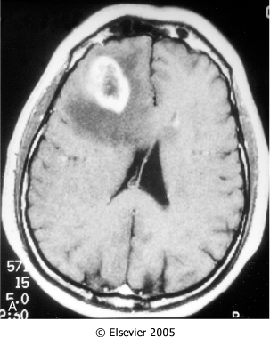
Case 2
Computed tomographic scan of a large tumor in the cerebral hemisphere showing signal enhancement with contrast material and pronounced peritumoral edema.

Slide 14
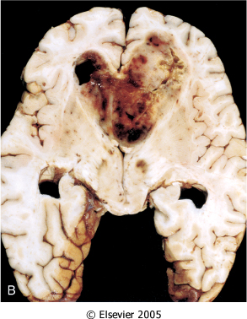
Case 2
Glioblastoma multiforme appearing as a necrotic, hemorrhagic and infiltrating mass.

Slide 15
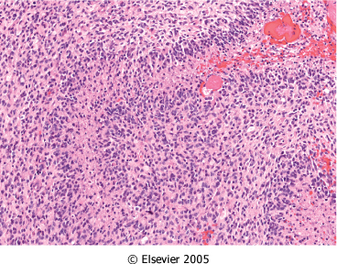
Case 2
Glioblastoma: Foci of necrosis with pseudopalisading of malignant nuclei.

Slide 16
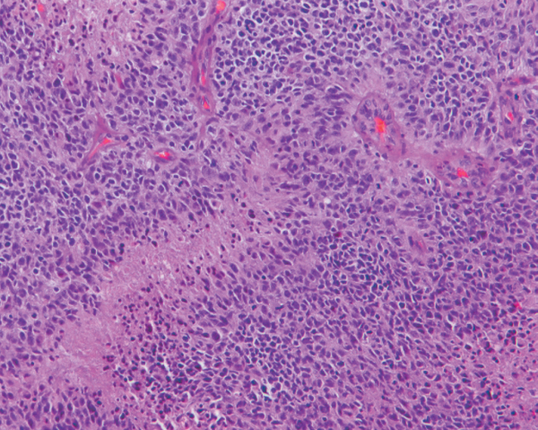
Case 2
Glioblastom: Foci of necrosis with pseudopalisading of malignant nuclei and endothelial cell proliferation

Slide 17
Case 3

Slide 18
Case 3
A 27 years old woman presents with a sudden onset of right sided blindness and weakness in her left leg. There is no history of trauma. However, she experienced a similar episode 8 months ago and was diagnosed as aseptic meningitis.

Slide 19
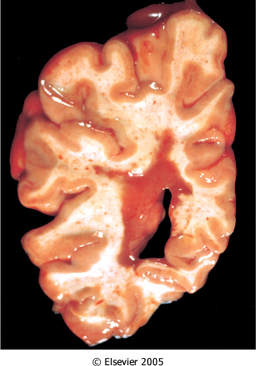
Case 3
Multiple sclerosis. Section of fresh brain showing brown plaque around occipital horn of the lateral ventricle.

Slide 20
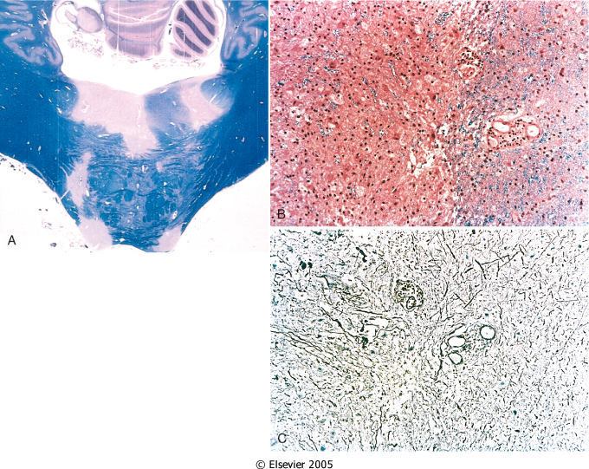
Case 3
Multiple sclerosis.
A, Unstained regions of demyelination (MS plaques) around the fourth ventricle (Luxol fast blue PAS stain for myelin).
B, Myelin-stained section shows the sharp edge of a demyelinated plaque and perivascular lymphocytic cuffs.
C, The same lesion stained for axons shows relative preservation.

Slide 21
Case 4

Slide 22
Case 4
A 39 years old man complains of a progressive hearing loss over a 2-year period. Except for occasional headaches, he has no other complaints . Evaluation discloses severe sensorineural hearing loss onthe left side. MRI shows a 1.5 cm mass at the left cerebellopontine angle.
What is your provisional diagnosis ?

Slide 23
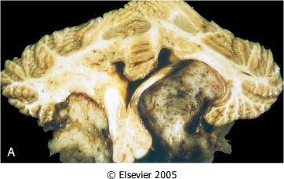
Case 4
Bilateral eighth nerve schwannomas. These are usually seen in neurofibromatosis type 2 syndrome

Slide 24
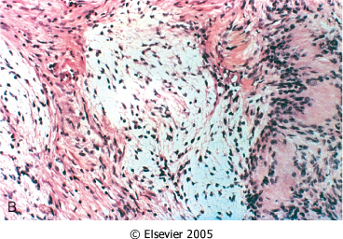
Case 4
Schwannoma: Tumor showing cellular areas, including Verocay bodies (far right), as well as looser myxoid regions.

Slide 25
End of Session 1
Thank You

Slide 26
Case 5

Slide 27
Case 5
A 9 months infant was suffering from an enlarged head size and was admitted to the hospital with convulsions. He went into a coma and died. Autopsy was done and the brain was large with dilated ventricles.
What is your provisional diagnosis?

Slide 28
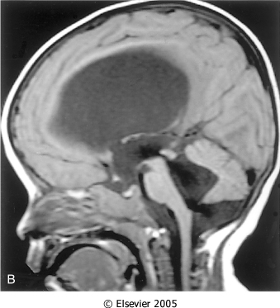
Case 5
Midsagittal magnetic resonance image of a child with communicating hydrocephalus, involving all ventricles.

Slide 29
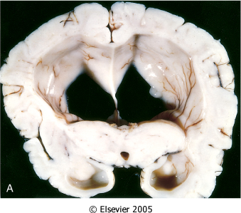
Case 5
Hydrocephalus. Dilated lateral ventricles seen in a coronal section through the midthalamus.

Slide 30
Case 6

Slide 31
Case 6
A 4 years old child who was treated from otitis media, suddenly complained of a headache, vomiting, fever and stiff neck. CSF was cloudy with an abnormal increase in neutrophils, increased protein and absence of sugar. Gram stain of the CSF fluid showed meningiococci.
What is your diagnosis ?

Slide 32
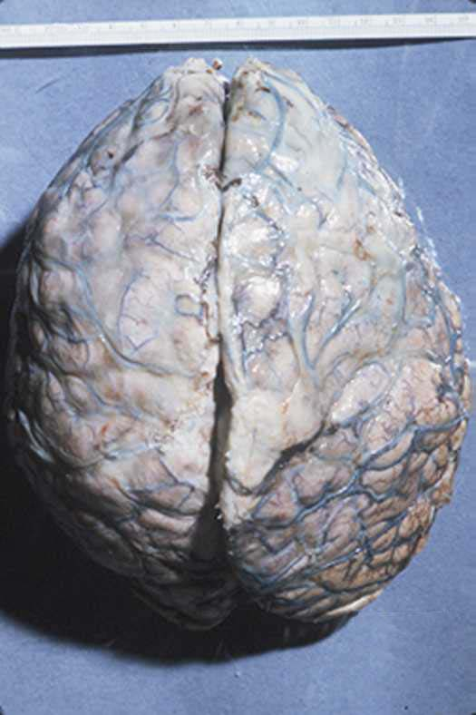
Meningitis

Slide 33
Case 7

Slide 34
Case 7
A 35 years old lady complains from an otitis media. Suddenly she suffers from a headache and convulsions. Brain MRI reveals a 5 cm fluid filled cavity in the temporal lobe. Examination of the CSF shows increased pressure with lymphocytes and increased protein but there is no change of sugar content.
What is your diagnosis ?

Slide 35
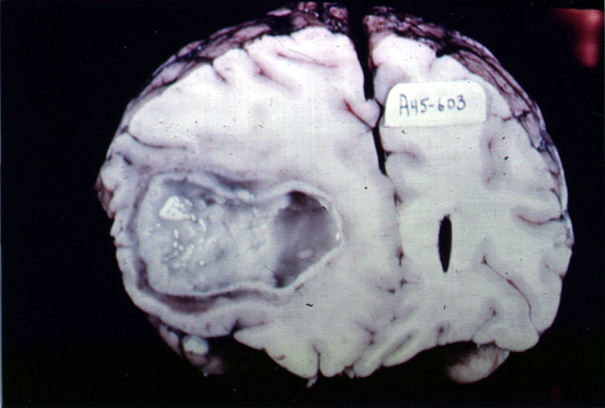
Brain Abscess

Slide 36
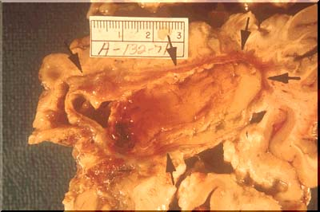
Brain Abscess

Slide 37
Case 8

Slide 38
Case 8
A previously healthy 31-year-old woman experiences a severe headache and loses consciousness within an hour. An emergent head CT scan reveals an extensive subarachnoid hemorrhage at the base of the brain. She is afebrile. A lumbar puncture yields cerebrospinal fluid with many red blood cells, but no white blood cells. The CSF protein is slightly increased, but the glucose is normal.
What is your provisional diagnosis ?

Slide 39
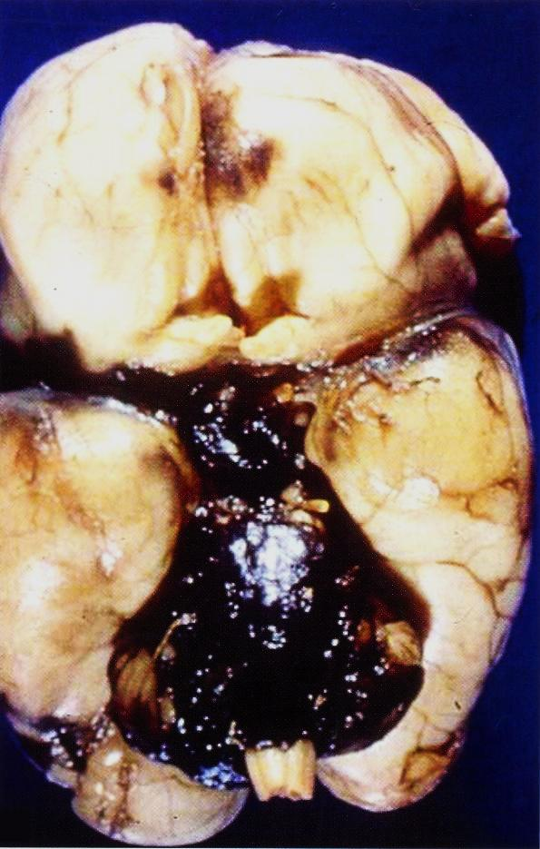
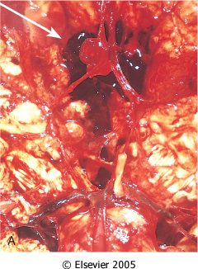
Ruptured berry aneurysm causing subarachnoid hemorrhage
Notes:
View of the base of the brain, dissected to show the circle of Willis with an aneurysm of the anterior cerebral artery (arrow).

Slide 40
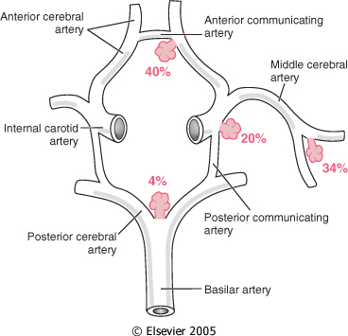
Case 8
Common sites of saccular (berry) aneurysms in the circle of Willis

Slide 41
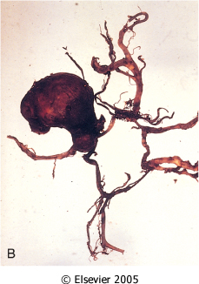
Case 8
Dissected circle of Willis to show large aneurysm.

Slide 42
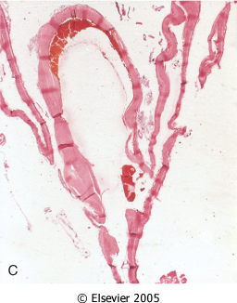
Case 8
Section through a saccular aneurysm showing the hyalinized fibrous vessel wall.

Slide 43
Case 9

Slide 44
Case 9
An 85 years old man complains of progressive loss of memory, disorientation and alterations in mood and behavior since 20 years. He was admitted to hospital because he was disabled and immobile and he died in hospital after one week of admission. Autopsy was done and the brain cortex was found to be atrophied.
What is your diagnosis ?

Slide 45
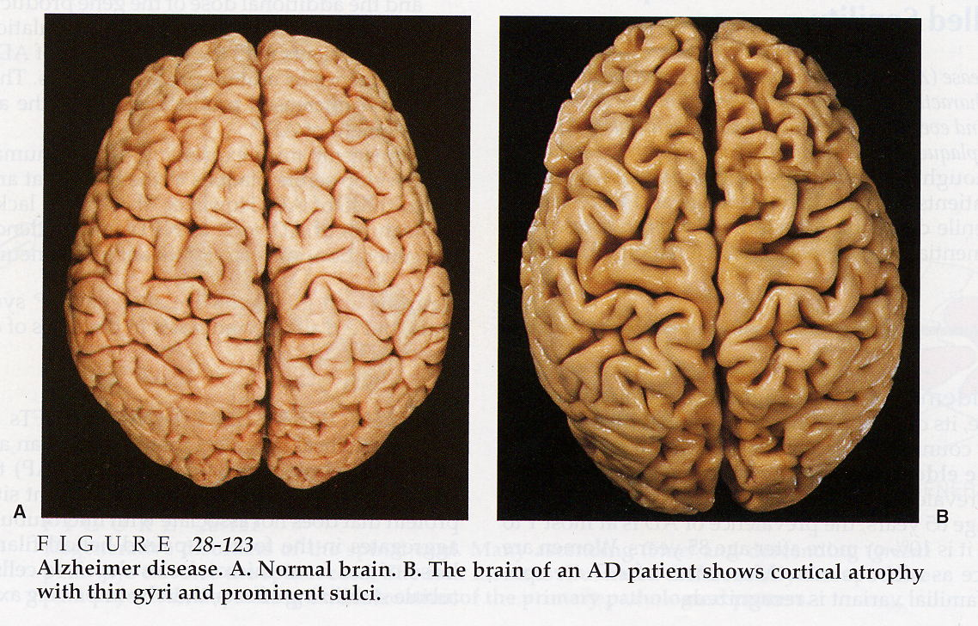
Case 9

Slide 46
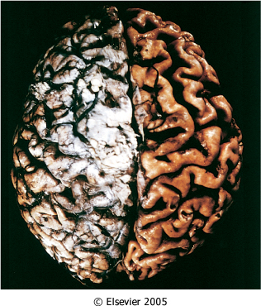
Case 9
Alzheimer disease with cortical atrophy most evident on the right, where meninges have been removed.

Slide 47
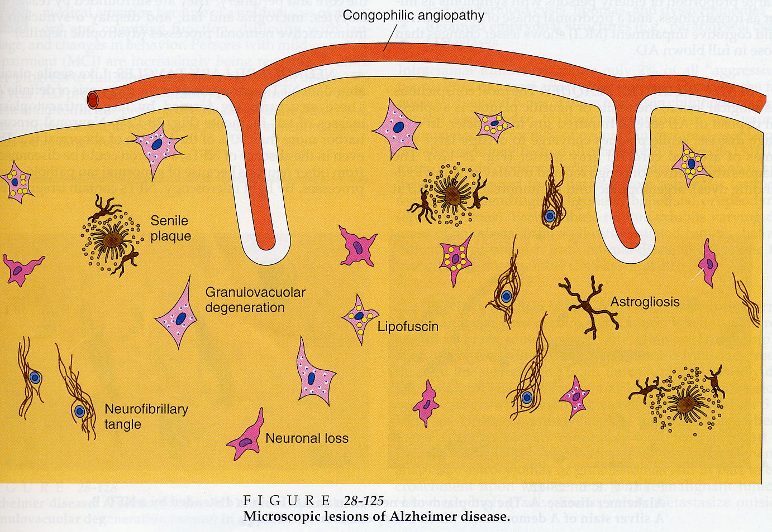

Slide 48
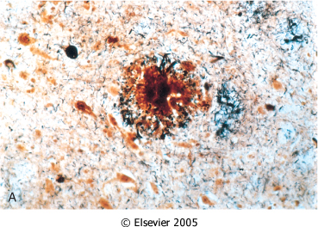
Case 9
Alzheimer disease. A, Neuritic plaque with a rim of dystrophic neurites surrounding an amyloid core.

Slide 49
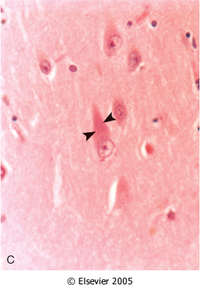
Case 9
Alzheimer Disease: Neurofibrillary tangles (arrowheads) are present within the neurons.

Slide 50
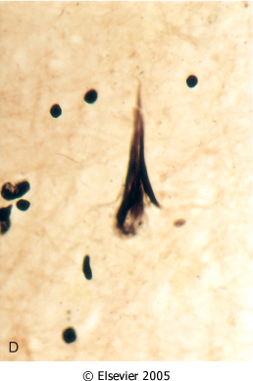
Case 9
Alzheimer Disease. D, Silver stain showing a neurofibrillary tangle within the neuronal cytoplasm.

Slide 51
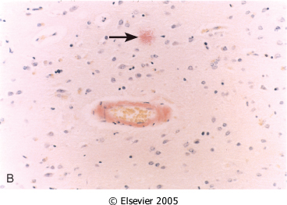
Case 9
Alzheimer Disease: Congo red stain of the cerebral cortex showing amyloid deposition in the blood vessels and the amyloid core of the neuritic plaque (arrow)

Slide 52
Alzheimer Disease
Macroscopic examination of the brain shows a variable degree of cortical atrophy with widening of the cerebral sulci that is most pronounced in the frontal, temporal, and parietal lobes.
Microscopic examination: neuritic (senile) plaques, neurofibrillary tangles, and amyloid angiopathy.

