Slide 1
Electromyography & Nerve Conduction (EMG & NC)
By
Dr. Ola Mawlana

Slide 2
Objectives
At the end of the session the students should be able to:
Understand the basic principle of EMG and NCS.
Perform the EMG and NCS by themselves.
For the EMG: students should know the appearance and characteristics of a normal EMG study and enumerate a few abnormalities that may be seen in neuromuscular diseases.
For the NCS: Determine and calculate motor nerve conduction velocity of the major peripheral nerves.

Slide 3
Definition
EMG is an electrodiagnostic technique for recording the electrical activity (action potentials) of skeletal muscles.

Slide 4
Principle
EMG is performed by inserting a small sharp needle (recording electrode) through the skin into the muscle under study. The needle electrode is inserted into the belly of the muscle, near the expected region of the motor endplate. In general, the endplate region is the thickest part of the muscle belly.

Slide 5
Principle (cont.)
After insertion of the needle, the electrical activity of the muscle will be recorded at rest, during mild-moderate muscle activity, and during maximal muscle contraction, The recording is observed in each case. The potentials recorded upon muscle contraction are derived from the motor units of the muscle, and are known as motor unit potentials (MUPs).

Slide 6
In physiology student lab, surface electrodes will be used instead of needle electrodes and the same steps will be followed.
Surface electrodes record the sum of all MUPs occurring in the muscle which is called “the compound motor action potential”.

Slide 7
Indication of EMG
EMG is a major diagnostic tool for identifying and characterizing disorders of the motor unit, including anterior horn cells, peripheral nerves, neuromuscular junctions, and muscles.
Along with nerve conduction studies (NCS), EMG can help;
Confirm a diagnosis.
Grade the severity of the disease.
Define evolution, stage, and prognosis.

Slide 8
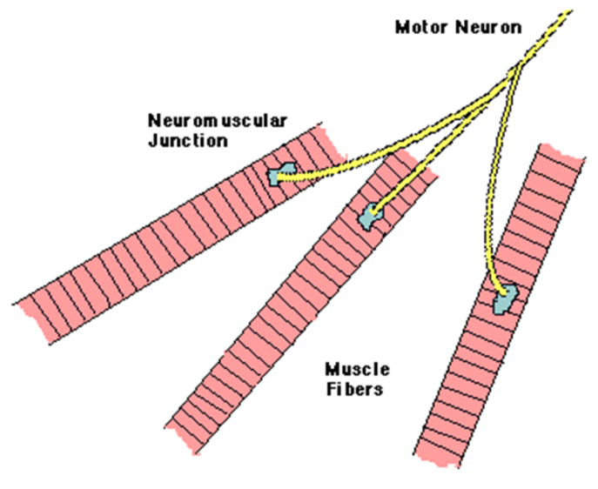
Motor unit potentials (MUPs).
A motor unit is defined as one motor neuron and all the muscle fibers it innervates.

Slide 9
Procedure
Recordings will be obtained from the Abductor Pollicis Brevis (APB) muscle in the hand
Select a volunteer and explain the procedure to her.
Three surface electrodes need to be placed on the volunteer. An electrode jell should be applied to each electrode before placement;
The ground is placed on the dorsum of the hand where the muscle will be tested.
The recording electrode is placed on belly of the APB “midbelly”.
The reference electrode is placed approximately 2-3 cm away from the recording and on a bony prominence.

Slide 10
3. Once the electrodes are in place, start recording;
At the beginning, ask the subject to relax (not to contract the muscle), and record the muscle electrical activity during this period.
Then, ask the subject to exert mild to moderate voluntary effort while you continue recording.
Finally, ask the subject to do maximum contraction of the muscle and record the electrical activity during this period.

Slide 11
Normal MUP

Slide 13
Analysis of a motor unit potential (MUP)
MUP characteristics | Normal | Neuropathic | Myopathic
Duration (ms) | 3-15ms | Longer | Shorter
Amplitude | 300-5000µV | Larger | Smaller
Phases | Biphasic/triphasic | Polyphasic | May be polyphasic
Resting activity | Absent | Present | Present
Interference pattern | Full | Partial | Full with small amplitude MUPs

Slide 14
Normal EMG activity

Slide 15
Insertional activity
The electrical activity results from insertion of the electrode to the muscle. These are discharge potentials provoked by the disruption of the cell membrane itself.
-Decreased in atrophied muscle or fatty tissue.
- Increased in many abnormal conditions that cause membrane instability, such as neuropathies, radiculopathies, and inflammatory myopathies.

Slide 16
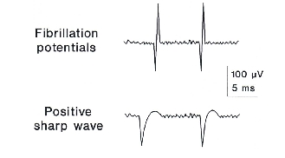
Abnormalities of EMG
- At rest
Positive sharp waves.
Fibrillation.
Fasciculation.

Slide 17
Positive sharp waves:
Positive sharp potentials with a fast downstroke and slower return to baseline.
Causes: neuropathy, myopathy

Slide 18
Fibrillation Potentials
Action potential of a single muscle fiber that are twitching spontaneously in the absence of innervation
Low amplitude, short duration, biphasic
Not seen under the skin but recorded during EMG
Caused by neuropathy and myopathy

Slide 19
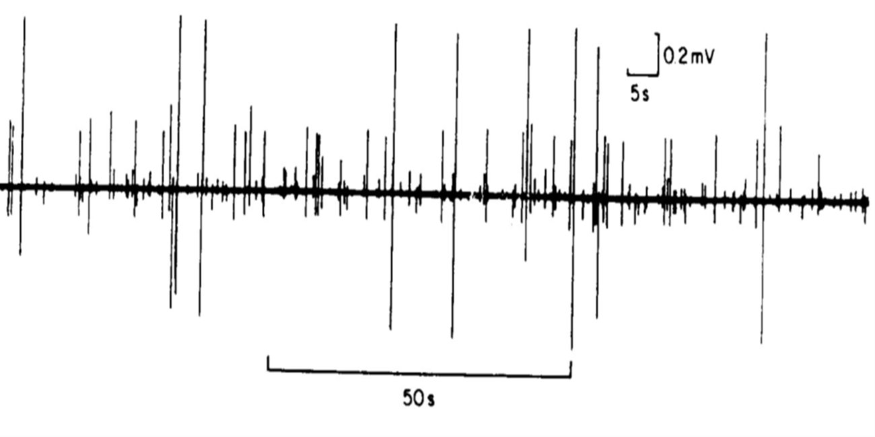
Fasciculation potentials
Randomly discharging action potentials of a group of muscle fibers due to partial re-innervation of denervated muscle fiber
high voltage, polyphasic, long duration potentials (Giant Potentials)
Visible, can be seen in motor neuron disease, radiculopathy and neuropathy.

Slide 20
- During muscle contraction
Abnormalities can be seen in the MUPs as well as the recruitment.
Patterns of abnormal MUPs
Patterns of abnormal recruitment

Slide 21
Abnormal patterns MUPs

Slide 22
Abnormal patterns of Recruitment

Slide 23
Normal EMG

Slide 24
Neuropathic EMG changes

Slide 25
Myopathic EMG changes

Slide 27
Nerve Conduction Studies (NCS)
A Nerve conduction study (NCS) is a test used to evaluate the function of peripheral nerves by measuring their conduction velocity and response latency.
Both sensory and motor nerve conduction can be studied.

Slide 28
Principle
Motor NCS are performed by electrical stimulation of a peripheral nerve and recording from a muscle supplied by this nerve. A nerve potential is initiated at the stimulation electrode and is conducted along the nerve fibers to the muscle. When the muscle contracts, the compound muscle action potential is recorded and observed on the display screen. The latency of the response (the time it takes for the impulse to travel from the stimulating to the recording site) is measured in milliseconds (ms). The size of the response (the amplitude) is also noted. The motor amplitudes are measured in millivolts (mV).

Slide 29
Cont.
This is repeated by stimulating the motor nerve at a second site along its path. The distance between the two stimulation points is measured and the difference in latency times determined. By dividing the distance between stimulation points by the difference in latency times, the motor nerve conduction velocity can be calculated.

Slide 30
Procedure
The motor nerve conduction study (MNCS) will be measured for the median nerve.
Select a volunteer and explain the procedure to him/her.
Clean the area of the skin where the electrodes will be placed to improve skin conductivity.
Surface electrodes are used for MNCS, after applying the electrode jell to each of the electrodes they will be placed as follows;

Slide 31
The recording electrodes are placed on the muscle supplied by the nerve under study (the APB for the median nerve) so that the cathode or negative (active) electrode is placed over the belly of the muscle, while the anode or positive (reference) electrode is placed over the distal tendon.
The grounding electrode should be placed between stimulating and recording electrode, preferably, over bone rather than muscle ( on the dorsum of the hand)

Slide 32
C. The stimulating electrodes are placed between the flexor carpii radialis tendon and the Palmaris longus tendon with the cathode electrode placed distally to the anode. This will stimulate the median nerve at the wrist. A recording of the compound muscle action potential (CMAP) is obtained and the latency is noted.
D. The median nerve is then stimulated at the elbow medial to the biceps tendon and over the pulse of the brachial artery (antecubital fossa). A recording of the CMAP is obtained and the latency is noted.

Slide 33
e. The distance between the two stimulating electrodes is measured. And the median nerve conduction velocity is calculated using the following formula;
$MNCV=\frac{Distance (mm)}{L1−L2 (msec)}$
MNCV= Motor nerve conduction velocity (m/sec)
Distance= distance between the two stimulating electrodes.
L1= latency at elbow.
L2=latency at wrist.

Slide 36
Normal values for conduction velocity
In arm
50 – 70 m / sec.
In leg
40 – 60 m / sec.

Slide 37
Comparing results
- Compare nerves same limb (hand median vs ulnar or radial)
- Compare left and right limb
- Compare upper and lower limbs
- Compare to previous results in same subject
- Compare to ‘normal’ reference values

Slide 38
Abnormal features
Axonal degeneration neuropathy features | Demyelinating Neuropathy features
Low amplitudes | Normal amplitudes
Normal / slight delay in latency | Significant delay in latency
Normal / slightly low conduction velocity | Significantly low conduction velocity

Slide 39
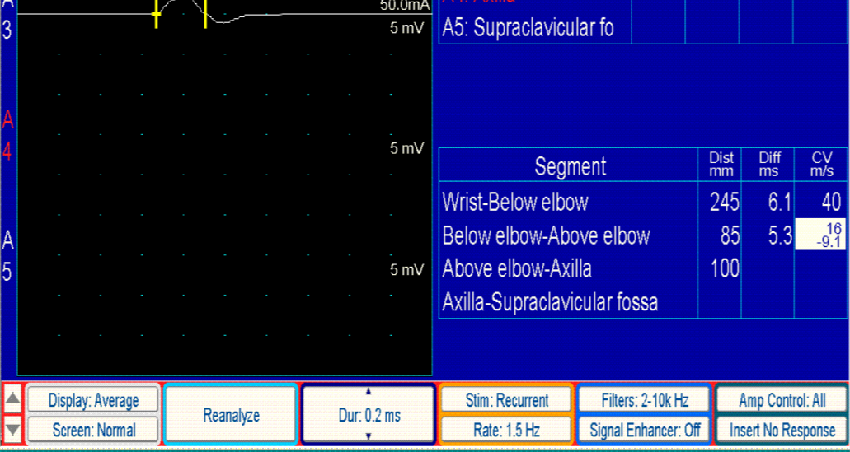

Slide 40
Conduction is faster in myelinated fibers
Conduction is dramatically slowed (20-30m/s) in demyelinated peripheral neuropathies (Diabetes, Gillain Barré) and in some nerve compression or entrapment (Carpal tunnel syndrome)

Slide 41
$$MNCV=\frac{Distance (mm)}{L1−L2 (msec)}$$
Distace = 24 Cm
Latency at wrist = 2.5 msec
Latency at elbow = 6.5 msec
MNCV =(24 × 10)÷ (6.5-2.5)
MNCV = 240/4.0 = 60 m/sec

Slide 42
THANK YOU

