Slide 1
Vision (Visual Acuity, Color Vision, Light and Accommodation Reflex)
By
Dr. Ola Mawlana

Slide 2
Visual Acuity
The shortest distance by which two lines can be separated and still perceived as two lines.
It depends on
The refractive ability of the refractive media (cornea and lens) of the eye
The density of the photoreceptors.
The fovea centralis is the place of greatest visual acuity during the daylight and the mid-peripheral portion of the retina is the place of greatest visual acuity in the dim light.

Slide 3
Testing far vision
Procedure
Ask the subject to stand about 6-meter (20-feet) away from the Snellen’s chart. This distance is referred to as “d”.
Keep wearing eye glasses if they are for distant vision.
Cover one of his eyes with an eye patch.
Ask him to read the chart from the other eye and find out the smallest letters he could read.
Note the distance written below the last line he is able to read fully. This distance is referred to as “D”.
Repeat the same procedure for the other eye.

Slide 4
Snellen’s chart

Slide 5
$$Visual Acuity (VA) =\frac{d}{D}$$
d = the distance from where the subject is reading the chart.
D = the distance from which a normal subject can read that line.
$$Visual Acuity (VA) =\frac{6}{9}$$
It means that the subject is able to read from 6 meters only which a normal person can read from 9 meters, so his visual acuity for the far vision is disturbed. Normal Visual Acuity for far vision is 6/6 (in meters) or 20/20 (in feet).

Slide 6
Refractive error
Myopia
Is a refractive error in which close objects are seen clearly, but the far objects appear blurred, that is why this condition is also called nearsightedness. It occurs if the eyeball is too long or the lens has too much curvature. As a result, the light entering the eye from a distant object isn’t focused exactly on the retina but focuses in front of it, so that distant object looks blurred. This refractive error can be corrected by applying concave (minus) lenses in front of the eyes or performing surgery to flatten cornea that will decrease the refractive ability of the cornea and the light rays from a far object will focus on the retina.

Slide 7
Hypermetropia
If the eyeball is smaller or the lens is weak, the image from a near object is focused behind the retina, making the object look blurred. In these cases near vision is affected and the far vision remains intact, so this refractive error is known as farsightedness or in medical terms, hypermetropia. These patients need convex (plus) lenses in front of eye so that the light rays entering the eyes from any near object will focus exactly on the retina and the near objects can be seen clearly.

Slide 8
A myopic eye with the image focusing in front of the retina.
(B) A hyperopic eye with the image focusing behind the retina.

Slide 9
Testing near vision
The near vision test is measuring the ability to read and see objects within an arm's distance from the body. This test is important in cases of hypermetropia or presbyopia.
Most clinics record the near vision as a Snellen fraction (distance equivalent) or as a Jaeger notation such as J1,. In performing the near visual acuity assessment it is of great importance to note at what distance the chart is to be held from the patient. Some charts are calibrated for 12, 14, or 16 inch testing distances. Patients should be wearing their corrective lenses even if they are for distance viewing. If the patient wears specific reading glasses, they should be worn rather than the distance glasses.

Slide 10
Procedure
Ask the subject to hold the Jaeger’s chart at a distance of 14 inches (36 cm) from his eyes.
Keep wearing eye glasses if any.
Cover one of his eyes with an eye patch.
Ask him to read from the largest line to the smallest line that he can read easily or ask him to recognize the smallest size of the picture drawn in the chart and take note.
Repeat the same procedure for the other eye.

Slide 11
Interpretation
The Jaeger type scale ranges from J1+ to J16 with J1+ being the smallest type. J1+ is considered the equivalent of 20/20 distance visual acuity at the reading distance indicated on the card (14 inches from your eyes), so a person with normal near vision should be able to read up to this line.
Suppose that the subject can read or recognize the picture up to the line marked J3, it means that he can read or recognize at 36 cm distance from his eye which can be read or recognized by a normal subject at 72 cm.

Slide 12
Jaeger’s chart

Slide 14
Testing for Astigmatism
Astigmatism
Is a type of refractive error that causes blurred vision mainly due to the irregular shape of the cornea and sometimes uneven curvature of the lens inside. An irregular shaped cornea or lens prevents light from focusing properly on the retina. Astigmatism frequently occurs with other vision conditions like myopia and hypermetropia. Slight amounts of astigmatism usually don't affect vision and don't require treatment. However, larger amounts of astigmatism cause distorted or blurred vision, eye discomfort and headaches Astigmatism treated by adding cylindrical lenses in eyeglasses that will correct the astigmatism by altering the way light enters the eyes.

Slide 15
Procedure
Ask the subject to stand at a 6-meter (20-feet) distance from an Astigmatism chart.
Remove eye glasses if any.
Cover one of his eyes with an eye patch.
Ask him to see the chart from the other eye. This chart consists of a number of dark lines radiating from a central point, like spokes of a bicycle wheel.
If astigmatism is present, some of the spokes will appear sharp and dark, whereas the others will appear blurred and lighter because they come to focus either in front of or behind the retina when they pass through uneven curvature of the cornea.
Repeat the same procedure for the other eye.

Slide 16
Astigmatism chart

Slide 17
Demonstration of the blind spot
The blind spot is the area in the visual field where an object cannot be seen keeping one eye closed. It is due to the fact that light rays from that area of the visual field focus on the optic disc of the retina which lacks photoreceptors.

Slide 18
Procedure
Hold the blind spot card in your right hand and bring it in front of your face about 20 inches away from your right eye.
Close your left eye.
Focus on the “plus” sign which can be easily done if the “plus” sign is positioned in line with your right eye.
Keeping your right eye focused on the “plus” sign, gradually bring the blind spot card closer to your face until the “circle” drawn on the blind spot card disappears. This is the blind spot of your right eye. If you move the blind spot card further close to your right eye, the circle will reappear.
Repeat the same procedure for the left eye, but this time you will focus on the circle and the plus sign will disappear.

Slide 19
Determination of near point
Near point is the nearest possible distance at which the near object can be clearly seen. The near point of vision changes dramatically with age, averaging about 8cm at the age of 10 and about 100 cm at the age of 70.
Age | Near point
10 years | 8 cm
20 years | 10 cm
30 years | 12.5 cm
40 years | 18 cm
50 years | 40 cm
60 years | 83 cm
70 years | 100 cm

Slide 20
Procedure
Ask the subject to sit comfortably.
Select the test eye and close the other eye.
Hold a common pin at an arm’s length (about 10 inches) in front of his eye and ask him to look at the pin-head.
Keeping the pin-head in focus, gradually bring the pin closer to his eye.
Ask the subject to indicate when the pin-head first appears to be blurred or cannot be seen.
Measure the distance with a ruler.
Repeat the same procedure for the other eye.

Slide 21
Testing accommodation Purkinje-Sanson images
If a small bright light, usually a candle, is held in front of and a little to one side of the eye in a very dark room, three images are seen:
The first image comes from the cornea and it is small, bright and upright.
The second image comes from anterior surface of the lens. It is large, upright but less bright.
The third or last image comes from posterior surface of the lens and it is small, bright and inverted.
During accommodation, the second image comes closer to the first image and also becomes smaller when the eye was at rest. And since an image reflected from a convex surface is diminished in proportion to the convexity of that surface, it is obvious that the front of the lens became more convex when the eye adjusted itself for near vision and this is how we can observe the process of accommodation by using these images.

Slide 22
Procedure
Make the subject comfortably seated in a dark room.
Ask him to look at a distant object.
Hold a candle light in front of and a little to the side of the subject’s any one eye.
Look into the subject’s eye from the side opposite to the candle.
Observe how many images of the candle light are reflected in the subject’s papillary area and take note of the relative size, brightness and position of the images.
Now ask the subject to look at a nearby object and observe carefully the changes that are produced in the size, brightness and position of the images.

Slide 23
Purkinje-Sanson images

Slide 24
Image | Before accommodation | After accommodation
First image | Bright, small and upright from cornea | image does not change (corneal curvature unchanged)
Second image | Dim, large and upright from anterior surface of lens | image becomes smaller and moves toward the upright image ( due to the increase in curvature of anterior surface of lens)
Third image | Small and inverted from posterior surface of lens | changes very little ( the curvature of the posterior lens surface changes very little)

Slide 25
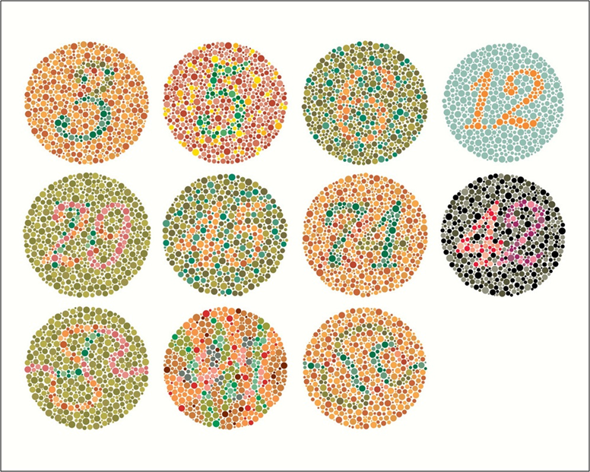
Test for color vision
Color vision is the function of the cones. There are three types of cones in our eyes; red, green and blue. Relative lack or deficiency of one, two or all of them will lead to a defect in color vision.

Slide 26
Procedure
Select the eye for testing and close or cover the other eye.
Ask the subject to read the numbers showing in several colored Ishihara’s plates or trace the zigzag pathway given in some plates.
Note if the subject has difficulty or fails to read the number or trace the path correctly in a plate and then refer to the key given for that plate to decide which type of color blindness he is having.
Repeat the same procedure for the other eye.

Slide 27
TYPE OF COLOR BLINDNESS | DEFINITION & PATHOLOGY
PROTANOPIA (RED BLINDNESS) | A form of colorblindness characterized by defective perception of red and confusion of red with green or bluish green due to the complete absence of red cones.
DEUTERANOPIA (GREEN BLINDNESS) | A form of colorblindness characterized by insensitivity to green, moderately affecting red–green hue discrimination due to the complete absence of green cones.
TRITANOPIA (BLUE BLINDNESS) | A very rare visual defect characterized by the inability to differentiate between blue and yellow due to the complete absence of blue cones.
PROTANOMALY | A type of anomalous trichromatic vision with defective perception of red due to less sensitivity of red cones.
DEUTERANOMALY | A type of anomalous trichromatic vision in which the green cones have decreased sensitivity, mildly affecting red–green hue discrimination.
TRITANOMALY | A rare type of anomalous trichromatic vision in which the blue cones have decreased sensitivity, affecting blue–yellow hue discrimination.

Slide 28
Thank You

