Slide 1
Esophagus and Stomach
Anatomy Practical
By Dr. Shimaa
Anatomy Department
College of Medicine
King Saud University

Slide 2
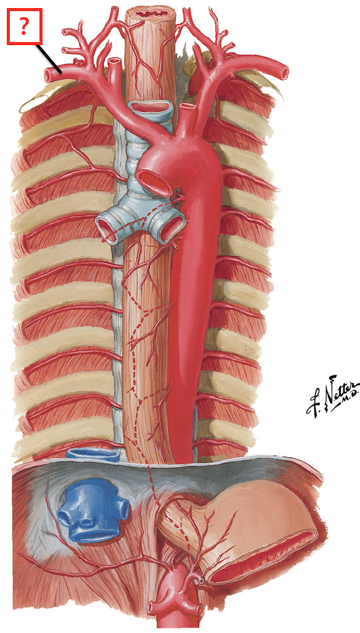
Esophagus
Esophagus is a muscular tube of 25 cm long
Cervical part
Thoracic part
Piercing diaphragm
at level of T10
Abdominal part

Slide 3
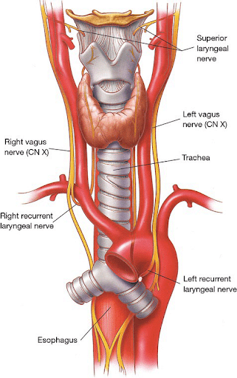
Relations of the Cervical Part of the Esophagus
Anteriorly | Trachea, recurrent laryngeal nerves
Posteriorly | Vertebral column
Laterally | Lobes of thyroid gland
Thyroid
Esophagus

Slide 4
Relations of the Thoracic Part of the Esophagus
Anteriorly | Trachea, Left recurrent laryngeal nerve, Left principal bronchus, Pericardium, Left atrium
Posteriorly | Bodies of the thoracic vertebrae, Thoracic duct, Azygos vein, Descending thoracic aorta
Laterally | On the Right side: Right mediastinal pleura, Terminal part of the azygos vein. On the Left side: Left mediastinal pleura, Left subclavian artery, Aortic arch, Thoracic duct
Descending thoracic aorta
Heart
Thoracic vertebrae

Slide 5
Relations of the Abdominal Part of the Esophagus
Descending thoracic aorta
Anteriorly | left lobe of the liver.
Posteriorly | left crus of the diaphragm.
Azygos vein
Diaphragm
Abdominal Esophagus
liver

Slide 6
Arterial Supply of the Esophagus
Upper third by the inferior thyroid artery.
The middle third by descending thoracic aorta.
The lower third by the left gastric artery.
descending thoracic aorta

Slide 7
Stomach
Parts of the Stomach
1- Fundus.
2- Body.
3- Pylorus.
4- Lesser curvature.
5- Greater curvature.
1
4
2
3
5

Slide 8
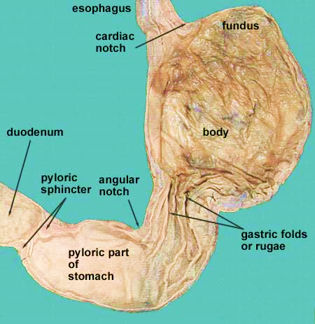
Parts of the Stomach

Slide 9
Anterior Relations of the Stomach
Anterior abdominal wall.
Left costal margin.
Left pleura & lung.
Diaphragm.
Left lobe of the liver.
Diaphragm
Liver
Stomach

Slide 10
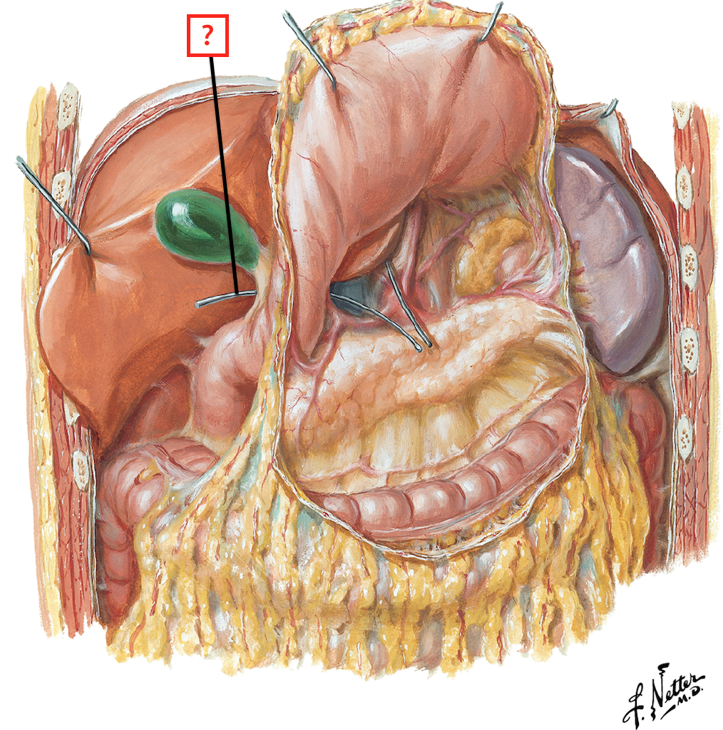
Posterior Relations of the Stomach (Stomach Bed)
Peritoneum of Lesser sac.
Left crus of diaphragm.
Left suprarenal gland.
Part of left kidney.
Spleen.
Splenic artery.
Pancreas.
Transverse mesocolon.
Diaphragm
Stomach
Transverse colon

Slide 11
Blood Supply of the Stomach
3
1- Celiac trunk.
2- splenic artery.
3- left gastric artery.
4- right gastric artery.
5- short gastric arteries.
6- left gastroepiploic artery.
7- right gastroepiploic artery.
5
1
11111
2
4
6
Greater Omentum
7

Slide 12
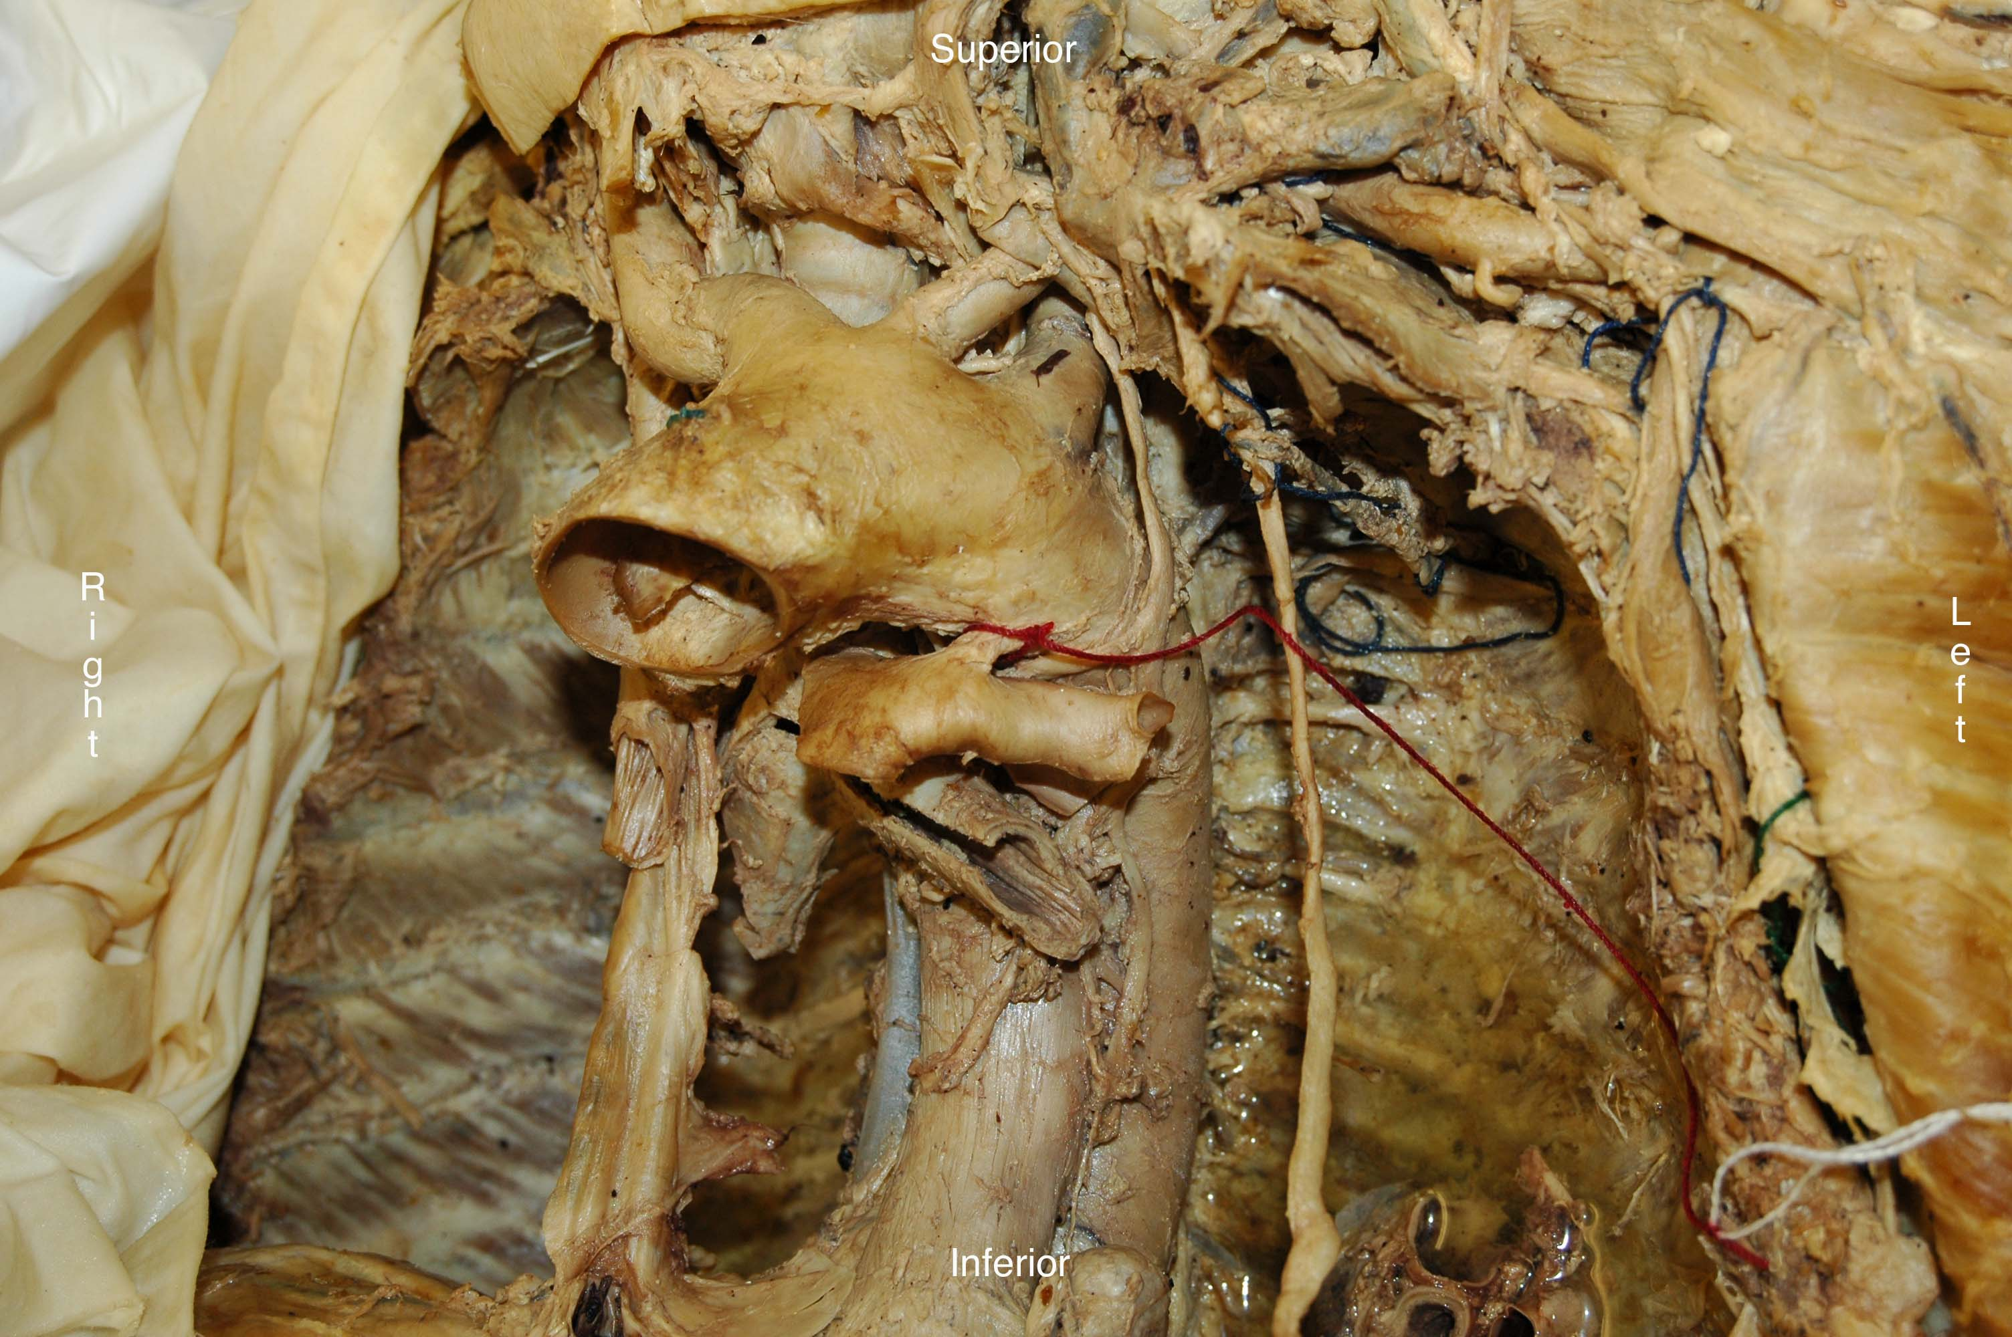
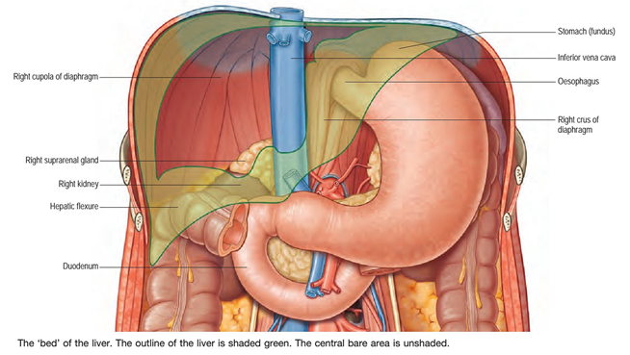
Revision
Name the structure (A).
Mention the lateral relations of (A).
Mention the sites of anatomical constrictions of (A).
Name the structure (B).
Enumerate the structures forming the posterior relations of (B).
B
A

