Slide 1
GIT OSPE
Anatomy Revision
Dr. Shimaa Mahmoud

Slide 2
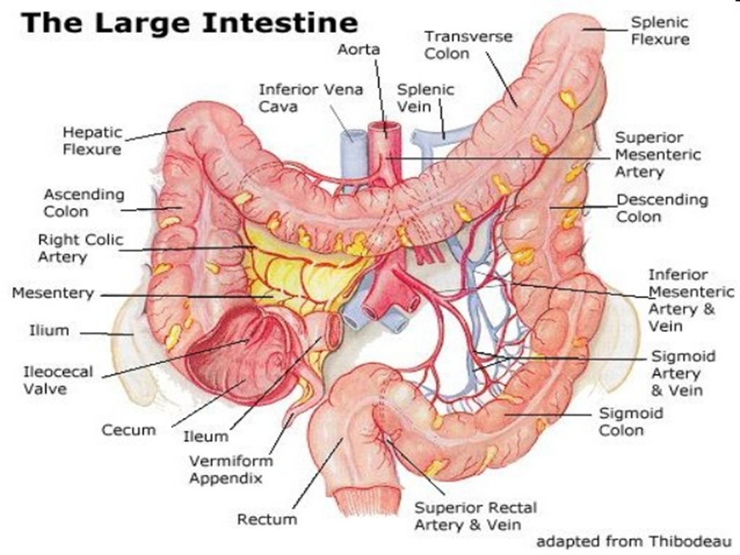
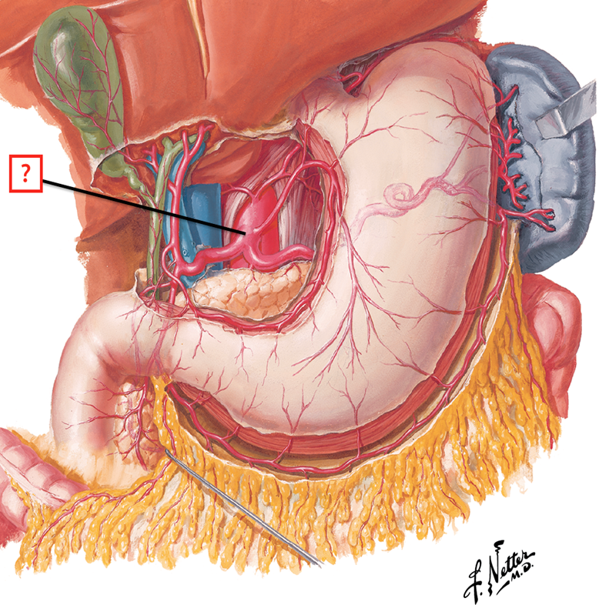
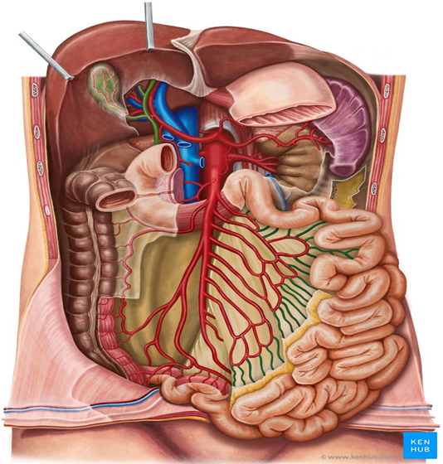
Blood supply of GIT

Slide 3
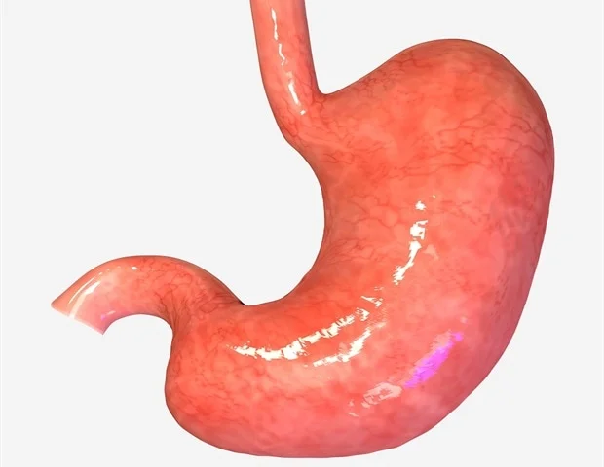
Station One
A
List blood supply of the stomach.
Left gastric.
Right gastric.
Left gastroepiploic.
Right gastroepiploic.
Short gastric
Structures forming stomach bed (posterior relations)
1. Lesser sac 2. Left crus of diaphragm.
3. Left suprarenal gland 4. left kidney.
5. Spleen 6. Splenic artery.
7. Pancreas 8. Transverse mesocolon.
Blood supply of (A)
Left gastric artery from coeliac trunk
Enumerate structures running in the lesser omentum along the lesser curvature of the stomach.
Right gastric vessels
Left gastric vessels

Slide 4
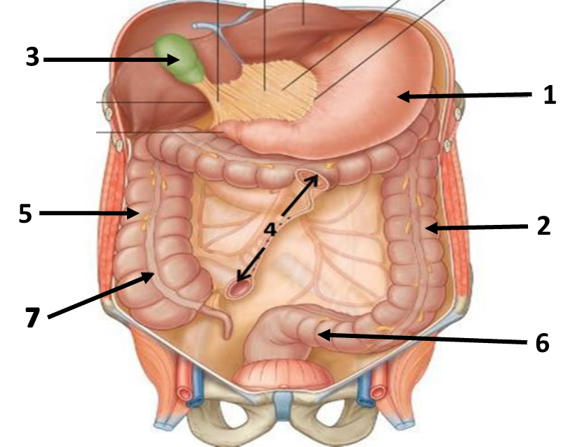
During cholecystectomy a resident damaged the cystic artery before the clamp was properly placed. The assistant surgeon applied pressure on top of the free margin of the lesser omentum to stop the bleeding.
Identify
1. Stomach 2. Descending colon
3. Gallbladder 4. Root of mesentery
5. Ascending colon 6. Sigmoid colon
7. Teniae coli
Blood supply of (3) and its origin?
Cystic artery from Right hepatic artery of coeliac trunk
Station Two

Slide 5
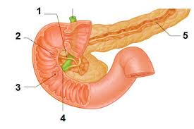
Station Three
A 57-year-old male brought to the ER where he diagnosed with perforated duodenal ulcer in the posterior wall of the first part of the duodenum.
Which artery lies behind the ulcer in his case?
Gastroduodenal artery
Enumerate 3 different organs supplied by this artery.
stomach
duodenum
pancreas
Identify:
Accessory pancreatic duct
Minor duodenal papilla
Major duodenal papilla
Bile duct
Main pancreatic duct

Slide 6
A 48-year-old man has lost 10 kilos over the last 3 months and presented with upper abdominal pain that radiates to the back between the scapulae. During examination the doctor noticed jaundice. CT scan reveals tumor of the head of the head of the pancreas.
List the arterial supply of the pancreas and its origin
Superior pancreaticoduodenal artery: from gastroduodenal branch of hepatic artery of celiac
Inferior pancreaticoduodenal artery: from superior mesenteric artery
Splenic artery: from coeliac trunk
Where does the main pancreatic duct open?
Major duodenal papilla in the 2nd part of the duodenum
Structures passing posterior to the head of the pancreas
1. IVC 2. Lower part of bile duct

Slide 7
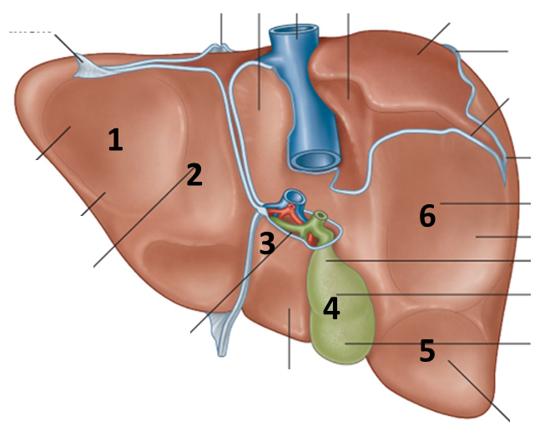
Station Four
What Are The Structures Related To Marked Areas
Gastric (Fundus Of Stomach)
Abdominal Part Of Esophagus
Duodenum
Right Suprarenal Gland
Right Colic Flexure
Right Kidney
Mention the peritoneal folds of liver
Falciform ligament
Right triangular ligament
Left triangular ligament
Coronary ligament
Lesser omentum
2
4
3

Slide 8
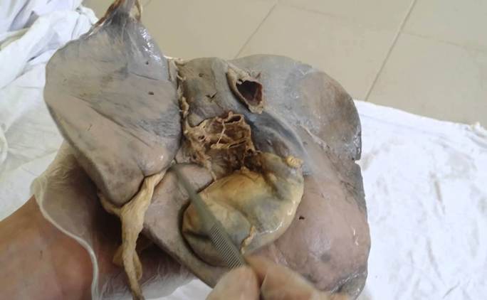
Identify
A. caudate lobe
B. Fundus of gall bladder
C. Inferior Vena Cava
D. Porta hepatis
What is the surface anatomy of (B)
Fundus corresponds to the tip of the right 9th
costal cartilage
Mention the contents of (D)
Right and left hepatic ducts
Right and left branches of the hepatic artery
Right and left branches of the portal vein
A
C
D
B

Slide 9
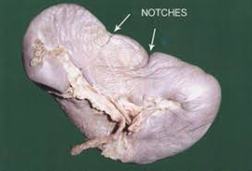
Station Five
Identify The Structures Related To Marked Areas
Colic (left colic flexure)
Renal (left kidney)
Gastric (stomach)
Pancreatic (tail of pancreas)
Enumerate The Ligaments Attaches To This Organ And Mention Its Contents
Gastrosplenic ligament: short gastric and left gastroepiploic vessels.
Lienorenal (splenorenal) ligament: splenic vessels and the tail of pancreas.
C
B
D
A

Slide 10
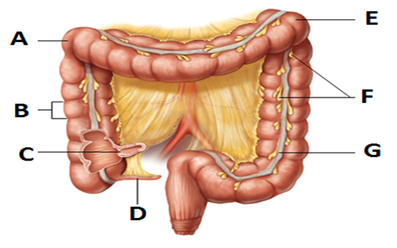
Station Six
Identify
Right colic (hepatic) flexure
Ascending colon
Ileocecal junction
Appendix
Left colic (splenic) flexure
Appendices epiploica
Taenia coli
Mention the anterior relations of (H)
Greater omentum.
Anterior abdominal wall
H

Slide 11
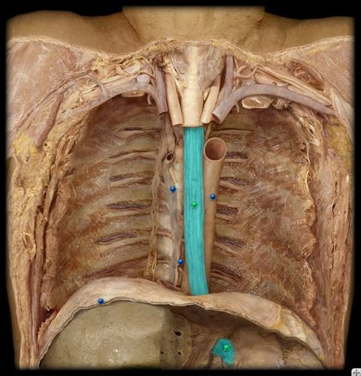
Station Seven
Identify (A)
Abdominal part of esophagus
Posterior relations of (A)
Left crus of the diaphragm
Sites of normal constrictions of this organ
At the pharyngeoesophageal junction
Where it is crossed anteriorly by the aortic arch and
the left main bronchus
At esophageal hiatus where it passes through the diaphragm to join stomach
The level of the esophageal opening of the diaphragm
T10
A

Slide 12
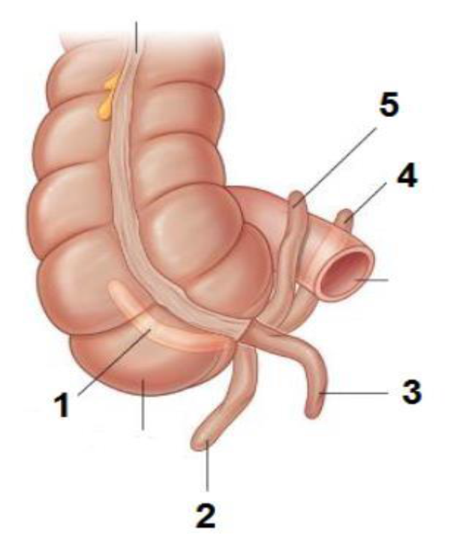
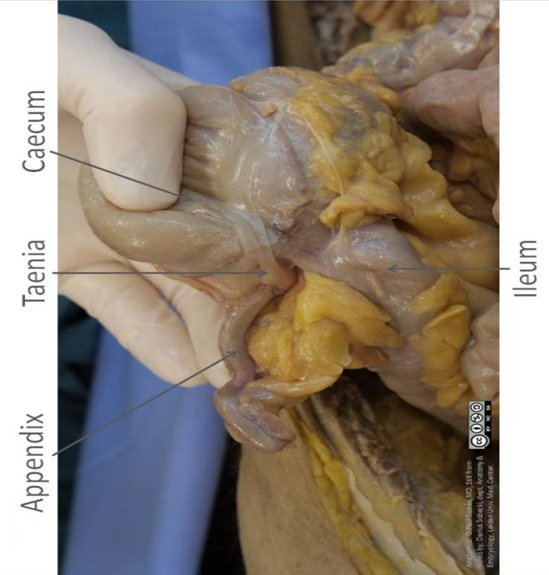
Station Eight
A 12 year old boy is brought to the ER with a fever, nausea, and abdominal pain. Investigation revealed leucocytosis. The case is diagnosed as acute appendicitis.
Identify the positions of the appendix:
Retrocecal
Subcecal
Pelvic
Postileal
Preileal
Which artery we need to be ligate during appendectomy?
Appendicular artery
From where does this artery arise?
Ileocolic of superior mesenteric artery

Slide 13
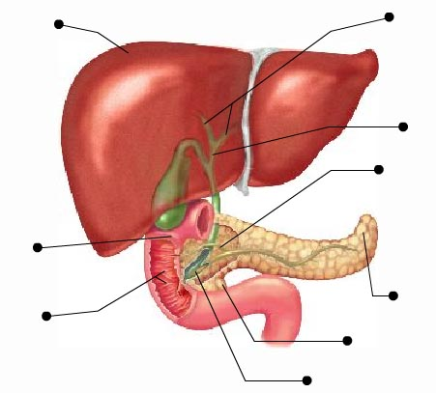
Station Nine
Identify
Right lobe of liver
Right and left hepatic ducts
Common hepatic duct
Cystic duct
Uncinate process of head of pancreas
Second (descending) part of duodenum
Mention the vertebral level of (6)
L1 to L3
Mention the anterior relations of (6)
Liver
Transverse colon
Small intestine
1
2
4
3
6
5

Slide 14
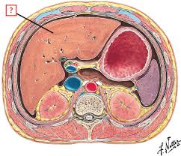
Station Ten
Liver
Spleen
Stomach
Gall bladder
Portal vein
IVC
Abdominal aorta
Lesser omentum
Lesser sac
Epiploic foramen

Slide 15
THANK YOU good luck

