Slide 1
Integrated Practical Acute & Chronic Pancreatitis
2018
GNT
PART 1
Pathology
Dr. Maha Arafah

Slide 2
Objectives of the Practical Class
Understand the uses of serum amylase in the assessment of patients with acute pancreatitis.
Hands-on training on measurement of serum amylase by using a biochemical kit and spectrophotometer.
Discuss and work on cases covering concepts related to the practical class and application of knowledge learnt.

Slide 3
Case 1
A 65-year-old retired school teacher is referred to King Khalid Hospital by his general practitioner because of repeated abdominal pain and evidence of gallstones shown by ultrasound.
On arrival to the hospital, he has upper abdominal pain, vomited once, and tenderness in the epigastrium.
His vital signs are shown in the table

Slide 4
Vital signs

Slide 5
Blood tests
Liver function Tests (including serum bilirubin, Aspartate aminotransferase (AST),
Alanine aminotransferase (ALT),
Alkaline phosphatase (ALP),
serum albumin,
and prothrombin time): all within normal range

Slide 6
Question 1: Which body organ do you think is the source of his pain?
Pancreas

Slide 7
Question 2: Interpret the clinical presentation and the laboratory test results.
Upper abdominal pain, vomiting, and tenderness in the epigastrium.
Lab: Increased serum amylase and lipase.

Slide 8
Question 3 What is your possible diagnosis? Justify your views.
Acute Pancreatitis
due to gallstones obstructing the exocrine pancreatic ducts leading to auto digestion of the pancreatic substance and release of amylase and lipase in circulating blood.

Slide 9
Question 4 Which one/or more of the following images represents the pathological changes you would expect? Describe the pathological changes in the image you have selected. Justify your views for selecting this particular image.
Image B and C

Slide 10
Image B
Severe acute pancreatitis: black areas of hemorrhage are present within the pancreas as well as chalky, yellow-white areas of fat necrosis. Pancreatic parenchyma is soft and gray-white due to necrosis.

Slide 11
Image C
Severe acute pancreatitis: shows an area of acute inflammation with necrosis. Within the necrotic area is a blood vessel showing fibrinoid necrosis of the vessel wall leads to severe, hemorrhagic, acute pancreatitis.

Slide 12
Case 2:

Slide 13
Case 2
James Michael is a 55-year-old engineer who works with a Saudi construction in Riyadh. He travels a lot from the UK to Riyadh to supervise the developments of the joint projects, and at times spent 30-40 days abroad.
During his last visit to Riyadh, he has upper abdominal pain and was admitted to KKUH. He gives a history of recurrent upper abdominal pain for over 2 years. The pain this time is felt also into his back.
He has loose bowel motions for some time and he gives a history of loss of 3 kg in body weight. He has no family history of diabetes or hypertension.
On examination, his vital signs are within normal range. His Body Mass Index is 25 Kg/m². The doctor arranges for some investigations and the results are shown in the table:

Slide 14
Stool tests:
Biochemistry tests:
Liver function Tests (including serum bilirubin, AST, ALT, Alkaline phosphatase, serum albumin, and prothrombin time): all within normal range.
Complete blood count: Normal

Slide 15
Question 1: Which body organ do you think is the source of his pain?
Pancreas.

Slide 16
Question 2: Interpret the clinical presentation and the laboratory test results. What is the significance of high faecal fats together with a raised blood glucose level?
History of recurrent upper abdominal pain for over 2 years, loose bowel motions and loss of 3 kg in body weight.
Significance of high faecal fats together with a raised blood glucose level:
Chronic pancreatitis is characterized by irreversible parenchymal damage caused by long-standing inflammation, fibrosis, and destruction of the exocrine (acini) pancreas; in its late stages, the endocrine parenchyma (islet cells) also is lost.
Increased faecal fat due to decreased lipase from pancreatic acini leading to steatorrhea.
Increased Fasting blood glucose due to decreased insulin caused by islet cell loss.

Slide 17
Question 3 What is your possible diagnosis? Justify your views.
Chronic pancreatitis resulting from recurrent bouts of acute pancreatitis.
It is not caused by alcohol abuse because liver function tests are normal.

Slide 18
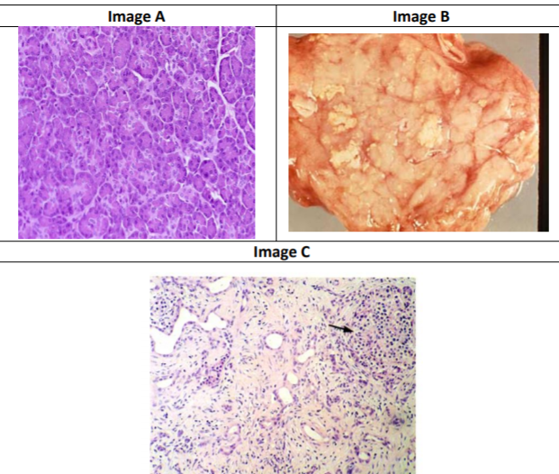
Question 4 Which one/or more of the following images represents the pathological changes you would expect? Describe the pathological changes in the image you have selected. Justify your views for selecting this particular image.
Image B and C.

Slide 19
Image B
Chronic pancreatitis showing calcium deposition is secondary to fat necrosis and dystrophic calcification.

Slide 20
Image C
Chronic Pancreatitis: parenchymal fibrosis, chronic inflammatory infiltrate and reduced number and size of acini with variable dilatation of pancreatic ducts and relative sparing of islets of langerhans (arrow).

Slide 21
