Slide 1
College of Medicine, KSU
Medical education Department
Pathology Department
Medical Biochemistry Unit
GIT Block (2nd Year)
Integrated Practical (Biochemistry / Pathology)
Liver Function Tests

Slide 2
Measurement of total bilirubin
By
Medical Biochemistry Unit

Slide 3
Q1. What are the liver function tests (LFTs)?

Slide 4
Q1. What are the liver function tests (LFTs)?
(ALT)
e.g. Viral hepatitis
(AST)

Slide 5
Q2. What is bilirubin and how is it produced in the body?

Slide 6
Q2. What is bilirubin and how is it produced in the body?
Bilirubin is a yellow bile pigment.
It is produced from the degradation of heme; which is one of the breakdown products of red blood cells.

Slide 7
Q3. Which form of bilirubin is carried to the liver and how?

Slide 8
Q3. Which form of bilirubin is carried to the liver and how?
The unconjugated form of bilirubin is carried to the liver
Unconjugated bilirubin forms a complex with albumin to be transported

Slide 9
Q4.
How & why is bilirubin conjugated?
Mention 2 syndromes due to congenital deficiency of the conjugating enzyme (bilirubin glucuronyl-transferase).

Slide 10
How & why is bilirubin conjugated?
Bilirubin is conjugated by addition of glucuronic acid in hepatocytes.
The conjugated-bilirubin is water soluble and can be excreted in the urine and faeces.
This prevents precipitation and deposition in tissues.

Slide 11
Defective enzymatic conjugation of bilirubin
Examples of clinical conditions due to congenital deficiency of the conjugating enzyme ( bilirubin glucuronyl transferase)
Crigler-Najjar syndrome
Gilbert syndrome

Slide 12
Q5: On the picture, mark the intracellular location for the process of conjugation?

Slide 13
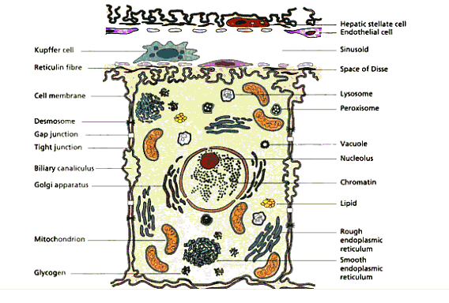

Slide 14
Q5.
How is bilirubin eliminated from the body?
What are the fates of bilirubin in the intestine?

Slide 17
Hands – on Practical

Slide 18
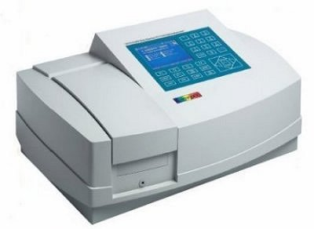
Measurement of Total Bilirubin
200µl serum
1
Add 200µl
Reagent 1
4
Mix and allow to stand for 10 minutes
at room temperature
To blank and test
2
Add 50µl Reagent 2
Blank
Test
5
Only in test
Add 1 ml Reagent 4
To blank and test
3
Add 1 ml Reagent 3
To blank and test
Mix and allow to stand for 15 minutes
at room temperature
6
Blank
Test
8
7
Add blank and set
The base line at wavelength 578 nm
Add test and take reading (A) at 578 nm
Transfer(Pour) to cuvette

Slide 19
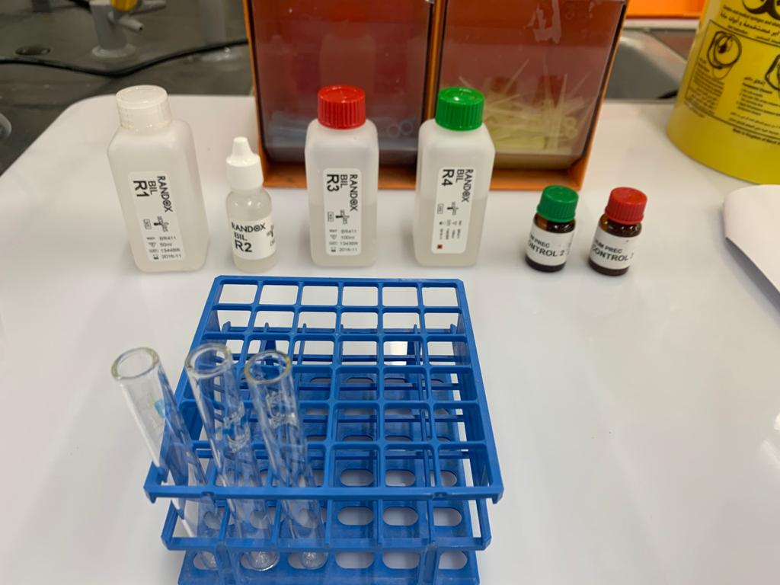

Slide 20
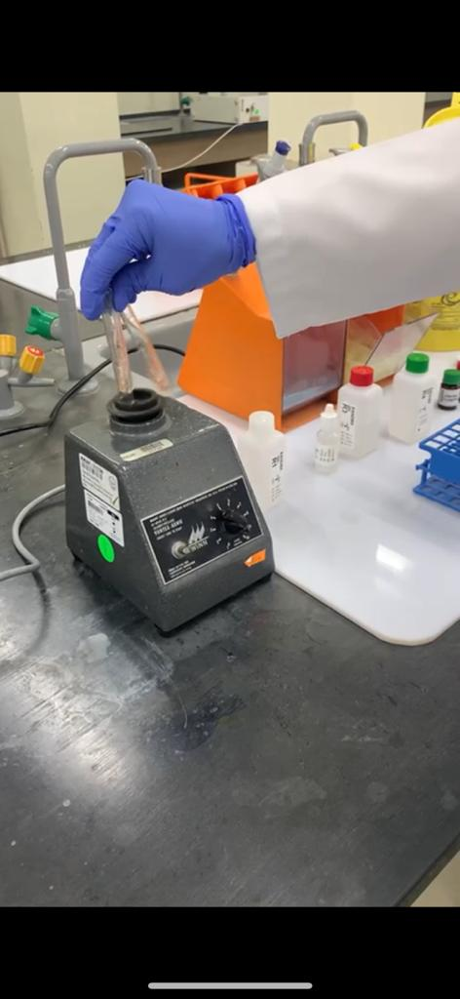

Slide 21
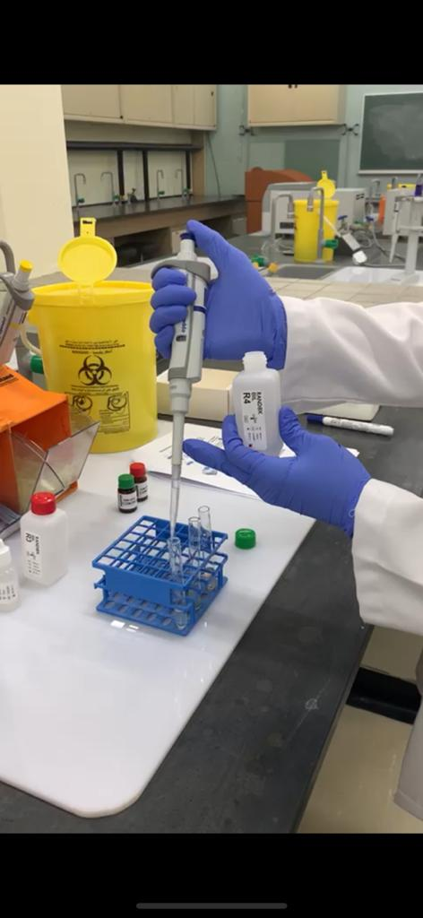

Slide 22
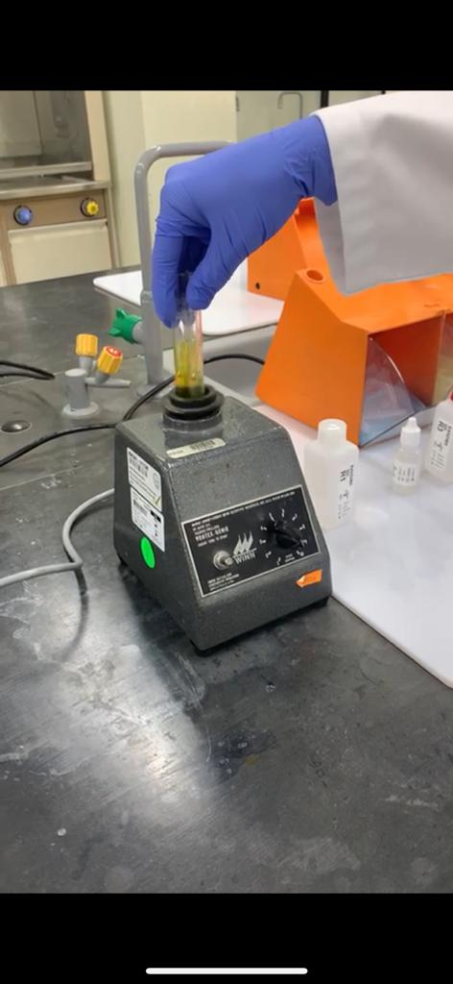

Slide 23
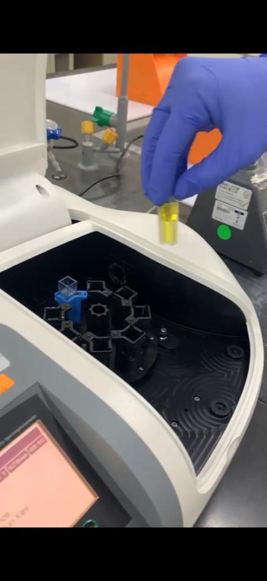

Slide 24
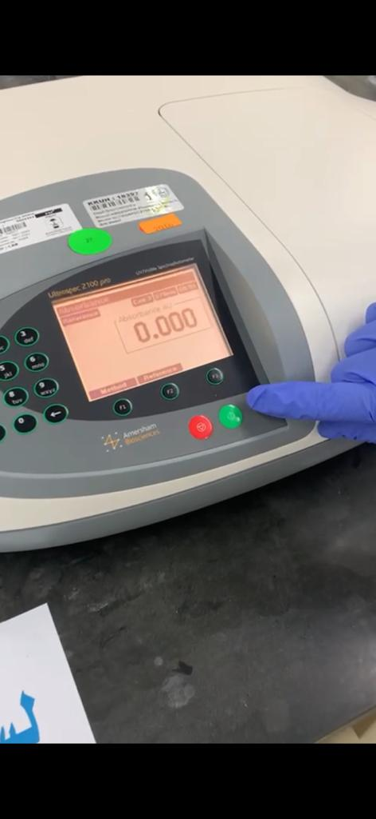

Slide 25
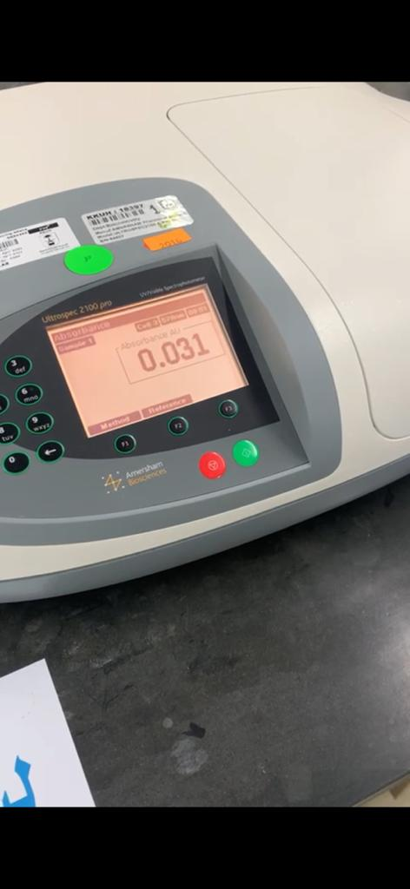

Slide 26
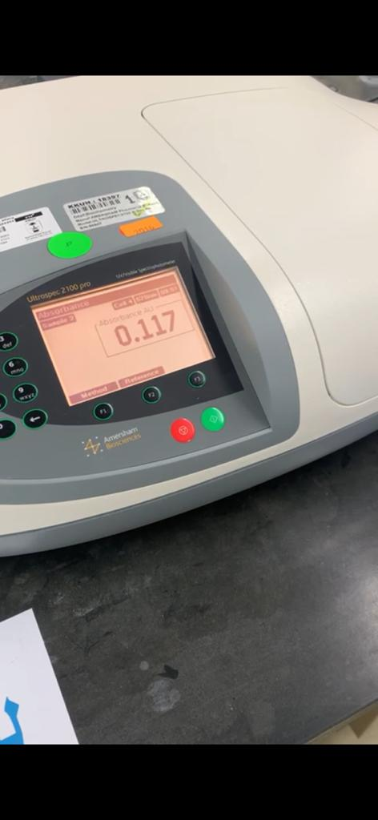

Slide 27
Calculation of total bilirubin concentration
Conc. of serum total bilirubin:
A × 185 = …... µmol/L
Note- (Normal range: 2 – 17 µmol/L)

Slide 28
Sensitivity
Sensitivity answers the following question:
If a person has a disease, how often will the test be positive (true positive rate)? i.e.: if the test is highly sensitive and the test result is negative you can be nearly certain that the individuals don’t have disease. A Sensitive test helps rule out disease (when the result is negative). Sensitivity rule out or "Snout“
true positives
Sensitivity=
X 100
true positive + false negative

Slide 29
2 X 2 Contingency Table
Test | Disease
 | + | -
+ | True Positive (TP) | False Positive (FP)
- | False Negative (FN) | True Negative (TN)
TP
Sensitivity=
X 100
TP+ FN

Slide 30
Specificity
Specificity answers the following question:
If a person does not have the disease how often will the test be negative (true negative rate)?
i.e., if the test result for a highly specific test is positive you can be nearly certain that the individuals actually have the disease. A very specific test rules in disease with a high degree of confidence (when the result is positive).
Specificity rule in or "Spin"
true negatives
Specificity=
X 100
true negatives + false positives

Slide 31
2 X 2 Contingency Table
Test | Disease
 | + | -
+ | True Positive (TP) | False Positive (FP)
- | False Negative (FN) | True Negative (TN)
TN
Specificity=
X 100
TN+ FP

Slide 32
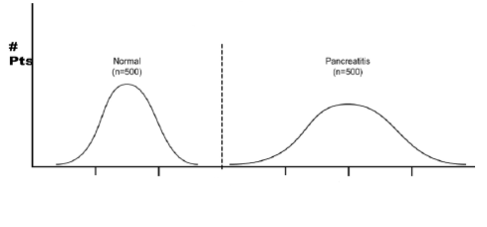
An ideal diagnostic lab test results for many subjects (normal and patients)
Normal
N = 500
Hepatitis
N= 500
A perfect test for acute hepatitis:
The test identifies ALL patients with disease and All subjects without disease 100% of the time.

Slide 33
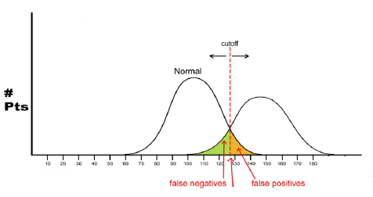
In most diagnostic lab tests, this is not the case..
Acute hepatitis
Normal
Disease
Serum bilirubin level
The lab test results in normal and disease conditions overlap.
To increase the overall accuracy of the test, the centermost point of overlapping is chosen as the cutoff value.
There are some normal subjects who will have a positive results (False positives)
There are some patients who will have negative results (False negatives)

Slide 34
Example of calculation
A Lab test to measure serum bilirubin was performed on 1000 individuals. The test gave the following results:
Number of positive results in patients with acute hepatitis: 440
Number of positive results in normal subjects: 50
Number of negative results in normal subjects: 450
Number of negative results in patients with acute hepatitis: 60
For this Serum bilirubin test, calculate the following quality measures:
The sensitivity
The specificity

Slide 35
Test | Disease
 | + | -
+ | TP | FP
- | FN | TN
Test | Disease
 | + | -
+ | 440 | 50
- | 60 | 450
Answer: draw a
2 X 2 Contingency Table
TP
440
Sensitivity= 88%
Sensitivity=
X 100
=
X 100
=
0.88 x100
TP+ FN
440+ 60
TN
450
Specificity= 90%
Specificity=
=
X 100
X 100
=
0.90x100
450+ 50
TN+ FP

Slide 36
Thank
you

