Slide 1
RADIOLOGICAL ANATOMY OF THE SMALL & LARGE BOWEL
Practical Session (2)
Radiology

Slide 2
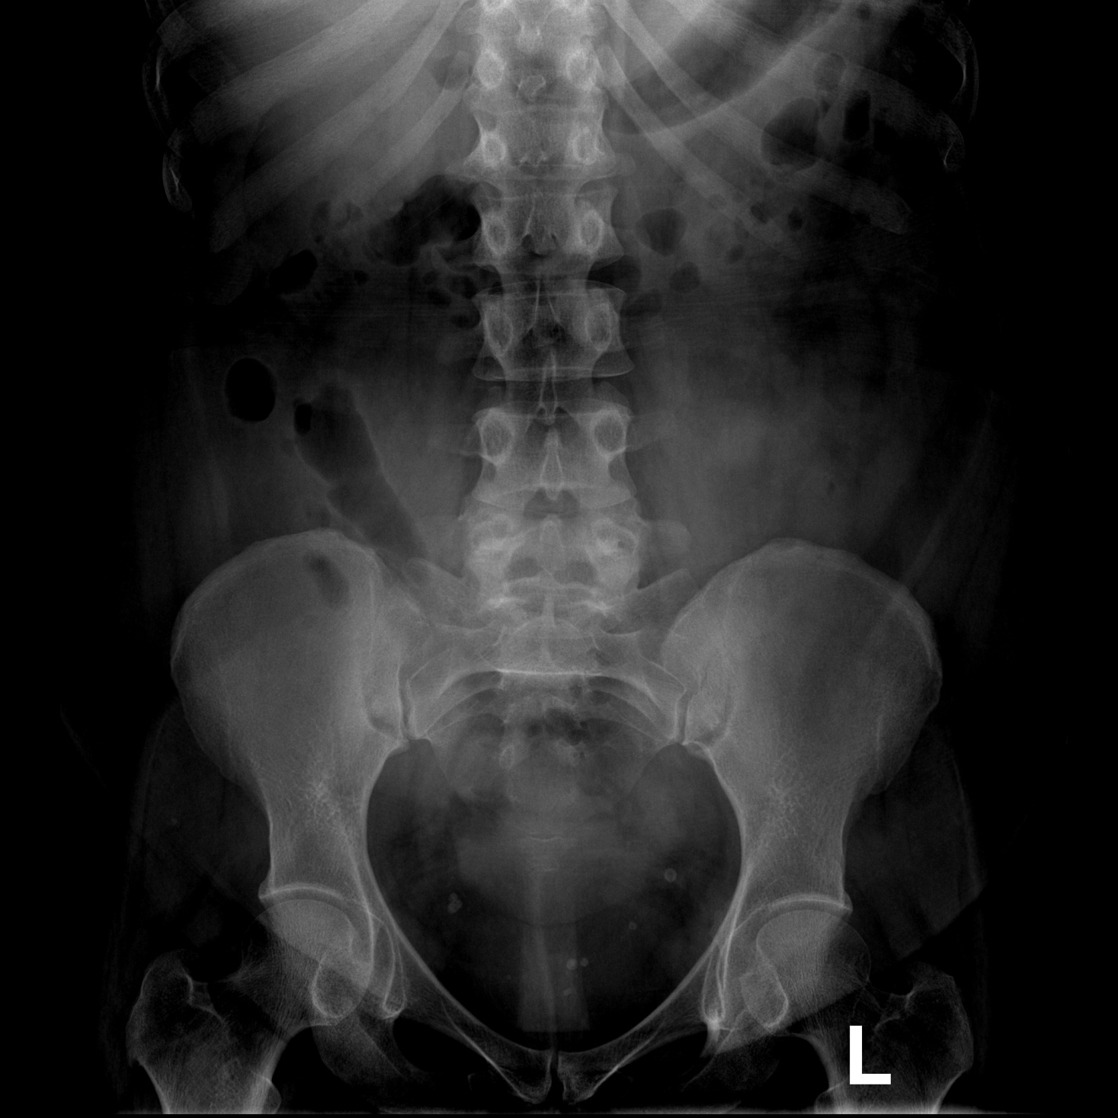
2
1
5
3
4

Slide 3
Transverse colon
stomach
Small bowel
cecum
Descending colon

Slide 4
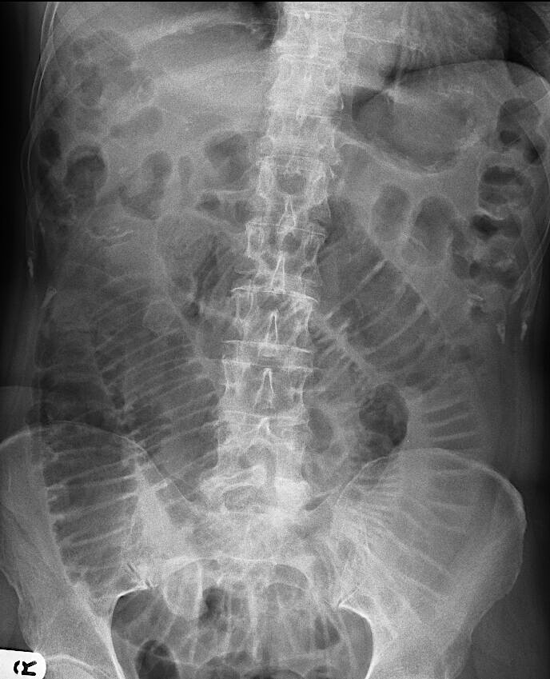
Where is the small bowel and where is the large bowel ?

Slide 5
Large bowel
Small bowel

Slide 6
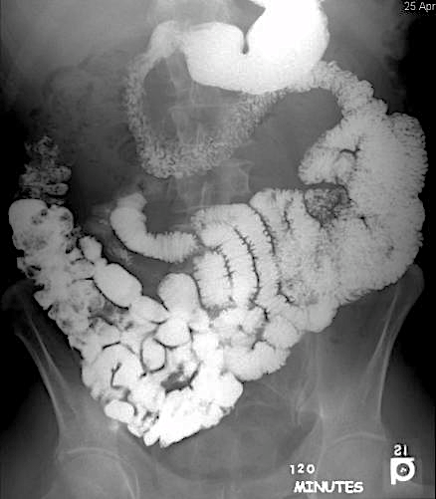
1
2
5
3
4

Slide 7
1
2
1- Stomach
2- Duodenum
3- Jejunum
4- Ileum
5- Cecum
5
3
4

Slide 8
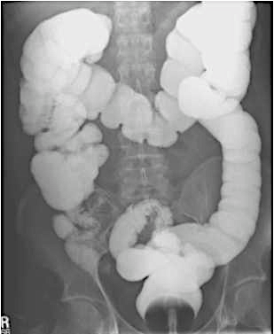
5
3
4
2
6
1
7
8

Slide 9
5
3
Cecum
Ascending colon
Hepatic flexure
Transvers colon
Splenic flexure
Descending colon
Sigmoid colon
rectum
4
2
6
1
7
8

Slide 10
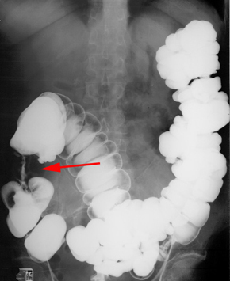
Is this study normal or abnormal? And why?

Slide 11
Abnormal study
Colon Cancer (apple core sign)

Slide 12
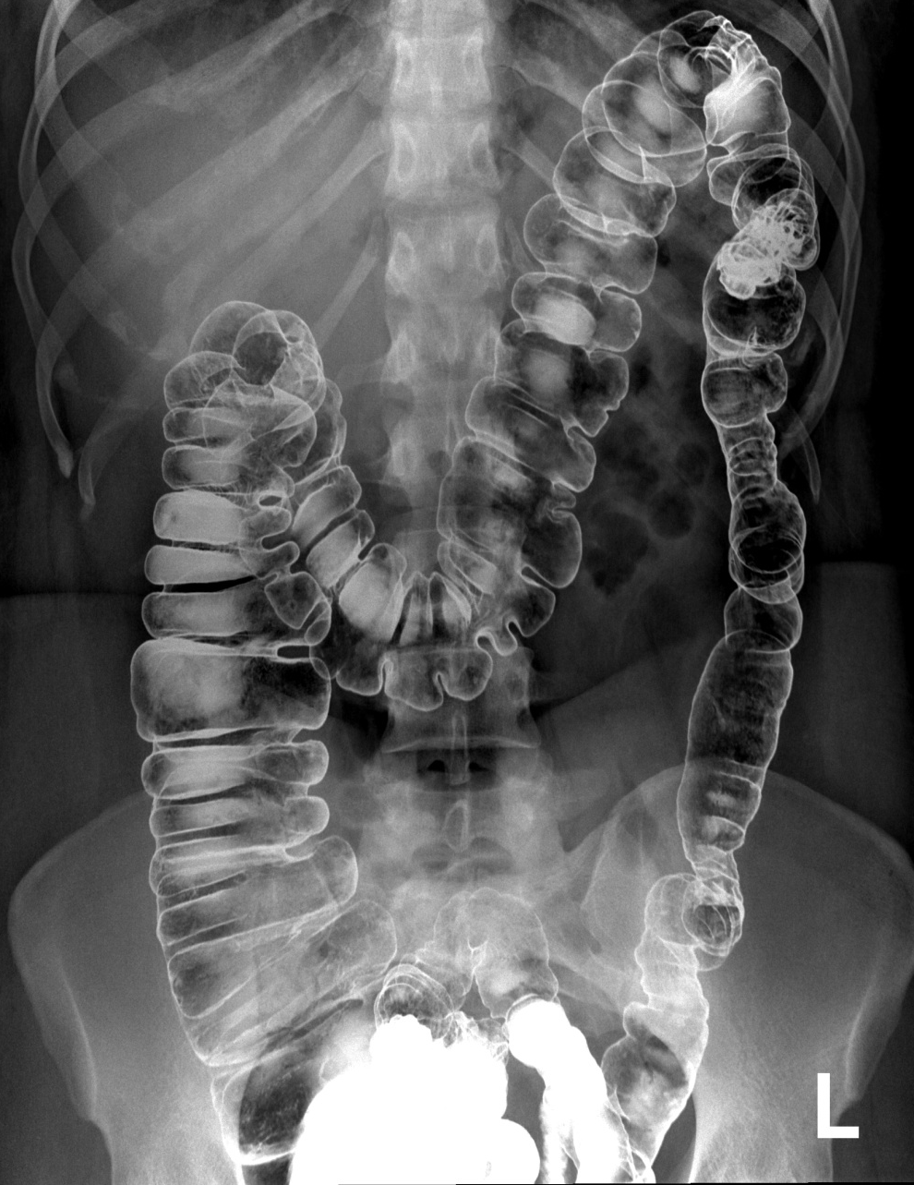
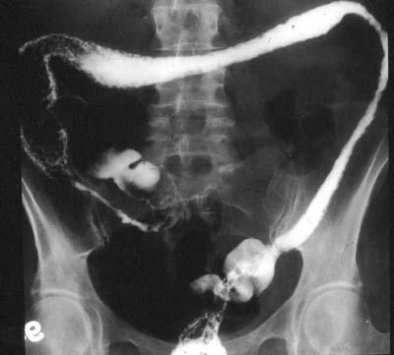
Normal
Abnormal

Slide 13
abnormal study normal
Ulcerative colitis
Feature-less colon(lead pipe appearance)

Slide 14
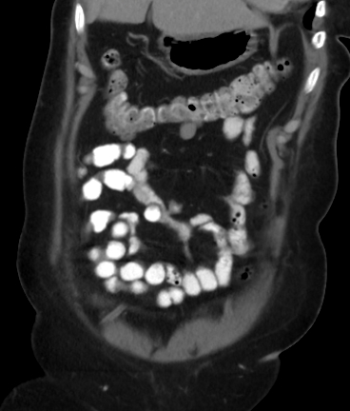
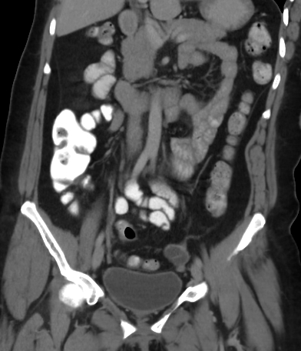
2
3
4
1

Slide 15
2
3
4
1
Ileum
Transverse colon
Jejunum
Cecum

Slide 16
3
2
4
1
5
6

Slide 17
3
2
4
1
5
6
Descending colon
Splenic flexure
Hepatic flexure
Ascending colon
cecum
Sigmoid colon

Slide 18
5
2
1
6
4
3

Slide 19
5
2
1
6
4
3
1- Rectum 2-Sigmoid colon 3-Descending colon 4-Ascending colon
5-Transverse colon 6-Cecum

Slide 20
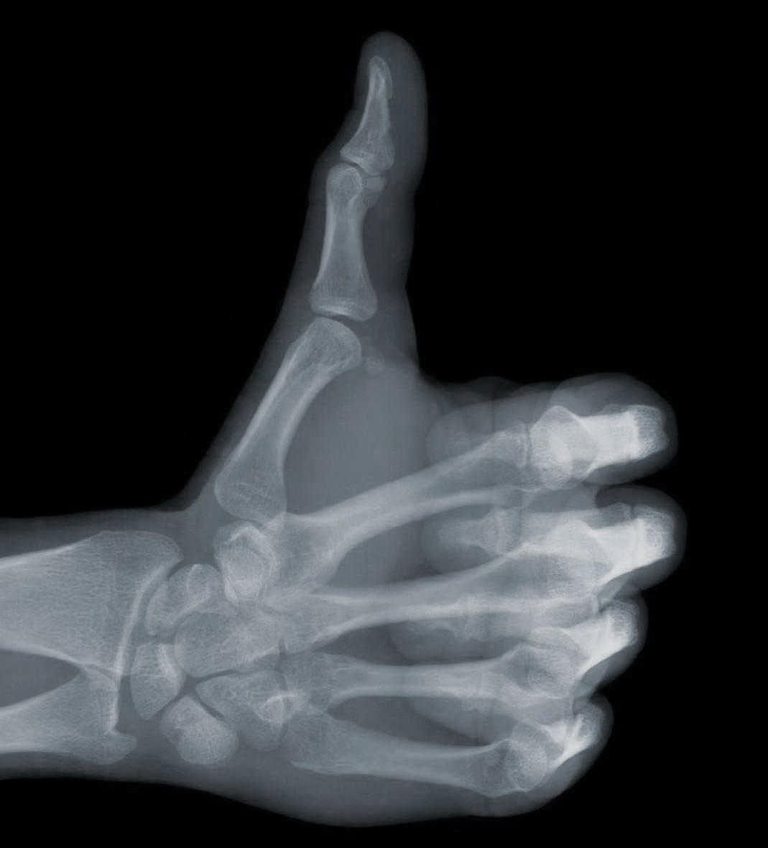
Thank you

