Slide 1
Metabolic Syndrome
Endocrine Block
Dr. Sumbul Fatma

Slide 2
Objectives
Define metabolic syndrome, insulin resistance and dyslipidemia
Discuss the risk factors for metabolic syndrome and other medical conditions associated with it
Define the diagnostic criteria for Metabolic syndrome
Discuss the management of metabolic syndrome and current treatment options

Slide 3
Overview
Introduction
Features of metabolic syndrome
Insulin resistance
Dyslipidemia
Risk factors
Markers
Diagnosis
Management and treatment

Slide 4
Metabolic Syndrome
A combination of metabolic abnormalities which increase the risk of heart disease, diabetes and other diseases
Obesity is a component of met. synd.
Signals from adipocytes in obesity cause metabolic abnormalities such as:
Dyslipidemia
Glucose intolerance
Insulin resistance
Hypertension

Slide 5
Features of metabolic syndrome
Obesity
High serum triglycerides (TGs)
Low HDL cholesterol
Hypertension
Hyperglycemia
Insulin resistance (hyperinsulinemia)

Slide 6
Insulin Resistance
Cells become less responsive to insulin 🡪 high plasma insulin 🡪 hyperglycemia
Hydrolysis of stored fats 🡪 high plasma FFAs
Reduction of glucose uptake/use by cells
Reduction of glycogenesis 🡪 hyperglycemia
Compensatory hyperinsulinemia causes down regulation of insulin receptor
Defects in insulin receptor

Slide 7
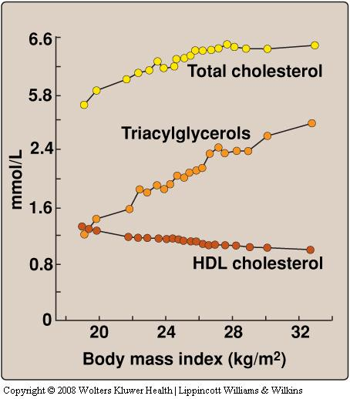
Dyslipidemia
Insulin resistance in adipocytes 🡪 increased activity of hormone-sensitive lipase 🡪 high plasma FFAs
FFAs 🡪 TGs/cholesterol in the liver
Excess TGs/cholesterol are released as VLDL in the blood
HDL levels are decreased

Slide 8
Dyslipidemia and met. synd. are strongly related
Dyslipidemia is an early indicator of insulin resistance
Liver fat plays a major role in dyslipidemia due to insulin resistance

Slide 9
Risk factors for metabolic syndrome
Obesity
Alcoholism
Sedentary Lifestyle
Smoking
Hypercortisolism (Steroid use/Cushing disease)
Drugs (rifampicin, isoniazid, etc.)
Mutations in insulin receptor

Slide 10
Metabolic syndrome is linked to:
Heart disease
1 .5-3 fold increase in atherosclerosis
Type-2 diabetes mellitus
5-fold increase
Kidney disease
Reproductive abnormalities in women
Polycystic ovarian syndrome
Impaired ovulation and fertility
Irregular menstruation

Slide 11
Metabolic syndrome is linked to:
Nonalcoholic steatohepatitis (fatty liver disease)
Related to impaired lipid metabolism
Cancer
Obesity is a major risk factor for cancer of esophagus, colon and rectum, liver, gall bladder
Being overweight and obese accounts for 14% of all cancer deaths in men and 20% of those in women

Slide 12
Diagnosis – WHO criteria (1999)
Impaired glucose tolerance
Diabetes mellitus
Insulin resistance
PLUS any of these two:
Component | Criterion
Hypertension | BP >140/90 mmHg
Dyslipidemia | High plasma TGs (>1.7mmol/L) Low HDL cholesterol (men <0.9, women <1.0 mmol/L)
Central or General obesity | Waist to hip ratio >0.9 in men, >0.85 in women And/or BMI >30
Microalbuminuria | Urinary albumin excretion rate ≥ 20ug/min or albumin:creatinine ratio ≥ 30mg/g

Slide 13
NCEP* ATP** III Guideline (2002)
Diagnosis: If any 3 or more of these risk factors are present
Waist circumference:
Men >102 cm (>40 in)
Women >88 cm (>35 in)
Triglycerides >150 mg/dL
HDL cholesterol:
Men <40 mg/dL
Women <50 mg/dL
Blood pressure 130/ 85 mm Hg
Fasting glucose >100 mg/dL
*National Cholesterol Education Program
**Adult Treatment Panel

Slide 14
Markers of metabolic syndrome
Lipoproteins (LDL, HDL)
Adipokines (Leptin, adiponectin)
Inflammatory markers
c-reactive protein, TNF-α, IL-6, IL-8
Hemostatic marker
Plasminogen activator inhibitor-1

Slide 15
Managing Metabolic Syndrome
Primary intervention: Lifestyle changes
Weight reduction
Target BMI < 25
Reduced intake of calories and fats
More physical activity
Smoking cessation

Slide 16
Managing metabolic syndrome
Secondary intervention: Medication to treat existing risk factors
Management of
Blood pressure (anti-hypertensive drugs)
Lipids (statins, fibrates)
Blood glucose (metformin, TZDs)
Aspirin for CVD prevention

Slide 17
Lowering blood pressure
Modification | Recommendation | Average drop in SBP
Weight loss | Maintain normal body weight | 5-10 for every 22lbs loss
Healthy eating plan | Meals rich in fruits, vegetables; low fat dairy; low saturated fats and cholesterol | 8-14
Sodium restriction | < 2400 mg/day | 2-8
Regular physical activity | 30 min. most of the week | 4-9

Slide 18
Hypertension and clotting disorders
Treat hypertension to goal (< 130/80 mmHg)
Low dose diuretics
ACE inhibitor
Aspirin:
To treat clotting disorders
Daily low dose aspirin (81-325mg) for:
Men > 45
Postmenopausal women

Slide 19
Current Treatment
Statins
Metformin
Fibrates
Thiazolidinediones (TZDs)
Aspirin

Slide 20
Metformin
Reduces blood glucose levels by inhibiting hepatic gluconeogenesis
Hepatic gluconeogenesis is active in patients due to liver’s resistance to the effects of insulin
Reduces lipid synthesis in the liver
Helps reducing blood lipids

Slide 21
Fibrates
Reduce blood lipid levels
Activate transcription factor:
Peroxisome proliferator activated receptor-α (PPAR-α)
Activated PPAR- α 🡪 transcription of genes of lipid degradation / uptake by the cells:
Carnitine:palmitoyl transferase I (enhances FA uptake into mitochondria)
Lipoprotein Lipase
Stimulates apoAI and apoAII protein synthesis (major proteins in HDL)

Slide 22
Thiazolidinediones (TZDs)
Used for the treatment of insulin resistance and type-2 diabetes mellitus
TZDs activate PPAR-γ class of transcription factors expressed primarily in the adipose tissue
Activates the transcription of adiponectin
Adiponectin reduces the fat content of the liver and enhances insulin sensitivity

Slide 23
Take home message
Metabolic syndrome is a combination of metabolic abnormalities that increase the risk of heart disease, diabetes and other diseases
The features of metabolic syndrome include obesity, high serum triglycerides (TGs), low HDL cholesterol, hypertension, hyperglycemia and insulin resistance
Obesity, alcoholism, sedentary lifestyle and smoking are some of the risk factors for metabolic syndrome
Management of the syndrome includes lifestyle modifications to reduce weight and medications

Slide 24
References
Textbook of Biochemistry with Clinical Correlations by Thomas M. Devlin, 6th Edition, pp 862-863.
Lippincott’s Biochemistry. 5th Edition, pp 353-355, Lippincott Williams & Wilkins, New York, USA.

