Slide 1
Biochemistry of Cushing Syndrome
Endocrine Block

Slide 2
Objectives
To identify different causes of Cushing’s syndrome
To understand the diagnostic algorithm for Cushing’s syndrome
To understand the interpretation of laboratory and radiological tests of Cushing’s syndrome
To identify the importance of radiological investigations for diagnosis of Cushing’s syndrome.

Slide 3
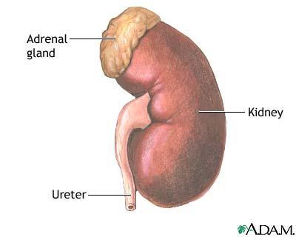
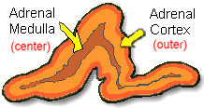
ANATOMICALLY:
The adrenal gland is situated on the anteriosuperior aspect of the kidney
HISTOLOGICALLY:
The adrenal gland consists of two distinct tissues of different embryological origin, the outer cortex and inner medulla.

Slide 4
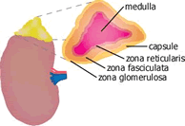
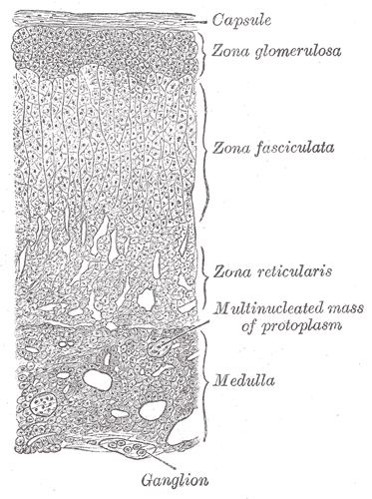
The adrenal cortex comprises three zones based on cell type and function:
Zona Glomerulosa
The outermost zone → aldosterone (the principal mineralocorticoid).
The deeper layers of the cortex:
Zona Fasciculata
→ glucocorticoids – mainly cortisol (95%)
Zona Reticularis → Sex hormones

Slide 5
Steroid Hormone Synthesis
Cholesterol (27C)
Pregnenolone (21C)
3-β-Hydroxysteroid dehydrogenase
Progesterone (21C)
17-α-Hydroxylase
17-α-Hydroxyprogesterone (21C)
21-α-Hydroxylase
11-Deoxycorticosterone (21C)
Androstenedione (19C)
11-Deoxycortisol (21C)
11- β -Hydroxylase
Testosterone (19C)
Corticosterone
Peripheral tissues
Aldosterone (21C)
Cortisol (21C)
Estradiol (18C)

Slide 6
Hypothalamic-Pituitary-Adrenal (HPA) Axis
The hypothalamus secretes corticotropin-releasing hormone (CRH) which stimulates the anterior pituitary gland to synthesis and release ACTH.
ACTH acts on the zona fasiculata cells → release of glucocorticoids (Cortisol).

Slide 7
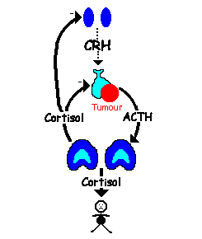
Regulation of ACTH and Cortisol Secretion:
1. Negative feedback control:
ACTH release from the anterior pituitary is stimulated by hypothalamic secretion of corticotrophin releasing hormone (CRH).
CRH → ↑ ACTH → ↑[Cortisol]
↑[Cortisol] or synthetic steroid suppress CRH & ACTH secretion
Hypothalamus
Pituitary
Adrenal

Slide 8
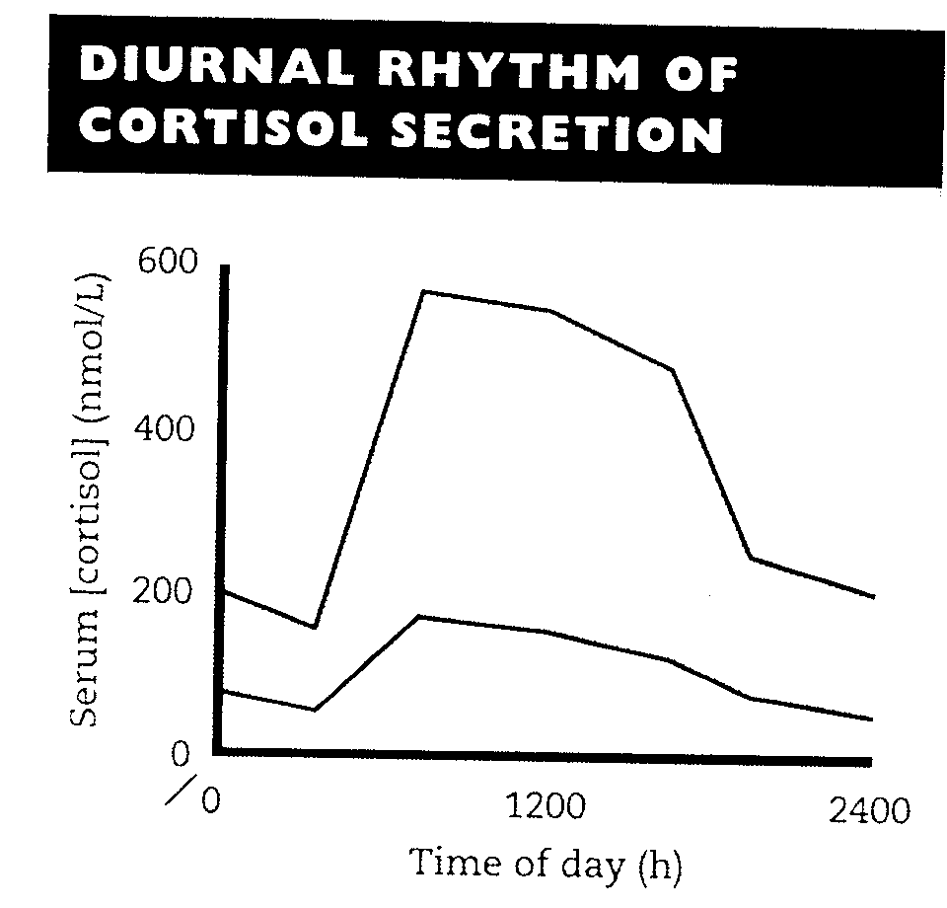
2. Stress (e.g. major surgery, emotional stress) Stress → ↑↑ CRH & ACTH → ↑↑ Cortisol
3. The diurnal rhythm of plasma cortisol:
Highest Cortisol level in the morning ( 8 - 9 AM ).
Lowest Cortisol level in the
late afternoon and evening
( 8 - 9 PM ).
The diurnal rhythm of cortisol secretion; the area between the curves represents values that lie within the reference range

Slide 9
Plasma [CBG] :
In the circulation, glucocorticoids are mainly protein-bound (about 90%), chiefly to cortisol-binding globulin (CBG or transcortin).
↑↑ in pregnancy and with estrogen treatment (e.g. oral contraceptives).
↓↓ in hypoproteinemic states (e.g. nephrotic syndrome).
The biologically active fraction of cortisol in plasma is the free (unbound) component.

Slide 10
Cortisol and ACTH measurements
Serum [cortisol] and plasma [ACTH]:
Serum measurement is preferred for cortisol and Plasma for ACTH.
Samples must be collected (without venous stasis) between 8 a.m. and 9 a.m. and between 10 p.m. and 12 p.m. because of the diurnal rhythm.
Temporary ↑↑ in these hormones may be observed as a response to emotional stress.

Slide 11
Urinary cortisol excretion :
Cortisol is removed from plasma by the liver → metabolically inactive compounds → excreted in urine mainly as conjugated metabolites (e.g. glucuronides).
A small amount of cortisol is excreted unchanged in the urine (UFC).
In normal individuals:
Urinary free cortisol (UFC) is < 250 nmol/24 h.
Cortisol / Creatinine ratio in an early morning specimen of urine is < 25 μmol cortisol / mol creatinine.

Slide 12
CAUSES OF ADRENOCORTICAL HYPERFUNCTION: CUSHING’S SYNDROME
ACTH - dependent :
1. ↑ Pituitary ACTH 70% (Cushing's disease).
2. Ectopic ACTH by neoplasms 10%.
ACTH - independent :
1. Adrenal tumor 20% (adenoma or carcinoma)
2. Glucocorticoid therapy.

Slide 13
Causes of elevated serum cortisol concentrations:
1. Increased cortisol secretion:
• Cushing's syndrome
• Exercise
• Stress, Anxiety, Depression
• Obesity
• Alcohol abuse
• Chronic renal failure
2. Increased cortisol binding globulin (CBG):
• Congenital
• Estrogen therapy
• Pregnancy

Slide 14
Glucocorticoid functions
Glucocorticoids have widespread metabolic effects on carbohydrate, fat and protein metabolism.
Upon binding to its target, CORTISOL enhances metabolism in several ways:
In the liver, Cortisol is an insulin antagonist and has a weak mineralocorticoid action →
↑↑ Gluconeogenesis → production of glucose from newly-released amino acids and lipids
↑↑ Amino acid uptake and degradation
↑↑ Ketogenesis.

Slide 15
In the adipose tissue: Cortisol → ↑↑ Lipolysis through breakdown of fat .
In the muscles: Cortisol →↑↑ proteolysis and amino acid release.
Conserving glucose: by inhibiting uptake into muscle and fat cells.

Slide 16
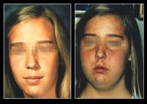
Cushing’s Syndrome
Symptoms:
Weight gain: trunk and face with sparing of the limbs (central obesity)
Buffalo’s hump.
Moon face
Excessive sweating

Slide 17
Symptoms …. (contd)
Atrophy of the skin and mucous membranes
Purple striae on the trunk and legs
Proximal muscle weakness (hips, shoulders)
Hirsuitism
The excess cortisol may also affect other endocrine systems → ↓ libido, amenorrhoea and infertility
Patients frequently suffer various psychological disturbances ranging from euphoria to frank psychosis.

Slide 18
Signs:
Loss of diurnal rhythm of cortisol and ACTH.
Hypertension (due to the aldosterone - like effects)
Hyperglycemia or diabetes due to insulin resistance.
Hypokalemic alkalosis
↑ protein metabolism.
Impaired immunity.

Slide 19
Investigations of suspected adrenocortical hyperfunction
A. Screening tests (out-patient): to assess the clinical diagnosis of adrenocortical hyperfunction.
B. Confirmatory tests (in-patient): to confirm or exclude the provisional diagnosis
C. Tests to determine the cause: to ascertain:
(a) The site of the pathological lesion
(adrenal cortex, pituitary or elsewhere?)
(b) The nature of the pathological lesion.

Slide 20
? Cushing
Screening
Low DST/UFC
Pesudo-Cushing
True Cushing
Confirmatory
Insulin hypoglycemia
Normal response
No response
Cause
ACTH/High DST
Alcoholism
Depression
ACTH-dependent
Adrenal
Severe illness
CRH Test
Pituitary
Ectopic
ULS/CT adrenals
MRI pituitary
CT chest

Slide 21
A. Screening tests:
Effective screening tests need to be sensitive but do not have to be highly specific.
It includes:
Low-dose dexamethasone (DXM) suppression test (DST):
(Overnight suppression test)
DXM → ↓ CRH → ↓ ACTH → ↓ cortisol
24-hour urinary free cortisol

Slide 22
A. Screening tests:
Low-dose DST: (outpatient procedure)
Procedure:
1 mg DXM administered at 11-12 PM the night before attending the clinic.
serum cortisol is measured at 8-9 AM.
Result:
Cortisol < 50 nmol/L (suppression)→ exclude hypercortisolnemia (Cushing Syndrome)
Precautions: Drugs that induce hepatic microsomal enzymes (Phenobarbitone & phenytoin) → ↑ DXM metabolism and ↓ DXM blood level to achieve CRH suppression (false diagnosis of Cushing)

Slide 23
A. Screening tests: …. Cont’D
24- hour urinary free cortisol:
Result: Cortisol < 250 nmol/day → exclude Cushing Syndrome.
Disadvantage: incomplete collection of urine → a false-negative result
- An alternative is to determine the urinary cortisol : creatinine ratio on an early morning specimen

Slide 24
Interpretation of screening tests:
The screening tests serve to:
distinguish simple non-endocrine obesity from obesity due to Cushing's syndrome.
Confirmatory tests (in-patient basis) are required to rule out pseudo-Cushing's syndrome
Pseudo-Cushing's syndrome:
Depressed or extremely anxious patients
Severe intercurrent illness
Alcoholism

Slide 25
B. Confirmatory tests: (Inpatient)
Insulin-induced hypoglycemia
Pseudo-Cushing patients show abnormal diurnal rhythm of S. cortisol, but, with Insulin-induced hypoglycemia → ↑ CRH, ACTH and cortisol blood levels
True Cushing patients:
No response to hypoglycemia

Slide 26
B. Confirmatory tests: … Cont’d
Insulin-induced hypoglycemia:
Hypoglycemia →↑ CRH →↑ ACTH →↑ cortisol
To test the integrity of the hypothalamic-pituitary-adrenal (HPA) axis.
To distinguish true Cushing's syndrome from pseudo-Cushing’s syndrome
Contraindicated in: epilepsy or heart disease.

Slide 27
Insulin hypoglycemia test …. Cont’d
Procedure:
Insulin I.V. (0.15 U/kg) to lower blood glucose to 2.2 mmol/L or less .
Samples for simultaneous measurement of serum glucose and cortisol levels are taken basally (before insulin injection) and at 30, 45, 60 and 90 min after I.V. insulin injection.
Failure to achieve a glucose level of 2.2 mmol/L invalidates the test and should be repeated with increment in step of 0.05U/kg.

Slide 28
Insulin hypoglycemia test …. Cont’d
Interpretation of the results:
Normally:
Basal serum cortisol: at least 145 nmol/L
At 60 - 90 minutes: the level > 425 nmol/L
Patients with Cushing's syndrome:
Whatever the cause, do not respond normally to insulin-induced hypoglycemia.
High basal serum cortisol than normal .
At 60 - 90 minutes: no increase in S. cortisol, despite the production of an adequate degree of hypoglycemia.

Slide 29
C. Tests used to determine the cause of Cushing's syndrome:
To differentiate ACTH-dependant from ACTH-independent: Plasma ACTH (Diurnal rhythm)
To distinguish between ACTH-dependent causes (Pitutary Vs Lung):
High-dose DST.
CRH stimulation test
Radiological tests: MRI of pituitary and ultrasound or CT of adrenals

Slide 30
1. Plasma [ACTH]:
Plasma [ACTH] should be measured on blood specimens collected at 8-9 a.m. and 8-9 p.m.
Plasma ACTH
Undetectable
↑↑ ACTH
↑ ↑↑ ↑ ACTH
❖
❖
❖
Functional adrenal tumor → confirmed by an abdominal CT scan to detect an adrenal mass
Cushing's disease (pituitary-dependent)
Ectopic (non-endocrine) origin of ACTH

Slide 31
2 (a). High-dose DST:
It is used to distinguish Cushing's disease from ectopic ACTH secretion.
2 mg dexamethasone six-hourly for 48 hours to suppress cortisol secretion.
Basal (pre-dexamethasone) serum cortisol or 24-hour urine free cortisol is compared with the results at the end of the 48-hour period.

Slide 32
2 (a). High-dose DST ………. Continued
Suppression is defined as a fall to less than 50 % of basal value.
About 90 % of patients with Cushing's disease show suppression of cortisol output.
In contrast, only 10% of patients with ectopic ACTH production (or with adrenal tumors) show suppression.

Slide 33
2 (b). CRH stimulation test:
Measures the ACTH and cortisol levels basally and 60 minutes after injection of 100 µg CRH.
Ectopic ACTH & adrenal tumors
Cushing's disease
No response
False-positive responses are unusual
↑↑ ACTH & cortisol above basal at 60 min
10% of patients fail to respond
In Cushing's disease: High-dose dexamethasone suppression test + the CRH test → 100 % specificity and sensitivity.

Slide 34
3. Radiological Investigations:
CT scanning of the adrenal glands/ Lungs
MRI of the pituitary gland

Slide 35
Other blood tests commonly performed for patients suspected to have Cushing’s syndrome are:
Full blood count
Blood glucose
Blood electrolytes and pH
Renal function tests
Liver function tests

Slide 36
? Cushing
Screening
Low DST/UFC
Pesudo-Cushing
True Cushing
Confirmatory
Insulin hypoglycemia
Normal response
No response
Cause
ACTH/High DST
Alcoholism
Depression
ACTH-dependent
Adrenal
Severe illness
CRH Test
Pituitary
Ectopic
ULS/CT adrenals
MRI pituitary
CT chest

Slide 37
Adrenal Hyperfunction Summary of Biochemical Tests
Test | Cushing’s disease | Adrenal tumor | Ectopic ACTH secreting tumor
S. cortisol | ↑ | ↑ | ↑
Low dose DST | Not suppressed | Not suppressed | Not suppressed
Urinary cortisol | ↑ | ↑ | ↑
Diurnal rhythm | Lost | Lost | Lost
Insulin-induced hypoglycemia | No response | No response | No response
Plasma [ACTH] | Normal or ↑ | Not detectable | ↑ ↑ ↑
High dose DST | suppressed | Not suppressed | Not suppressed
CRH test | ↑ | No response | No response

Slide 38
Case study
58 years old man was admitted with weight loss and respiratory distress. He had increased pigmentation and BP was 140/80.
Lab tests
Urea 8.6 (2.5-7 mmol/L)
Sodium 144 (135-145 mmol/L)
Potassium 2.0 (3.5-4.5 mmol/L)
Cortisol 1650 (150-550 nmol/L)
Post overnight DMX 1530 (<50nmol/L)
Further investigation revealed the following
DMX suppression test Basal after 48 h after 48h
0.5 mg qid 2.0 mg qid
Serum cortisol 1350 1420 1100 No suppression
8 am 22.00 pm
Plasma ACTH (ng/L) 220 180 Ref. range: 7-51
CRH showed flat response for cortisol and ACTH

Slide 39
Take Home Message
ACTH-dependent Cushing: due to pituitary causes (Cushing’s disease) and due to ectopic production of ACTH.
ACTH-independent Cushing: due to adrenal adenoma or carcinoma and due to steroid therapy (iatrogenic).
Initial screening for Cushing by 24 h urine free cortisol or low-dose dexamethasone suppression test
Confirmatory tests for Cushing by diurnal rhythm of plasma cortisol and insulin-induced hypoglycemia
Tests to determine the cause of Cushing: Plasma ACTH, high-dose dexamethasone suppression test, CRH stimulation test and radiological investigations

Slide 40
References
Lecture notes, Clinical Biochemistry, Wiley BlackWell, 9th edition, 2013, chapter 9, page 116-133.
Clinical Chemistry, Principles, Procedures, Correlations, Lippincott Williams & Wilkins, 7th edition, 2013, chapter 21, page 453-471.
Lippincott’s Illustrated Reviews: Biochemistry 6th edition, Unit III, Chapter 18, Pages 219-244.

