Slide 1
Biochemistry of Addison’s Disease
Endocrine Block

Slide 2
Objectives
To identify different causes of primary adreno-cortical hypofunction (Addison’s disease)
To identify secondary causes of adreno-cortical hypofunction
To understand the diagnostic algorithm for adreno-cortical hypofunction
To understand the interpretation of laboratory tests of adreno-cortical hypofunction

Slide 3
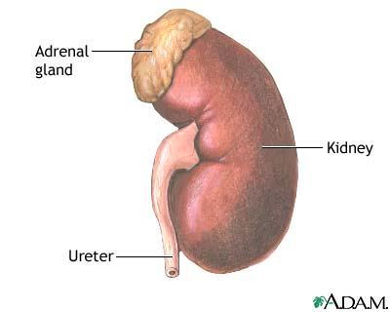
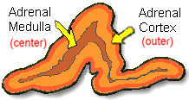
ANATOMICALLY:
The adrenal gland is situated on the anteriosuperior aspect of the kidney
HISTOLOGICALLY:
The adrenal gland consists of two distinct tissues of different embryological origin, the outer cortex and inner medulla.

Slide 4
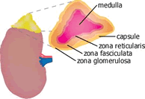
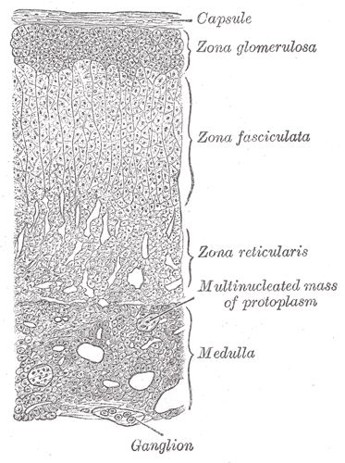
The adrenal cortex comprises three zones based on cell type and function:
Zona Glomerulosa
The outermost zone → aldosterone (the principal mineralocorticoid).
The deeper layers of the cortex:
Zona Fasciculata
→ glucocorticoids – mainly cortisol (95%)
Zona Reticularis → Sex hormones

Slide 5
Steroid Hormone Synthesis
Cholesterol (27C)
Pregnenolone (21C)
3-β-Hydroxysteroid dehydrogenase
Progesterone (21C)
17-α-Hydroxylase
17-α-Hydroxyprogesterone (21C)
21-α-Hydroxylase
11-Deoxycorticosterone (21C)
Androstenedione (19C)
11-Deoxycortisol (21C)
11- β -Hydroxylase
Testosterone (19C)
Corticosterone
Peripheral tissues
Aldosterone (21C)
Cortisol (21C)
Estradiol (18C)

Slide 6
Aldosterone Hormone
The principal physiological function of aldosterone is to conserve Na⁺, mainly by facilitating Na⁺ reabsorption and reciprocal K⁺ or H⁺ secretion in the distal renal tubule.
aldosterone is a major regulator of water and electrolyte balance, as well as blood pressure.

Slide 7
Aldosterone, by acting on the distal convoluted tubule of kidney, leads to:
↑↑ potassium excretion
↑↑ sodium and water reabsorption
Renin-Angiotensin system is the most important regulatory mechanism for aldosterone secretion

Slide 8
The renin - angiotensin system
It is the most important system controlling aldosterone secretion.
It is involved in B.P. regulation.
Renin:
a proteolytic enzyme produced by the juxtaglomerular cells of the afferent renal arteriole.
Sensitive to B.P. changes through baroreceptors
released into the circulation in response to :
a fall in circulating blood volume.
a fall in renal perfusion pressure.
loss of Na⁺.

Slide 9
Angiotensinogen
(α2-Globulin made in the liver)
Renin
Angiotensin I
ACE
Angiotensin II
↑↑ Aldosterone sec.
↓↓ Renin release
Degraded
Angiotensin III
Vasoconstriction
↑↑ B.P

Slide 10
Causes of adrenocortical hypofunction (AC)
A. Primary AC hypofunction (destruction of adrenal gland, Addison’s disease):
Autoimmune
Infection, e.g., tuberculosis
Infiltrative lesions, e.g., amylodosis
B. Secondary AC hypofunction:
Pituitary tumors
Vascular lesions
Head trauma
Hypothalmic diseases
Iatrogenic (steroid therapy, surgery or radiotherapy)

Slide 11
Signs and symptoms of primary adrenal failure (Addison’s disease)
The symptoms are precipitated by trauma, infection or surgery:
Lethargy, weakness, nausea & weight loss.
Hypotension especially on standing (postural)
Hyperpigmentation (buccal mucosa, skin creases, scars)
Deficiency of both glucocorticoids and mineralocorticoids
Hypoglycemia, ↓ Na⁺, ↑ K⁺ and raised urea
Life threatening and need urgent care.

Slide 12
Hyperpigmentation in Addison’s disease
Hyperpigmentation occurs because melanocyte-stimulating hormone (MSH) and (ACTH) share the same precursor molecule, Pro-opiomelanocortin (POMC).
The anterior pituitary POMC is cleaved into ACTH, γ-MSH, and β-lipotropin.
The subunit ACTH undergoes further cleavage to produce α-MSH, the most important MSH for skin pigmentation.
In secondary adrenocortical insufficiency, skin darkening does not occur.

Slide 13
Investigation of Addison’s disease (AD)
The patient should be hospitalized
Basal measurement of: Serum urea, Na⁺, K⁺ & glucose Serum cortisol and plasma ACTH
Definitive diagnosis and confirmatory tests should be done later after crisis.

Slide 14
Investigation of Addison’s disease (AD)
Cont’d
Normal serum cortisol and UFC does not exclude AD.
Simultaneous measurement of cortisol and ACTH improves the accuracy of diagnosis of primary adrenal failure: Low serum cortisol ( <200nmol/L) and High plasma ACTH (>200 ng/L)

Slide 15
Confirmatory Tests
1. Short tetracosactrin (Synacthen) test (Short ACTH stimulation test)
Measure basal S. cortisol
Stimulate with I.M. synthetic ACTH (0.25 mg)
Measure S. cortisol 30 min after I/M injection
Normal: ↑ of S. cortisol to >500 nmol/L
Failure of S. cortisol to respond to stimulation, confirm AD.
Abnormal results:
emotional stress
glucocorticoid therapy
estrogen contraceptives.

Slide 16
Confirmatory Tests
Cont’d
2. Adrenal antibodies
Detection of adrenal antibodies in serum of patients with autoimmune Addison’s disease
3. Imaging (Ultrasound/CT)
Ultrasound or CT for adrenal glands for
identifying the cause of primary adrenal failure

Slide 17
Investigation of Secondary AC Insufficiency
Low serum cortisol with low plasma ACTH
No response to short synacthen test: Adrenocortical cells fail to respond to short ACTH stimulation
Depot Synacthen test (confirmatory test)
Measure basal S. cortisol
Stimulate with I.M. synthetic ACTH (1.0 mg) on each of three consecutive days
Measure S. cortisol at 5 hours after I.M. injection on each of the three days

Slide 18
Investigation of Secondary AC Insufficiency Depot Synacthen test …. Cont’d
Interpretation of results:
Addison’s disease: No rise of S. cortisol >600 nmol/L at 5 h after 3rd injection.
Secondary AC: Stepwise increase in the S. cortisol after successive injections
Limitations: Hypothyroidism: Thyroid deficiency must be corrected before testing of adrenocortical functions Prolonged steroid therapy

Slide 19
Investigation of Secondary AC Insufficiency …. Cont’d Other Investigations
Insulin-induced hypoglycemia:
Adrenal failure secondary to pituitary causes
MRI for pituitary gland

Slide 20
Investigation for Addison’s disease
Screening
Basal plasma ACTH and basal serum cortisol, glucose, urea and electrolytes
High ACTH and Low cortisol
Confirmation
Short ACTH stimulation test: No response
Others
Adrenal autoantibodies
Ultrasound/CT adrenal glands

Slide 21
Investigation for Secondary AC Insufficiency
Screening
Low ACTH and Low cortisol
Confirmation
Long ACTH stimulation test: Stepwise increase in S. cortisol
Others
Insulin-induced hypoglycemia
MRI pituitary gland

Slide 22
Take home messages
Addison’s disease is due to destruction of adrenals by autoimmune, infection, or infiltrative lesions.
Adrenocortical hypofunction may occur secondary to pituitary disease, e.g., tumors, infection, trauma, or iatrogenic (surgery or radiation).
Initial screening for Addison’s disease by serum cortisol and ACTH. Other tests to support the diagnosis include serum urea, electrolytes and glucose.
Confirmatory tests for Addison’s disease by short Synacthen test.
Diagnosis of secondary adrenocortical hypofunction by depot (long) Synacthen test.

Slide 23
References
Lecture notes, Clinical Biochemistry, Wiley BlackWell, 9th edition, 2013, chapter 9, page 116-133.
Clinical Chemistry, Principles, Procedures, Correlations, Lippincott Williams & Wilkins, 7th edition, 2013, chapter 21, page 453-471.
Lippincott’s Illustrated Reviews: Biochemistry 6th edition, Unit III, Chapter 18, Pages 219-244.

