Slide 1
Glucose Homeostasis
By
Dr. Sumbul Fatma

Slide 2
Objective
Define glucose homeostasis and the metabolic processes involved
Differentiate between different phases of glucose homeostasis
Discuss the primary sources of energy and major organs utilizing glucose during the five phases of homeostasis
Understand the role of hormones in maintaining glucose homeostasis

Slide 3
Overview
Introduction
Sources of glucose
Phases of glucose homeostasis
Hormones in glucose homeostasis (actions, role in CHO metabolism) – Insulin – Glucagon – Cortisol – Growth hormone – Epinephrine

Slide 4
Glucose homeostasis
A process that
Controls glucose metabolism and
Maintains blood glucose level in the body
Glucose is a major source of body’s energy
The liver plays a key role in maintaining blood glucose level
Blood glucose level is tightly controlled because the brain constantly needs glucose
Severe hypoglycemia can cause coma and death
Chronic hyperglycemia results in glycation of proteins, endothelial dysfunction and diabetes
Notes:
‹#›

Slide 5
Sources of glucose
Dietary sources:
Dietary CHO is digested in the GI to monosaccharides
Starch provides glucose directly
Fructose and galactose are converted to glucose in the liver
Metabolic sources (via gluconeogenesis):
Glycerol, lactate, pyruvate, glucogenic amino acids
Notes:
‹#›

Slide 6
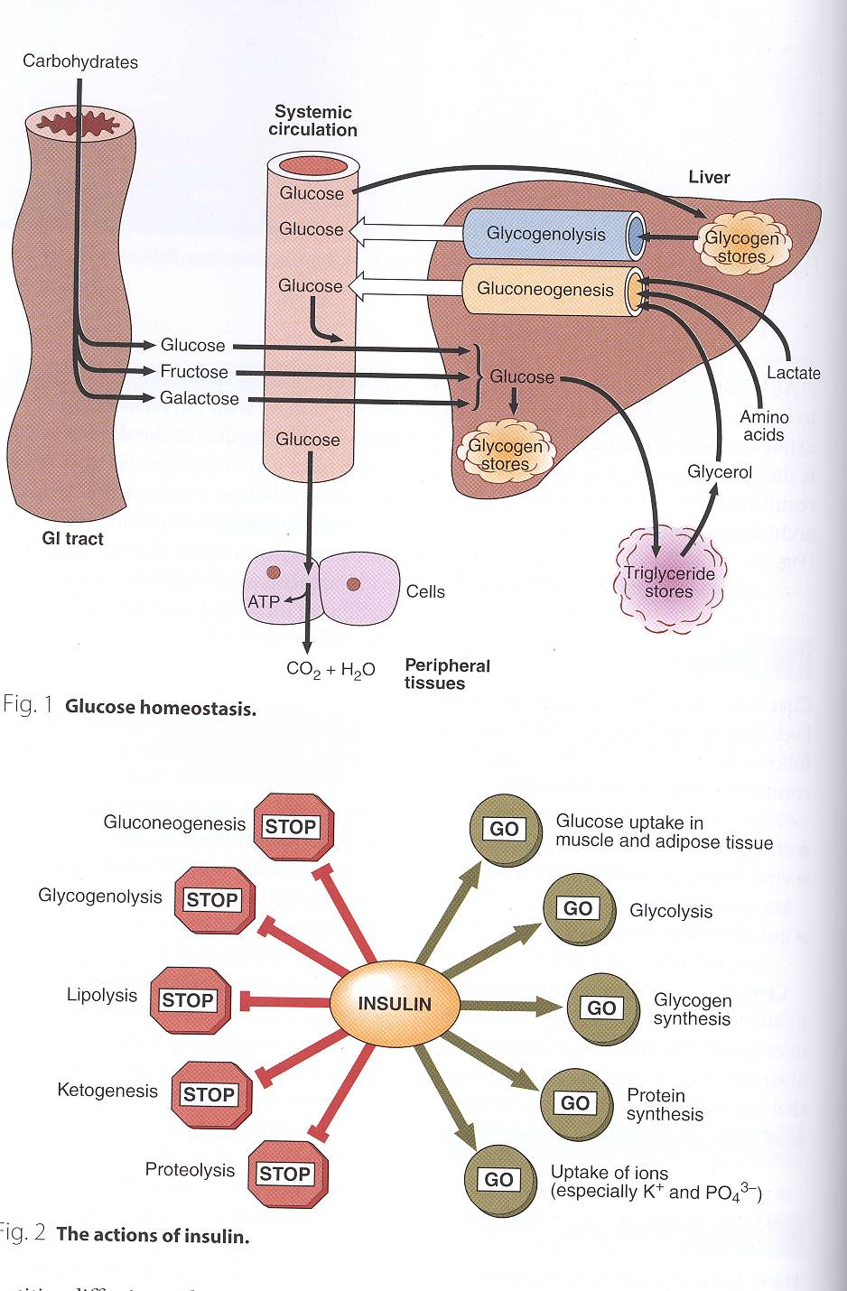
Notes:
‹#›

Slide 7
Phases of glucose homeostasis
Five phases:
Phase I (Well-fed state)
Phase II (Glycogenolysis)
Phase III (Gluconeogenesis)
Phase IV (Glucose, ketone bodies (KB) oxidation)
Phase V (Fatty acid (FA), KB oxidation)
Notes:
‹#›

Slide 10
Phase I (Well-fed state)
Glucose is mainly supplied by dietary CHOs
Liver removes about 70% of glucose load after a CHO meal
All body tissues use dietary glucose for energy in this phase
Some glucose is converted to glycogen for storage in the liver (glycogenesis)
Notes:
‹#›

Slide 11
Phase I (Well-fed state) contd..
Excess glucose is converted to fatty acids and triglycerides in the liver
These are transported via VLDL (very low density lipoproteins) to adipose tissue for storage
Gluconeogenesis is inhibited in this phase
Cori and glucose-alanine cycles are inhibited
Notes:
‹#›

Slide 12
Phase II (Glycogenolysis)
Phase II starts during early fasting when dietary glucose supply is exhausted
Hepatic glycogenolysis maintains blood glucose level in this phase
Glycogenolysis is the major source of blood glucose in this phase
Notes:
‹#›

Slide 13
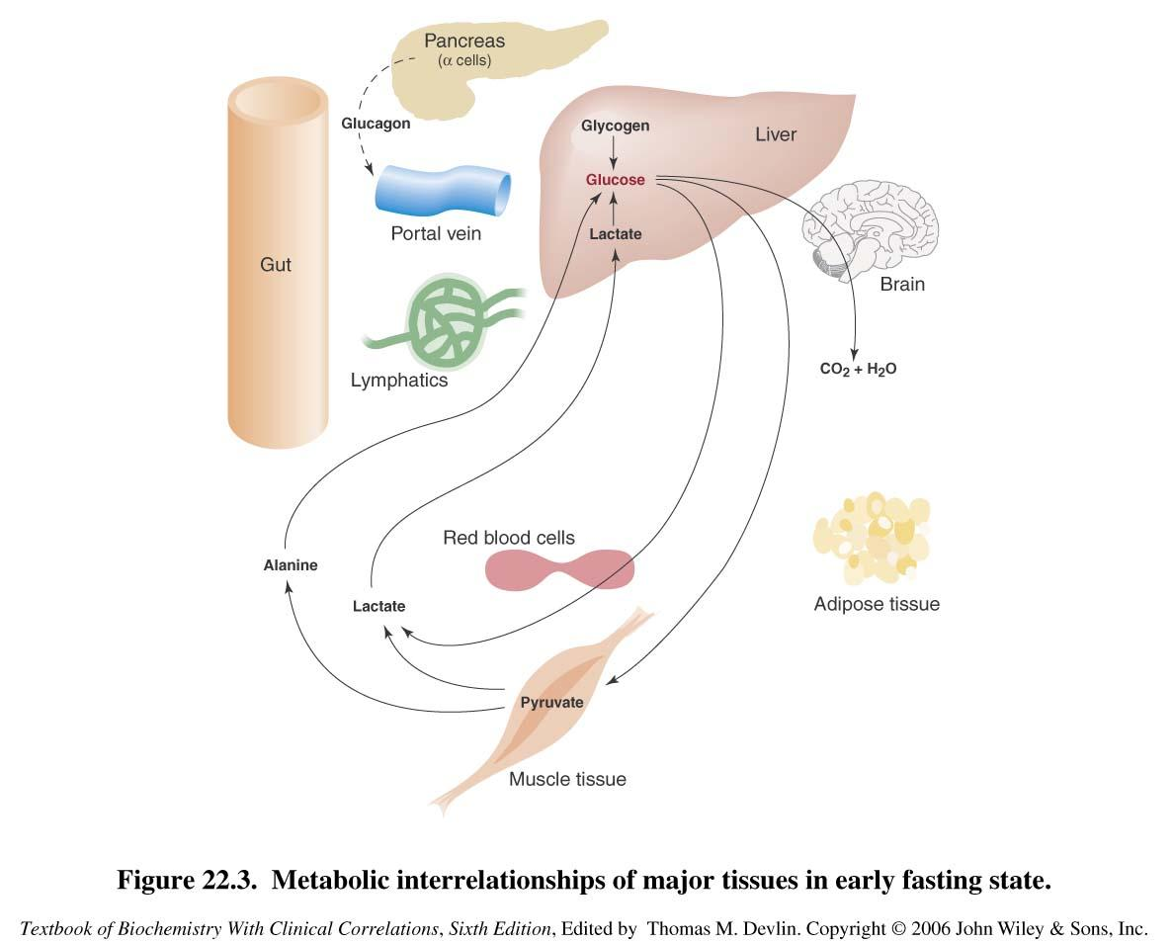

Slide 14
Phase III (Gluconeogenesis)
Phase III starts when glycogen stores in liver are exhausted (within 20 hours)
Duration of phase III depends on
Feeding status
Hepatic glycogen stores
Physical activity
Hepatic gluconeogenesis from lactate, pyruvate, glycerol and alanine maintains blood glucose level
Gluconeogenesis is the major source of blood glucose in this phase
Notes:
‹#›

Slide 15
Phase IV (Glucose and KB oxidation)
Several days of fasting leads to phase IV
Gluconeogenesis starts to decrease
KB accumulation increases which enter the brain for energy production
Brain uses both glucose and KB for energy
Notes:
‹#›

Slide 16
Phase V (FA and KB oxidation)
Prolonged fasting leads to phase V
Less dependence on gluconeogenesis
All body tissues use FA and KB oxidation for energy production
Gluconeogenesis somewhat maintains blood glucose level in this phase
Notes:
‹#›

Slide 17
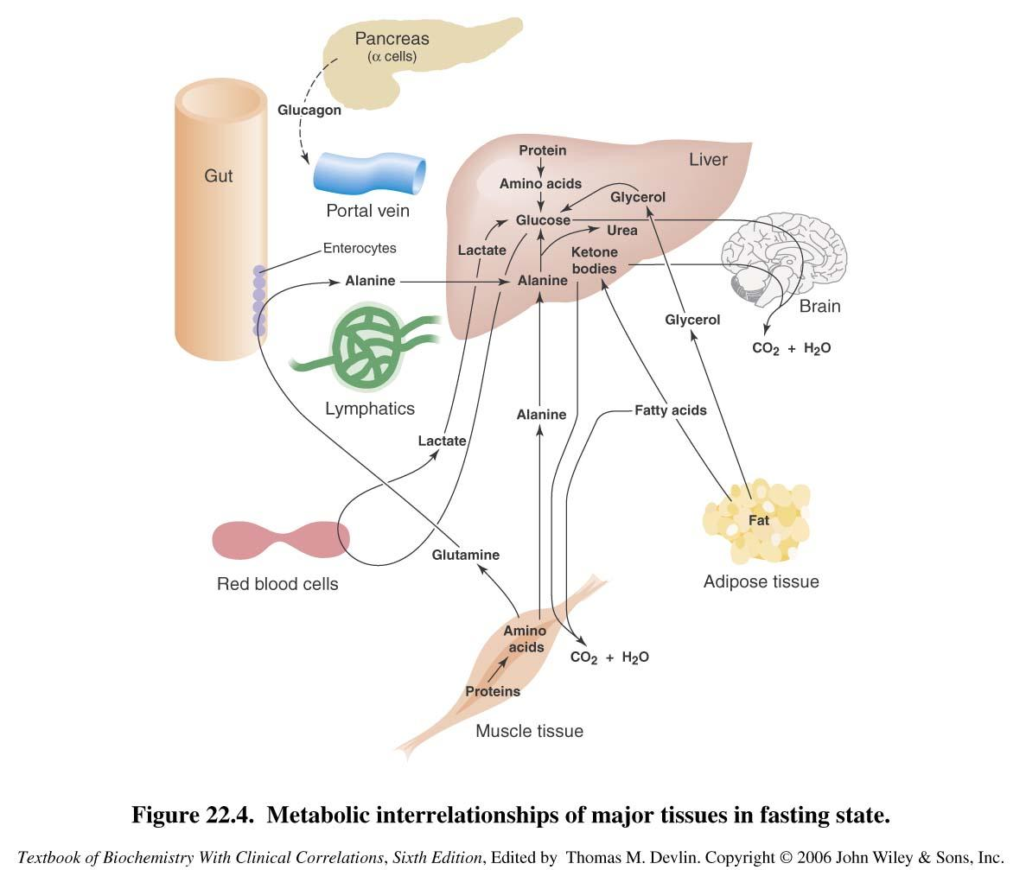

Slide 18
Phase V (FA and KB oxidation
High KB conc. and glucose levels inhibit proteolysis in muscle (conservation of muscle)
When all fat and KBs are used up
Body uses muscle protein to maintain blood glucose level
Notes:
‹#›

Slide 19
Hormones and glucose homeostasis
Hormones that regulate glucose metabolism:
Insulin (lowers blood glucose level)
Glucagon
Cortisol
Growth hormone
Adrenaline
Antagonize insulin action
Notes:
‹#›

Slide 20
Insulin
Plays a major role in glucose homeostasis
Synthesized by the β-cells of islets of Langerhans of pancreas
A small protein composed of two chains
Formed as prepro-insulin and converted to pro-insulin upon secretion
Rise in blood glucose level stimulates insulin secretion
Promotes entry of glucose into cells
Notes:
‹#›

Slide 21
Insulin actions
Notes:
‹#›

Slide 22
Mechanism of action
The insulin receptor is present on the plasma membrane of cell
Composed of
2α-subunit (extracellular)
2β-subunit (cytoplasmic)
Binding of insulin to α-subunit causes phosphorylation of β-subunit
This activates the receptor
The activated receptor then phosphorylates intracellular proteins generating a biological response
Notes:
‹#›

Slide 23
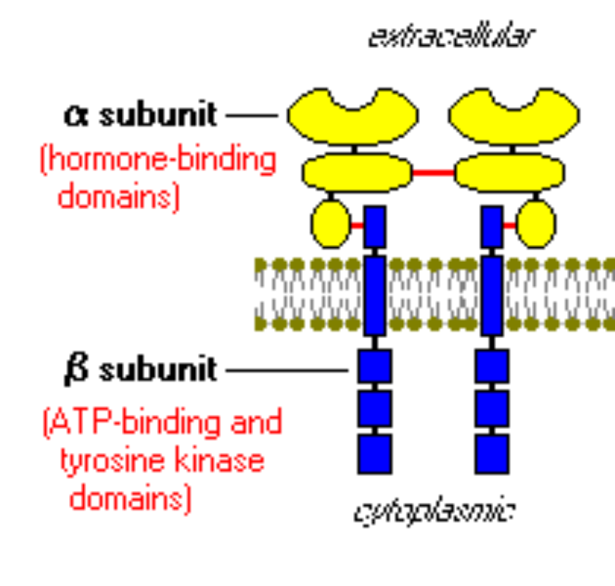

Slide 24
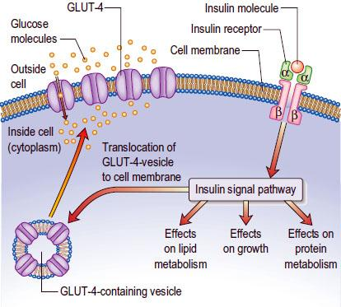

Slide 25
Insulin and CHO metabolism
Promotes glucose uptake into cell:
Glucose is diffused into cells through hexose transporters such as GLUT4
GLUT4 is present in cytoplasmic vesicles
Insulin binding to its receptor causes vesicles to diffuse into plasma membrane
GLUT4 is inserted into the membrane
Allowing glucose transport into the cell
Brain and liver have non-insulin dependent glucose transporter
Notes:
‹#›

Slide 26
Insulin and CHO metabolism
Stimulates glycogen synthesis
Decreases blood glucose levels
Increases glycolysis
Stimulates protein synthesis
Insulin deficiency causes diabetes mellitus
Hyperinsulinemia is due to insulin resistance in:
Diabetes mellitus or
Metabolic syndrome
Notes:
‹#›

Slide 27
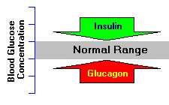
Glucagon
A peptide hormone secreted by α-cells of pancreatic islets
Secreted in response to hypoglycemia
Increases glucose levels
Stimulates glycogenolysis
Activates hepatic gluconeogenesis
Notes:
‹#›

Slide 28
Glucocorticoids (Cortisol)
Cortisol is a steroid hormone secreted by adrenal gland
Contributes to glucose homeostasis
Maintains normal glucose levels in fasting
Stimulates gluconeogenesis in the liver
Mobilizes amino acids for gluconeogenesis
Inhibits glucose uptake by cells
Stimulates fat breakdown in adipose tissue
Notes:
‹#›

Slide 29
Growth hormone
A protein hormone secreted by anterior pituitary gland
Maintains blood glucose levels by:
Inhibiting insulin action
Stimulating gluconeogenesis in the liver
Notes:
‹#›

Slide 30
Epinephrine
A catecholamine hormone secreted by adrenal gland
Stimulates lipolysis in adipose tissue when glucose blood levels fall
Promotes glycogenolysis in skeletal muscle
Notes:
‹#›

Slide 31
References
Textbook of biochemistry with clinical correlation by Devlin
http://www.vivo.colostate.edu/hbooks/pathphys/endocrine/pancreas/insulin_phys.html

