Slide 1
Epidemiology of Diabetes Mellitus
Dr Ambreen Kamran
Assistant Professor
Princess Nora Research Chair for Women Health
Dept. of Family & Community Medicine
College of Medicine, KSU

Slide 2
Objectives
To list the types of Diabetes Mellitus
To describe the prevalence of Diabetes Mellitus
To recognize the importance of diagnostic criteria for estimating the prevalence of diabetes mellitus
To discuss the risk factors and complications of type II diabetes mellitus

Slide 3
Definition
A metabolic disorder of multiple aetiology characterized by chronic hyperglycaemia with disturbances of carbohydrate, fat and protein metabolism resulting from defects in insulin secretion, insulin action or both

Slide 4
Types of diabetes
Type 1: sudden onset absolute deficiency in insulin. Usually affects younger age group (not always)
Type 2: gradual onset of relative insulin insensitivity. Usually older age group (not always)
Gestational diabetes: Gestational diabetes mellitus (GDM) is defined as any degree of glucose intolerance with onset or first recognition during pregnancy

Slide 5
Types of diabetes
Secondary diabetes: The diabetes is not the main illness, a secondary condition that results because of the main illness. If it is possible to treat the main illness successfully the diabetes may/will disappear e.g. cystic fibrosis, chronic pancreatitis, infections.
Pre-diabetes: Impaired glucose tolerance A person with pre-diabetes has a blood sugar level higher than normal, but not high enough for a diagnosis of diabetes; & is at higher risk for developing type 2 diabetes. May remain undiagnosed for years; risk of complications same as for T2DM

Slide 6
Global Prevalence of Diabetes
2.8% in 2000;4.4% in 2030 worldwide (171 million in 2000; 366 million by 2030)
DM worldwide was already 366 million in 2011
The prevalence increased to 382 millions (8.2%) by 2013 and current figures are >415 million
There is a large percentage of undiagnosed cases and a large percentage at high risk of developing DM
A huge percentage of the reported diabetics are in the 40-59 age group, among whom 80% live in countries with low and middle-income economies

Slide 7
Global Prevalence of Diabetes
In 2013, about half of all diabetes-related deaths in adults were in the age group below 60 years.
Every six seconds there is a diabetes-related death and more so in the poorly-developed regions
35 out of 219 countries (16%) show very high prevalence of diabetes, more than 12%
These countries fall mainly in the regions of the Middle-East, North Africa, South Asia and Western Pacific

Slide 8
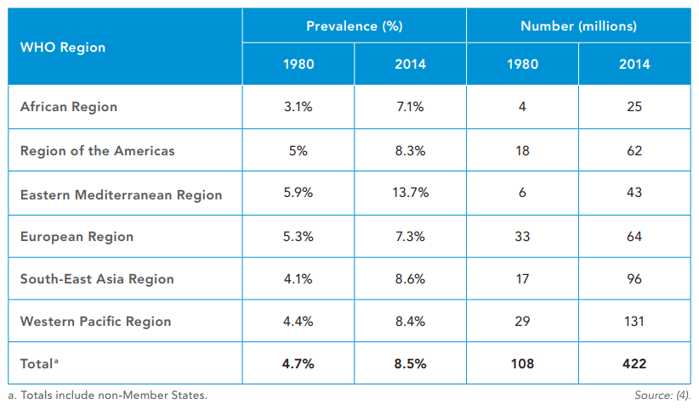
Estimated prevalence and number of people with diabetes (18+ years)
Source, WHO 2016

Slide 9
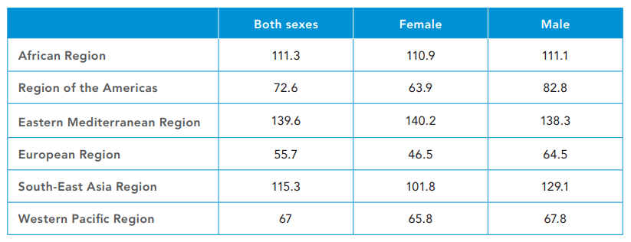
High blood glucose age-standardized mortality rates per 100000 by WHO region, age 20+, 2012
Source, WHO 2016

Slide 10
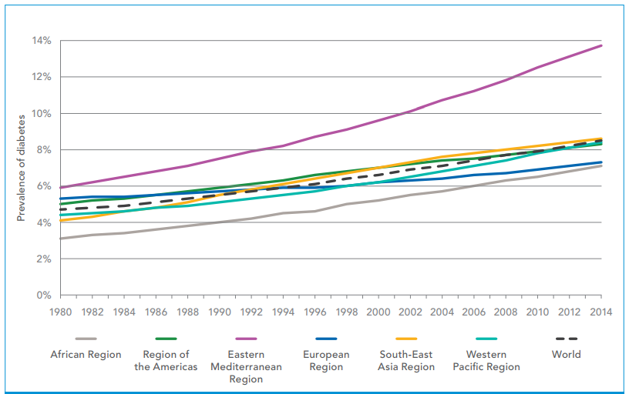
Trends in prevalence of diabetes, 1980–2014, by WHO region
Source, WHO 2016

Slide 11
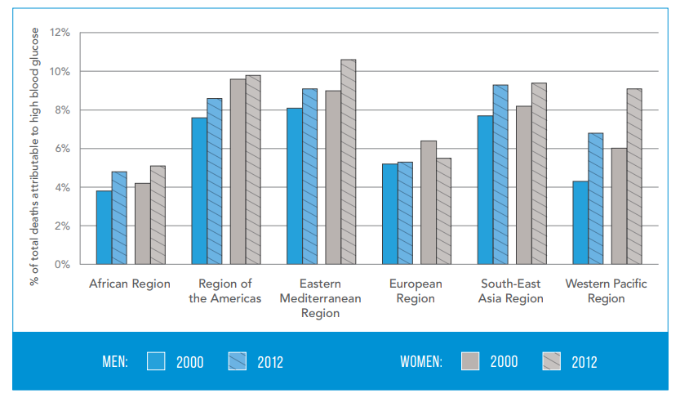
Percentage of all deaths attributable to high blood glucose for adults aged 20–69 years, by WHO region and sex, 2000 and 2012
Source, WHO 2016

Slide 12
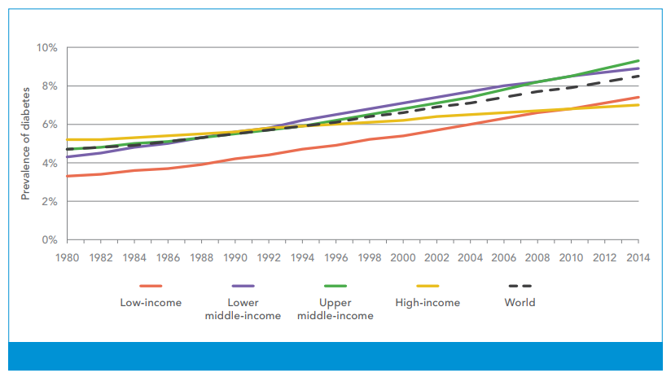
Trends in prevalence of diabetes, 1980–2014, by country income group
Source, WHO 2016

Slide 13
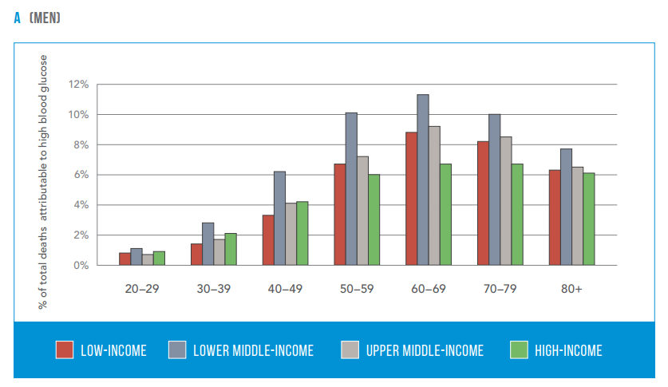
Percentage of all-cause deaths globally attributed to high blood glucose in men, 2012
Source, WHO 2016

Slide 14
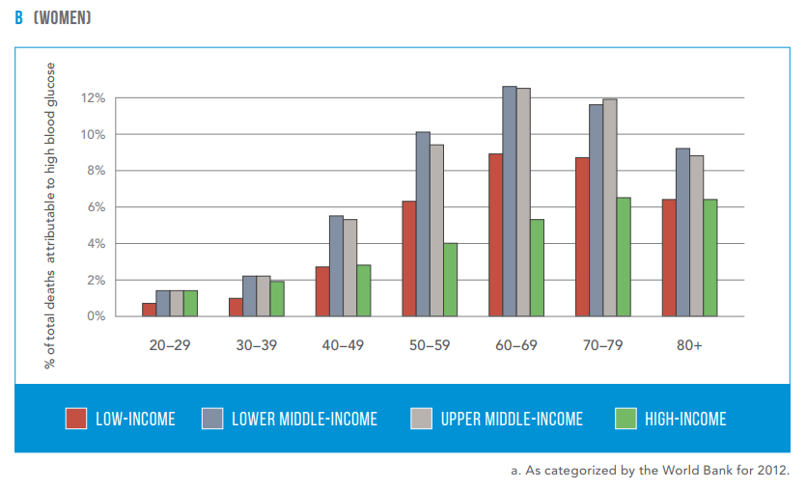
Percentage of all-cause deaths globally attributed to high blood glucose in women, 2012
Source, WHO 2016

Slide 15
Regional and Local prevalence
There are 20 Arab countries in which nearly 20.5 million people are living with diabetes and another 13.7 million are in the pre-diabetes stage, with Impaired Glucose Tolerance (IGT)
Six of the top ten countries having the highest prevalence rates of diabetes globally are found in the Gulf region, namely:
Kuwait, Lebanon, Qatar, Bahrain, UAE and Saudi Arabia
Bahrain 15.4%; Kuwait 14.6%; UAE 18.7%; Qatar 15.4%

Slide 16
Diabetes Mellitus and KSA
WHO ranks SA 2nd in the prevalence of diabetes in the Middle East region & 7th in the world: considered an epidemic
A more recent study reported that the prevalence of diabetes had risen to 34.1% in males and 27.6% in females.
The mean reported age for diabetes onset in males and females is 57.5 and 53.4 years
The number of deaths attributed to diabetes in Saudi Arabia is about 170,000 adults, which is greater than 10% of all deaths in the country

Slide 17
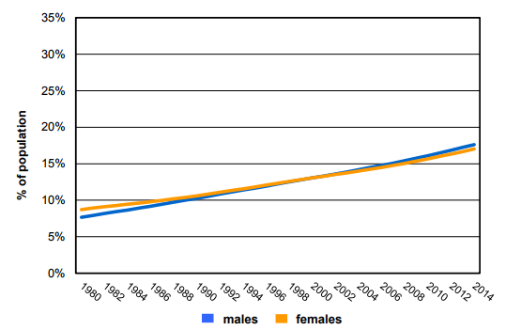
Trends in age-standardized prevalence of diabetes in Saudi Arabia
WHO Diabetes country profiles, 2016.

Slide 18
Diabetes Mellitus and KSA
Saudi Arabia reported that 40.3% of diabetic patients are unaware of their having the disease
Increasing age is a risk factor, recent studies showing different trend
The incidence of T1DM is also on the increase over the last 30 years , with prevalence among the Saudi children and adolescents at 109.5 per 100,000
Healthcare expenditures incurred by people with diabetes are increasing
In 2010 on average, people diagnosed with diabetes spent ten times more towards medical healthcare expenditure

Slide 19
Diabetes Mellitus and KSA
Prevalence of DM in the central region (Riyadh), was 23.7% (age group 30-70 years), while another 14.1% had IFG
The incidence of diabetes was significantly higher in the urban regions (25.5 vs 19.5 in the rural areas)
The Northern (27.9%) and Eastern (26.4%) provinces showing greater rates of the prevalence of DM than the Southern region (18.2%), which supports a more rural lifestyle and a population with less tendency for obesity than those of the Northern and Eastern provinces

Slide 20
Diagnosis (Sign & Symptoms)
Thirst
Passing lots of urine
Fatigue
Infections (thrush)
Weight loss
Diagnosis:
Random plasma glucose
Fasting plasma glucose
Oral glucose tolerance test – 2h glucose

Slide 21
Diagnosis
The International committee on DM, recognized an intermediate group of subjects whose glucose levels, although not meeting criteria for diabetes, are nevertheless too high to be considered normal.
The categories of FPG values are as follows:
FPG <100 mg/dl (5.6 mmol/l) = normal fasting glucose;
FPG 100–125 mg/dl (5.6–6.9 mmol/l) = IFG (impaired fasting glucose);
FPG ≥126 mg/dl (7.0 mmol/l) = provisional diagnosis of diabetes (the diagnosis must be confirmed)

Slide 22
Diagnosis
The corresponding categories when the OGTT is used are the following:
2-h postload glucose <140 mg/dl (7.8 mmol/l) = normal glucose tolerance;
2-h postload glucose 140–199 mg/dl (7.8–11.1 mmol/l) = IGT (impaired glucose tolerance);
2-h postload glucose ≥200 mg/dl (11.1 mmol/l) = provisional diagnosis of diabetes (the diagnosis must be confirmed)

Slide 23
Diagnosis
.
1. Symptoms of diabetes plus casual plasma glucose concentration ≥200 mg/dl (11.1 mmol/l). Casual is defined as any time of day without regard to time since last meal. The classic symptoms of diabetes include polyuria, polydipsia, and unexplained weight loss. OR
2. FPG ≥126 mg/dl (7.0 mmol/l). Fasting is defined as no caloric intake for at least 8 h. OR
3. 2-h postload glucose ≥200 mg/dl (11.1 mmol/l) during an OGTT. The test should be performed as described by WHO, using a glucose load containing the equivalent of 75 gms glucose dissolved in water.
Ref: Diagnosis and Classification of Diabetes Mellitus American Diabetes Association Diabetes Care 2006 Jan; 29(suppl 1): s43-s48

Slide 24
Glycosylated Hemoglobin A1c
In July 2009, the International Expert Committee recommended the use of the A1C test in the diagnosis of diabetes, with a threshold of 6.5%
Internationally as marker to track the blood sugar control
Limitations
HbA1c may be increased falsely in certain medical conditions: kidney failure, chronic excessive alcohol intake, and hypertriglyceridemia. Medical conditions that may falsely decrease HbA1c include acute or chronic blood loss, sickle cell disease or thalassemia,
Gestational diabetes may falsely increase or decrease HbA1c.

Slide 25
Why is diabetes so important?
Complications
Cardiovascular
Eyes
Renal - Hypertension, renal failure
Feet and Skin infections,
sexual, psycho-sexual, depression
Quality of life
Premature mortality
Social Factors
The burden to patients and the family and to the health system

Slide 26
Complications
Diabetes accounts for more than 5% of the global deaths, which are mostly due to CVD
Study in one province of SA, found >70% patients having ≥ 1 complication
Diabetes is responsible for over one third of end-stage renal disease requiring dialysis (23% to 29%)
Amputations are at least 10 times more common in people with diabetes (61% PAD, 31% neuropathy)
A leading cause of blindness & visual impairment
Diabetics are 20 times more likely to develop blindness than non-diabetics

Slide 27
Complications
High risk for Diabetes nephropathy: Diabetes duration, retinopathy, neuropathy, hypertension, age >45 years, hyperlipidemia, male gender, smoking, and poor glycemic control
Number of diabetic patients seeking renal replacement therapy increased from 4% in the early 1980s to 14.8% in the mid-1990s, even higher to 40% in the late 1990s.
Most of the deaths [60%] in dialysis patients are of those with DM
Nearly 37–41% of diabetic patients in Saudi Arabia develop a stroke while 61% of them develop peripheral artery disease
It is recommended that every Saudi above 30 years of age should undergo screening for both T2DM and T1DM and pre-diabetes

Slide 28
Risk factors
Risk factors for Type 2 DM are complex modifiable and non-modifiable risk factors
- Age, Gender, SES, obesity
- Genetics
Life style factors (overfeeding and sedentary life)
There are patho-physiological changes (weight gain insulin resistance and reduction of insulin secretion) may lead to glucose intolerance and diabetes
Important factors are physical inactivity, dietary imbalance and infections

Slide 29
Risk factors
Autoimmune disease and viral infections may be risk factors for TIDM
Physiologic or emotional stress: causes prolonged elevation of stress hormone levels (cortisol, epinephrine, glucagon and growth hormone), which raises blood glucose levels
Pregnancy as predisposing factor causes weight gain and increases levels of estrogen and placental hormones, which antagonize insulin
Medications that are known to antagonize the effects of insulin: thiazide diuretics, adrenal corticosteroids, oral contraceptives

Slide 30
Future Directions
Tackling environmental factors and lifestyle
Appropriate use of screening tools to control diabetes mellitus
Early interventions in high risk populations
Therapeutic and management choices and updated criteria for treatment
Rehabilitation services for complications

Slide 31
Future Directions
The Saudi National Diabetes Registry (SNDR) was recently established with the primary goal of developing a database including all the diagnosed national diabetic patients
The objective of the SNDR is to act as an electronic medical file to provide the medical teams correct clinical, investigational, and management data.
It is a surveillance-monitoring tool for clinical and epidemiology practitioners by identifying the significant performance indicators linked to this disease in either acute or chronic cases.
The SNDR also provides data relating to the association of diabetes with hypertension, hyperlipidemia, and obesity

Slide 32
References
1. Al Dawish MA, Robert AA, Braham R, Al Hayek AA, Al Saeed A, Ahmed RA, Al Sabaan FS. Diabetes Mellitus in Saudi Arabia: A Review of the Recent Literature. Curr Diabetes Rev. 2016;12(4):359-368. Review.
2. Asirvatham Alwin Robert , Abdulrahman Al-Dawish, Muhammad Mujammami,and Mohamed Abdulaziz Al Dawish. Type 1 Diabetes Mellitus in Saudi Arabia: A Soaring Epidemic. International Journal of Pediatrics Volume 2018, Article ID 9408370, 9 pages https://doi.org/10.1155/2018/9408370
3. Zahid Naeem. Burden of Diabetes Mellitus in Saudi Arabia. International Journal of Health Sciences, Qassim University, Vol. 9, No. 3 (July-Sept 2015)

