Slide 1
Pathology of Thyroid Gland
Hypo, Hyperthyroidism and Hashimoto’s Thyroiditis
Dr.Amany Fathaddin, MD

Slide 2
Objectives
To know the ways in which thyroid disorders present.
To understand the major causes and clinical manifestations of hypo, hyperthyroidism and thyroiditis .
To recognize the pathophysiology, gross and microscopic morphology and clinical manifestations of Graves disease and Hashimoto thyroiditis.
To Know the causes of the thyroid goiter and its pathology.

Slide 3
Thyroid anatomy
The thyroid gland consists of two bulky lateral lobes connected by a relatively thin isthmus, usually located below and anterior to the larynx.
The thyroid gland develops embryologically from an envagination of the developing pharyngeal epithelium that descends from the foramen cecum at the base of the tongue to its normal position in the anterior neck

Slide 4
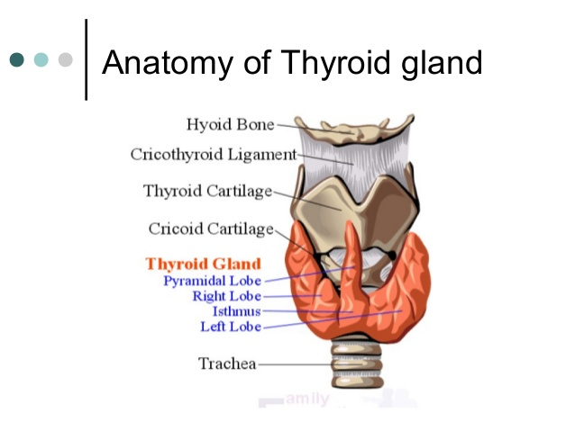
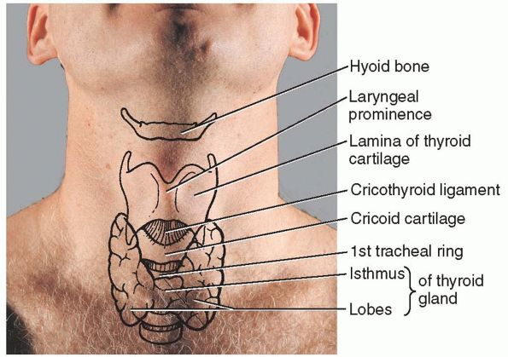

Slide 5
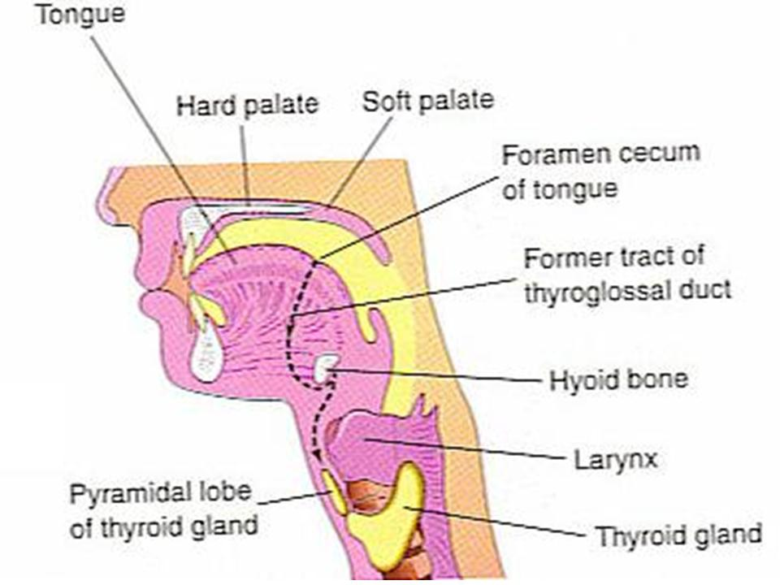
Ectopic thyroid tissue

Slide 6
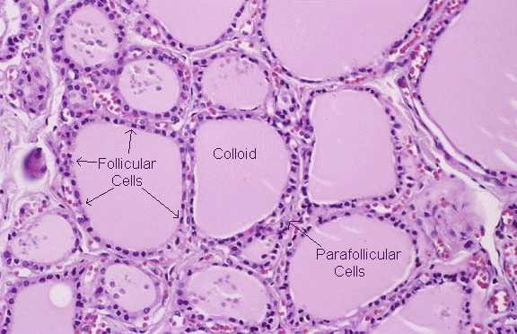
Histology

Slide 7
Thyroid Diseases
Clinical recognition of diseases of the thyroid is important, because most are amenable to medical or surgical management.
Diseases include:
Excessive release of thyroid hormones (hyperthyroidism).
Thyroid hormone deficiency (hypothyroidism).
Mass lesions .

Slide 8
Hyperthyroidism
Thyrotoxicosis is a hypermetabolic state due to elevated circulating levels of free T₃ and T₄.
Because it is caused most commonly by hyperfunction of the thyroid gland, thyrotoxicosis often is referred to as hyperthyroidism.
In certain conditions, however, the oversupply either is related to excessive release of pre-formed thyroid hormone (e.g., in thyroiditis) or comes from an extrathyroidal source, rather than a hyperfunctioning gland

Slide 9
Hyperthyroidism
The three most common causes of thyrotoxicosis:
Primary:
• Diffuse hyperplasia of the thyroid associated with Graves disease (accounts for 85% of cases)
• Hyperfunctional (toxic) multinodular goiter
• Hyperfunctional ( toxic )adenoma of the thyroid

Slide 10
Causes of Thyrotoxicosis
ASSOCIATED WITH HYPERTHYROIDISM
Primary
Diffuse toxic hyperplasia (Graves disease)
Hyperfunctioning (“toxic”) multinodular goiter
Hyperfunctioning (“toxic”) adenoma
Iodine-induced hyperthyroidism
Neonatal thyrotoxicosis associated with maternal Graves disease
Secondary
TSH-secreting pituitary adenoma (rare)[*]
NOT ASSOCIATED WITH HYPERTHYROIDISM
Granulomatous (de Quervain) thyroiditis (painful)
Subacute lymphocytic thyroiditis (painless)
Struma ovarii (ovarian teratoma with ectopic thyroid)
Factitious thyrotoxicosis (exogenous thyroxine intake)

Slide 11
Clinical manifestation of thyrotoxicosis:
Hypermetabolic state induced by excessive amounts of thyroid hormone ,over activity of the sympathetic nervous system:
Constitutional symptoms
Gastrointestinal
Cardiac
Neuromuscular
Ocular
Thyroid storm (medical emergency)
Apathetic hyperthyroidism

Slide 12
Diagnosis of hyperthyroidism:
The diagnosis of hyperthyroidism is based on clinical features and laboratory data.
The measurement of serum TSH is the most useful single screening test for hyperthyroidism
Free thyroid hormone assays
Measurement of radioactive iodine uptake by the thyroid gland

Slide 13
Hypothyroidism
Hypothyroidism is caused by any structural or functional derangement that interferes with the production of adequate levels of thyroid hormone
Worldwide, the most common cause of hypothyroidism is dietary deficiency of iodine , while in most developed nations, autoimmune causes predominate

Slide 14
Causes of hypothyroidism

Slide 15
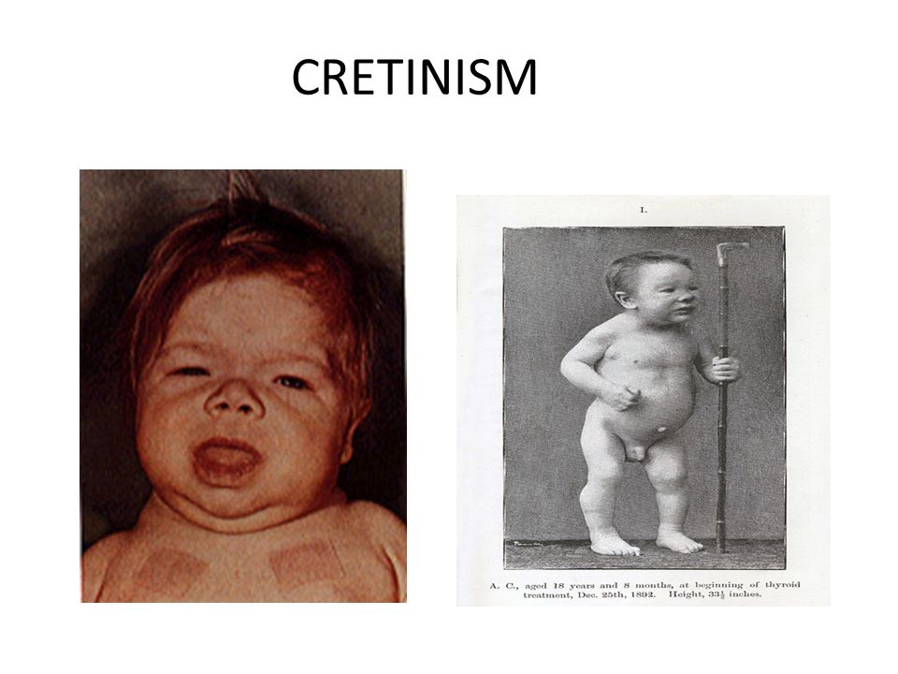
Clinical manifestations of hypothyroidism
Cretinism refers to hypothyroidism developing in infancy or early childhood: Endemic cretinism, sporadic cretinism
Clinical features of cretinism include impaired development of the skeletal system and central nervous system, with severe mental retardation, short stature, coarse facial features, a protruding tongue, and umbilical hernia.

Slide 16
Clinical manifestations of hypothyroidism
Hypothyroidism developing in older children and adults results in a condition known as myxedema
Manifestations of myxedema include
generalized apathy and mental sluggishness that in the early stages of disease may mimic depression.
Cold intolerance, obesity. The skin is cold and plae
Shortness of breath.
Broadening and coarsening of facial features ( matrix substance)
enlargement of the tongue, and deepening of the voice.
Constipation. Pericardial effusions are common
In later stages, the heart is enlarged, and heart failure may supervene.

Slide 17
Laboratory evaluation
Measurement of serum TSH is the most sensitive screening test for this disorder
The serum TSH is increased in primary hypothyroidism
Serum T₄ is decreased in patients with hypothyroidism of any origin.

Slide 18
Thyroiditis
Clinically significant types of thyroiditis:
(1)Hashimoto thyroiditis (chronic lymphocytic thyroiditis)
(2) Subacute granulomatous (de Quervain) thyroiditis
(3) Subacute lymphocytic thyroiditis.

Slide 19
Chronic Lymphocytic (Hashimoto) Thyroiditis
Hashimoto thyroiditis is the most common cause of hypothyroidism in areas of the world where iodine levels are sufficient.
It is characterized by gradual thyroid failure secondary to autoimmune destruction of the thyroid gland.
It is most prevalent between the ages of 45 and 65 years and is more common in women than in men, with female predominance in a ratio of 10:1 to 20:1.

Slide 20
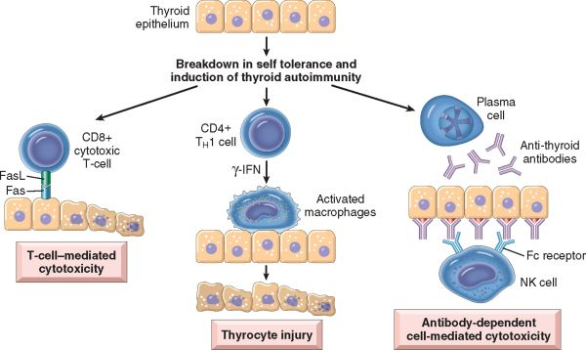
Hashimoto Thyroiditis Pathogenesis
Hashimoto thyroiditis is caused by a breakdown in self-tolerance to thyroid autoantigens. Thus, circulating autoantibodies against thyroid antigens are present in the vast majority of patients

Slide 21
Chronic Lymphocytic (Hashimoto) Thyroiditis
A significant genetic component.
Increased susceptibility to Hashimoto thyroiditis is associated with polymorphisms in multiple immune regulation–associated genes, the most significant of which is the linkage to cytotoxic T lymphocyte–associated antigen-4gene (CTLA4)

Slide 22
Hashimoto Thyroiditis: clinical features
Painless enlargement of the thyroid, usually associated with some degree of hypothyroidism
It may be preceded by transient thyrotoxicosis caused by disruption of thyroid follicles, with secondary release of thyroid hormones (hashitoxicosis).
As hypothyroidism supervenes, T₄ and T₃ levels progressively fall, accompanied by a compensatory increase in TSH.
Patients with Hashimoto thyroiditis often have other autoimmune diseases and are at increased risk for the development of B cell non-Hodgkin lymphomas

Slide 23
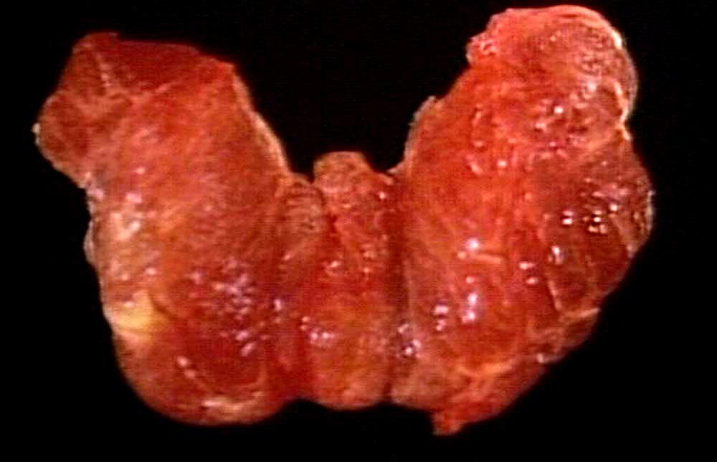
Hashimoto Thyroiditis Morphology
Diffuse and symmetrical enlargement
The cut surface is pale and gray-tan
in appearance, and the tissue is firm
and somewhat friable.

Slide 24
Hashimoto Thyroiditis :Morphology
1)infiltration of the parenchyma by a mononuclear inflammatory infiltrate containing small lymphocytes, plasma cells, and well-developed germinal centers.
2) The thyroid follicles are atrophic and are lined in many areas by epithelial cells distinguished by the presence of abundant eosinophilic, granular cytoplasm, termed Hürthle, or oxyphil, cells.
3) Interstitial connective tissue is increased and may be abundant. Less commonly, the thyroid is small and atrophic as a result of more extensive fibrosis (fibrosing variant)
Unlike in Reidel thyroiditis, the fibrosis does not extend beyond the capsule of the gland.

Slide 25
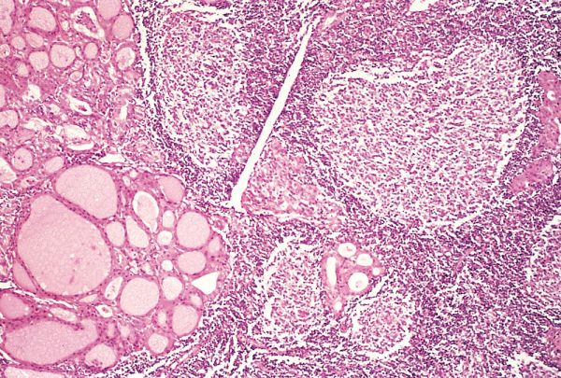
Hashimoto Thyroiditis Morphology

Slide 26
Subacute Granulomatous (de Quervain) Thyroiditis
De Quervain thyroiditis is most common between 30 and 50 years of age and, like other forms of thyroiditis, occurs more frequently in women than in men.
Subacute thyroiditis is believed to be caused by a viral infection or an inflammatory process triggered by viral infections.
A majority of patients have a history of an upper respiratory infection just before the onset of thyroiditis.
The onset of this form of thyroiditis often is acute, characterized by pain in the neck (particularly with swallowing), fever, malaise, and variable enlargement of the thyroid.

Slide 27
Subacute Granulomatous (de Quervain) Thyroiditis
Transient hyperthyroidism may occur, as in other cases of thyroiditis, as a result of disruption of thyroid follicles .
The leukocyte count and erythrocyte sedimentation rates are increased.
With progression of disease and gland destruction, a transient hypothyroid phase may ensue.
The condition typically is self-limited, with most patients returning to a euthyroid state within 6 to 8 weeks.

Slide 28
Subacute Granulomatous (de Quervain) Thyroiditis: Morphology
The gland is firm, with an intact capsule, and may be unilaterally or bilaterally enlarged.
Histologic examination reveals disruption of thyroid follicles, with extravasation of colloid leading to a polymorphonuclear infiltrate, which is replaced over time by lymphocytes, plasma cells, and macrophages.
The extravasated colloid provokes an exuberant granulomatous reaction with giant cells.
Healing occurs by resolution of inflammation and fibrosis

Slide 29
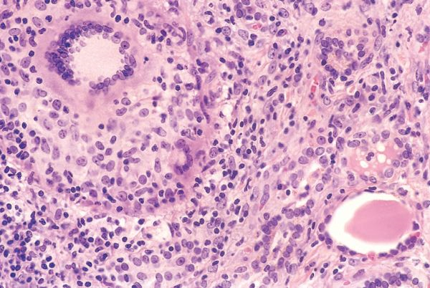
Subacute Granulomatous (de Quervain) Thyroiditis: Morphology

Slide 30
Subacute Lymphocytic Thyroiditis
In a subset of patients the onset of disease follows pregnancy (postpartum thyroiditis). This disease is most likely to be autoimmune in etiology.
Painless neck mass or features of thyroid hormone excess.
The histologic features consist of lymphocytic infiltration and hyperplastic germinal centers within the thyroid parenchyma.

Slide 31
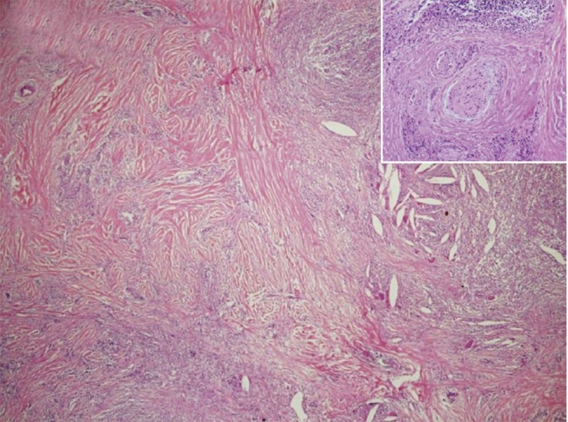
Riedel thyroiditis
Riedel thyroiditis, a rare disorder that is a manifestation of IgG4-related disease
Characterized by extensive fibrosis involving the thyroid and contiguous neck structures.
Clinical evaluation demonstrates a hard and fixed thyroid mass, simulating a thyroid neoplasm.
It may be associated with idiopathic fibrosis in other sites in
the body, such as the retroperitoneum.

Slide 32
Graves disease
Graves disease is the most common cause of endogenous hyperthyroidism. It is characterized by a triad of manifestations:
1-Thyrotoxicosis, caused by a diffusely enlarged, hyperfunctional thyroid, is present in all cases.
2-An infiltrative ophthalmopathy with resultant exophthalmos is noted in as many as 40% of patients.
3-A localized, infiltrative dermopathy (sometimes designated pretibial myxedema) is seen in a minority of cases.

Slide 33
Graves disease
Graves disease has a peak incidence between the ages of 20 and 40, with women being affected up to seven times more commonly than men.
Genetic factors are important in the causation of Graves disease
Graves disease is associated with the presence of certain human leukocyte antigen (HLA) haplotypes, specifically HLA-DR3, and polymorphisms in genes whose products regulate T-cell responses, including the inhibitory T-cell receptor CTLA-4 .

Slide 34
Graves disease: Pathogenesis
Graves disease is characterized by a breakdown in self-tolerance to thyroid autoantigens, of which the most important is the TSH receptor. The result is the production of multiple autoantibodies, including:
Thyroid-stimulating immunoglobulin: An IgG antibody that binds to the TSH receptor and mimics the action of TSH, relatively specific for Graves disease.
Thyroid growth-stimulating immunoglobulins: Also directed against the TSH receptor.
TSH-binding inhibitor immunoglobulins: These anti-TSH receptor antibodies prevent TSH from binding to its receptor on thyroid epithelial cells and in so doing may actually inhibit thyroid cell function.
The coexistence of stimulating and inhibiting immunoglobulins in the serum of the same patient is not unusual—a finding that may explain why some patients with Graves disease spontaneously develop episodes of hypothyroidism.

Slide 35
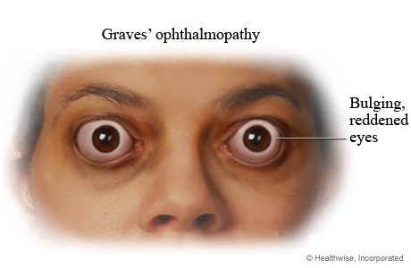
In Graves ophthalmopathy, a result of several causes
(1) marked infiltration of the retroorbital space by mononuclear cells ( mainly T cells)
(2) inflammatory edema and swelling of extraocular muscles
(3) accumulation of extracellular matrix components (glycosaminoglycan)
(4) increased numbers of adipocytes

Slide 36
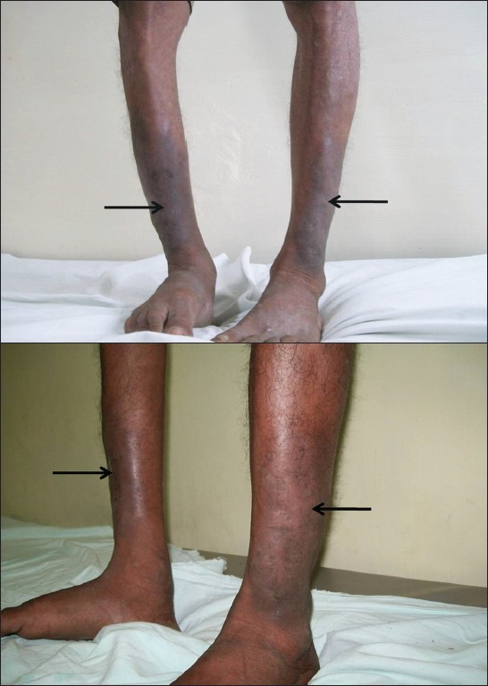
The dermopathy, if present, is characterized by thickening of the dermis, as a result of deposition of glycosaminoglycans and lymphocyte infiltration.

Slide 37
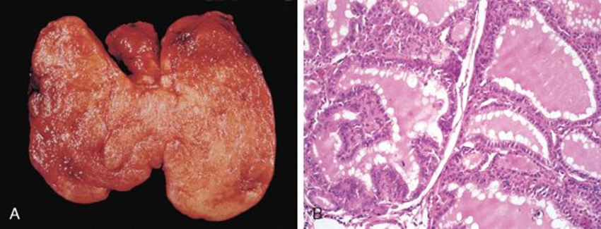
Graves disease: morphology
The thyroid gland is enlarged (usually symmetrically) due to diffuse hypertrophy and hyperplasia of thyroid follicular epithelial cells. The gland is usually smooth and soft, and its capsule is intact.

Slide 38
Graves disease: morphology
On microscopic examination, the follicular epithelial cells in untreated cases are tall, columnar, and more crowded than usual. This crowding often results in the formation of small papillae. Such papillae lack fibrovascular cores, in contrast with those of papillary carcinoma.
The colloid within the follicular lumen is pale, with scalloped margins.
Lymphoid infiltrates, are present throughout the interstitium; germinal centers are common.

Slide 39
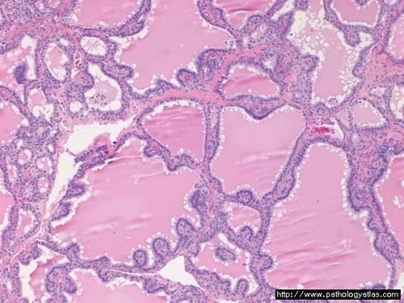
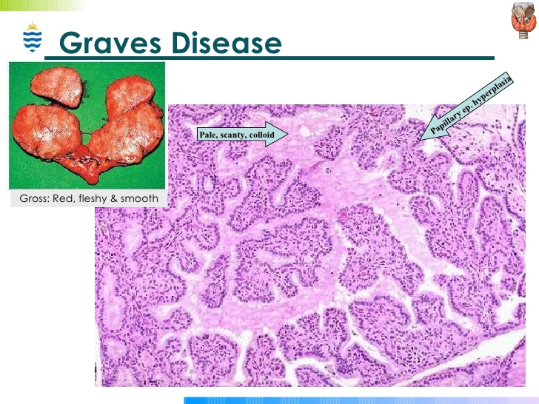
Graves disease: morphology

Slide 40
Laboratory findings in Graves disease include elevated serum free T4 and T3 and depressed serum TSH.
Because of ongoing stimulation of the thyroid follicles by TSIs, radioactive iodine uptake is increased, and radioiodine scans show a diffuse uptake of iodine

Slide 41
DIFFUSE AND MULTINODULAR GOITER
Goiter: Enlargement of the thyroid, is the most common manifestation of thyroid disease.
They reflect impaired synthesis of thyroid hormone, most often caused by dietary iodine deficiency
Impairment of thyroid hormone synthesis leads to a compensatory rise in the serum TSH, causes hypertrophy and hyperplasia of thyroid follicular cells and, ultimately, gross enlargement of the thyroid gland.
The compensatory increase in functional mass of the gland is enough to overcome the hormone deficiency, ensuring a euthyroid metabolic state in the vast majority of affected persons.
If the underlying disorder is sufficiently sever the compensatory responses may be inadequate to overcome the impairment in hormone synthesis, resulting in goitrous hypothyroidism

Slide 42
Goiter
Goiters can be endemic or sporadic.
diffuse, symmetric enlargement of the gland (diffuse goiter): The follicles are lined by crowded columnar cells, which may pile up and form projections
colloid-rich gland (colloid goiter)
All long-standing diffuse goiters convert into multinodular goiters.
Multinodular goiters typically are hormonally silent, although a minority (approximately 10% over 10 years) can manifest with thyrotoxicosis secondary to the development of autonomous nodules that produce thyroid hormone independent of TSH stimulation. This condition, known as toxic multinodular goiter or Plummer syndrome.

Slide 43
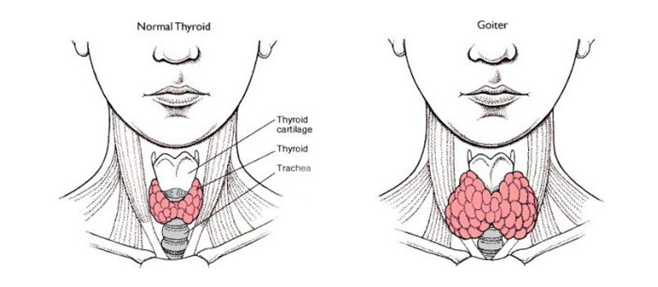

Slide 44
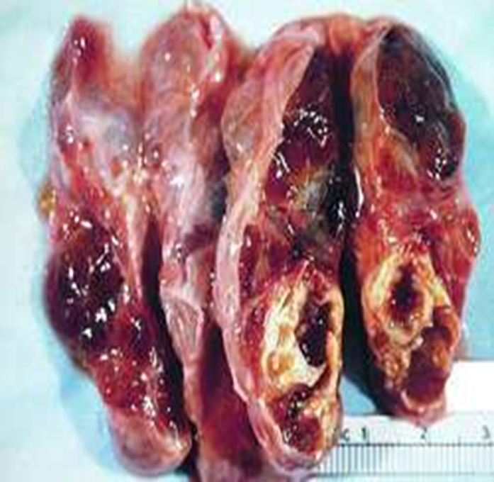
Multinodular goiter
Multinodular goiters are multilobulate, asymmetrically enlarged glands, which may attain massive size.
On cut surface, irregular nodules containing variable amounts of brown, gelatinous colloid are evident . Older lesions often show areas of fibrosis, hemorrhage, calcification, and cystic change.
.

Slide 45
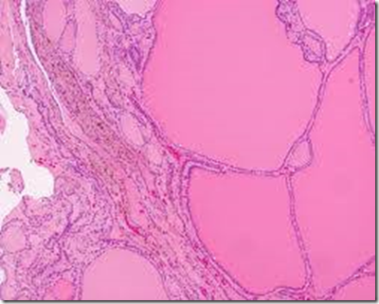
Multinodular Goiter
The microscopic appearance includes colloid-rich follicles lined by flattened, inactive epithelium and areas of follicular epithelial hypertrophy and hyperplasia

Slide 46
Clinical features
The dominant clinical features of goiter are those caused by the mass effects of the enlarged gland.
In addition to the obvious cosmetic problem of a large neck mass, goiters also may cause airway obstruction, dysphagia, and compression of large vessels in the neck
a hyperfunctioning (toxic) nodule may develop within a long-standing goiter, resulting in hyperthyroidism.
The incidence of malignancy in long-standing multinodular goiters is low (less than 5%) but not zero, and concern for malignancy arises with goiters that demonstrate sudden changes in size or associated symptoms (e.g., hoarseness).

Slide 47
Summary
Clinical recognition of diseases of the thyroid is important, because most are amenable to medical or surgical management. Diseases include hyperthyroidism, hypothyroidism) and mass lesions.
Chronic lymphocytic (Hashimoto) thyroiditis is the most common cause of hypothyroidism, it is an autoimmune disease
Graves’ disease, the most common cause of endogenous hyperthyroidism, is an autoimmune disorder. Enlargement of the thyroid, or goiter, is the most common manifestation of thyroid disease

Slide 48
Reference
Robbins Basic Pathology , 10th ed

