Slide 1
Adrenal Gland Pathology
Dr. Amany Fathadin

Slide 2
Objectives
Understand the structure and function of adrenal glands.
Know the disorders that can cause hypo or hyper function of the adrenal cortex.
Understand the histopathological features of both medullary (pheochromocytoma) and adrenocortical neoplasms.
Notes:
The adrenal glands are paired endocrine organs consisting of both cortex and medulla, which differ in their development, structure, and function. In the adult, the normal adrenal gland weighs about 4 gm; but with acute stress, lipid depletion may reduce the weight, or prolonged stress, such as dying after a long chronic illness, can induce hypertrophy and hyperplasia of the cortical cells and more than double the weight of the normal gland. Beneath the capsule of the adrenal is the narrow layer of zonaglomerulosa. An equally narrow zonareticularis abuts the medulla. Intervening is the broad zonafasciculata, which makes up about 75% of the total cortex. The adrenal cortex synthesizes three different types of steroids: (1) glucocorticoids (principally cortisol), which are synthesized primarily in the zonafasciculata with a small contribution from the zonareticularis; (2) mineralocorticoids, the most important being aldosterone, which is generated in the zonaglomerulosa; and (3) sex steroids (estrogens and androgens), which are produced largely in the zonareticularis. The adrenal medulla is composed of chromaffin cells, which synthesize and secrete catecholamines, mainly epinephrine. Catecholamines have many effects that allow rapid adaptations to changes in the environment.

Slide 3
Adrenal Glands
The adrenal glands: paired endocrine organs: cortex and medulla: 4 layers
Three layers in the cortex:
Zona glomerulosa
Zona reticularis abuts the medulla.
Intervening is the broad zona fasciculata (75%) of the total cortex.
Notes:
The adrenal glands are paired endocrine organs consisting of both cortex and medulla, which differ in their development, structure, and function. In the adult, the normal adrenal gland weighs about 4 gm; but with acute stress, lipid depletion may reduce the weight, or prolonged stress, such as dying after a long chronic illness, can induce hypertrophy and hyperplasia of the cortical cells and more than double the weight of the normal gland. Beneath the capsule of the adrenal is the narrow layer of zonaglomerulosa. An equally narrow zonareticularis abuts the medulla. Intervening is the broad zonafasciculata, which makes up about 75% of the total cortex. The adrenal cortex synthesizes three different types of steroids: (1) glucocorticoids (principally cortisol), which are synthesized primarily in the zonafasciculata with a small contribution from the zonareticularis; (2) mineralocorticoids, the most important being aldosterone, which is generated in the zonaglomerulosa; and (3) sex steroids (estrogens and androgens), which are produced largely in the zonareticularis. The adrenal medulla is composed of chromaffin cells, which synthesize and secrete catecholamines, mainly epinephrine. Catecholamines have many effects that allow rapid adaptations to changes in the environment.

Slide 4
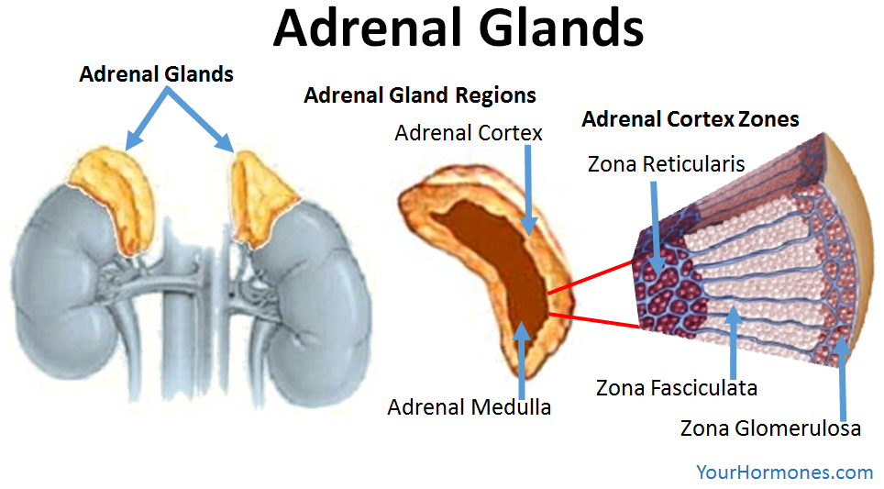

Slide 5
Adrenal Gland
The adrenal cortex synthesizes three different types of
steroids:
(1) Glucocorticoids (principally cortisol) zona fasciculata
(2) Mineralocorticoids (aldosterone) zona glomerulosa
(3) Sex steroids (estrogens and androgens) zona reticularis.
The adrenal medulla is composed of chromaffin cells,
which synthesize and secrete catecholamines, mainly epinephrine.

Slide 6
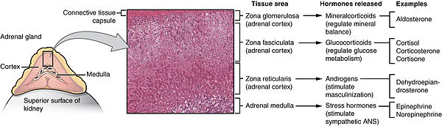
Adrenal Gland

Slide 7
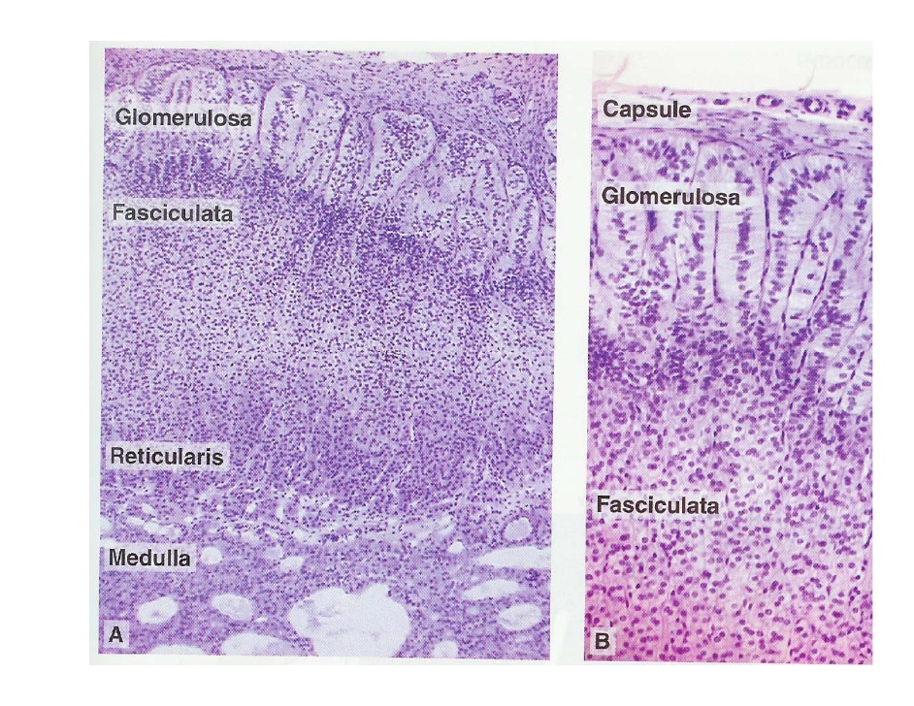
Adrenal Gland
Notes:
medulla

Slide 8
ADRENOCORTICAL HYPERFUNCTION (HYPERADRENALISM)
There are three distinctive hyperadrenal clinical syndromes, each caused by abnormal production of one or more of the hormones produced by the three layers of the cortex:
(1) Cushing syndrome, characterized by an excess of cortisol;
(2) hyperaldosteronism
(3) adrenogenital or virilizing syndromes, caused by an excess of androgens
Notes:
three basic types of corticosteroids elaborated by the adrenal cortex (glucocorticoids, mineralocorticoids, and sex steroids), so there are three distinctive hyperadrenal clinical syndromes: (1) Cushing syndrome, characterized by an excess of cortisol; (2) hyperaldosteronism; and (3) adrenogenital or virilizing syndromes caused by an excess of androgens. The clinical features of these syndromes overlap somewhat because of the overlapping functions of some of the adrenal steroids.

Slide 9
Hypercortisolism (Cushing Syndrome)
Broadly divided into *exogenous and *endogenous causes.
The vast majority of cases of Cushing syndrome are the result of the administration of exogenous glucocorticoids (“iatrogenic” Cushing syndrome).
The endogenous causes can:
** ACTH dependent and ** ACTH independent

Slide 10
Cause | Relative Frequency (%) | Ratio of Females to Males
ACTH-DEPENDENT
Cushing disease (pituitary adenoma; rarely CRH-dependent pituitary hyperplasia) | 70 | 3.5:1.0
Ectopic corticotropin syndrome (ACTH-secreting pulmonary small-cell carcinoma, bronchial carcinoid) | 10 | 1:1
ACTH-INDEPENDENT
Adrenal adenoma | 10 | 4:1
Adrenal carcinoma | 5 | 1:1
Macronodular hyperplasia (ectopic expression of hormone receptors, including GIPR, LHR, vasopressin and serotonin receptors) | <2 | 1:1
Primary pigmented nodular adrenal disease (PRKARIA and PDE11 mutations) | <2 | 1:1
McCune-Albright syndrome (GNAS mutations) | <2 | 1:1

Slide 12
Primary hypothalamic-pituitary disease associated with hypersecretion of ACTH, also known as Cushing disease
accounts for approximately 70% of cases of spontaneous, endogenous Cushing syndrome.
four times higher among women than among men
In the vast majority of cases, the pituitary gland contains an ACTH-producing microadenoma that does not produce mass effects in the brain.
The adrenal glands in patients with Cushing disease show variable degrees of bilateral nodular cortical hyperplasia , secondary to the elevated levels of ACTH (“ACTHdependent” Cushing syndrome

Slide 13
Ectopic ACTH
Secretion of ectopic ACTH by nonpituitary tumors accounts for about 10% of cases of Cushing syndrome.
In many instances the responsible tumor is a small-cell carcinoma of the lung, although other neoplasms, including carcinoids, medullary carcinomas of the thyroid, and PanNETs, have been associated with the syndrome.
As in the pituitary variant, the adrenal glands undergo bilateral cortical hyperplasia secondary to elevated ACTH.

Slide 14
Neoplasms and hyperplasia
Primary adrenal neoplasms, such as adrenal adenoma and carcinoma, and rarely, primary cortical hyperplasia, are responsible for about 15% to 20% of cases of endogenous Cushing syndrome, also designated ACTH-independent Cushing syndrome
Primary cortical hyperplasia of the adrenal cortices is a rare cause of Cushing syndrome. There are two variants of this entity; the first presents as macronodules of varying sizes (typically less than 3 cm in diameter) and the second as micronodules (1–3 mm).

Slide 15
ADRENOCORTICAL HYPERFUNCTION, Morphology
One of the following abnormalities:
Cortical atrophy: results from exogenous glucocorticoids
Diffuse hyperplasia: individuals with ACTH-dependent Cushing syndrome
In primary cortical hyperplasia, the cortex is replacedby macronodules or 1- to 3-mm darkly pigmented micronodules. The pigment is believed to be lipofuscin, a wear-and-tear pigment
Adenoma or carcinoma

Slide 16
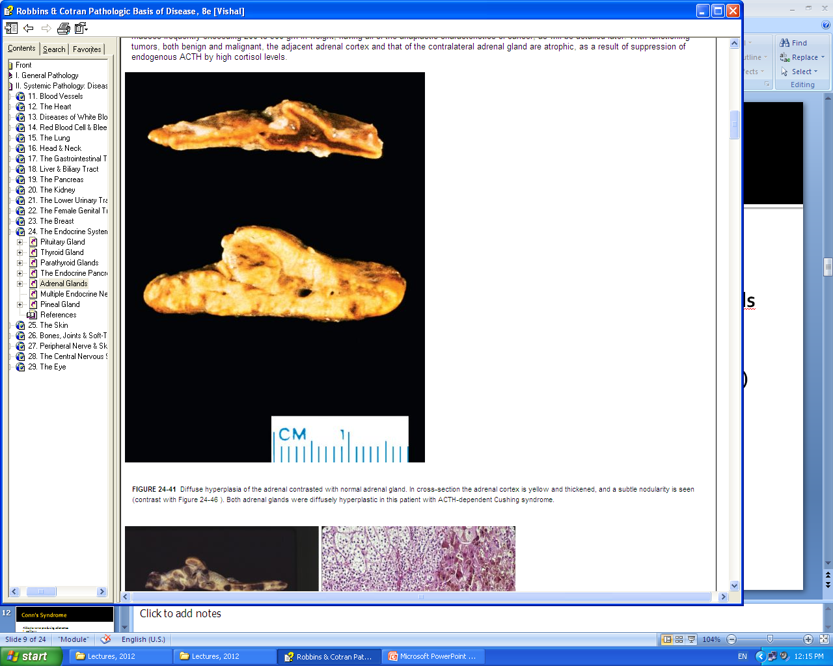
Diffuse Cortical Hyperplasia

Slide 17
Morphology
Functional adenomas or carcinomas of the adrenal cortex are not morphologically distinct from nonfunctioning adrenal neoplasms
Adrenocortical adenomas are yellow tumors surrounded by thin or well-developed capsules, and most weigh less than 30 g .
On microscopic examination, they are composed of cells similar to those encountered in the normal zona fasciculata.

Slide 18
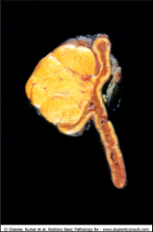
The adenoma is distinguished from nodular hyperplasia by its solitary, circumscribed nature

Slide 19
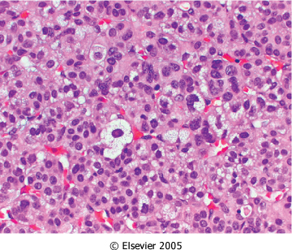
neoplastic cells are vacuolated because of the presence of intracytoplasmic lipid. There is mild nuclear pleomorphism. Mitotic activity and necrosis are not seen.
Notes:
Vacuolated cytoplasm, adenoma

Slide 20
Morphology
Carcinomas are non encapsulated masses frequently exceeding 200 to 300 g in weight, having all of the anaplastic characteristics of cancer
With functioning tumors, both benign and malignant, the adjacent adrenal cortex and that of the contralateral adrenal gland are atrophic, as a result of suppression of endogenous ACTH by high cortisol levels.

Slide 21
Morphology cont.
The pituitary in Cushing syndrome shows changes that vary with different causes. The most common alteration, resulting from high levels of endogenous or exogenous glucocorticoids, is termed Crooke hyaline change. In this condition, the normal granular, basophilic cytoplasm of the ACTH-producing cells in the anterior pituitary is replaced by homogeneous, lightly basophilic material. This alteration is the result of the accumulation of intermediate keratin filaments in the cytoplasm

Slide 22
Clinical Features of Cushing Syndrome
Hypertension and weight gain.
Truncal obesity, “moon facies,” and accumulation of fat in the posterior neck and back (“buffalo hump”)
Proximal limb weakness. (atrophy of type 2 fibers)
Glucocorticoids induce gluconeogenesis and inhibit the uptake of glucose by cells, with resultant hyperglycemia, glucosuria, and polydipsia, mimicking diabetes mellitus.
The skin is thin, fragile, and easily bruised; cutaneous striae .
Osteoporosis, with consequent increased susceptibility to fractions
Increased risk for a variety of infections.

Slide 23
Hirsutism and menstrual abnormalities.
Mental disturbances, including mood swings, depression, and frank psychosis.
Extra adrenal Cushing syndrome caused by pituitary or ectopic ACTH secretion usually is associated with increased skin pigmentation secondary to melanocyte-stimulating activity in the ACTH precursor molecule.

Slide 24
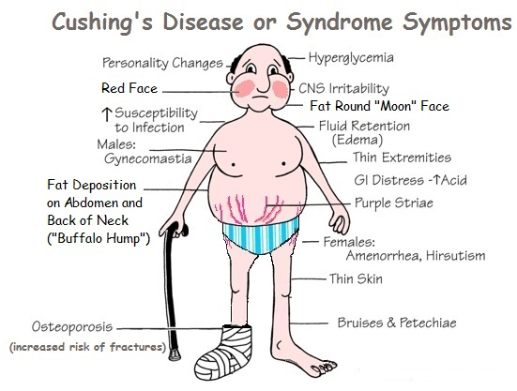

Slide 25
In pituitary and ectopic Cushing syndrome, ACTH levels are elevated and the urine is characterized by high levels of excreted corticosteroids.
In contrast, ACTH levels are low in Cushing syndrome secondary to adrenal tumors.

Slide 26
ADRENOCORTICAL NEOPLASMS
While functional adenomas are most commonly associated with hyperaldosteronism and with Cushing syndrome, a virilizing neoplasm is more likely to be a carcinoma.
Not all adrenocortical neoplasms, however, elaborate steroid hormones.
Determination of whether a cortical neoplasm is functional or not is based on clinical evaluation and measurement of the hormone or its metabolites in the laboratory.

Slide 27
ADRENOCORTICAL NEOPLASMS
Most cortical adenomas do not cause hyperfunction and usually are encountered as incidental findings at the time of autopsy or during abdominal imaging for an unrelated cause
On cut surface, adenomas usually are yellow to yellow-brown, owing to the presence of lipid within the neoplastic cells . As a general rule they are small, averaging 1 to 2 cm in diameter.
On microscopic examination, adenomas are composed of cells similar to those populating the normal adrenal cortex. The nuclei tend to be small, although some degree of pleomorphism may be encountered even in benign lesions (endocrine atypia).
The cytoplasm of the neoplastic cells ranges from eosinophilic to vacuolated, depending on their lipid content; mitotic activity generally is inconspicuous.

Slide 28
Adrenocortical carcinomas
Adrenocortical carcinomas are rare neoplasms that may occur at any age, including in childhood.
Two rare inherited causes of adrenal cortical carcinomas are Li-Fraumeni syndrome and Beckwith-Wiedemann syndrome .
In most cases, adrenocortical carcinomas are large, invasive lesions that efface the native adrenal gland.
On cut surface, adrenocortical carcinomas typically are variegated, poorly demarcated lesions containing areas of necrosis, hemorrhage, and cystic change

Slide 29
Adrenal carcinoma. The tumor dwarfs the kidney and compresses the upper pole. It is largely hemorrhagic and necrotic.

Slide 30
Anaplastic cells

Slide 31
Hyperaldosteronism
Chronic excess aldosterone secretion
Primary aldosteronism (autonomous overproduction of aldosterone) with resultant suppression of the renin-angiotensin system and decreased plasma renin activity
Secondary hyperaldosteronism, in contrast, aldosterone release occurs in response to activation of the renin-angiotensin system:
*Decreased renal perfusion * Arterial hypovolemia * Pregnancy
Notes:
Primary Hyperaldosteronism
Hyperaldosteronism is the generic term for a small group of closely related, uncommon syndromes, all characterized by chronic excess aldosterone secretion. Excessive levels of aldosterone cause sodium retention and potassium excretion, with resultant hypertension and hypokalemia. Hyperaldosteronism may be primary, or it may be a secondary event resulting from an extra-adrenal cause.
Primary hyperaldosteronism indicates an autonomous overproduction of aldosterone, with resultant suppression of the renin-angiotensin system and decreased plasma renin activity. Primary hyperaldosteronism is caused by one of three mechanisms115 (Fig. 24-44):Adrenocortical neoplasm, either an aldosterone-producing adrenocortical adenoma (the most common cause) or, rarely, an adrenocortical carcinoma. In approximately 80% of cases, primary hyperaldosteronism is caused by a solitary aldosterone-secreting adenoma, a condition referred to as Conn syndrome. This syndrome occurs most frequently in adult middle life and is more common in women than in men (2:1). Multiple adenomas may be present in an occasional patient.Primary adrenocortical hyperplasia (idiopathic hyperaldosteronism), characterized by bilateral nodular hyperplasia of the adrenal glands, highly reminiscent of those found in the nodular hyperplasia of Cushing syndrome. The genetic basis of idiopathic hyperaldosteronism is not clear, although it is possibly caused by an overactivity of the aldosterone synthase gene, CYP11B2.116Glucocorticoid-remediable hyperaldosteronism is an uncommon cause of primary hyperaldosteronism that is familial and genetic. In some families, it is caused by a chimeric gene resulting from fusion between CYP11B1 (the 11β-hydroxylase gene) and CYP11B2 (the aldosterone synthase gene).117 This leads to a sustained production of hybrid steroids in addition to both cortisol and aldosterone. The activation of aldosterone secretion is under the influence of ACTH and hence is suppressible by exogenous administration of dexamethasone.

Slide 32
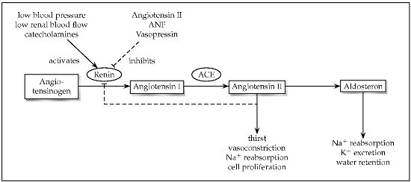

Slide 33
Primary aldosteronism: Causes
Bilateral idiopathic hyperaldosteronism, characterized by bilateral nodular hyperplasia of the adrenal glands. This is the most common underlying cause of primary hyperaldosteronism, accounting for about 60% of cases. The pathogenesis is unclear. Some have mutations in the KCNJ5 gene
Adrenocortical neoplasm, either an aldosterone-producing adenoma or, rarely, an adrenocortical carcinoma. In approximately 35% of cases, primary hyperaldosteronism is caused by a solitary aldosterone-secreting adenoma, a condition referred to as Conn syndrome.
Rarely, familial hyperaldosteronism may result from a genetic defect that leads to overactivity of the aldosterone synthase gene, CYP11B2.

Slide 34
Primary Hyperaldosteronism, Causes
Notes:
nsecondary hyperaldosteronism, in contrast, aldosterone release occurs in response to activation of the renin-angiotensin system (Chapter 4). It is characterized by increased levels of plasma renin and is encountered in conditions such as the following:Decreased renal perfusion (arteriolar nephrosclerosis, renal artery stenosis)Arterial hypovolemia and edema (congestive heart failure, cirrhosis, nephrotic syndrome)Pregnancy (due to estrogen-induced increases in plasma renin substrate).

Slide 35
Hyperaldosteronism, Clinical
Presents with hypertension.
Primary hyperaldosteronism may be the most common cause of secondary hypertension (i.e., hypertension secondary to an identifiable cause).
Aldosterone promotes sodium reabsorption.
Hypokalemia results from renal potassium wasting and, when present, can cause a variety of neuromuscular manifestations, including weakness, paresthesias, visual disturbances.

Slide 36
Morphology
Aldosterone-producing adenomas are almost always solitary, small (<2 cm in diameter), well-circumscribed lesions. They are bright yellow on cut section and are composed of lipid-laden cortical cells
-The cells tend to be uniform in size and shape; occasionally there is some nuclear and cellular pleomorphism.
A characteristic feature of aldosterone-producing adenomas is the presence of eosinophilic, laminated cytoplasmic inclusions, known as spironolactone bodies. These typically are found after treatment with the anti-hypertensive agent spironolactone, which is the drug of choice in primary hyperaldosteronism.
* They do not usually suppress ACTH secretion. Therefore, the adjacent adrenal cortex and that of the contralateral gland are not atrophic.
Bilateral idiopathic hyperplasia is marked by diffuse or focal hyperplasia of cells resembling those of the normal zona glomerulosa.
Notes:
Morphology. Aldosterone-producing adenomas are almost always solitary, small (<2 cm in diameter), well-circumscribed lesions, more often found on the left than on the right. They tend to occur in the thirties and forties, and in women more often than in men. These lesions are often buried within the gland and do not produce visible enlargement, a point to be remembered in interpreting sonographic or scanning images. They are bright yellow on cut section (Fig. 24-45) and, surprisingly, are composed of lipid-laden cortical cells that more closely resemble fasciculata cells than glomerulosa cells (the normal source of aldosterone). In general, the cells tend to be uniform in size and shape and resemble mature cortical cells; occasionally, there is some nuclear and cellular pleomorphism but no evidence of anaplasia (Fig. 24-46). A characteristic feature of aldesterone-producing adenomas is the presence of eosinophilic, laminated cytoplasmic inclusions, known as spironolactone bodies, found after treatment with the antihypertensive drug spironolactone. In contrast to cortical adenomas associated with Cushing syndrome, those associated with hyperaldosteronism do not usually suppress ACTH secretion. Therefore, the adjacent adrenal cortex and that of the contralateral gland are not atrophic.

Slide 37
Hypersecretion of sex steroids
The adrenal cortex can secrete excess androgens in either of two settings:
adrenocortical neoplasms (usually virilizing carcinomas) or congenital adrenal hyperplasia (CAH).
CAH consists of a group of autosomal recessive disorders characterized by defects in steroid biosynthesis, usually cortisol; the most common subtype is caused by deficiency of the enzyme 21-hydroxylase.
Reduction in cortisol production causes a compensatory increase in ACTH secretion, which in turn stimulates androgen production.
Androgens have virilizing effects, including masculinization in females (ambiguous genitalia, oligomenorrhea, hirsutism), precocious puberty in males.
Cortisol deficiency places persons with CAH at risk for acute adrenal insufficiency

Slide 38
Adrenocortical Insufficiency
Adrenocortical insufficiency, or hypofunction, may be caused by either
**primary adrenal disease (primary hypoadrenalism): Acute (crisis ) or chronic (Addison disease)
** decreased stimulation of the adrenals resulting from a deficiency of ACTH (secondary hypoadrenalism)

Slide 40
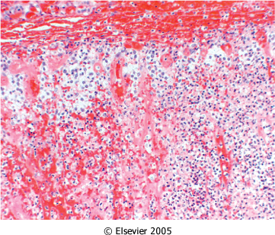
Waterhouse-Friderichsen syndrome. Bilateral adrenal hemorrhage in an infant with overwhelming sepsis, resulting in acute adrenal insufficiency. At autopsy, the adrenals were grossly hemorrhagic and shrunken; in this photomicrograph, little residual cortical architecture is discernible.
Notes:
Waterhouse-Friderichsen syndrome. At autopsy, the adrenals were grossly hemorrhagic and shrunken; microscopically, little residual cortical architecture is discernible. Autoimmune adrenalitis

Slide 41
Waterhouse-Friderichsen syndrome is classically associated with Neisseria meningitidis septicemia but can also be caused by other organisms, including Pseudomonas spp., pneumococci, and Haemophilus influenzae.
The pathogenesis of the Waterhouse-Friderichsen syndrome remains unclear but probably involves endotoxin-induced vascular injury with associated disseminated intravascular coagulation

Slide 42
Chronic Adrenocortical Insufficiency: Addison Disease
uncommon disorder resulting from progressive destruction of the adrenal cortex.
More than 90% of all cases are attributable to one of four disorders:
1-Autoimmune adrenalitis (most common cause) autoimmune destruction of steroid-producing cells, and autoantibodies
2-Infection: tuberculosis and fungal
3- Acquired immune deficiency syndrome (AIDS)
4- Metastatic neoplasms: Carcinomas of the lung and breast are the source of a majority of metastases in the adrenals.

Slide 43
Morphology
Primary autoimmune adrenalitis is characterized by irregularly shrunken glands, which may be exceedingly difficult to identify within the suprarenal adipose tissue.
On histologic examination, the cortex contains only scattered residual cortical cells in a collapsed network of connective tissue. A variable lymphoid infiltrate is present in the cortex and may extend into the subjacent medulla
In tuberculosis or fungal diseases, the adrenal architecture may be effaced by a granulomatous inflammatory reaction identical to that encountered in other sites of infection

Slide 45
Clinical features
Gastrointestinal disturbancesare common and include anorexia, nausea, vomiting, weight loss, and diarrhea.
In patients with primary adrenal disease, increased levels of ACTH precursor hormone stimulate melanocytes, with resultant hyperpigmentation of the skin and mucosal surfaces.
Decreased mineralocorticoid (aldosterone) activity in patients with primary adrenal insufficiency results in potassium retention and sodium loss, with consequent hyperkalemia, hyponatremia, volume depletion, and hypotension,
Secondary hypoadrenalism is characterized by deficient cortisol and androgen output but normal or near-normal aldosterone synthesis.
Hypoglycemia occasionally may occur.
Stresses such as infections, trauma, or surgical procedures in affected patients may precipitate an acute adrenal crisis, manifested by intractable vomiting, abdominal pain, hypotension, coma, and vascular collapse. Death follows rapidly unless corticosteroids are replaced immediately.

Slide 46
Pheochromocytoma
Neoplasms composed of chromaffin cells, which, like their nonneoplastic counterparts, synthesize and release catecholamines
Similar to aldosterone-secreting adenomas, give rise to surgically correctable forms of hypertension.
Notes:
PHEOCHROMOCYTOMA
Pheochromocytomas are uncommon neoplasms composed of chromaffin cells, which synthesize and release catecholamines and in some instances peptide hormones. These tumors are important because they (similar to aldosterone-secreting adenomas) give rise to surgically correctable forms of hypertension. Although only about 0.1% to 0.3% of hypertensive patients have an underlying pheochromocytoma, the hypertension can be fatal when the pheochromocytoma goes unrecognized. Occasionally, one of these tumors produces other steroids or peptides and so may be associated with Cushing syndrome or some other endocrinopathy.

Slide 47
Pheochromocytoma
"rule of 10s":
10% of pheochromocytomas are extraadrenal (paragangliomas)
• 10% of adrenal pheochromocytomas are bilateral; this proportion may rise to 50% in cases that are associated with familial syndromes.
• 10% of adrenal pheochromocytomas are malignant
10% of adrenal pheochromocytomas are not associated with hypertension
Notes:
Pheochromocytomas usually subscribe to a convenient "rule of 10s":10% of pheochromocytomas arise in association with one of several familial syndromes (Table 24-11). These include the MEN-2A and MEN-2B syndromes (described later), type I neurofibromatosis (Chapter 5), von Hippel-Lindau syndrome (Chapter 28), and Sturge-Weber syndrome (Chapter 16).10% of pheochromocytomas are extra-adrenal, occurring in sites such as the organ of Zuckerkandl and the carotid body, where these chromaffin-negative tumors are usually called paragangliomas to distinguish them from pheochromocytomas.10% of nonfamilial adrenal pheochromocytomas are bilateral; this figure may rise to 70% in cases that are associated with familial syndromes.10% of adrenal pheochromocytomas are biologically malignant, although the associated hypertension represents a serious and potentially lethal complication of even "benign" tumors. Frank malignancy is somewhat more common (20% to 40%) in tumors arising in extra-adrenal sites.10% of adrenal pheochromocytomas arise in childhood, usually the familial subtypes, and with a strong male preponderance. The nonfamilial pheochromocytomas most often occur in adults between 40 and 60 years of age, with a slight female preponderanc

Slide 48
One “traditional” 10% rule that has since been modified pertains to familial cases.
It is now recognized that as many as 25% of individuals with pheochromocytomas and paragangliomas harbor a germ line mutation in one of at least six known genes, including RET, which causes type 2 MEN syndromes ; NF1, which causes type 1 neurofibromatosis ); VHL, which causes von Hippel-Lindau disease

Slide 49
Pheochromocytoma
Gross
Pheochromocytomas range in size from small, circumscribed lesions confined to the adrenal to large, hemorrhagic masses weighing several kilograms.
On cut surface, smaller pheochromocytomas are yellow-tan, well-defined lesions that compress the adjacent adrenal gland. Larger lesions tend to be hemorrhagic, necrotic, and cystic and typically efface the adrenal gland.

Slide 50
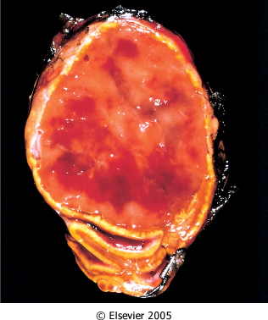
Pheochromocytoma. The tumor is enclosed within an attenuated cortex and demonstrates areas of hemorrhage. The comma-shaped residual adrenal gland is seen (lower portion
Notes:
The criteria for determining malignancy in pheochromocytomas can be a vexing issue. There is no single histologic feature that can reliably predict clinical behavior in pheochromocytomas. Tumors with "benign" histologic features may metastasize, while bizarrely pleomorphic tumors may remain confined to the adrenal gland. In fact, cellular and nuclear pleomorphism, including the presence of giant cells, and mitotic figures are often seen in benign pheochromocytomas, while cellular monotony is paradoxically associated with an aggressive behavior (see below). Even capsular and vascular invasion may be encountered in benign lesions. Therefore, the definitive diagnosis of malignancy in pheochromocytomas is based exclusively on the presence of metastases. These may involve regional lymph nodes as well as more distant sites, including liver, lung, and bone. Several histologic features, such as numbers of mitoses, confluent tumor necrosis, and spindle cell morphology, have been associated with an aggressive behavior and increased risk of metastasis, but in and of itself, no single criterion is entirely reliable.¹²⁸Pheochromocytoma. The tumor is enclosed within an attenuated cortex and demonstrates areas of hemorrhage. The comma-shaped residual adrenal is seen below

Slide 51
Pheochromocytoma Morphology
polygonal to spindle-shaped chromaffin cells and their supporting cells, compartmentalized into small nests, or Zellballen, by a rich vascular network
The cytoplasm of the neoplastic cells often has a finely granular appearance
Electron microscopy reveals variable numbers of membrane-bound, electron-dense granules
The nuclei of the neoplastic cells are often quite pleomorphic. Both capsular and vascular invasion may be encountered in benign lesions, and the mere presence of mitotic figures does not imply malignancy. Therefore, the definitive diagnosis of malignancy in pheochromocytomas is based exclusively on the presence of metastases. These may involve regional lymph nodes as well as more distant sites, including liver, lung, and bone.
Notes:
Pheochromocytomas range from small, circumscribed lesions confined to the adrenal (Fig. 24-55) to large hemorrhagic masses weighing kilograms. The average weight of a pheochromocytoma is 100 gm, but variations from just over 1 gm to almost 4000 gm have been reported. The larger tumors are well demarcated by either connective tissue or compressed cortical or medullary tissue. Richly vascularized fibrous trabeculae pass into the tumor and produce a lobular pattern. In many tumors, remnants of the adrenal gland can be seen, stretched over the surface or attached at one pole. On section, the cut surfaces of smaller pheochromocytomas are yellow-tan. Larger lesions tend to be hemorrhagic, necrotic, and cystic and typically efface the adrenal gland. Incubation of fresh tissue with a potassium dichromate solution turns the tumor a dark brown color owing to oxidation of stored catecholamines, thus the term chromaffin.
The histologic pattern in pheochromocytoma is quite variable. The tumors are composed of polygonal to spindle-shaped chromaffin cells or chief cells, clustered with the sustentacular cells into small nests or alveoli (zellballen) by a rich vascular network (Fig. 24-56). Uncommonly, the dominant cell type is a spindle or small cell; various patterns can be found in any one tumor. The cytoplasm has a finely granular appearance, best demonstrated with silver stains, owing to the appearance of granules containing catecholamines. The nuclei are usually round to ovoid, with a stippled "salt and pepper" chromatin that is characteristic of most neuroendocrine tumors. Electron microscopy reveals variable numbers of membrane-bound, electron-dense granules, representing catecholamines and sometimes other peptides (Fig. 24-57). Immunoreactivity for neuroendocrine markers (chromogranin and synaptophysin) is present in the chief cells, while the peripheral sustentacular cells label with S-100, a calcium-binding protein expressed by a variety of mesenchymal cell types.

Slide 53
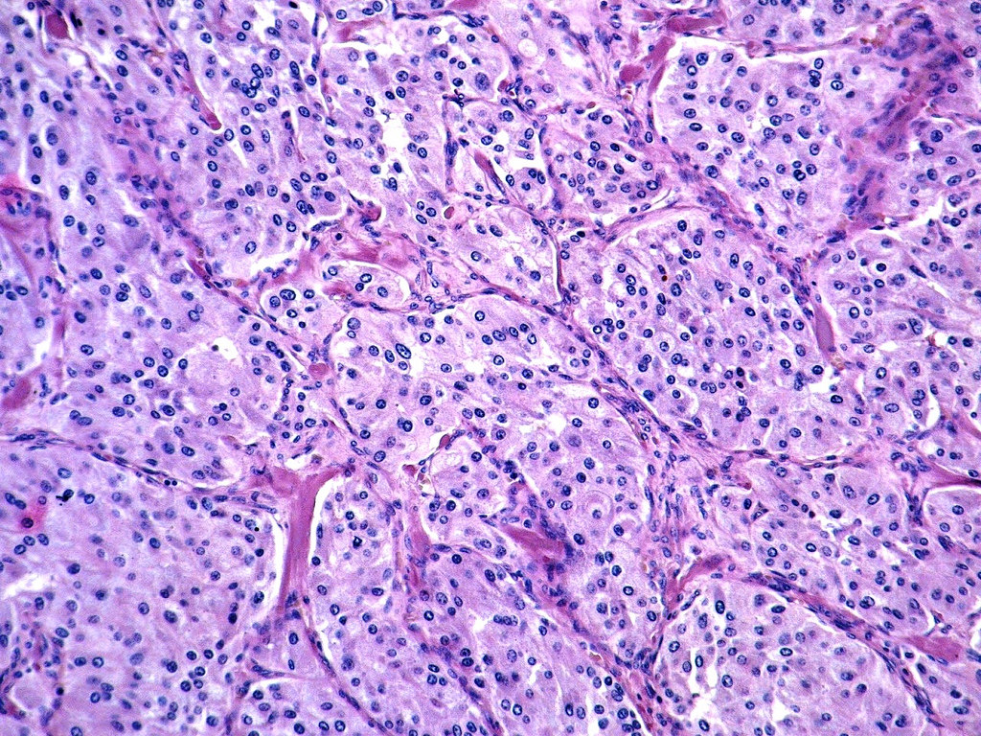

Slide 54
Clinical features
The predominant clinical manifestation of pheochromocytoma is hypertension.
The characteristic presentation with a hypertensive episode is one of abrupt elevation in blood pressure, associated with tachycardia, palpitations, headache, sweating, tremor, and a sense of apprehension.
increased risk of myocardial ischemia, heart failure, renal injury, and stroke (cerebrovascular accident).
Sudden cardiac death may occur, probably secondary to catecholamine-induced myocardial irritability and ventricular arrhythmias.
The laboratory diagnosis of pheochromocytoma is based on demonstration of increased urinary excretion of free catecholamines and their metabolites, such as vanillylmandelic acid and metanephrines

Slide 55
Summary:
The most common cause of hypercortisolism is exogenous
administration of steroids.
• Primary adrenocortical insufficiency can be acute (WaterhouseFriderichsen syndrome) or chronic (Addison disease).Chronic adrenal insufficiency in then Western world most often is secondary to autoimmune adrenalitis.
Pheochromocytomas are neoplasms composed of chromaffin cells, which, like their nonneoplastic counterparts, synthesize and release catecholamines

Slide 56
Refrence
Robbins Basic Pathology , 10th ed

