Slide 1
Introduction to Endocrinology
Dr Nervana Mustafa
Associate Professor of Physiology
College of Medicine - KSU

Slide 2
Topics:
 Endocrine vs exocrine gland.
 Chemical messengers
Hormone:
Definition:
¡ Chemical structure.
¡ Paracrine, autocrine, endocrine, neuroendocrine.
¡ Transport and clearance.
Mechanism of action:
¡ Receptors, down-regulation and up-regulation.
¡ Intracellular signaling.
¡ Second messenger (cAMP, IP3).
Guyton and Hall Textbook -Medical Physiology- 14th Ed

Slide 3
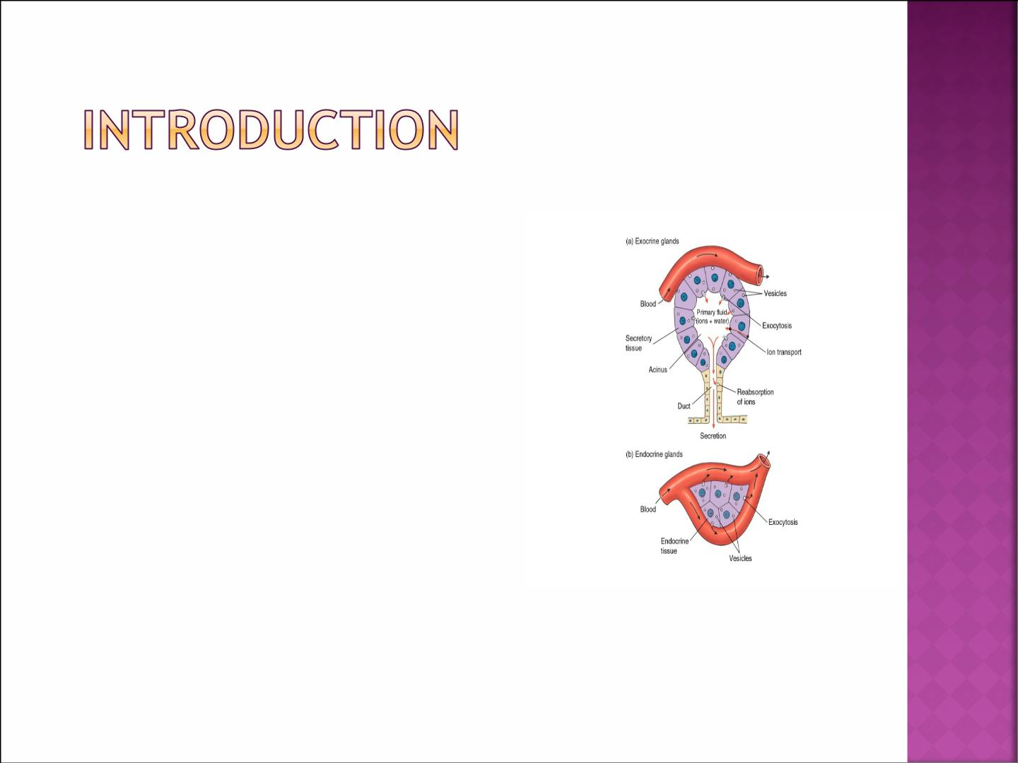
Glands
A. Exocrine gland
¡ Ducts
¡ Secrets enzymes
¡ Lumen and surfaces
B. Endocrine gland
¡ No ducts
¡ Secrets Chemical
messengers
¡ Blood stream

Slide 4

Chemical messengers:
 The activities of cells, tissues and organs are
coordinated by chemical messengers:
¡ Neurotransmitters
¡ Endocrine hormones
¡ Neuroendocrine hormones
¡ Paracrines
¡ Autocrines
¡ Cytokines

Slide 5
Neurotransmitters are released by axon terminals of neurons into the synaptic junctions and act locally to control nerve cell functions.
Endocrine hormones are released by glands or specialized cells into the circulating blood and influence the function of target cells at another location in the body.
Neuroendocrine hormones are secreted by neurons into the circulating blood and influence the function of target cells at another location in the body.

Slide 6
4. Paracrines are secreted by cells into the extracellular fluid and affect neighbouring target cells of a different type.
5. Autocrines are secreted by cells into the extracellular fluid and affect the function of the same cells that produced them.
6. Cytokines are peptides secreted by cells into the extracellular fluid and can function as autocrines, paracrines, or endocrine hormones. Examples of cytokines include the interleukins.

Slide 7
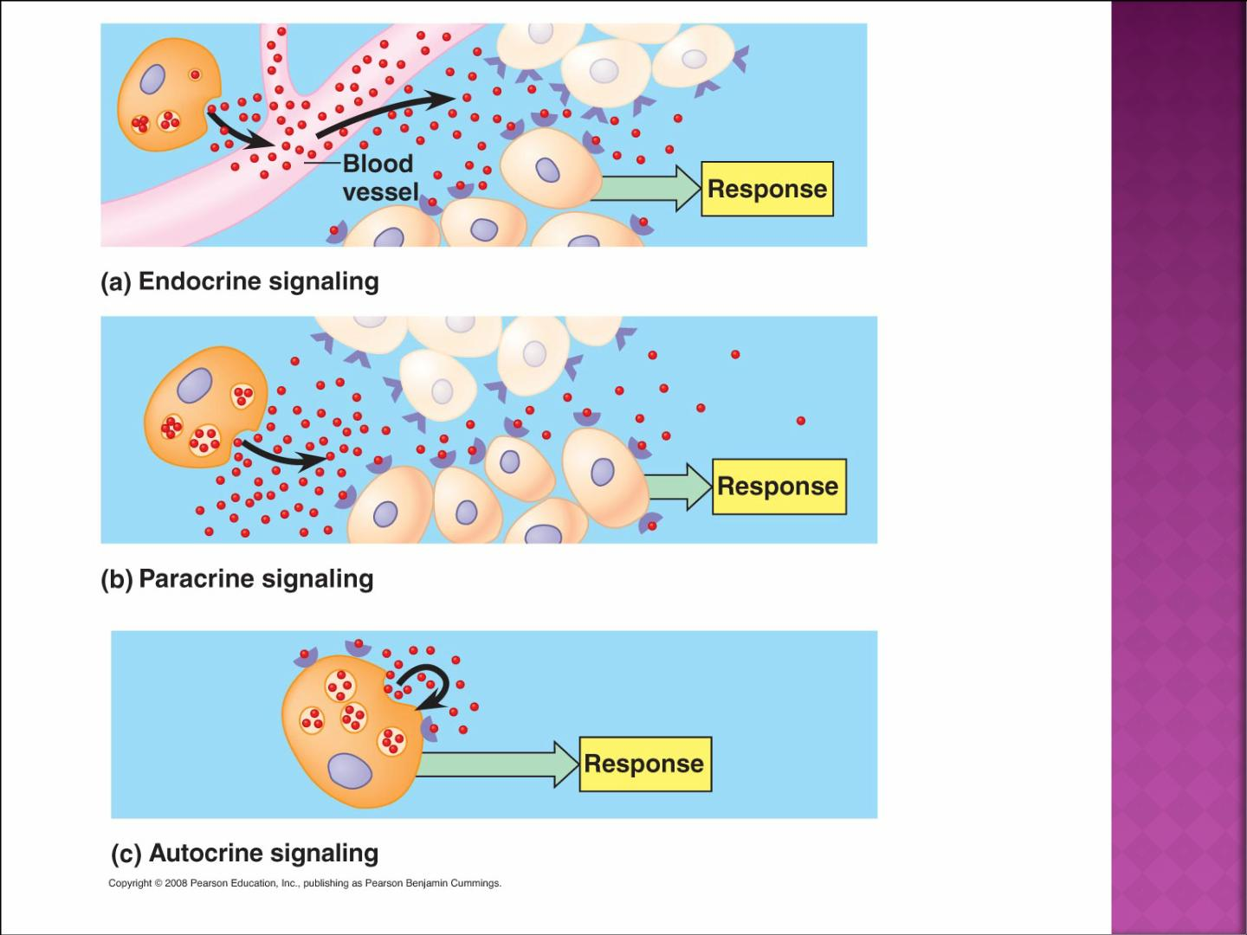

Slide 8
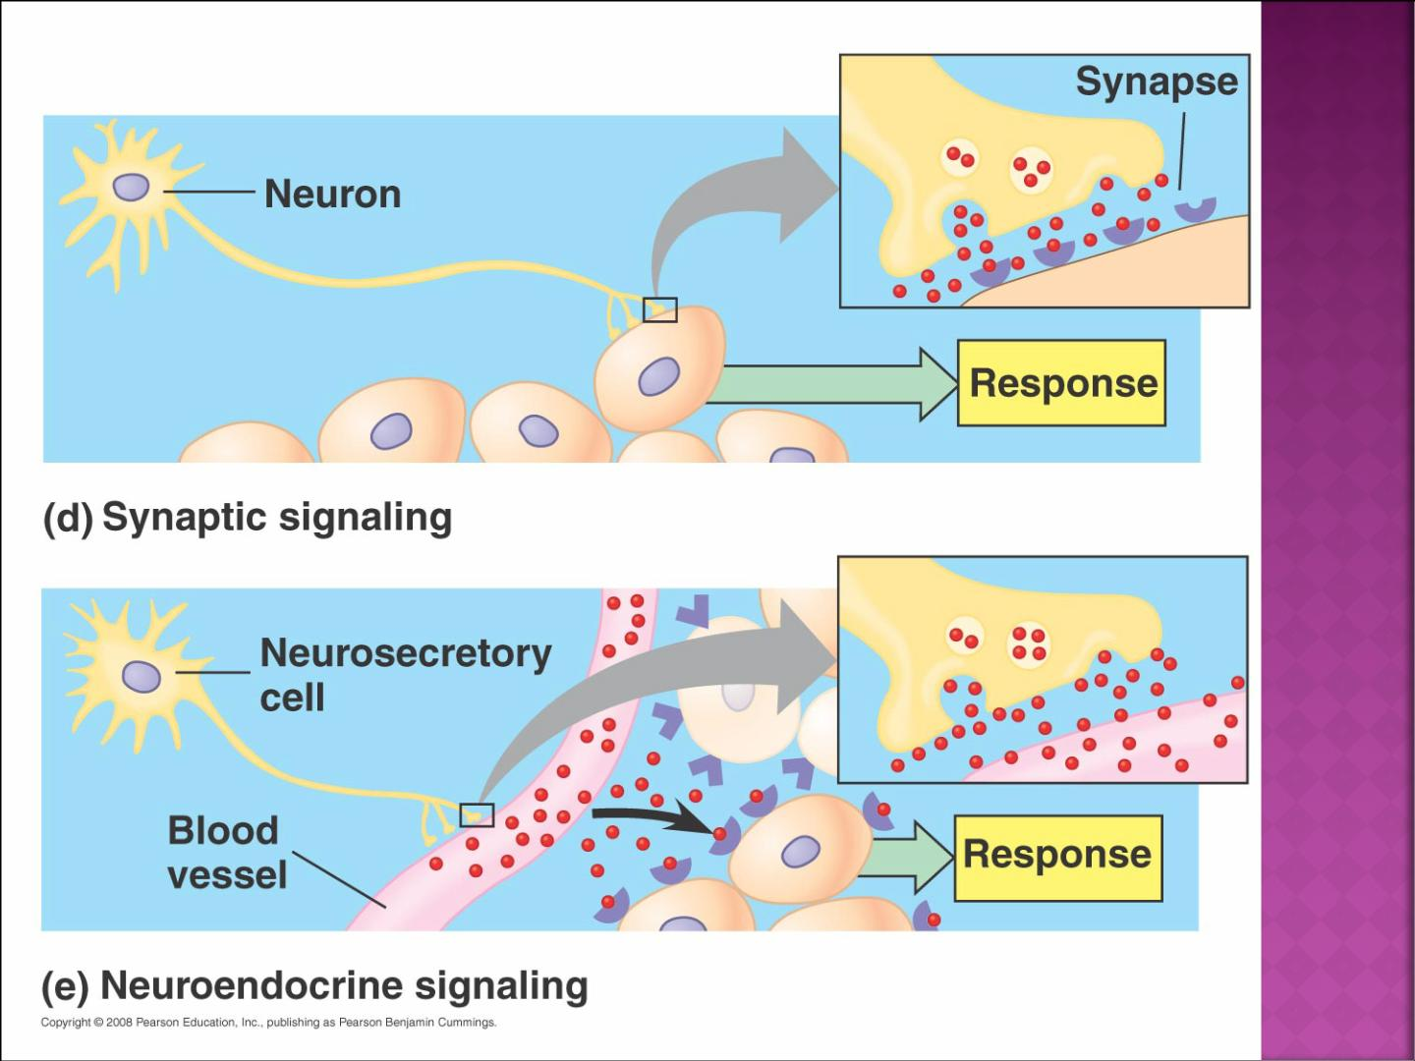

Slide 9
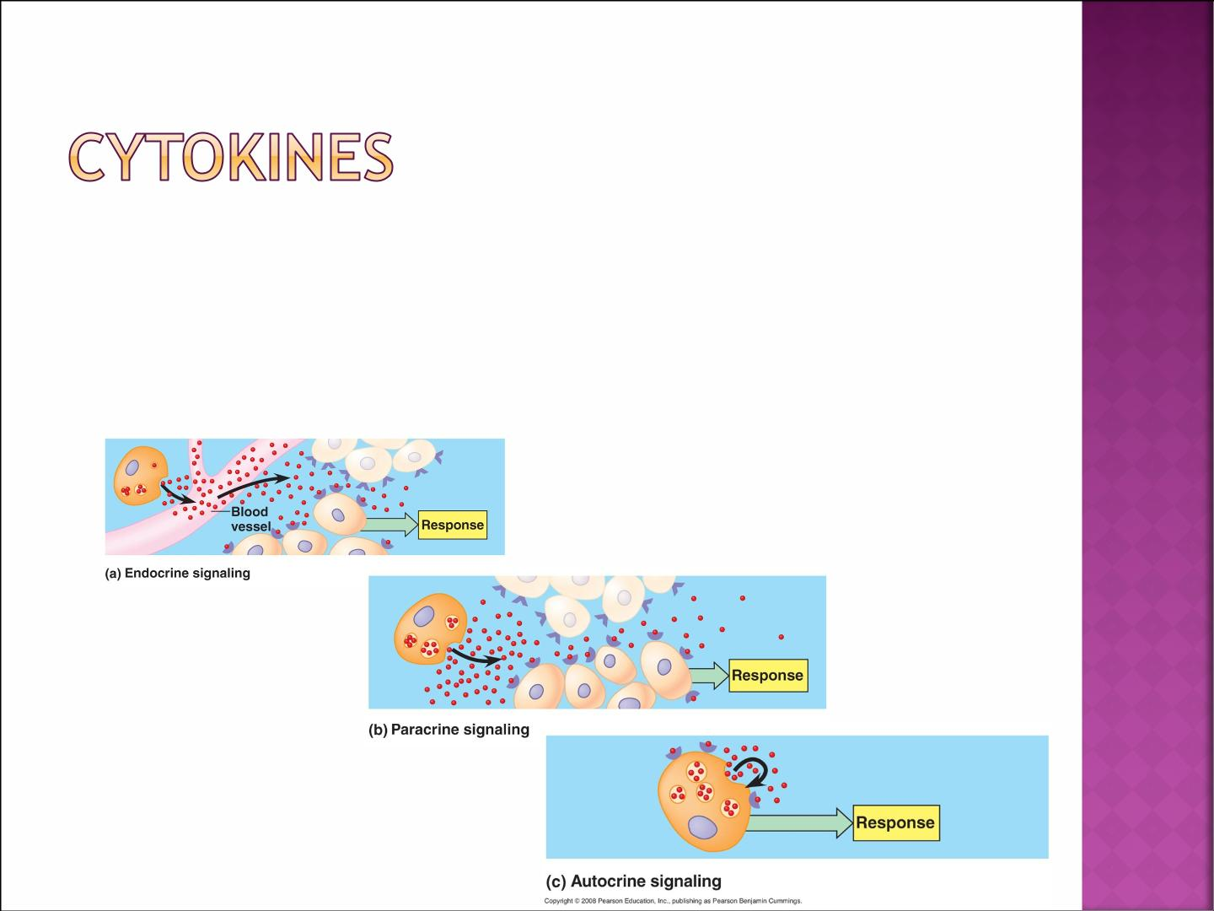
 Peptides (interleukins, lymphokines, adipokines).
 Secreted by cells into extracellular fluid (ECF).
 Can function as endocrine, paracrine or autocrine.

Slide 10
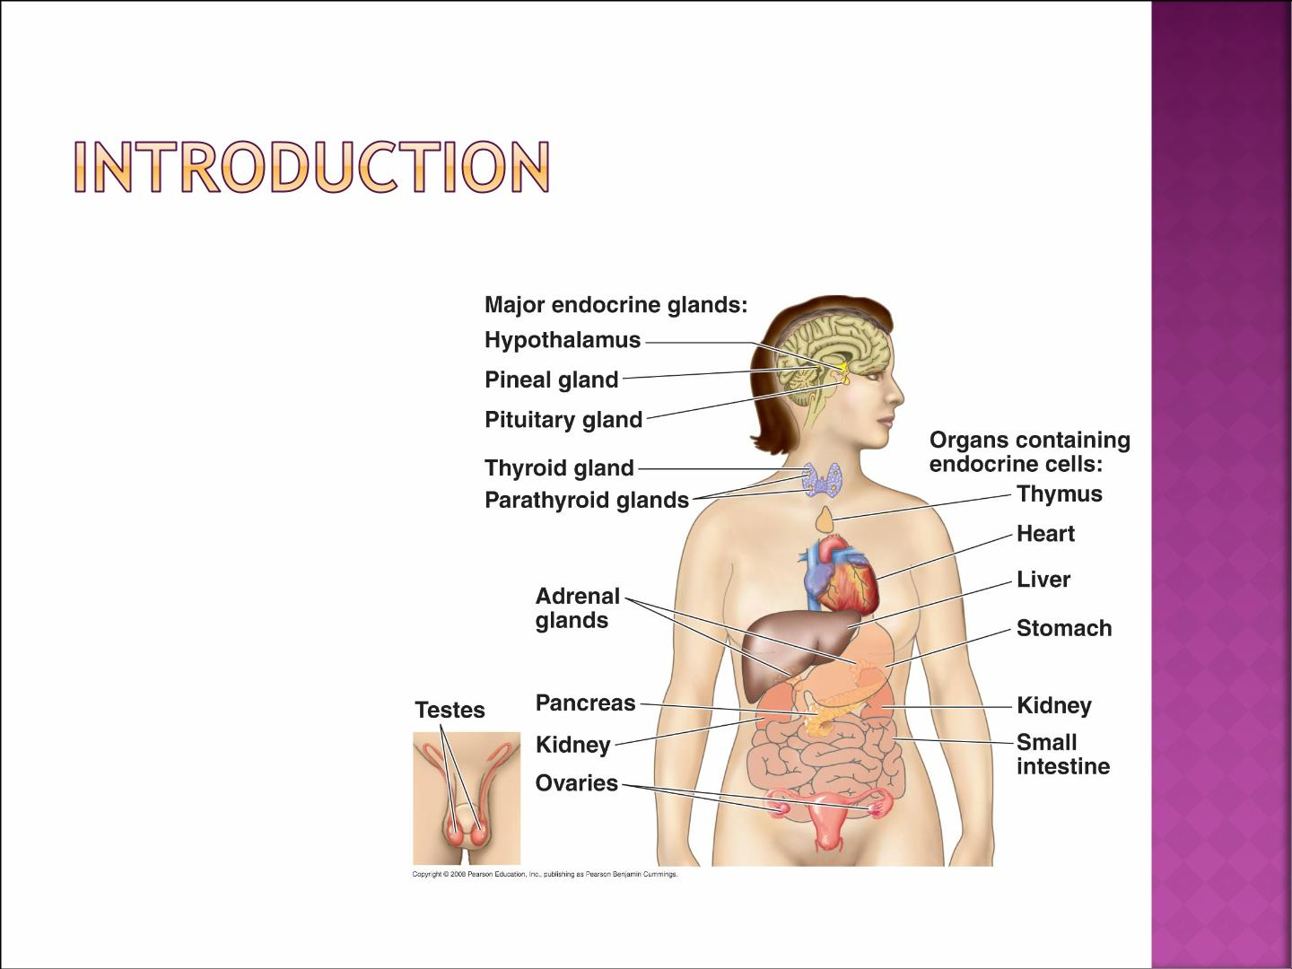
 Endocrine glands:
¡ Pituitary
¡ Thyroid
¡ Parathyroid
¡ Adrenal
¡ Pancreas
¡ Ovaries
¡ Testes

Slide 11

 The multiple hormone systems play a key
role in regulating almost all body
functions:
¡ Metabolism
¡ Growth and development
¡ Water and electrolyte balance
¡ Reproduction
¡ Behavior

Slide 12

 Definition :
¡ Hormone is a chemical substance released by
group of cells to control the function of other type of cells.
 Types of hormones:
¡ Affect many different types of cells (eg. GH and
Thyroxin).
¡ Affect only specific target cells (eg. ACTH and
estrogen).

Slide 13
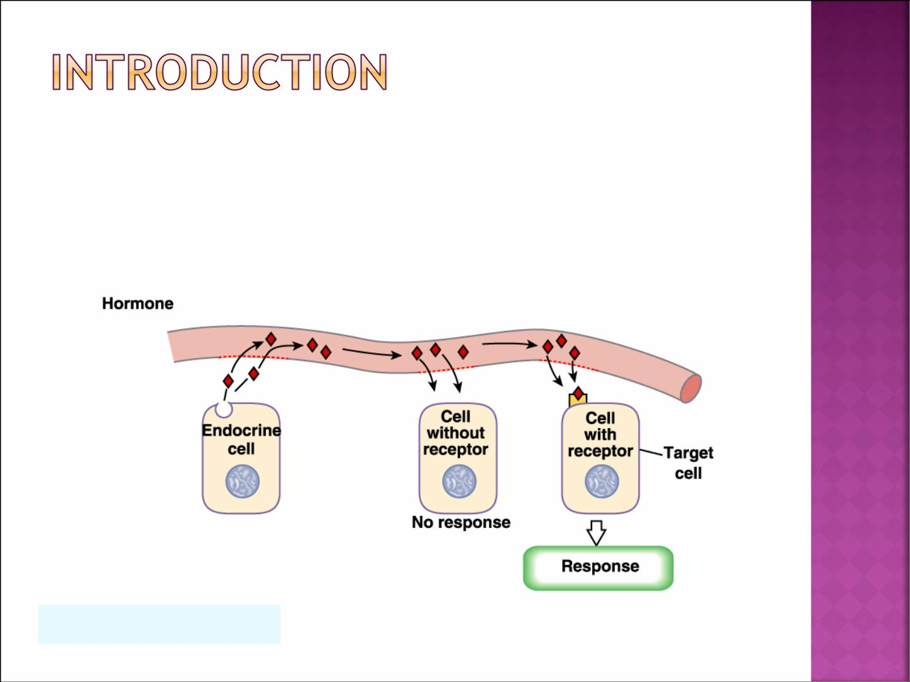
 What are target cells?
Target cells refer to cells that contain specific
receptors (binding sites) for a particular hormone.
Silverthorn, Human Physiology, 3rd
edition Figure 6-1&2

Slide 14
Chemical Structure and Synthesis of Hormones
There are 3 general classes of hormones
1- Proteins and polypeptides: [stored in vesicles until needed]
- anterior and posterior pituitary gland
- pancreas (insulin and glucagon)
- parathyroid gland (parathyroid hormone)
2- Steroids: [diffuse across the cell membrane]
- adrenal cortex (cortisol and aldosterone)
- ovaries (estrogen and progesterone)
- testes (testosterone)
3- Derivatives of the amino acid tyrosine:
- thyroid hormones.
- adrenal medullae (epinephrine and norepinephrine)

Slide 15
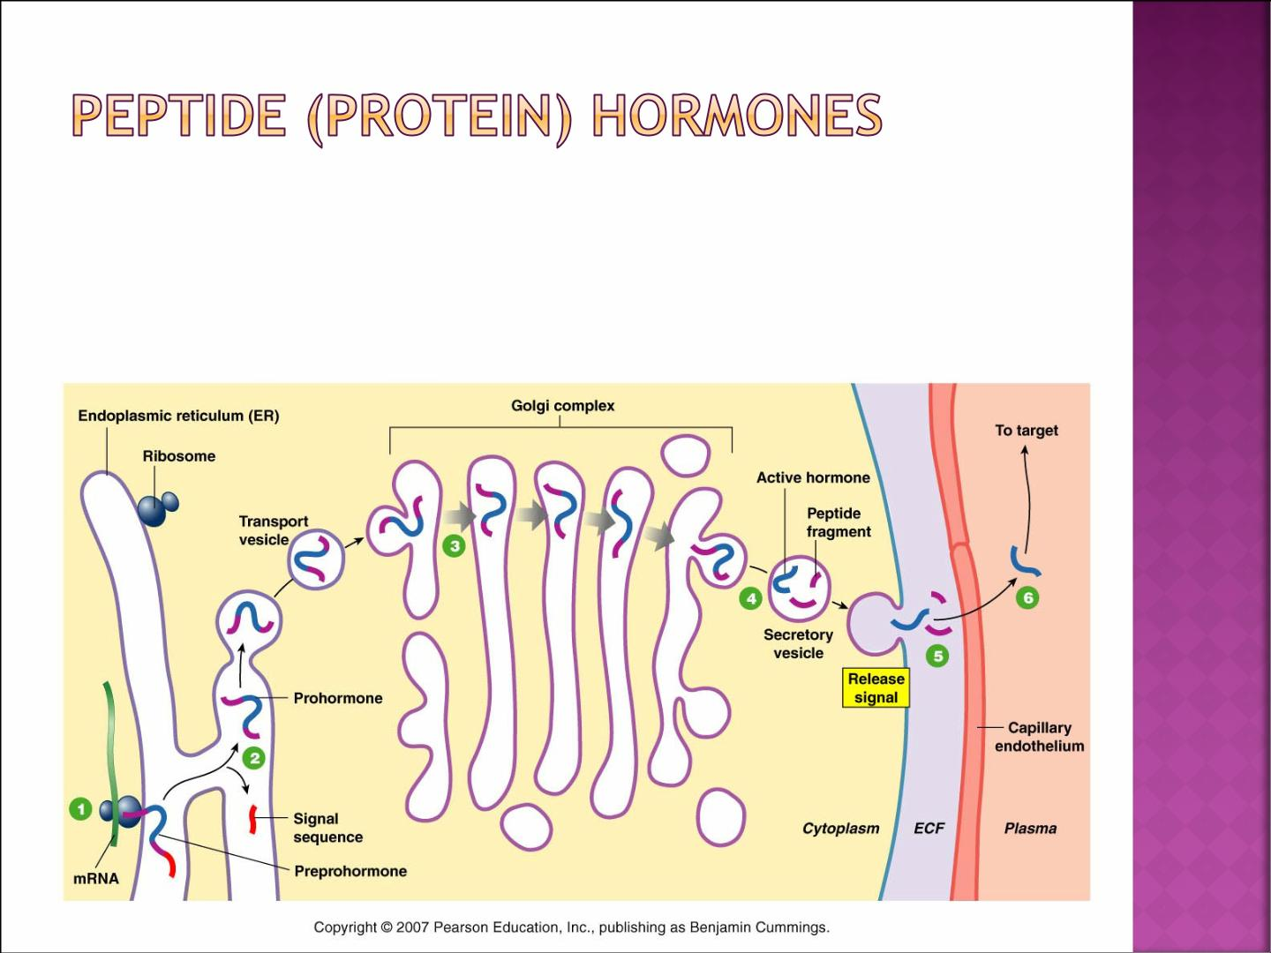
®
 Synthesized as preprohormone post-
translational modification to prohormone
then hormone
®

Slide 16
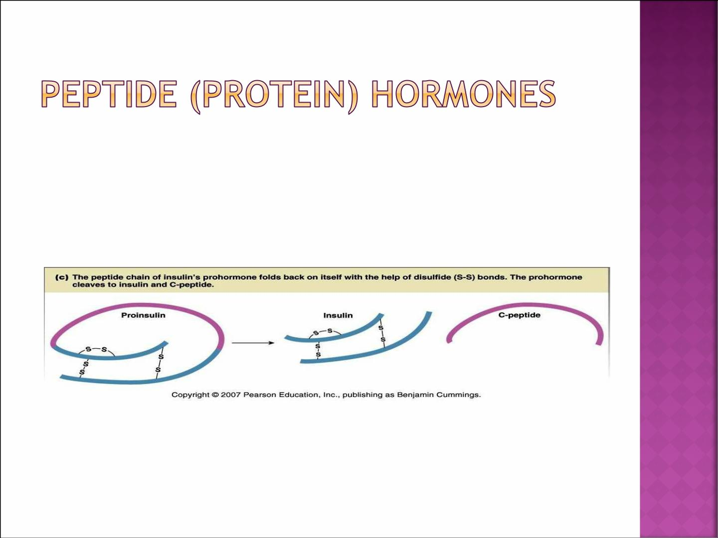
 Example of protein hormone:
¡ Insulin

Slide 17
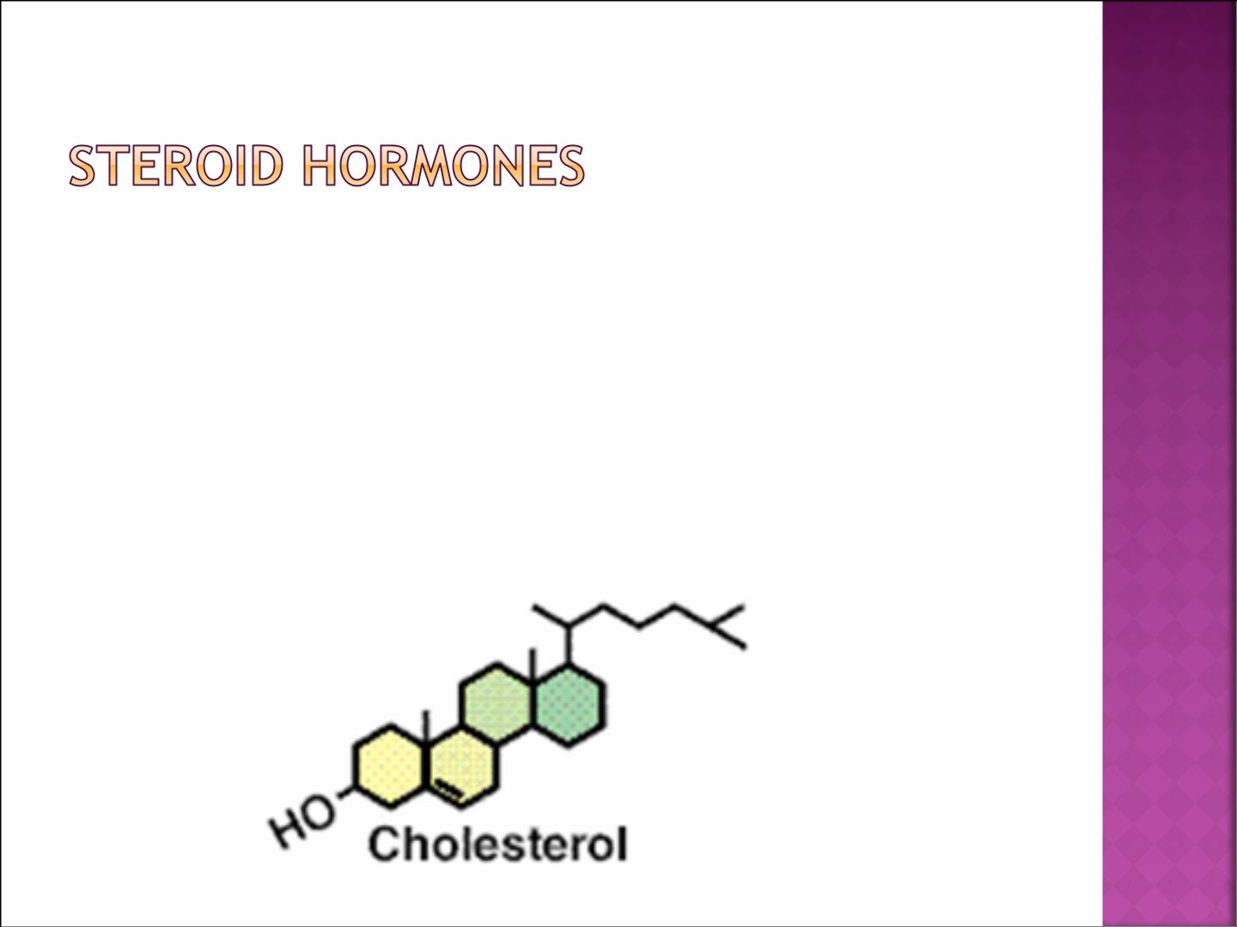
 Secreted by gonads, adrenals, placenta.
 Derived from cholesterol (lipophilic)
¡ Cross membranes (no storage)
 On-demand synthesis (SER)
 Usually Bound to Carrier proteins

Slide 18
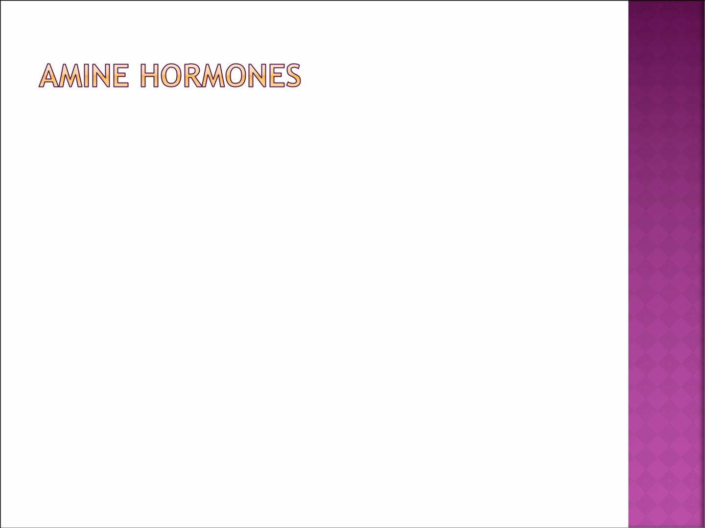
 Derived from tyrosine or tryptophan.
 3 groups
Þ
¡ Tryptophan Melatonin
Þ
¡ Tyrosine Catecholamines
behave like peptide hormones
Þ
¡ Tyrosine Thyroid hormones
behave like steroid hormones

Slide 19
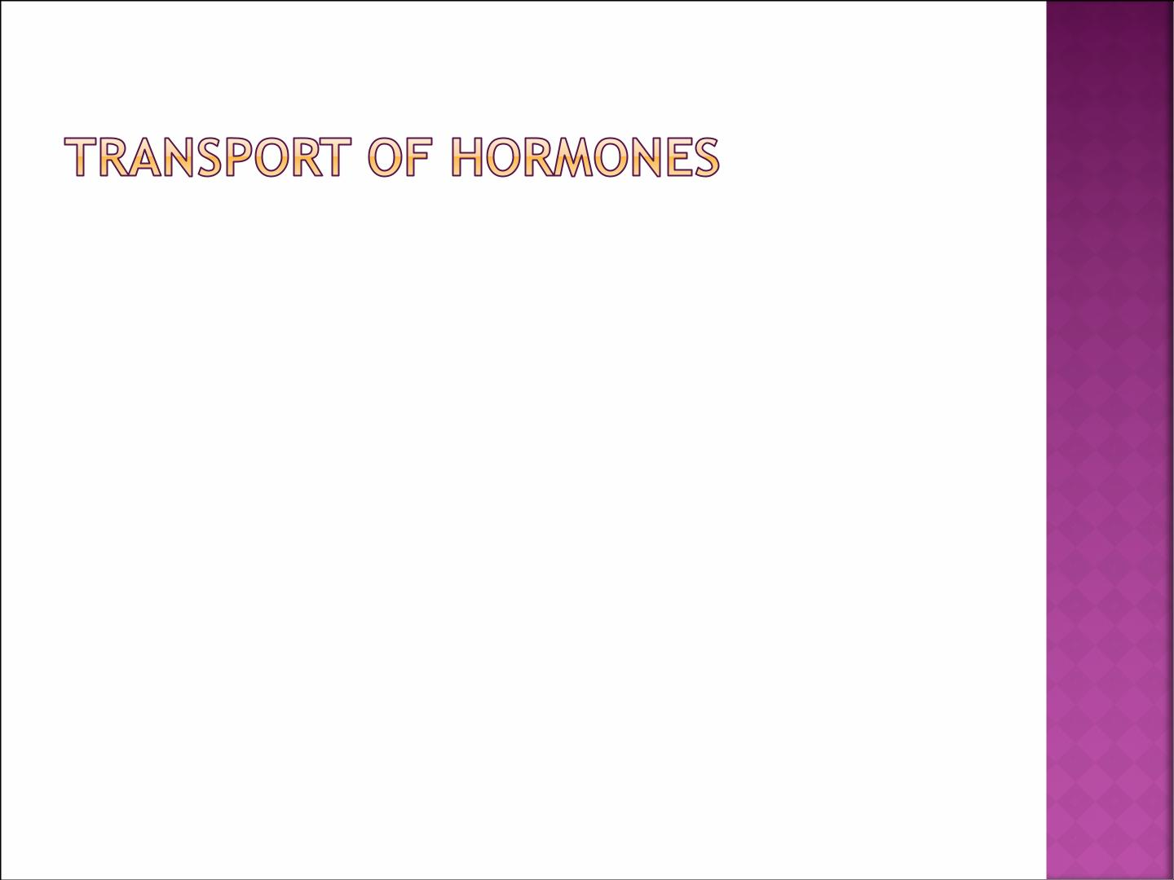
 Water soluble hormones- hydrophilic
(peptides & catecholamines) dissolved in Plasma.
 Fat soluble hormones – hydrophobic Steroids
and thyroid hormones transported bound to
plasma proteins (90%),
binding to proteins helps to:
¡ Provide reservoirs.
¡ Slow hormones clearance.

Slide 20
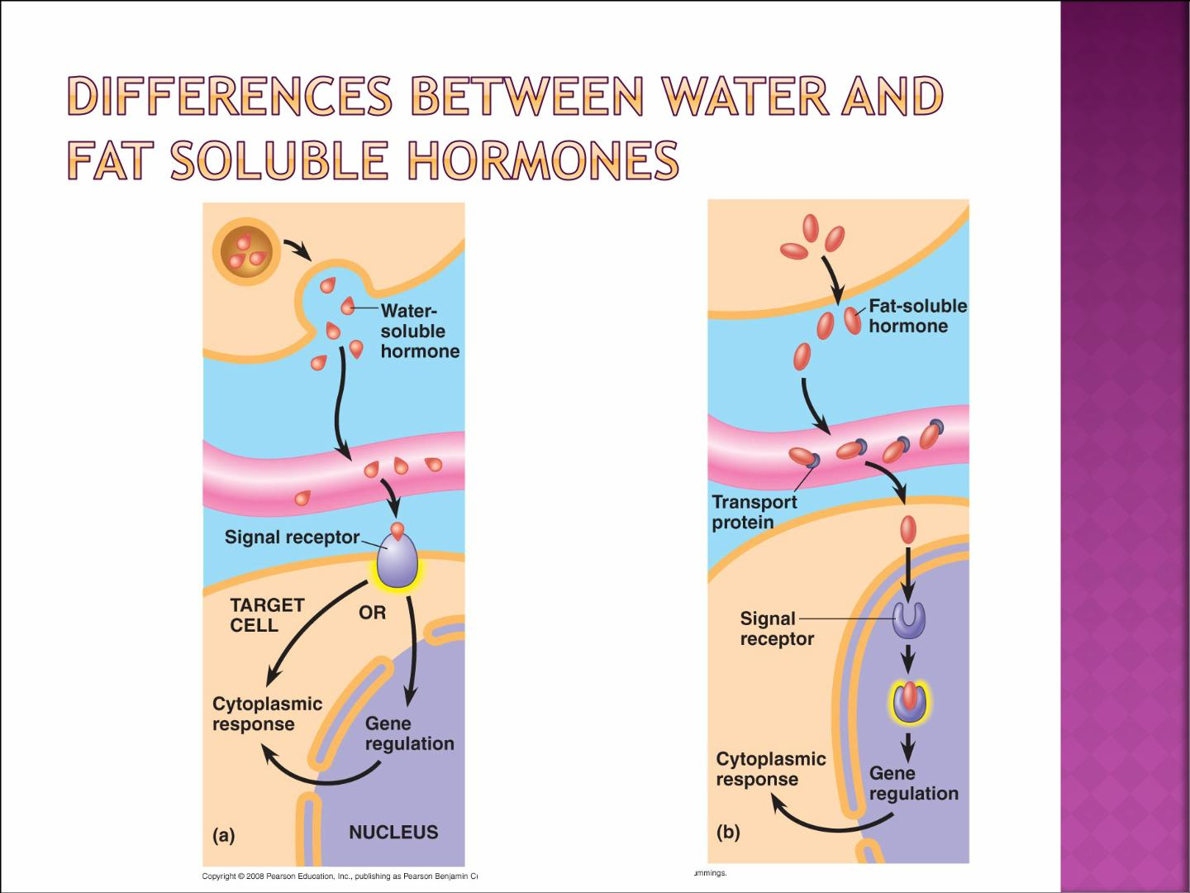
The differences between water-soluble & fat-soluble hormones

Slide 21
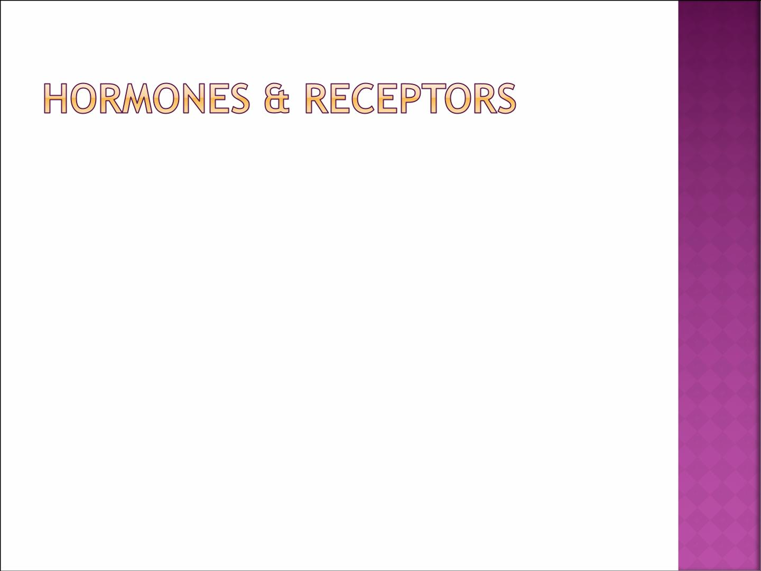
 Receptors:
¡ Hormonal receptors are large proteins.
¡ 2000-100,000 receptors/cell.
¡ Receptors are highly specific for a single hormone.
 Receptor’s Location:
¡ On the surface of cell membrane (proteins, peptides and catecholamines).
¡ In the cell cytoplasm (Steroids).
¡ In the cell nucleus (thyroid hormones).

Slide 22
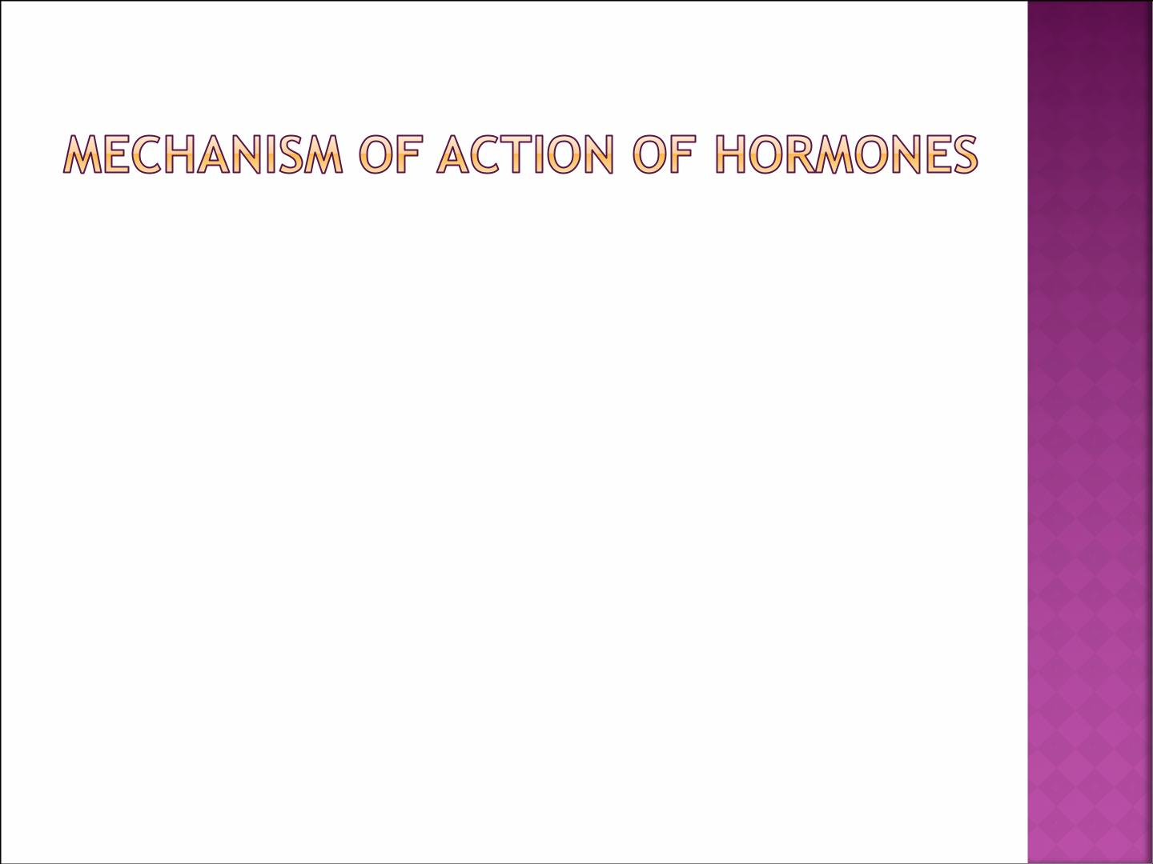
 Mechanism of action:
1. Hormone-receptor interaction (1^{st messenger)}
2. Enzyme activation.
3. Release of the second messenger.
4. Effects on cellular function.

Slide 23
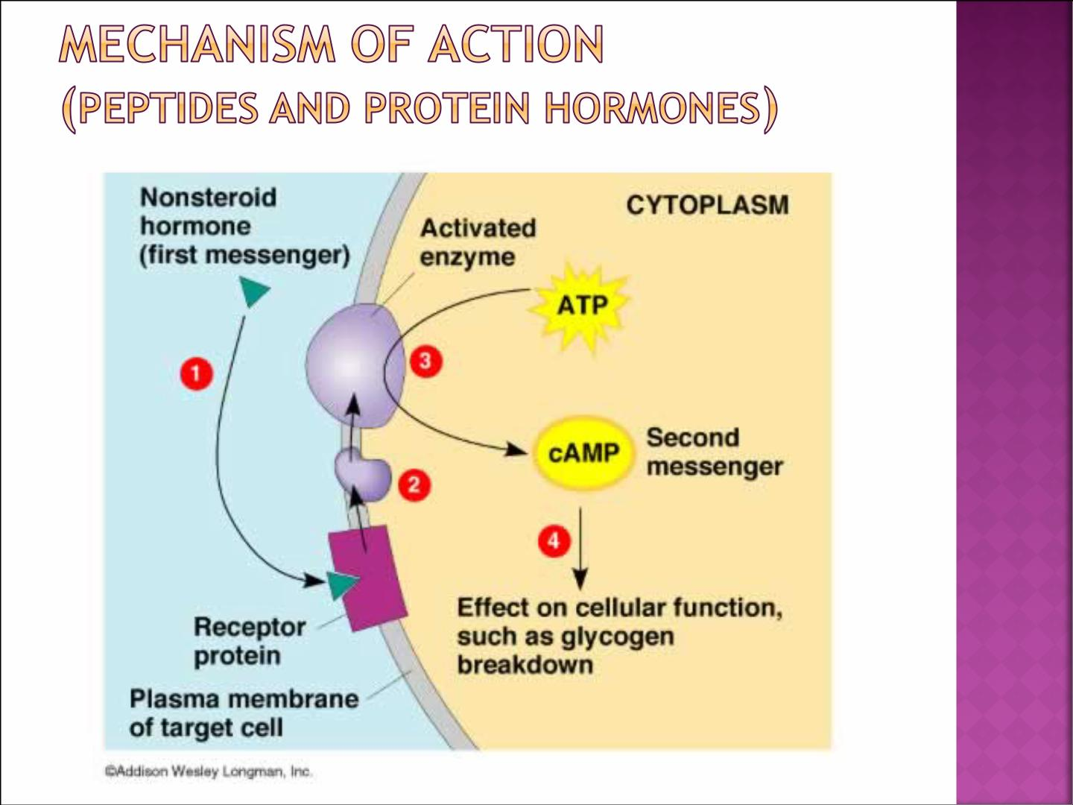

Slide 24
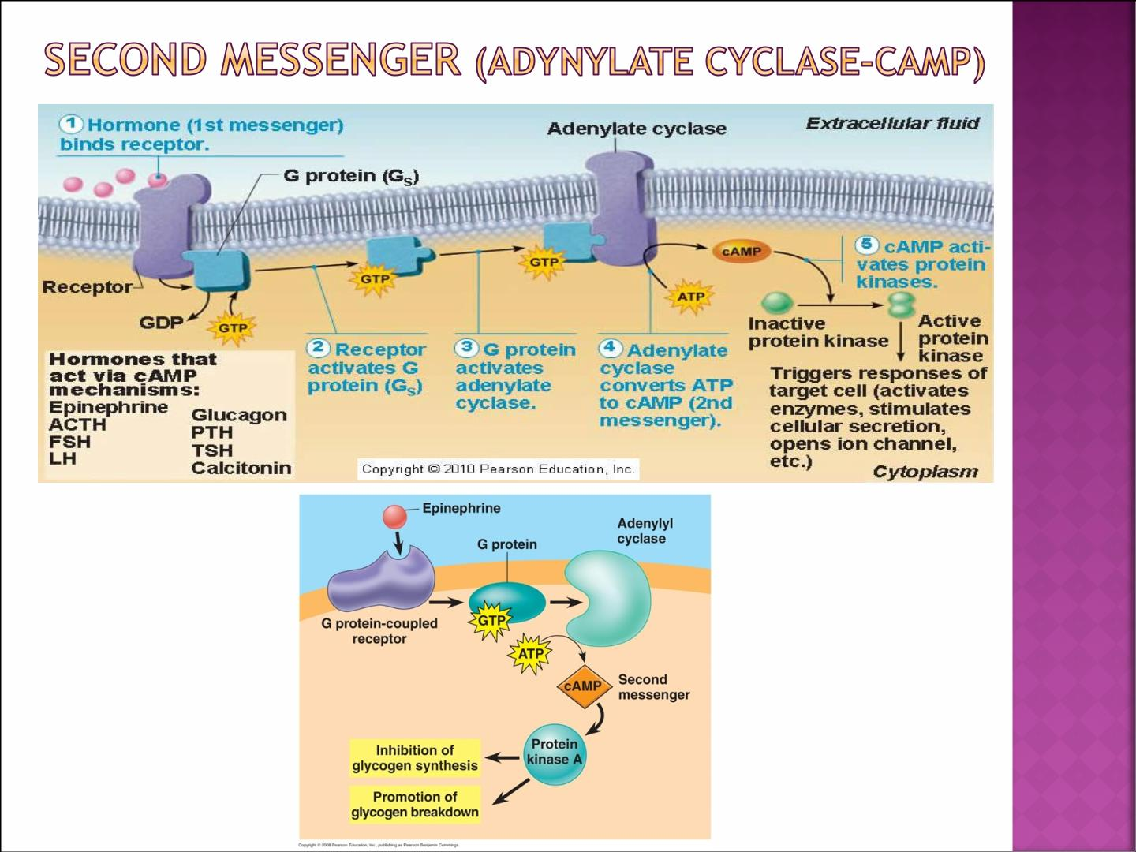

Slide 25
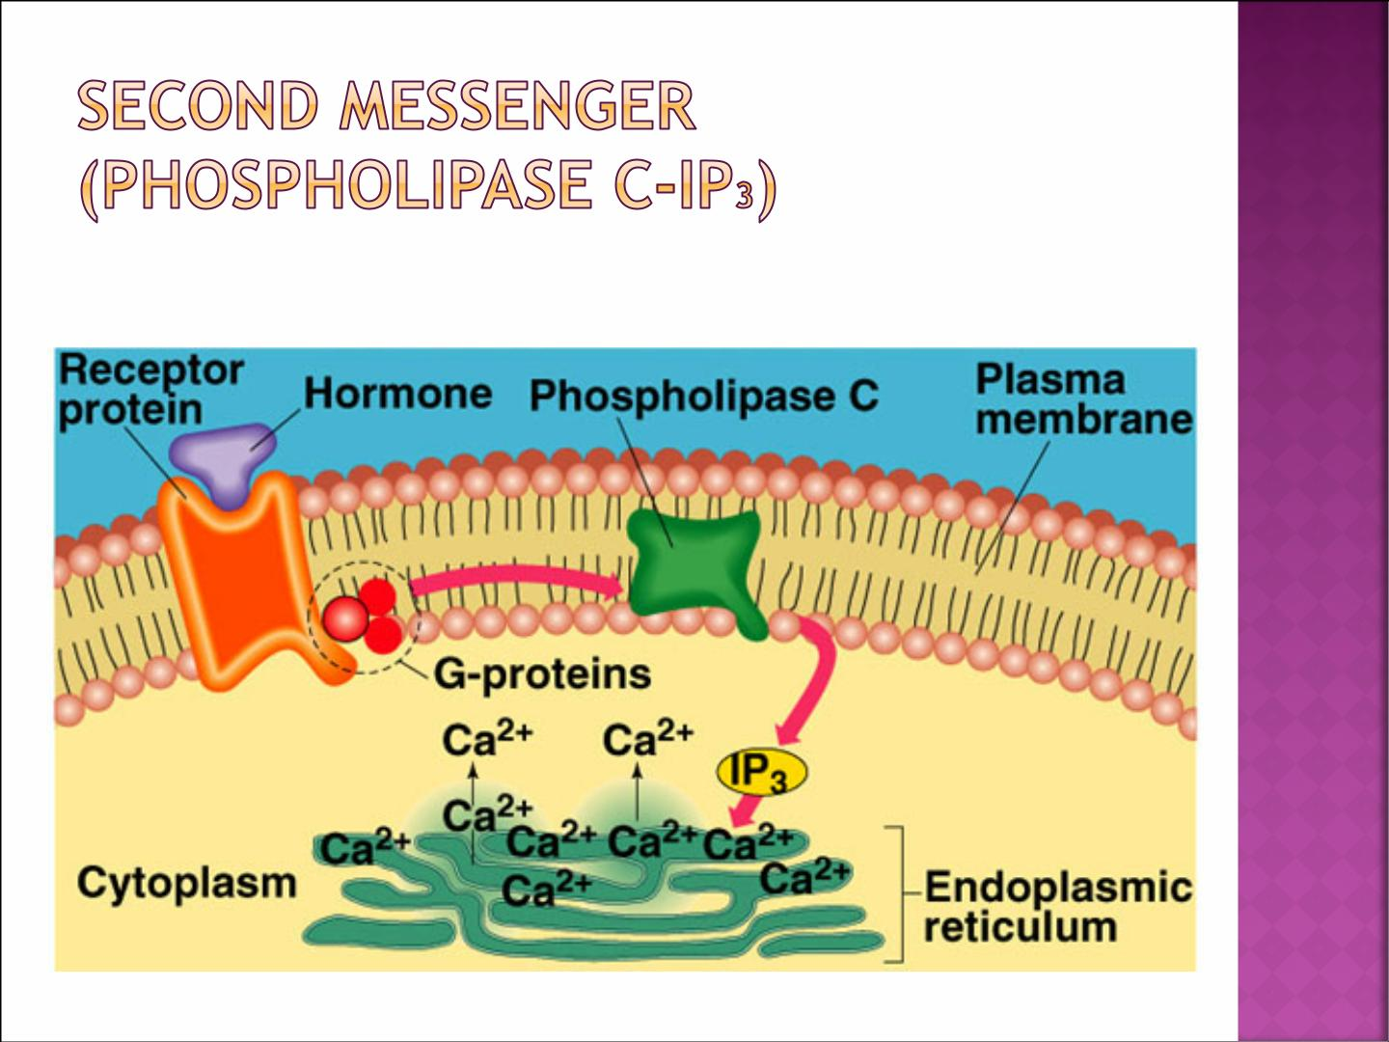

Slide 26
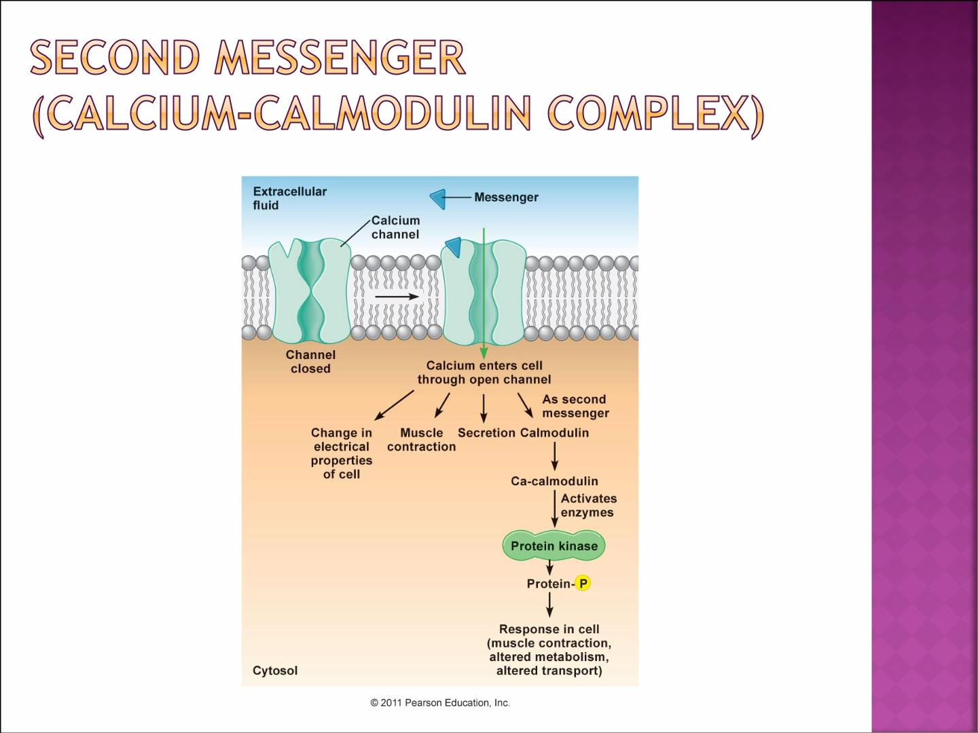

Slide 27
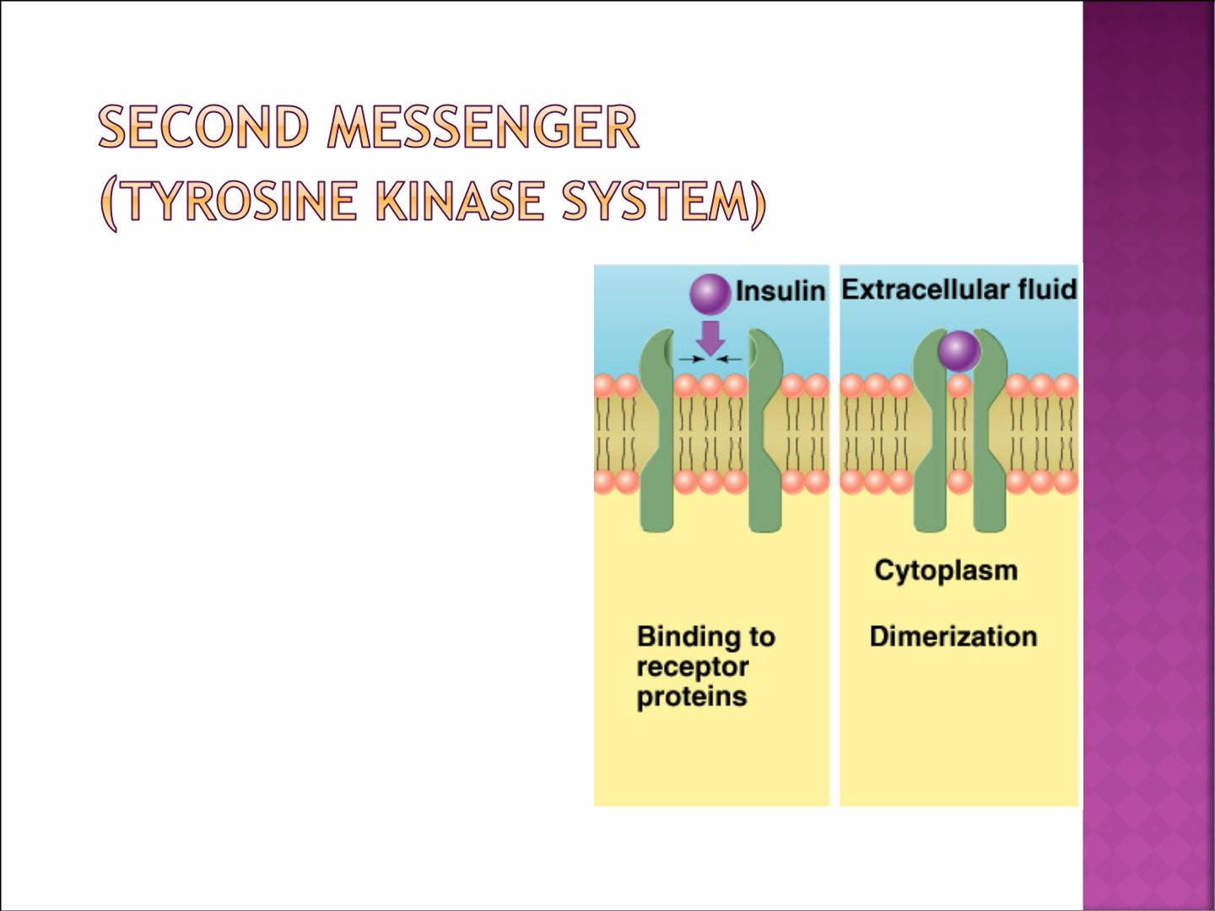
 Is used by insulin &
many growth factors to
cause cellular effects.
 Surface receptor is
tyrosine kinase
¡ Consists of 2 units
that form active
dimer when insulin
binds.

Slide 28
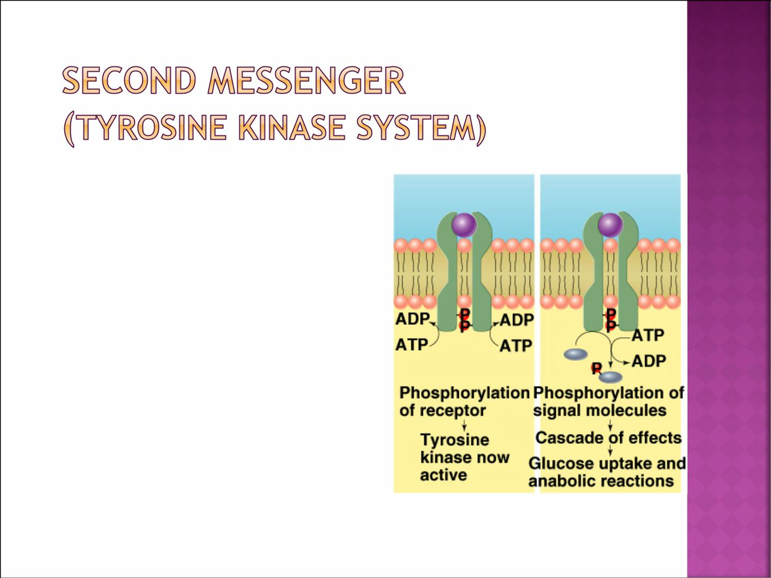
 Activated tyrosine kinase phosphorylates signalling molecules.
- Induction of hormone/growth
factor effects.

Slide 29
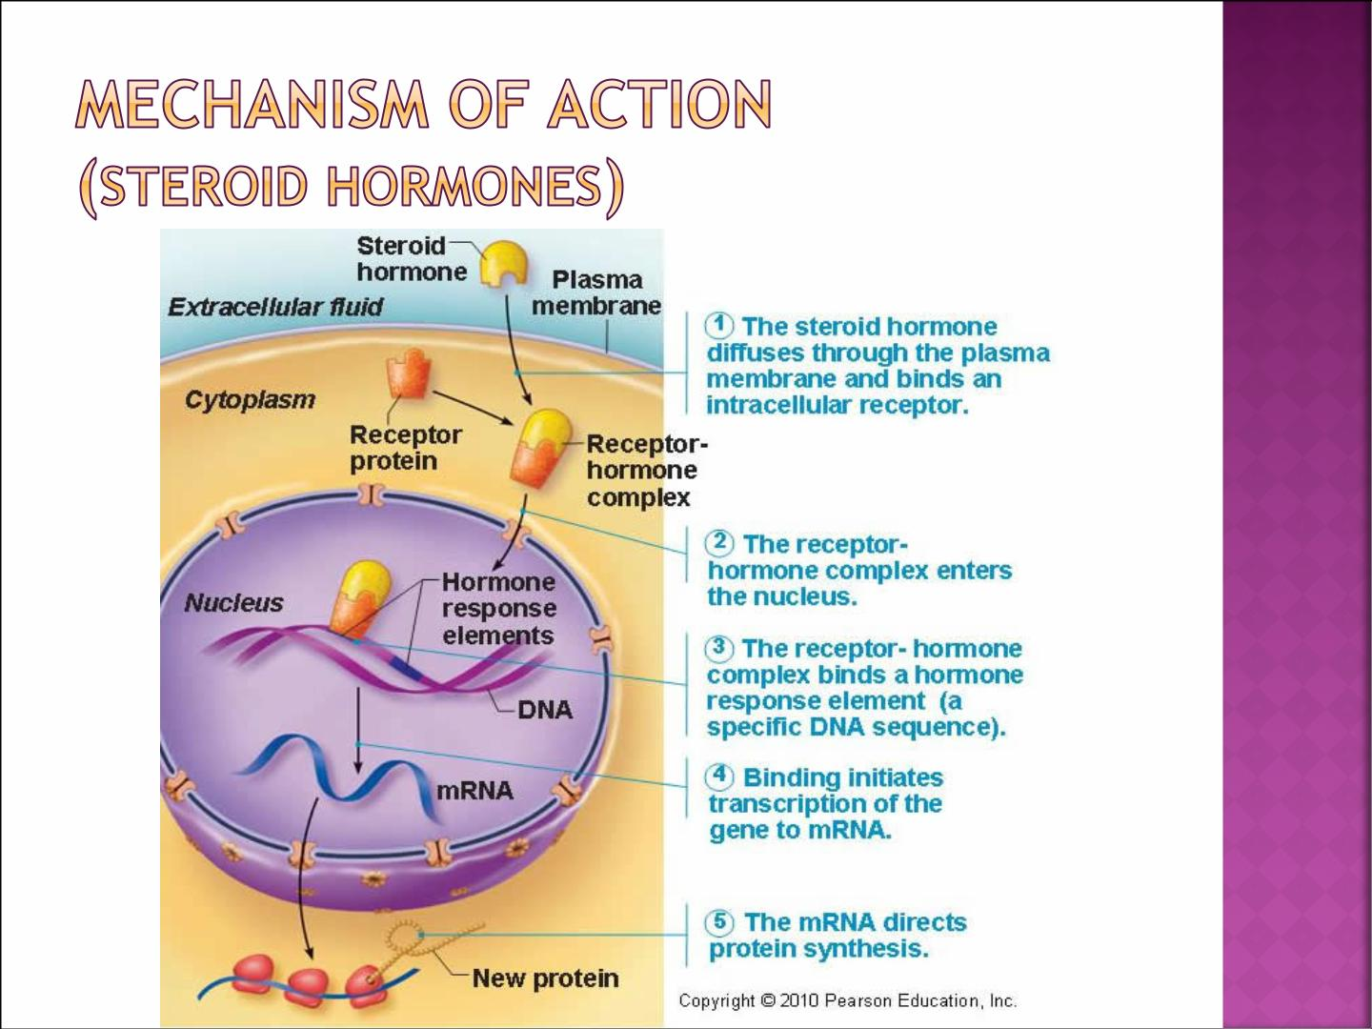

Slide 30
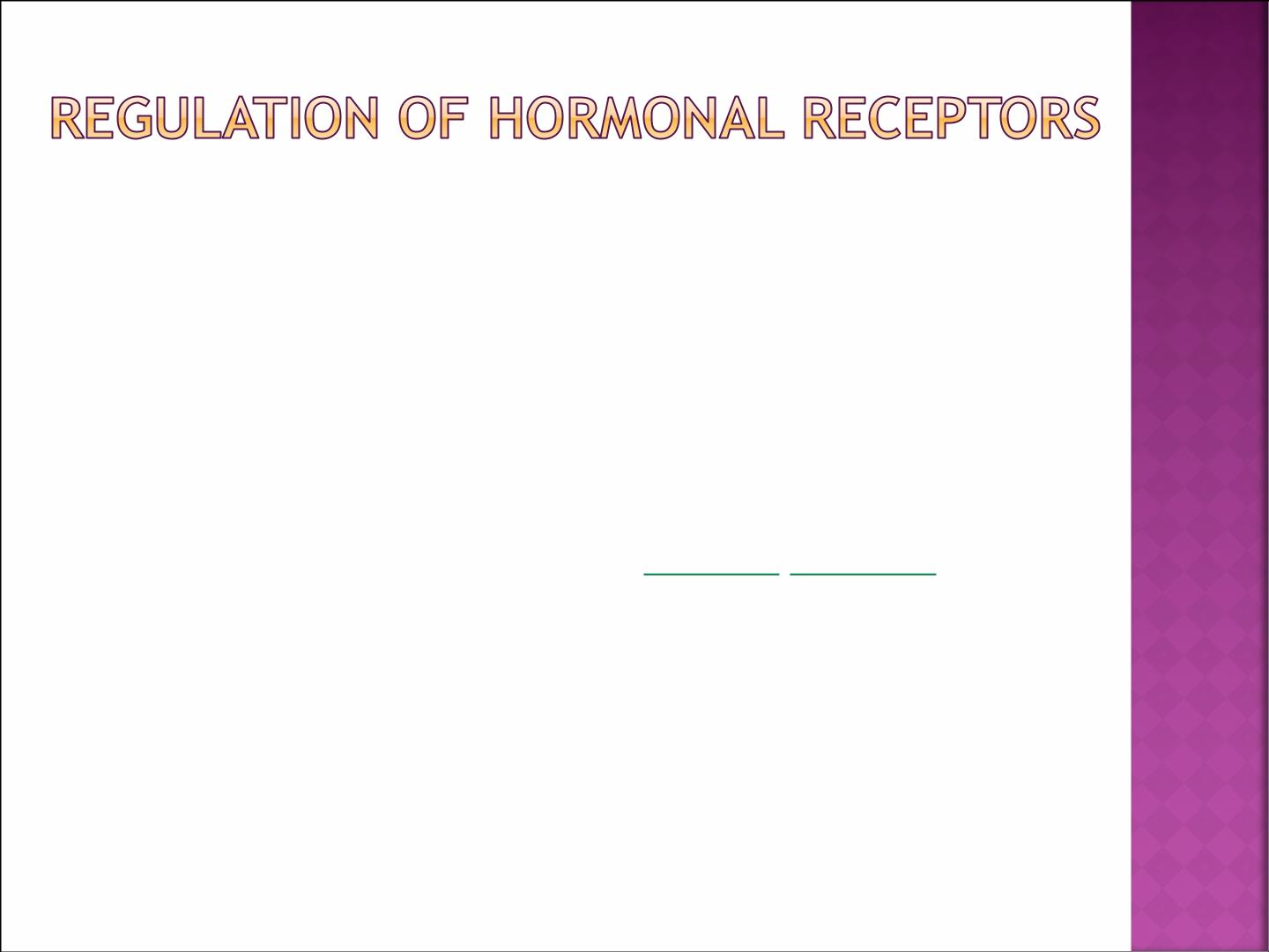
¡ Receptors does not remain constant
¢ Inactivated or destroyed
¢ Reactivated or manufactured
¡ Downregulation
¢ Increase hormone concentration leads to decrease in
the number of active receptors.
¢ Most peptide hormones have pulsatile secretion which
prevents downregulation.
¡ Upregulation
¢ The hormone induces greater than normal formation
of a receptor or intracellular signaling proteins.

Slide 31
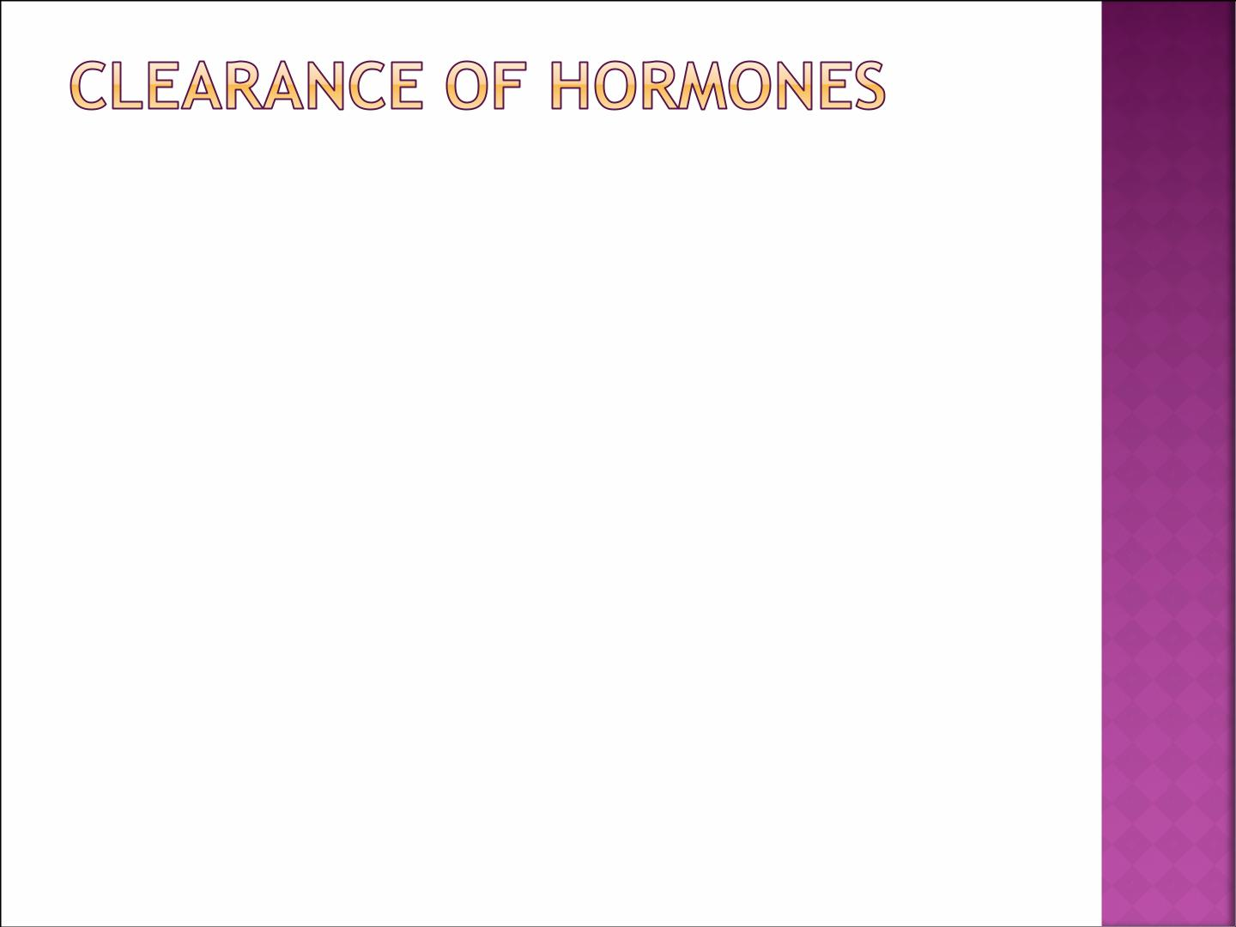
 Two factors control the concentration of a
hormone in the blood:
¡ The rate of its secretion
¡ The rate of its removal (metabolic clearance)
 Hormones are cleared by:
¡ Metabolic destruction by tissues
¡ Binding with tissues
¡ Excretion by the liver into bile
¡ Excretion by the kidney into urine
 Clearance of protein bound hormones is
slower than clearance of peptide hormones

Slide 32
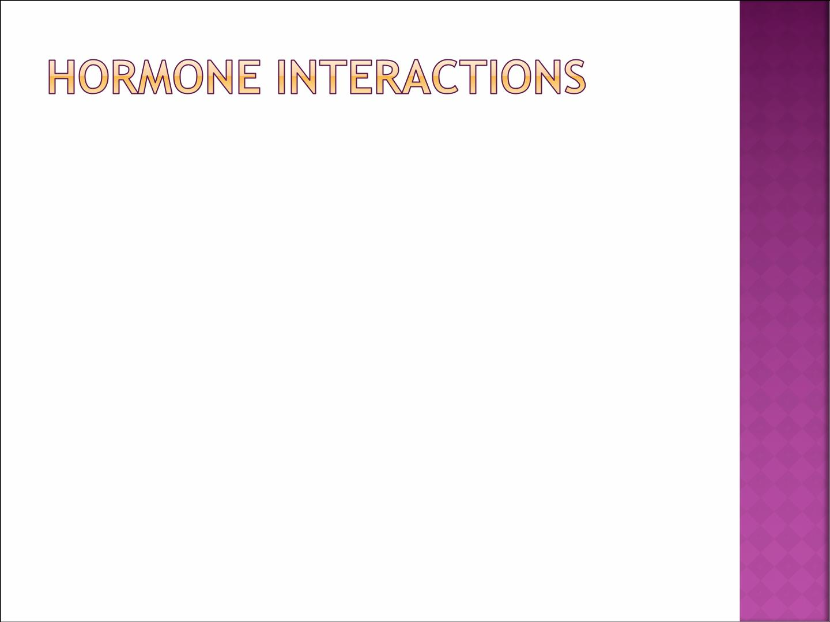
 Multiple hormones can affect a single target
simultaneously
 Three types of hormone interactions:
1. Synergism
2. Permissiveness
3. Antagonism

Slide 33
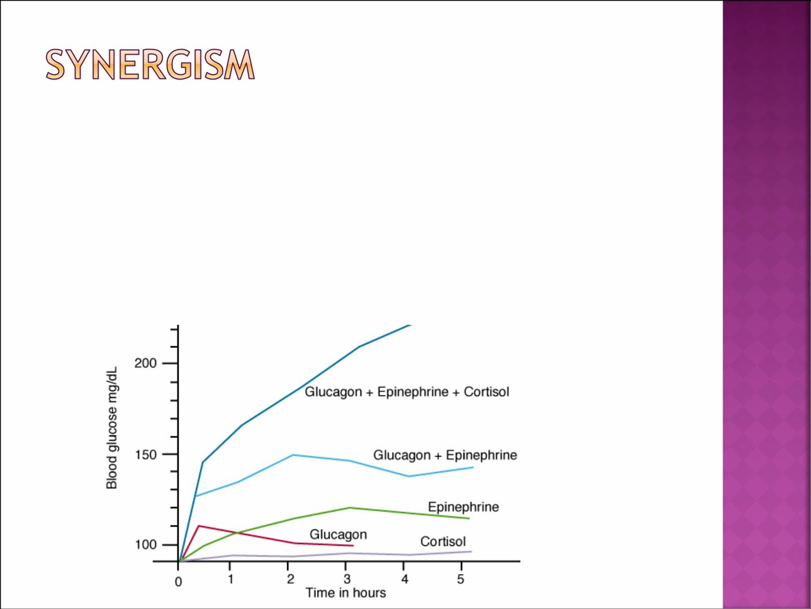
 Combined action of hormones is more
than just additive.
 Example: Blood glucose levels & synergistic effects of glucagon, cortisol and epinephrine.

Slide 34

 One hormone allows another hormone to have
its full effect
¡ Especially during growth.
 Example
¡ Thyroid hormone have permissive effect on
growth hormone action.
¡ Deficiency of thyroid hormone in infants leads
to dwarfism.

Slide 35

 Antagonistic hormones have opposing
physiological actions.
¡ Hormone B diminishes the effect of hormone A
 Example
¡ Glucagon antagonizes the action of insulin.

Slide 36
بالتوفيق

