Slide 1
Endocrinology
PHYSIOLOGY OF HYPOTHALAMO-PITUITARY AXIS AND REGULATORY MECHANISMS
Dr Nervana Mustafa
Associate professor of Physiology
College of medicine
KSU

Slide 2
PHYSIOLOGY OF HYPOTHALAMO-PITUITARY AXIS & REGULATORY MECHANISMS
⦿ Structure of pituitary gland:
◼ Anterior pituitary cell types and hormones.
◼ Posterior pituitary cell types and hormones.
⦿ Hypothalamic control of pituitary gland:
◼ Hypothalamo-hypophysial portal system.
◼ Hypothalamo-hypophysial tract.
⦿ Feedback mechanisms:
◼ Positive feedback.
◼ Negative feedback.

Slide 3
STRUCTURE OF PITUITARY GLAND
⦿ Pituitary gland consist of two lobes:
◼ - Anterior (Adenohypophysis)
◼ - Posterior (Neurohypophysis)

Slide 4
HISTOLOGY OF PITUITARY GLAND
⦿ Anterior pituitary originates from Rathke’s
pouch (pharyngeal epithelium).
⦿ Posterior pituitary originates from
hypothalamus (glial-type cells).
Anterior
Pituitary
Posterior
Pituitary

Slide 5
STRUCTURE OF PITUITARY GLAND
[RELATION TO OPTIC CHIASM]

Slide 6
HYPOTHALAMIC CONTROL OF PITUITARY SECRETIONS
⦿ Almost all secretions by the pituitary are
controlled by either:
◼ Hormonal secretion of hypothalamus
(The anterior pituitary)
or
◼ Nervous signals from hypothalamus
(The Posterior pituitary)

Slide 7
CONTROL OF ANTERIOR PITUITARY BY
HYPOTHALAMUS
⦿ Special neurons in the hypothalamus synthesize and secrete the hypothalamic releasing and inhibitory hormones that control secretion of anterior pituitary.
⦿ Neurons send their nerve fibers to the median eminence (extension of hypothalamic tissue into the pituitary stalk).
⦿ Hormones are secreted to the tissue fluids, absorbed into the hypothalamic-hypophysial portal system and transported to the sinuses of the anterior pituitary.

Slide 8
HYPOTHALAMIC CONTROL OF
ANTERIOR PITUITARY GLAND (ADENOHYPOPHYSIS)
⦿ Anterior pituitary gland is connected to hypothalamus by portal system: “hypothalamic-hypophysial portal vessels”.

Slide 9
CONTROL OF ANTERIOR PITUITARY
BY HYPOTHALAMUS

Slide 10
STRUCTURE OF PITUITARY GLAND
⦿ Anterior pituitary
contains 5 cell types:
◼ Somatotrops: GH 40%
◼ Corticotrops: ACTH 20%
◼ Thyrotropes: TSH
◼ Gonadotropes: LH & FSH
◼ Lactotrops: PRL

Slide 11
HYPOTHALAMIC RELEASING & INHIBITING HORMONES
⦿ Growth hormone releasing hormone (GHRH):
◼ Stimulates release of
growth hormone.
⦿ Growth hormone
inhibiting hormone (GHIH), also called Somatostatin:
◼ Inhibits release of
growth hormone.

Slide 12
HYPOTHALAMIC RELEASING & INHIBITING HORMONES
⦿ Thyrotropin-releasing hormone (TRH):
◼ Stimulates release of thyroid stimulating hormone (TSH).

Slide 13
HYPOTHALAMIC RELEASING &
INHIBITING HORMONES
⦿ Corticotropin-releasing hormone (CRH):
◼ Stimulates release of adrenocorticotropin hormone (ACTH)

Slide 14
HYPOTHALAMIC RELEASING &
INHIBITING HORMONE
⦿ Gonadotropin
releasing hormone (GnRH).
⦿ causes release of the
2 gonadotropic hormones:
Luteinizing (LH).
- Follicle-stimulating hormone (FSH).
◼

Slide 15
HYPOTHALAMIC RELEASING & INHIBITING HORMONES
⦿ Prolactin Iinhibitory hormone (PIH) also known as;
Dopamine
◼ Inhibits prolactin secretion

Slide 16
POSTERIOR PITUITARY GLAND
(Neurohypophysis)

Slide 17
HYPOTHALAMIC CONTROL OF
POSTERIOR PITUITARY GLAND (NEUROHYPOPHYSIS)
⦿ Hormones synthesized in the supraoptic and paraventricular nuclei of the hypothalamus and released in posterior pituitary.

Slide 18
SECRETION OF POSTERIOR PITUITARY HORMONES

Slide 20
FEEDBACK MECHANISM
Positive feedback Negative feedback
Release of hormone (A) stimulates the release of
hormone (B).
- Hormone (B) stimulates further release of hormone (A).
- Release of hormone (A)
stimulates the release of hormone (B).
- Hormone (B) inhibits the release of hormone (A).

Slide 21
NEGATIVE FEEDBACK

Slide 22
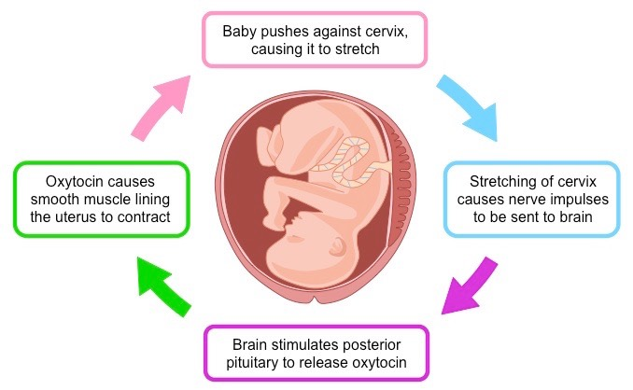

Slide 23
NEGATIVE FEEDBACK MECHANISM:
Long and short loop reflexes

Slide 24
Negative feedback control mechanism of CORTISOL

Slide 25
Negative feedback mechanism of sex steroid hormones

Slide 26
وفقن الله

