Slide 1
Introduction to Endocrinology
Dr Nervana Mustafa
Associate Professor of Physiology
College of Medicine - KSU

Slide 2
Pituitary gland
Anterior Pituitary = adenohypophysis
hypothalamus
Hypothalamo- hypophyseal portal vessels

Slide 3
Anterior Pituitary Adenohypophysis
Anterior pituitary gland is connected to hypothalamus by portal system:
“hypothalamic-hypophysial portal
vessels”.

Slide 4
PITUITARY GLANDS
⦿ Anterior pituitary hormones
◼ Growth Hormone (GH)
Physiological functions.
- Regulation of GH secretion.
Feedback mechanism
Factors controlling secretion.
◼ Prolactin
- Physiological functions
- Regulation of prolactin secretion.

Slide 5
Growth Hormone - GH
[Somatotropin]

Slide 6
Growth hormone (GH) (somatotrophin)
In childhood & adolescence regulates growth & metabolism.
In adults regulates energy metabolism.
Actions:
The effect on growth is mediated through:
[Insulin-like growth factor – IGF-1]/ [somatomedian C],
which is secreted by the liver.
Growth stops with the closure of the epiphysis.

Slide 7
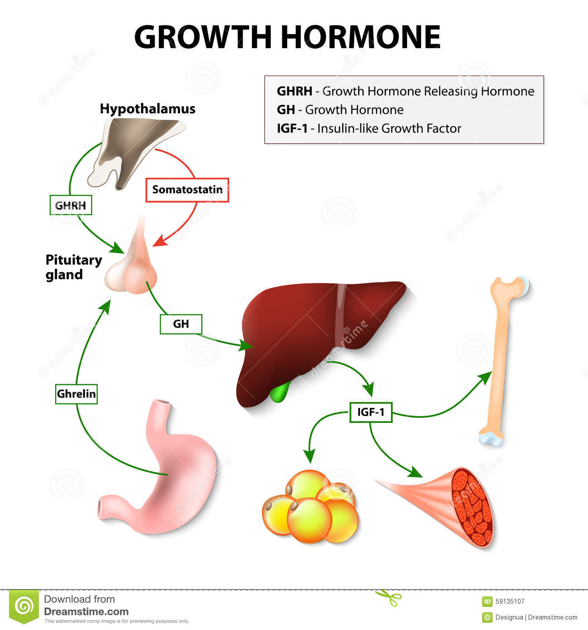

Slide 8
Mechanism of Action
Direct Effect

Slide 9
Indirect Effect
SOMATOMEDINS

Slide 10
FUNCTIONS OF GROWTH HORMONE:
A) Long term effect Promotion of growth:
▪ cellular sizes & mitosis
▪ tissue growth & organ size
Indirect effect
Depends on somatomedin C "insulin– like growth factor“ [IGF-I&II] secreted by the liver, which is responsible for effect of GH on bone & cartilage growth & increase the synthesis of protein in skeletal muscles.

Slide 11
BONE GROWTH
Epiphysis
Diaphysis
Bone growth
Compact
bone
Dividing chondrocytes
Chondrocytes
Chondrocyte
Old chondrocytes
Osteoblasts
Cartilage
Epiphyseal plate
Osteoblast
Diaphysis
Newly
calcified
bone

Slide 12
MECHANISMS OF BONE GROWTH
1. Linear growth of long bones:
● When bony fusion occurs between shaft & epiphysis at each end, no further lengthening of long bone occur.
2. Deposition of New Bone (cell proliferation) on surfaces of older bone & in some bone cavities,  thickness of bone.
● Occurs in membranous bones, e.g. jaw & skull bones.

Slide 13
FUNCTIONS OF GH:
B. Short term Metabolic effects:
Protein metabolism (Anabolic).
Increase rate of protein synthesis in all cells through:
◼ amino acids transport into cells.
◼ DNA transcription= RNA synthesis.
◼ RNA translation= protein synthesis.
◼ ↓Protein catabolism “protein sparer”.

Slide 14
FUNCTIONS OF GH:
❑ Fat metabolism: Catabolic
▪-Stimulate mobilization of FFAs from adipose tissue stores.
- Conversion of FFT to acetyl CoA to provide energy.
▪

Slide 15
FUNCTIONS OF GH:
❑ CHO metabolism: Hyperglycemic
▪ Glucose uptake by tissues (skeletal muscles & fat).
▪ Glucose production by the liver
( gluconeogenesis)
▪ Insulin resistance (Diabetogenic)
▪

Slide 16
OTHER EFFECTS OF GH:
⦿ Increases calcium absorption from GIT.
⦿ Strengthens & increases the mineralization of bone.
⦿ Retention of Na+ and K+.
⦿ Increases muscle mass.
⦿ Stimulates the growth of all internal organs excluding the brain.
⦿ Stimulates the immune system.

Slide 17
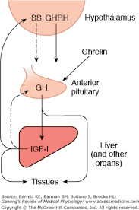

Slide 18
CONTROL OF GH SECRETION:
1. The hypothalamus:
a. GHRH GH secretion.
b. GHIH (somatostatin) GH secretion.
2. Hypoglycemia (fasting) GH secretion.
(high glucose intake GH secretion).
3. Muscular exercise GH secretion.
4. Intake of protein/amino acids GH secretion (after meals).

Slide 19
CONTROL OF GH SECRETION:
5. During sleep GH more in children.
6. Stress conditions, e.g. trauma or
emotions GH secretion.
7. FFAs GH secretion
8. Ghrelin (stomach) GH secretion.

Slide 20
Table 76-3 Factors That Stimulate or Inhibit Secretion of GH
Stimulate Growth Hormone Secretion | Inhibit Growth Hormone Secretion
Decreased blood glucose level Decreased blood free fatty acid levels Increased blood amino acid levels (arginine) Starvation or fasting, protein deficiency Trauma, stress, excitement Exercise Testosterone, estrogen Deep sleep (stages 2 and 4) Growth hormone–releasing hormone Ghrelin | - Increased blood glucose level Increased blood free fatty acid levels Aging Obesity Growth hormone inhibitory hormone (somatostatin) Growth hormone (exogenous) Insulin-like growth factors (somatomedins)

Slide 21
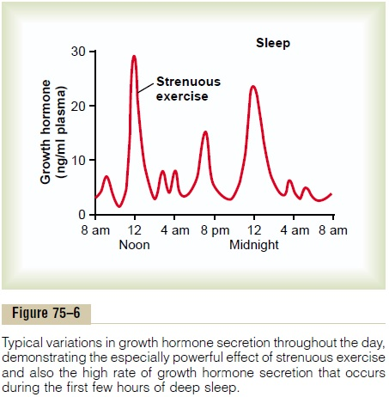

Slide 22
ABNORMALITIES OF GH
SECRETION GH SECRETION:
⦿ Childhood:
⦿ Adults:
⦿
Signs & Symptoms
⦿ Signs & Symptoms
(Gigantism),
o Increased Height as it occurs before epiphyseal fusion of long bones with their shafts.
Acromegally,
o soft tissue continue to grow
in thickness (skin, tongue, liver,
kidney, …)
o Enlargement of bones of
hands & feet.
o Enlargement of membranous
o Hyperglycemia
(diabetes).
bones including cranium, nose,
forehead bones, supraorbital
ridges, vertebrae.
o Protrusion of lower jaw (?)
o Hunched back (kyphosis)
(enlargement of vertebrae).
o Hyperglycemia (diabetes).

Slide 23
Gigantism.
the acidophilic, growth hormone-producing cells of the anterior pituitary gland become excessively active.
All body tissues grow rapidly, including the bones.
If the condition occurs before adolescence, height increases so that the person becomes a giant-up to 8 feet tall.

Slide 24
GH IN CHILDREN

Slide 25
Acromegaly.
Acidophilic tumor occurs after adolescence (after closure of the epiphyses of long bones) i.e. the person cannot grow taller, but the bones can become thicker and the soft tissues can continue to grow.
1- Enlargement is marked in the bones of
hands & feet
membranous bones (cranium, nose, bosses on the forehead, supraorbital ridges, lower jawbone, & vertebrae)
*Consequently, the lower jaw protrudes forward, sometimes as much as half an inch.
2- Tissue organs (tongue, liver, and kidneys) become greatly enlarged.

Slide 26
Abnormalities of GH secretion
Dwarfism.
Usually results from generalized deficiency of anterior pituitary secretion (panhypopituitarism) during childhood.
Body parts develop in appropriate proportion to one another, but the rate of development is decreased.
panhypopituitary dwarfism does not pass through puberty.
However, only growth hormone is deficient; these persons do mature sexually and occasionally reproduce.
# If decreased production in adulthood metabolic effects only

Slide 27
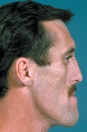

Slide 28
GH IN AN ADULT

Slide 29
Summary slides

Slide 30
PROLACTIN

Slide 31
FUNCTIONS & CONTROL OF
PROLACTIN SECRETION
◼ Function:
The major function of prolactin is milk production.
◼Control of secretion:
- Release is inhibited by PIH (dopamine).
- Suckling inhibits PIH release leading to increase prolactin release.

Slide 32
FUNCTIONS OF PROLACTIN
⦿ Effect on the breast:
◼ - Increases mRNA.
◼ - Increases production of casein and Lactalbumin.
⦿ Other effects:
◼ - Stimulates the secretion of dopamine in
median eminence (inhibits its own secretion).
◼ - Inhibits the effects of gonadotropins.

Slide 33
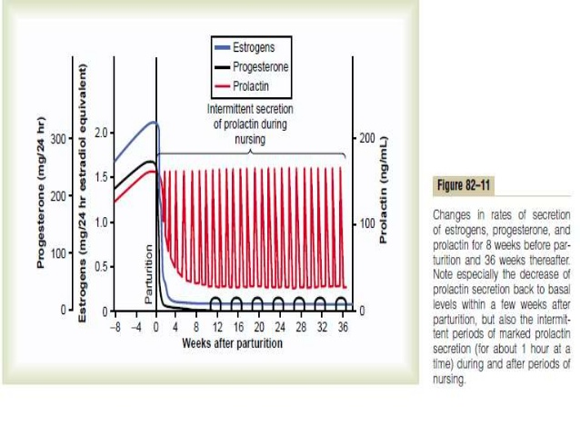

Slide 34
Actions of prolactin:
Highest level is found at term.
1- During pregnancy:
Growth of mammary glands.
(no milk production due to the inhbitory effect of placental hormones)
2- After delivery
PRL initiates and maintains milk production. (suckling stim. PRL release).
3- PRL decreases the sensitivity of ovaries to gonadotrophins leading to suppression of menstrual cycle.
Occurs in 50% of lactating women.
physiological birth control.
4- PRL acts on the limbic system producing the characteristic maternal and nursing behavior.

Slide 35
/ Exercise

