Slide 1
Endocrinology
Posterior Pituitary
Dr Nervana Mustafa
Associate Professor of Physiology
College of Medicine - KSU

Slide 2
Learning Objectives
• Describe the posterior pituitary relationship with the
hypothalamus.
• List the target organs & functional effects of oxytocin.
• Name the stimuli for oxytocin release in relation to its
reproductive & lactation functions.
• List the target cells for vasopressin & explain why
vasopressin is also known as antidiuretic hormone.
• Describe the stimuli & mechanisms that control
vasopressin secretion.
• Identify disease states caused by a) over-secretion, and b)
under-secretion of vasopressin & list the principle
symptoms of each.

Slide 3
Pituitary (Hypophysis)

Slide 4
The Posterior Pituitary & Hypothalamic
Hormones
• The posterior lobe is a downgrowth of
hypothalamic neural tissue.
• Has a neural connection with the hypothalamus (hypothalamic-hypophyseal tract)
• Nuclei of the hypothalamus synthesize
oxytocin and antidiuretic hormone (ADH)
• Their axons terminate in the posterior pituitary.

Slide 5
Oxytocin and Vasopressin
• Vasopressin: Cys-Tyr-Phe-Gln-Asn-Cys-Pro-Arg-GlyNH2
• Oxytocin: Cys-Tyr-Ile-Gln-Asn-Cys-Pro-Leu-GlyNH2

Slide 6
Posterior Pituitary
- Does not synthesize
Hormones.
- Consists of axon terminals of hypothalamic neurons.

Slide 7
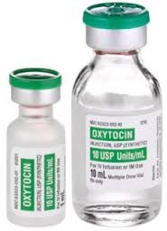
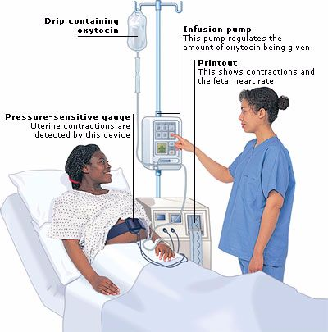
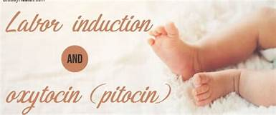
Oxytocin

Slide 8
Synthesis of Oxytocin
• Oxytocin is synthesized in the cell bodies of hypothalamic neurons (paraventricular nucleus)
pituitary
• Oxytocin is stored in the posterior

Slide 9
Functions of oxytocin
• Oxytocin is a strong stimulant of uterine
contractions.
• Regulated by a positive feedback mechanism.
• This leads to increased intensity of uterine
contractions, ending in birth.
• Oxytocin triggers milk ejection (“letdown” reflex)
Contracts the myoepithelial cells of the alveoli.
• Increases contraction of smooth muscle of the vas
deferens, helping in the ejaculation process.

Slide 10
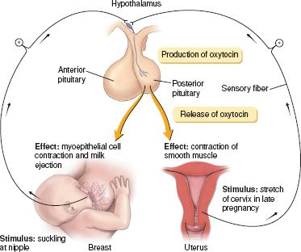
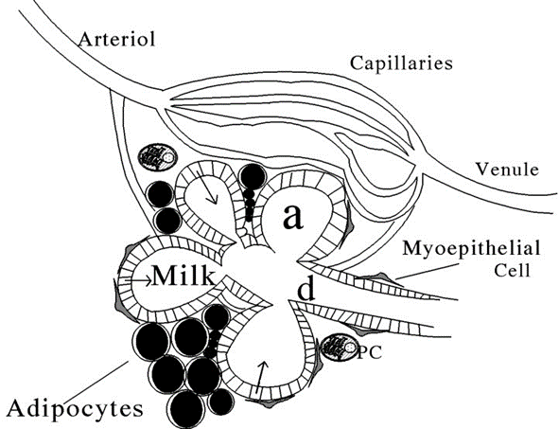
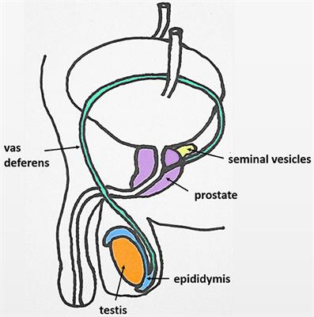

Slide 11
Antidiuretic Hormone
(ADH)
(vasopressin)

Slide 12
Synthesis of ADH
• It is synthesized as pre-prohormone and
processed into a nonapeptide (9 amino
acids)
• ADH synthesized in the cell bodies of
hypothalamic neurons(supraoptic nucleus)
• ADH is stored in the posterior pituitary

Slide 13
Receptors of ADH (vasopressin)
• There are 2 types of receptors for ADH:
• V
• V
1
2
 V1 receptors mediate vasoconstriction.
 V2 receptors are located in the principle cells in
distal convoluted tubule & collecting ducts in the
kidneys.

Slide 14
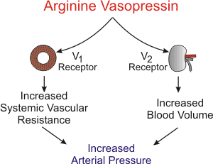
Actions of ADH

Slide 15
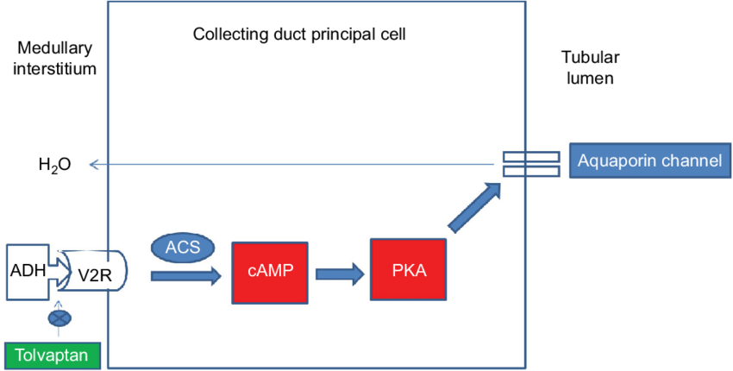
Mechanism of action of ADH

Slide 16
Control of ADH Release
Osmotic pressure:
Osmoreceptors in the hypothalamus:
hosmotic pressure " #ADH secretion
• $ osmotic pressure " $ ADH secretion
Blood volume:
Baroreceptor in carotid artery, aortic arch and left atrium:
• #blood pressure " $ ADH secretion
• $blood pressure " # ADH secretion
• Pain, fear, trauma, and stress

Slide 17
Regulation of ADH
Hypothalamus receives feedback from:
• Osmoreceptors
• Aortic arch baroreceptors
• Carotid baroreceptors
• Atrial stretch receptors
Any increase in osmolality or
decrease in blood volume will
stimulate ADH secretion from
posterior pituitary.

Slide 18
Increased
Blood
ADH
V1 receptor
Pressure

Slide 19
ADH Disorders
• Diabetes Insipidus (DI):
Neurogenic (central):
failure of hypothalamus or neurohypophysis to synthesize or secrete ADH
Nephrogenic:
failure of the kidney to respond appropriately to ADH
• Syndrome of Inappropriate Antidiuretic
Hormone (SIADH)

Slide 20
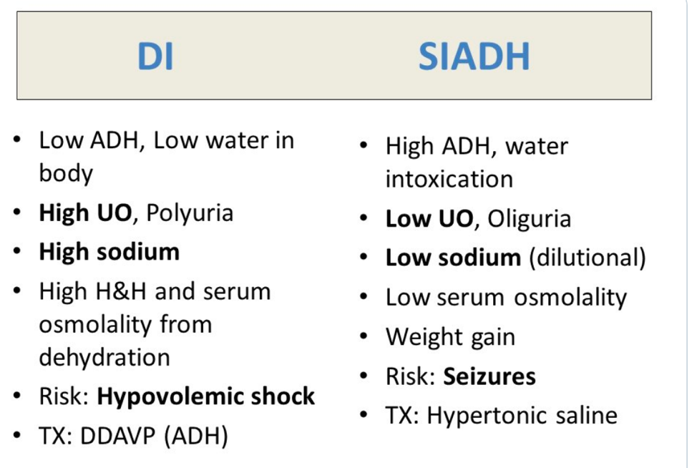

Slide 21
DIABETES INSIPIDUS
• DI is a disorder resulting from deficiency of anti-
diuretic hormone (ADH) or its action and is
characterized by the passage of copious amounts
of dilute urine.
• It must be differentiated from other polyuric
states such as primary polydipsia & osmotic
duiresis. Central DI is due to failure of producing
adequate ADH.

Slide 22
DIABETES INSIPIDUS
• Nephrogenic DI results when the renal tubules
fail to respond to circulating ADH.
• The resulting renal concentration defect leads to
the loss of large volumes of dilute urine.
This causes cellular and extracellular dehydration and hypernatremia.

Slide 23
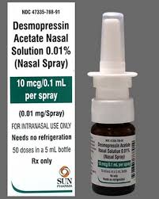
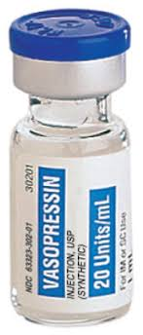
Treatment
• DESMOPRESSIN (DDAVP) A SYNTHETIC
ANALOG IS SUPERIOR TO NATIVE AVP
BECAUSE:
• IT HAS LONGER DURATION OF ACTION (8-
10 h vs 2-3 h)
• MORE POTENT
• ITS ANTIDIURETIC ACTIVITY IS 3000 TIMES
GREATER THAN ITS PRESSOR ACTIVITY

Slide 24
Treatment of Nephrogenic DI
• CORRECTION OF UNDERLYING CAUSE
• PROVISION OF ADEQUATE FLUIDS & CALORIE
• LOW SODIUM DIET
• DIURETICS
• HIGH DOSE OF DDAVP

