Slide 1
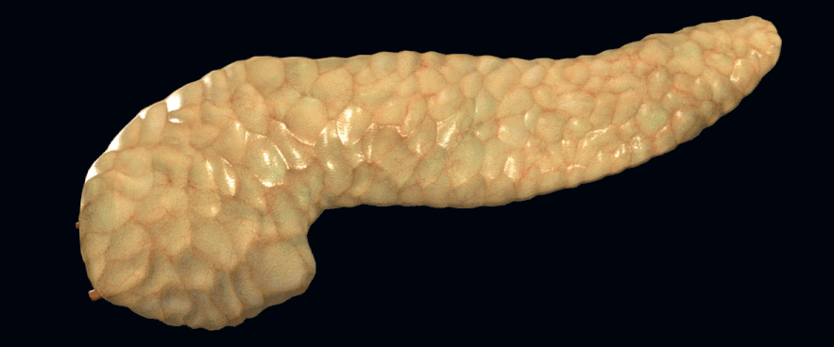
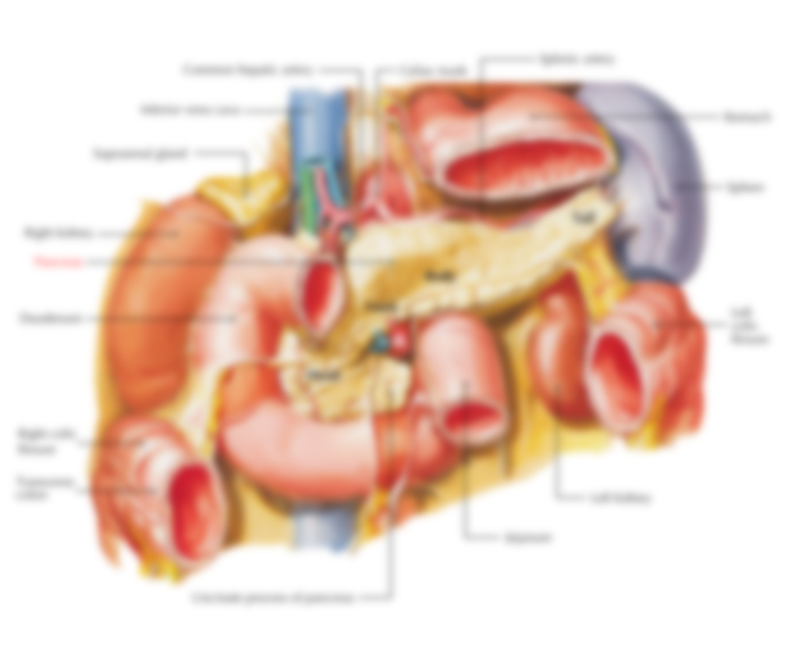
ANATOMY OF PANCREASE
DR. ZAHID ALI KAIMKHANI
M.D; M.Phil; Ph.D

Slide 2
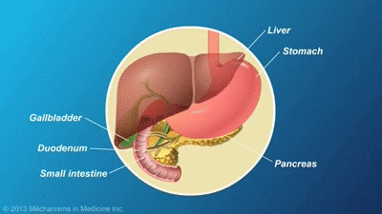
The Pancreases
“All Flesh”

Slide 3
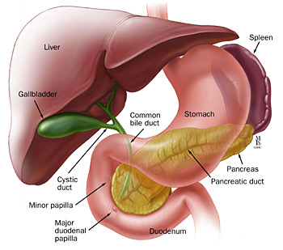
The Pancreases “All Flesh”
Lies in the upper abdomen behind the stomach
Both exocrine and endocrine functions
Endocrine component
makes and secretes hormones (insulin, glucagon, somatostatin)
control energy metabolism and storage throughout the body (Endocrine pancreas Islet's of Langerhans).
comprise 1-2% of pancreatic mass.
Exocrine component
makes and secretes digestive enzymes into the intestine (Exocrine pancreas)
comprise more than 95% of the pancreatic mass

Slide 4
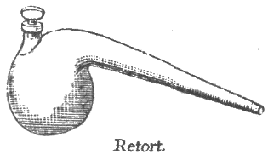
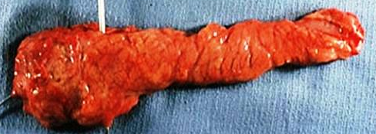
The Pancreases “All Flesh”
LOCATION
In the epigastric and left hypochondriac regions, (from concavity of the duodenum to the hilum of spleen opposite the level of T12– L3 vertebrae).
PERITONEUM
The greater part is retroperitoneal behind the lesser sac.
SHAPE
The pancreas is “J”-shaped or RETORT shaped being set obliquely.
SIZE
Length: 12–15 cm(6-10 inch).
Weight: 60–100 g.
NECK
BODY
HEAD
TAIL

Slide 5
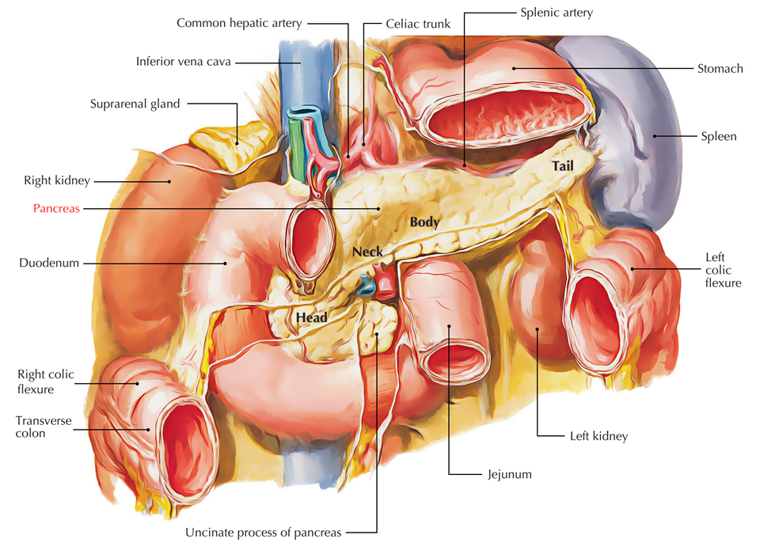
The Pancreases “All Flesh”
PARTS (SUBDIVISIONS)
Head (with one process— uncinate process).
Neck.
Body (with one process—tuber omentale).
Tail.
HEAD OF THE PANCREAS
is the enlarged, disc-shaped right end of the pancreas.
lies in the concavity of the C-shaped duodenal loop in front of the L2 vertebra
RELATIONS
Anterior surface is related from above downward to:
The gastroduodenal artery,
transverse colon,
root of the transverse mesocolon and
jejunum.
Posterior surface is related to:
IVC,
left renal vein,
bile duct and
right crus of diaphragm.
Uncinate process is related to:
anteriorly to superior mesenteric vessels and
posteriorly to the abdominal aorta.

Slide 6
The Pancreases “All Flesh”
NECK OF THE PANCREAS
Best defined as “narrow band of pancreatic tissue that Lies in front of superior mesenteric and the portal vein”
Its antero-superior surface supports/related to the pylorus
The superior mesenteric vessels emerge from its inferior border

Slide 7
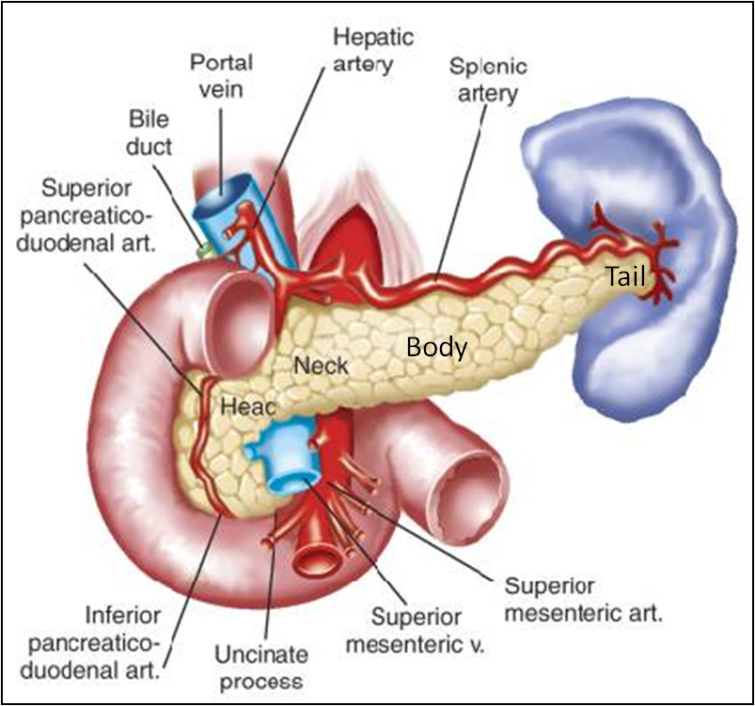
The Pancreases “All Flesh”
BODY OF THE PANCREAS
runs upward and to the left.
lies in front of the vertebral column at or just below the transpyloric plane.
is triangular in cross section.
The splenic vein is embedded in its posterior surface
The splenic artery runs over its upper border
One process: Tuber omentale (a part of the body projects above the lesser curvature of the stomach and comes in contact with the lesser omentum across the lesser sac).

Slide 8
The Pancreases “All Flesh”
TAIL OF THE PANCREAS
Narrow, short segment, ending at the splenic hilum
It is mobile unlike the other major retroperitoneal parts of the gland.
contains the largest number of islets of Langerhans
Lies in the splenicorenal (lienorenal) ligament (may get injured during splenectomy) along with splenic vessels, at the level of the T12 vertebra
Anteriorly, related to splenic flexure of colon

Slide 9
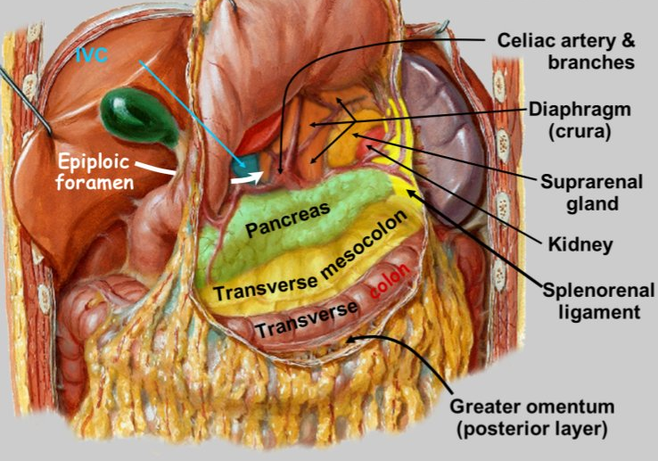
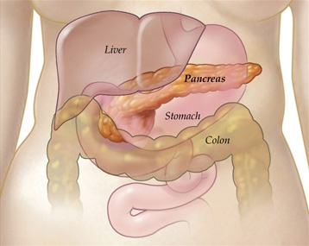
The Pancreases “All Flesh”
RELATIONS OF THE PANCREAS
Anterior Relations
Stomach separated by lesser sac
Transverse colon &
Transverse mesocolon
Stomach

Slide 10
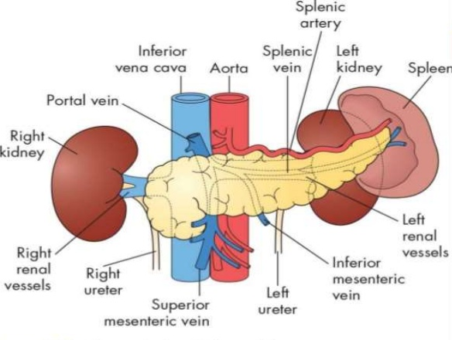
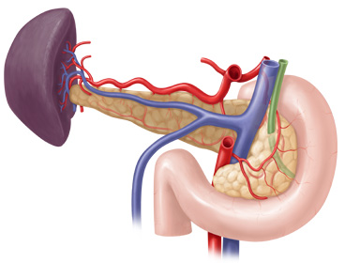
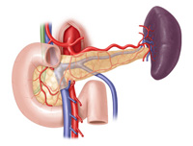
The Pancreases “All Flesh”
RELATIONS OF THE PANCREAS
Posterior Relations (from right to left)
Bile duct, portal & splenic veins,
inferior vena cava,
aorta & origin of SMA
Left psoas muscle,
left renal vessels & left kidney
Hilum of the spleen.
Portal vein
Portal vein
Bile duct
Superior mesenteric vessels
Posterior view
Anterior view

Slide 11
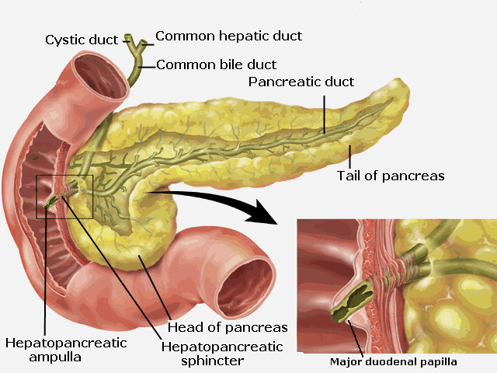
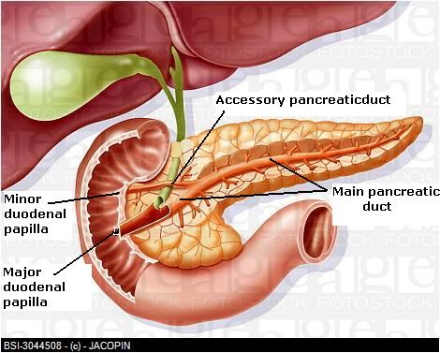
The Pancreases “All Flesh”
PANCREATIC DUCTS
Main duct (of Wirsung)
Accessory duct (of Santorini)
Main duct (of Wirsung)
runs the entire length of pancreas beginning from the tail.
It drain whole pancreas EXCEPT upper portion of the head i.e. tail, body, neck, inferior portion of head & uncinate process.
Joins common bile duct & together they open into a small hepatopancreatic ampulla (Ampulla of Vater) in the 2nd part of the duodenum.
The ampulla opens by a narrow mouth on the summit of major duodenal papilla 8–10 cm distal to the pylorus.

Slide 12
The Pancreases “All Flesh”
PANCREATIC DUCTS
Main duct (of Wirsung)
Accessory duct (of Santorini)
Accessory duct (of Santorini)
drains superior portion of the head
empties separately into 2nd part of duodenum at (minor duodenal papilla) about 2–3 cm above the opening of main pancreatic duct (6–8 cm distal to pylorus)

Slide 13
The Pancreases “All Flesh”
Celiac trunk
Hepatic artery
Gastroduodenal A (GDA)
Superior pancreatico-duodenal A
BLOOD SUPPLY OF THE PANCERAS
Arterial Supply
Head & Neck
Supplied by branches from:
Superior pancreatico-duodenal artery br of gastroduodenal artery (GDA), branch of hepatic artery branch of Celiac trunk
Inferior pancreatico-duodenal artery branch of Superior mesenteric artery
Body and tail:
Supplied by Splenic artery (main artery) through 8-10 branches

Slide 14
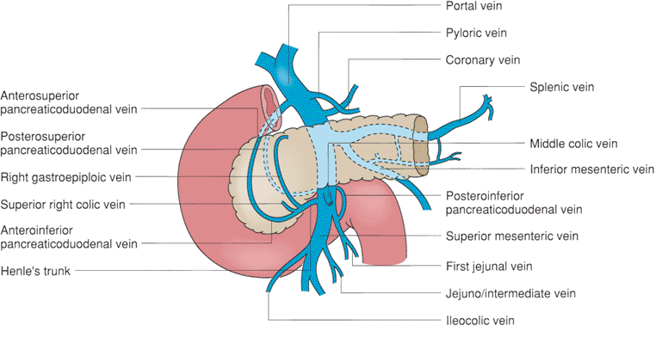
The Pancreases “All Flesh”
BLOOD SUPPLY OF THE PANCERAS
VENOUS DRAINAGE
Head & Neck
Drained by anterior and posterior venous arcades that form the superior & inferior pancreaticoduodenal veins which follow the corresponding arteries.
Body and tail:
Drained by the splenic vein, which is a tributary of the portal vein

Slide 15
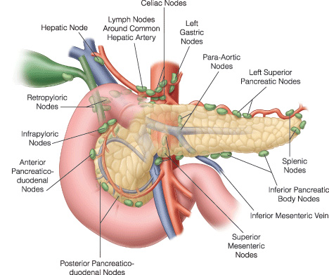
The Pancreases “All Flesh”
LYMPHATIC DRAINAGE
Rich network that drains into:
Pyloric
Hepatic &
Splenic nodes
Ultimately the efferent vessels drain into:
the celiac &
superior mesenteric lymph nodes.
INNERVATION
Sympathetic fibers
from the thoracic splanchnic nerves.
have a predominantly inhibitory effect
Parasympathetic fibers
from the Vagus.
stimulate both exocrine and endocrine secretions

Slide 16
CLINICAL ANATOMY
Carcinoma of the head of pancreas
Is common.
Compresses the bile duct leading to persistent obstructive jaundice.
May press the portal vein or may involve the stomach due to close vicinity of these structures to the head of pancreas.
Acute pancreatitis
Is the acute inflammation of the pancreas.
Occurs due to obstruction of pancreatic duct, ingestion of alcohol, viral infections (mumps), or trauma.
It is serious condition because activated pancreatic enzymes leak into the substance of pancreas and initiates the autodigestion of the gland.
Clinically, it presents as very severe pain in the epigastric region radiating to the back, fever, nausea, and vomiting.
Pancreatic pseudocyst

Slide 17
Thank you

