Slide 1
Thyroid Hormones and Thermogenesis
Endocrine Block
Dr. Usman Ghani

Slide 2
Objectives:
By the end of this lecture, the Second Year students will be able to:
Describe the types and biosynthesis of thyroid hormones
Discuss the thyroid hormone actions
Understand the regulation of thyroid hormones
List and interpret the thyroid function tests
Define goiter and differentiate between hypo and hyperthyroidism
Discuss the role of thyroid hormone in thermogenesis

Slide 3
Types and Biosynthesis of Thyroid Hormones
Thyroxine (T₄) and tri-iodothyronine (T₃)
Synthesized in the thyroid gland by:
Iodination and coupling of two tyrosine molecules
Binding to thyroglobulin protein
Thyroid gland mostly secretes T₄
Peripheral tissues (liver, kidney, etc.) de-iodinate T₄ to T₃
Deiodination is catalyzed by deiodinase enzymes
T₄ can be metabolized to rT₃ (inactive form)
Notes:
3

Slide 4
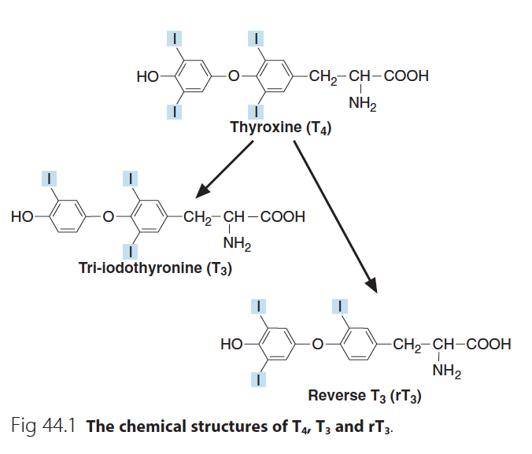
Notes:
4

Slide 5
Types and Biosynthesis of Thyroid Hormones
T₃ is a more biologically active form
Most of T₄ is transported in plasma as protein-bound
Thyroxin binding globulin (TBG)-bound (70%)
Albumin-bound (25%)
Transthyretin (pre-albumin)-bound (5%)
The unbound (free) form of T₄ and T₃ are biologically active
Notes:
5

Slide 6
Thyroid hormone action
Plays essential role in the maturation of all body tissues
Involved in thermogenesis and metabolic regulation
Increases cellular oxygen consumption and stimulates the metabolic rate
Affects the rate of protein, carbohydrate and lipid metabolism
Notes:
6

Slide 7
Thyroid Hormone Action
Clinical evidence of the wide spectrum of thyroid hormone action:
Untreated congenital hypothyroidism →permanent brain damage
Hypothyroid children have:
Delayed skeletal maturation →short stature
Delayed puberty
Hypothyroid patients have high serum cholesterol due to:
Down regulation of LDL receptors on liver cells
Failure of sterol excretion via the gut
Notes:
7

Slide 8
Regulation of Thyroid Hormone Secretion
The hypothalamic-pituitary-thyroid axis regulates thyroid secretion
The hypothalamus senses low levels of T₃/T₄ and releases thyrotropin releasing hormone (TRH)
TRH stimulates the pituitary to produce thyroid stimulating hormone (TSH)
Notes:
8

Slide 9
Regulation of Thyroid Hormone Secretion
TSH stimulates the thyroid to produce T₃/T₄ until levels return to normal
T₃/T₄ exert negative feedback control on the hypothalamus and pituitary
Controlling the release of both TRH and TSH
Notes:
9

Slide 10
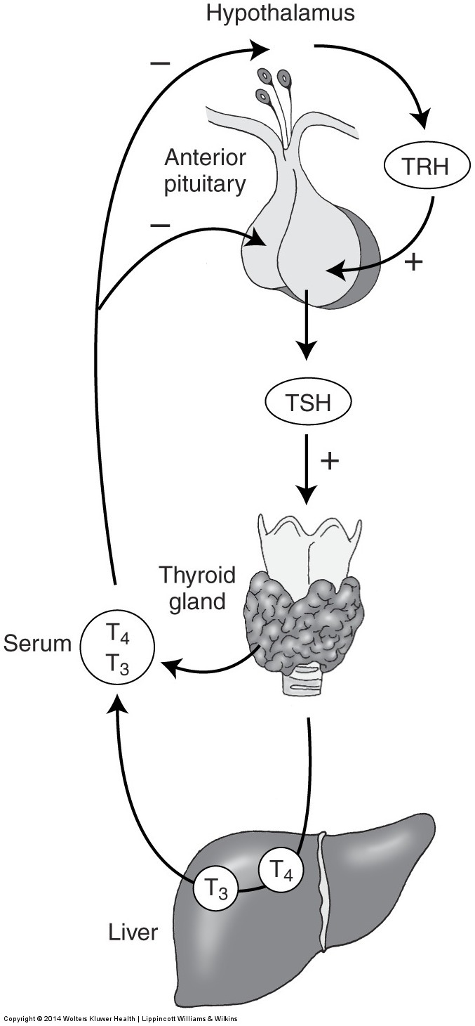
Regulation of Thyroid Hormone Secretion
High thyroid hormone levels
suppress TRH, TSH
Low thyroid hormone levels
stimulate TRH, TSH to produce more hormone
Clinical Chemistry, Bishop, 7th Edition, pp. 492.
Notes:
10

Slide 11
Thyroid Function Tests
TSH measurement:
Assessment of thyroid function
Highly sensitive test (detects very low conc.)
Total T₄ or free T₄:
Assessment of thyroid function
Monitors thyroid treatment (both anti-thyroid and thyroid replacement treatment)
TSH may take up to 8 weeks to adjust to new level during treatment
Notes:
11

Slide 12
Thyroid Function Tests
Total T₃ or free T₃:
Useful for assessing hyperthyroidism in which rise in T₃ is independent of T₄
In some patients only T₃ rises (T₄ is normal): T₃ toxicosis
For earlier identification of thyrotoxicosis
Antibodies:
Diagnosis and monitoring of autoimmune thyroid disease:
Hashimoto’s thyroiditis (antibodies against TSH receptors that suppress thyroid secretion)
Graves’ disease (antibodies against TSH receptors that stimulate thyroid secretion)
Notes:
12

Slide 13
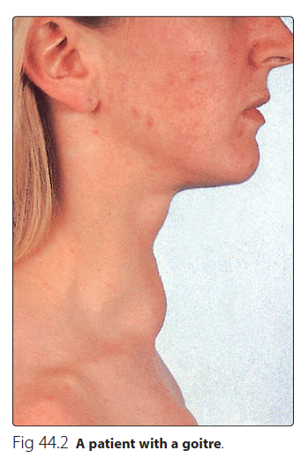
Goitre, Hypo and Hyperthyroidism
Enlarged thyroid gland
Goitre may be associated with:
Hypofunction
Hyperfunction
Normal thyroid hormone conc. (euthyroid)
Causes:
Iodine, selenium deficiency
Hashimoto’s thyroiditis
Graves’ disease (hyperthyroidism)
Congenital hypothyroidism / thyroid cancer
Notes:
13

Slide 14
Hypothyroidism
Deficiency of thyroid hormones
Primary hypothyroidism:
Failure of thyroid gland (Elevated TSH, deficiency of thyroid hormones)
Secondary hypothyroidism:
Failure of the pituitary gland to secrete TSH (rare)
Failure of the hypothalamic-pituitary-thyroid axis
Notes:
14

Slide 15
Hypothyroidism
Causes:
Hashimoto’s thyroiditis
Radioiodine or surgical treatment of hyperthyroidism
Drug effects
TSH deficiency
Congenital defects in thyroid synthesis / thyroid resistance
Severe iodine deficiency
Clinical features
Tiredness / cold intolerance / weight gain / dry skin
Treatment
Replacement therapy with levothyroxine (T₄)
Notes:
15

Slide 16
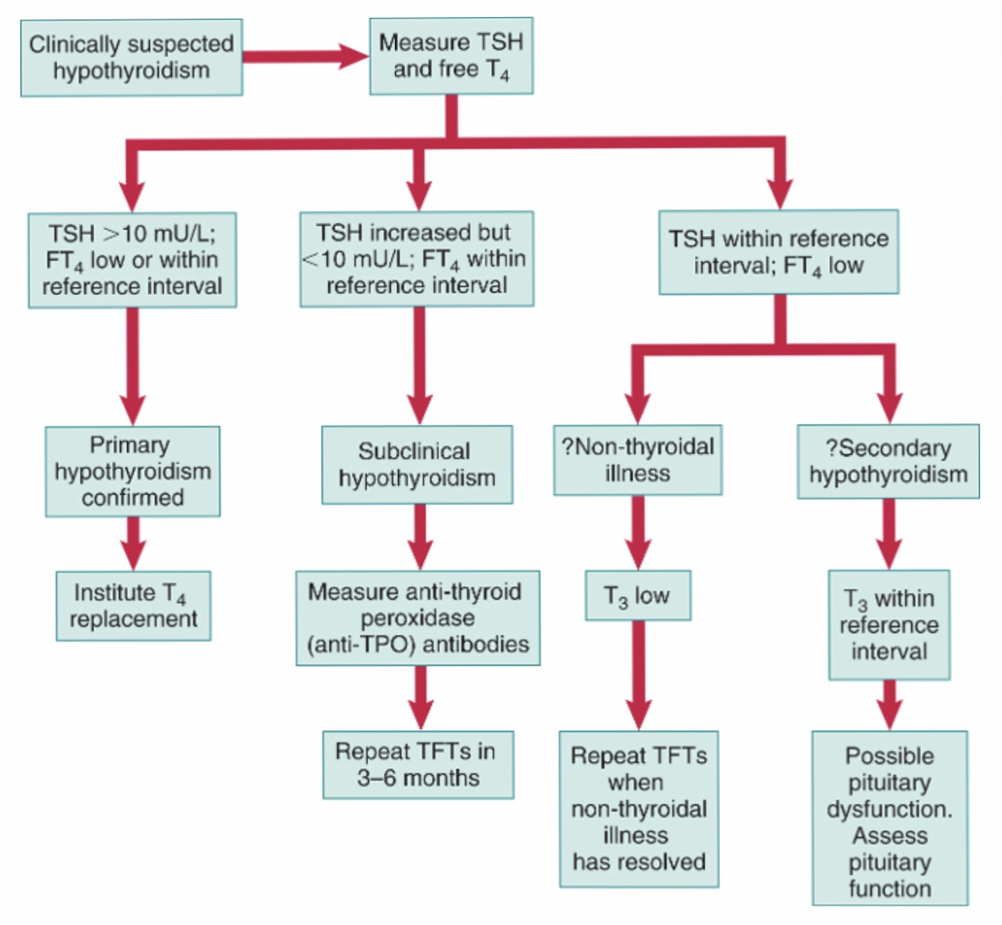
Strategy for the biochemical
investigation of suspected
hypothyroidism
Notes:
16

Slide 17
Hypothyroidism
Non-thyroidal illness
In some diseases, the normal regulation of TSH, T₃ and T₄ secretion and metabolism is disturbed
Most of T₄ is converted to rT₃ (inactive)
Causing thyroid hormone deficiency
Secretion of T₄ and T₃ is decreased
Notes:
17

Slide 18
Hyperthyroidism
Hyperstimulation of thyroid gland by pituitary gland
Hypersecretion of thyroid hormones
Tissues are exposed to high levels of thyroid hormones (thyrotoxicosis)
Causes:
Graves’ disease
Toxic multinodular goitre
Thyroid adenoma
Thyroiditis
Excessive intake of iodine / iodine drugs
Excessive intake of T₄ and T₃
Notes:
18

Slide 19
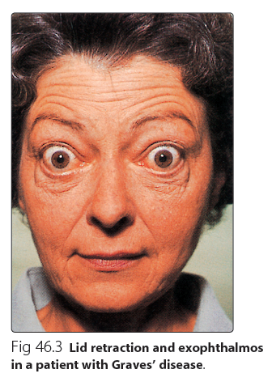
Hyperthyroidism
Clinical features:
Weight loss with normal appetite
Sweating / heat intolerance
Fatigue
Palpitation / agitation, tremor
Angina, heart failure
Diarrhea
Eyelid retraction and lid lag
Notes:
19

Slide 20
Graves’ disease
Most common cause of hyperthyroidism
An autoimmune disease
Due to antibodies against TSH receptors on thyroid gland
The antibodies mimic the action of pituitary hormone
Causing hypersecretion of thyroid hormone
Notes:
20

Slide 21
Hyperthyroidism
Diagnosis
Suppressed / undetectable TSH level
Raised thyroid hormones levels
Confirms primary hyperthyroidism
Problems in diagnosis
Total serum T₄ varies due to changes in binding protein levels
High estrogens in pregnancy increase TBG synthesis
Notes:
21

Slide 22
Hyperthyroidism
Congenital TBG deficiency can also influence results
Free T₄ and TSH are first-line tests for diagnosis of thyroid dysfunction
Treatment
Antithyroid drugs: carbimazole, propylthiouracil
Radioiodine: sodium ¹³¹I inhibits T₄/T₃ synthesis
Surgery: thyroidectomy
Notes:
22

Slide 23
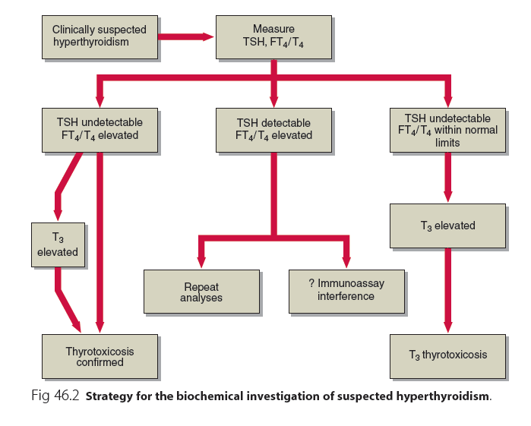
Notes:
23

Slide 24
Thermogenesis (Heat production)
Humans are homeothermic (keep constant body temp.)
Tightly controlled temperature homeostasis
Thermogenesis is of two types:
Obligatory: Heat production due to basal metabolic rate
Facultative: On-demand extra heat production from metabolic activity in brown adipose tissue, skeletal muscle, etc.
Facultative thermogenesis in brown adipose tissue is stimulated by sympathetic nervous system

Slide 25
Thyroid Hormone and Thermogenesis
Thyroid hormone plays essential roles in thermogenesis
It upregulates body temperature set by the brain
It acts centrally on the hypothalamus that controls brown adipose tissue for thermogenesis

Slide 26
Two mechanisms of thyroid thermogenesis
1. Classical,
peripheral
Thyroid hormone (T₃)
2. New: Central
brown fat
Body tissue cells
(muscle, liver)
Hypothalamus
Activates brown
adipose tissue
Activates certain
enzymes by an
unknown mechanism
Increased
body energy
expenditure
THERMOGENESIS

Slide 27
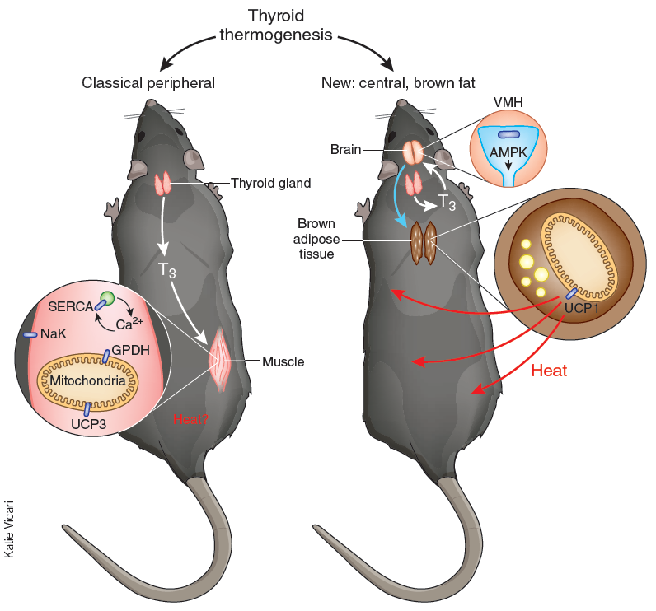
Two mechanisms
of thyroid thermogenesis

Slide 28
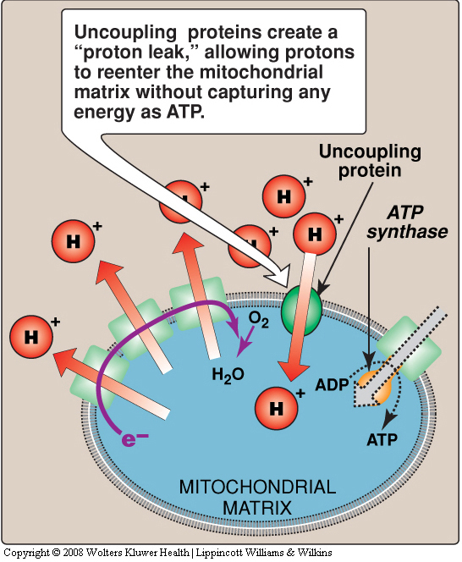
In respiratory chain, some protons reenter the mitochondrial matrix thru uncoupling proteins (UCPs) without ATP synthesis
These protons are released as heat
Thyroid hormone regulates mitochondrial UCPs
Examples:
UCP1 in brown adipose tissue
UCP3 in muscle, other tissues

Slide 29
Take home message
Thyroid hormones are synthesized in the thyroid gland by iodination, coupling and binding to thyroglobulin protein
Thyroid hormones regulate metabolism and thermogenesis in the body
It is regulated by hypothalamic-pituitary-thyroid axis
Thyroid function tests such as TSH, total and free T₄ and T₃, and antibodies help diagnose and follow up thyroid disorders
Goiter, hypo- and hyperthyroidism are due to abnormalities in thyroid functions
Notes:
29

Slide 30
References
Clinical Biochemistry: An Illustrated Colour Text, 5th Edition, Allan Gaw, pp. 88-93, Churchill Livingstone, UK.
Nedergaard, J and Cannon, B. Thyroid hormones: igniting brown fat via the brain. Nature Medicine, Volume 16, Number 9, pp. 965-967, 2010.
Notes:
30

