Slide 1
Biochemistry of Cushing Syndrome
Endocrine Block

Slide 2
Objectives
To identify physiological and biochemical characteristics of Cortisol.
To understand the diagnostic algorithm for Cushing’s Syndrome.
To understand the interpretation of laboratory and radiological investigations for diagnosis of Cushing’s Syndrome.

Slide 3
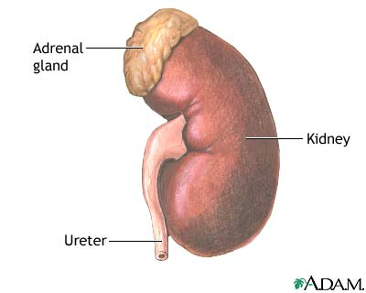
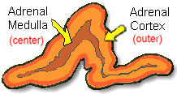
Anatomically:
The adrenal gland is situated on the anteriosuperior aspect of the kidney
Histologically:
The adrenal gland consists of two distinct tissues of different embryological origin, the outer cortex and inner medulla.

Slide 4
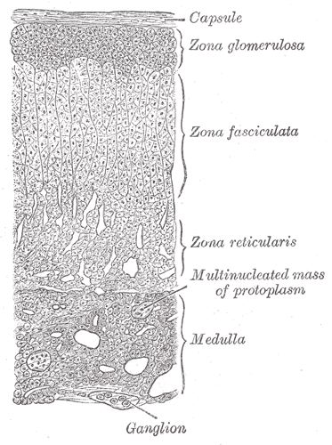
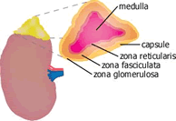
The adrenal cortex
Based on cell type and function, the adrenal cortex comprises three zones:
Zona Glumerulosa (the outmost zone) ➔ aldosterone, the principle mineralocorticoid.
Zona Fasciculata ➔ glococorticoids, mainly cortisol (95%).
Zona Reticularis ➔ sex hormones.

Slide 5
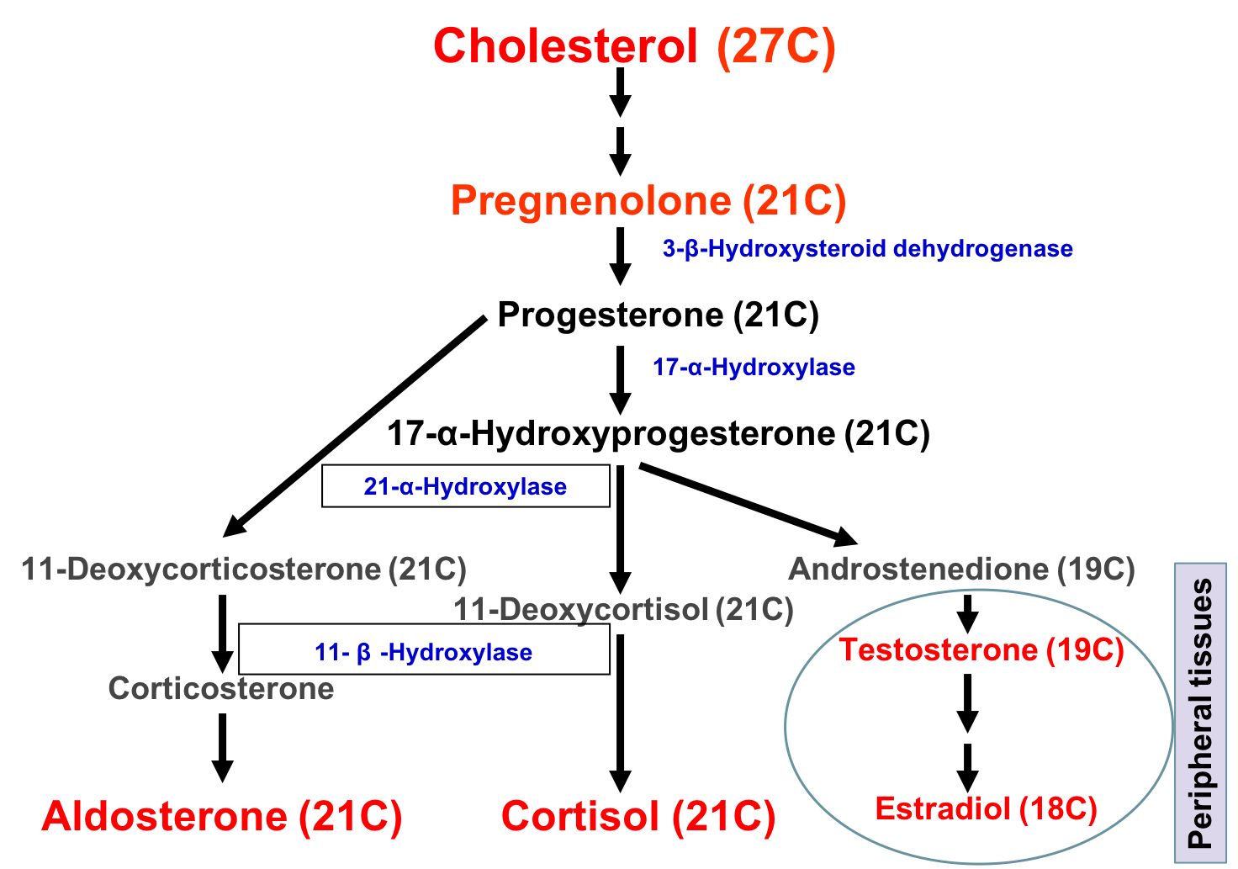
Steroid hormone synthesis

Slide 6
Hypothalamic-Pituitary-Adrenal (HPA) Axis
The hypothalamus secretes corticotropin-releasing hormone (CRH) which stimulates the anterior pituitary gland to synthesis and release ACTH.
ACTH acts on the zona fasiculata cells → release of glucocorticoids (Cortisol).

Slide 7
Glucocorticoid functions
Glucocorticoids have widespread metabolic effects on carbohydrate, fat and protein metabolism.
Upon binding to its target, CORTISOL enhances metabolism in several ways:
In the liver, Cortisol is an insulin antagonist and has a weak mineralocorticoid action:
↑↑ Gluconeogenesis → production of glucose from newly-released amino acids and lipids
↑↑ Amino acid uptake and degradation
↑↑ Ketogenesis.
In the adipose tissue: Cortisol → ↑↑ Lipolysis through breakdown of fat.
In the muscles: Cortisol →↑↑ proteolysis and amino acid release.
Conserving glucose: by inhibiting uptake into muscle and fat cells.

Slide 8
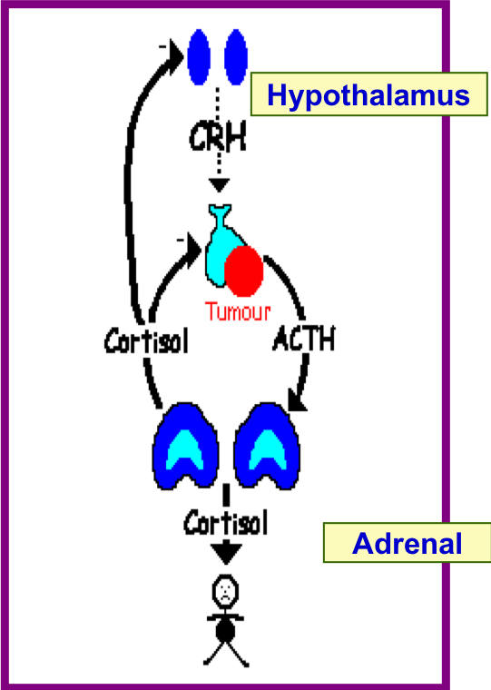
Regulation of ACTH and Cortisol Secretion
1. Negative feedback control:
ACTH release from the anterior pituitary is stimulated by hypothalamic secretion of corticotrophin releasing hormone (CRH).
CRH → ↑ ACTH → ↑[Cortisol]
↑[Cortisol] or synthetic steroid suppress CRH & ACTH secretion
2. Stress:
(e.g. major surgery, emotional stress) Stress → ↑↑ CRH & ACTH → ↑↑ Cortisol

Slide 9
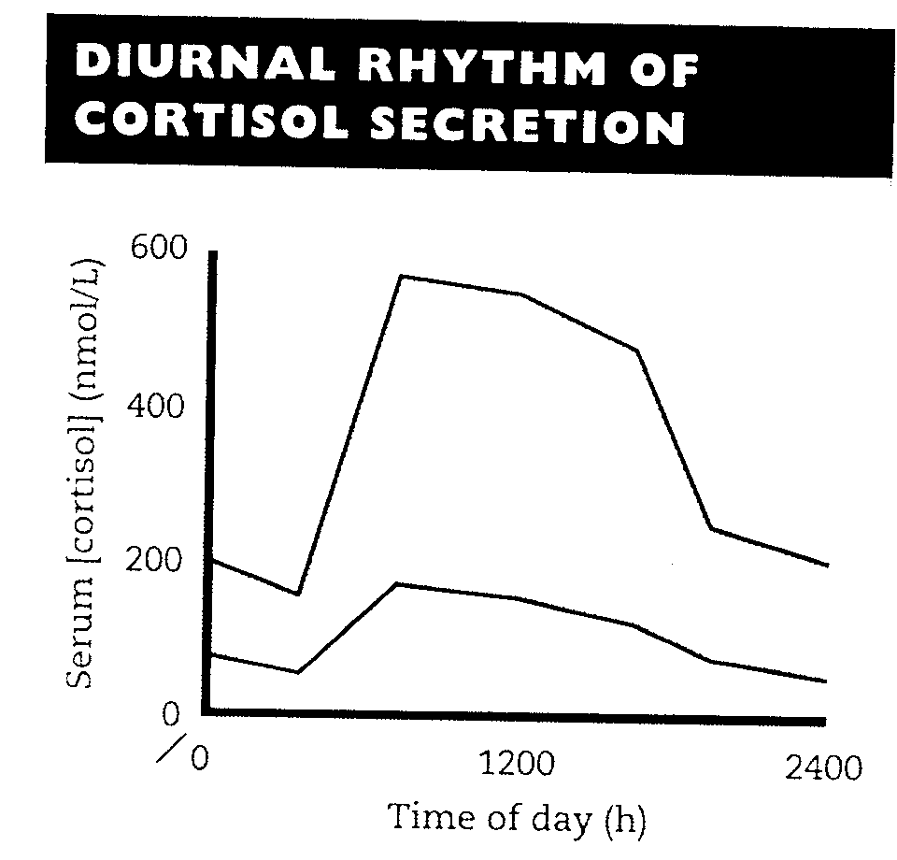
3. The diurnal rhythm of serum cortisol:
Highest Cortisol level in the morning ( 8 - 9 AM ).
Lowest Cortisol level in the late afternoon and evening ( 8 - 9 PM ).
The diurnal rhythm of cortisol secretion; the area between the curves represents values that lie within the reference range

Slide 10
Plasma Cortisol-binding globulin (CBG)
In the circulation, glucocorticoids are mainly protein-bound (about 90%), chiefly to CBG (transcortin).
↑↑ in pregnancy and with estrogen treatment (e.g. oral contraceptives).
↓↓ in hypoproteinemic states (e.g. nephrotic syndrome).
The biologically active fraction of cortisol in plasma is the free (unbound) component.

Slide 11
Cortisol and ACTH measurements
Serum (Cortisol) and plasma (ACTH):
Samples must be collected (without venous stasis) between 8 a.m. and 9 a.m. and between 10 p.m. and 12 p.m. because of the diurnal rhythm.
Temporary ↑↑ in these hormones may be observed as a response to emotional stress.
Urinary Cortisol excretion:
Cortisol is removed from plasma by the liver → metabolically inactive compounds → excreted in urine mainly as conjugated metabolites (e.g. glucuronides).
A small amount of cortisol is excreted unchanged in the urine (UFC).
In normal individuals:
Urinary free cortisol (UFC) is < 250 nmol/24 h.

Slide 12
Causes of elevated serum cortisol
Increased cortisol secretion:
• Cushing's syndrome
• Exercise
• Stress, Anxiety, Depression
• Obesity
• Alcohol abuse
• Chronic renal failure
Increased CBG:
• Congenital
• Estrogen therapy
• Pregnancy

Slide 13
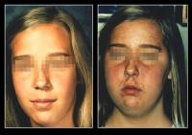
Symptoms of Cushing’s syndrome
Weight gain, central obesity.
Buffalo’s hump.
Moon face
Excessive sweating
Atrophy of the skin and mucous membranes
Purple striae on the trunk and legs
Proximal muscle weakness (hips, shoulders)
Hirsutism
The excess cortisol may also affect other endocrine systems → ↓ libido, amenorrhoea and infertility
Patients frequently suffer various psychological disturbances ranging from euphoria to frank psychosis.

Slide 14
signs
Loss of diurnal rhythm of cortisol and ACTH.
Hypertension (due to the aldosterone - like effects)
Hyperglycemia or diabetes due to insulin resistance.
Hypokalemic alkalosis
↑ protein metabolism.
Impaired immunity.

Slide 15
Investigations of suspected adrenocortical hyperfunction
A. Screening and confirmatory tests: to assess the clinical diagnosis of adrenocortical hyperfunction.
B. Tests to determine the cause: to ascertain:
(a) The site of the pathological lesion (adrenal cortex, pituitary or elsewhere?)
(b) The nature of the pathological lesion.

Slide 16
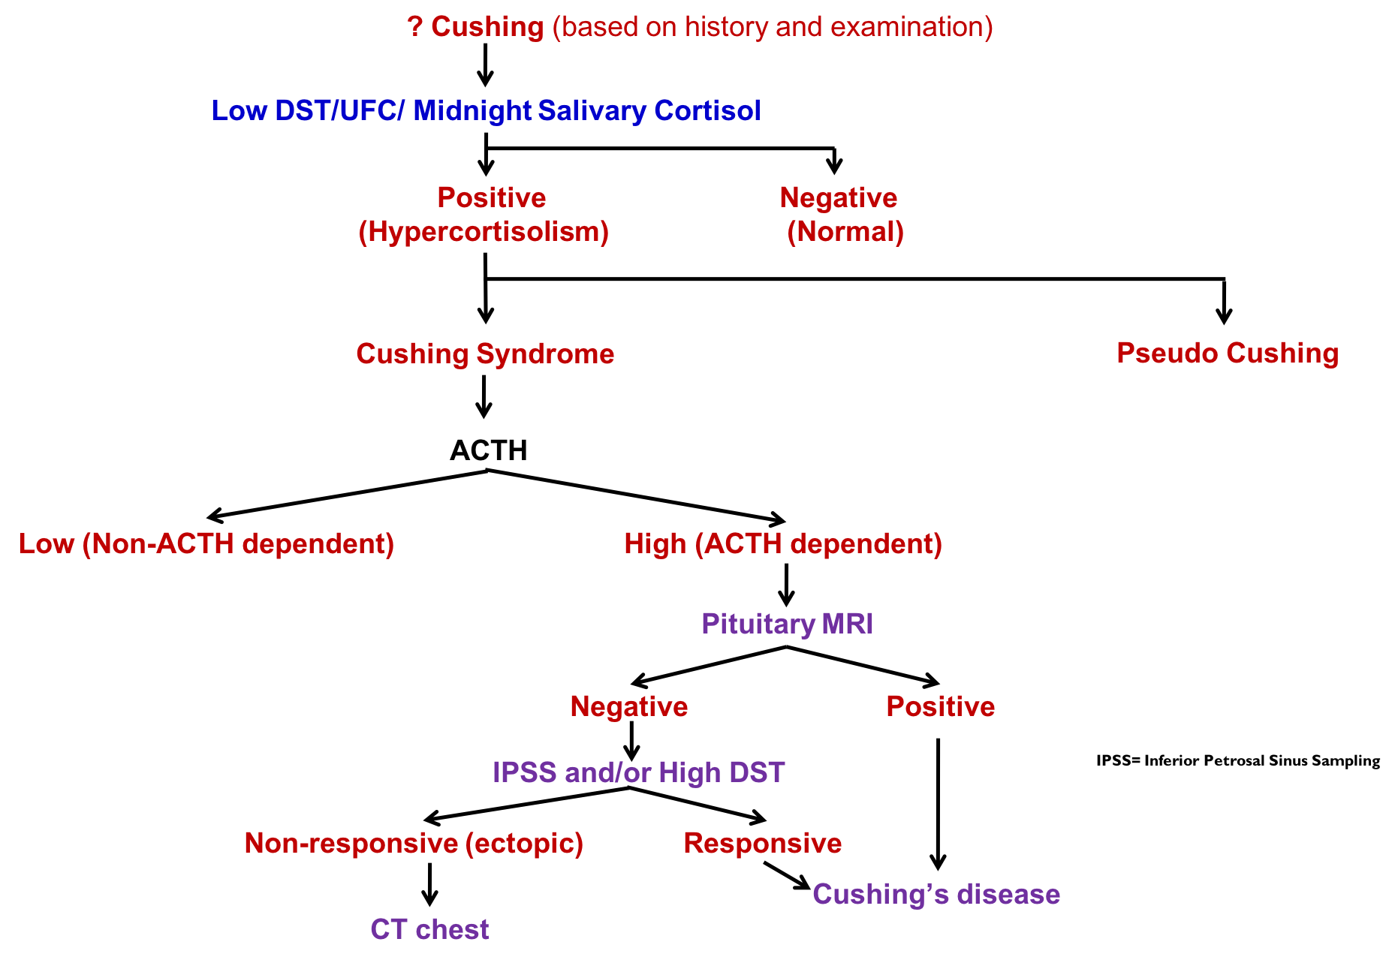

Slide 17
Screening tests
1. Low-dose DST:
Procedure:
1 mg dexamethasone (DXM) administered at 11-12 PM the night before attending the clinic. Serum cortisol is measured at 8-9 AM.
Result:
Cortisol < 50 nmol/L (suppression)→ exclude hypercortisolnemia (Cushing Syndrome)
Precautions:
Drugs that induce hepatic microsomal enzymes (Phenobarbitone & phenytoin) → ↑ DXM metabolism and ↓ DXM blood level to achieve CRH suppression (false diagnosis of Cushing)

Slide 18
2. 24- hour urinary free cortisol:
Result: Cortisol < 250 nmol/day → exclude Cushing Syndrome.
Disadvantage: incomplete collection of urine → a false-negative result.
3. Midnight Salivary Cortisol.
Result: Cortisol < 100 ng/dL → exclude Cushing Syndrome.

Slide 19
Confirmatory tests
Positive results of at least two screening tests would confirm the clinical diagnosis.
Further investigations are required.

Slide 20
Tests used to determine the cause of Cushing's syndrome
To differentiate ACTH-dependent from ACTH-independent:
Plasma ACTH (Diurnal rhythm)
To distinguish between ACTH-dependent causes (Pitutary Vs Lung):
High-dose DST.
Inferior Petrosal Sinus Sampling.
Radiological tests: MRI of pituitary and ultrasound or CT of adrenals.

Slide 21
Causes of adrenocortical hyperfunction (Cushing’s syndrome)
ACTH - dependent:
↑ Pituitary ACTH >90% (Cushing's disease).
Ectopic ACTH by neoplasms <10%.
ACTH - independent:
Glucocorticoid therapy.
Adrenal tumor <20% (adenoma or carcinoma).

Slide 22
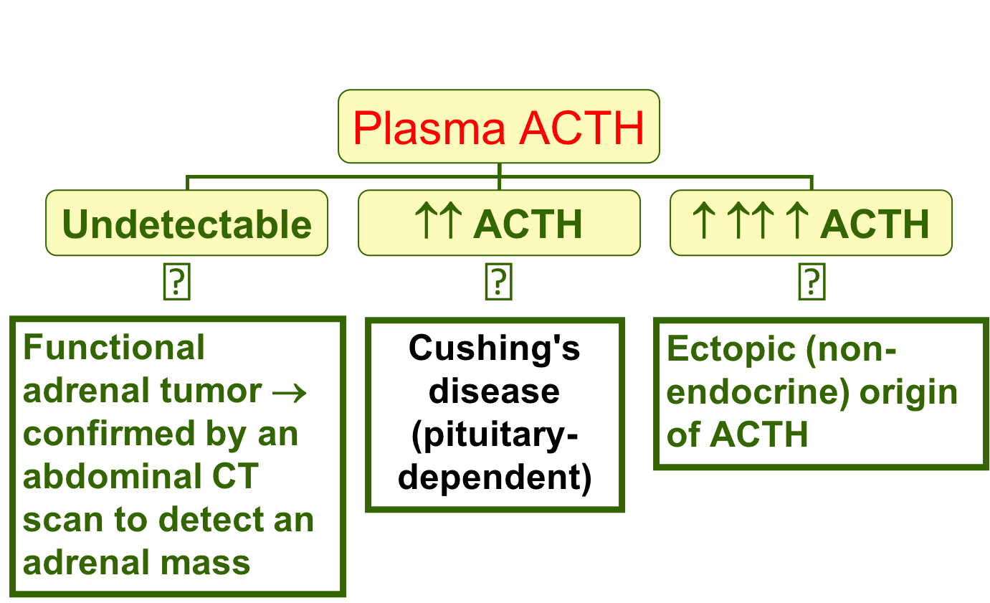
Plasma ACTH
It should be measured on blood specimens collected at 8-9 a.m. and 8-9 p.m.

Slide 23
High-dose DST
It is used to distinguish Cushing's disease from ectopic ACTH secretion.
2 mg DXM six-hourly for 48 hours to suppress cortisol secretion.
Basal (pre-DXM) serum cortisol or 24-hour urine free cortisol is compared with the results at the end of the 48-hour period.
Suppression is defined as a fall to less than 50 % of basal value.
About 90 % of patients with Cushing's disease show suppression of cortisol output.
In contrast, only 10% of patients with ectopic ACTH production (or with adrenal tumors) show suppression.

Slide 24
Other blood test
The following blood tests are commonly performed for patients suspected to have Cushing’s syndrome:
Full blood count
Blood glucose
Blood electrolytes and pH
Renal function tests
Liver function tests

Slide 25
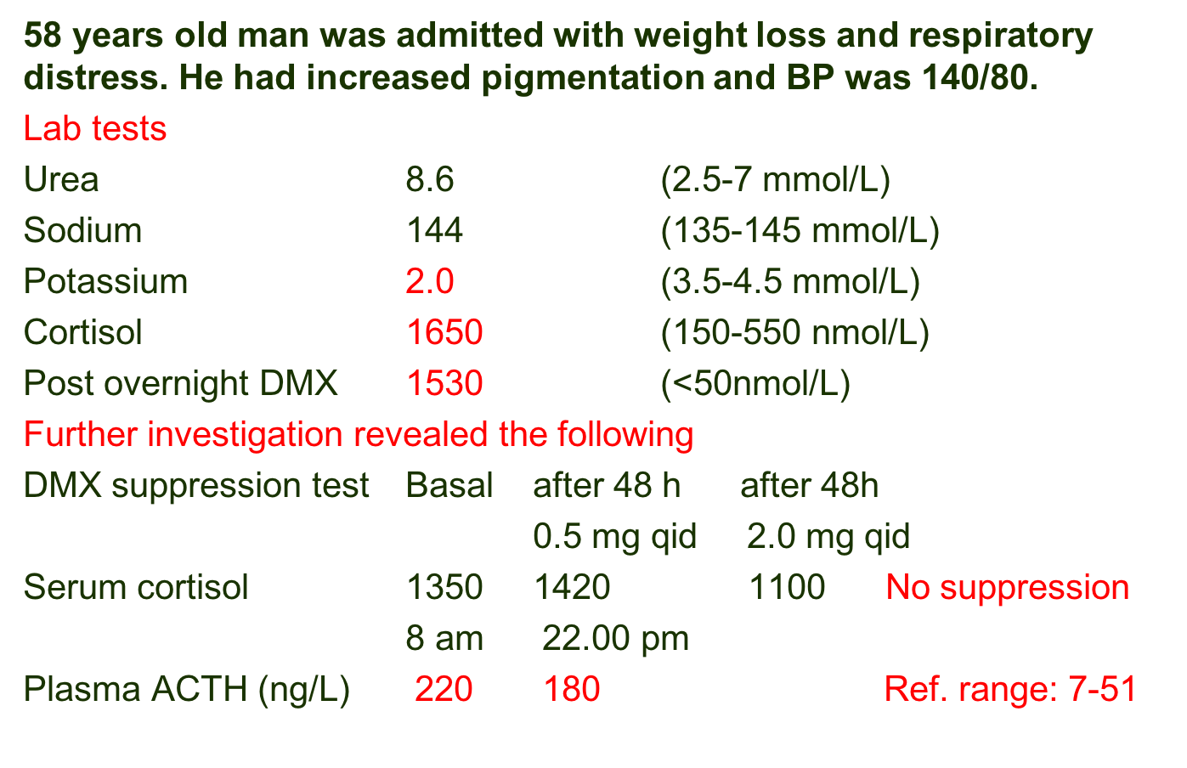
Case study

Slide 26
Take home messages
Initial screening for Cushing by 24 h urine free cortisol, low-dose dexamethasone suppression test or midnight Salivary Cortisol.
Confirmatory tests for Cushing by getting positive results of at least two of the screening tests.
Tests to determine the cause of Cushing: Plasma ACTH, high-dose dexamethasone suppression test, Inferior Petrosal Sinus Sampling and radiological investigations.
ACTH-dependent Cushing: due to pituitary causes (Cushing’s disease) and due to ectopic production of ACTH.
ACTH-independent Cushing: due to adrenal adenoma or carcinoma and due to steroid therapy (iatrogenic).

Slide 27
References
Lecture notes, Clinical Biochemistry, Wiley BlackWell, 9th edition, 2013, chapter 9, page 116-133.
Clinical Chemistry, Principles, Procedures, Correlations, Lippincott Williams & Wilkins, 7th edition, 2013, chapter 21, page 453-471.
Lippincott’s Illustrated Reviews: Biochemistry 6th edition, Unit III, Chapter 18, Pages 219-244.
https://www.mayocliniclabs.com/test-catalog/Clinical+and+Interpretive/84225

