Slide 1
Thyroid Nodules and Neoplasms

Slide 2
Objectives
To Know the definition of a solitary nodule in the thyroid.
To Recognize the differential diagnosis of a solitary thyroid nodule, neoplastic and non- neoplastic.
To know the benign causes of thyroid nodules.
To Understand the classification, pathology, gross and microscopic morphology and behavior of thyroid carcinoma ( papillary, follicular, medullary and anaplastic)

Slide 3
Thyroid nodules
Several clinical criteria provide a clue to the nature of a given thyroid nodule:
Solitary nodules, in general, are more likely to be neoplastic than are multiple nodules.
Nodules in males are more likely to be neoplastic than are those in females.
Nodules in younger patients are more likely to be neoplastic than are those in older patients.
A history of radiation treatment to the head and neck region is associated with an increased incidence of thyroid malignancy.
Nodules that take up radioactive iodine in imaging studies (hot nodules) are more likely to be benign than malignant.

Slide 4
Ultimately, it is the morphologic evaluation of a given thyroid nodule by fine needle aspiration, combined with histologic study of surgically resected thyroid parenchyma, that provides the most definitive information about its nature.

Slide 5
Thyroid Nodules
Non-neoplastic:
e.g., a dominant nodule in multinodular goiter, simple cysts, or foci of thyroiditis
Neoplastic:
*Adenoma
* Carcinoma

Slide 6
Adenoma
Adenomas of the thyroid are benign neoplasms derived from follicular epithelium. Follicular adenomas usually are solitary.
On clinical and morphologic grounds, they may be difficult to distinguish from a dominant nodule in multinodular goiter, or from follicular carcinomas
In general, follicular adenomas are not forerunners to carcinomas

Slide 7
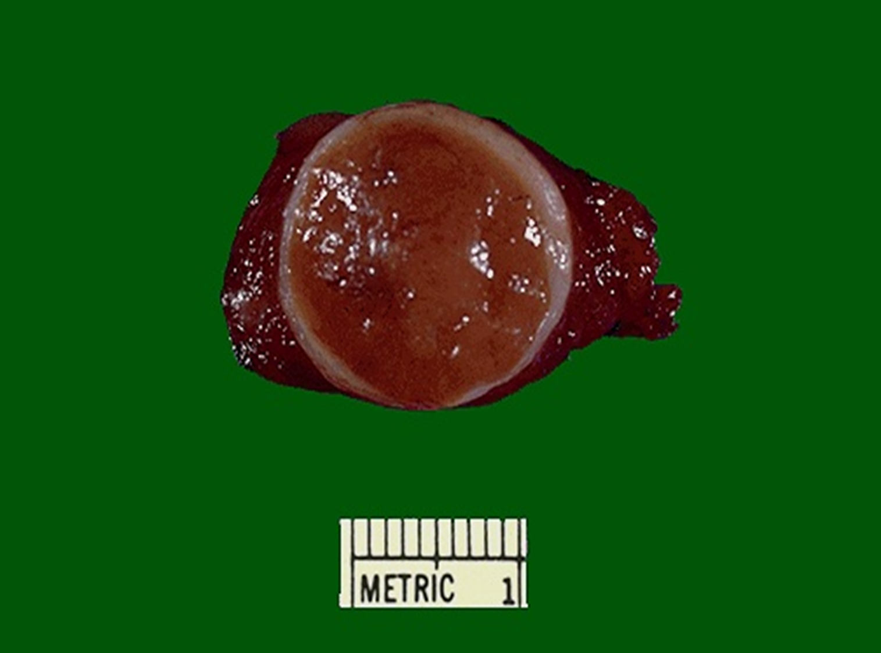
Adenoma
The typical thyroid adenoma is a solitary, spherical lesion that compresses the adjacent non-neoplastic thyroid.
The neoplastic cells are demarcated from the adjacent parenchyma by a well-defined, intact capsule . These features are important in making the distinction from multinodular goiters, which contain multiple nodules on their cut surface , do not demonstrate compression of the adjacent thyroid parenchyma, and lack a well-formed capsule.
On microscopic examination, the constituent cells are arranged in uniform follicles that contain colloid .

Slide 8
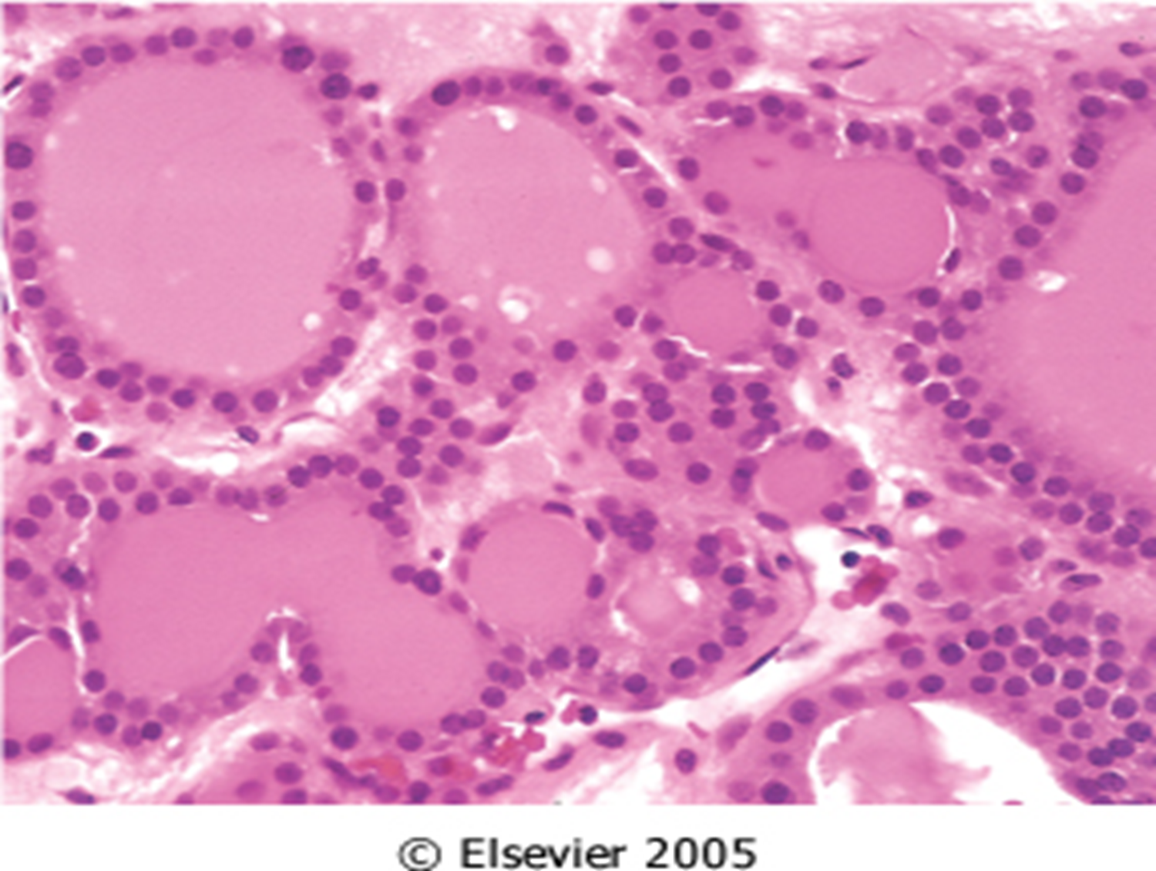
Adenoma

Slide 9
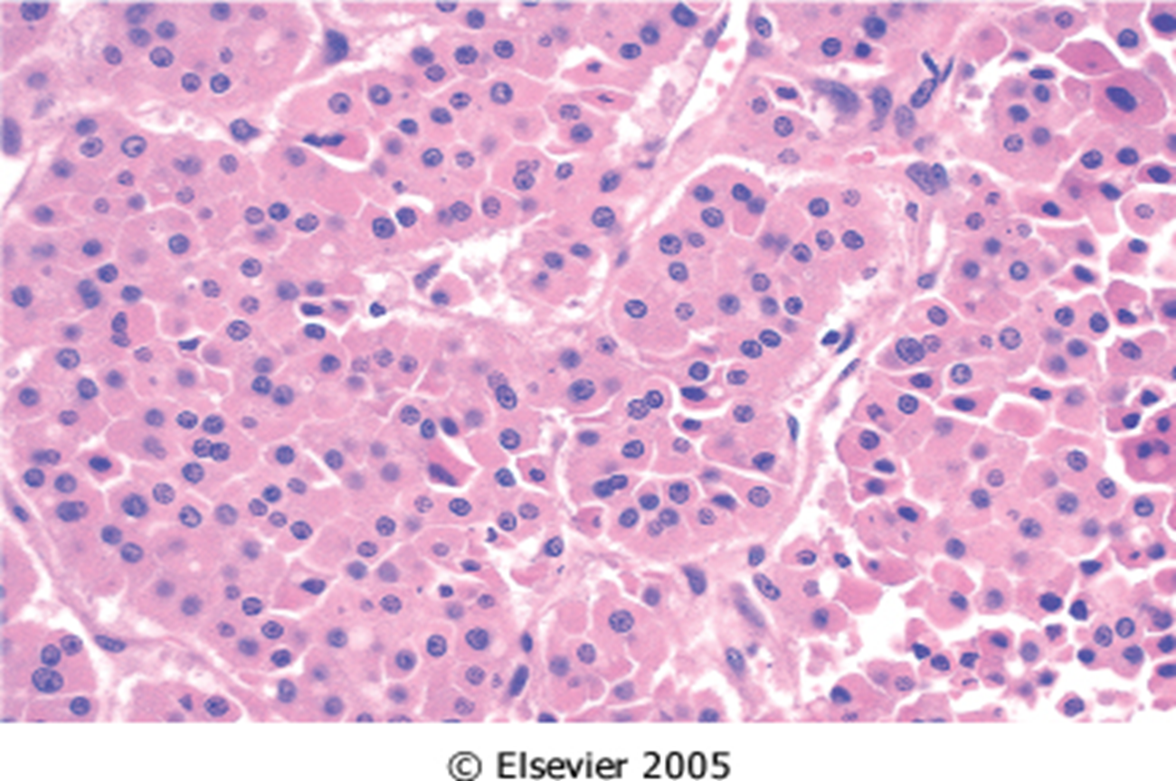
Adenoma
Occasionally, the neoplastic cells acquire brightly eosinophilic granular cytoplasm (oxyphil or Hürthle cell change)
the clinical presentation and behavior of a Hürthle cell adenoma are no different from those of a conventional adenoma.
Careful evaluation of the integrity of the capsule is critical in distinguishing follicular adenomas from follicular carcinomas, which demonstrate capsular and/or vascular invasion

Slide 10
On radionuclide scanning, adenomas appear as cold nodules relative to the adjacent normal thyroid gland.
Essential techniques used in the preoperative evaluation of suspected adenomas are ultrasonography and fine needle aspiration biopsy.
Suspected adenomas of the thyroid are removed surgically to exclude malignancy.
Thyroid adenomas carry an excellent prognosis and do not recur or metastasize.

Slide 11
Carcinomas
Carcinomas of the thyroid : 1.5% of all cancers
Papillary carcinoma (> 85% of cases)
Follicular carcinoma (05% to 15% of cases)
Medullary carcinoma (5% of cases)
Anaplastic carcinoma (<5% of cases)

Slide 12
Pathogenesis
Follicular Thyroid Carcinomas: mutations in the RAS family of oncogenes
Papillary Thyroid Carcinomas. rearrangements of the tyrosine kinase receptors RET or NTRK1 or activating point mutations in BRAF
Medullary Thyroid Carcinomas: Familial medullary thyroid carcinomas occur in multiple endocrine neoplasia type 2 (MEN-2) RET protooncogene mutation
Anaplastic Carcinomas: Inactivating point mutations in the p53 tumor suppressor gene are rare in well-differentiated thyroid carcinomas but common in anaplastic tumors.

Slide 13
Pathogenesis
Environmental Factors. The major risk factor predisposing to thyroid cancer is exposure to ionizing radiation
Most often between the ages of 25 and 50
Majority of thyroid carcinomas associated with previous exposure to ionizing radiation.
The incidence of papillary carcinoma has increased markedly in the last 30 years
Solitary or multifocal lesions

Slide 14
Papillary carcinoma(PTC)
papillary carcinomas represent the most common form of thyroid cancer. These tumors may occur at any age, and they account for the vast majority of thyroid carcinomas associated with previous exposure to ionizing radiation.
Papillary carcinomas are nonfunctional tumors, so they manifest most often as a painless mass in the neck, either within the thyroid or as metastasis in a cervical lymph node.
A preoperative diagnosis usually can be established by fine-needle
Papillary carcinomas are indolent lesions, with 10-year survival rates in excess of 95%.
Prognosis of PTC is dependent on several factors including age (in general, the prognosis is less favorable among patients older than 55 years), the presence of extra-thyroidal extension, and presence of distant metastases (stage).

Slide 15
PTC
The diagnosis of papillary carcinoma is based on nuclear features even in the absence of a papillary architecture.
The nuclei of papillary carcinoma cells show:
Very finely dispersed chromatin, with an optically clear appearance, giving rise to the designation ground glass or “Orphan Annie eye” nuclei .
Grooves.
invaginations of the cytoplasm may give the appearance of intranuclear inclusions (pseudoinclusions)
papillary architecture
Concentrically calcified structures termed psammoma bodies often are present
There are over a dozen variants of papillary thyroid carcinoma, but the most common is one composed predominantly or exclusively of follicles (follicular variant of papillary thyroid carcinoma).

Slide 16
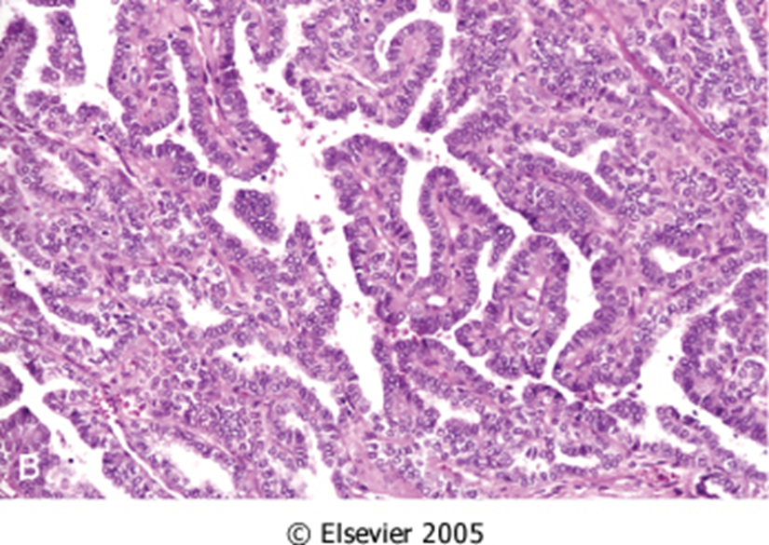
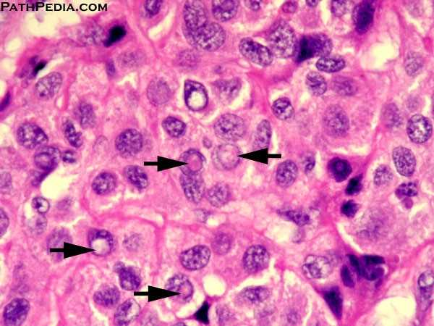

Slide 18
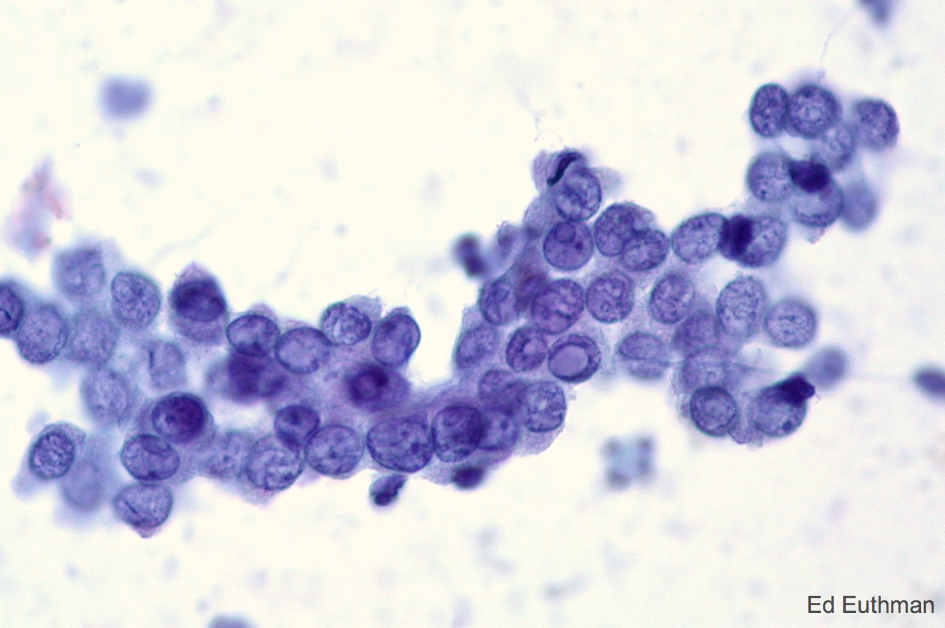
Fine needle aspiration cytology

Slide 19
Follicular carcinoma
5% to 15% of primary thyroid cancers.
More common in women (3 : 1)
Peak incidence between 40 and 60 years.
More frequent in areas with dietary iodine deficiency

Slide 20
Follicular carcinoma
Follicular carcinomas manifest most frequently as solitary cold thyroid nodules.
These neoplasms tend to metastasize through the bloodstream to the lungs, bone, and liver.
Minimally invasive( well encapsulated), 10 year survival rate 90%.
Widely invasive carcinoma, 10 year survival rate less than 50%.

Slide 21
Morphology
On microscopic examination, most follicular carcinomas are composed of fairly uniform cells forming small follicles, reminiscent of normal thyroid
Follicular carcinomas may be
widely invasive, infiltrating the thyroid parenchyma and extrathyroidal soft tissues, or
minimally invasive. are sharply demarcated lesions that may be impossible to distinguish from follicular adenomas on gross examination.This distinction requires extensive histologic sampling of the tumor capsule–thyroid interface, to exclude capsular and/or vascular invasion

Slide 22
Follicular carcinoma

Slide 23
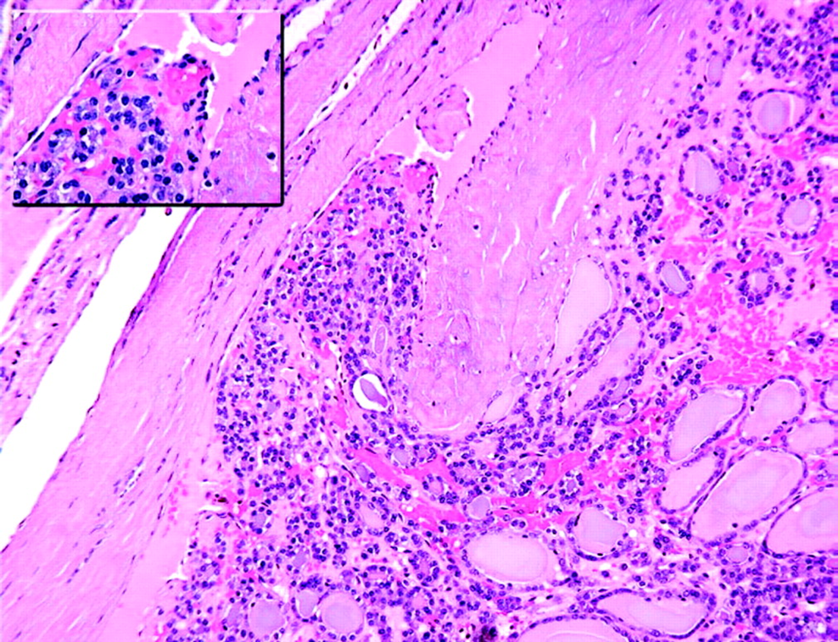
Follicular carcinoma

Slide 24
Medullary carcinoma
Medullary carcinomas of the thyroid are neuroendocrine neoplasms derived from the parafollicular cells, or C cells, of the thyroid.

Slide 25
Medullary carcinoma
Medullary carcinomas, similar to normal C cells, secrete calcitonin, the measurement of which plays an important role in the diagnosis and postoperative follow-up of patients.
About 70% of tumors arise sporadically.
The remainder occurs in the setting of MEN syndrome 2A or 2B or as
Familial tumors without an associated MEN syndrome (familial medullary thyroid carcinoma, or FMTC)

Slide 26
Medullary carcinoma
Medullary carcinomas may arise as a solitary nodule or may manifest as multiple lesions involving both lobes of the thyroid.
Multicentricity is particularly common in familial cases.
Larger lesions often contain areas of necrosis.
On microscopic examination, composed of polygonal to spindle-shaped cells, which may form nests, trabeculae, and even follicles.
Amyloid deposits, are present in the adjacent stroma in many cases and are a distinctive feature.
One of the characteristic features of familial medullary carcinomas is the presence of multicentric C cell hyperplasia in the surrounding thyroid parenchyma, a feature usually absent in sporadic lesions.

Slide 27
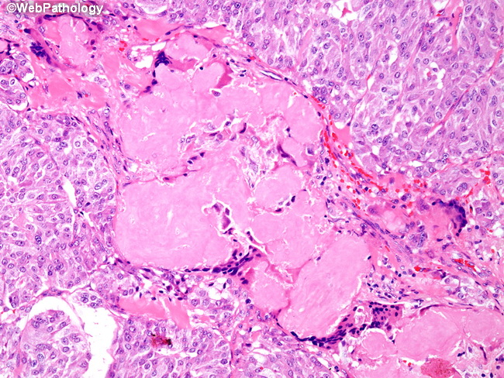
Medullary carcinoma

Slide 28
Anaplastic Carcinomas
Anaplastic carcinomas of the thyroid are undifferentiated tumors of the thyroid follicular epithelium.
Can be arising from a more differentiated carcinoma (papillary)
Lethal (100%)
Older age group > 65 year

Slide 29
Anaplastic Carcinomas
Anaplastic carcinomas manifest as bulky masses that typically
grow rapidly beyond the thyroid capsule into adjacent neck
structures.
On microscopic examination, these neoplasms are
composed of highly anaplastic cells, which may be large and
pleomorphic or spindle shaped and in some cases mixture of
the two cell types.

Slide 30
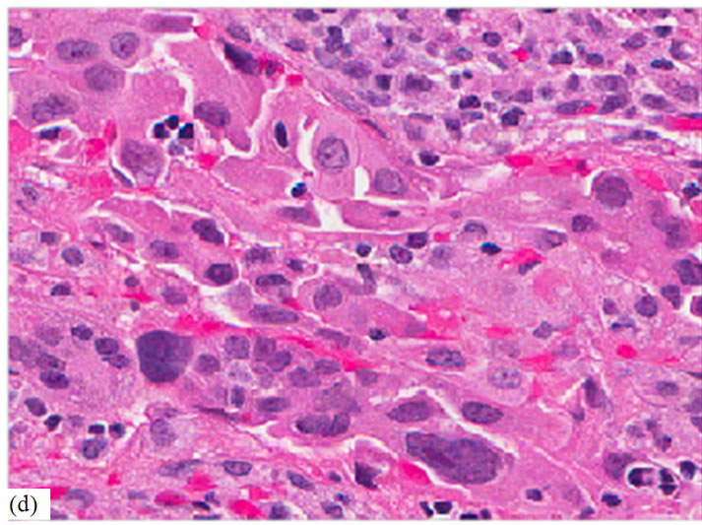
Anaplastic Carcinomas

Slide 31
summary
Follicular adenomas are the most common benign neoplasms, while papillary carcinoma is the most common malignancy.
Multiple genetic pathways are involved in thyroid carcinogenesis.
Follicular adenomas and carcinomas are distinguished by evidence of capsular and/or vascular invasion.
Papillary carcinomas are recognized based on nuclear features.
Anaplastic carcinomas are highly aggressive.
Medullary cancers are nonepithelial neoplasms arising from the parafollicular C cells.

Slide 32
Refernce
Robbins Basic pathology 10th edition

