Slide 1
OSPE Revision Endocrine Block
Dr. Shimaa Mahmoud

Slide 2
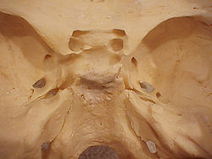
Pituitary Gland
A- Hypophyseal fossa.
B- Sella turcica
Common question in OSPE:
1- Identify the marked area “A”
2- Identify the structure related to this area “pituitary gland”
3- Mention the anterior or posterior or superior or inferior or lateral relations to this structure
4- Blood supply of this structure
B
A

Slide 3
Relations Of Pituitary Gland
Blood supply of pituitary gland
1- Optic Chiasma (Anteriorly).
2- Mamillary Bodies(Posteriorly).
3- Diaphragma sellae (superior)
4- Sphenoidal Air Sinuses (Inferior)
5- Cavernous Sinuses (Lateral) .
1- Superior hypophyseal artery.
2-inferior hypophyseal artery.
Both are branches of internal carotid artery
3- Hypophyseal veins drain into Cavernous Sinuses

Slide 4
The question will be only Identify the marked area:
1- Optic Chiasma
2- Mamillary Bodies
3- Body Of Sphenoid
4-Sphenoidal Air Sinus
1
2
3
4

Slide 5
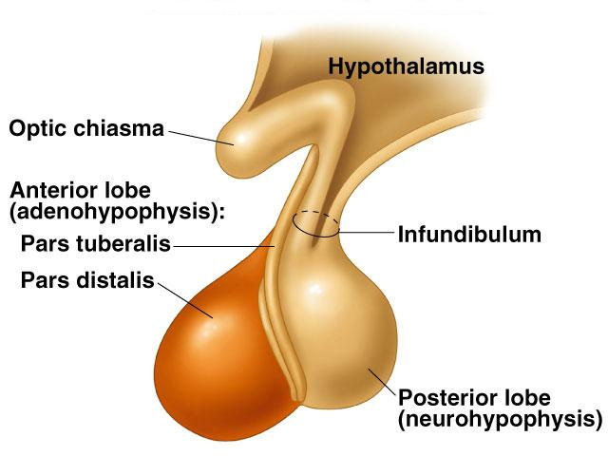
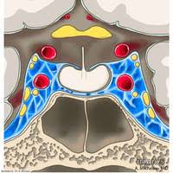
Identify :
1- Pituitary gland.
2- Diaphragma sellae
3-Sphenoidal air sinuses
4-Cavernous sinuses (list its contents and structures in the lateral wall)
5- pituitary stalk(infundibulum)

Slide 6
Thyroid Gland
The thyroid gland question is very clear, only picture for thyroid and ask to identify a part of the gland and better to say:
Right lobe of thyroid gland
Left lobe of thyroid gland
Isthmus of thyroid gland
Pyramidal lobe of thyroid gland
Then ask one question of :
Relations of this structure (Anterolateral, posterior or medial)
Blood supply of this structure (The artery and its origin)
Sometimes level (extension)

Slide 7
Example
Q: Identify the marked area A
A- Left lobe of thyroid gland
Q: Mention the anterolateral relations of this structure
(sometimes asking question indirect as what are the muscles or tubes or nerves related to this structure)
Q: Mention the arterial supply of structure A and its origin
Q: Mention the venous drainage of structure A
Q: Mention the extension of structure A (Apex till oblique line of the thyroid cartilage; its base lies at the 4th or 5th tracheal ring).
A

Slide 8
RELATIONs OF THE THYROID
Anterolaterally: (4 S)
1. Sternothyroid
2. Sternohyoid
3. Superior belly of omohyoid
4. Sternomastoid
Posteriorly:
Carotid sheath & its contents.
posterior border is related to the superior & inferior Parathyroid glands.
Medially:
Above:
Larynx & pharynx .
Below:
Trachea & esophagus.
(Recurrent laryngeal nerve in between).
-Cricothyroid muscle & external laryngeal nerve

Slide 9
Blood supply of thyroid
Arterial supply
1-Superior thyroid artery: From the external carotid artery
2-Inferior thyroid artery: From the thyrocervical trunk of 1st part of subclavian artery
3- Thyroid ima artery: from aortic arch or from brachiocephalic artery.
Venous drainage
-Superior thyroid vein & Middle thyroid vein : internal jugular vein
- Inferior thyroid vein : left brachiocephalic vein

Slide 10
Adrenal Gland The question will be: Q: Identify one of the two suprarenal (adrenal) glands and you have to write right or left Then Q: Mention the anterior or posterior relations of this structure OR Q: Mention the blood supply of this structure Q: Mention the level (T12)

Slide 11
Adrenal Gland
Relations
Blood supply
Right adrenal gland
Anterior: right lobe of the liver.
inferior vena cava.
Posterior: diaphragm
Medial :Celiac plexus and ganglia
left adrenal gland
Anterior: Pancreas, lesser sac, stomach
Posterior: diaphragm
Arterial
Superior suprarenal from Inferior phrenic
Middle suprarenal from Abdominal Aorta
Inferior suprarenal from Renal artery.
Venous
Suprarenal vein: drains into Inferior vena cava on the right & Renal vein on the left

Slide 12
* Questions of the last year OSPE were one about pituitary gland position on the skull and its relations and the other was about relations of thyroid gland with identify the lobe and arterial supply with its origin. * Please read the question and focus on what we need exactly * If disturbed in one answer or forget it write all what you know please * If you need any question till the exam please contact me anytime

Slide 13
Thank you GOOD LUCK
DR. SHIMAA
Email: shimaamahmoud81@gmail.com
T: 0595356742

