Slide 1
Pituitary Gland
Anatomy Practical
By Dr. Sahar Shareef
Anatomy Department
College of Medicine
King Saud University

Slide 2
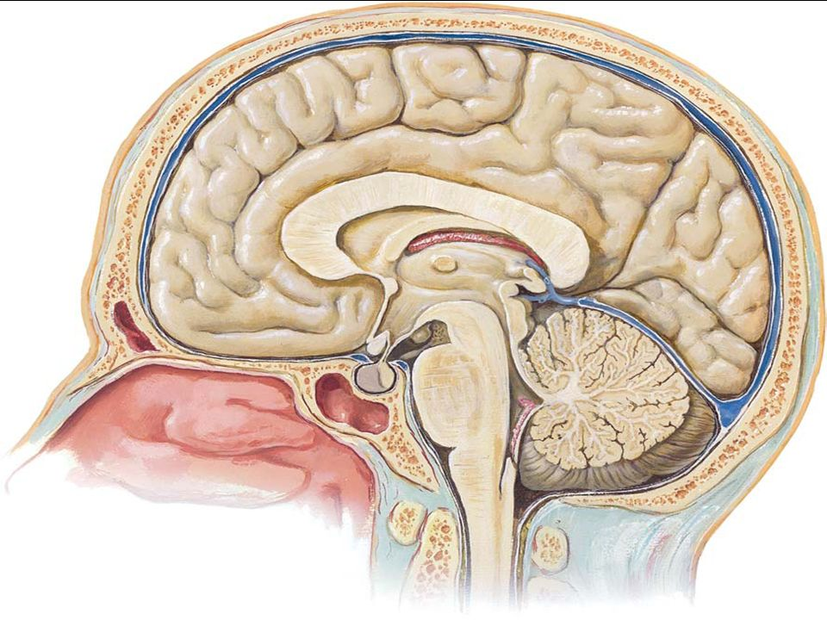
Pituitary Gland
Definition
Pituitary gland or hypophysis cerebri is a small oval structure attached to the undersurface of the brain by the infundibulum. It is called the master endocrine gland.

Slide 3
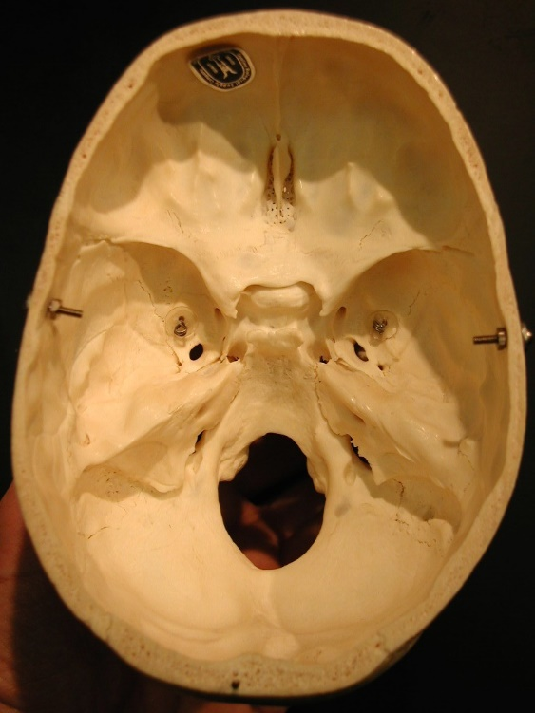
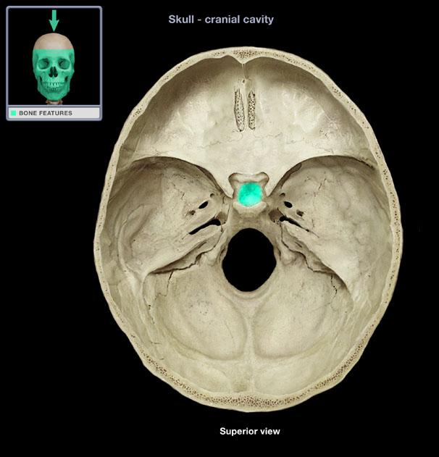
Location:
In the sella turcica (hypophyseal fossa) of the body of sphenoid bone.
Sella turcica

Slide 4
The sella turcica is found in the middle cranial fossa of the skull.

Slide 5
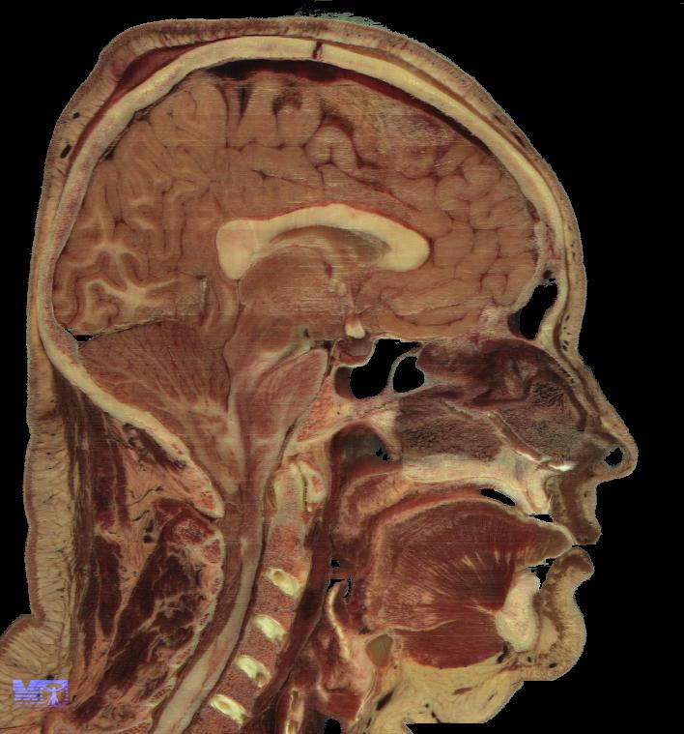
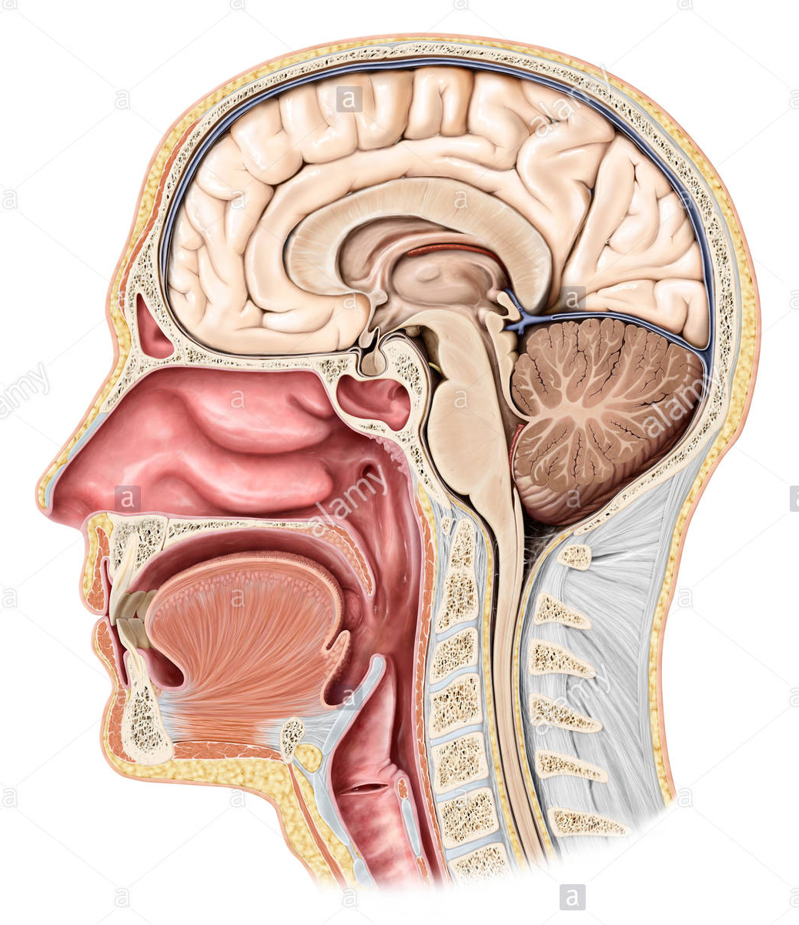
Pituitary gland

Slide 6
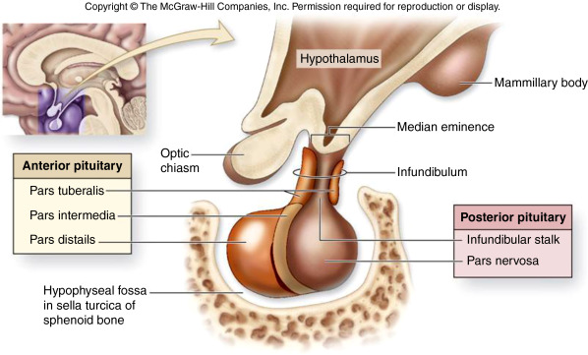
SUBDIVISIONS OF PITUITARY GLAND

Slide 7
Relations of Pituitary Gland
Optic chiasma
(Anteriorly)
Pituitary gland
Mammillary bodies
(Posteriorly)

Slide 8
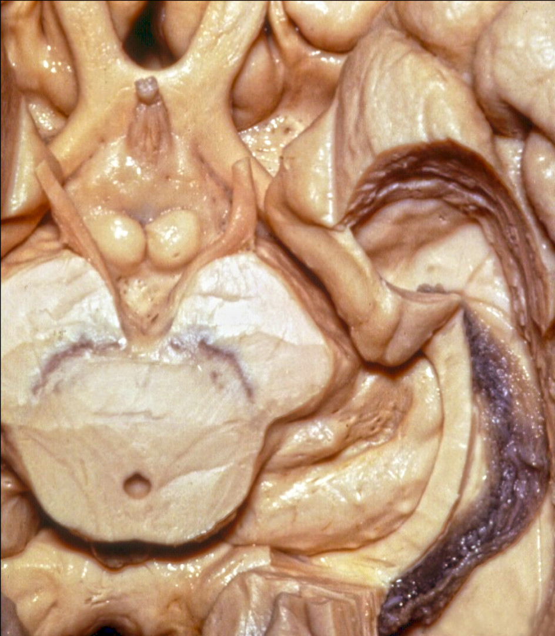
Relations of Pituitary Gland
Optic chiasma
(Anteriorly)
Infundibulum (pituitary stalk)
Mammillary bodies
(Posteriorly)
midbrain
Inferior view of the brain

Slide 9
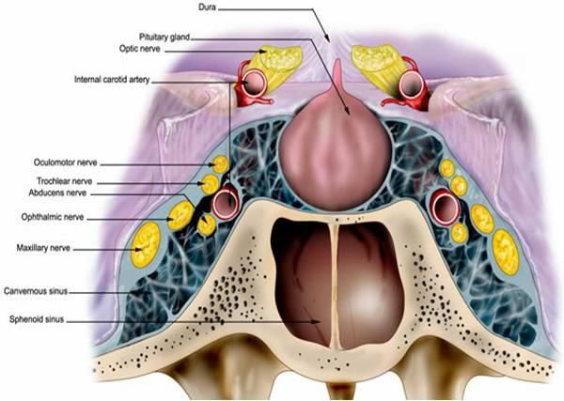
Relations of Pituitary Gland
diaphragma sellae
(superiorly)
cavernous sinus
(laterally)
sphenoidal air sinuses
(Inferiorly)

Slide 10
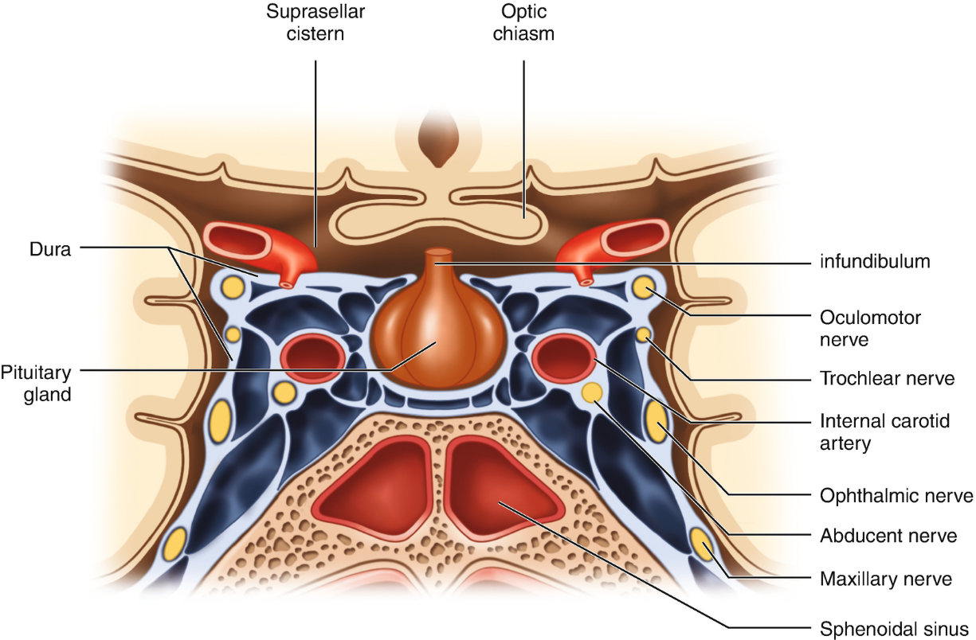
Relations of Pituitary Gland
The cavernous sinus is a dural venous sinus. it’s walls are made of dura, and it is lined by endothelium.
The sinuses are situated on each side of the body of sphenoid.
The internal carotid artery and abducent nerve pass through the sinus, while the 3rd, 4th, ophthalmic and maxillary nerves run in the lateral wall of the sinus.

Slide 11
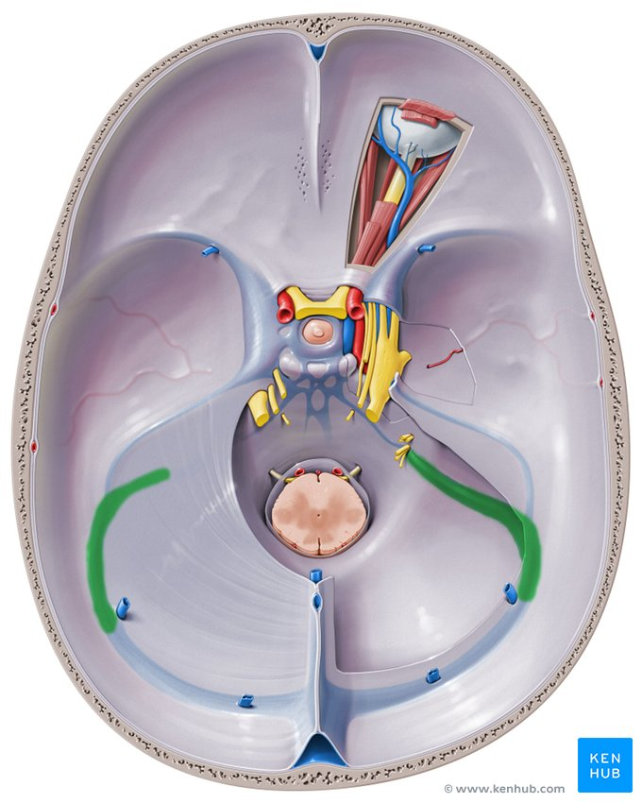
Relations of Pituitary Gland
cavernous sinus
(laterally)
N.B. :
In this diagram, the right cavernous sinus is open, while left sinus is closed.
Diaphragma sellae:
Is a fold of dura mater covers the pituitary gland & has an opening for passage of infundibulum (pituitary stalk), that connects the gland to the hypothalamus.
Infundibulum (pituitary stalk)
diaphragma sellae
(superiorly)

Slide 12
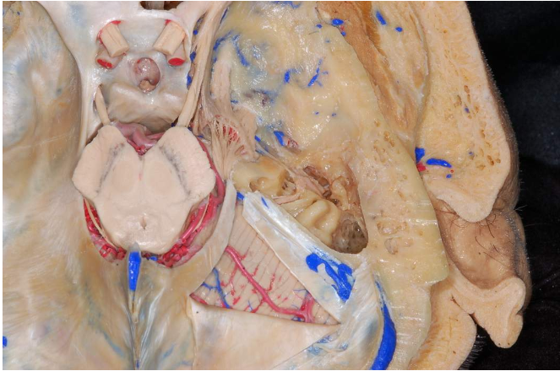
Relations of Pituitary Gland
diaphragma sellae
Right cavernous sinus (open)
Left cavernous sinus (closed)
N.B.:
The picture showing cranial cavity, with pituitary gland in the sella turcica, covered by diaphragma sellae.

Slide 13
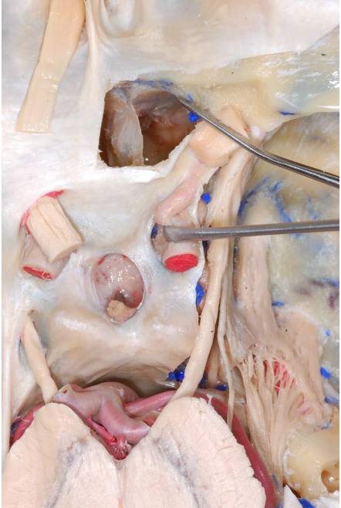
Relations of Pituitary Gland
Optic nerve
( entering optic canal)
diaphragma sellae
(superiorly)

Slide 14
Relations of pituitary
Posteriorly:
dorsum sellae, basilar artery, pons and mammillary bodies
Superiorly:
Diaphragma sellae
Diaphragma sellae
Dorsum sellae
Basilar artery

Slide 15
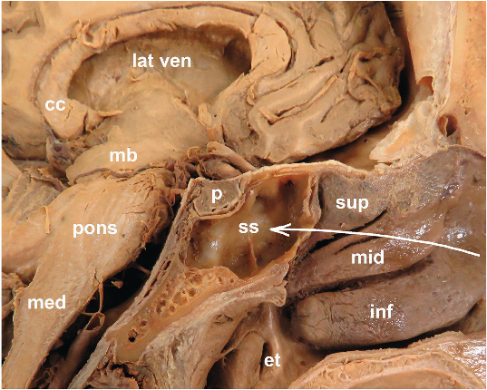
Relations of Pituitary Gland
mb: midbrain
med: medulla oblongata
P: pituitary gland
ss: sphenoid air sinuses
cc: corpus callosum
H: hypothalamus
H
Sagittal section of head

Slide 16
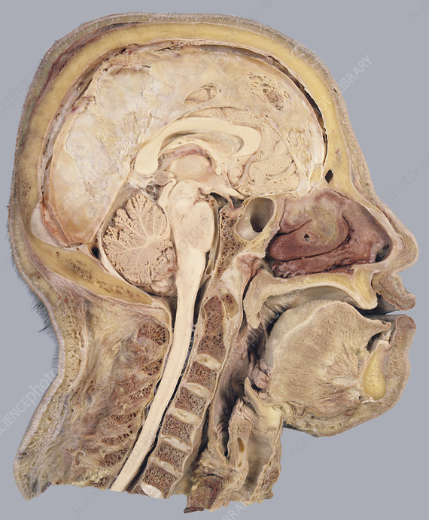
Optic chiasma
(Anteriorly)
infundibulum
Mamillary body
(Posteriorly)
Pituitary gland

