Slide 1
Histology Lab
Thyroid and Parathyroid Glands
Dr. Muhammad Atteya
Anatomy Department
College of Medicine
King Saud University
© 2020 KSU ANATOMY
Notes:
This is the Histology Practical Lab of Thyroid and Parathyroid Glands.

Slide 2
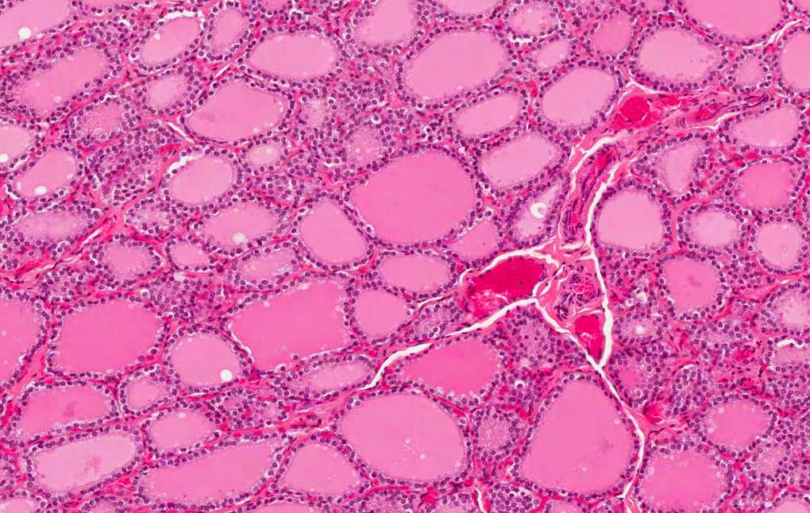
Thyroid follicles
Interlobular CT
Thyroid Gland
Notes:
This is a section in the thyroid gland. With the low power, we can see:
The thyroid gland is divided into lobules by thin interlobular CT septa.
The lobules consist of many thyroid follicles surrounded by blood capillaries.
The follicles are of different sizes and shapes depending on how and where the section cuts them.

Slide 3
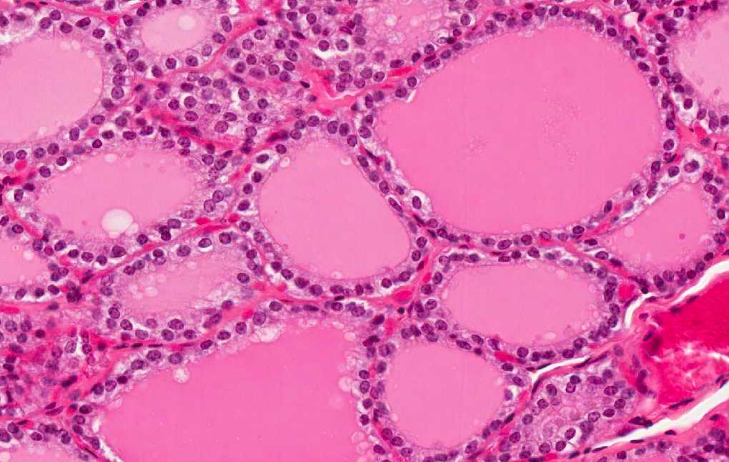
Colloid in follicular lumen
Parafollicular (C) cells
Follicular cells
Blood capillaries
Thyroid Gland
Notes:
Thyroid follicles are lined by simple cuboidal epithelium with two types of cells:
1. Follicular cells: are the majority of the cells and have rounded nuclei and basophilic cytoplasm.
2. Parafollicular cells: also called clear or C cells. They are the minority of the cells but are larger and paler than the follicular cells.
The lumen of the follicles is filled with a homogeneous acidophilic material called colloid.
Identifying features of a section in the thyroid gland include:
Thyroid follicles.
Colloid.
Simple cuboidal epithelium.
Follicular cells.
Parafollicular or C cells.
Blood capillaries.

Slide 4
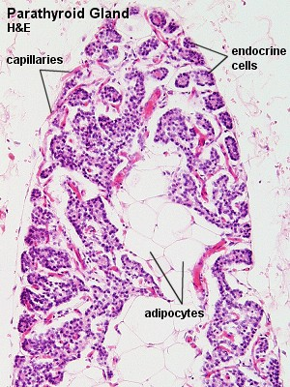
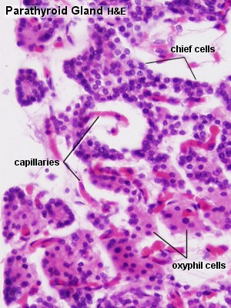
Parathyroid Gland
From Blue Histology (https://www.lab.anhb.uwa.edu.au/mb140/)
Notes:
This is a section in the parathyroid gland. It has a thin CT capsule and thin septa. Stroma in older adults often contains many fat cells. The parenchyma is formed of cords or clusters of epithelial cells (chief cells & oxyphil cell) with blood capillaries in between. Chief cells are small with round central nuclei and pale acidophilic or clear cytoplasm. Oxyphil cells are arranged in groups or as isolated cells. They are deep acidophilic and are less numerous but larger than chief cells.
Identifying features of a section in the parathyroid gland include:
Thin capsule and septa.
Chief cells.
Oxyphil cells.
Fat cells.
Blood capillaries.

Slide 5
Thank You
© 2020 KSU ANATOMY

Slide 6
Disclosure
Please be advised that this work is intended for non-profit purely educational purposes. We used some images from the internet and other sources. We did our best to link all images to their original sources to preserve copyrights. If you are the owner of one of those images, and you are not satisfied with our copyright level, please contact us and let us know how to make things right. We deeply appreciate your cooperation and consideration.
Contact: anatomy@ksu.edu.sa
© 2020 KSU ANATOMY

