Slide 1
Histology Lab
Adrenal Gland
Dr. Muhammad Atteya
Anatomy Department
College of Medicine
King Saud University
© 2020 KSU ANATOMY
Notes:
This is the Histology Practical Lab of Adrenal Gland.

Slide 2
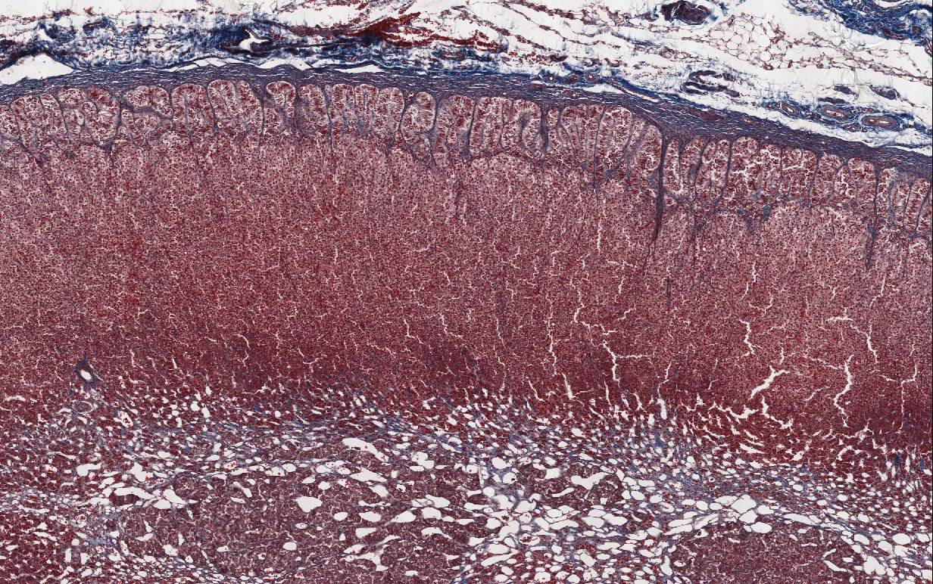
Zona glomerulosa
Capsule
CORTEX
Zona fasciculata
Zona reticularis
MEDULLA
Adrenal Gland
Notes:
This is a section in the adrenal gland. With the low power we can see:
A relatively thick CT capsule.
An outer thick cortex.
A central thin medulla.
Both cortex and medulla are composed of epithelial cells arranged in clumps or cords and separated by capillaries and sinusoids. The cortex is divided into three zones not sharply defined from each other:
Zona glomerulosa: immediately below the capsule. Its cells are arranged in arches.
Zona fasciculata: the thickest layer. Its cells are arranged in longitudinal columns.
Zona reticularis: relatively thin and not sharply defined from the medulla. Its cells are arranged in anastomosing cords.

Slide 3
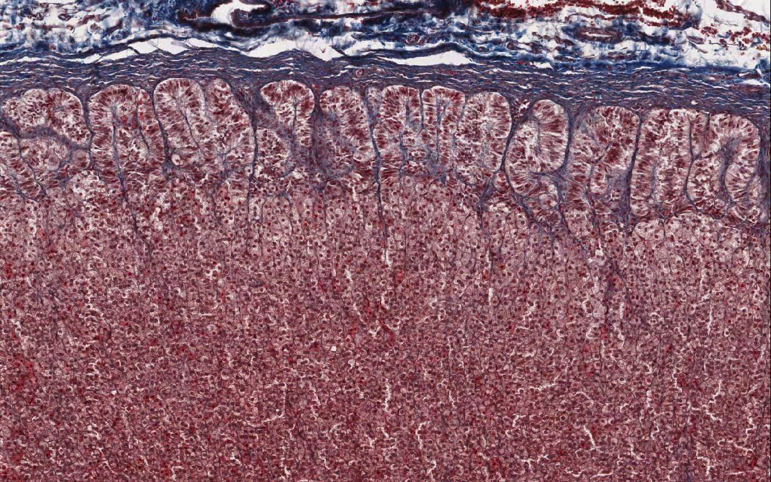
Capsule
Zona glomerulosa
Zona fasciculata
Spongiocytes
Adrenal Gland
Notes:
This is a higher magnification showing the first two zones of the cortex.
Zona glomerulosa: its cells are columnar and form round or oval arches.
Zona fasciculata: its cells are polygonal and arranged in longitudinal straight columns.
Identifying features of a section in the adrenal gland include:
Thick capsule.
Thick outer cortex.
Thin central medulla.
Zona glomerulosa; arches of columnar cells.
Zona fasciculata; columns of polygonal cells (spongiocytes).
Zona reticularis; anastomosing cords of polygonal cells.

Slide 4
Thank You
© 2020 KSU ANATOMY

Slide 5
Disclosure
Please be advised that this work is intended for non-profit purely educational purposes. We used some images from the internet and other sources. We did our best to link all images to their original sources to preserve copyrights. If you are the owner of one of those images, and you are not satisfied with our copyright level, please contact us and let us know how to make things right. We deeply appreciate your cooperation and consideration.
Contact: anatomy@ksu.edu.sa
© 2020 KSU ANATOMY

